Slide 1

SCRATCH CODING LEARNER
Session 22
Decision making with codes-2

Slide 2

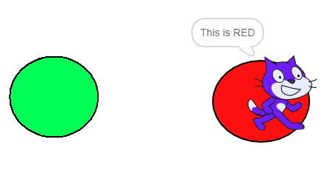
Recall
Use if statement to change
directions
Learn conditional coding

Slide 3
Decision making with codes 2…
We will Learn today:
Conditional coding in apps to create to evaluate outcomes, decision making capabilities.
Use if-else statement to evaluate outcomes.
Make never ending game

Slide 4
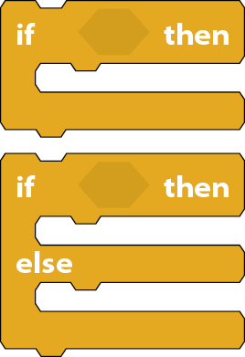
If-Else Statement…
Also called “two way branch”
Decision making:
If “True” Execute code of one branch
Else Execute Code of other branch
Example:
If you like football, raise your hand
Else stand up

Slide 5

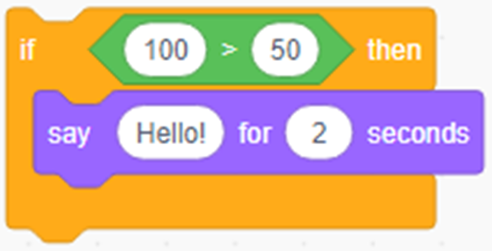
If-Else Statement – Why?
If condition in “if statement” evaluates to “True”, then the output is like

Slide 6

If-Else Statement – Why?
If condition in “if statement” evaluates to “False”, then there is no output

Slide 7
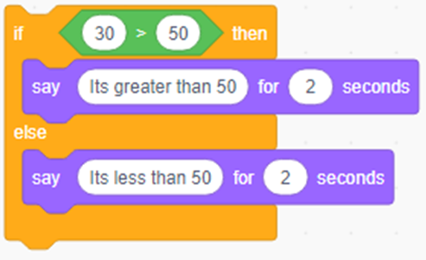
If-Else Statement – Why?
So to show at least one answer even if condition evaluated to false we need “Else” block as shown

Slide 8

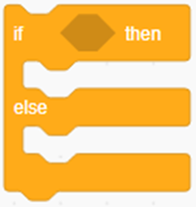

Executing If-Else Statement - 1
Step-by-step Execution of If-Else:
Sensing – ask “Give me a number” and wait
Control- Take if then else block
In if take math operator “>” and then give condition to evaluate

Slide 9




Executing If-Else Statement - 2
Step-by-step Execution of If-Else:
Sensing – Take answer from sensing
Control- Take if then else block condition.
Looks- say “Its greater than 50”
If step evaluates to false then output is:
Looks- say “Its less than 50”

Slide 10
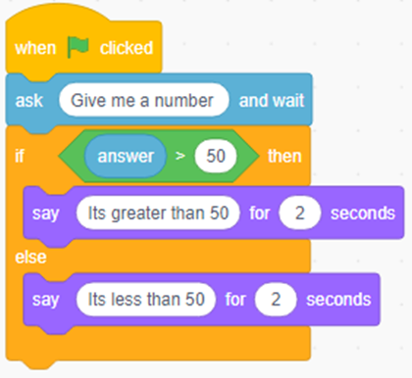
Executing If-Else Statement - 3
The Final Code is :
Events – When Clicked
Sensing – ask “Give me a number” and wait
Control- Take if then else block
In if take math operator “>” and then give condition to evaluate

Slide 11

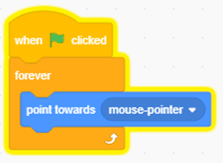
Make Never ending game…
Steps:
Take sprite “mouse 1”
Use Loop Forever
Then move sprite towards “mouse-pointer” position

Slide 12
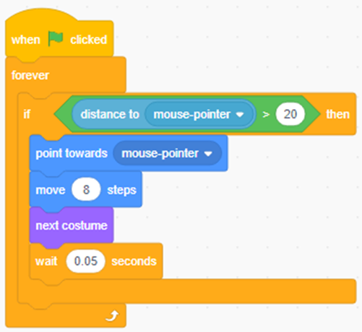
Make Never ending game…
Steps:
Motion: Take ”move 8 steps” to move “sprite” little bit fast
Control: “if distance to mouse-pointer is greater than 20 ” then “sprite” will move otherwise it will stop moving
Control: “wait 0.05 seconds “ so that it will move slowly

Slide 13

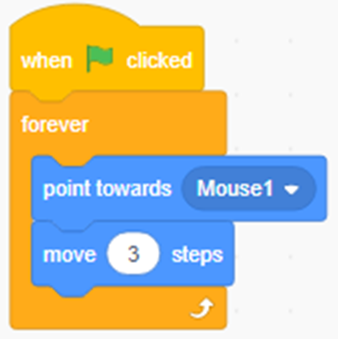
Make Never ending game…
Steps:
Now add one more sprite “Cat 2”
Control: Forever
Motion: Point towards “Mouse1”
Motion: Take ”Move 3 steps”. So that this sprite “Cat 2” will move 3 steps towards sprite”mouse1” direction

Slide 14
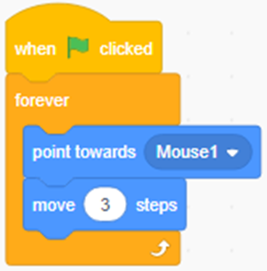
Make Never ending game…
Steps:
Now add one more sprite “Cat 2”
Control: Forever
Motion: Point towards “Mouse1”
Motion: Take ”Move 3 steps”. So that this sprite “Cat 2” will move 3 steps towards sprite”mouse1” direction
Now at last add a backdrop

Slide 15
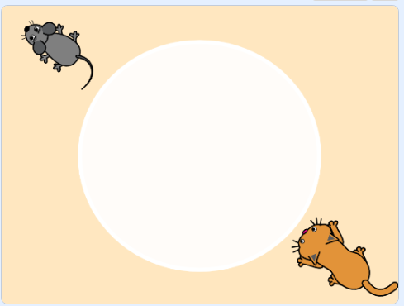
Make Never ending game…
The final game looks like this:

Slide 16
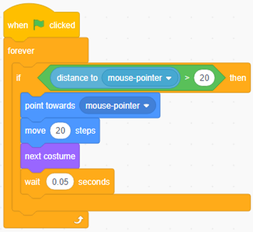
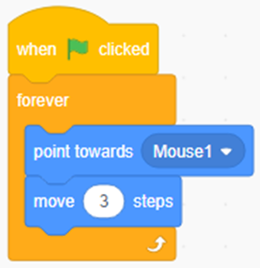
Make Never ending game…
Final Codes for the game
Mouse Code
Cat Code

Slide 17
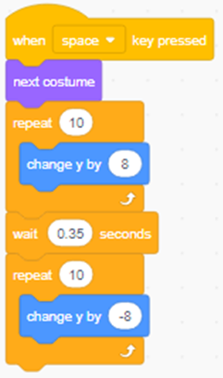
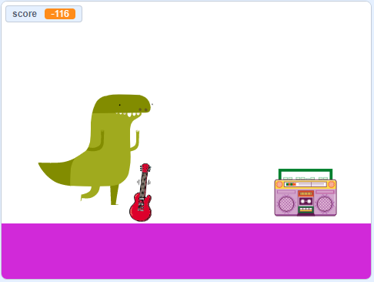
Practice Now…
Make Google’s offline Dyno jump game

Slide 18
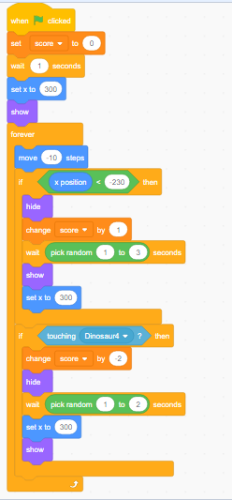
Practice Now…
Make Google’s offline Dyno jump game

Slide 19
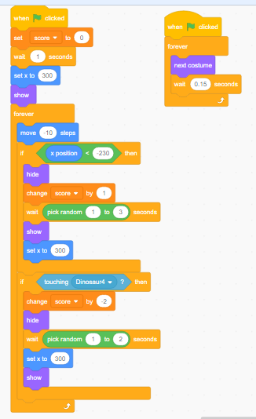
Practice Now…
Make Google’s offline Dyno jump game

Slide 20

Summary…
Conditional coding in apps to create to evaluate outcomes, decision making capabilities.
Use if-else statement to evaluate outcomes.
Make never ending game

Slide 21

Next Session…
Nested Loops:
Learn to recognize patterns
Draw different shapes
Create loops for repeating tasks and to draw shapes

