Slide 1

SCRATCH CODING LEARNER
Session 23
Nested Loops

Slide 2

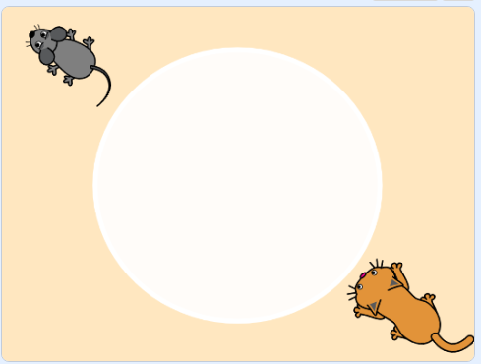
Recall
Conditional coding in apps to create to evaluate outcomes, decision making capabilities.
Use if-else statement to evaluate outcomes.
Make never ending game

Slide 3
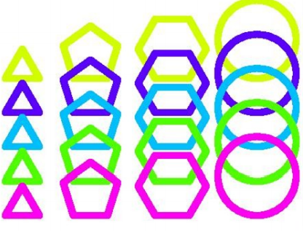
Nested Loops.…
We will Learn today:
Learn to recognize patterns
Draw various shapes
Create loops for repeating tasks and to draw shapes

Slide 4
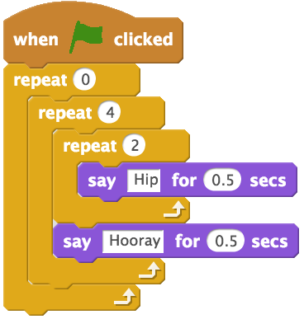
Nested Loops
When one loop is used inside of another loop, it is called a nested loop
A nested loops decreases the amount of blocks used to do an action

Slide 5
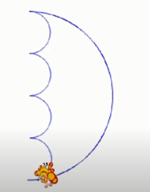
Nested Loops…
The goal of this code is to draw an half circle as shown in image

Slide 6

Nested Loops Scratch View…
The Nested Loop
Located in the Control Menu
True or False test
Inner loop executes only if outer loop is True
Statements to do only if test is true

Slide 7
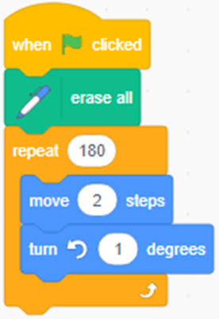
Nested Loop Practice
Let’s create an If Statement
Take Repeat(180 times)
Move 2 steps
Turn anticlockwise 1 degrees
Change x by 10

Slide 8
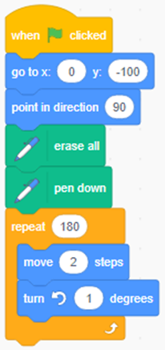
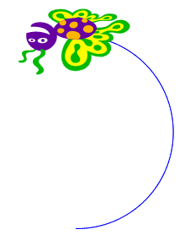
Nested Loop Practice
Now code to draw a circle by butterfly
Set ‘x’ and ‘y’ direction before it started
Point in direction 90
Move 2 steps
Output

Slide 9
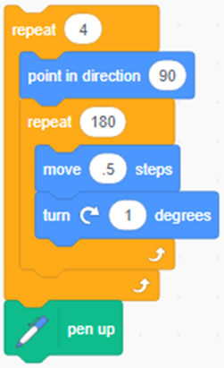
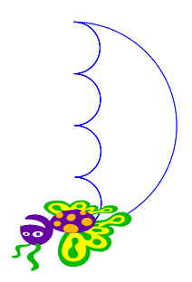
Nested Loop Practice
After drawing first circle, draw 4 more circles
Take repeat loop (outer loop)
Next one more repeat loop
Move by 0.5 steps
Turn by 1 degree in clockwise direction
Output

Slide 10
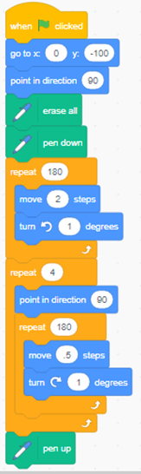
Nested Loop Practice
The Final Code is:

Slide 11
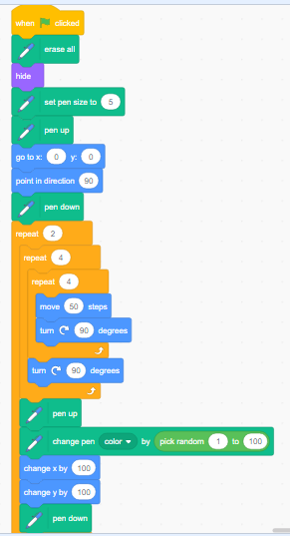
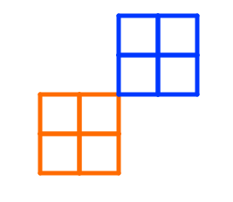
Nested Loop Practice
Create the following program using nested loop on your own

Slide 12
Nested Loop Practice
Create interesting shapes by using loops nested inside other loops

Slide 13
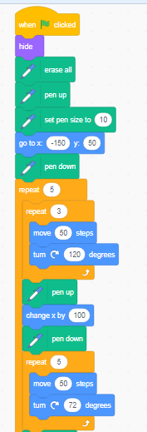
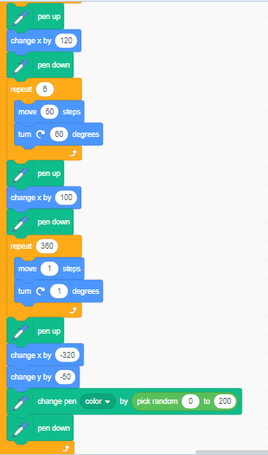
Code…
Continue…

Slide 14

Summary…
Nested Loops
Draw various shapes using nested loops
Creating Loops or repeating tasks in
Scratch.

Slide 15
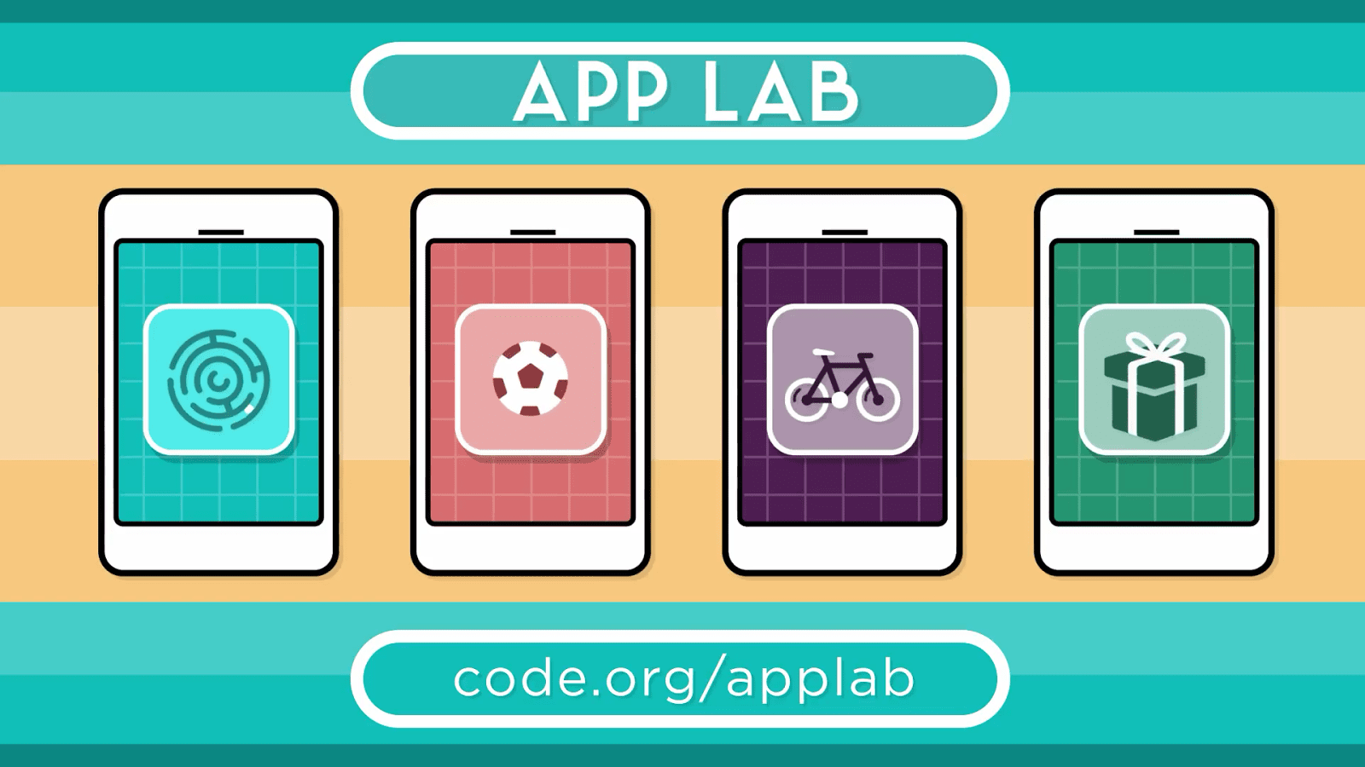
Next Session…
Introduction to App Lab…
Introduction to App Lab
Creating code.org account
Exploring App Lab
Various Designs and Codes

