Slide 1

BLOCK CODING LEARNER
Session 24
Introduction to App Lab

Slide 2

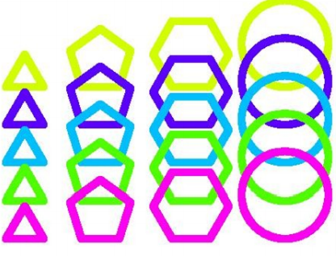
Recall.…
Nested Loops
Recognize patterns
Drawing different shapes
Creating loops for repeating tasks and to draw shapes

Slide 3
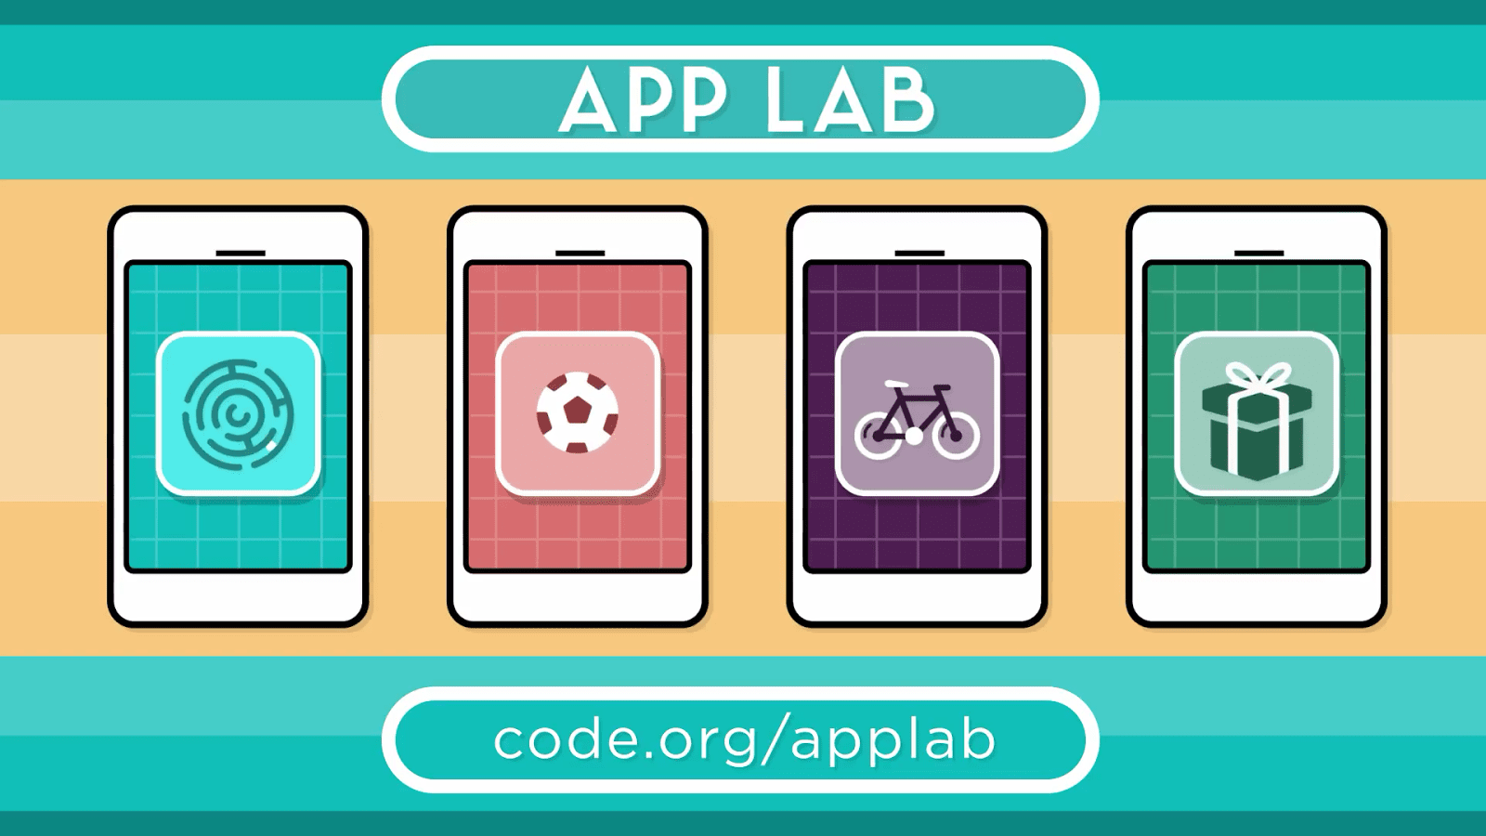
Introduction to App Lab…
We will Learn today:
Introduction to App Lab
Creating code.org account
Exploring App Lab
Various Designs and Codes

Slide 4

Introduction to App…
What is App Lab
Programming Environment for developing Apps
Designing Apps
Code with blocks or JavaScript to make it work
Share your app in seconds

Slide 5





Supported Browsers…
Desktop Browsers
Chrome
Edge
Firefox
Safari
Tablet Browsers
Mobile Chrome
Mobile Safari

Slide 6
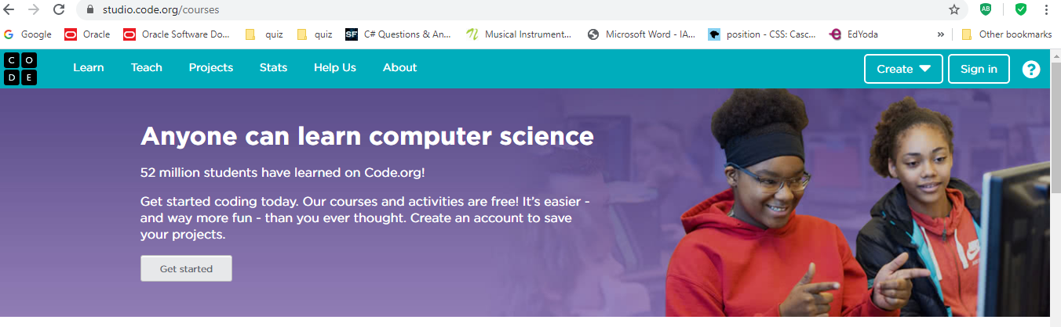
App Lab Experience
Visit – https://studio.code.org

Slide 7
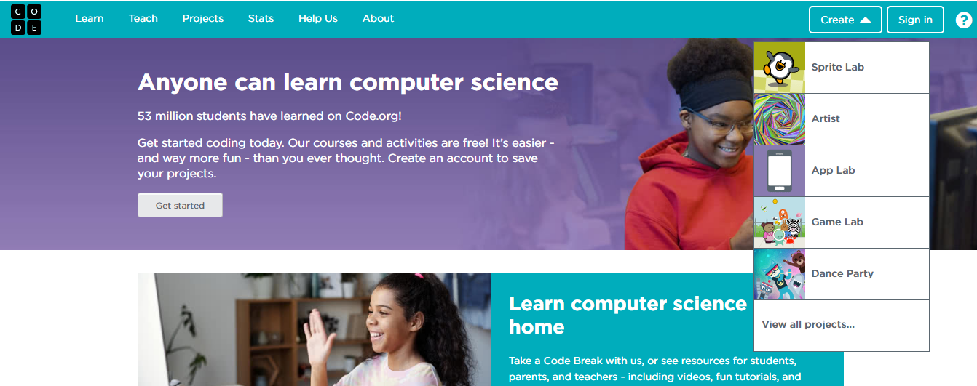
App Lab Experience…
Click on create, App Lab option is highlighted…

Slide 8
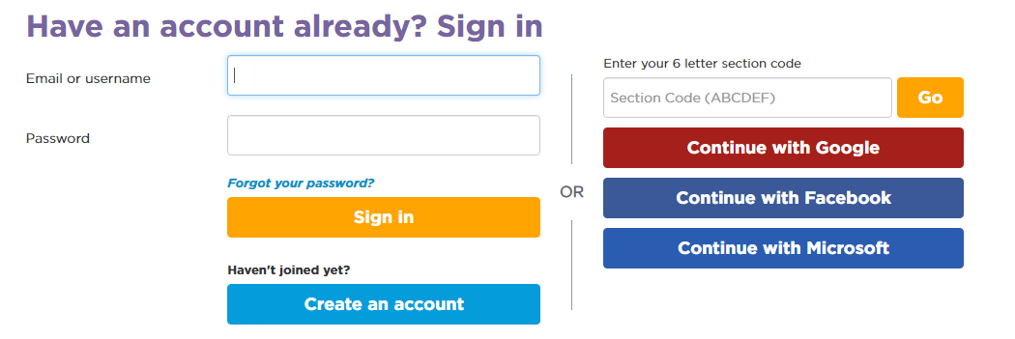
Join App Lab…
Create your account

Slide 9
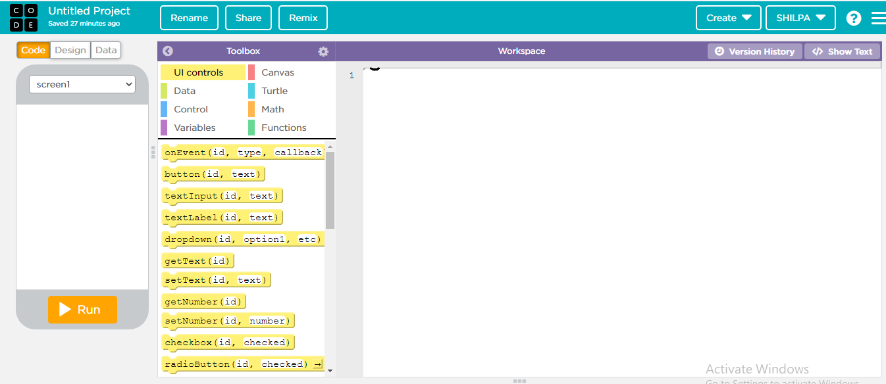
Default App Lab Screen…
Code Area
Your APP
Block Area

Slide 10
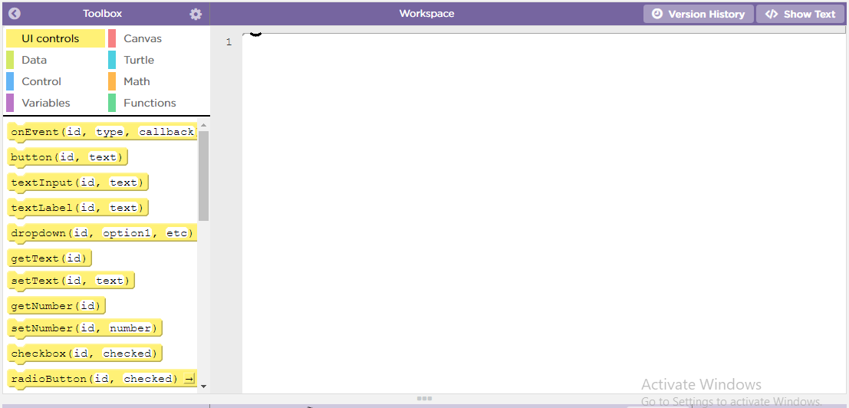
The Block Palette…
Code Blocks
UI controls
Data
Control
Variables
Canvas
Turtle
Math
Functions
Scripting Area

Slide 11
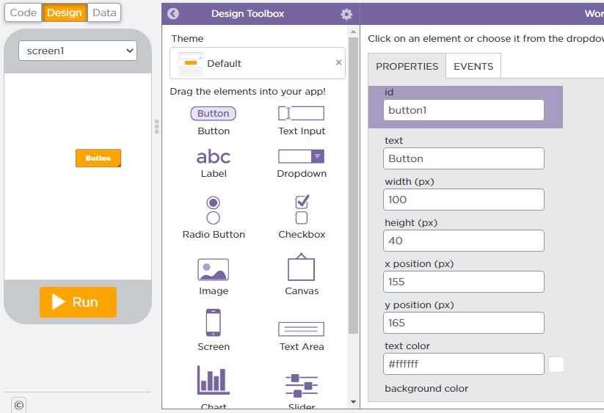
Design Tab…
To design click on Design
Use UI Tools to design screens with buttons, label
UI Tools are objects that perform actions in a project
Set Properties
Design Area

Slide 12
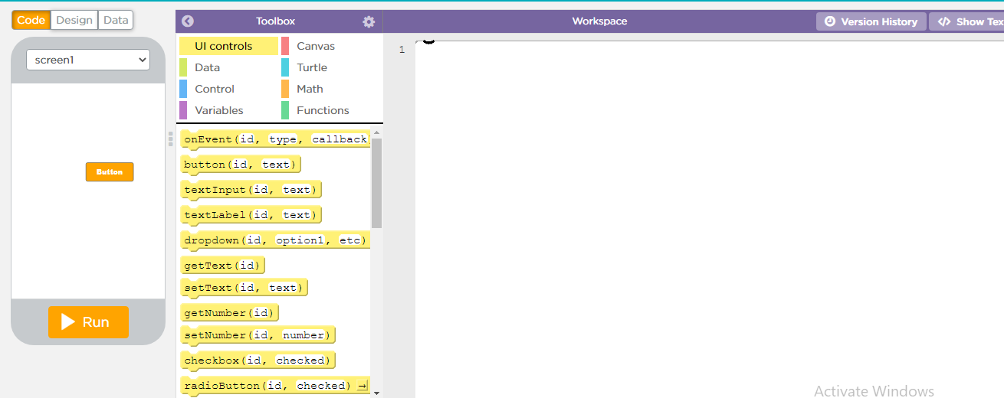
The code Tab
Blocks are colour coded
Click on the code tab to code app
Drag the code to scripting area

Slide 13
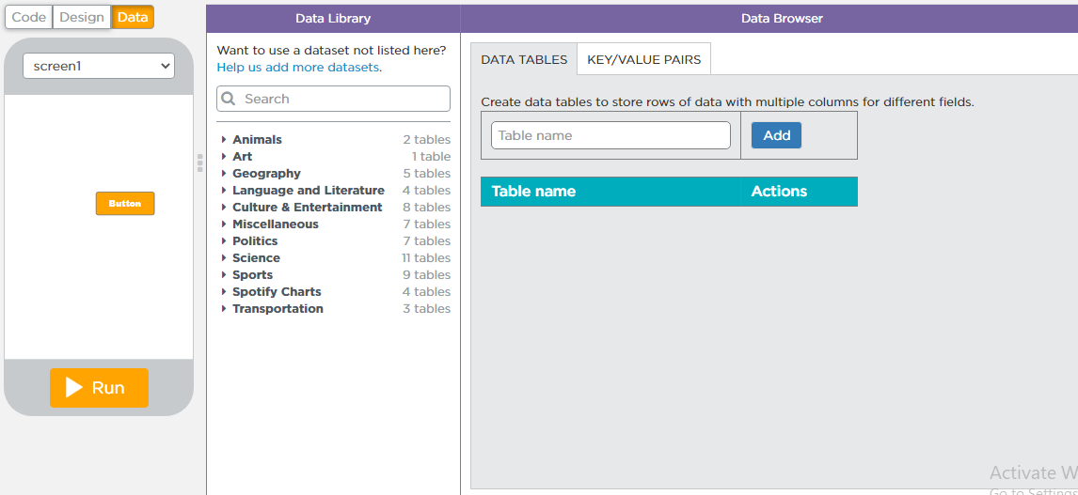
Data Tab…
This tab is used to create and manipulate database table
This tab make dynamic interaction in your page

Slide 14
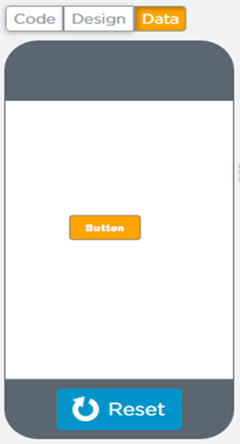
The Stage Area…
See your codes come to life
Run Button is used to execute code

Slide 15
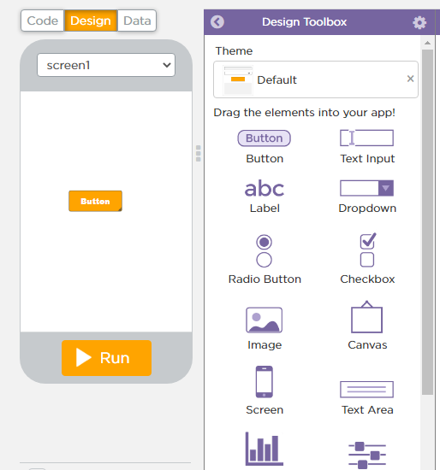
The Design Info Pane…
Add and delete UI controls like button here
Access this pane by drag and drop of the desired elements

Slide 16
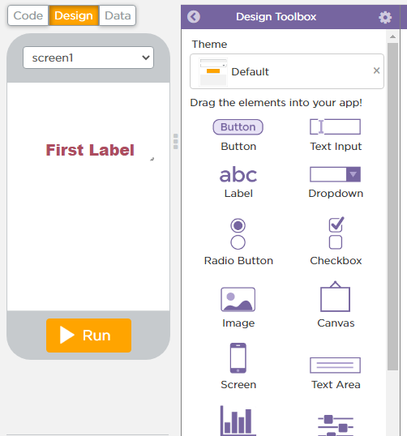
The Design Info Pane…
Add and delete UI controls like label from Toolbox
Access this pane by drag and drop of the desired elements

Slide 17
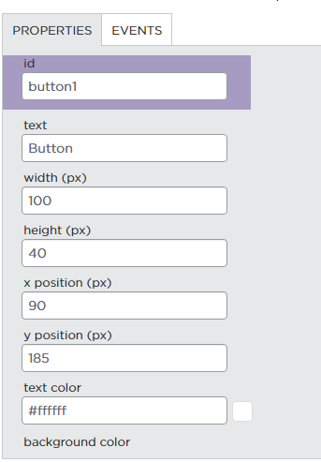
The Design Info Pane…
Set the properties of the elements which you dragged on design window

Slide 18
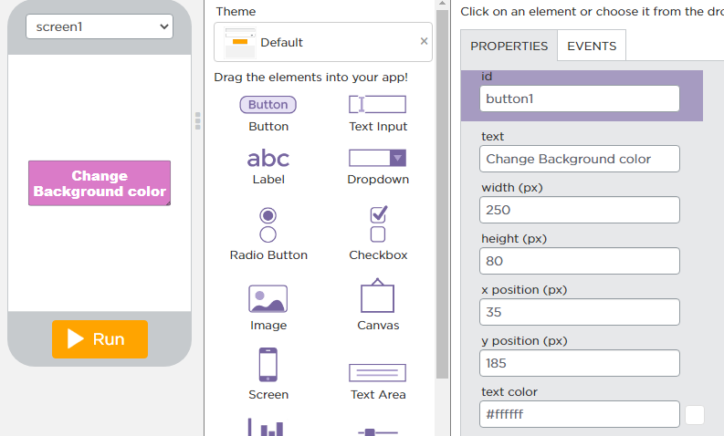
The Design Info Pane…
First Drag the Button on the Design tab
Then set various properties like width, height , font-size etc. from properties window
Change the background color of screen by clicking on the button

Slide 19
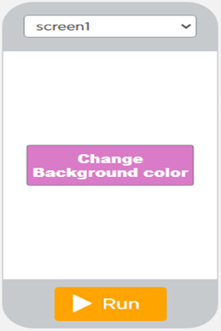

Introduction to App Lab…
Your First Design in App Lab

Slide 20

Summary…
What is App Lab
Learn Various Designs and codes
Design your first App

Slide 21

Next Session…
Creating UI Buttons
Create apps using text, label and UI button
Code your button and other controls
Make a small calculator App

