Slide 1

BLOCK CODING LEARNER
Session 25
Creating UI Buttons

Slide 2

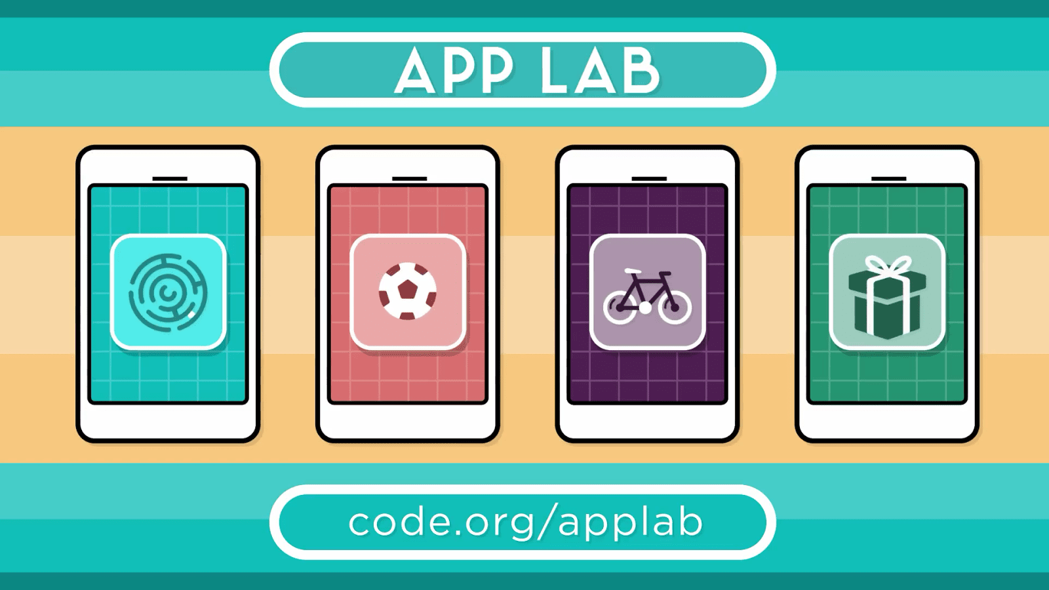
Recall…
Introduction to App Lab
Creating code.org account
Exploring App Lab
Various Designs and Codes

Slide 3

Creating UI Buttons…
We will Learn today:
Create apps using text, label and UI button
Code your button and other controls
Make a small calculator App

Slide 4
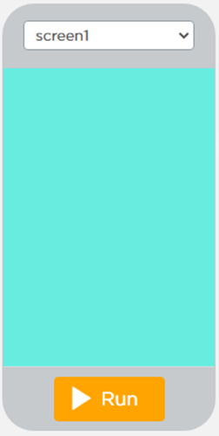
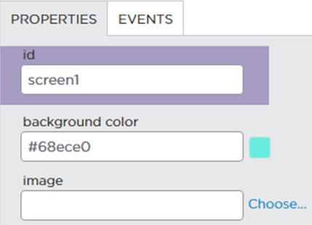
Designing First App…
Change the Background color of Screen

Slide 5
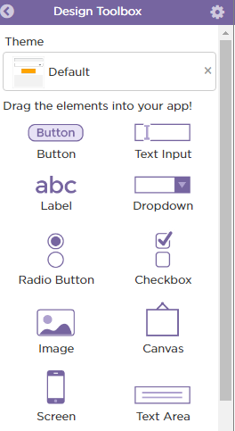
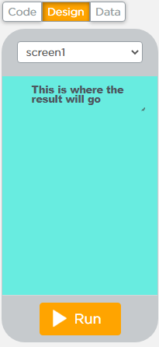
The UI…
Take the “First Label” to show the result
Drag Label and drop in the design area
Drag from here

Slide 6
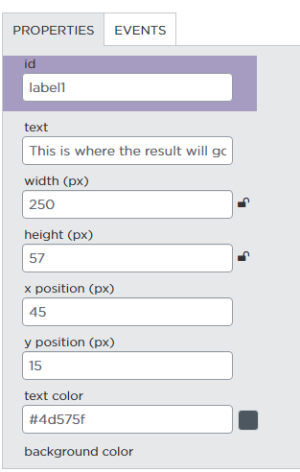
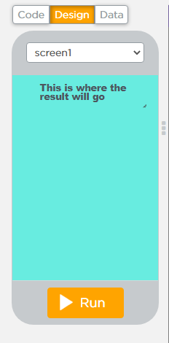
Label Properties…
Set the Label properties

Slide 7
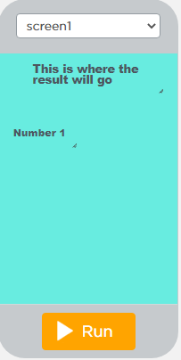
Label…
Next Take Label “Number 1”

Slide 8
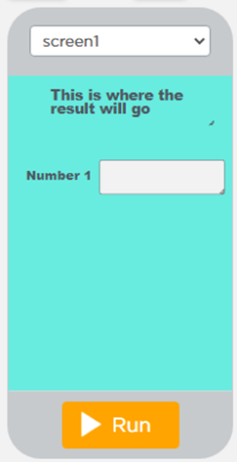
Text Input Box…
Next Take Text Input to Enter 1st Number
Just drag & drop

Slide 9
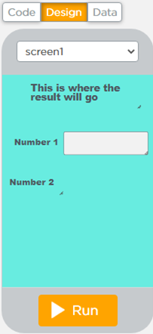
Label…
Next Take Label “Number 2”
Set properties

Slide 10
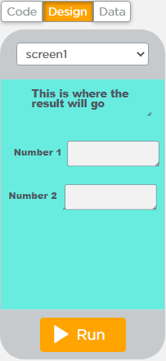
Text Input Box…
Take another “Text Input” Box to enter Text Input

Slide 11
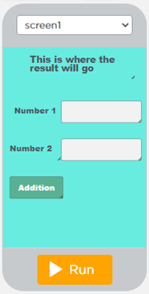
Buttons…
Next Take “Addition” Button to add the Inputs

Slide 12
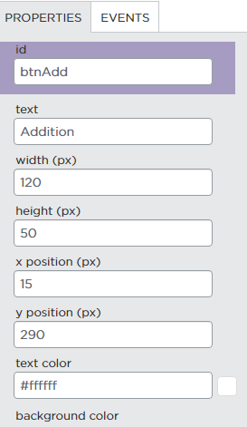
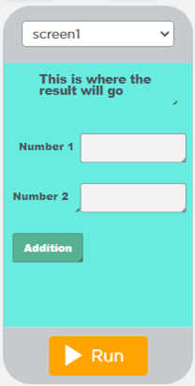
Button Properties…
Click on Properties to set property of Buttons

Slide 13
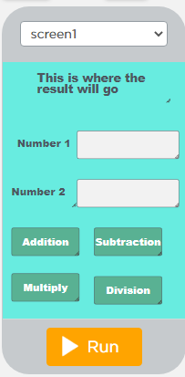
Add Buttons…
Add Three more buttons:
Subtraction
Multiplication
Division

Slide 14
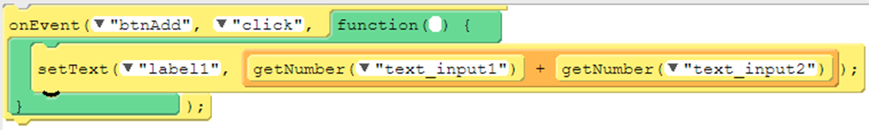
Let’s Code…
Interactive Apps Need:
UI
Event Handlers
UI element, with unique id, must exist before the onEvent function can be used
OnEvent in UI Controls have 2 parameters:
“id” :The user clicked on the specified element in “id” [button]
eventType: The user clicked on the specified element in “id” UI

Slide 15
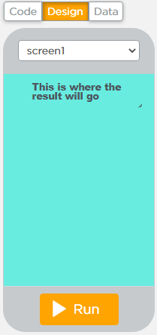
setText Control…
Has 2 parameters:
id:- The unique identifier for the screen element
text: The text displayed within the screen element

Slide 16
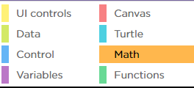

Math Control…
To Add 2 numbers:
Take “+” block from Math Control
Text_input1
Text_input2

Slide 17
getNumber Function…
Use getNumber function to get the number from:
Text_input1
Text_input2
Repeat for other buttons:
Subtract
Multiply
Division

Slide 18
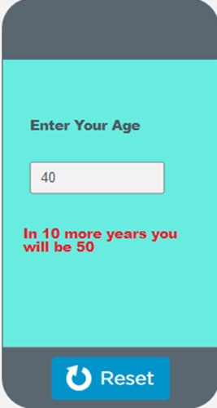
Now it’s your turn…
Create an app that will show the Result
Enter age in Given Text Box
Output will be the age you entered in text box + 10
Note: Please do this without using buttons

Slide 19
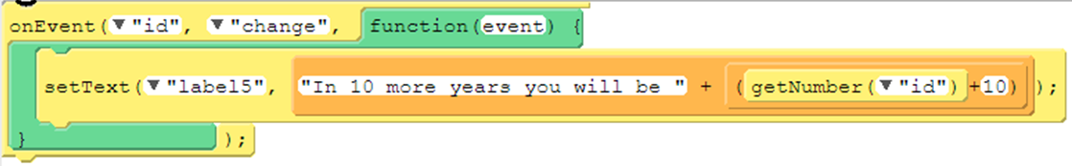
Solution…
Code

Slide 20

Summary…
Designing Calculator App
Code functions
onEvent
setText
Math control
getNumber

Slide 21
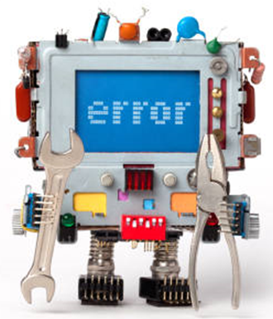
Next Session…
Debugging Codes:
What is debugging?
Debug codes
Fix codes

