Slide 1

BLOCK CODING LEARNER
Session 26
Debugging Codes

Slide 2

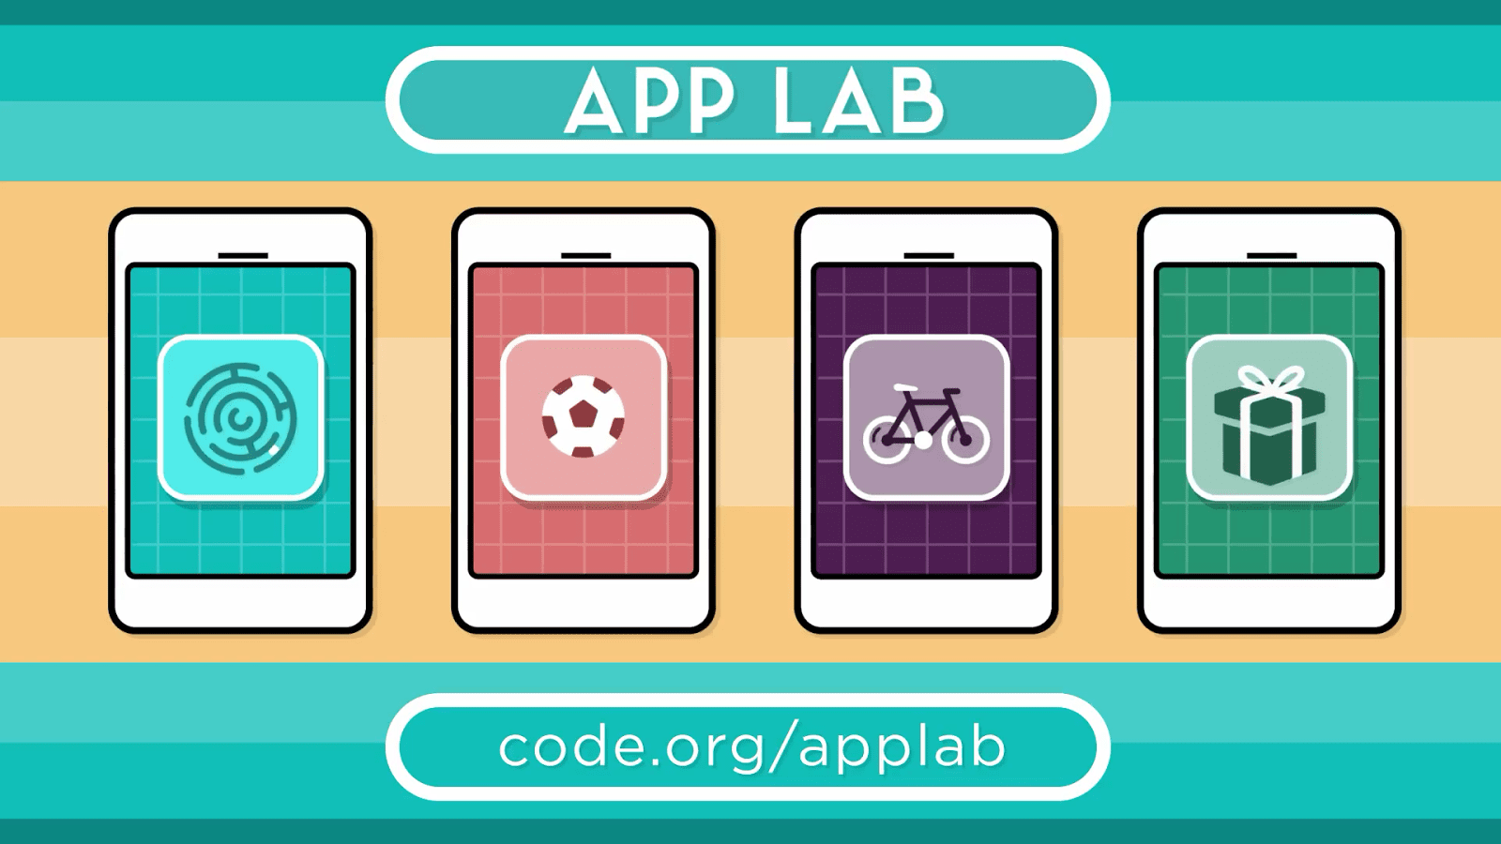
Recall…
Designing Calculator App
Code functions
onEvent
setText
Math control
getNumber

Slide 3

Debugging Codes…
We will Learn today:
What is debugging?
Debug codes
Fix codes
Debug and fix code in app lab

Slide 4
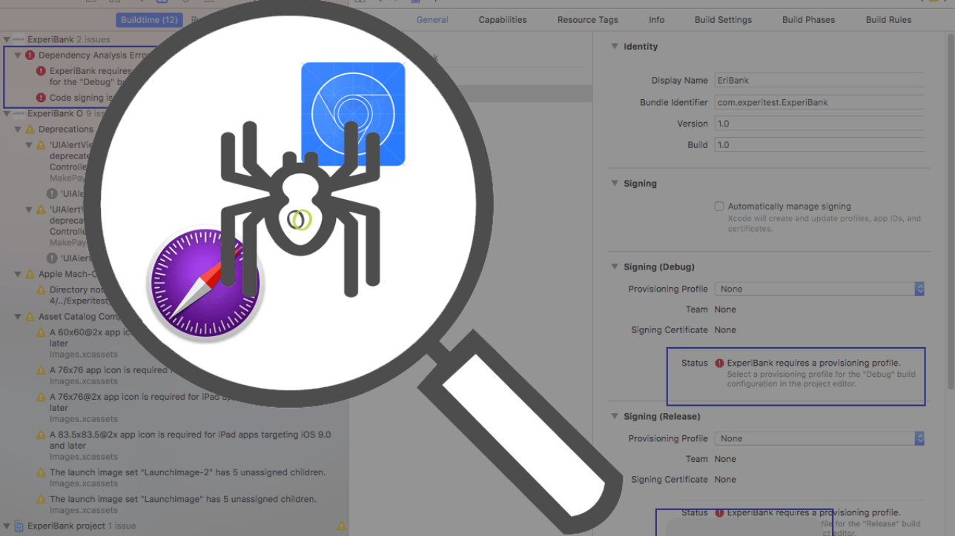
Debugging…
Process of finding and resolving bugs (errors) within computer programs, software, or systems
Analyze the error to:
Understand the type of bug
Reduce the number of errors

Slide 5

Why it is called Debugging?
Admiral Grace Hopper coined the term Debugging
Interesting story behind this
She was working on a Mark II computer
Discovered a moth stuck in a relay
Thereby obstructing operation
The bug was taken out and she said, “debugged the computer”

Slide 6
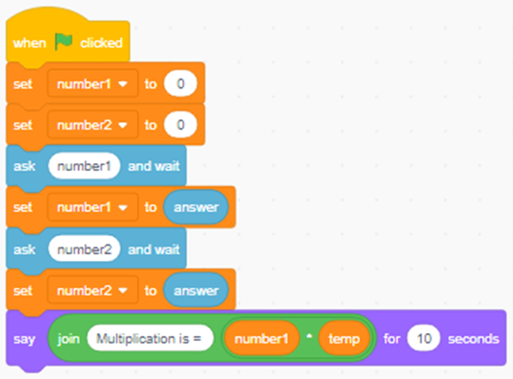
Debugging codes in Scratch…
Let’s Start Debugging:
First take 2 variables in Scratch ‘number1’ & ‘number’”
Code multiplication of two numbers
Take one more variable called ‘temp’
In the last line of code multiplied ‘number1’ by ‘temp’ , instead of ‘number2’

Slide 7
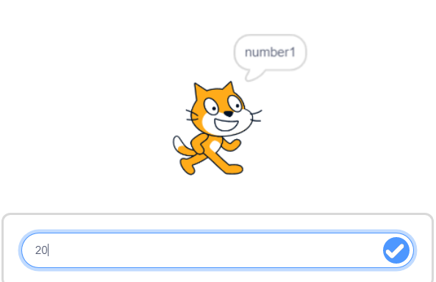
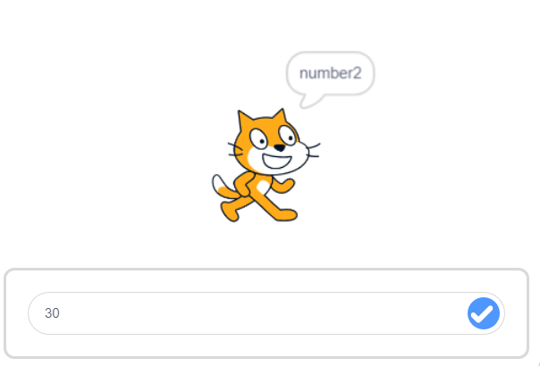
Debugging codes with scratch…
In the first image, enter value for ‘number1’ as 20
Then in second image, enter value for ‘number2’ as 30
As per multiplication coding in previous slide, what will be the output?

Slide 8
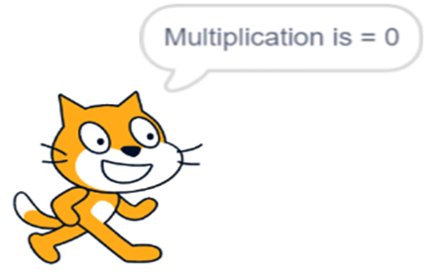
The Output is…
Why you did not get the correct output?
After analyzing the code found a different variable

Slide 9
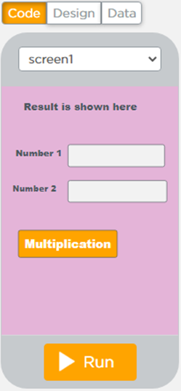
Debugging codes in App Lab…
Let’s see how to Debug in App Lab:
There are 2 Textboxes in App
For Number 1 -> text_input1
For Number 2 -> text_input2

Slide 10
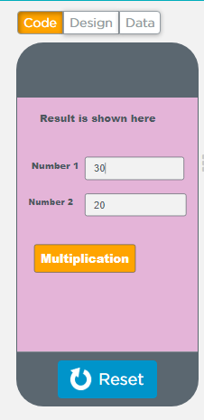
Debugging codes…
Enter the values as shown below to multiply two numbers:
Enter value for ‘number1’ as 30
Enter value for ‘number2’ as 20

Slide 11
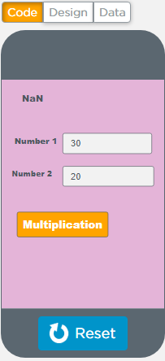

Output Screen…
The output is displayed as ‘NaN’
And below in ‘Debug Console’ warning will appear
WARNING: Line: 2: The getNumber() id parameter refers to an id (‘text_input3”) which does not exists
Variable / Property

Slide 12
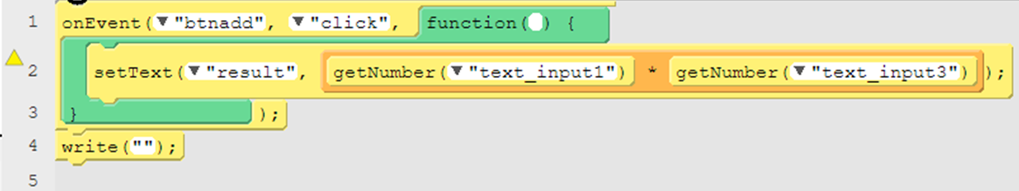
Code Error…
The code will also show the error
Noticed the ‘yellow triangle’ in the image below?
It shows an error in line 2

Slide 13
Debugging codes…
In the Debug Console you will see option ‘Clear’
WARNING: Line: 2: The getNumber() id parameter refers to an id (‘text_input3”) which does not exists
Variable / Property

Slide 14
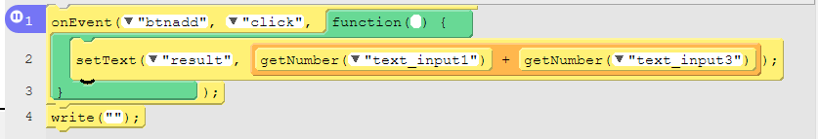
Debugging codes…
Put debugging point in code like this

Slide 15
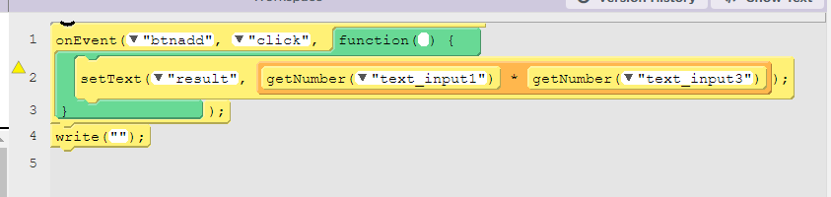
Debugging codes…
-> Then the result is like this :
In code we will also see the point where error occurs.

Slide 16

Now Your Turn…
Put a debug point and find bug in your App
Fix the bug
Share bugged code with your Coding friends and ask them to debug

Slide 17

Summary…
Story behind the word Debug
Debug codes
Fix codes
Debug and fix codes in app lab

Slide 18
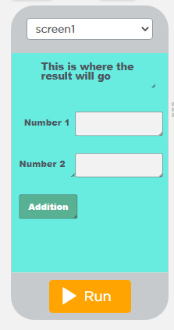
Next Session…
App Publishing
Need to publish apps
How to publish an app
How to export apps from your local PC
Publish apps via social media

