Slide 1

BLOCK CODING LEARNER
Session 27
App Publishing

Slide 2


Recall…
What is debugging?
Debugging codes
Fixing codes
Debug and fix code in app lab

Slide 3
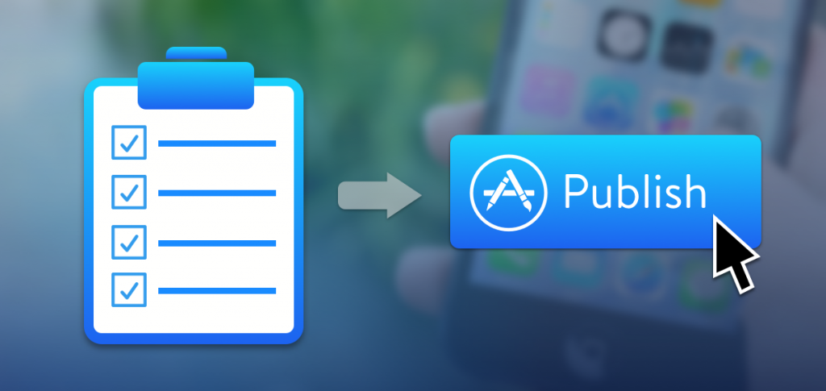
App Publishing…
We will Learn today:
Need to publish apps
How to publish an app
How to export apps from your local PC
Publish apps via social media

Slide 4
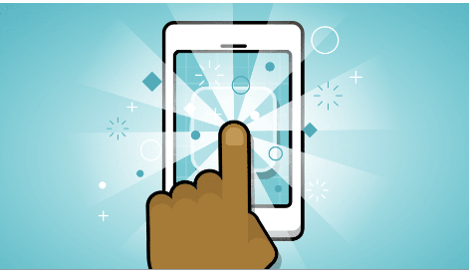
Publishing First App... (why?)
In App Lab you can design simple apps with code blocks and then share your Apps
This allows teachers to start teaching with App Lab so students can quickly create apps and then graduate to more advanced features in a professional development environment.

Slide 5
Publishing First App...
-> So here is how to publish your app.
1. Go to the ‘Share’ button at the top left of App Lab.

Slide 6
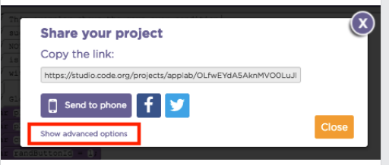
Publishing First App...
2. Select ‘Show advanced options’ to bring up the ‘Export’ tab.

Slide 7
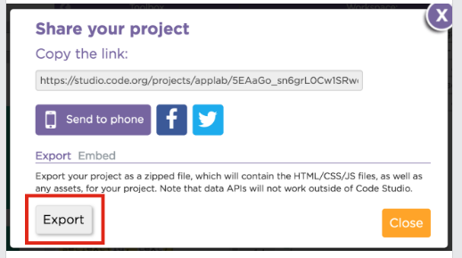
Publishing First App...
3. Select the export button. This will download a zipped archive.

Slide 8
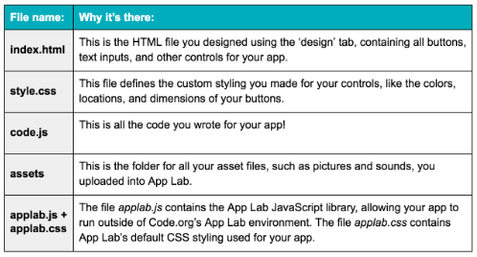
Publishing First App...
4. Here’s what’s in the zip file….

Slide 9
Publishing First App...
Once you export your app, click on the ‘index.html’ file to open your app on your browser.
Your app should now be running locally on your computer!
You can edit these files locally with any text editor or modern development environment.
You can also upload the files to your own web server or online web development environment.

Slide 10
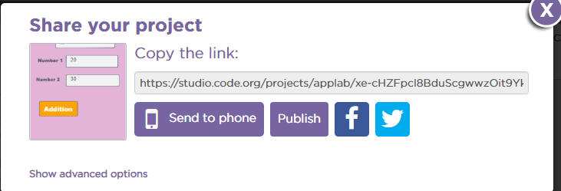
Publishing First App...
You can also share your app via social media like facebook and twitter.

Slide 11
Publishing First App...
You can also share your app to your friends and others via link given below at whatsapp, email etc.

Slide 12

Summary…
Need to publish apps…
How to export apps in
Your local pc.
Publish apps via social media
Student will be able to
publish app

Slide 13
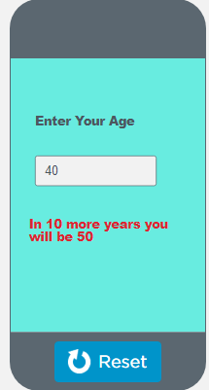
Now It’s Your Turn?…
Try to publish and export every app which
You made in App lab.
Try to Export your app in local pc and
Work in local pc in any code environment
like notepad++, sublime etc.

Slide 14
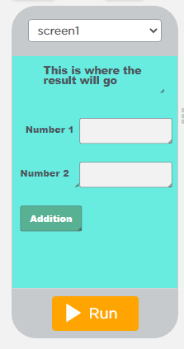
Next Session…
Text to Speech app
Learn to create Text to speech app.
Using variables and logic gates to create Text to Speech app.

