Slide 1

BLOCK CODING LEARNER
Session 28
Talk to Me app

Slide 2


Talk to me app…
We will Learn today:
How to make talk to me app using Thunkable
Designs and Blocks in Thunkable
How to run app

Slide 3
Talk to me app…
Thunkable is building the world's largest gallery of open sourced apps to help inspire you and save you time.

Slide 4
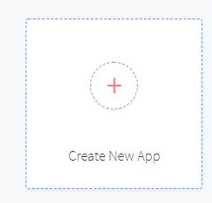
Talk to me app…
Let’s begin that how to create New Project in Thunkable.

Slide 5
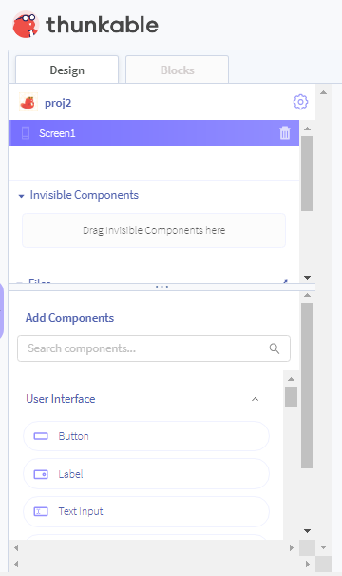
Talk to me app…
The design block
Drag components from here

Slide 6
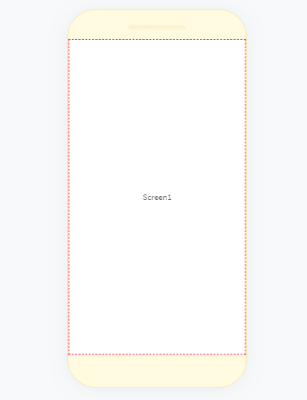
Talk to me app…
The design block
Drag and Drop components here

Slide 7
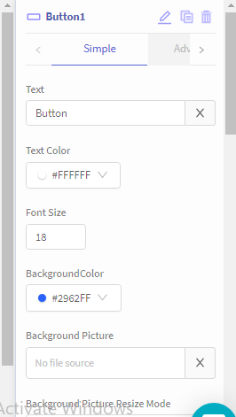
Talk to me app…
The design block
Property window.. set properties of UI controls here

Slide 8
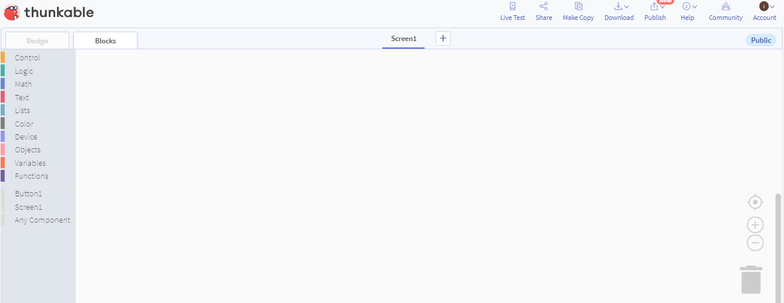
Talk to me app…
The Block side….(you can write code here with block)

Slide 9
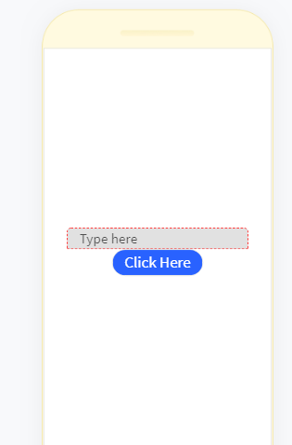
Talk to me app…
Let’s begin our app
1. Do the Design
2. Drag a button and Text Input from Design Blocks

Slide 10
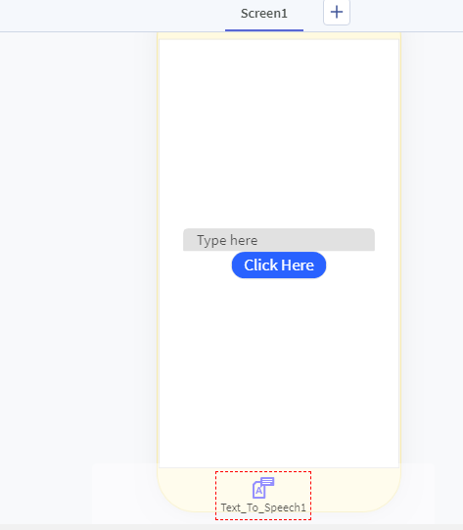
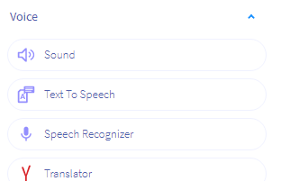
Talk to me app…
Let’s begin our app
3. Here we need to take invisible component also.
4. In our case that is “Text to speech” control
Invisible component always shown at bottom side

Slide 11
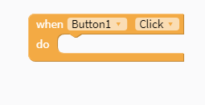
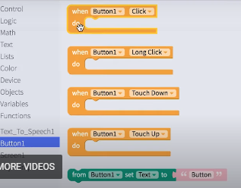
Talk to me app…
Use Blocks for Coding.
First take a button click event block like as in image
When we take a button in Design , then in blocks there is all possible events are generated for button

Slide 12
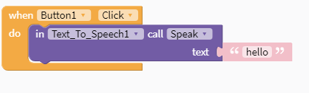
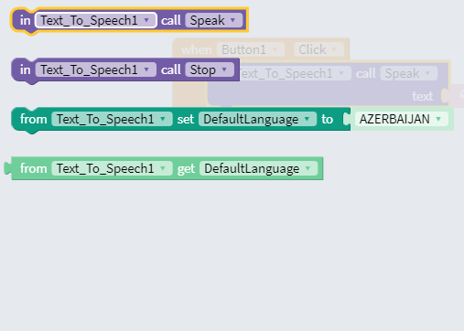
Talk to me app…
2. Next take “text to speech” call speak function from blocks
When we take “Text to speech” in Design , then in blocks there is all possible events are generated for “Text to Speech”.

Slide 13
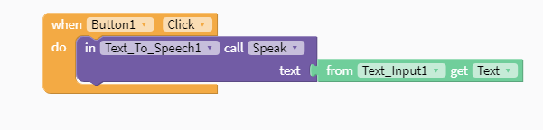
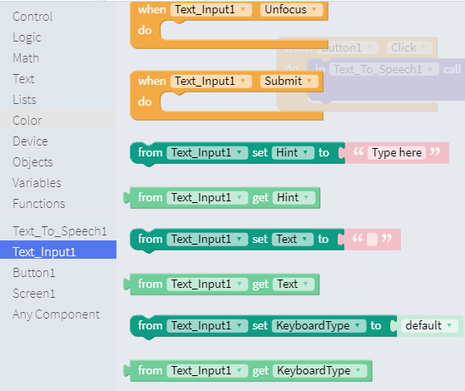
Talk to me app…
3. Next take “Text_Input Text” function from blocks
When we take “Text_Input” in Design , then in blocks there is all possible events are generated for “Text_Input”.

Slide 14

Talk to me app…
4. Run the App using live Test button at top right side .

Slide 15
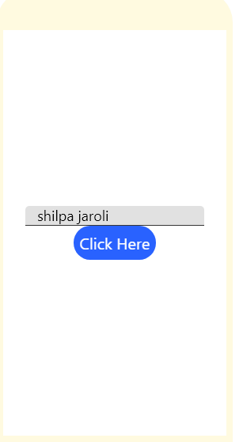
Talk to me app…
4. After clicking on live test app is looking like this.
5. When I write Text in Textbox “Shilpa Jaroli” and click on button click here , then it will speak “Shilpa Jaroli” as written in Text Box.

Slide 16

Summary…
How to make talk to me app using Thunkable
Designs and Blocks in Thunkable
How to run app

Slide 17
Next Session…
Multiscreen app:
Learn to navigate in app by switching context between multiple screens.
Create multiple screens and navigate in an app.
Student will be able to create a simple classification apps like classification of desserts.

