Slide 1

BLOCK CODING LEARNER
Session 29
Multiscreen apps

Slide 2

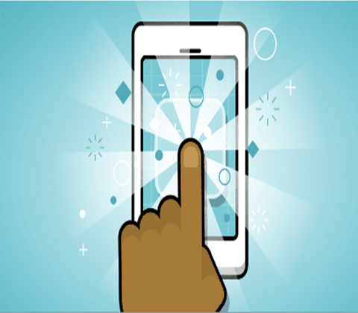
Multiscreen app…
We will Learn today:
Learn to navigate in an app by switching context between multiple screens
Create multiple screens and navigate in an app

Slide 3
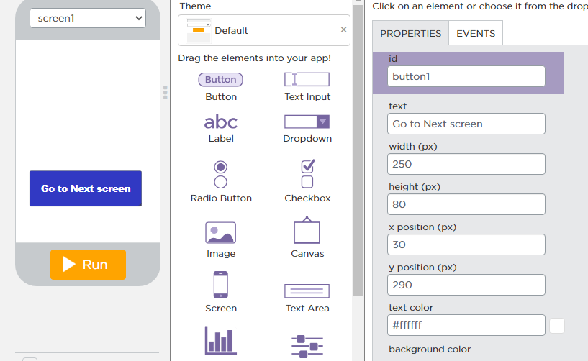
Multiscreen app…
Let’s begin that how to create multiscreen app
First at screen1, Drag a Button and drop and set properties

Slide 4
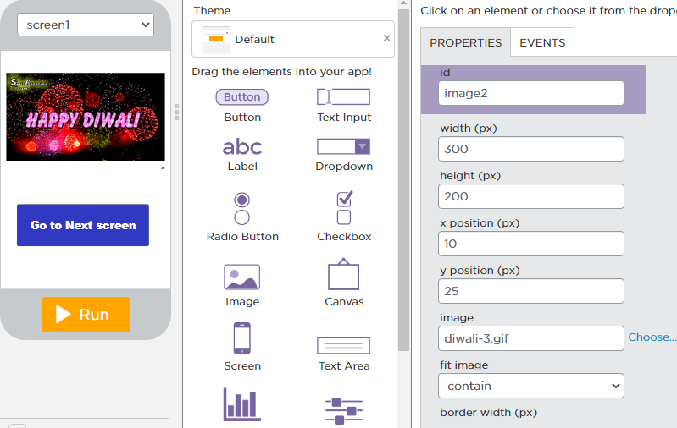
Multiscreen app…
Then take an Image on the screen1 as shown here

Slide 5
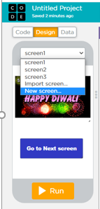
Multiscreen app…
Now create another screen as shown in image
Just click on New screen option

Slide 6
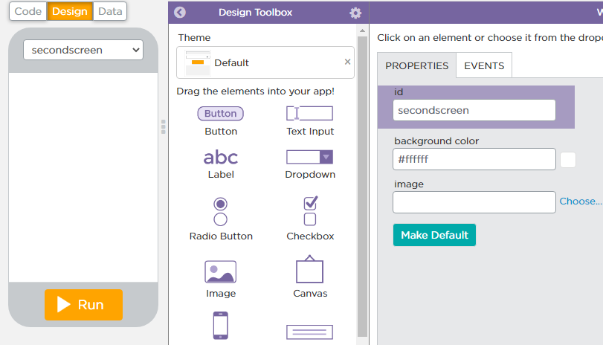
Multiscreen app…
After clicking on new screen option a new screen appear there as shown in image
Change the Id of the screen to “secondscreen” as shown in image

Slide 7
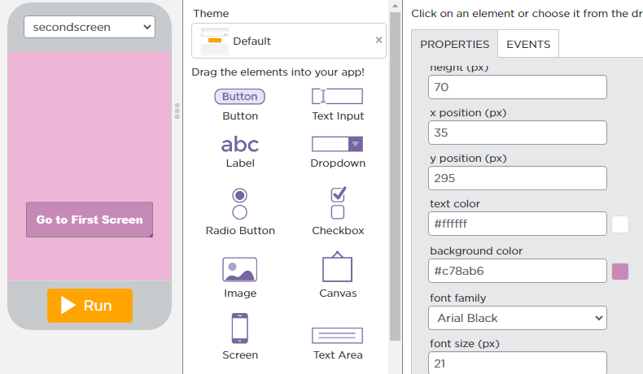
Multiscreen app…
Then change the background color of the screen
Take one button here and set properties as shown in image

Slide 8
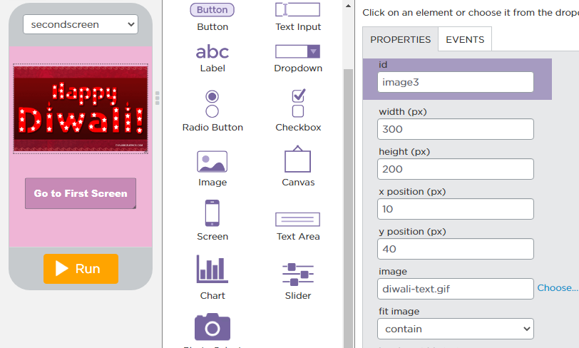
Multiscreen app…
Then take image from the given elements and click on choose properties to upload image from your PC

Slide 9
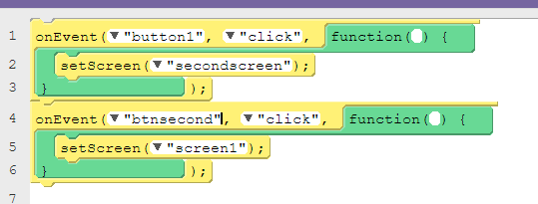
Multiscreen app…
Code…

Slide 10
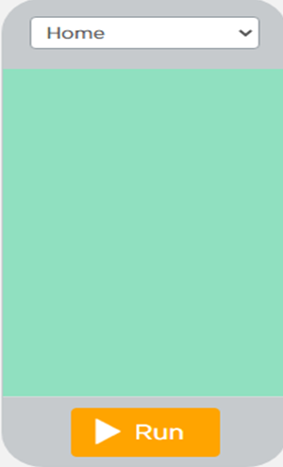
Multiscreen app…
Another example of multiscreen app…
Make survey app
Name the id of first screen as “Home”.
Change the background color also

Slide 11
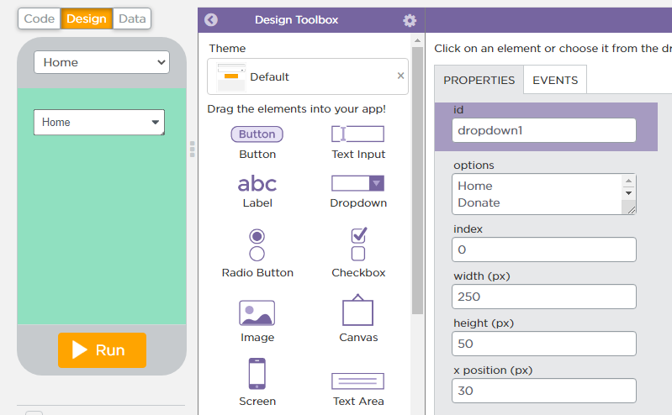
Multiscreen app…
Then take a dropdown list here in “Home” screen.

Slide 12
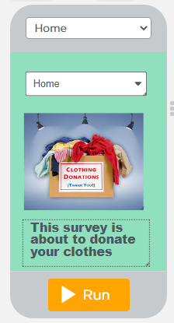
Multiscreen app…
Then take an image and label in “Home” screen.

Slide 13
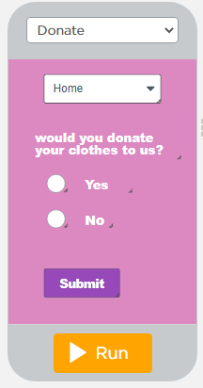
Multiscreen app…
Now make second screen set “id” of this as “Donate”
Here first take dropdown as we take for first screen (“Home”)
Then take label and give text “would you donate your clothes to us?”
Then take 2 radio buttons and give text to it “yes” or “no”
After than take submit button

Slide 14
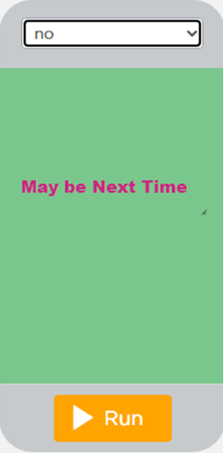
Multiscreen app…
Now make Third screen set “id” of this as “no”
Here just take a label and set the label text as “May be Next Time”

Slide 15
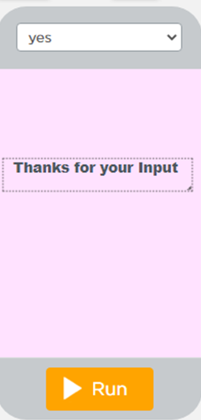
Multiscreen app…
Now make Fourth screen set “id” of this as “yes”
Here just take a label and set the label text as “Thanks for your input”

Slide 16
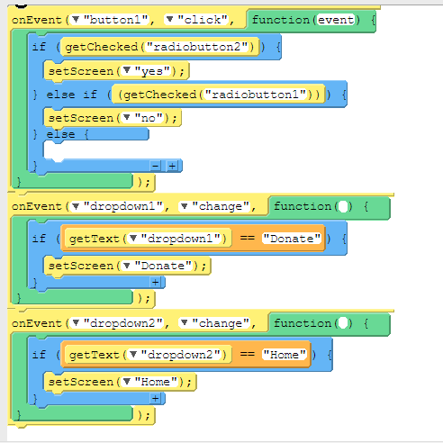
Multiscreen app…
Now the Final code is…

Slide 17
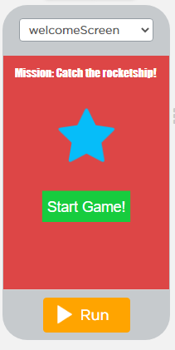
Now It’s your turn ? ….
Make an Game app…
First screen Id is : “welcomeScreen”

Slide 18
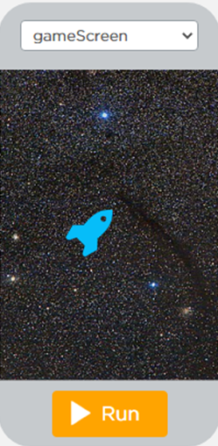
Now It’s your turn ? ….
Second screen Id is : “gameScreen”

Slide 19
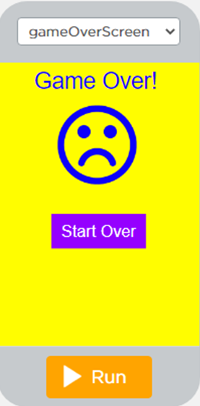
Now It’s your turn ? ….
Third screen Id is : “gameoverscreen”

Slide 20
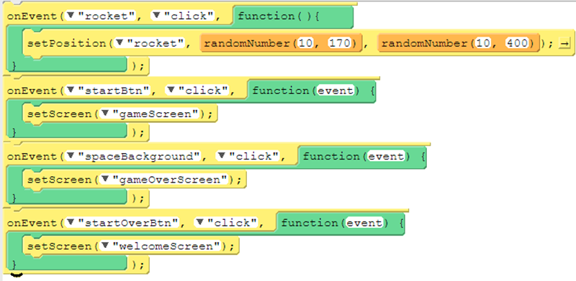
Now It’s your turn ? ….
Code….

Slide 21

Summary…
Learn to navigate in an app by switching context between multiple screens.
Create multiple screens and navigate in an app.

Slide 22
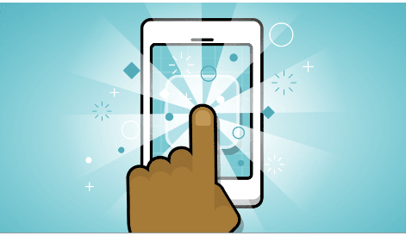
Next Session…
Algorithm and coding for programming …..
Learn algorithm and programming for coding
Analyze and breakdown coding structure

