Slide 1

BLOCK CODING LEARNER
Session 30
Algorithm and programming for coding

Slide 2


Algorithm and coding for programming…
We will Learn today:
Learn algorithm and programming for coding
Analyze and breakdown coding structure

Slide 3
Algorithm and coding for programming…
Informally, an algorithm is any well-defined computational procedure that takes some value, or set of values, as input and produces some value, or set of values, as output.
An algorithm is thus a sequence of computational steps that transform the input into the output.

Slide 4
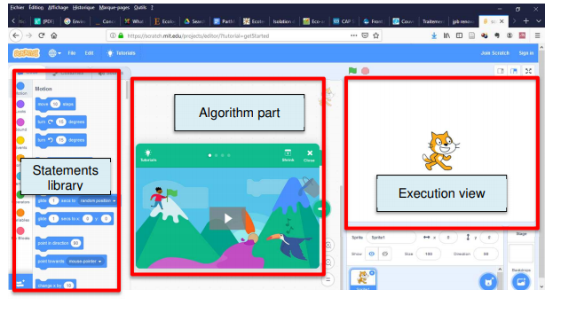
Algorithm and coding for programming…
After having created a new project, you access to the interface where you can create your algorithms and observe the result of their execution (with the sprite).

Slide 5
Algorithm and coding for programming…
To build an algorithm, we only need to drag and drop elements from the block library to the algorithm part.
The library contains a huge set of block, ordered by categories. Each category has its own color.

Slide 6
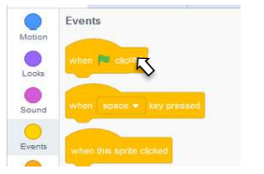

First Algorithm with Scratch…
Aim :- Run 1 statement when the green flag is clicked .
Answer: As a first algorithm, we want that, when the user clicks on the green flag, the sprite moves by 10 steps from its actual location.
First, we need a block that is activated when the event “click on the green flag” is triggered.
In the library, chose Events and the block .
Drag and drop this block in the algorithm part

Slide 7
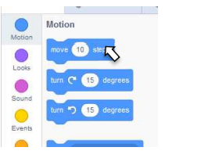

First Algorithm with Scratch…
The block describing the sprite’s move can be found in the Motion set of statements.
Chose and drag and
drop it into the algorithm part. Drop the second block (move) just below the former one, they will stick together.

Slide 8
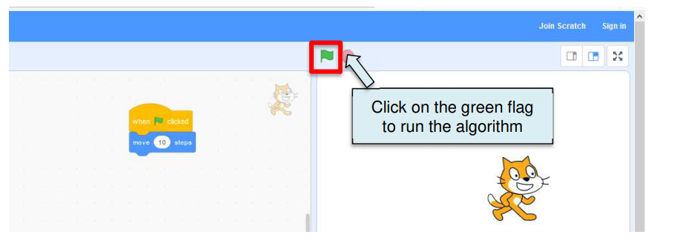
First Algorithm with Scratch…
Now the user can click on the green flag and observe the sprite’s move. Try to click again on the green flag to make it move again.

Slide 9


Algorithm and coding for programming…
In an algorithm, it is often useful and necessary to store results of intermediate computations and to be able to reuse them in the sequel of the algorithm.
It is done using variables.
User-defined variables :- Scratch allows the developer to create his own variables. The menu Variables is dedicated to this purpose. To create a new variable, click on “Make a variable” button.
Built-in variables: In Scratch, sprites have built-in variables such as their location ( and )

Slide 10
Algorithm with Scratch…
Aim :- Swap 2 variables .
Answer: Create a new algorithm, with 2 variables x and y, initialized to 10 and 50. Write the algorithm that swap the value of the two variables x and y. At the end, x should be equals to 50 and y to 10
First, we need a block that is activated when the event “click on the green flag” is triggered.
In the library, chose Events and the block .
Drag and drop this block in the algorithm part.

Slide 11
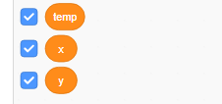



Algorithm with Scratch…
3. Create Variable x , y and temp in Variable Section.
In the library, chose Variable and the block .
6. In the library, chose Variable and the block .
7. In the library, chose Variable and the block and assign the value of “x” to temp.

Slide 12



Algorithm with Scratch…
8. In swapping process, next assign the value of variable “y” to variable “x”.
9. In swapping process, next assign the value of variable “temp” to variable “y”.
10. Next use Join statement to show the output of swapping variable like…

Slide 13
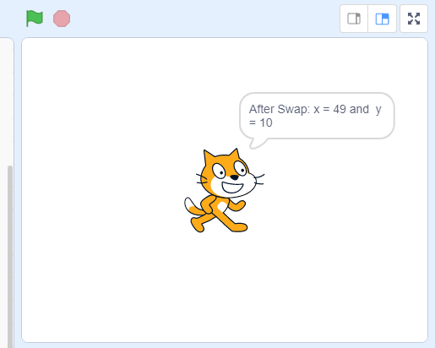
Algorithm with Scratch…
Now the user can click on the green flag and observe the sprite’s , that notify about swapping values.

Slide 14

Summary…
Learn algorithm and programming for coding
Analyze and breakdown coding structure

Slide 15
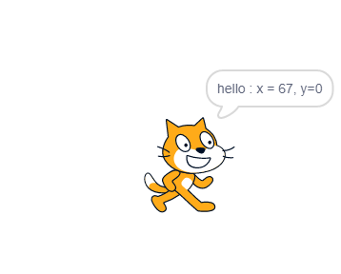
Now It’s your turn ?
Write an algorithm to display the coordinates (Xposition and Yposition) of the sprite.
Then arrange the blocks in the scratch according the algorithm to show the output as Image(right side).

Slide 16
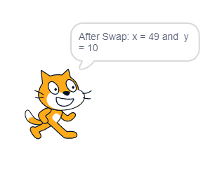
Next Session…
Arithmetic Operators -1:
Learn 2 Arithmetic operators {+ and -}
Student will be able to solve arithmetic operations.

