Slide 1

BLOCK CODING LEARNER
Session 41
GUI

Slide 2

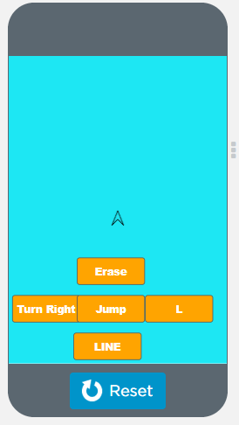
Recall…
What we have learnt in last session
What challenges you are facing

Slide 3

GUI…
We will Learn today:
Rich GUI Apps in App Lab
Create Slider, checkbox, and other controls in app

Slide 4
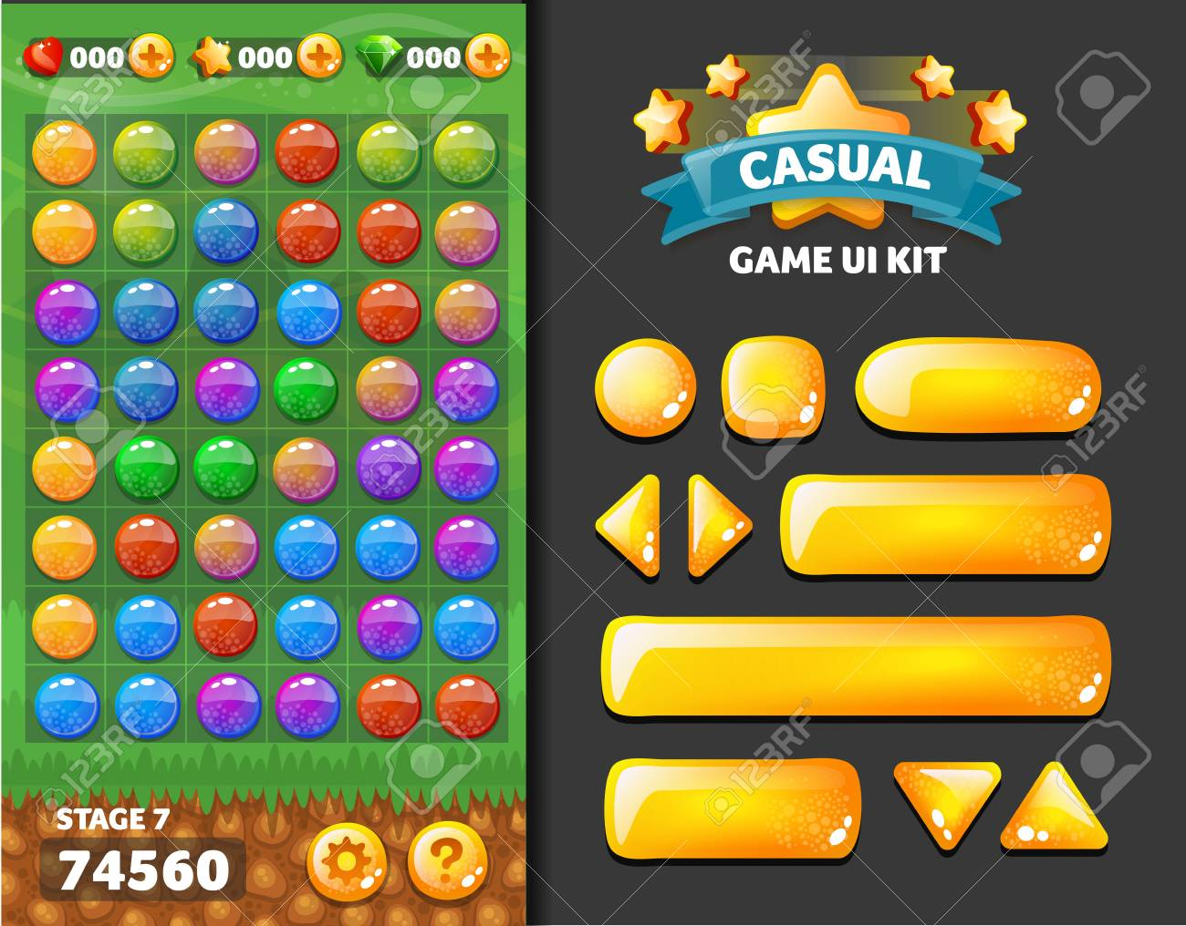
GUI…
Graphical User Interface is a form of user interface that allows users to interact with electronic devices through graphical icons
A GUI displays objects that convey information, and represent actions that can be taken by the user
The objects change color, size, or visibility when the user interacts with them

Slide 5
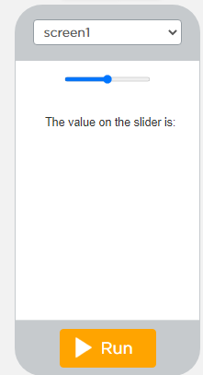
Sliders….
Slider – Allows users to set a value by moving the indicator:
Drag an slider and an label from UI tools

Slide 6
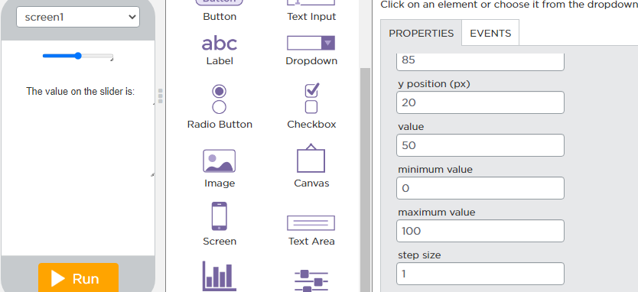
Sliders….
2. Set Properties of Slider (Min and Max value) as shown in figure:

Slide 7
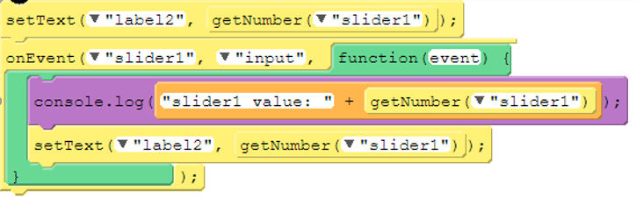
Code for sliders….

Slide 8
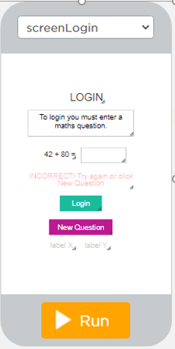
Another Example Of Sliders….
Make one screen named “screen Login”
Take a Label “LOGIN”
Take one more label.
Then take a textbox to give the result of “42+80=“
Then take buttons “Login” and “New Questions”
At the end again take two labels “label X” and “label Y”

Slide 9
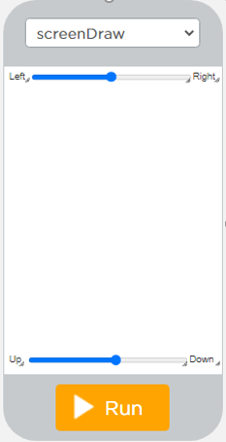
Another example for sliders….
Make another screen named “screen draw”.
Take 2 sliders here
Named 1 slides as “xslider” and set its properties minimum value to “0” and maximum value to “320”
Named 2nd slider as “yslider” and set its properties minimum value to “30” and maximum value to “410”

Slide 10
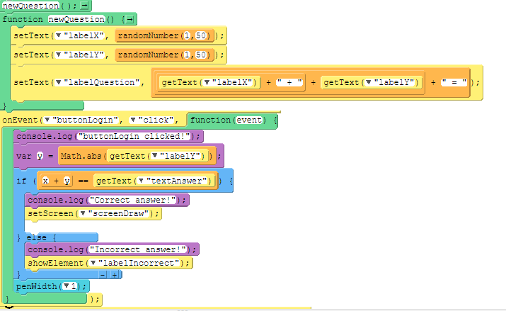
Code for sliders….
Contd…

Slide 11
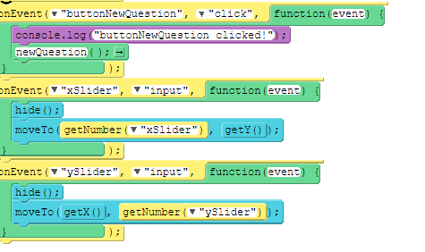
Code for sliders….

Slide 12
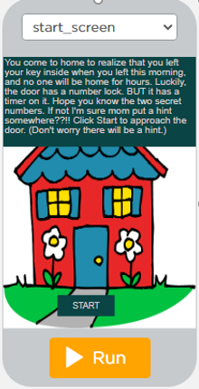
Checkbox Demo…
First make a screen and name it as “start screen”
Take a “LABEL”
Take an Image
Take a Button named “START”

Slide 13
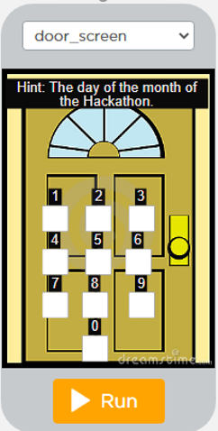
Checkbox demo…
Next make a screen and name it as “door screen”
Make the design as shown in figure:

Slide 14
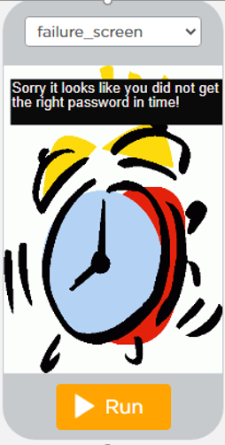
Checkbox demo…
Next make a screen and name it as “failure screen”
Make the design as shown in figure:

Slide 15
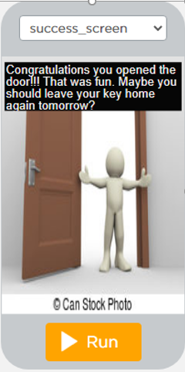
Checkbox demo…
Fourth make a screen and named it as “success screen”
Make the design as shown in figure:

Slide 16
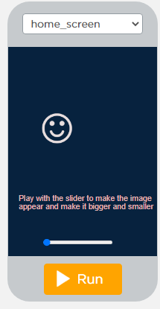
Now It’s Your Turn ?
Make slider game like this..

Slide 17
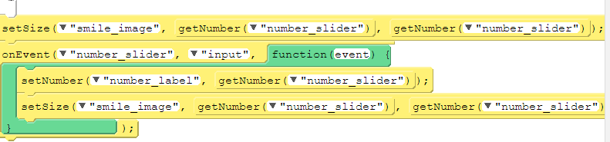
Code…

Slide 18

Summary…
Rich GUI Apps in App Lab
Create Slider, checkbox, and other controls in app

Slide 19
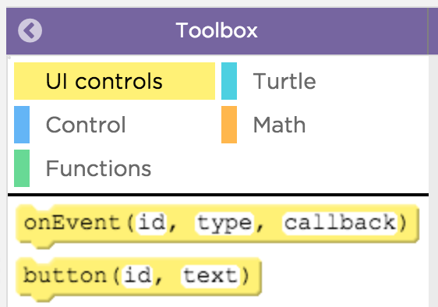
Next Session…
Extended UI:
Learn to use Extended UI for apps
Use string functions with extended UI components in apps

