Slide 1

BLOCK CODING LEARNER
Session 42
Extended UI

Slide 2


Recall…
What we have learnt in last session
What challenges you are facing

Slide 3
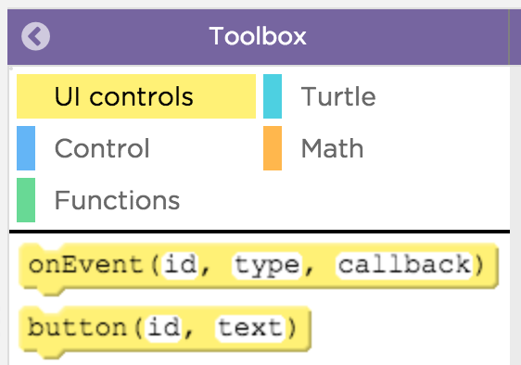
Extended UI…
We will learn today:
Learn to use Extended UI for apps
Use string functions with extended UI components in apps

Slide 4
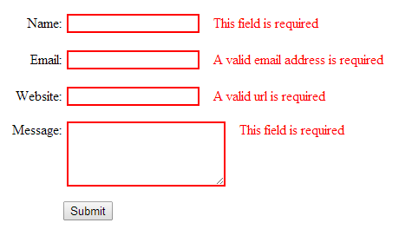
Extended UI (Strings)…
The primary data type we have used so far is Numbers
If we want to interact with user-submitted text then we have to learn about a new data type called “String”
A string is a sequence of ASCII characters

Slide 5
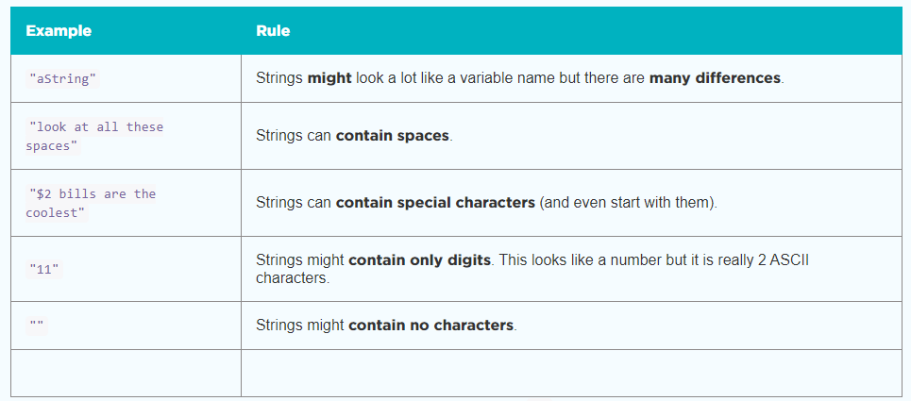
Extended UI (Strings)…

Slide 6
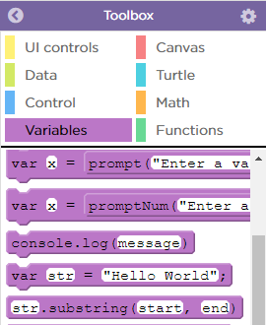
Extended UI (Strings)…
You can store strings in a variable just like a number
In this example the variable name is “str” but you should choose a name that is descriptive and meaningful
Combining Strings: often you will want to combine multiple strings to create one longer string
You can do this with the + operator
The formal name of this process is concatenation

Slide 7
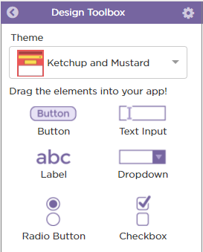
Extended UI (Strings)…
So far we've been using “promptNum” as a simple way to get a number as input
Now that we know a little about strings we are going to create user interface elements that users can use to submit text (i.e. strings) instead
The first and simplest example is “textInput” which you can find in Design Mode:

Slide 8
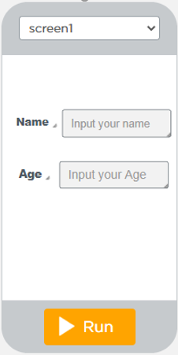
Extended UI (Strings)…
Add two text input elements to this program, one for the name and one for the age of the user
Give your text input elements descriptive and meaningful IDs
In Design Mode set their default text to prompt the user for their name and age

Slide 9
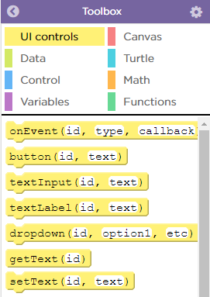
Extended UI (Strings)…
We saw a user can now input text whenever they want.
Now we'll need a way to access that text
In order to access text, you'll need to use the “getText” command
This command is available in the UI Controls tab

Slide 10

Extended UI (Strings)…
You can use “getText” command just like a string within a “console.log” or “write” command
Just like in “setText” you will refer to the UI element by its ID

Slide 11
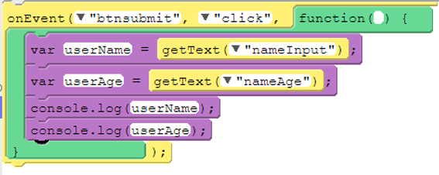
Extended UI (Strings)…
Create two variables inside your event handler to store the age and name of the user
Use “getText()” to update the values stored in each of these variables
Change your console.log statements to use your variable instead of “getText”

Slide 12
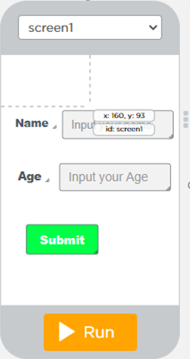
Extended UI (Strings)…
Often we want to save the information we pull in from the user for later use in our program
The best way to do this is to save it in a variable

Slide 13
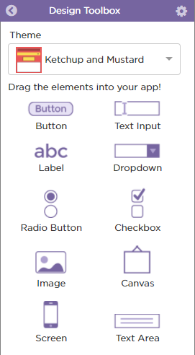
Generating Text Output…
So far we've been sending our output messages to the console
We can also display them in the app by using a new UI element called a “textArea”
You can use “setText” with a “textArea” just like you would with a “textLabel
This will combine user input & default text

Slide 14
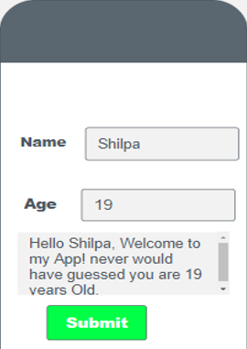
Generating Text Output…
Add a “textArea to your app and give it a descriptive & meaningful ID
Create a variable inside your event handler called “userMessage” to hold the full message that will be sent to the user
Use string concatenation to compose a message from the user input
Use “setText” to place your “userMessage” inside the “textArea” you created

Slide 15
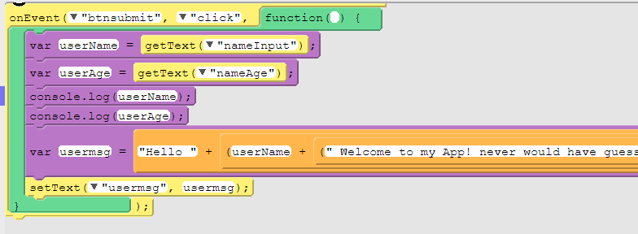
Code for Strings…

Slide 16
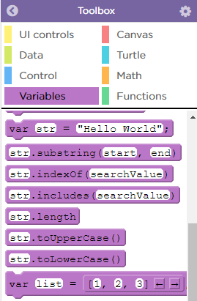
Extended UI(Strings)…
String Capitalization: If you want to change the case from upper to lower or vice versa of a string you can do so with two new functions:
Str.toUpperCase()
Str.toLowerCase()
These functions evaluate a new string in which all characters have been made uppercase / lowercase

Slide 17

Extended UI(Strings)…
If you want to update the value in your original variable you'll have to do so manually, as shown below:

Slide 18
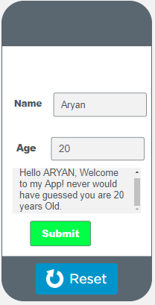
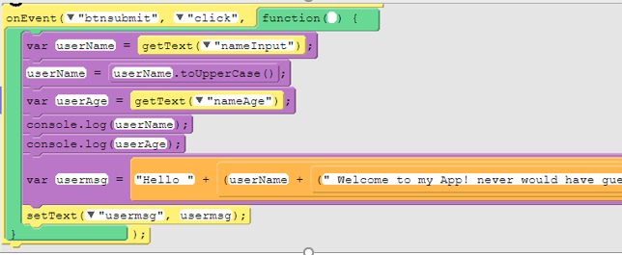
Extended UI(Strings) Final Code…

Slide 19
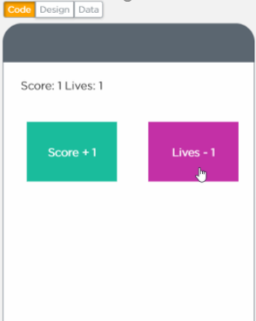
Now It’s Your Turn ?
Make the design as given in Image and change the value of variables Score and Lives

Slide 20
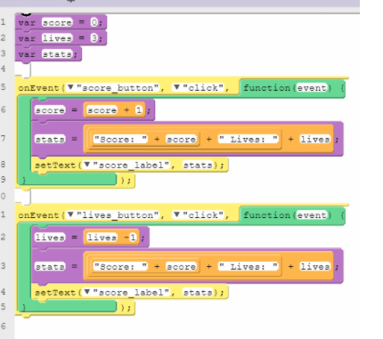
Code…

Slide 21

Summary…
Extended UI for Apps in App Lab
Use string functions with Extended UI components in apps

Slide 22
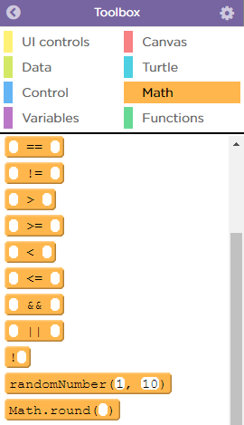
Next Session…
Randomization:
Learn what is Randomization
Classify animals into various categories.

