Slide 1

BLOCK CODING LEARNER
Session 43
Randomization

Slide 2

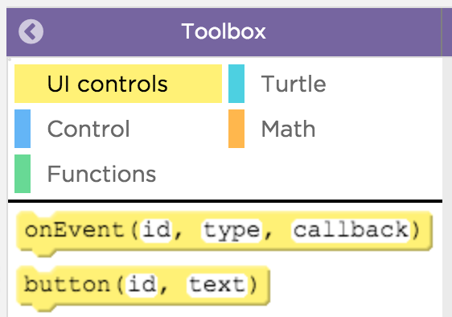
Recall…
What we have learnt in last session
What challenges you are facing

Slide 3
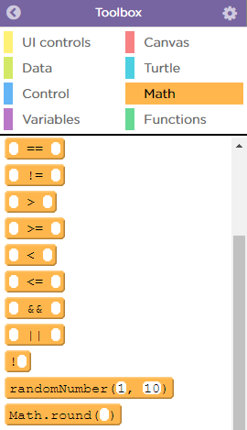
Randomization…
We will Learn today:
What is randomization in App Lab
Classify animals into various categories

Slide 4

Randomization…
The “randomNumber()” block can be used to generate random numbers in your programs
The parameters set the minimum and maximum value that could be generated
You can use this block anywhere that you could write a number.
This example is like a dice that could randomly generate any number from 1 to 6

Slide 5
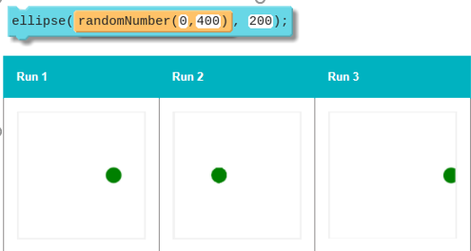
Drawing and Random Numbers…
You can use randomNumber() as a parameter in drawing commands to make random drawings
With the following command, your program might generate different drawings each time it is run

Slide 6
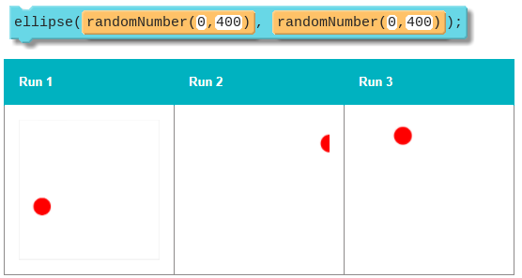
Multiple Random Numbers…
If you use randomNumber() multiple times in your program it will generate new random numbers every time
You can think of each randomNumber() like a new roll of a dice

Slide 7
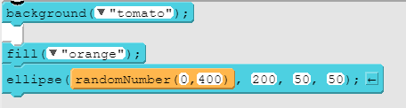
Randomization…
randomNumber() chooses a random number between a minimum and maximum value. You can use this code instead of writing in the specific number
If you make your drawings with random numbers it will look a little bit different every time you run your program.

Slide 8
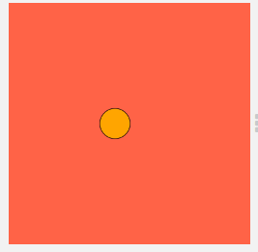
Randomization…
Run the program several times to see how it works
Change the numbers inside randomNumber and run the code again a few times to see what changes
Right now only the x-coordinate is random, but you can make the y-coordinate random, too

Slide 9
Randomization Code…

Slide 10
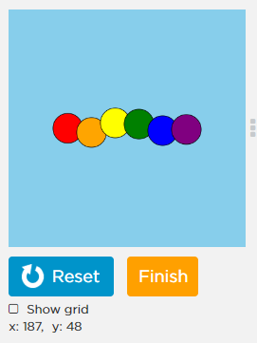
Now It’s Your Turn ?
Draw a rare breed of rainbow snake
To make the snake draw differently every time, you'll need to use random numbers

Slide 11
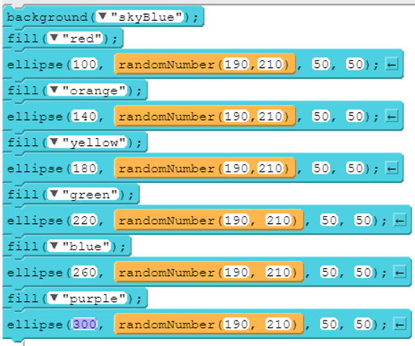
Code…

Slide 12

Summary…
What is randomization in App Lab
Classify animals into various categories

Slide 13
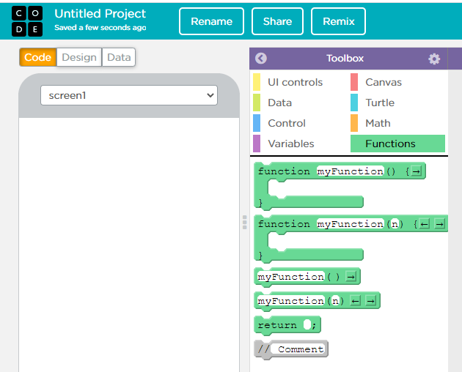
Next Session…
Function:
Learn what is Function
Use function to make a List

