Slide 1

BLOCK CODING LEARNER
Session 44
Function

Slide 2

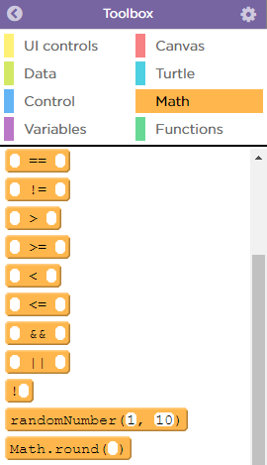
Recall…
What we have learnt in last session
What challenges you are facing

Slide 3
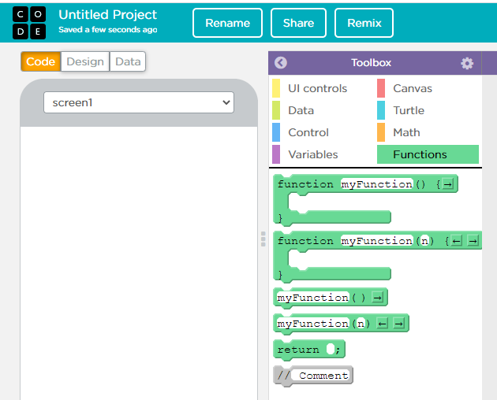
Function…
We will Learn today:
What is function.
Use function to make a list.

Slide 4


Function…
Functions let you build your own blocks and decide what code goes inside of them
This is the command that lets you create a new function
You use or "call" your function like any other block by using the name you gave it
The blocks to create and call functions can be found in the "Functions" tab of the palette

Slide 5
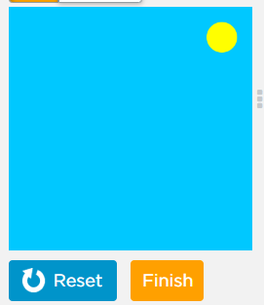
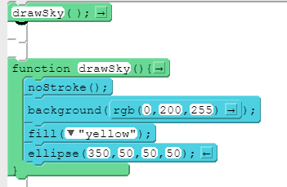
Function…
Here we create a “drawSky” function Now See how this function will work

Slide 6
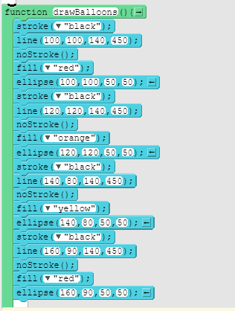
Function Code…
Here we create a “drawBallons” function with drawSky()
Now See how this function will work

Slide 7
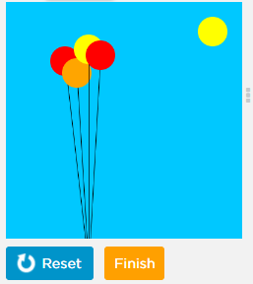
Function Output…

Slide 8
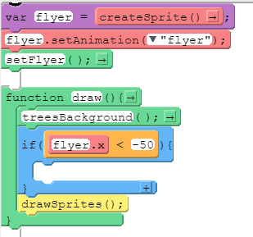
Calling Function Multiple Times…
You'll often want to use the same code at many places in your program
Once you've created a function you can call it as many times as you like
This code creates a sprite that moves across the screen once. How can you make it go back across the screen?
Note: The function is already called once at the beginning of your program
Use this if-statement and the function written for you to make the sprite move across the screen multiple times

Slide 9
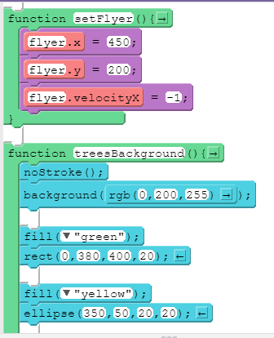
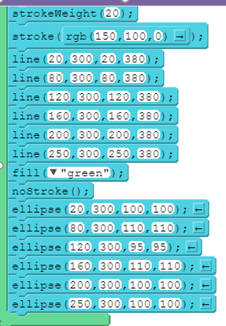
Calling Function Multiple Times…

Slide 10
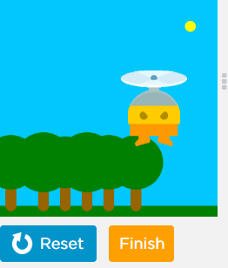
Calling Function Multiple Times…
Final output

Slide 11
Function…
We can also use functions in List
For example you might want to find the average of a list of numbers then you can do this by using functions
Create a list of numbers
Create a blank variable to store the average
In a function create a local variable to store the total value of all elements in the list
Use a for loop to access each element in the list and add its value to total
After the for loop, calculate the average by dividing total by the length of the list

Slide 12
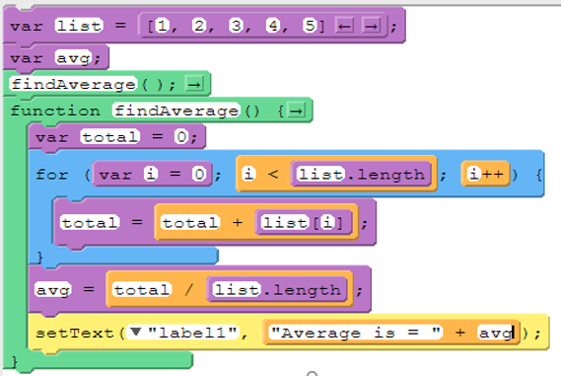
Function Code…

Slide 13
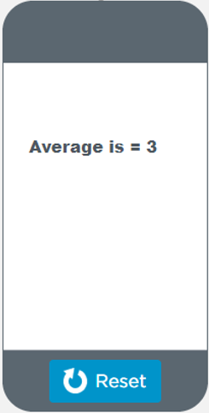
Function Output…

Slide 14
Function…
Another example - to find the smallest number from a list of numbers by using functions
Create a list of numbers
Create a blank variable to store the smallest number
In a function create a local variable to store a temporary value
Use a for loop to access each element in the list
If that element is less than the value stored in temp, set the value of temp to the current element
After the for loop set the value of smallest to the value stored in temp

Slide 15
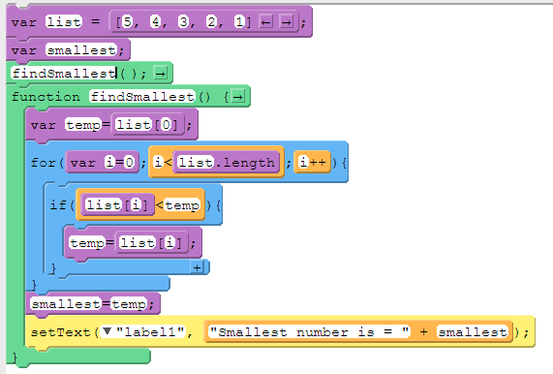
Function Code…

Slide 16
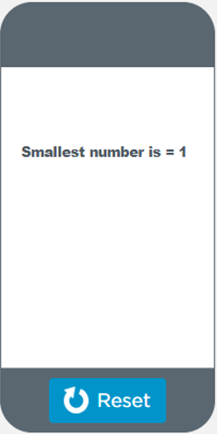
Function Output…

Slide 17
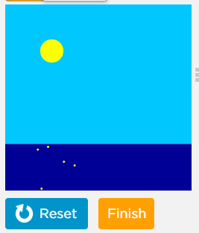
Now It’s Your Turn ?
Draw a day time scene or a night time scene, depending on the location of the mouse

Slide 18
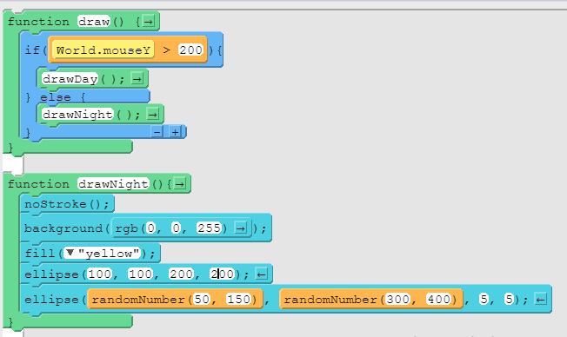
Code…

Slide 19
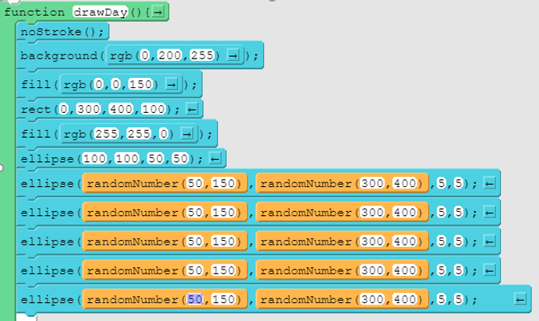
Code…

Slide 20
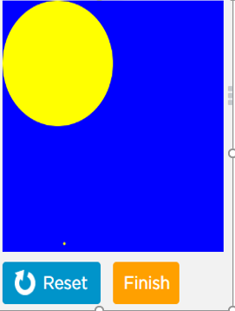
Function Output…
Day time Scene
Night time Scene

Slide 21

Summary…
What is function.
Use function to make a list.

Slide 22
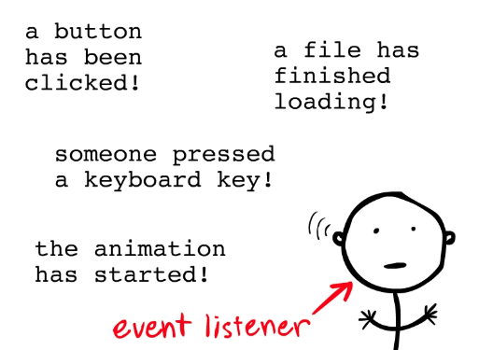
Next Session…
Event Listeners:
Learn what is an Event Handler.
Use two click event handler in an app.

