Slide 1

BLOCK CODING LEARNER
Session 49
Cloud Database

Slide 2

Recall…
What we have learnt in last session
What challenges you are facing

Slide 3
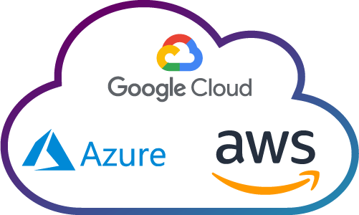
Cloud Database…
We will Learn today:
What is Database
What is Table & Record
Understanding Cloud Database

Slide 4
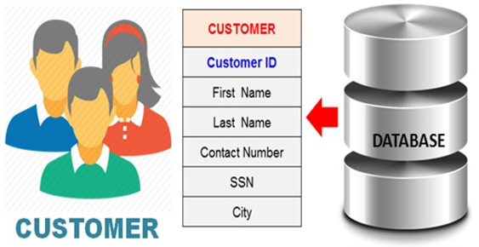
What Is A Database…
A database is an organized collection of structured information, or data, typically stored electronically in a computer system
The data can then be easily accessed, managed, modified, updated, controlled, and organized
Most databases use Structured Query Language (SQL) for writing and querying data

Slide 5
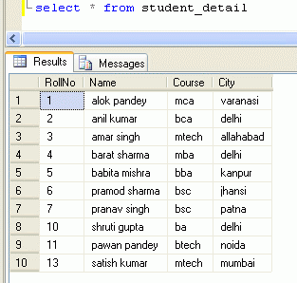
A Database Structure…
There are many ways of structuring database.
The most common way is creating a table with collections of rows and columns
When you enter information to your account, it will be added to appropriate database table of rows and columns
This will help server to quickly find out the requested data later

Slide 6
What is Fields & Records…
Table
A Table is a collection of records with shared column names
It is an organized collection of information, or data
“Fields" refers to columns, or vertical categories of data
“Records" refers to rows, or horizontal groupings of unique field data

Slide 7
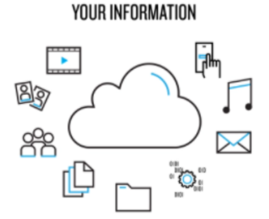
What Is Cloud Database…
It is a database service built and accessed through a cloud platform
How your friends access the mails, messages, photos that you share?
The information you share is not stored locally, it is delivered to your friend by an app that connects to remote servers (cloud) where the sharable data is stored

Slide 8




Understanding Cloud Database…
When you post an image from your account, it is uploaded over the internet on one of the servers
When your friend logs in to their account, a web request is made and server finds your photos stored and sends it to your friend’s device
Server acts a central hub ensuring information is accessible from web by multiple users
This network of servers is called as the Cloud Database

Slide 9
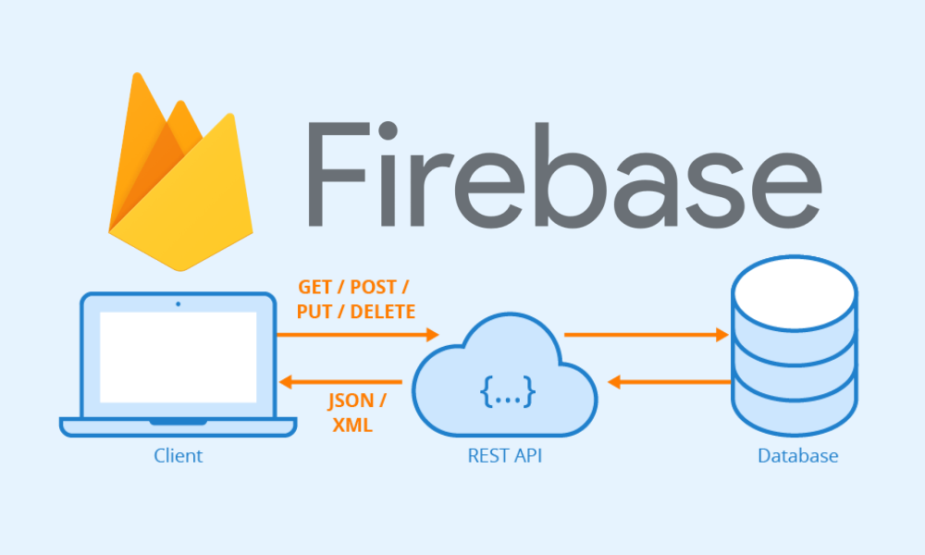
Google Firebase…
Firebase is a platform developed by Google for creating mobile and web applications
Firebase Realtime Database is an API that synchronizes application data across iOS, Android, and Web devices, and stores it on Firebase's cloud
It assists software developers in building real-time, collaborative applications

Slide 10
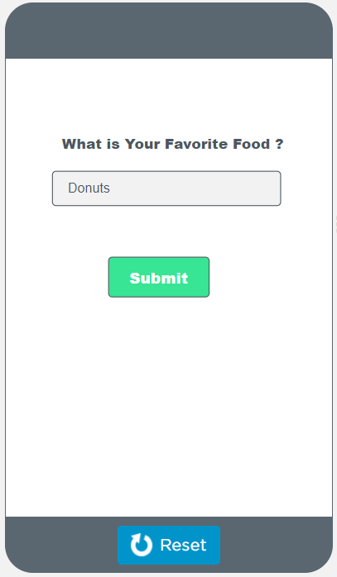
Activity…
Let’s make a Simple Survey App to Ask Users’ Favorite Foods and Save answers to the database
With these results we can compare with multiple users information

Slide 11
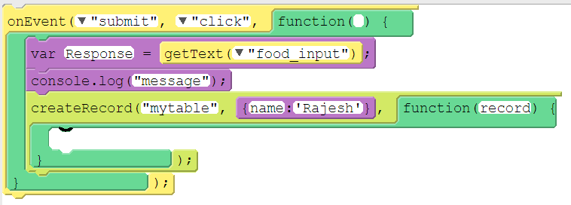
Activity Code…

Slide 12

Activity Code…

Slide 13
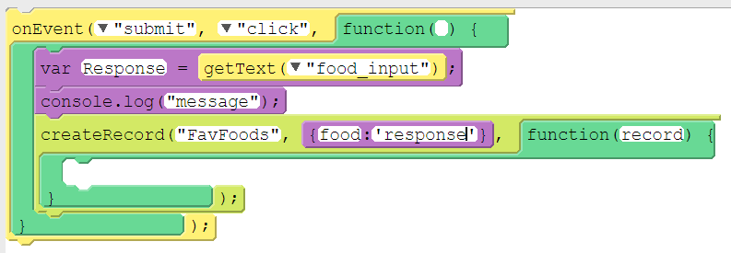
Activity Code…

Slide 14
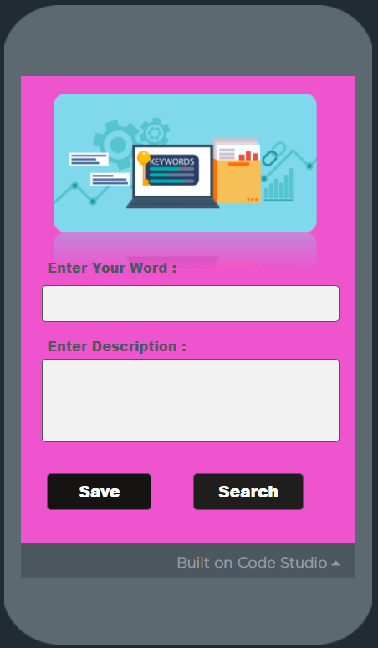
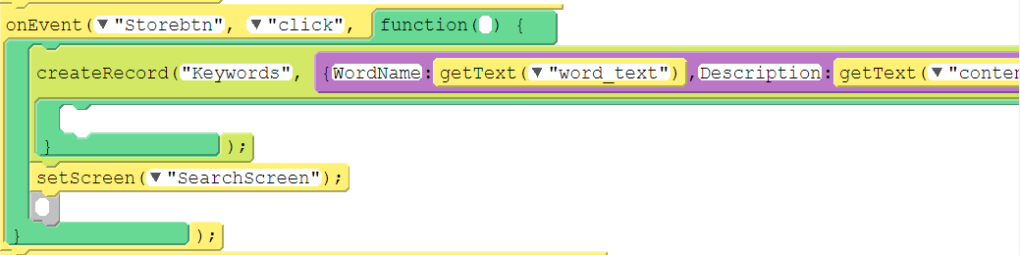
Now, It’s your turn to Practice…
“Save” button code

Slide 15
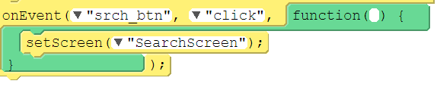
Now, It’s your turn to Practice…
“Search” button code

Slide 16
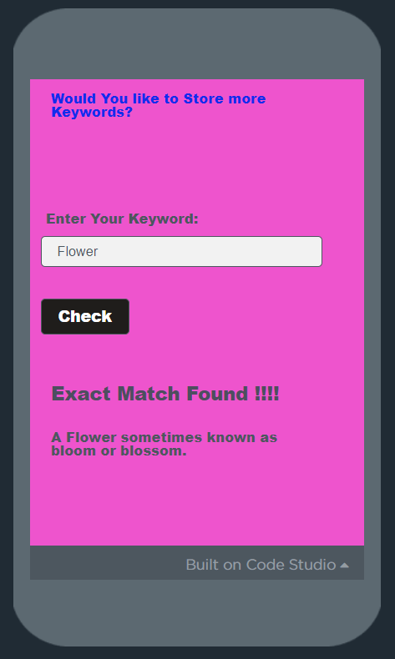
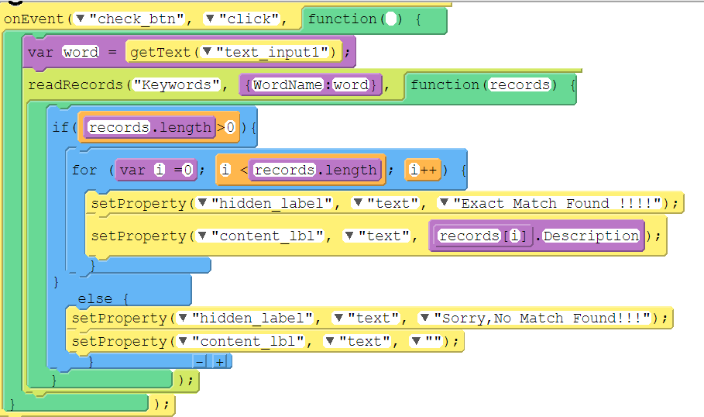
Now, It’s your turn to Practice…
“Check” button code

Slide 17
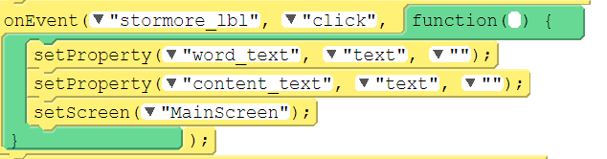
Now, It’s your turn to Practice…
“Would you like to Store more keywords?” label code

Slide 18

Summary…
What is Database
What is Table & Record
Understanding Cloud Database

Slide 19
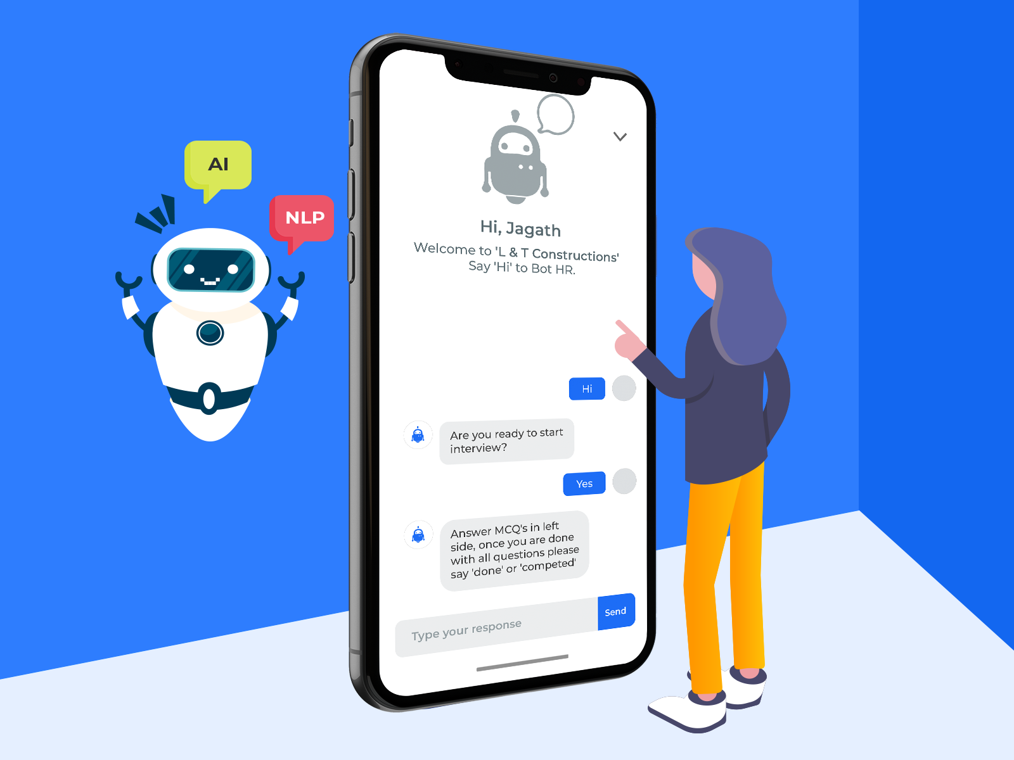
Next Session…
Build Personal Chatbot Assistant:
What are Chat bots?
How Chat bots work?

