Slide 1
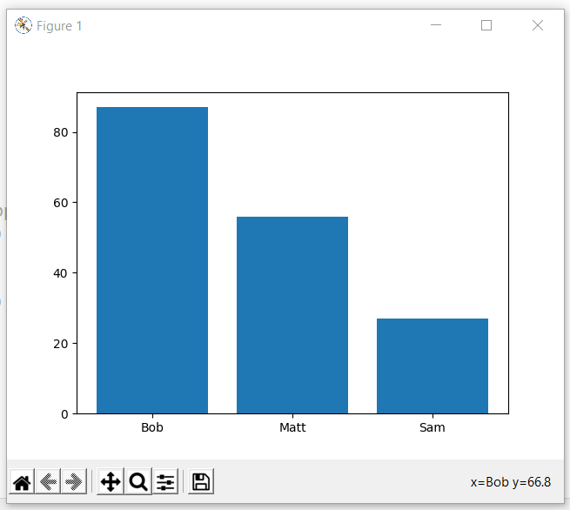
Bar Plot
Bar Plot
student={"Bob":87,"Matt":56,"Sam":27}
names=list(student.keys())
values=list(student.values())
plt.bar(names,values)
plt.show()

Slide 2
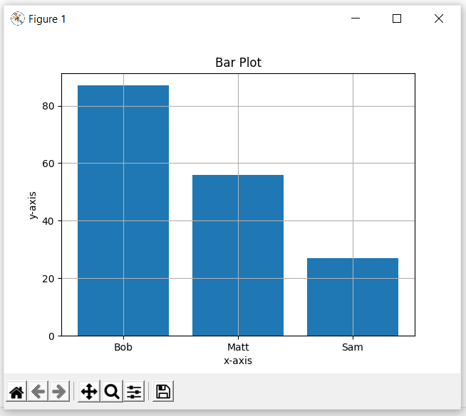
Bar Plot
Adding Title and Labels
student={"Bob":87,"Matt":56,"Sam":27}
names=list(student.keys())
values=list(student.values())
plt.bar(names,values)
plt.title("Bar Plot")
plt.xlabel("x-axis")
plt.ylabel("y-axis")
plt.grid(True)
plt.show()

Slide 3
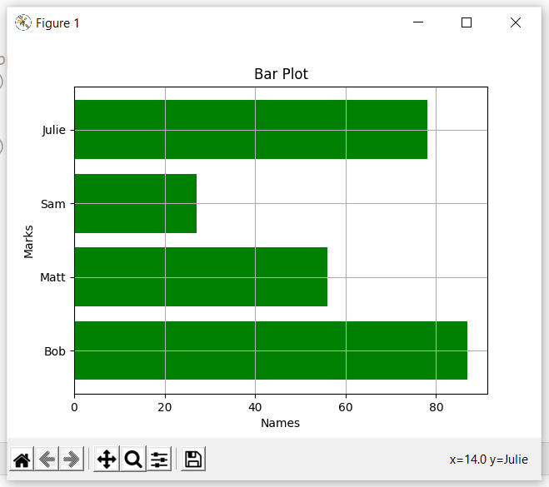
Horizontal Bar Plot
Horizontal Bar Plot
plt.barh(names,values,color=‘g’)
plt.title(“Bar Plot")
plt.xlabel(“Names")
plt.ylabel(“Marks")
plt.grid(True)
plt.show()

Slide 4
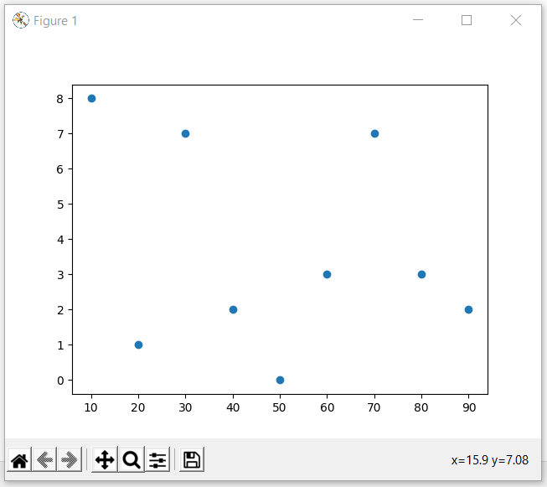
Scatter Plot
Creating a basic scatter plot
x=[10,20,30,40,50,60,70,80,90]
y=[8,1,7,2,0,3,7,3,2]
plt.scatter(x,y)
plt.show()

Slide 5
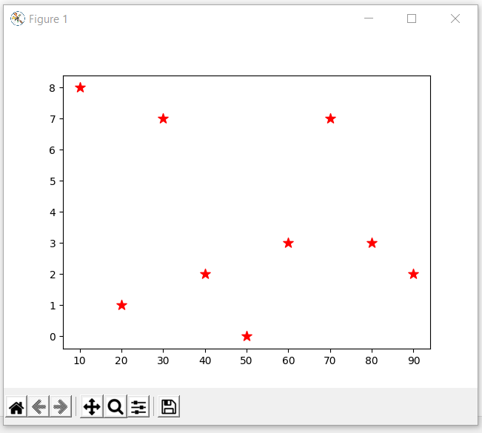
Scatter Plot
Changing Mark Aesthetics
x=[10,20,30,40,50,60,70,80,90]
y=[8,1,7,2,0,3,7,3,2]
plt.scatter(x,y,marker="*",c="r",s=100)
plt.show()

Slide 6
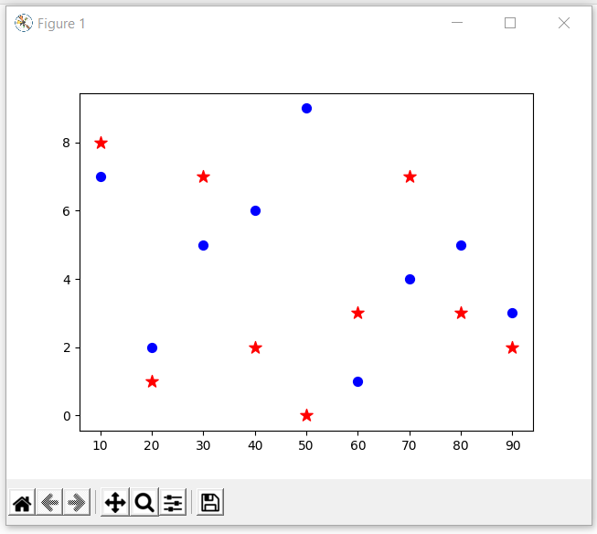
Scatter Plot
Adding two markers in the same plot
x=[10,20,30,40,50,60,70,80,90]
a=[8,1,7,2,0,3,7,3,2]
b=[7,2,5,6,9,1,4,5,3]
plt.scatter(x,a,marker="*",c="r",s=100)
plt.scatter(x,b,marker=".",c="b",s=200)
plt.show()

Slide 7
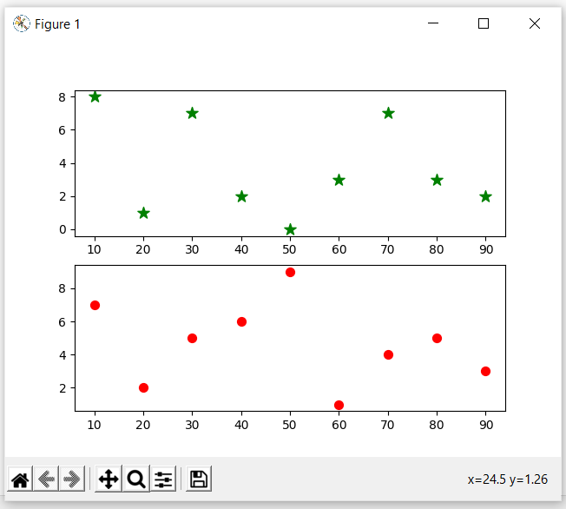
Scatter Plot
Adding sub-plots
x=[10,20,30,40,50,60,70,80,90]
a=[8,1,7,2,0,3,7,3,2]
b=[7,2,5,6,9,1,4,5,3]
plt.subplot(2,1,1)
plt.scatter(x,a,marker="*",c="g",s=100)
plt.subplot(2,1,2)
plt.scatter(x,b,marker=".",c="r",s=200)
plt.show()

