Slide 1
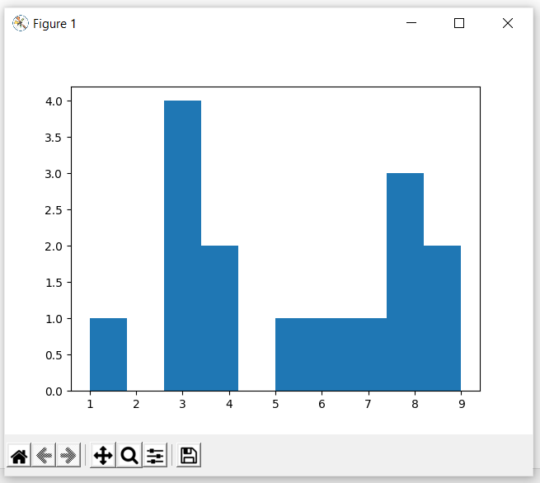
Histogram
Creating data
data=[1,3,3,3,3,9,9,5,4,4,8,8,8,6,7]
Making histogram
plt.hist(data)
plt.show()

Slide 2
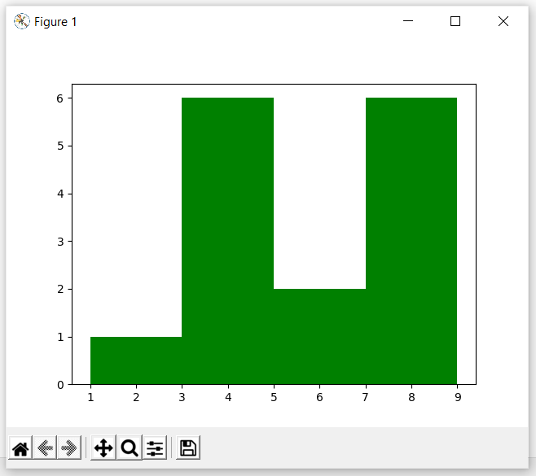
Histogram
Changing Aesthetics
data=[1,3,3,3,3,9,9,5,4,4,8,8,8,6,7]
Making histogram
plt.hist(data,color=‘g’,bins=4)
plt.show()

Slide 3
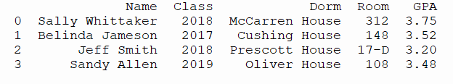
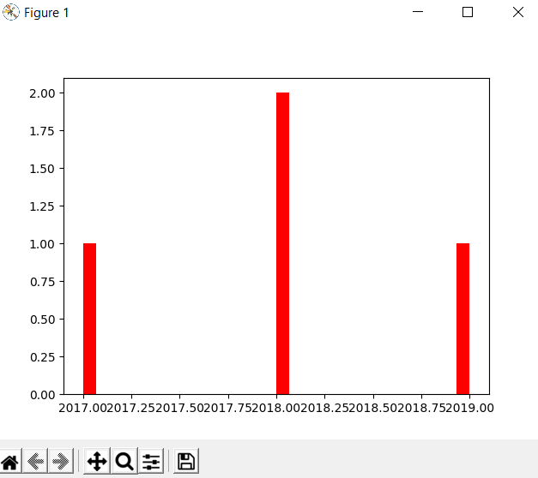
Histogram
Working with a dataset
import pandas as pd
from matplotlib import pyplot as plt
#reading csv file data
info=pd.read_csv('data.csv')
print(info.head())
plt.hist(info['Class'],bins=30,color='r')
plt.show()

Slide 4
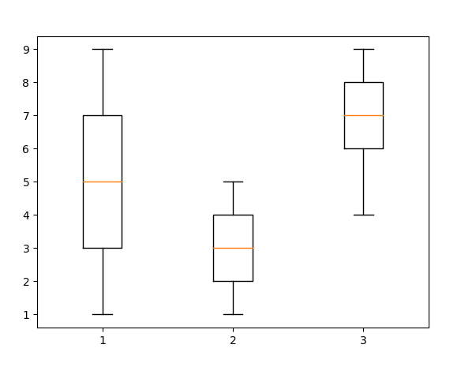
Box Plot
Creating data
one=[1,2,3,4,5,6,7,8,9]
two=[1,2,3,4,5,4,3,2,1]
three=[6,7,8,9,8,7,6,5,4]
data=list([one,two,three])
print(data)
Making Plot
plt.boxplot(data)
plt.show()

Slide 5
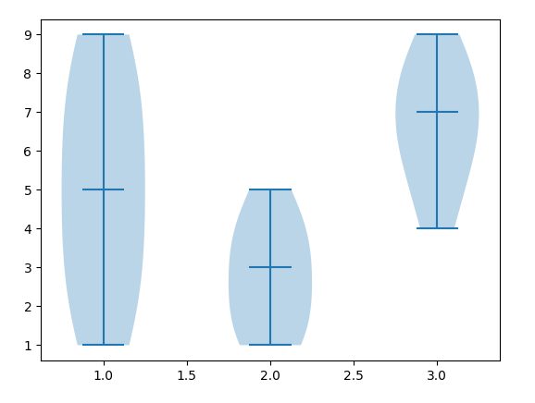
Violin Plot
Creating data
one=[1,2,3,4,5,6,7,8,9]
two=[1,2,3,4,5,4,3,2,1]
three=[6,7,8,9,8,7,6,5,4]
data=list([one,two,three])
print(data)
Making Plot
plt.violinplot(data,showmedians=True)plt.show()

Slide 6
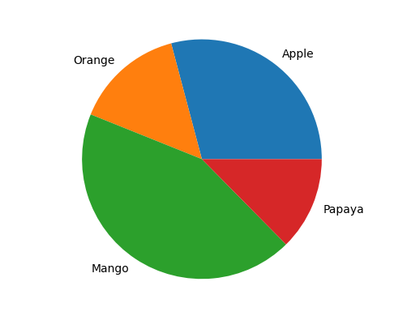
Pie Chart
Creating data
fruit=['Apple','Orange','Mango','Papaya']
quantity=[67,34,100,29]
Making Plot
plt.pie(quantity,labels=fruit)
plt.show()

Slide 7
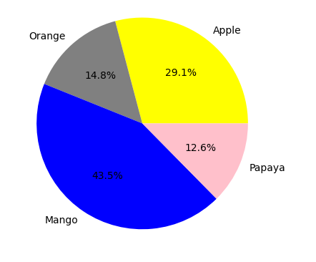
Pie Chart
Creating data
fruit=['Apple','Orange','Mango','Papaya']
quantity=[67,34,100,29]
Changing Aesthetics
plt.pie(quantity,labels=fruit,autopct='%0.1f%%',colors=['yellow','grey','blue','pink’])
plt.show()

Slide 8
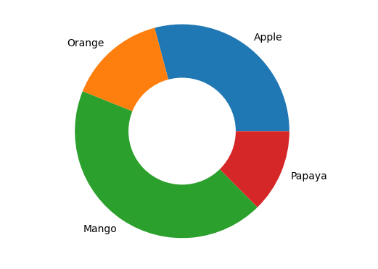
Doughnut Chart
Creating data
fruit=['Apple','Orange','Mango','Papaya']
quantity=[67,34,100,29]
Making Plot
plt.pie(quantity,labels=fruit,radius=1)
plt.pie([100],colors=['w'],radius=0.5)
plt.show()

