Slide 1


MatplotLib in Python
Line Plot
Matplotlib is a python library used for data visualization.
You can create bar-plots,scatter-plots,histograms and a lot more with matplotlib.

Slide 2
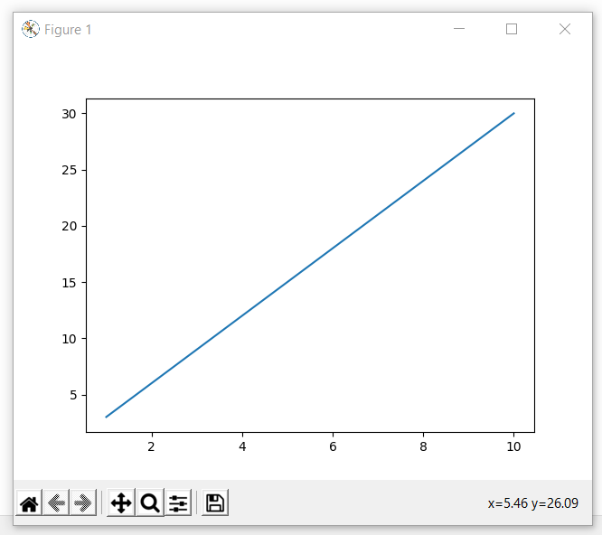
Line Plot
import numpy as np
from matplotlib import pyplot as plt
x=np.arange(1,11)
y=x*3
plt.plot(x,y)
plt.show()
Output

Slide 3
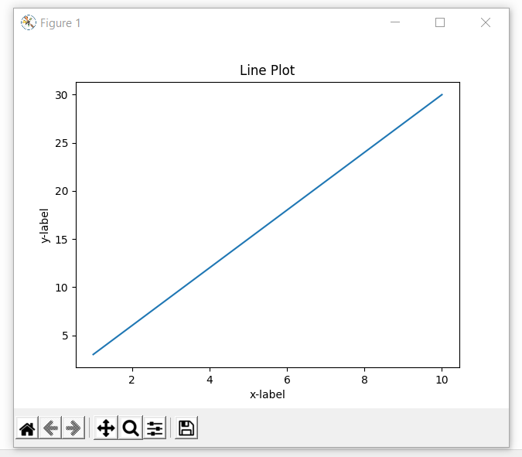
Line Plot
Adding Title and Labels
plt.plot(x,y)
plt.title("Line Plot")
plt.xlabel("x-label")
plt.ylabel("y-label")
Output

Slide 4
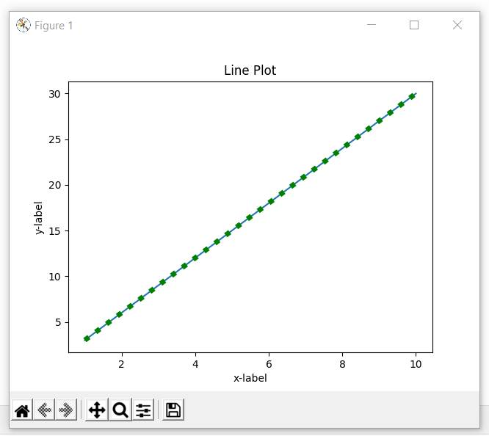
Line Plot
Changing Line Aesthetics
plt.plot(x,y,color='g',linestyle=":",linewidth=5)
Output

Slide 5
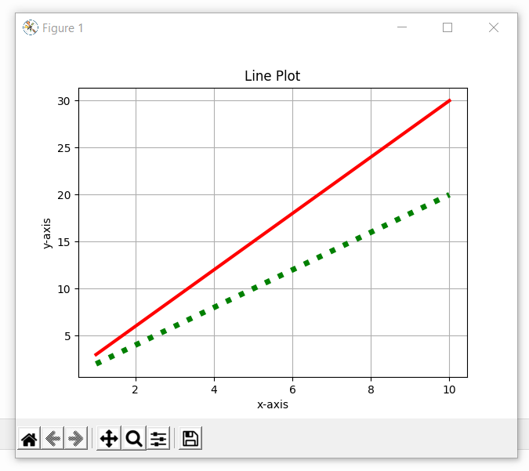
Line Plot
Adding two lines in the same plot
import numpy as np
from matplotlib import pyplot as plt
x=np.arange(1,11)
y1=2*x
y2=3*x
plt.plot(x,y1,color='g',linestyle=":",linewidth=5)
plt.plot(x,y2,color='r',linestyle="-",linewidth=3)
plt.title("Line Plot")
plt.xlabel("x-axis")
plt.ylabel("y-axis")
plt.grid(True)
plt.show()
Output

Slide 6
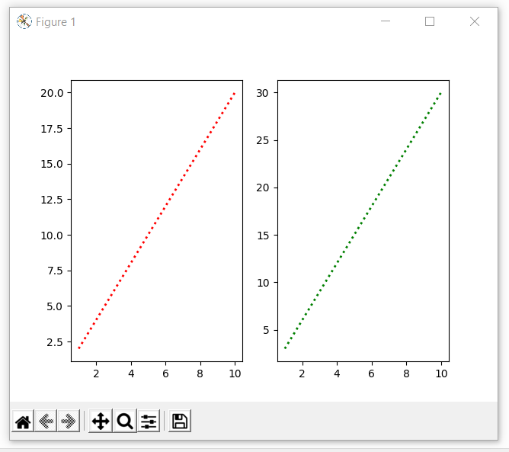
Line Plot
Adding subplots
import numpy as np
from matplotlib import pyplot as plt
x=np.arange(1,11)
y1=2*x
y2=3*x
plt.subplot(1,2,1) #subplot(1row,2col,index of subplot)
plt.plot(x,y1,color='r',linestyle=":",linewidth=2)
plt.subplot(1,2,2)
plt.plot(x,y2,color='g',linestyle=":",linewidth=2)
plt.show()
Output

