Slide 1
Agenda
What is Python
Python History
Why Learn Python
Applications of Python
Installing Python & Python IDEs
Python data Structures
Flow control Statements
Object Oriented Programming
Inheritance
Libraries such as Numpy, Pandas, Matplotlib
File Handling Operations in Python
Mini Project/Game

Slide 2
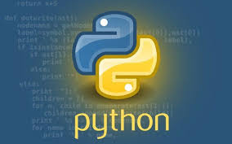
What is Python?
Multi-Paradigm Programming Language
Interpreted language
Supports dynamic datatype
Independent from platforms
Focused on development time
Simple and Easy grammar
High-Level internal object data types
Automatic memory management
Its free (open source)

Slide 3
Python History
Python born,name picked –Dec 1989
By Guido van Rossum, now at Dropbox
First public release(USENET)-Feb 1991
Python.org website-1996 or 1997
Python Software Foundation-2001
Rossum chose the name “Python”, since he was a big fan of Monty Python’s Flying Circus.

Slide 4
Why Learn Python?
Fun to use “Scripting language”
Object-oriented, imperative,functional programming and procedural styles
Highly educational
Very easy to learn,It runs on any platform.
Powerful,scalable,easy to maintain
High productivity
Lots of libraries
Glue language
Interactive front-end for FORTRAN/C/C++ code.
Reduce development time
Reduce Code length.

Slide 5
Where to Use Python
GUI Programming (eg: tinker)
Free and Open Source
Web Application (eg: DJango, Flask,Pyramid)
Computer Software and Desktop Application
Scientific, Computing Applications
Machine Learning and Artificial Intelligence (eg: Keras,CyKitLearn)
Image Processing
Website Design
Scripting
Gaming
Education

Slide 6
Python 3 or Python 2 ?

Slide 7
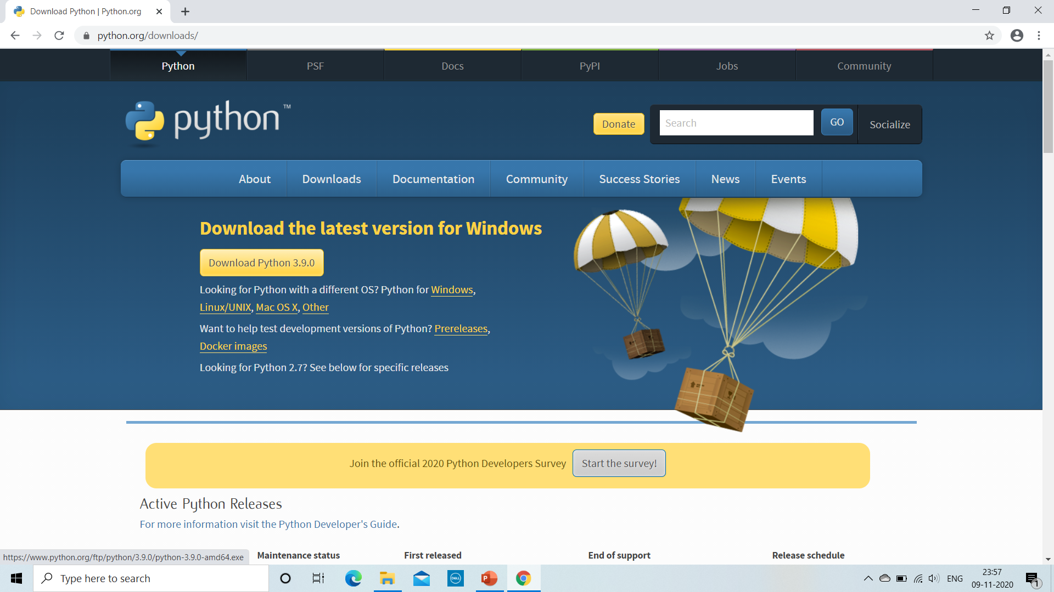
Installing Python & Python IDE
This is the site to install Python- https://www.python.org/downloads/

Slide 8
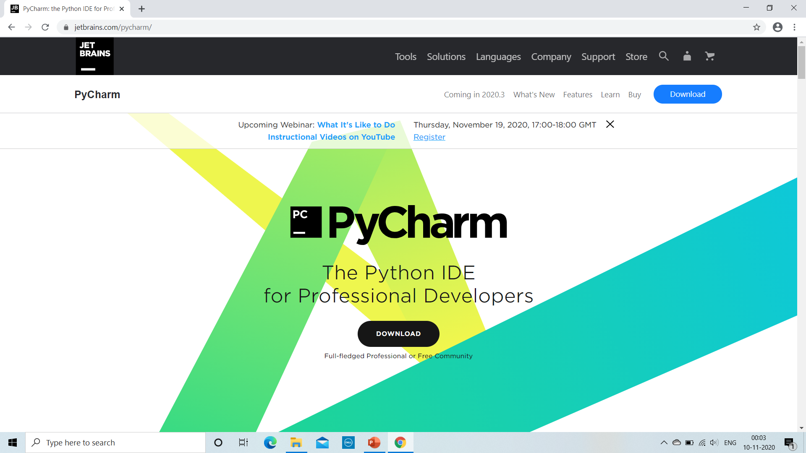
Installing PyCharm
This is the site to install PyCharm-> https://www.jetbrains.com/pycharm/

Slide 9

Installing Anaconda
This is the site to install Anaconda -> https://www.anaconda.com/

Slide 10
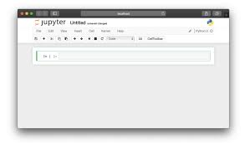
Intro to Jupyter Notebook
Jupyter Notebook is a browser-based interpreter that allows us to interactively work with Python

Slide 11
After installing Anaconda distribution, we get;
Anaconda Navigator, which is basically a GUI interface.
Anaconda Prompt, which is command prompt.
To launch Jupyter Notebook,windows user can click on launch command and similarly if you want to use Anaconda Prompt then type in prompt as:
- jupyter notebook

