Slide 1
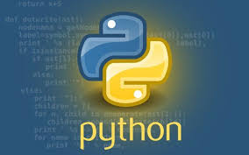
Python Tokens
Smaller meaningful Component in a Program.
Keywords
identifiers
Literals
Operators

Slide 2
Keywords are special reserved words.
False | Class | Finally | Is | Return
None | Continue | For | Lambda | Try
True | Def | From | Nonlocal | While
And | Del | Global | Not | With
As | Elif | If | Or | yield

Slide 3
Python Identifiers
Identifiers are names used for variables, functions or objects.
Rules
No special character expect _(Underscore)
Identifiers are case sensitive
First letter cannot be a digit

Slide 4
Example:
>>student=“Martha”
>>Student=“Julie”
>>print(student)
output: Martha

Slide 5

Python Literals
Literals are constants in python.
I am a constant.
I don’t change
Example: a=“hello world”->hello world is the literal

Slide 6
Comment in Python
Comments
As program get bigger and more complicated, they get more difficult to read.
It is often difficult to look at a piece of code and figure out what it is doing, or why.
For this reason, it is a good idea to add roles to your programs to explain what the program is doing.
A comment in a computer program is intended only for the human reader.- it is completely ignored by the interpreter.
In Python, the # token starts a comment. The rest of the line is ignored. Here is a new version of Hello World!.
Example:
print(“Hello”) # printing Hello with print.

