Slide 1
File Handling in Python
Files are named locations on disk to store related information. They are used to permanently store data in a non-volatile memory (e.g. hard disk).
Since Random Access Memory (RAM) is volatile (which loses its data when the computer is turned off), we use files for future use of the data by permanently storing them.
Python treats file differently as text or binary and this is important.
Each line of code includes a sequence of characters and they form text file.
Each line of a file is terminated with a special character, called the EOL or End of Line characters like comma {,} or newline character. It ends the current line and tells the interpreter a new one has begun.
Python provides inbuilt functions for creating, writing and reading files.
There are two types of files that can be handled in python, normal text files and binary files (written in binary language, 0s and 1s).
Text files: In this type of file, Each line of text is terminated with a special character called EOL (End of Line), which is the new line character (‘\n’) in python by default.
Binary files: In this type of file, there is no terminator for a line and the data is stored after converting it into machine-understandable binary language.

Slide 2
Working of open() function
The syntax being: open(filename, mode). There are three kinds of mode, that Python provides and how files can be opened:
“ r “, for reading.
“ w “, for writing.
“ a “, for appending.
“ r+ “, for both reading and writing

Slide 3
Example:
# a file named "geek", will be opened with the reading mode.
file = open('geek.txt', 'r')
# This will print every line one by one in the file
for each in file:
print (each)

Slide 4
Working of read() mode
There is more than one way to read a file in Python. If you need to extract a string that contains all characters in the file then we can use file.read().

Slide 5
Example:
# Python code to illustrate read() mode
file = open("file.text", "r")
print file.read()

Slide 6
Another way to read a file is to call a certain number of characters like in the following code the interpreter will read the first five characters of stored data and return it as a string:
# Python code to illustrate read() mode character wise
file = open("file.txt", "r")
print file.read(5)
print(file.readline()) # This method reads a file till the newline, including the newline character.
print(file.readlines()) # returns a list of remaining lines of the entire file

Slide 7
Creating a file using write() mode
# Python code to create a file
file = open('geek.txt','w')
file.write("This is the write command")
file.write("It allows us to write in a particular file.")
file.close()

Slide 8
Closing Files in Python
When we are done with performing operations on the file, we need to properly close the file.
f = open("test.txt", encoding = 'utf-8’) # perform file operations
f.close()
The best way to close a file is by using the with statement. This ensures that the file is closed when the block inside the with statement is exited.
with open("sun.txt","wt") as f:
f.write("This is a better way to write.")
# Python code to illustrate with() read():
with open("file.txt") as file:
data = file.read()
# do something with data

Slide 9
Working of append() mode
# Python code to illustrate append() mode
file = open('geek.txt','a')
file.write("This will add this line")
file.close()

Slide 10
Example
#Program to read each line from file and print word count from each line
f=open("D:\\Python_Tutorial\\Python_Programs-Solutions\\funny.txt","r")
f_out=open("D:\\Python_Tutorial\\Python_Programs-Solutions\\funny_wc.txt","w")
for line in f:
tokens= line.split(' ') #split whenever space occurs and return list of array in output
f_out.write(" word count : "+str(len(tokens))+" "+line) #it writes output into another file
print(len(tokens))
f.close()
f_out.close()

Slide 11
Seek(), tell() Functions in File
>>f=open(“harry.txt”)
>>print(f.tell()) # tells at which position the file pointer in file
>>print(f.readline())
>>print(f.tell())
>>…
#To reset file pointer using seek()
>>f=open(“harry.txt”)
>>print(f.readline())
>>f.seek(10) # it will reset file pointer from the specified position of char in file
>>print(f.readline())

Slide 12
With Statement
# Python code to illustrate split() function
>>with open("file.text", "r") as file:
data = file.readlines() #prints in list format
for line in data:
word = line.split()
print word
>>with open(“harry.txt”) as f:
a=f.read(4)
print(a)

Slide 13
Example:
# Python program to demonstrate writing to a file and Opening a file
file1 = open('myfile.txt', 'w')
L = ["This is Delhi \n", "This is Paris \n", "This is London \n"]
s = "Hello\n"
# Writing a string to file
file1.write(s)
# Writing multiple strings at a time
file1.writelines(L)
# Closing file
file1.close()
# Checking if the data is written to file or not
file1 = open('myfile.txt', 'r')
print(file1.read())
file1.close()

Slide 14
Example:
#test.py
fh=open(‘demo.txt’,’w’) #to write into the file
fh.write(‘Use open() function to open the file.’)
#use for loop to print 10 lines
for i in range(10):
fh.write("\nThis is line no {}\n".format(i))
fh.close() #closes the file and immediate free up memory spaces.
#To avoid overriding of file content-use ‘a’ mode
fh=open(‘demo.txt’,a’) #to append into the file
fh.write(‘Use open() function to open the file.’)
#use for loop to print 10 lines
for i in range(10):
fh.write("\nThis is line no {}\n".format(i))
fh.close()

Slide 15
Example
#Print the count of characters written into the file
>>f= open(“harry.txt”,”w”)
>>a=f.write(“Programming is fun\n”)
>>print(a)
>>f.close()
#To read and write into and from file together
>>f=open(“harry.txt”,”r+”)
>>print(f.read())
>>f.write(“thank you”)

Slide 16
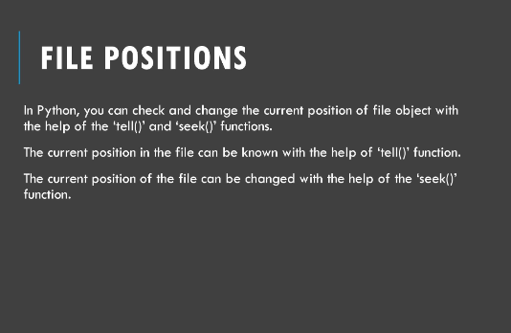

Slide 17
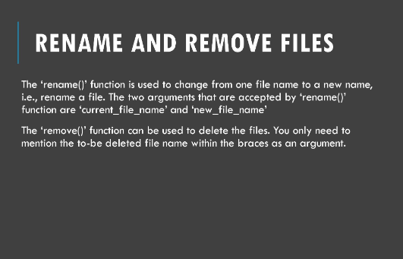

Slide 18
File handling using try block
#test.py
fh=open(‘demo.txt’,’a’)
try:
for i in range(10):
fh.write ("\nThis is line no {}\n".format(i))
finally:
fh.close()
#or with short notation- file closes automatically
with open(‘demo.txt’,’a’) as fh:
for i in range(10):
fh.write ("\nThis is line no {}\n".format(i))

Slide 19
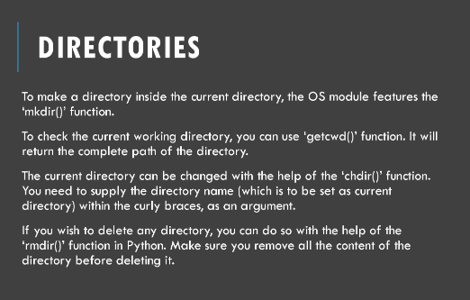

Slide 20
To create file into another directory…
#test.py
with open(‘C:\\Users\\DELL\\demo.txt’,’a’) as fh:
for i in range(10):
fh.write ("\nThis is line no {}\n".format(i))

Slide 21
Example…
fh=open(‘demo.txt’ , ‘r’) #’r’ mode is a default mode
print(fh.read())
#to read first 4 chars from file
print(fh.read(4))
#to read entire first line
print(fh.readline(7))
print(fh.readline())
print(fh.readline())
#to read all lines in the form of list
print(fh.readlines())
#Since it reads in the form of list, we can access data using index
print(fh.readlines() [4])
#to iterate using for loop
for line in fh:
print(line)
#to count no of characters in each line
for line in fh:
print(len(line))
#to count no of words in each line
for line in fh:
print(len(line.split( ‘ ‘)))
fh.close()
#or
With open(‘demo.txt’,’r’) as fh:
for line in fh:
print(len(line.split( ‘ ‘)))

Slide 22
# In Python 3.4+ you can use
# contextlib.suppress() to selectively
# ignore specific exceptions:
import contextlib
with contextlib.suppress(FileNotFoundError):
os.remove('somefile.tmp')
# This is equivalent to:
try:
os.remove('somefile.tmp')
except FileNotFoundError:
pass
# contextlib.suppress docstring:
#
# "Return a context manager that suppresses any
# of the specified exceptions if they occur in the body
# of a with statement and then resumes execution with
# the first statement following the end of
# the with statement."

Slide 23
Python JSON
JSON JavaScript Object Notation is a format for structuring data.
JSON is a data exchange format similar to XML.
It is mainly used for storing and transferring data between the browser and the server.
Python too supports JSON with a built-in package called json.
This package provides all the necessary tools for working with JSON Objects including parsing, serializing, deserializing, and many more.
There is no object called JSON in python.
Python’s native objects are either numbers, strings, dictionaries.
JSON is just a format which is implemented by different languages such as JavaScript, python.
You can read JSON data using any language that supports JSON such as JavaScript, C++,etc.
Hence this is called Data exchange format (i.e. exchanging data from python program to JavaScript program).

Slide 24
JSON vs XML
JSON
{
“name” : “tom”,
“address” : “1 green street,NY”,
“phone” : “898798098”
}
XML
<name>tom</name>
<address>1 green street,NY</address>
<phone> 898798098</phone>
XML takes lot more volume of data n so its heavyweight, because it includes opening & closing tags with data.
JSON is lightweight.

Slide 25
Example
#Two Programs:
#1-To create address book & write some records into it.
#2- read this address book
book={}
#first record of tom
book['tom']={
'name':'tom',
'address':'1 red street, NY',
'phone': 9988877777
}
#Second record of tom
book['bob']={
'name':'bob',
'address':'1 green street, NY',
'phone': 5567567567
}
import json
s=json.dumps(book) #prints in json format
# print(s)
#Now write to a file
with open("demo.txt","w") as f:
f.write(s)
f=open("demo.txt","r")
s=f.read()
print(s)
book=json.loads(s) #reads string
print(book)
print(book['bob']['phone'])
#to print all records from book
for person in book:
print(book[person])

Slide 26
Example
import json
# JSON string
employee = '{"id":"09", "name": "Nitin", "department":"Finance"}'
# Convert JSON string to Python dict
employee_dict = json.loads(employee)
print(employee_dict)
print(type(employee_dict))
print("\n")
# Convert Python dict to JSON string
json_object = json.dumps(employee_dict, indent=4)
print(json_object)
print(type(json_object))

Slide 27
How to handle JSON file in Python
JSON is used to store and exchange data.
#test.py
import json
a={‘name’:’Max’,
‘age’:22,
‘marks’:[90,50,60,80],
‘pass’:True
}
print(json.dumps(a))
#or
print(json.dumps(a, indent=4,separators=(‘. ‘,’ = ‘)))))
#to sort in alphabetical order
print(json.dumps(a,sort_keys=True))
#You can convert list,tuple,dictionary,int,float,string into json format

Slide 28
Writing into a json file
Import json
a={‘name’:’Max’,
‘age’:22,
‘marks’:[90,50,60,80],
‘pass’:True
}
with open(‘demo.json’,’w’) as fh:
fh.write(json.dumps(a,indent=2))

Slide 29
Reading from a json file
import json
with open(‘demo.json’,’r’) as fh:
print(fh.read()) #reads string value
#or
with open(‘demo.json’,’r’) as fh:
json_value=json.load(fh) #loads() is used to convert from string to json value and prints in dict form.
print(json_value[‘name’])
print(json_value)

Slide 30
Example 1: Python JSON to dict
import json
person = '{"name": "Bob", "languages": ["English", "Fench"]}'
person_dict = json.loads(person)
# Output: {'name': 'Bob', 'languages': ['English', 'Fench']}
print( person_dict)
# Output: ['English', 'French']
print(person_dict['languages'])

Slide 31
Example 2: Python read JSON file
You can use json.load() method to read a file containing JSON object.
Suppose, you have a file named person.json which contains a JSON object.
{"name": "Bob",
"languages": ["English", "Fench"]
}
Here's how you can parse this file:
import json
with open('path_to_file/person.json') as f:
data = json.load(f)
# Output: {'name': 'Bob', 'languages': ['English', 'Fench']}
print(data)

Slide 32
Example 3: Convert dict to JSON
import json
person_dict = {'name': 'Bob',
'age': 12,
'children': None
}
person_json = json.dumps(person_dict)
# Output: {"name": "Bob", "age": 12, "children": null}
print(person_json)

Slide 33
Example 4: Writing JSON to a file
import json
person_dict = {"name": "Bob",
"languages": ["English", "Fench"],
"married": True,
"age": 32
}
with open('person.txt', 'w') as json_file:
json.dump(person_dict, json_file)

Slide 34
Command Line Arguments in Python with argparse
There are two kinds of arguments that argparse support:
Positional argument
Optional argument – it doesn’t follow the order of args passed.
Here we are writing a program that takes 3 inputs:
First number
Second number
Operation(“add”, “subtract”,”multiply”)
It should return result of operation based on inputs.

Slide 35
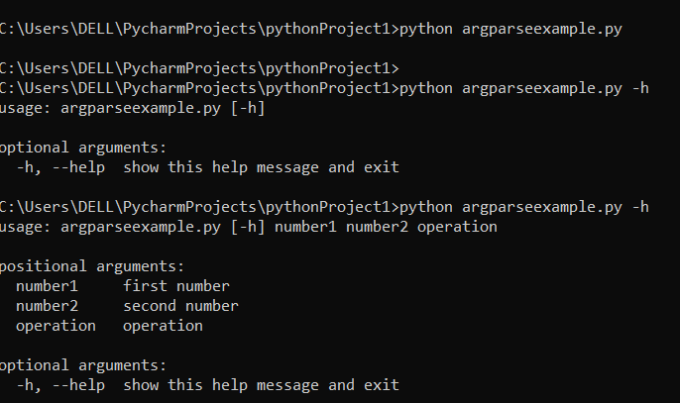
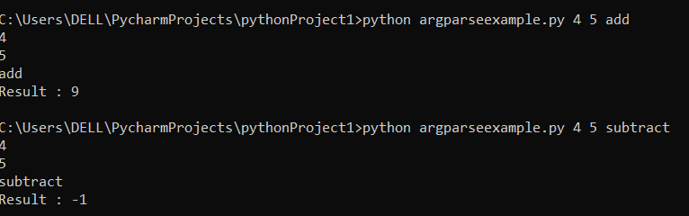
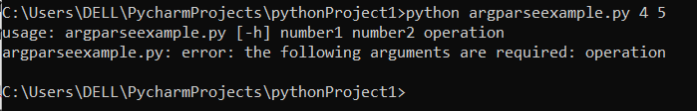
Example – Positional arguments
import argparse
if __name__ =="__main__":
parser = argparse.ArgumentParser()
parser.add_argument("number1",help="first number")
parser.add_argument("number2", help="second number")
parser.add_argument("operation", help="operation")
args = parser.parse_args()
print(args.number1)
print(args.number2)
print(args.operation)
n1=int(args.number1)
n2=int(args.number2)
result=None
if args.operation =="add":
result=n1+n2
elif args.operation =="subtract":
result=n1-n2
elif args.operation == "multiply":
result=n1*n2
print("Result :",result)
OUTPUT:

Slide 36
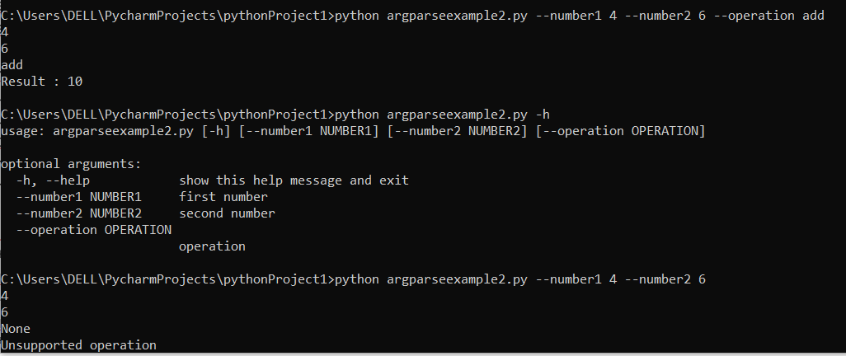
Example – Optional arguments
import argparse
#Optional Argument Example
if __name__ =="__main__":
parser = argparse.ArgumentParser()
parser.add_argument("--number1",help="first number") # here to make arg optional add -- infront of argument name
parser.add_argument("--number2", help="second number")
parser.add_argument("--operation", help="operation")
args = parser.parse_args()
print(args.number1)
print(args.number2)
print(args.operation)
n1=int(args.number1)
n2=int(args.number2)
result=None
if args.operation =="add":
result=n1+n2
elif args.operation =="subtract":
result=n1-n2
elif args.operation == "multiply":
result=n1*n2
else:
print("Unsupported operation")
print("Result :",result)

Slide 37
Example
import argparse
#Optional Argument Example
if __name__ =="__main__":
parser = argparse.ArgumentParser()
parser.add_argument("--number1",help="first number") # here to make arg optional add -- infront of argument name
parser.add_argument("--number2", help="second number")
parser.add_argument("--operation", help="operation",choices=["add","subtract","multiply"])
#now here we passed choices parameter so that in next line it checks for valid arg of operation entered.
args = parser.parse_args()
print(args.number1)
print(args.number2)
print(args.operation)
n1=int(args.number1)
n2=int(args.number2)
result=None
if args.operation =="add":
result=n1+n2
elif args.operation =="subtract":
result=n1-n2
elif args.operation == "multiply":
result=n1*n2
else:
print("Unsupported operation")
print("Result :",result)

Slide 38
Example
#myparser.py
import argparse
if __name__==‘__main__’:
#initialize the parser
parser=argparse.ArgumentParse(description=“my math script”)
#Add positional parameters
parser.add_argument(‘num1’, help=“Number 1” type=float) #by default type is string
parser.add_argument(‘num2’, help=“Number 2” type=float)
parser.add_argument(‘operation’, help=“provide operator”,default=‘+’) #Add default parameter
#Parse arguments
args=parser.parse_args()
print(args)
result=None
if args.operation==‘+’:
result=args.num1+args.num2
print(“Result=“,result)
#run the code in terminal by copying the current path of the python project
C:\Users\DELL\PycharmProjects\argparseex> python myparser.py –h
C:\Users\DELL\PycharmProjects\argparseex> python myparser.py 20 30 +

Slide 39
#myparser.py
import argparse
if __name__==‘__main__’:
#initialize the parser
parser=argparse.ArgumentParse(description=“my math script”)
#Add optional parameters
parser.add_argument(‘-a’,‘--num1’, help=“Number 1” type=float) #by default type is string
parser.add_argument(‘-b’,‘--num2’, help=“Number 2” type=float)
parser.add_argument(‘-o’,‘--operation’, help=“provide operator”,default=‘+’) #Add default parameter
#Parse arguments
args=parser.parse_args()
print(args)
result=None
if args.operation==‘+’:
result=args.num1+args.num2
print(“Result=“,result)
#run the code in terminal by copying the current path of the python project
C:\Users\DELL\PycharmProjects\argparseex> python myparser.py –h
C:\Users\DELL\PycharmProjects\argparseex> python myparser.py –a=30 –b=40 –o=*

Slide 40
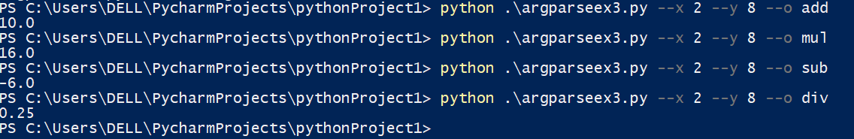
Example-Creating Command line Utility in Python
import argparse import sys def calc(args): if args.o == "add": return args.x + args.y elif args.o == "mul": return args.x * args.y elif args.o == "sub": return args.x - args.y elif args.o == "div": return args.x / args.y else: return "Something went wrong" if __name__ =="__main__": parser = argparse.ArgumentParser() parser.add_argument('--x',type=float,default=1.0,help="Enter first Number. This is a utility for calculation. Please contact Sunanda") parser.add_argument('--y', type=float, default=3.0, help="Enter Second Number. This is a utility for calculation. Please contact Sunanda") parser.add_argument('--o', type=str, default="add", help="This is a utility for calculation. Please contact Sunanda") args = parser.parse_args() sys.stdout.write(str(calc(args)))

Slide 41
Exercise:Creating Health Management System:
import datetime def gettime(): return datetime.datetime.now() def take(k): if k==1: c=int(input("Enter 1 for Exercise and 2 for Food:")) if(c==1): value=input("Type here:") with open("Pari-ex.txt","a") as f: f.write(str(str(gettime()))+":"+value+"\n") print("Succesfully Written!!") elif(c==2): value = input("Type here:") with open("Pari-food.txt", "a") as f: f.write(str(str(gettime())) + ":" + value + "\n") print("Succesfully Written!!") elif k==2: c=int(input("Enter 1 for Exercise and 2 for Food:")) if(c==1): value=input("Type here:") with open("Rianshi-ex.txt","a") as f: f.write(str(str(gettime()))+":"+value+"\n") print("Succesfully Written!!") elif(c==2): value = input("Type here:") with open("Rianshi-food.txt", "a") as f: f.write(str(str(gettime())) + ":" + value + "\n") print("Succesfully Written!!") elif k==3: c=int(input("Enter 1 for Exercise and 2 for Food:")) if(c==1): value=input("Type here:") with open("Manasvi-ex.txt","a") as f: f.write(str(str(gettime()))+":"+value+"\n") print("Succesfully Written!!") elif(c==2): value = input("Type here:") with open("Manasvi-food.txt", "a") as f: f.write(str(str(gettime())) + ":" + value + "\n") print("Succesfully Written!!") else: print("Please enter valid input:(1-Pari),(2-Rianshi),(3-Manasvi)")
def retrieve(k): if k==1: c=int(input("Enter 1 for Exercise and 2 for Food:")) if c==1: with open("Pari-ex.txt") as f: for i in f: print(i,end="") elif c==2: with open("Pari-food.txt") as f: for i in f: print(i,end="") elif k==2: c=int(input("Enter 1 for Exercise and 2 for Food:")) if c==1: with open("Rianshi-ex.txt") as f: for i in f: print(i,end="") elif c==2: with open("Rianshi-food.txt") as f: for i in f: print(i,end="") elif k==3: c=int(input("Enter 1 for Exercise and 2 for Food:")) if c==1: with open("Manasvi-ex.txt") as f: for i in f: print(i,end="") elif c==2: with open("Manasvi-food.txt") as f: for i in f: print(i,end="")
print("------------------Health Management System-----------------") while(True): a=int(input("Press 1 for log the value and 2 for retrieve ")) if a==1: b=int(input("Press 1 for Pari, 2 for Rianshi, 3 for manasvi")) take(b) else: b = int(input("Press 1 for Pari, 2 for Rianshi, 3 for manasvi")) retrieve(b)

