Slide 1
Agenda
Introduction to Artificial Intelligence
Why Python for AI?
Features of Python
Python Packages for AI

Slide 2
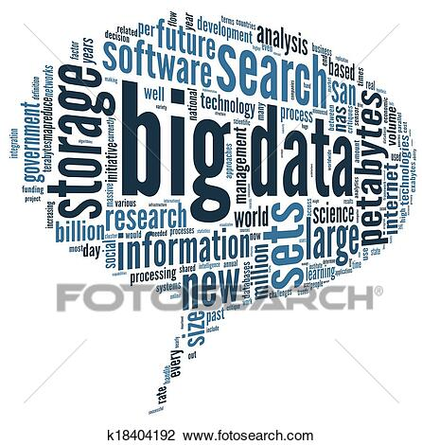
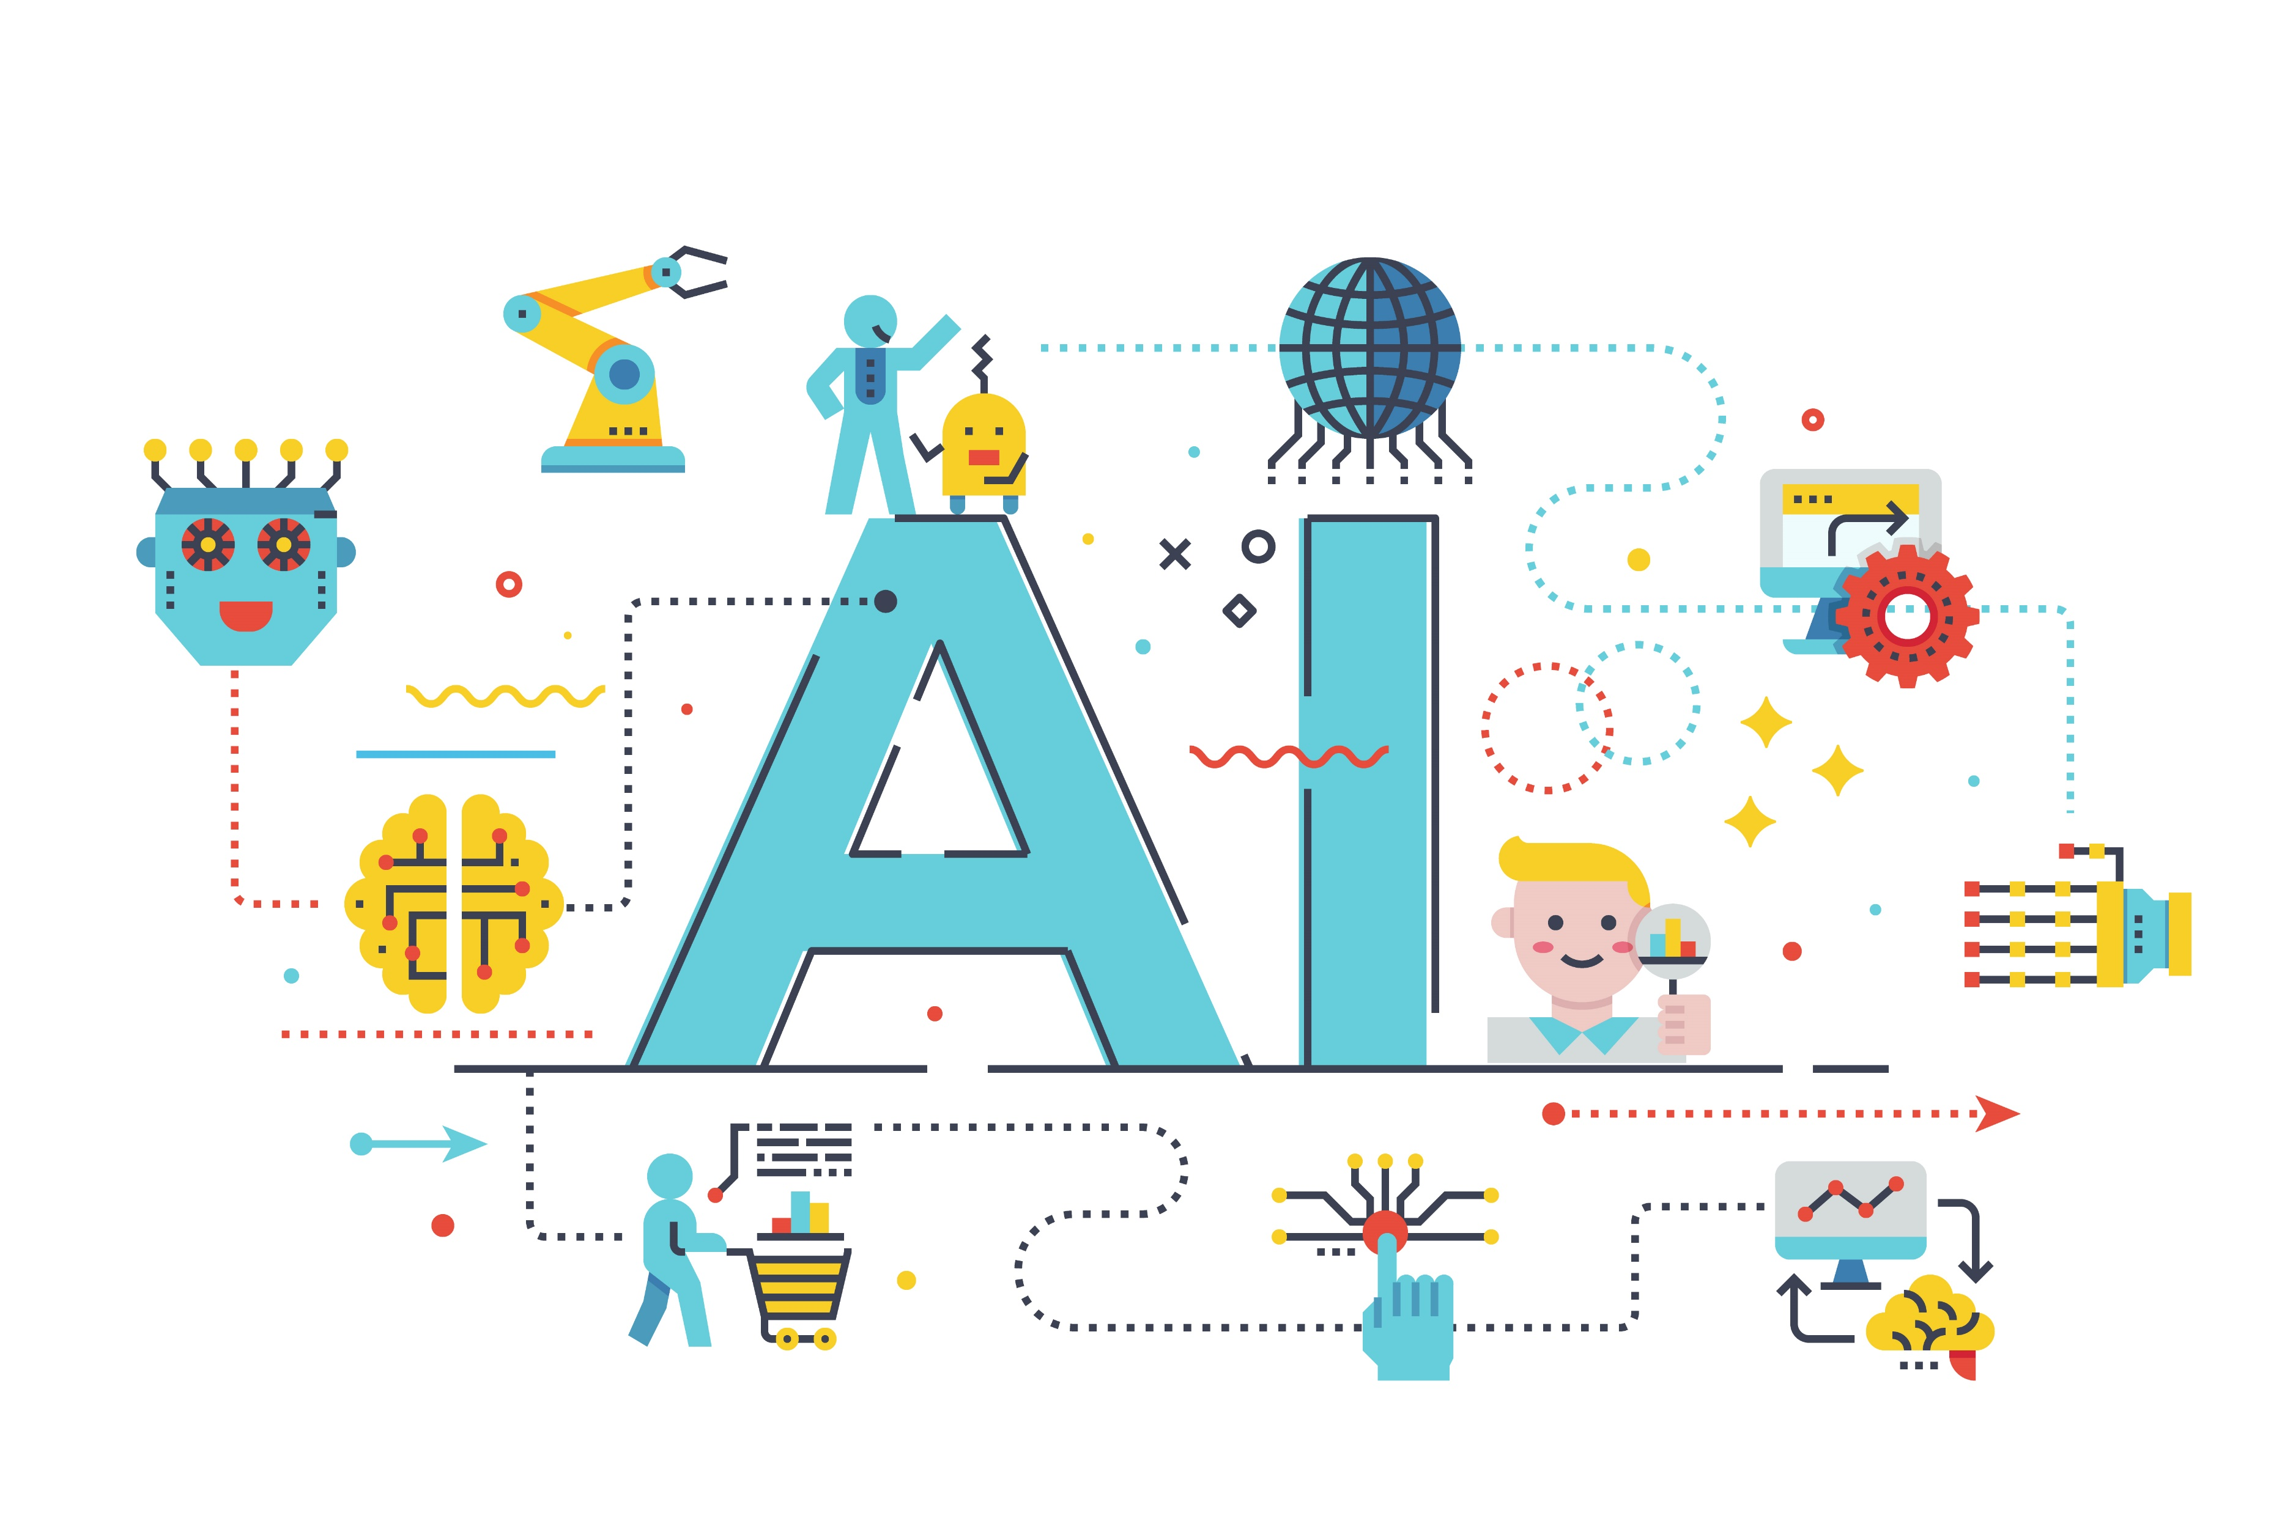
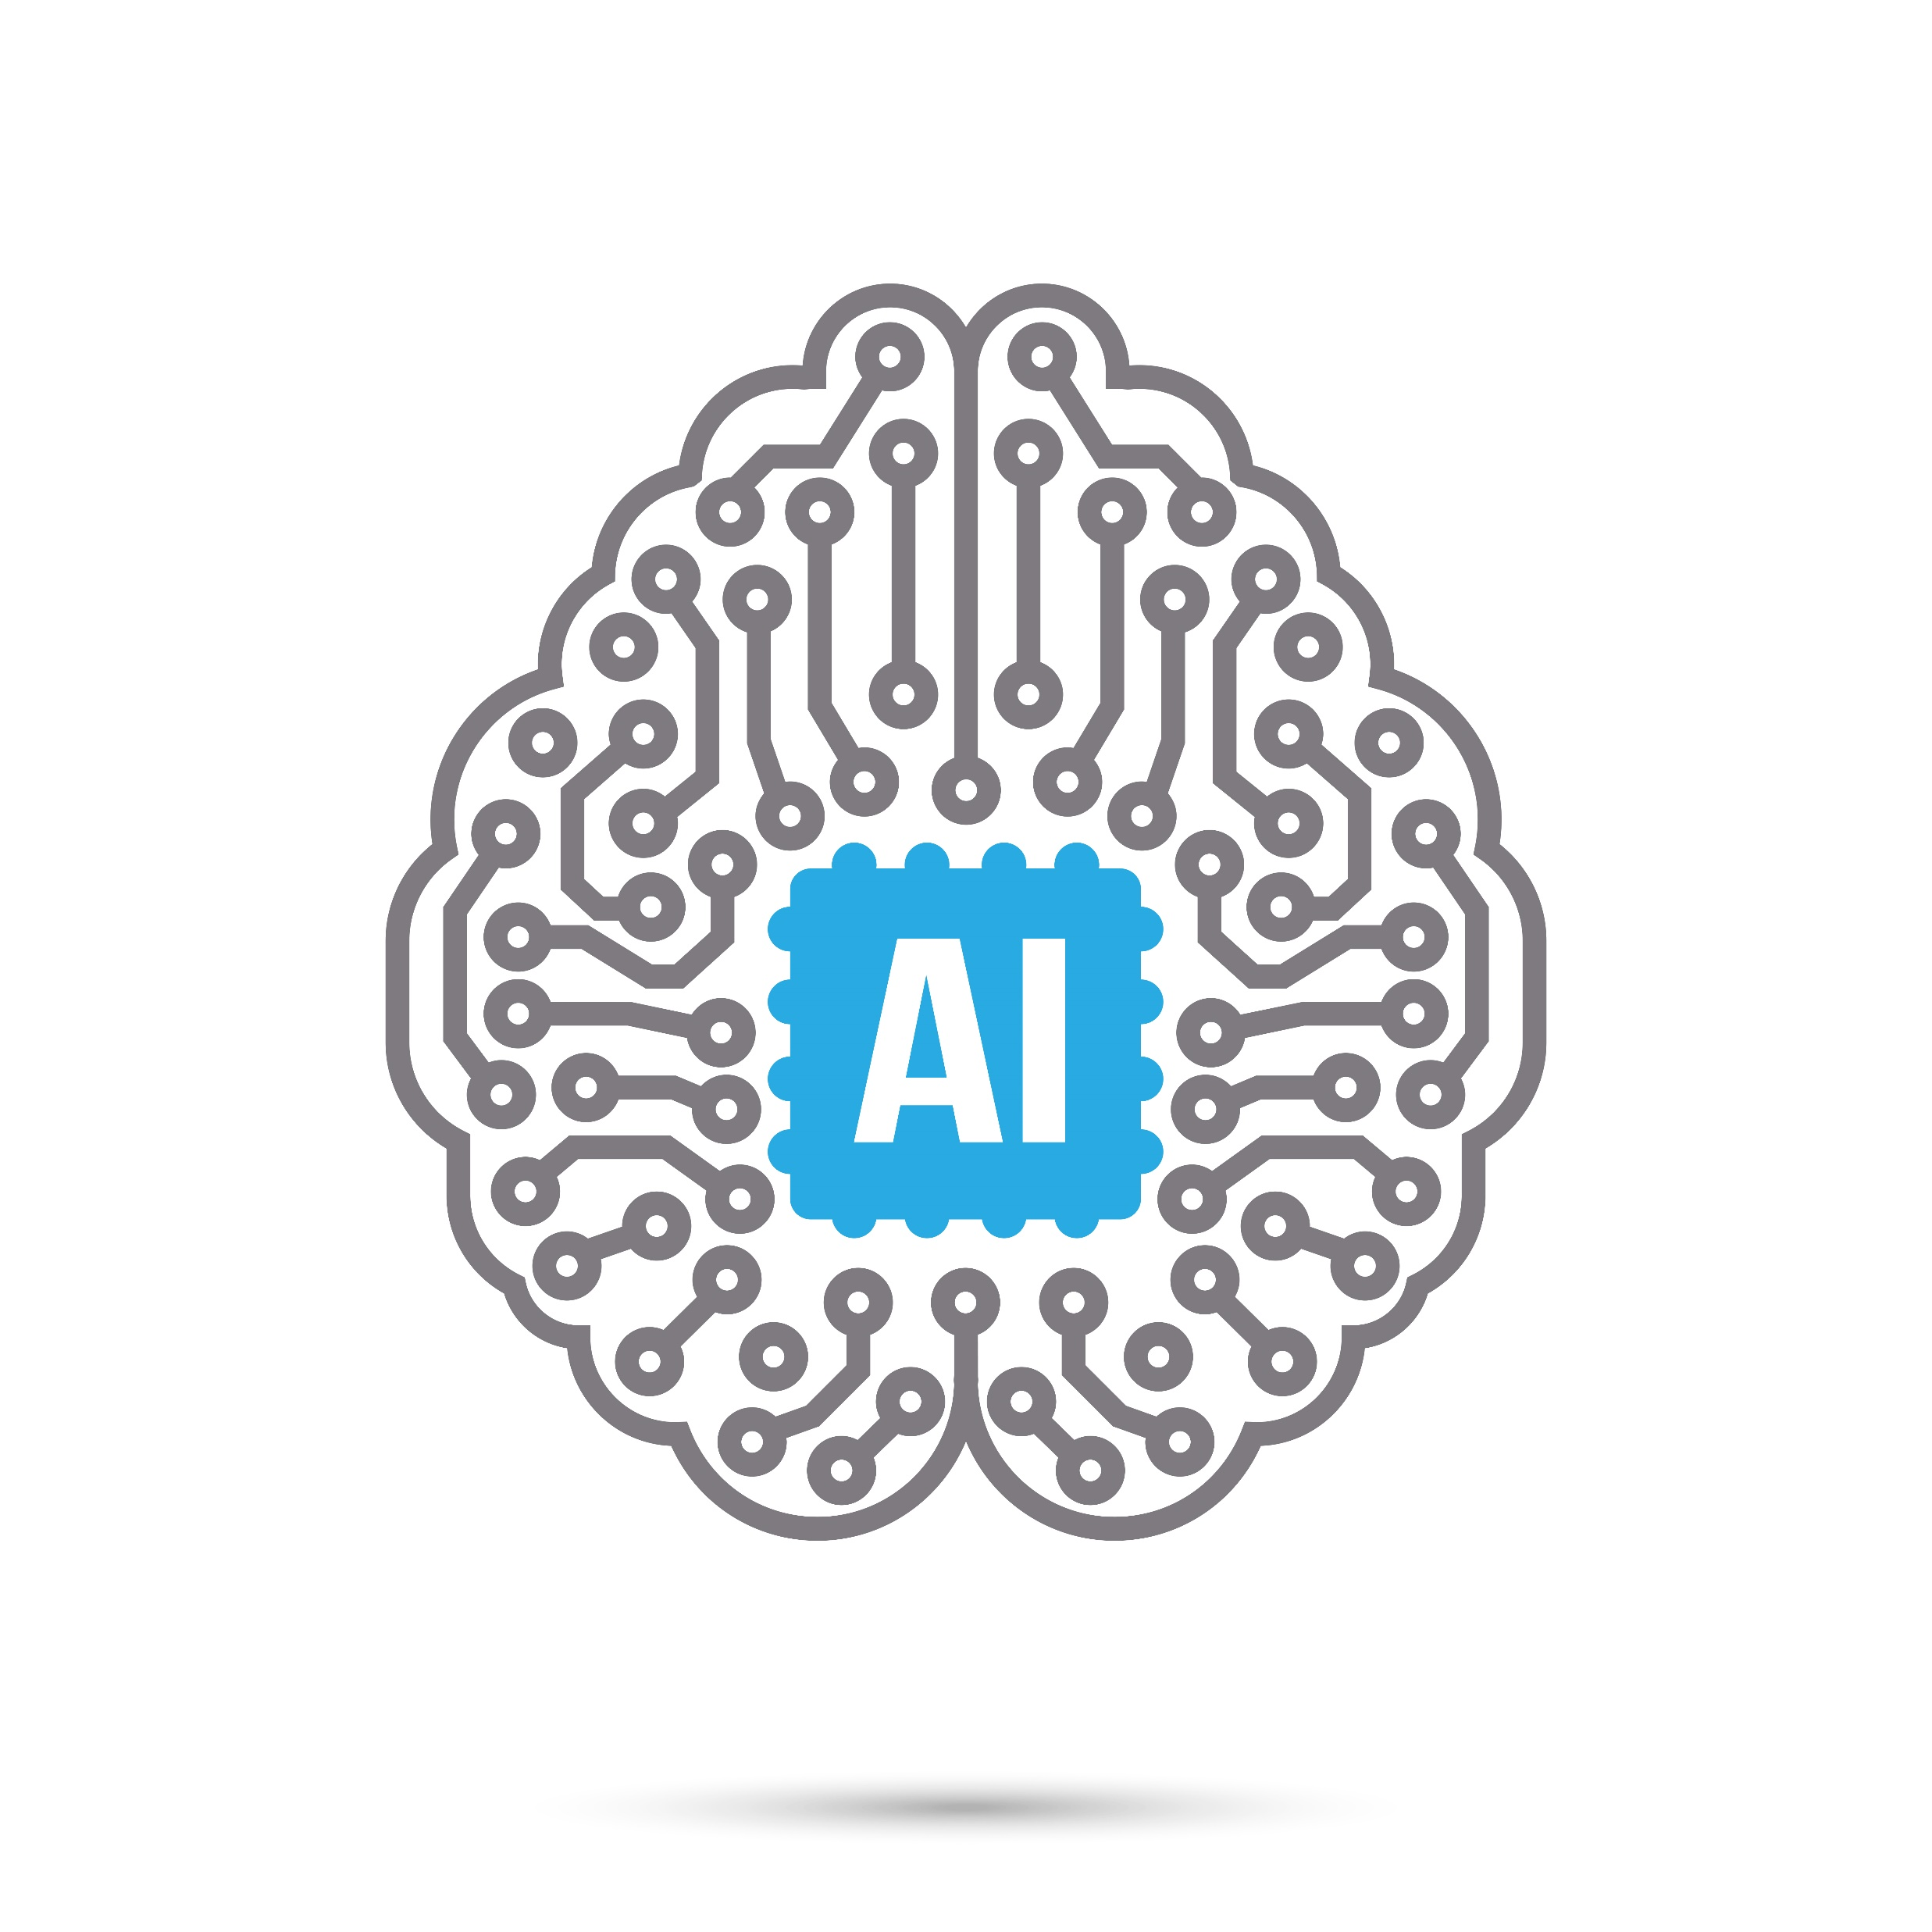


Introduction to AI – Demand of AI
More computational Power
More Data
Broad Investment
Better Algorithms

Slide 3
What is AI ?
The Theory and development of computer systems able to perform tasks normally requiring human intelligence, such as visual perception, speech recognition, decision-making and translation between languages.
Machine Learning
NLP
Knowledge Base
Deep Learning
Computer Vision
Expert System

Slide 4
History of AI
John McCarthy first coined the AI in the yer 1956.
The science and engineering of making intelligent machines.

Slide 5
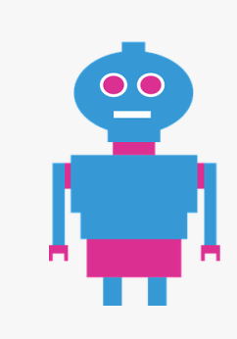

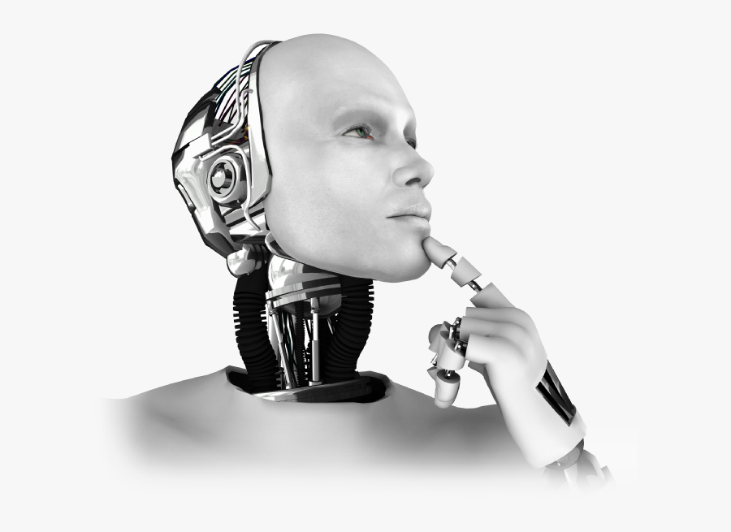
Types of AI
Artificial Narrow Intelligence
Artificial General Intelligence
Artificial Super Intelligence

Slide 6
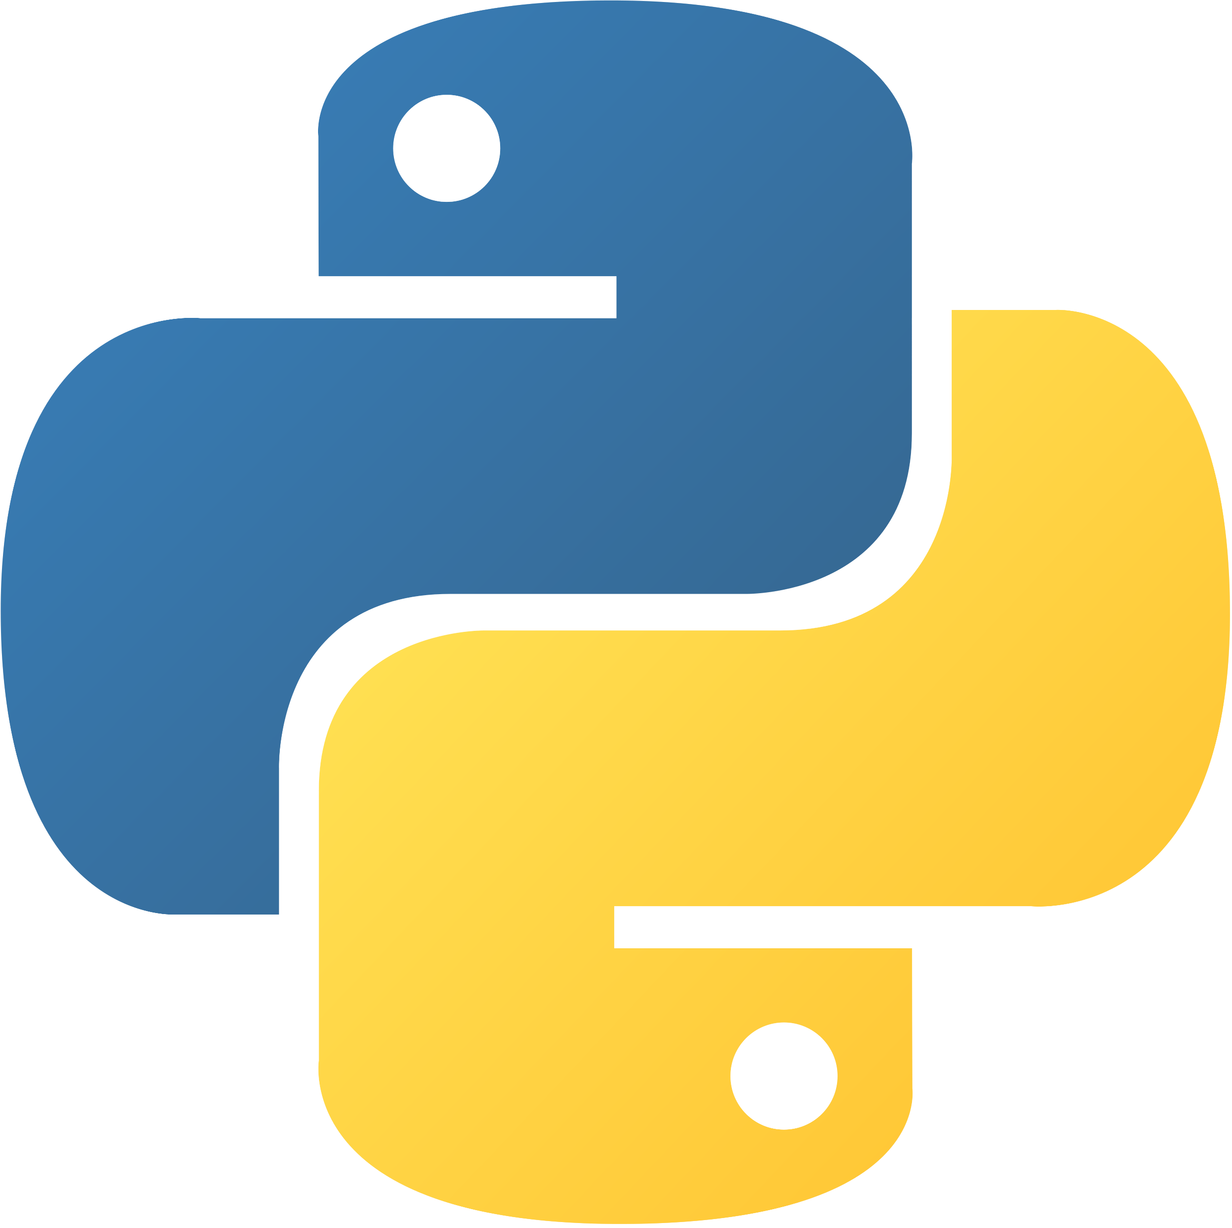
Why Python for AI?
Python is most widely used to create models for AI.
Less Code
Pre-built Libraries
Ease of learning
Platform Independent
Massive community support

Slide 7
Python Packages for AI
Inside Python we have different packages to be used for developing AI.
For eg: To develop DEEP Learning models, we use a package called Tensorflow
Tensorflow is a package which can be used in python to do ML/DL models.

Slide 8
TensorFlow
TensorFlow library was developed by Google in collaboration with Brain team. It is popularly used in writing Machine Learning Algorithms.
Features are:
Responsive construct
Flexible
Easily trainable

Slide 9
Sci-kit Learn
Sci-kit learn is a Python library associated with NumPy and SciPy. It is considered as one of the best libraries for working with complex data.
Features are:
Cross validation
Unsupervised learning algorithms
Feature extraction

Slide 10
NumPy
NumPy is a python library mainly used for computing scientific/mathematical data.
Features are:
Supports multi-dimensional arrays
Numerical Analysis
Intuitive

Slide 11
Keras
Keras simplifies the implementation of neural networks. It also provides some of the best utilities for compiling models, processing data-sets, visualization of graphs and much more.
Features are:
Runs smoothly on both CPU & GPU
Supports all types of Neural Networks
Completely Python based.

Slide 12
Theano
Theano is a Python Library that allows you to define, optimize and evaluate mathematical expressions involving multi-dimensional arrays efficiently.
Features are:
Tight integration with NumPy
Transparent use of a GPU
Extensive unit-testing and self-verification

Slide 13
Natural Language Analyses with NLTK
The Natural Language toolkit(NLTK) is an open source Python Library for Natural Language Processing , text analysis and text mining.
Features are:
Study natural language text
Text Analysis
Sentimental analysis

