Slide 1
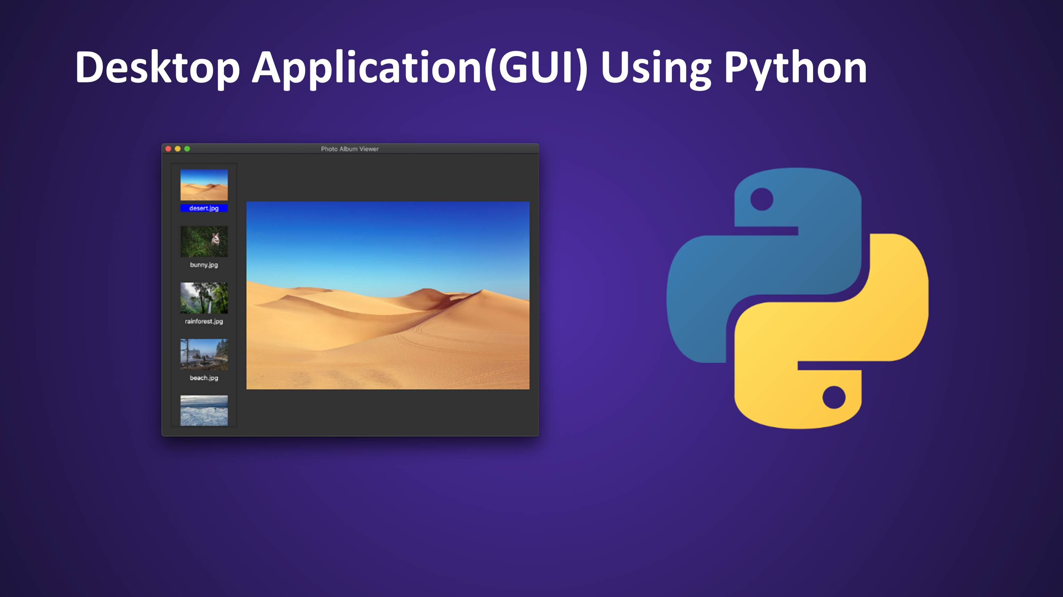
Creating GUIs Using TKinter

Slide 2
Agenda
Introduction to Tkinter
Installing and working with Tkinter
Overwiew of all the concepts in Tkinter
Looking at code to understand theory.

Slide 3
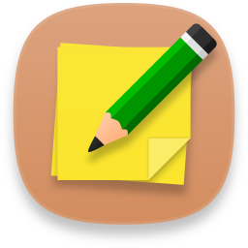

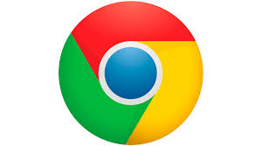
What is GUI?
GUI is a Graphical User Interface, it is a Desktop app which helps you to interact with computers.
They are used to perform different tasks on laptops, desktops or any electronic device as well.
GUI
Text Editors
Games
Apps

Slide 4


Why We Need GUI?
Command Line
Graphical User Interface
The Graphical user interface, is a type of user interface that allows users to interact with electronic devices through graphical icons and visual indicators.

Slide 5



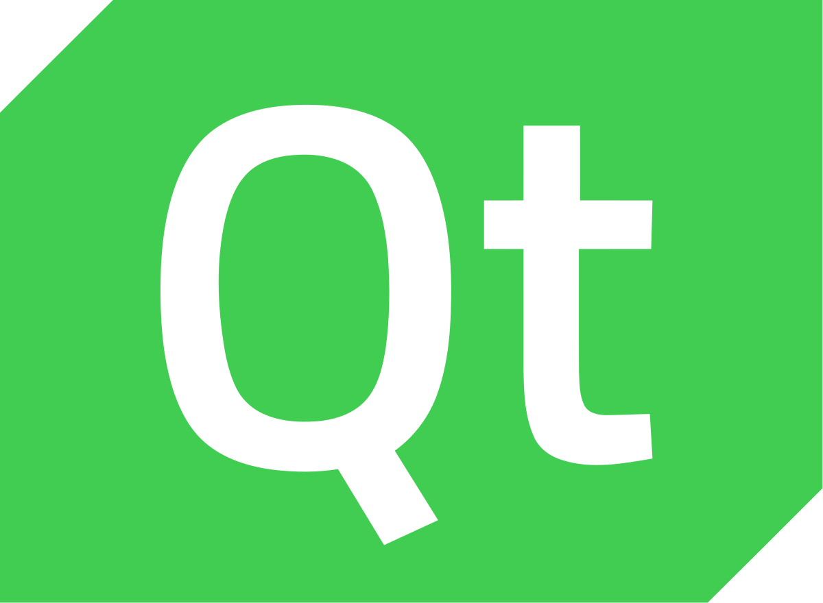
Python Libraries for GUI
kivy
Qt
wxPython
Tkinter

Slide 6
What is Tkinter?
Tkinter in Python GUI Programming is standard Python GUI library it gives us an object-oriented interface to the Tk GUI toolkit.
Python with tkinter is the fastest and easiest way to create the GUI applications.
Creating a GUI using tkinter is an easy task.
To Create Tkinter App:
Import the tkinter module
Create the GUI application main window
Enter the main event loop
Add Widgets

Slide 7
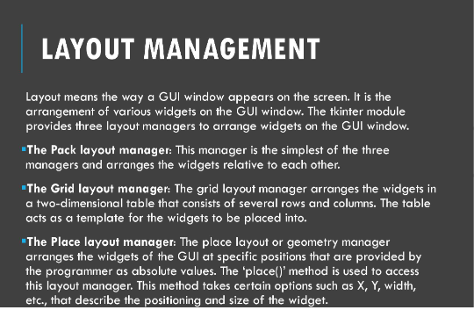

Slide 8
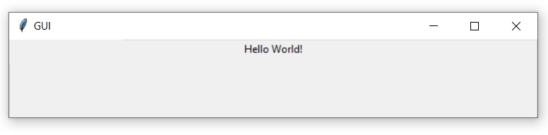
Example
Importing tkinter is same as importing any other module in the Python code. Note that the name of the module in Python 2.x is ‘Tkinter’ and in Python 3.x it is ‘tkinter’.
import tkinter
window=tkinter.Tk()
#to rename the title of the window
window.title(“GUI”)
#pack is used to show the object in the window
label=tkinter.Label(window,text=“Hello World!”).pack()
window.mainloop()
mainloop(): There is a method known by the name mainloop() is used when your application is ready to run. mainloop() is an infinite loop used to run the application, wait for an event to occur and process the event as long as the window is not closed.

Slide 9
Tkinter Widgets
A Widget is an element of a graphical user Interface(GUI) that displays information or provides a specific way for a user to interact with the operating system or an application.
Label
Button
Entry
ComboBox
CheckButton
Radio
ScrolledText
SpinBox
MenuBar
NoteBook

Slide 10
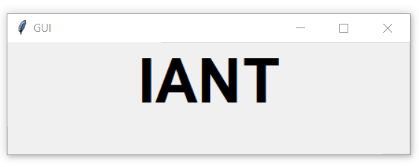
Label Widget
Label- You can set the label front so you can make it bigger and maybe bold.
//Example
import tkinter window=tkinter.Tk() #to rename the title of the window window.title("GUI") #pack is used to show the object in the window label=tkinter.Label(window,text="IANT",font=("Arial Bold",50)).pack() window.mainloop()
//Output
Changing the font style and size

Slide 11
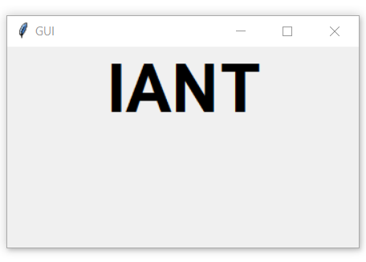
Label- We can set the default window size using geometry function.
//Example
//Output
import tkinter window=tkinter.Tk() #to rename the title of the window window.title("GUI") #pack is used to show the object in the window label=tkinter.Label(window,text="IANT",font=("Arial Bold",50)).pack() window.geometry('350x200') #sets the window width to 350px and height to 200px window.mainloop()

Slide 12
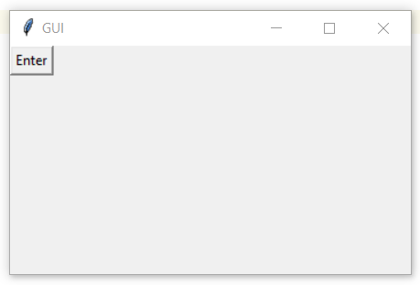
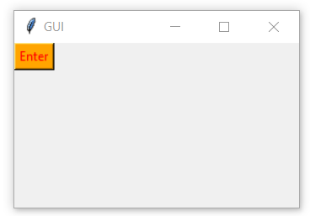
Button Widget
Button – Lets start by adding the button to the window, the button is created and added to the window the same as the label.
//Example
//Output
import tkinter window=tkinter.Tk() #to rename the title of the window window.title("GUI") button=tkinter.Button(window, text="Enter") button.grid(column=0,row=0) #using grid function to set position of button window.geometry('350x200’) window.mainloop()
//Example
button=tkinter.Button(window, text="Enter",bg="orange",fg="red")
Changing background & foreground color

Slide 13
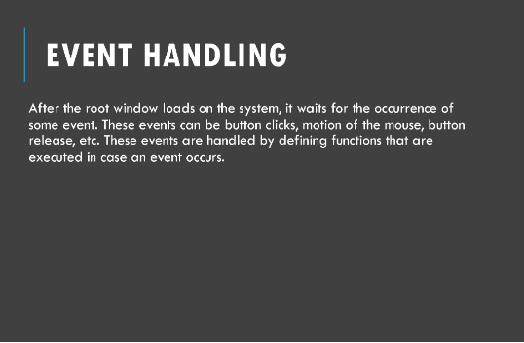

Slide 14
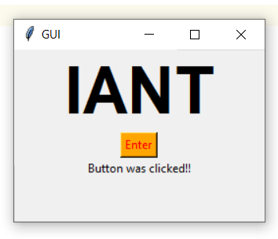
Event Listener
Button- Lets add button click event
First, we will write the function that we need to execute when the button is clicked.
//Example
//Output
import tkinter window=tkinter.Tk() def clicked(): mylabel=tkinter.Label(window,text="Button was clicked!!") mylabel.pack() #to rename the title of the window window.title("GUI") #pack is used to show the object in the window label1=tkinter.Label(window,text="IANT",font=("Arial Bold",50)).pack() button=tkinter.Button(window, text="Enter",bg="orange",fg="red",command=clicked) button.pack() window.mainloop()

Slide 15
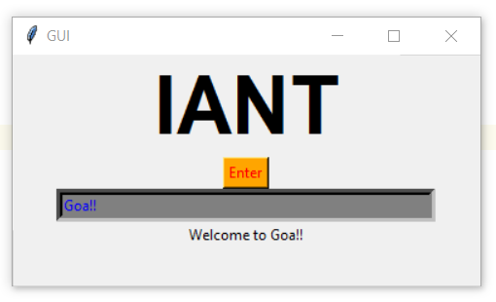
Entry Widget
Entry: It is used to input the single line text entry from the user.. For multi-line text input, Text widget is used.
//Example
import tkinter window=tkinter.Tk() #Creating input box txt=tkinter.Entry(window,width=50,bg="grey",fg="blue",borderwidth=5) txt.insert(0,"Enter Name") def clicked(): result="Welcome to "+ txt.get() mylabel=tkinter.Label(window,text=result) mylabel.pack() #to rename the title of the window window.title("GUI") label1=tkinter.Label(window,text="IANT",font=("Arial Bold",50)) button=tkinter.Button(window, text="Enter",bg="orange",fg="red",command=clicked) label1.pack() button.pack() txt.pack() window.mainloop()
//Output

Slide 16
ComboBox Widget
Combobox is a combination of Listbox and an entry field.
It is one of the Tkinter widgets where it contains a down arrow to select from a list of options.
It helps the users to select according to the list of options displayed.
When the user clicks on the drop-down arrow on the entry field, a pop up of the scrolled Listbox is displayed down the entry field.
The selected option will be displayed in the entry field only when an option from the Listbox is selected.

Slide 17
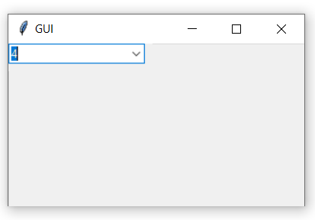
Example
//Output
import tkinter from tkinter import ttk
window=tkinter.Tk() combo=ttk.Combobox(window) combo['values']=(1,2,3,4,5,"Text") combo.grid(column = 0, row = 2) combo.current()

Slide 18
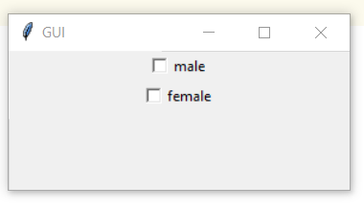
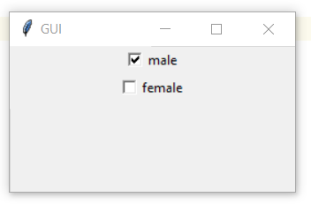
Checkbox Widget
CheckButton: To select any number of options by displaying a number of options to a user as toggle buttons.
//Example
//Output
from tkinter import * window=tkinter.Tk()
var1 = IntVar()
var1.set(True) #by default sets checkbox value to true or selected
Checkbutton(window, text='male', variable=var1).pack()
var2 = IntVar()
Checkbutton(window, text='female', variable=var2).pack()
window.mainloop()

Slide 19
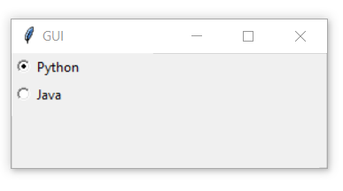
RadioButton Widget
RadioButton: It is used to offer multi-choice option to the user. It offers several options to the user and the user has to choose one option.
//Example
//Output
from tkinter import * window=tkinter.Tk()
#Radiobutton widget rad1=Radiobutton(window,text='Python',value=1).pack(anchor=W) rad2=Radiobutton(window,text='Java', value=2).pack(anchor=W) window.mainloop()

Slide 20
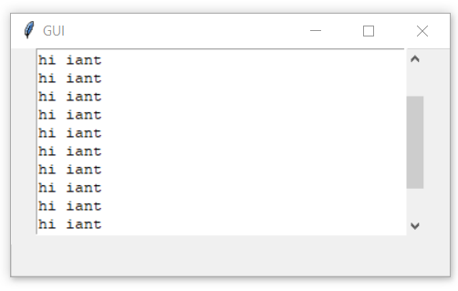
ScrolledText Widget
ScrolledText widget is a text widget with a scroll bar.
The tkinter.scrolledtext module provides the text widget along with a scroll bar. This widget helps the user enter multiple lines of text.
//Example
//Output
from tkinter import scrolledtext
window=tkinter.Tk()
#ScrolledText Widget
txt=scrolledtext.ScrolledText(window,width=40,height=10)
txt.focus()
txt.pack()
window.mainloop()
txt=scrolledtext.ScrolledText(window,width=40,height=10)
# Inserting Text which is read only
txt.insert(tkinter.INSERT,
"""This is a scrolledtext widget to make tkinter text read only.
Hi
Geeks !!!
Geeks !!!
Geeks !!! """)

Slide 21
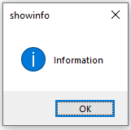
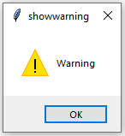
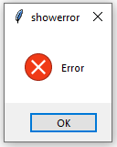
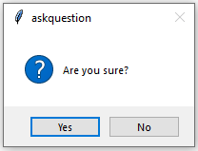
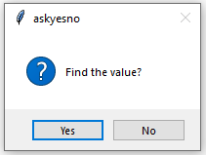
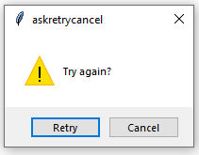
MessageBox Widget
MessageBox Widget is used to display the message boxes in the python applications.
from tkinter import messagebox
window=tkinter.Tk()
#MessageBox Widget
messagebox.showinfo("showinfo", "Information")
messagebox.showwarning("showwarning", "Warning")
messagebox.showerror("showerror", "Error")
messagebox.askquestion("askquestion", "Are you sure?")
messagebox.askokcancel("askokcancel", "Want to continue?")
messagebox.askyesno("askyesno", "Find the value?")
messagebox.askretrycancel("askretrycancel", "Try again?")
window.mainloop()
//Example
import tkinter
from tkinter import messagebox
window=tkinter.Tk()
def clicked():
messagebox.showinfo("showinfo", "Information")
button=tkinter.Button(window, text="Enter",bg="orange",fg="red",command=clicked)
button.pack()
//Output

Slide 22

SpinBox Widget
SpinBox: It is an entry of ‘Entry’ widget. Here, value can be input by selecting a fixed value of numbers.
//Example
//Output
from tkinter import *
import tkinter
window=tkinter.Tk()
#SpinBox Widget
spin = Spinbox(window, from_ = 0, to = 10,width=5)
spin.pack()
window.mainloop()

Slide 23
MenuBar Widget
Menus are the important part of any GUI. A common use of menus is to provide convenient access to various operations such as saving or opening a file, quitting a program, or manipulating data. Toplevel menus are displayed just under the title bar of the root or any other toplevel windows.
from tkinter import *
from tkinter.ttk import *
from time import strftime
# creating tkinter window
root = Tk()
root.title('Menu Demonstration')
# Creating Menubar
menubar = Menu(root)
# Adding File Menu and commands
file = Menu(menubar)
menubar.add_cascade(label ='File', menu = file)
file.add_command(label ='New File', command = None)
file.add_command(label ='Open...', command = None)
file.add_command(label ='Save', command = None)
file.add_separator()
file.add_command(label ='Exit', command = root.destroy)
# Adding Edit Menu and commands
edit = Menu(menubar)
menubar.add_cascade(label ='Edit', menu = edit)
edit.add_command(label ='Cut', command = None)
edit.add_command(label ='Copy', command = None)
edit.add_command(label ='Paste', command = None)
edit.add_separator()
edit.add_command(label ='Find...', command = None)
# Adding Help Menu
help_ = Menu(menubar)
menubar.add_cascade(label ='Help', menu = help_)
help_.add_command(label ='Tk Help', command = None)
help_.add_command(label ='Demo', command = None)
# display Menu
root.config(menu = menubar)
mainloop()

Slide 24

Notebook Widget
The Notebook widget allows you to select pages of contents by clicking on tabs.
When you click one of these tabs, the Notebook widget will display a child pane associated with the selected tab. Typically, a child pane is a Frame widget.
import tkinter as tk
from tkinter import ttk
# root window
root = tk.Tk()
root.geometry('400x300')
root.title('Notebook Demo')
# create a notebook
notebook = ttk.Notebook(root)
notebook.pack(pady=10, expand=True)
# create frames
frame1 = ttk.Frame(notebook, width=400, height=280)
frame2 = ttk.Frame(notebook, width=400, height=280)
frame1.pack(fill='both', expand=True)
frame2.pack(fill='both', expand=True)
# add frames to notebook
notebook.add(frame1, text='General Information')
notebook.add(frame2, text='Profile')
root.mainloop()

Slide 25
Geometry Management
All tkinter widgets will have geometric measurements.
Geometry Management Classes
Pack()
grid()
place()
It organizes the widgets in the block, which mean it occupies the entire available width.
It organizes the widgets in table-like structure.
Its used to place the widgets at a specific position you want.

Slide 26


Organizing Layout And Widgets
We use Frame class to arrange layout in a window.
Frame is used to create the divisions in the window. You can align the frames as you like with side parameter of pack() method.
Frame
Button
Button is used to create a button in the window. It takes several parameters like text, fg, bg.
grid
Grid is another way to organize the widgets. It uses the Matrix row column concepts.

Slide 27
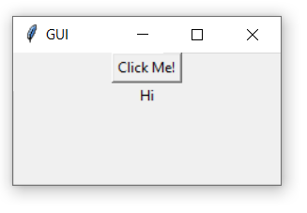
Binding Functions
Calling functions whenever an event occurs refers to a binding function.
Binding
import tkinter
window=tkinter.Tk()
window.title("GUI")
#creating a function called say_hi()
def say_hi():
tkinter.Label(window,text="Hi").pack()
tkinter.Button(window, text="Click Me!", command=say_hi).pack()
window.mainloop()

Slide 28
Event Handling
Events
Mousemove, mouseover, clicking, scrolling are some events.
Mouse Buttons
<Button-1>
<Button-2>
<Button-3>
Left Click
Middle Click
Right Click

Slide 29
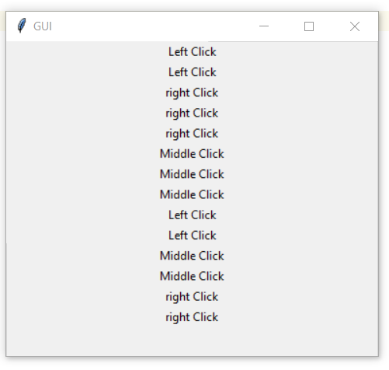
Example
import tkinter
window=tkinter.Tk()
window.title("GUI")
def left_click(event):
tkinter.Label(window,text="Left Click").pack()
def middle_click(event):
tkinter.Label(window,text="Middle Click").pack()
def right_click(event):
tkinter.Label(window,text="right Click").pack()
window.bind("<Button-1>",left_click)
window.bind("<Button-2>",middle_click)
window.bind("<Button-3>",right_click)
window.mainloop()

Slide 30
Images & Icons
Add Images
Images can be added using the PhotoImage method.
import tkinter
window=tkinter.Tk()
window.title("Iant")
#taking image from directory & storing in a variable
icon = tkinter.PhotoImage(file='C:/Users/DELL/PycharmProjects/pythonProject1/sun.png')
# Setting icon of master window
window.iconphoto(False, icon)
#Setting image in master window
img=tkinter.PhotoImage(file='C:/Users/DELL/PycharmProjects/pythonProject1/sun.png')
label=tkinter.Label(window, image=img)
label.pack()
window.mainloop()

Slide 31
Use Case
Lets design our own basic calculator.

