Slide 1



Functions in Python
Functions in Real Life
Eating
Running
Cycling

Slide 2
Benefits of Functions:
It makes code simpler
It makes code reusable that results in faster development of code
When you declare functions and store in variables.

Slide 3
Python Functions
Function is a block of code which performs a specific task.
Deposit
Function to deposit money
Withdraw
Function to withdraw money
Balance
Function to check balance

Slide 4
Example:
#function definition
def hello():
print(“Hello World!”)
#function invoke
hello()
#To print docstring from function
>>def func1():
“””this prints”””
print(“hello”)
>>func1()
>>print(func1.__doc__)
#function definition by passing parameter
def add_10(x):
return x+10
#function invoke
add_10(9)
add_10(5)
#function definition
def odd_even(x):
if x%2==0:
print(“x is even no.”)
else:
print(“x is odd no.”)
#function invoke
odd_even(5)
odd_even(10)

Slide 5
Example:
#Problem: You are given two lists of numbers and you need to find total of each of these list
def cal_total(exp):
total =0
for item in exp:
total = total + item
return total
tom_exp_list=[2100,3400,3500]
joe_exp_list=[200,500,700]
tom_total=cal_total(tom_exp_list)
joe_total=cal_total(joe_exp_list)
print("Tom's total expenses :",tom_total)
print("Joe's total expenses :", joe_total)

Slide 6
#Example:
def sum(arg1,arg2):
if(type(arg1)!=type(arg2)):
print(“Please give the args of same type.”)
return #---not return anything i.e. return None
else:
return (arg1+arg2)
#function invoking
sum(15,60)
sum(‘Hello', 'World’)
sum(3.14, 90.890)
sum(‘hello’, 15)

Slide 7
Example
# Python 3.5+ supports 'type annotations' that can be
# used with tools like Mypy to write statically typed Python:
def my_add(a: int, b: int) -> int:
return a + b
my_add(2,5)

Slide 8
The get() method on Python dicts and its "default" argument
# The get() method on dicts and its "default" argument
name_for_userid ={382: "Alice", 590: "Bob", 951: "Dilbert"}
def greeting(userid):
return "Hi %s!" % name_for_userid.get(userid, “unknown")
>>> greeting(382)
"Hi Alice!"
>>> greeting(333333)
"Hi unknown!"

Slide 9
Is Python call by reference or call by value
Python utilizes a system, which is known as “Call by Object Reference” or “Call by assignment”. In the event that you pass arguments like whole numbers, strings or tuples to a function, the passing is like call-by-value because you can not change the value of the immutable objects being passed to the function. Whereas passing mutable objects can be considered as call by reference because when their values are changed inside the function, then it will also be reflected outside the function.
# Python code to demonstrate
# call by value
string = "Geeks"
def test(string):
string = "GeeksforGeeks"
print("Inside Function:", string)
# Driver's code
test(string)
print("Outside Function:", string)
# Python code to demonstrate
# call by reference
def add_more(list):
list.append(50)
print("Inside Function", list)
# Driver's code
mylist = [10,20,30,40]
add_more(mylist)
print("Outside Function:", mylist)
def set_list(list):
list = ["A", "B", "C"]
return list
def add(list):
list.append("D")
return list
my_list = ["E"]
print(set_list(my_list))
print(add(my_list))

Slide 10
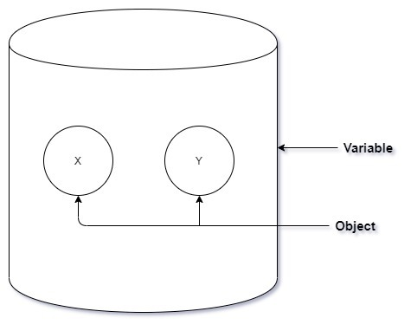
The variable is not the object passed:
What if I tell you The Ramayana was not written by Tulsi Das but The Ramayana was written by a man named Tulsi Das. Does that distinction make any sense? No right?!. But according to Python it does and it makes a crucial distinction. So, in Python and its PKD’s there is a big difference between the thing and the label we use to refer to that thing. “A man named Tulsi Das ” is just a man and “Tulsi Das” is a name used to refer to that man. So, consider a list
a = ["X", "Y"]
Here “a” is a variable that points to a list containing the element “X” and “Y”. But “a” itself is not the list. Consider “a” to be a bucket that contains the object “X” and “Y”.

Slide 11
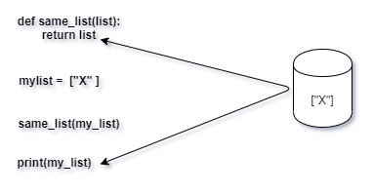
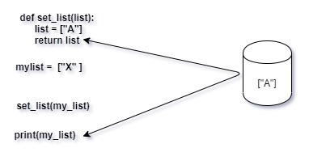
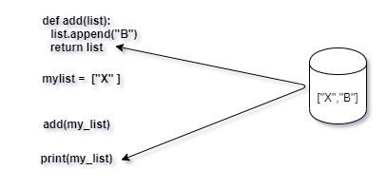
Pass By Reference
In pass by reference the variable( the bucket) is passed into the function directly. The variable acts as a Package that comes with it’s contents(the objects).
In the above code image both “list” and “my_list” are the same container variable and therefore refer to the exact same object in the memory. Any operation performed by the function on the variable or the object will be directly reflected to the function caller. For instance, the function could completely change the variable’s content, and point it at a completely different object:
Also, the function can reassign the contents of the variable with the same effect as below:

Slide 12
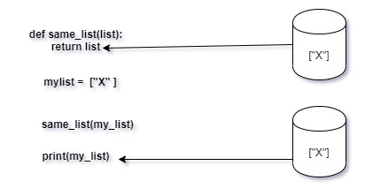
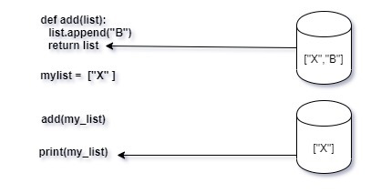
Pass By Value
In pass by value the function is provided with a copy of the argument object passed to it by the caller. That means the original object stays intact and all changes made are to a copy of the same and stored at different memory locations.

Slide 13
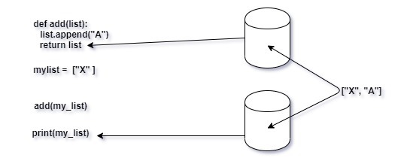
Pass Object By Reference
As python is different in this context, the functions in python receive the reference of the same object in the memory as referred by the caller. However, the function does not receive the variable(the bucket) that the caller is storing the same object in; like in pass-by-value, the function provides its own bucket and creates an entirely new variable for itself.
The same object in the memory is referred by both the caller and the function, so when the append function adds an extra element to the list, the caller object gets updated too. They have different names but are the same thing. Both the variables contain the same object. This is the meaning behind pass by object reference. The function and caller use the same object in memory, but get them through different variables. Any changes made to the function variable(bucket) won’t change the nature of the caller variable (bucket), only the content gets updated.

Slide 14
Global,Local and NonLocal Variables in Python
#Example:
def func():
print(x)
x=‘ram’
func()
#Output: global
#Example:
def func():
x=‘Local’
print(x)
X=‘global’
func()
print(x)
#Output: Local
global
#Example:
def func():
global x
print(x)
x=‘Local’
print(x)
X=‘global’
func()
print(x)
#Example:
def func():
x=50
def inner():
nonlocal x
x=100
inner() #function calling
print(x)
x=20
Func()
print(x)

Slide 15
Nested Function in Python
Example:
def pop(list):
def get_last_item(my_list):
return my_list(len(list)-1)
list.remove(get_last_item(list))
return list
a=[1,2,3,4,6]
print(pop(a))

Slide 16
Example
# Functions are first-class citizens in Python:
# They can be passed as arguments to other functions,
# returned as values from other functions, and
# assigned to variables and stored in data structures.
>>> def myfunc(a, b):
... return a + b
>>> funcs = [myfunc]
>>> funcs[0] <function myfunc at 0x107012230>
>>> funcs[0](2, 3) 5

Slide 17
Example
# Because Python has first-class functions they can
# be used to emulate switch/case statements
def dispatch_dict(operator, x, y):
return {
'add': lambda: x + y,
'sub': lambda: x - y,
'mul': lambda: x * y,
'div': lambda: x / y,
}.get(operator, lambda: None)()
def dispatch_if(operator, x, y):
if operator == 'add':
return x + y
elif operator == 'sub':
return x - y
elif operator == ‘*':
return x * y
elif operator == 'div':
return x / y
else:
return None
>>>print( dispatch_if(‘*', 2, 8))
16
>>> dispatch_dict('mul', 2, 8)
16
>>> dispatch_if('unknown', 2, 8)
None
>>> dispatch_dict('unknown', 2, 8)
None

Slide 18
Recursion in Python
A function calling itself is called recursion.
Calculate Fibonacci series: 0,1,1,2,3,5,8,13,……
>>def factorial_iterative(n):
fact=1
for i in range(n):
fact=fact*(i+1)
return fact
>>number=int(input(“Enter the number:”))
>>print(factorial_iterative(number))
>>def factorial_recursive(n):
if n==1:
return 1
else:
return n * factorial_recursive(n-1)
>>number=int(input(“Enter the number:”))
>>print(factorial_recursive(number))
>>def fibo(n):
if n==0:
return 0
elif n == 1:
return 1
else:
return (fibo(n-1)+fibo(n-2))
>>number=int(input(“Enter the number:”))
>>for i in range(number):
print(fibo(i))

Slide 19
Example…
#if no values provided to arg then use default values
def student(name=“Unknown name”,age=0):
print(“name:”,name)
print(“Age:”,age)
#Function invoking
student(‘tom’)
student(‘tom’,22)
def fibonacci(n):
if n<=1:
return n
else:
return(fibonacci(n-1) + fibonacci(n-2))
n = int(input('Enter a number, N, N>=2 : ')) fibo_series = []
for i in range(0,n): fibo_series.append(fibonacci(i)) print(fibo_series)

Slide 20
Variable-length Arguments(*args,**kwargs)
//*args-
def student(name, age,*marks):
print(“name:”,name)
print(“Age:”,age)
for m in marks:
print(m)
#function invoking
student(‘tom’,22, 67,79,80,90)
#**kwargs
def student(name,age,**marks):
print(“name:”,name)
print(“Age:”,age)
for key,value in marks.items():
print(key,”:”,value)
#function invoking
student(‘tom’,22,English=97,math=89,physics=80)
#Example:
>>def function_name_print(a,b,c,d):
print(a,b,c,d)
>>function_name_print(“Harry”,”Rohan”,”Max”,”Bob”)
>>def function_name_print(a,b,c,d,e,f,g):
print(a,b,c,d,e,f,g)
>>function_name_print(“Harry”,”Rohan”,”Max”,”Bob”,”Kevin”,”Parth”,”Anna”)
>>def funargs(*args):
#print(args[0])
for i in args:
print(i)
>>names=[“Harry”,”Rohan”,”Max”,”Bob”,”Kevin”,”Parth”,”Anna”]
>>funargs(*names)

Slide 21
Example - **kwargs
>>def funargs(*args,**kwargs):
for i in args:
print(i)
print(“\n Now I would like to introduce some of our heroes”)
for key,value in kwargs.items():
print(key,value)
#OR
print(f”{key} is a {value}”)
>>lists={“Max”:”Monitor”,”Harry”:”Coordinator”,”Bob”:”Programmer”,”Bill”:”Cook”}
>>funargs(*args, **kwargs)

Slide 22
Function argument Unpacking
# Function argument unpacking
def myfunc(x, y, z):
print(x, y, z)
tuple_vec = (1, 0, 1)
dict_vec = {'x': 1, 'y': 0, 'z': 1}
>>> myfunc(*tuple_vec)
1, 0, 1
>>> myfunc(**dict_vec)
1, 0, 1

Slide 23
You can assign a function to a variable. You can then use that variable the same as you would use the function itself:
>>> def func():
("I am function func()!")
>>> func()
I am function func()!
>>> var1= func
>>> var1()
I am function func()!

Slide 24
You can display a function to the console with print(), include it as an element in a composite data object like a list, or even use it as a dictionary key:
>>> def func():
... print("I am function func()!")
...
>>> print(“Hello world",func)
cat <function func at 0x7f81b4d29bf8> 42
>>> objects = ["cat", func, 42]
>>> objects[1]
<function func at 0x7f81b4d29bf8>
>>> objects[1]()
I am function func()!
>>> d = {"cat": 1, func: 2, 42: 3}
>>> d[func]
2

Slide 25
You can pass a function to another function as an argument:
This is known as function composition.
When you pass a function to another function, the passed-in function sometimes is referred to as a callback because a call back to the inner function can modify the outer function’s behavior.
>>> def inner():
... print("I am function inner()!")
...
>>> def outer(function):
... function()
...
>>> outer(inner)
I am function inner()!

Slide 26
Just as you can pass a function to another function as an argument, a function can also specify another function as its return value:
>>> def outer():
... def inner():
... print("I am function inner()!")
...
... # Function outer() returns function inner()
... return inner
...
>>> function = outer()
>>> function
<function outer.<locals>.inner at 0x7f18bc85faf0>
>>> function()
I am function inner()!
#OR
>>> outer()()
I am function inner()!

Slide 27
Python Callback Function
A callback is a function that is passed as an argument to other function. This other function is expected to call this callback function in its definition. The point at which other function calls our callback function depends on the requirement and nature of other function.
Callback Functions are generally used with asynchronous functions.
Example for Callback Function: Callback Function can be passed to a function to print out the size of file after the function reads given text file.
#Callback function
def display():
print("This is display function")
def add(a,b,display):
print(a+b)
display() #callback function
add(2,3,display)

Slide 28
A good example of this is the Python function sorted(). Ordinarily, if you pass a list of string values to sorted(), then it sorts them in lexical order:
>>> animals = ["ferret", "vole", "dog", "gecko"]
>>> sorted(animals)
['dog', 'ferret', 'gecko', 'vole']
However, sorted() takes an optional key argument that specifies a callback function that can serve as the sorting key.
>>> animals = ["ferret", "vole", "dog", "gecko"]
>>> sorted(animals, key=len)
['dog', 'vole', 'gecko', 'ferret']
sorted() can also take an optional argument that specifies sorting in reverse order.
>>> animals = ["ferret", "vole", "dog", "gecko"]
>>> sorted(animals, key=len, reverse=True)
['ferret', 'gecko', 'vole', 'dog']
But you could manage the same thing by defining your own callback function that reverses the sense of len():
>>> def reverse_len(s):
... return -len(s)
...
>>> sorted(animals, key=reverse_len)
['ferret', 'gecko', 'vole', 'dog']

Slide 29
Example – return function in python
def add(a, b):
return a + b
def subtract(a, b):
return a - b
def multiply(a, b):
return a * b
def getArithmeticOperation(operation):
if operation==1:
return add
elif operation==2:
return subtract
elif operation==3:
return multiply
while True:
print('Arithmetic Operations’)
print('1. Addition’)
print('2. Subtraction’)
print('3. Multiplication’)
print('0. Exit’)
operation = int(input('Enter the arithmetic operation : ‘))
if(operation==0):
break
func = getArithmeticOperation(operation)
a = int(input('Enter a : ‘))
b = int(input('Enter b : ‘))
result = func(a, b)
print('The result is :', result)

Slide 30
Building a Translator
For example: Google Language
Vowels->g
>>def translate(phrase):
translation=“”
for letter in phrase:
if letter in “AEIOUaeiou”:
translation = translation + “g”
else:
translation = translation + letter
return translation
#Drivers Code
print(translate(input(“Enter a phrase:”))
def translate(phrase):
translation=“”
for letter in phrase:
if letter.lower() in “aeiou”:
if letter.isupper():
translation=translation+”G”
else:
translation=translation+”g”
else:
translation=translation+letter
return translation
#Drivers Code
print(translate(input(“Enter a phrase:”))

Slide 31
Lambda Function in Python
# The lambda keyword in Python provides a
# shortcut for declaring small and
# anonymous functions:
>>> add = lambda x, y: x + y
>>> add(5, 3)
8
# You could declare the same add()
# function with the def keyword:
>>> def add(x, y):
... return x + y
>>> add(5, 3)
8
# So what's the big fuss about?
# Lambdas are *function expressions*:
>>> (lambda x, y: x + y)(5, 3)
8
# • Lambda functions are single-expression
# functions that are not necessarily bound
# to a name (they can be anonymous).
# • Lambda functions can't use regular
# Python statements and always include an
# implicit `return` statement.

Slide 32
Lambda Function (Anonymous/Inline function)
Syntax:
lambda <parameter_list>: <expression>
>>> reverse = lambda s: s[::-1]
>>> reverse("I am a string")
'gnirts a ma I'
#Example:
result=lambda x : x*x*x
result(7)
result(5)
result(10)
add=lambda x,y ; x+y
add(1,3)
a=lambda x : x%2 ==0
a(10)
>>> def reverse(s):
... return s[::-1]
...
>>> reverse("I am a string")
'gnirts a ma I'
>>def a_first(a):
return a[1]
>>a=[[1,14],[5,6],[8,23]]
>>a.sort(key=a_first)
>>print(a)
>>OR
>>a=[[1,14],[5,6],[8,23]]
>>a.sort(key=lambda x:x[1])
>>print(a)

Slide 33
You can also call the function defined by a lambda expression directly:
>>>print (lambda s: s[::-1])("I am a string")
'gnirts a ma I'
This is an anonymous lambda function to calculate the average of three numbers.
>>>print (lambda x1, x2, x3: (x1 + x2 + x3) / 3)(9, 6, 6)
7.0
>>> print(lambda x1, x2, x3: (x1 + x2 + x3) / 3)(1.4, 1.1, 0.5)
1.0
>>> animals = ["ferret", "vole", "dog", "gecko"]
>>> sorted(animals, key=lambda s: -len(s))
['ferret', 'gecko', 'vole', 'dog']
A lambda expression will typically have a parameter list, but it’s not required. You can define a lambda function without parameters. The return value is then not dependent on any input parameters:
>>> forty_two_producer = lambda : 42
>>>print( forty_two_producer())
42

Slide 34
A function defined with def can effectively return multiple values. If a return statement in a function contains several comma-separated values, then Python packs them and returns them as a tuple:
//Example:
import math
n1=int(input("Enter value for a:"))
n2=int(input("Enter value for b:"))
n3=int(input("Enter value for c:"))
print("Average is :",(lambda a,b,c : math.ceil((a+b+c)/3))(n1,n2,n3))
>>> def func(x):
... return x, x ** 2, x ** 3
...
>>>print( func(3))
(3, 9, 27)
This implicit tuple packing doesn’t work with an anonymous lambda function:
But you can return a tuple from a lambda function. You just have to denote the tuple explicitly with parentheses. You can also return a list or a dictionary from a lambda function:
>>> print(lambda x: (x, x ** 2, x ** 3))(3)
(3, 9, 27)
>>> (lambda x: [x, x ** 2, x ** 3])(3)
[3, 9, 27]
>>> (lambda x: {1: x, 2: x ** 2, 3: x ** 3})(3)
{1: 3, 2: 9, 3: 27}

Slide 35
Selecting Elements From an Iterable With filter()
filter() allows you to select or filter items from an iterable based on evaluation of the given function.
Syntax :
filter(<f>, <iterable>)
//Example:
>>numlist=[1,2,3,4,5,6,7,8,9]
>>def is_greater_5(n):
return n>5 # returns true or false
>>result = list(filter(is_greater_5, numlist))
>>print(result) #[6,7,8,9]
>>> def greater_than_100(x):
... return x > 100
...
>>> print(list(filter(greater_than_100, [1, 111, 2, 222, 3, 333])))
[111, 222, 333]
You could replace it with a lambda expression instead:
>>> list(filter(lambda x: x > 100, [1, 111, 2, 222, 3, 333]))
[111, 222, 333]

Slide 36
The following example uses filter() to select only the even numbers from the list and filter out the odd numbers:
Here’s an example using a built-in string method:
>>> list(range(10))
[0, 1, 2, 3, 4, 5, 6, 7, 8, 9]
>>> def is_even(x):
... return x % 2 == 0
...
>>> list(filter(is_even, range(10)))
[0, 2, 4, 6, 8]
>>> list(filter(lambda x: x % 2 == 0, range(10)))
[0, 2, 4, 6, 8]
>>> animals = ["cat", "Cat", "CAT", "dog", "Dog", "DOG", "emu", "Emu", "EMU"]
>>> def all_caps(s):
... return s.isupper() # returns true or false
...
>>> list(filter(all_caps, animals))
['CAT', 'DOG', 'EMU']
>>> list(filter(lambda s: s.isupper(), animals))
['CAT', 'DOG', 'EMU']

Slide 37
Lambda with filter()
#Example:
#lambda with filter() function returns Boolean result
l1=[87,56,45,23,12]
final_list= list(filter(lambda x: (x%2!=0), l1)) #-------filter(lambda,list)
print(final_list)
final_list= list(filter(lambda x: (x%2==0), l1)) #-------filter(lambda,list)
print(final_list)
final_list=filter(lambda x : True if x>45 else False, l1)
print(list(final_list))

Slide 38
Applying a Function to an Iterable With map()
With map(), you can apply a function to each element in an iterable in turn, and map() will return an iterator that yields the results.
Calling map() With a Single Iterable:
Syntax : map(<f>, <iterable>)
Suppose you’ve defined reverse(), a function that takes a string argument and returns its reverse using string slicing mechanism:
>>> def reverse(s):
... return s[ : : -1]
...
>>> reverse("I am a string")
'gnirts a ma I'
If you have a list of strings, then you can use map() to apply reverse() to each element of the list:
>>> animals = ["cat", "dog", "hedgehog", "gecko"]
>>> iterator = map(reverse, animals)
>>> iterator
//Alternatively using for loop
Def showmks(m):
return m
marks=[89,78,67,90,100]
print(marks)
#using for loop
for m in marks:
print(m)
Print(list(map(showmks,marks )))

Slide 39
Example – map()
#To find square of all the numbers in list using map():
>>def sq(a):
return a*a
>>n=[2,3,4,5,6,7,8,2,3]
>>result=list(map(sq , n))
>>print(result)
#Or using lambda instead of defining a user defined function:
>>n=[2,3,4,5,6,7,8,2,3]
>>result=list(map(lambda a: a*a, n))
>>print(result)
#Example:
>>def square(a):
return a*a
>>def cube(a):
return a*a*a
>>funclist=[square , cube]
>>for i in range(0,5):
val=list(map(lambda f : f(i), funclist)) #square(1), cube(1)
print(val)
>>numbers=[“3”,”34”,”64”,”78”] numbers=[3,34,65,78]
>>print(len(numbers)) #4
>>for i in range(len(numbers)):
numbers[i]=int(numbers[i]) #numbers[2] =64
print(numbers[i])
>>numbers[2]=numbers[2]+1 #64+1=65
>>print(numbers[2]) #65
>>print(numbers) #[3,34,65,78]
//But every time using for loop is not a good option,
//if we can write in one line of code.
>>numbers=[“3”,”34”,”64”]
>>print(map(int, numbers)) #this prints memory address
#typecast into list
>>num=list(map(int,numbers))
>>print(num)

Slide 40
But remember, map() doesn’t return a list. It returns an iterator called a map object. To obtain the values from the iterator, you need to either iterate over it or use list():
>>> animals = ["cat", "dog", "hedgehog", "gecko"]
>>> iterator = map(reverse, animals)
>>> for i in iterator:
... print(i)
...
tac
god
gohegdeh
okceg
>>> iterator = map(reverse, animals)
>>> list(iterator)
['tac', 'god', 'gohegdeh', 'okceg']
>>> def reverse(s):
... return s[::-1]
...
>>> reverse("I am a string")
'gnirts a ma I'

Slide 41
Rather than cluttering up the code with a throwaway function, you could use an anonymous lambda function instead:
>>> animals = ["cat", "dog", "hedgehog", "gecko"]
>>> iterator = map(lambda s: s[::-1], animals)
>>> list(iterator)
['tac', 'god', 'gohegdeh', 'okceg']
>>> # Combining it all into one line:
>>> list(map(lambda s: s[::-1], ["cat", "dog", "hedgehog", "gecko"]))
['tac', 'god', 'gohegdeh', 'okceg']
If the iterable contains items that aren’t suitable for the specified function, then Python raises an exception:
>>> list(map(lambda s: s[::-1], ["cat", "dog", 3.14159, "gecko"]))
Traceback (most recent call last):
File "<stdin>", line 1, in <module>
File "<stdin>", line 1, in <lambda>
TypeError: 'float' object is not subscriptable

Slide 42
Here’s a somewhat more real-world example:
>>> "+".join(["cat", "dog", "hedgehog", "gecko"])
'cat+dog+hedgehog+gecko'
This works fine if the objects in the list are strings. If they aren’t, then str.join() raises a TypeError exception. One way to remedy this is with a loop.
>>> strings = []
>>> for i in [1, 2, 3, 4, 5]:
... strings.append(str(i))
...
>>> strings
['1', '2', '3', '4', '5']
>>> "+".join(strings)
'1+2+3+4+5'
Alternatively, you can use map() to apply str() to the list objects before joining them:
>>> "+".join(map(str, [1, 2, 3, 4, 5]))
'1+2+3+4+5'

Slide 43
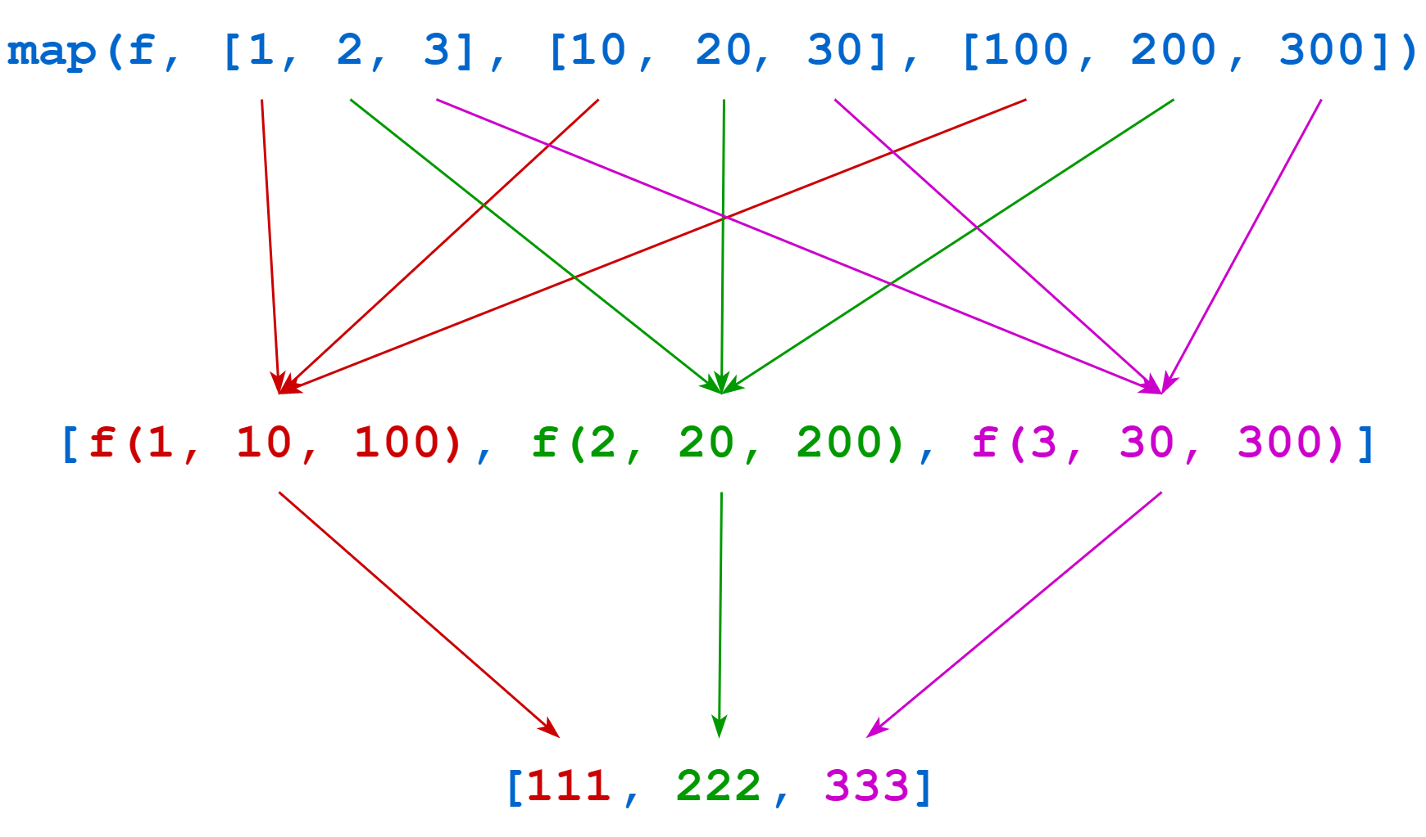
Calling map() With Multiple Iterables - There’s another form of map() that takes more than one iterable argument:
Syntax : map(<f>, <iterable₁>, <iterable₂>, ..., <iterableₙ>)
>>> def f(a, b, c):
... return a + b + c
...
>>>print( list(map(f, [1, 2, 3], [10, 20, 30], [100, 200, 300])))
[111, 222, 333]
Again in this case, since f() is so short, you could readily replace it with a lambda function instead:
>>> list(
... map(
... (lambda a, b, c: a + b + c),
... [1, 2, 3],
... [10, 20, 30],
... [100, 200, 300]
... )
... )

Slide 44
Lambda with map()
#Example:
#lambda with map() function
l1=[1,2,3,4,5,6,7,8]
#double the value
final_list=map(lambda x : x*2, l1)
print(list(final_list))
#Example:
my_list1=[2,5,8,10,9,3]
my_list2=[1,4,7,8,5,1]
a=map(lambda x , y : x+y, my_list1, my_list2)
print(list(b))

Slide 45
Reducing an Iterable to a Single Value With reduce()
reduce() applies a function to the items in an iterable two at a time, progressively combining them to produce a single result.
reduce() is no longer a built-in function, but it’s available for import from a standard library module.
To use reduce(), you need to import it from a module called’ functools’.
from functools import reduce
//Example:
>>> def addnum(x, y):
... return x + y
...
>>> from functools import reduce
>>> print(reduce(addnum, [1, 2, 3, 4, 5]))
15
>>> reduce(f, ["cat", "dog", "hedgehog", "gecko"])
'catdoghedgehoggecko'

Slide 46
Example – reduce()
>>numlist = [1,2,3,4]
>>num=0
>>for i in numlist:
num = num + i
>>print(num) # 10
#OR
>>from functools import reduce
>>numlist = [1,2,3,4]
>>result = reduce(lambda x,y : x + y , numlist) # 10

Slide 47
Lambda with reduce()
#Example:
from functools import reduce #--when we want final(consolidated) result
l1=[1,2,3,4,5,6,7,8]
sum=reduce(lambda x,y: x+y,l1)
print(sum)
>>> def multiply(x, y):
... return x * y
...
>>> def factorial(n):
... from functools import reduce
... return reduce(multiply, range(1, n + 1))
...
>>> factorial(4) # 1 * 2 * 3 * 4
24
>>> factorial(6) # 1 * 2 * 3 * 4 * 5 * 6
720
There’s a more straightforward way to do this. You can use factorial() provided by the standard math module:
>>> from math import factorial
>>> factorial(4)
24
>>> factorial(6)
720

Slide 48
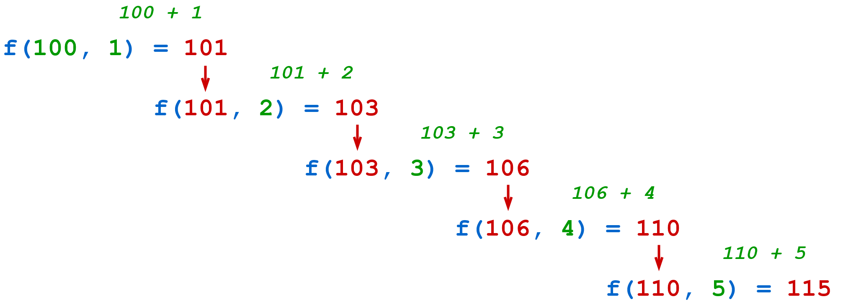
Calling reduce() With an Initial Value
There’s another way to call reduce() that specifies an initial value for the reduction sequence:
Syntax : reduce(<f>, <iterable>, <init>)
//Example:
>>> def f(x, y):
... return x + y
...
>>> from functools import reduce
>>> reduce(f, [1, 2, 3, 4, 5], 100) # (100 + 1 + 2 + 3 + 4 + 5)
115
>>> # Using lambda:
>>> reduce(lambda x, y: x + y, [1, 2, 3, 4, 5], 100)
115

Slide 49
Example:
//To find the maximum value in a list. Python provides the built-in function max()
import functools
#or
From functools import reduce
import operator as o
li=[5,8,10,20,50,100]
sum=f.reduce(o.add,li)
print(sum)
>>> max([23, 49, 6, 32])
49
//Alternatively, you could use reduce() as well:
>>> def greater(x, y):
... return x if x > y else y
...
>>> from functools import reduce
>>> reduce(greater, [23, 49, 6, 32])
49

Slide 50
You could have also used a lambda function instead:
>>> reduce(lambda x, y: x + y, [1, 2, 3, 4, 5])
15
>>> reduce(lambda x, y: x + y, ["foo", "bar", "baz", "quz"])
'foobarbazquz'
>>> def factorial(n):
... from functools import reduce
... return reduce(lambda x, y: x * y, range(1, n + 1))
...
>>> factorial(4)
24
>>> factorial(6)
720
>>> reduce((lambda x, y: x if x > y else y), [23, 49, 6, 32])
49

Slide 51
Lambda with accumulate()
#Example:
From itertools import accumulate
import itertools as it
lis=[1,3,4,10,4]
print(‘The summation of list is :”,end=“”)
print(list(it.accumulate(lis, lambda x,y : x+y)))
Output: The summation of list is: [1,4,8,18,22]
print(list(i.accumulate(lis, lambda x,y : x*y)))
Output: [1,3,12,120,480]

Slide 52
Enumerate function in Python
>>l1=[“Bhindi”,”Aloo”,”Chopsticks”,”chowmein”]
>>i=1
>>for item in l1:
if i%2 is not 0:
print(f”Jarvis Please buy {item}”)
i+=1 #i=i+1
//To shorten this code, we use enumerate function:
>> l1=[“Bhindi”,”Aloo”,”Chopsticks”,”chowmein”]
>>for index, item in enumerate(l1):
if index%2==0:
print(f”Jarvis Please buy {item}”)

Slide 53
Join Function in Python
>>lis=[“John”,”Cena”,”Randy”,”Orton”,”Khali”]
>>for item in lis:
print(item ,”and”, end=“ “)
#Now using join function:
>>lis=[“John”,”Cena”,”Randy”,”Orton”,”Khali”]
>>a=“and”.join(lis)
>>print(a, “other wwe superstars”)

