Slide 1
Agenda
What is Python
Python History
Why Learn Python
Applications of Python
Installing Python & Python IDEs
Python data Structures
Flow control Statements
Object Oriented Programming
Inheritance, Constructors, Polymorphism, Encapsulation
Libraries such as NumPy, Pandas, Matplotlib
Creating GUIs using Tkinter
File Handling Operations in Python
Mini Project/Game

Slide 2
Python Projects
Beginner level Python Projects
Voting system
Guessing Game
Scientific Calculator
Pattern Programs in Python
Intermediate level Python Projects
Drawing with turtle in python
Web App using python Flask
Web Browser Automation Using Selenium
Advanced Level Python Projects
GUI Calculator Using tkinter
Speech Recognition and Speech to Text
Object Detection Using OpenCV

Slide 3
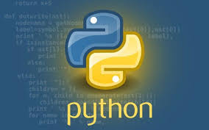
What is Python?
Multi-Paradigm Programming Language
Interpreted language
Supports dynamic datatype
Independent from platforms
Focused on development time
Simple and Easy grammar
High-Level internal object data types
Automatic memory management
Its free (open source)

Slide 4
Python History
Python born, name picked –Dec 1989
By Guido van Rossum, now at Dropbox
First public release(USENET)-Feb 1991
Python.org website-1996 or 1997
Python Software Foundation-2001
Rossum chose the name “Python”, since he was a big fan of Monty Python’s Flying Circus.

Slide 5
Why Learn Python?
Fun to use “Scripting language”
Object-oriented, imperative, functional programming and procedural styles
Highly educational
Very easy to learn (compact code syntax)
It runs on any platform.
Powerful, scalable, easy to maintain
High productivity
Lots of libraries( or module), has 1000+ libraries in python
Interactive front-end for FORTRAN/C/C++ code.
Reduce development time
Reduce Code length.
No Compilation.
Used heavily in Data Science, Machine Learning & Scientific Computing
Plenty of Job Opportunities ( Companies like Google, Facebook use it)
YouTube, Quora, SurveyMonkey, Dropbox are powered by python.

Slide 6
Where to Use Python
GUI Programming (eg: tinker)
Free and Open Source
Web Application (eg: Django, Flask,Pyramid)
Computer Software and Desktop Application
Scientific, Computing Applications
Machine Learning and Artificial Intelligence (eg: Keras,CyKitLearn)
Image Processing
Website Design
Scripting
Gaming
Education

Slide 7
Real-World Examples
1) NASA (National Aeronautics and Space Agency): One of Nasa’s Shuttle Support Contractors, United Space Alliance developed a Workflow Automation System (WAS) which is fast. Internal Resources Within critical project stated that:
“Python allows us to tackle the complexity of programs like the WAS without getting bogged down in the language”.
Nasa also published a website (https://code.nasa.gov/) where there are 400 open source projects which use python.
2) Netflix: There are various projects in Netflix which use python as follow:
Central Alert Gateway
Chaos Gorilla
Security Monkey
Chronos
Amongst all projects, Regional failover is the project they have as the system decreases outage time from 45 minutes to 7 minutes with no additional cost.
3) Instagram: Instagram also uses python extensively. They have built a photo-sharing social platform using Django which is a web framework for python. Also, they are able to successfully upgrade their framework without any technical challenges.

Slide 8
Applications of Python Programming
1) Web Development: Python offers different frameworks for web development like Django, Pyramid, Flask. This framework is known for security, flexibility, scalability.
2) Game Development: PySoy and PyGame are two python libraries that are used for game development.
3) Artificial Intelligence and Machine Learning: There is a large number of open-source libraries which can be used while developing AI/ML applications.
4) Desktop GUI: Desktop GUI offers many toolkits and frameworks using which we can build desktop applications. PyQt, PyGtk, PyGUI are some of the GUI frameworks.

Slide 9
Python 3 or Python 2 ?

Slide 10
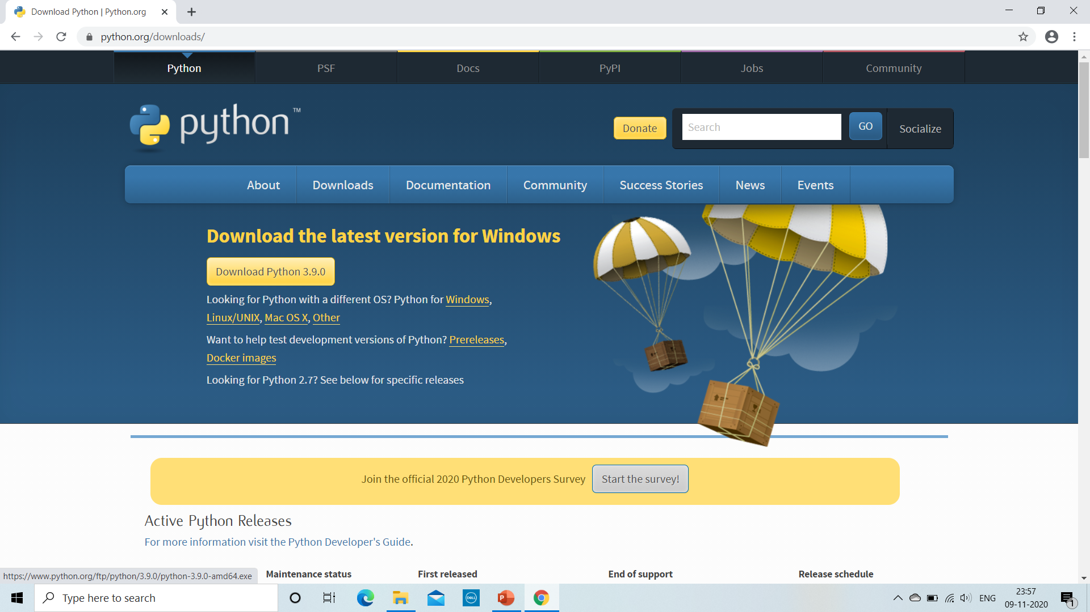
Installing Python & Python IDE
This is the site to install Python- https://www.python.org/downloads/

Slide 11
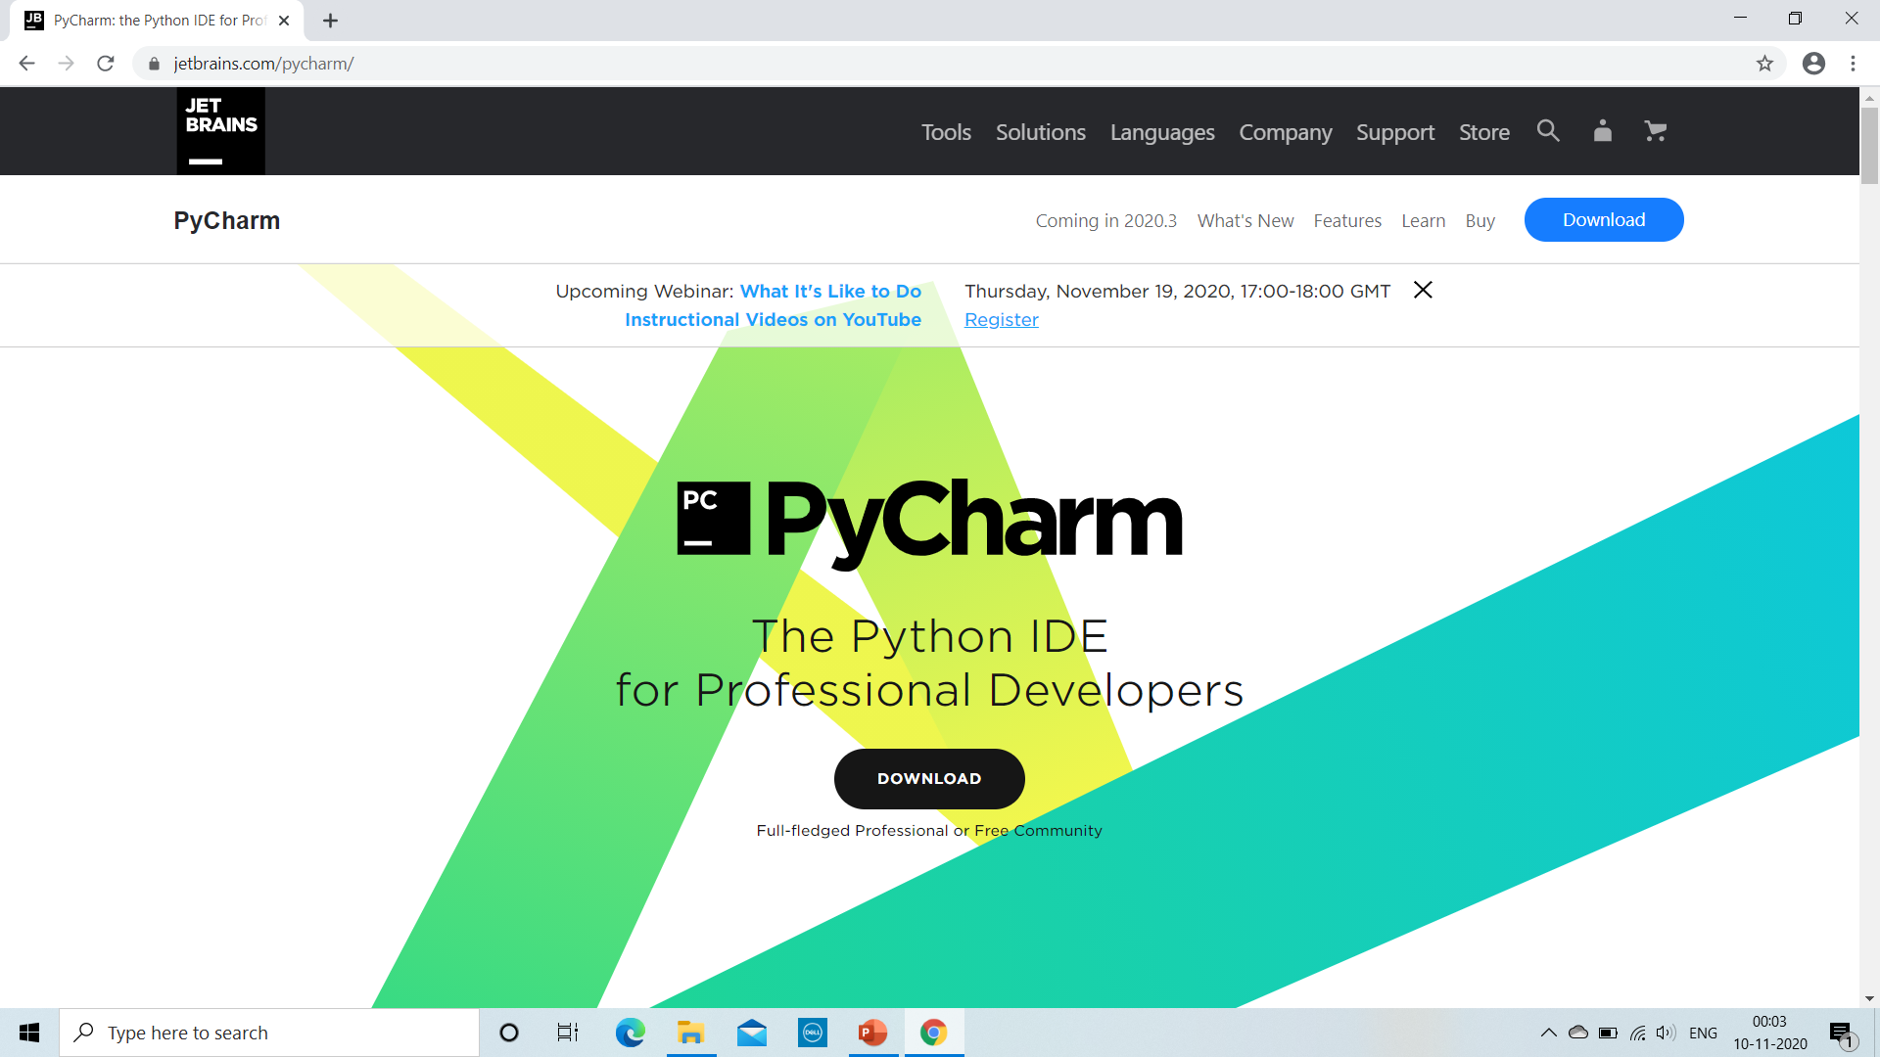
Installing PyCharm
This is the site to install PyCharm-> https://www.jetbrains.com/pycharm/

Slide 12
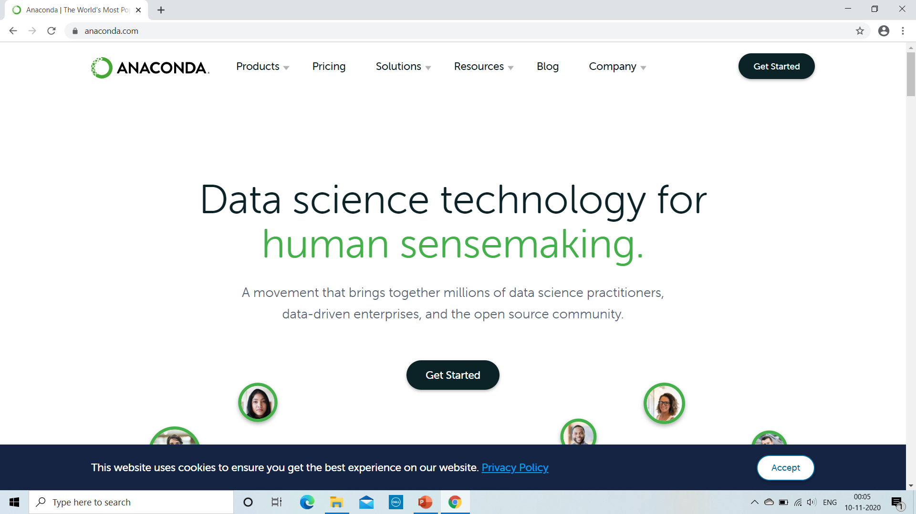
Installing Anaconda
This is the site to install Anaconda -> https://www.anaconda.com/

Slide 13
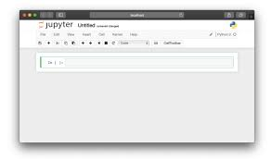
Intro to Jupyter Notebook
Jupyter Notebook is a browser-based interpreter that allows us to interactively work with Python
After installing python from python.org website, open cmd and type > python ,to verify if python installed successfully.
>exit()
To open jupyter editor, type> pip install jupyterlab and press enter.
Now to open Jupyter lab IDE hereafter, type > jupyter notebook

Slide 14
After installing Anaconda distribution, we get;
Anaconda Navigator, which is basically a GUI interface.
Anaconda Prompt, which is command prompt.
To launch Jupyter Notebook,windows user can click on launch command and similarly if you want to use Anaconda Prompt then type in prompt as:
- jupyter notebook

