Slide 1
Python with MYSQL Database

Slide 2
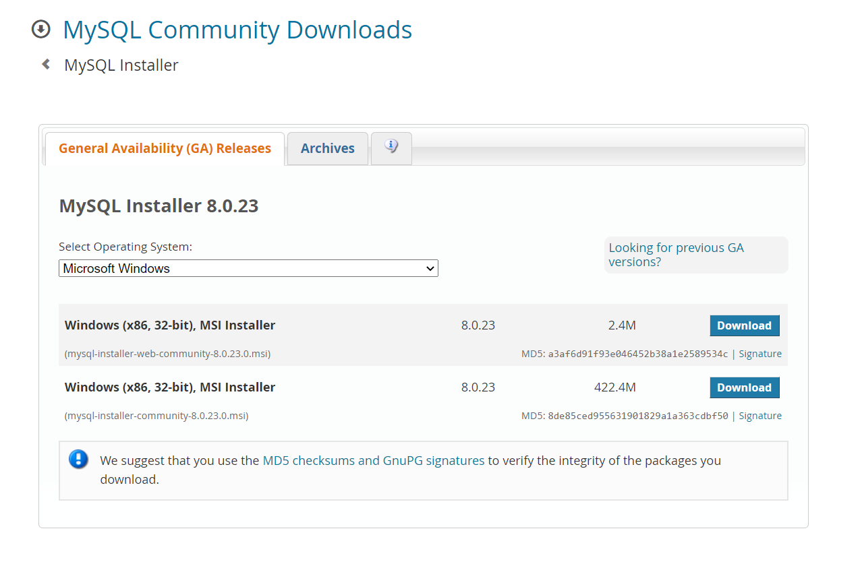
MYSQL Database
https://www.mysql.com/downloads/.

Slide 3

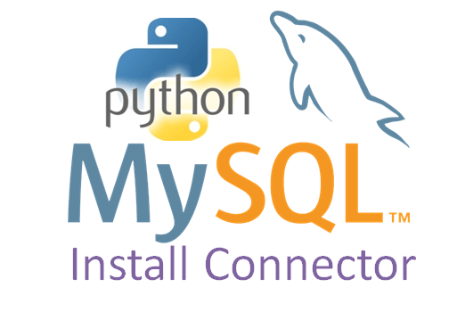
How to Connect Python With MYSQL Database
Python can be used in database applications.
One of the most popular databases is MySQL.
Python DB API
Mysql.connector.connect()
Connection request
Connection.cursor()
connected
Cursor.execute()
Python Application
Database
MYSQL Connector Python

Slide 4
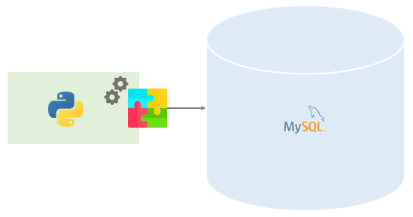
Introduction to MySQL Python connector
To access the MySQL database from Python, you need a database driver.
MySQL Connector/Python is a standardized database driver provided by MySQL.

Slide 5
Installing MySQL Connector/Python
Prerequisites
Before installing MySQL Connector/Python, you need:
Root or Administrator privileges in order to perform the installation.
Python installed on your system
Note that the MySQL Connector/Python installation requires python to be in the system’s PATH or it will fail.
Installation
The MySQL Python Connector is available on pypi.org, therefore, you can install it using the pip command.
The pip command allows you to install MySQL Python connector on any Operating system including Windows, macOS, Linux, and Unix:
pip install mysql-connector
pip install mysql-connector-python
If you found any issue while installing, you can explicitly specify the module version as follows:
pip install mysql-connector-python==8.0.17
Code language: SQL (Structured Query Language) (sql)
Note that to uninstall current MySQL Connector/Python, you use the following command:
pip uninstall mysql-connector-python
Code language: SQL (Structured Query Language) (sql)
It will prompt you for confirmation, you type y to confirm.
Proceed (y/n)? y

Slide 6
Verifying MySQL Connector/Python installation
After installing the MySQL Python connector, you need to test it to make sure that it is working correctly and you are able to connect to the MySQL database server without any issues.
To verify the installation, you use the following steps:
Open Python command line
Type the following code
>>> import mysql.connector
>>>mydb=mysql.connector.connect(host='localhost’,port=‘no’,database='mysql',user='root',password='your pass’)
>>print(mydb)
>>print(“Good Evening”)
If you see the following output, it means that you have been successfully installing the MySQL Connector/Python on your system.
PS D:\Python_Tutorial\Python_Programs-Solutions> python main.py
Good Evening
<mysql.connector.connection.MySQLConnection object at 0x000001ED5CEAA310>

Slide 7
Python MySQL – Connect to a MySQL Database in Python
To create a database in MySQL, use the "CREATE DATABASE" statement:
//Check if Database Exists
import mysql.connector mydb = mysql.connector.connect( host="localhost", user="yourusername", password="yourpassword" ) mycursor = mydb.cursor() mycursor.execute("CREATE DATABASE mydatabase")
import mysql.connector mydb = mysql.connector.connect( host="localhost", user="yourusername", password="yourpassword" ) mycursor = mydb.cursor() mycursor.execute("SHOW DATABASES") for x in mycursor: print(x)
import mysql.connector mydb = mysql.connector.connect( host="localhost", user="yourusername", password="yourpassword", database="mydatabase" )

Slide 8
Python MYSQL Create Table
To create a table in MySQL, use the "CREATE TABLE" statement.
import mysql.connector as connector
print ("Good Evening")
class DBHelper:
#create constructor
def __init__(self):
self.con=connector.connect(host='localhost',port='3306', user='root', password='Hrutu_26', database='pythontest')
query='Create Table if not exists User(userID int primary key, userName varchar(200), phone varchar(12))'
cur=self.con.cursor()
cur.execute(query)
print("Table created !!")
#Instantiate Object
helper=DBHelper()
Output:
Table created !!

Slide 9
Python MYSQL Insert Into Table
To fill a table in MySQL, use the "INSERT INTO" statement.
import mysql.connector as connector
class DBHelper:
#create constructor
def __init__(self):
#Code for connection to DB and Creation of table
self.con=connector.connect(host='localhost',port='3306', user='root', password='Hrutu_26', database='pythontest')
#print("Table created !!")
#insert
def insert_user(self,userid,username,phone):
query="insert into User(userID,userName,phone) values({},'{}','{}')".format(userid,username,phone)
print(query)
cur=self.con.cursor()
cur.execute(query)
self.con.commit()
print("User Saved to DB!!")
#Instantiate Object
helper=DBHelper()
helper.insert_user(104,'Guida Rossum','987875675')
Output:
insert into User(userID,userName,phone) values(101,'Simon DSouza','23445566')
User Saved to DB!!

Slide 10
Python MYSQL Select From
To select from a table in MySQL, use the "SELECT" statement.
import mysql.connector as connector
class DBHelper:
#create constructor
def __init__(self):
#Code for connection to DB and Creation of table
print("Table created !!")
#insert
def insert_user(self,userid,username,phone):
#Code for insert query
print("User Saved to DB!!")
#Fetch All records from DB
def fetch_all(self):
query ="Select * from User"
cur=self.con.cursor()
cur.execute(query)
#loop all records
for row in cur:
print("UserID :" ,row[0])
print("UserName :",row[1])
print("Phone No:",row[2])
print()
#Instantiate Object
helper=DBHelper()
helper.fetch_all()
Output:
UserID : 101
UserName : Simon DSouza
Phone No: 23445566
UserID : 102
UserName : Max Well
Phone No: 1267867867

Slide 11
Alternatively, To Select all records from the “User" table, Using fetchall() method and display the result.
import mysql.connector as connector
class DBHelper:
#create constructor
def __init__(self):
#Code for connection to DB and Creation of table
print("Table created !!")
#insert
def insert_user(self,userid,username,phone):
#Code for insert query
print("User Saved to DB!!")
#Fetch All records from DB
def fetch_all(self):
query ="Select * from User"
cur=self.con.cursor()
cur.execute(query)
rows=cur.fetchall()
#loop all records
for row in rows:
print("UserID :" ,row[0])
print("UserName :",row[1])
print("Phone No:",row[2])
print()
#Instantiate Object
helper=DBHelper()
helper.fetch_all()
Output:
UserID : 101
UserName : Simon DSouza
Phone No: 23445566
UserID : 102
UserName : Max Well
Phone No: 1267867867

Slide 12
Alternatively, If you are only interested in one row, you can use the fetchone() method.
The fetchone() method will return the first row of the result
import mysql.connector as connector
class DBHelper:
#create constructor
def __init__(self):
#Code for connection to DB and Creation of table
print("Table created !!")
#insert
def insert_user(self,userid,username,phone):
#Code for insert query
print("User Saved to DB!!")
#Fetch All records from DB
def fetch_all(self):
#Code to fetch all records
#fetch one record from DB
def fetch_one(self):
query ="Select * from User"
cur=self.con.cursor()
cur.execute(query)
row=cur.fetchone()
print(row)
#Instantiate Object
helper=DBHelper()
helper.fetch_one()
Output:
UserID : 101
UserName : Simon DSouza
Phone No: 23445566

Slide 13
Python MYSQL Delete From Table
You can delete records from an existing table by using the "DELETE FROM" statement.
import mysql.connector as connector
class DBHelper:
#create constructor
def __init__(self):
#Code for connection to DB and Creation of table
print("Table created !!")
#insert
def insert_user(self,userid,username,phone):
#Code for insert query
print("User Saved to DB!!")
#Fetch All records from DB
def fetch_all(self):
#Code to fetch all records
#fetch one record from DB
def fetch_one(self):
#code to fetch one record
#To delete record
def delete_user(self,userid):
query="Delete From User Where userID={}".format(userid)
print(query)
cur=self.con.cursor()
cur.execute(query)
self.con.commit()
print("Record Deleted !!")
#Instantiate Object
helper=DBHelper()
helper.delete_user(102)
helper.fetch_all()
Output:
Record Deleted !!
UserID : 101
UserName : Simon DSouza
Phone No: 23445566
UserID : 103
UserName : James Gosling
Phone No: 867675675

Slide 14
Python MYSQL Update Table
You can update existing records in a table by using the "UPDATE" statement.
import mysql.connector as connector
class DBHelper:
#create constructor
def __init__(self):
#Code for connection to DB and Creation of table
print("Table created !!")
#insert
def insert_user(self,userid,username,phone):
#Code for insert query
print("User Saved to DB!!")
#Fetch All records from DB
def fetch_all(self):
#Code to fetch all records
#fetch one record from DB
def fetch_one(self):
#code to fetch one record
#To delete record
def delete_user(self,userid):
#Code to delete record
#Update
def update_user(self,userid, newName, newPhone):
query="Update User Set userName='{}',phone='{}' where userID={}".format(newName,newPhone,userid)
print(query)
cur=self.con.cursor()
cur.execute(query)
self.con.commit()
print("Updated Succesfully!!")
#Instantiate Object
helper=DBHelper()
helper.update_user(104,'Hrutika','7972496401')
helper.fetch_all()
Output:
Updated Succesfully!!UserID : 101

