Slide 1
Python Machine Learning

Slide 2
Machine Learning
Machine Learning is making the computer learn from studying data and statistics.
Machine Learning is a step into the direction of artificial intelligence (AI).
Machine Learning is a program that analyses data and learns to predict the outcome.

Slide 3
Data Set
In the mind of a computer, a data set is any collection of data. It can be anything from an array to a complete database.
Example of an array:
[99,86,87,88,111,86,103,87,94,78,77,85,86]
Example of a database:
Carname | Color | Age | Speed | AutoPass
BMW | red | 5 | 99 | Y
Volvo | white | 7 | 86 | Y
VW | gray | 8 | 87 | N
VW | white | 7 | 88 | Y
By looking at the array, we can guess that the average value is probably around 80 or 90,
and we are also able to determine the highest value and the lowest value, but what else can we do?
And by looking at the database we can see that the most popular color is white, and the oldest car is 17 years,
but what if we could predict if a car had an AutoPass, just by looking at the other values?
That is what Machine Learning is for! Analyzing data and predicting the outcome!

Slide 4
Data Types
To analyze data, it is important to know what type of data we are dealing with.
We can split the data types into three main categories:
Numerical
Categorical
Ordinal
Numerical data are numbers, and can be split into two numerical categories:
Discrete Data - numbers that are limited to integers. Example: The number of cars passing by.
Continuous Data - numbers that are of infinite value. Example: The price of an item, or the size of an item
Categorical data are values that cannot be measured up against each other. Example: a color value, or any yes/no values.
Ordinal data are like categorical data, but can be measured up against each other. Example: school grades where A is better than B and so on.
By knowing the data type of your data source, you will be able to know what technique to use when analyzing them.

Slide 5
Mean , Median & Mode
In Machine Learning (and in mathematics) there are often three values that interests us:
Mean - The average value
Median - The mid point value
Mode - The most common value
Example: We have registered the speed of 13 cars:
speed = [99,86,87,88,111,86,103,87,94,78,77,85,86]
What is the average, the middle, or the most common speed value?

Slide 6
Mean
The mean value is the average value.
To calculate the mean, find the sum of all values, and divide the sum by the number of values:
(99+86+87+88+111+86+103+87+94+78+77+85+86) / 13 = 89.77
//Example
-Use the NumPy mean() method to find the average speed:
import numpy
speed = [99,86,87,88,111,86,103,87,94,78,77,85,86]
x = numpy.mean(speed)
print(x)

Slide 7
Median
The median value is the value in the middle, after you have sorted all the values:
77, 78, 85, 86, 86, 86, 87, 87, 88, 94, 99, 103, 111
It is important that the numbers are sorted before you can find the median.
If there are two numbers in the middle, divide the sum of those numbers by two.
The NumPy module has a method for this:
//Example
Use the NumPy median() method to find the middle value:
import numpy
speed = [99,86,87,88,111,86,103,87,94,78,77,85,86]
x = numpy.median(speed)
print(x)

Slide 8
Mode
The Mode value is the value that appears the most number of times:
99, 86, 87, 88, 111, 86, 103, 87, 94, 78, 77, 85, 86 = 86
Use the SciPy mode() method to find the number that appears the most:
Example:
from scipy import stats speed = [99,86,87,88,111,86,103,87,94,78,77,85,86] x = stats.mode(speed) print(x)

Slide 9
Machine Learning - Standard Deviation
What is Standard Deviation?
Standard deviation is a number that describes how spread out the values are.
A low standard deviation means that most of the numbers are close to the mean (average) value.
A high standard deviation means that the values are spread out over a wider range.
Example: This time we have registered the speed of 7 cars:
speed = [86,87,88,86,87,85,86]
The standard deviation is:
0.9
speed = [32,111,138,28,59,77,97]
The standard deviation is:
37.85

Slide 10
The NumPy module has a method to calculate the standard deviation:
Example
-Use the NumPy std() method to find the standard deviation:
import numpy
speed = [86,87,88,86,87,85,86]
x = numpy.std(speed)
print(x)

Slide 11
Variance
Variance is another number that indicates how spread out the values are.
In fact, if you take the square root of the variance, you get the standard deviation!
Or the other way around, if you multiply the standard deviation by itself, you get the variance!
Example
-Use the NumPy var() method to find the variance:
import numpy
speed = [32,111,138,28,59,77,97]
x = numpy.var(speed)
print(x)

Slide 12
Machine Learning - Percentiles
What are Percentiles?
Percentiles are used in statistics to give you a number that describes the value that a given percent of the values are lower than.
Example: Let's say we have an array of the ages of all the people that lives in a street.
ages = [5,31,43,48,50,41,7,11,15,39,80,82,32,2,8,6,25,36,27,61,31]
What is the 75. percentile? The answer is 43, meaning that 75% of the people are 43 or younger.
The NumPy module has a method for finding the specified percentile:
Example
Use the NumPy percentile() method to find the percentiles:
import numpy
ages = [5,31,43,48,50,41,7,11,15,39,80,82,32,2,8,6,25,36,27,61,31]
x = numpy.percentile(ages, 75)
print(x)

Slide 13
How to Calculate Percentile?
Step 1: Assigning Values: Let us consider a data set with 25 values as given below. We are required to find the 90th percentile of the data set. Data Set = 3, 67, 34, 89, 56, 23, 90, 67, 104, 29, 38, 46, 65, 62, 87, 86, 49, 50, 58, 72, 83, 16, 19, 48, 88 N = 25
Step 2: Ordering Data Set Arrange the numbers in the data set in ascending order. Data Set (Ordered) = 3, 16, 19, 23, 29, 34, 38, 46, 48, 49, 50, 56, 58, 62, 65, 67, 67, 72, 83, 86, 87, 88, 89, 90, 104
Step 3: Finding Index Number: Index Number (I) = 90% x 25 = 0.90 x 25 = 22.5 = 23 (Rounded Off)
Step 4: Percentile Calculation 90th Percentile = Value corresponding to the Index Number (23) = Value at 23rd place in data set = 89

Slide 14
Machine Learning – Data Distribution
Earlier in this Session we have worked with very small amounts of data in our examples, just to understand the different concepts.
In the real world, the data sets are much bigger, but it can be difficult to gather real world data, at least at an early stage of a project.
How Can we Get Big Data Sets?
To create big data sets for testing, we use the Python module NumPy, which comes with a number of methods to create random data sets, of any size.
Example
Create an array containing 250 random floats between 0 and 5:
import numpy x = numpy.random.uniform(0.0, 5.0, 250) print(x)

Slide 15
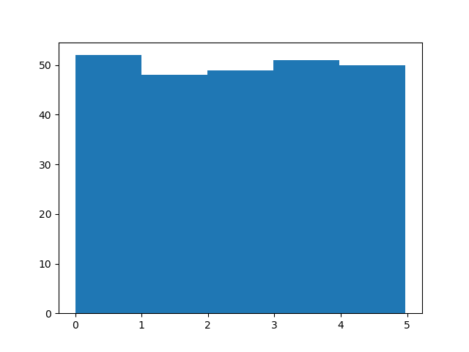
Histogram
To visualize the data set we can draw a histogram with the data we collected.
We will use the Python module Matplotlib to draw a histogram.
Example - Draw a histogram:
import numpy import matplotlib.pyplot as plt x = numpy.random.uniform(0.0, 5.0, 250) plt.hist(x, 5) plt.show()

Slide 16
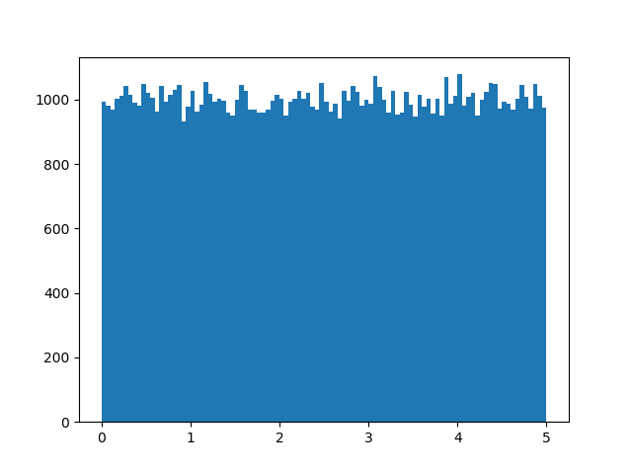
Big Data Distribution
An array containing 250 values is not considered very big, but now you know how to create a random set of values, and by changing the parameters, you can create the data set as big as you want.
Example
Create an array with 100000 random numbers, and display them using a histogram with 100 bars:
import numpy import matplotlib.pyplot as plt x = numpy.random.uniform(0.0, 5.0, 100000) plt.hist(x, 100) plt.show()

Slide 17
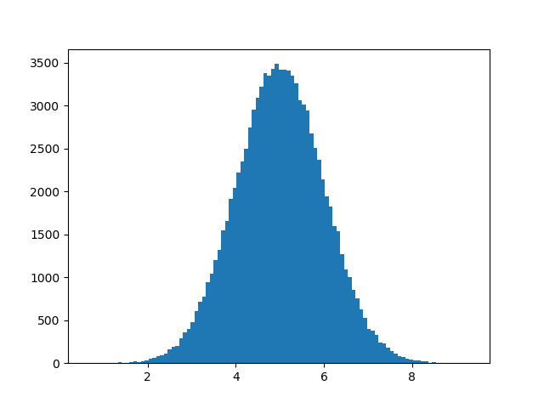
Normal Data Distribution
In the previous session we learned how to create a completely random array, of a given size, and between two given values.
In this session, we will learn how to create an array where the values are concentrated around a given value.
In probability theory this kind of data distribution is known as the normal data distribution, or the Gaussian data distribution, after the mathematician Carl Friedrich Gauss who came up with the formula of this data distribution.
Example
A typical normal data distribution:
import numpy import matplotlib.pyplot as plt x = numpy.random.normal(5.0, 1.0, 100000) plt.hist(x, 100) plt.show()

Slide 18
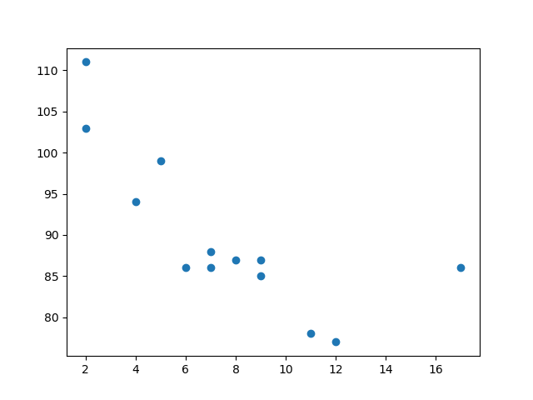
Machine Learning – Scatter Plot
A scatter plot is a diagram where each value in the data set is represented by a dot.
The Matplotlib module has a method for drawing scatter plots, it needs two arrays of the same length, one for the values of the x-axis, and one for the values of the y-axis.
Example
Use the scatter() method to draw a scatter plot diagram:
import matplotlib.pyplot as plt
x = [5,7,8,7,2,17,2,9,4,11,12,9,6]
y = [99,86,87,88,111,86,103,87,94,78,77,85,86]
plt.scatter(x, y)
plt.show()
The x-axis represents ages, and the y-axis represents speeds.
the two fastest cars were both 2 years old, and the slowest car was 12 years old.

Slide 19
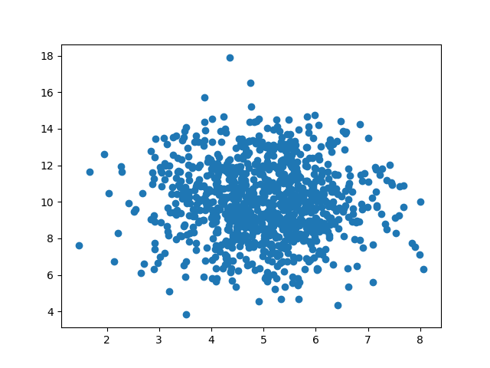
Random Data Distributions
In Machine Learning the data sets can contain thousands-, or even millions, of values.
You might not have real world data when you are testing an algorithm, you might have to use randomly generated values.
Let us create two arrays that are both filled with 1000 random numbers from a normal data distribution.
Example - A scatter plot with 1000 dots:
import numpy import matplotlib.pyplot as plt x = numpy.random.normal(5.0, 1.0, 1000) y = numpy.random.normal(10.0, 2.0, 1000) plt.scatter(x, y) plt.show()

Slide 20
What is Regression?
Regression is a key concept in the world of Machine Learning.
Regression is a method of modelling a target value based on independent predictors.
It is a statistical tool that is used to plot a relationship between two variables.
The two variables are independent variance and a dependent variable.
Very popular in the usage to determine cause-effect relationship.
In Machine Learning, and in statistical modeling, that relationship is used to predict the outcome of future events.

Slide 21
Why is Regression needed ?
Very important points:
Regression is done when dependent variable is continuous in nature.
And, independence variable can be continuous or categorical.
The goal is to find the best fit line to showcase relationship.
Mapping the relationship
y = f(x) showcases the relationship in regression.
Here, x is the independent variable and y is the dependent variable.

Slide 22
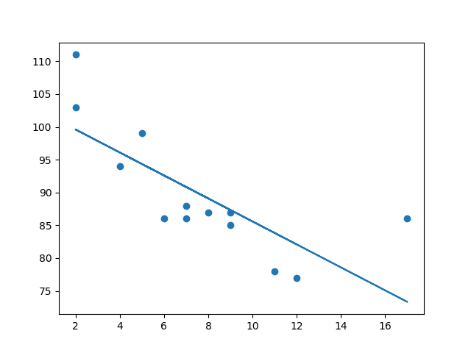
What is Linear Regression?
Linear regression uses the relationship between the data-points to draw a straight line through all them.
This line can be used to predict future values.
Consider, a single independent variable:
Y =mx + c is the equation for a linear line where ‘m’ is the slope and ‘c’ is the intercept.
With Linear Regression, we are actually trying to predict the best ‘m’ and ‘c’ values for dependent variable ‘Y’ and independent variable ‘x’.
Multiple Independent variables
Now the equation changes to this:
Y = (m1x1) +(m2x2) +….+(mnxn) + c
The above equation is not a line but a plane of multi-dimensions.

Slide 23
Example
Import scipy and draw the line of Linear Regression:
import matplotlib.pyplot as plt
from scipy import stats
x = [5,7,8,7,2,17,2,9,4,11,12,9,6]
y = [99,86,87,88,111,86,103,87,94,78,77,85,86]
slope, intercept, r, p, std_err = stats.linregress(x, y)
def myfunc(x):
return slope * x + intercept
mymodel = list(map(myfunc, x))
plt.scatter(x, y)
plt.plot(x, mymodel)
plt.show()

Slide 24
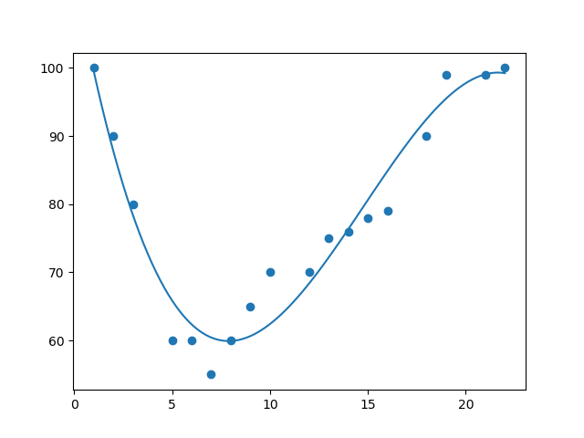
What is Polynomial Regression?
If your data points clearly will not fit a linear regression (a straight line through all data points), it might be ideal for polynomial regression.
Polynomial regression, like linear regression, uses the relationship between the variables x and y to find the best way to draw a line through the data points.

Slide 25
Example
In the example below, we have registered 18 cars as they were passing a certain tollbooth.
The x-axis represents the hours of the day and the y-axis represents the speed:
import numpy import matplotlib.pyplot as plt x = [1,2,3,5,6,7,8,9,10,12,13,14,15,16,18,19,21,22] y = [100,90,80,60,60,55,60,65,70,70,75,76,78,79,90,99,99,100] mymodel = numpy.poly1d(numpy.polyfit(x, y, 3)) myline = numpy.linspace(1, 22, 100) plt.scatter(x, y) plt.plot(myline, mymodel(myline)) plt.show()

Slide 26
Multiple Regression
Multiple regression is like linear regression, but with more than one independent value, meaning that we try to predict a value based on two or more variables.
Consider, We can predict the CO2 emission of a car based on the size of the engine, but with multiple regression we can throw in more variables, like the weight of the car, to make the prediction more accurate.
import pandas from sklearn import linear_model df = pandas.read_csv("cars.csv") X = df[['Weight', 'Volume']] y = df['CO2'] regr = linear_model.LinearRegression() regr.fit(X, y) #predict the CO2 emission of a car where the weight is 2300kg, and the volume is 1300cm³: predictedCO2 = regr.predict([[2300, 1300]]) print(predictedCO2)
Output:
[107.2087328]

Slide 27
Scale
When your data has different values, and even different measurement units, it can be difficult to compare them. What is kilograms compared to meters? Or altitude compared to time?
The answer to this problem is scaling. We can scale data into new values that are easier to compare. (Refer cars.csv datasets)
It can be difficult to compare the volume 1.0 with the weight 790, but if we scale them both into comparable values, we can easily see how much one value is compared to the other.
There are different methods for scaling data.
The standardization method uses this formula: z = (x - u) / s
Where z is the new value, x is the original value, u is the mean and s is the standard deviation.
If you take the weight column from the data set above, the first value is 790, and the scaled value will be:
(790 - 1292.23) / 238.74 = -2.1
If you take the volume column from the data set above, the first value is 1.0, and the scaled value will be:
(1.0 - 1.61) / 0.38 = -1.59
Now you can compare -2.1 with -1.59 instead of comparing 790 with 1.0.

Slide 28
Example
The Python sklearn module has a method called StandardScaler() which returns a Scaler object with methods for transforming data sets.
import pandas from sklearn import linear_model from sklearn.preprocessing import StandardScaler scale = StandardScaler() df = pandas.read_csv("cars2.csv") X = df[['Weight', 'Volume']] scaledX = scale.fit_transform(X) print(scaledX)
Output:
[[-2.10389253 -1.59336644]
[-0.55407235 -1.07190106]
[-1.52166278 -1.59336644]
[-1.78973979 -1.85409913]
[-0.63784641 -0.28970299]
[-1.52166278 -1.59336644]
[-0.76769621 -0.55043568]
……

