Slide 1


Python Pandas
Pandas stands for Panel Data and is the core library for data manipulation and data analysis.
It consists of single and multi-dimensional data structures for data manipulation.

Slide 2
Pandas DataStructures
Single-dimensional
Multi-dimensional
Series Object
Data Frame

Slide 3
Pandas Series Object
Series Object is one-dimensional labeled array.
import pandas as pd
s1=pd.Series([1,2,3,4,5])
print(s1)
Output:
0 1
1 2
2 3
3 4
4 5
dtype : int64
type(s1)
Output: pandas.core.series.Series

Slide 4
Changing Index
import pandas as pd
s1=pd.Series([1,2,3,4,5])
print(s1)
Output:
0 1
1 2
2 3
3 4
4 5
dtype : int64
import pandas as pd
s1=pd.Series([1,2,3,4,5],index=[‘a’,’b’,’c’,’d’,’e’])
print(s1)
Output:
a 1
b 2
c 3
d 4
e 5
dtype : int64

Slide 5
Series Object from Dictionary
You can also create a series objects from a dictionary!!
import pandas as pd
s1=pd.Series({‘a’:10,’b’:20,’c’:30})
print(s1)
Output:
a 10
b 20
c 30
dtype : int64

Slide 6
Changing index position
You can change the index positions.
import pandas as pd
s1=pd.Series ({‘a’:10,’b’:20,’c’:30}) ,index=[‘a’, ’b’, ’c’, ’d’, ’e’])
print(s1)
Output:
a 10.0
b 20.0
c 30.0
d NaN
e NaN
dtype : float64

Slide 7
Extracting Individual Elements
Extracting elements from backward
Extracting a single element
s1=pd.Series([1,2,3,4,5,6,7,8,9])
print(s1[3])
Output: 4
s1=pd.Series([1,2,3,4,5,6,7,8,9])
print(s1[-3 : ])
Output: 6 7
7 8
8 9
dtype :int64
Extracting a sequence of elements
s1=pd.Series([1,2,3,4,5,6,7,8,9])
print(s1[:3])
Output:
0 1
1 2
2 3
3 4
4 5
dtype : int64

Slide 8
Basic Math Operations on Series
Adding a scalar value
To Series Elements
Adding two Series Objects
s1=pd.Series([1,2,3,4,5,6,7,8,9])
s2=pd.Series([10,20,30,40,50,60,70,80,90])
s1+s2
Output:
0 11
22
33
44
55
66
77
88
99
Dtype :int64
s1 + 5
Output:
0 6
1 7
2 8
3 9
4 10
5 11
6 12
7 13
8 14
dtype: int64

Slide 9
Pandas Dataframe
Dataframe is a 2-dimensional labelled data structure.
A dataframe comprises of rows and columns.
Output:
Name | Marks
Bob | 76
Sam | 25
Anne | 92
0
1
2

Slide 10
Creating a DataFrame
This is how you can create a data frame
import pandas as pd
pd.DataFrame({“Name”:[“Bob”,”Sam”,”Anne”],”Marks”:[76,25,92]})
Output:
23
20
22
Age
Mexico
New Jersey
California
Name | Marks
Bob | 76
Sam | 25
Anne | 92
Address
0
1
2

Slide 11
Data Frame In-Built Functions
head()
shape
describe()
tail()

Slide 12
#Example:
import pandas as pd
data=pd.read_csv(“data.csv”) #refer python_pandas.py for data
data.head() #------prints first 5 records
data.tail() # ------prints last 5 records
data.shape #-----(no of rows,no of cols)
data.describe() #----prints mean value

Slide 13
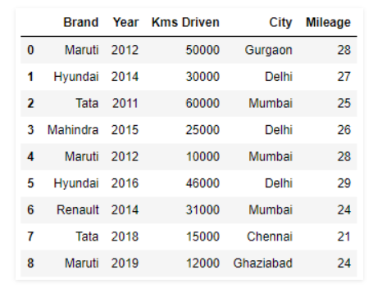
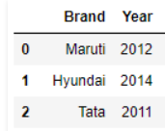
Pandas iloc and loc
.iloc[]
#selecting rows from 0 to 3 and columns from 0 to 2
data.iloc[0:3,0:2]

Slide 14
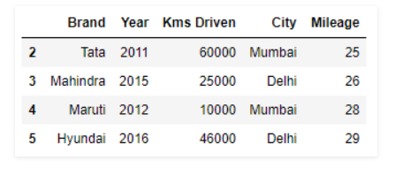
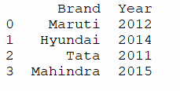
.loc[]
# selecting range of rows from 2 to 5
print(data.loc[2 : 5])
print(data.loc[0:3,("Brand","Year")])

Slide 15
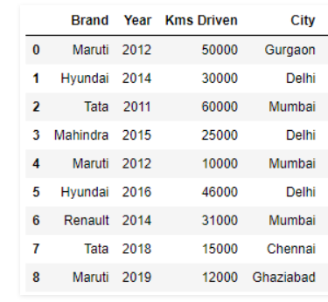
Dropping columns
data.drop(“Mileage”,axis=1)
axis=1 to drop columns

Slide 16

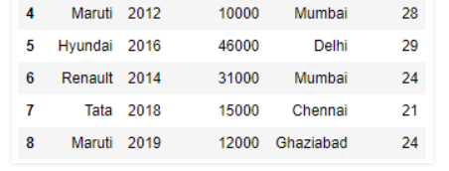
Dropping rows
data.drop([1,2,3],axis=0)
axis=0 to drop rows

Slide 17


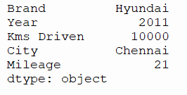
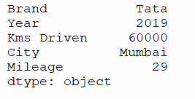
Pandas Functions
Mean
Median
print(data.mean())
Output:
print(data.median())
Output:
Minimum
Maximum
print(data.min())
Output:
print(data.max())
Output:

Slide 18
More Pandas Functions
Kms Driven Mileage
0 25000.0 14.0
1 15000.0 13.5
2 30000.0 12.5
3 12500.0 13.0
4 5000.0 14.0
5 23000.0 14.5
6 15500.0 12.0
7 7500.0 10.5
8 6000.0 12.0
def half(s):
return s* 0.5
print(data[['Kms Driven','Mileage']].apply(half))

Slide 19
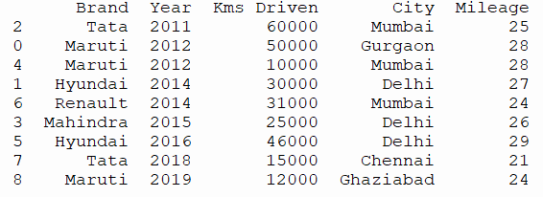
value_counts()
sort_values()
print(data['City'].value_counts())
Output:
Mumbai 3
Delhi 3
Ghaziabad 1
Gurgaon 1
Chennai 1
Name: City, dtype: int64
print(data.sort_values(by='Year’))
Output:

