Slide 1
Python Unit Testing

Slide 2
Python Testing Frameworks
Python offers 3 basic frameworks for testing the python code:
Unittest
Nose
Pytest
Among 3 pytest is the based.
>pip install pytest from windows command prompt.

Slide 3
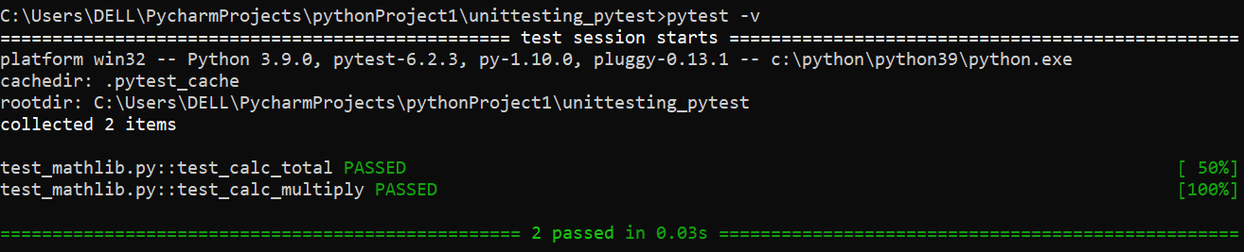
Example
Create a folder: unittesting_pytest and create two python files : mathlib.py and test_mathlib.py
//test_mathlib.py
import mathlib def test_calc_total(): total= mathlib.calc_total(4,5) assert total== 9 #this is the expected result def test_calc_multiply(): result = mathlib.calc_multiply(10,3) assert result ==30
//mathlib.py
def calc_total(a,b): return a+b def calc_multiple(a,b): return a*b
Open command prompt, go to the code directory location and type :
>python –m pytest #any file that has ‘test_’ prefix will be executed.
Another way of testing :
>py.test
>py.test –v #gives details of the two tests whether passed or failed.

Slide 4
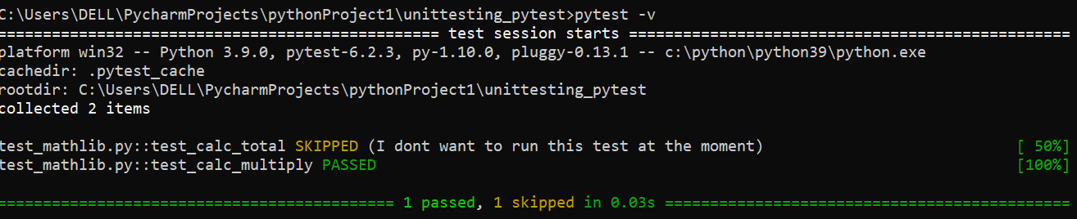
Skip Tests
Lets say due to some reason, we want to skip some tests from running,
For example :
import mathlib
import pytest
@pytest.mark.skip(reason="I dont want to run this test at the moment")
#Unit testing
def test_calc_total():
total= mathlib.calc_total(4,5)
assert total== 9 #this is the expected result
def test_calc_multiply():
result = mathlib.calc_multiply(10,3)
assert result ==30
def calc_total(a,b):
return a+b
def calc_multiply(a,b):
return a*b
//OUTPUT:

Slide 5
Now sometimes, you want to skip the test if it meets certain conditions. Use pytest decorator.
For example:
def calc_total(a,b):
return a+b
def calc_multiply(a,b):
return a*b
import mathlib
import pytest
import sys
@pytest.mark.skipif(sys.version_info <(3,5), reason="I dont want to run this test at the moment")
#Unit testing
def test_calc_total():
total= mathlib.calc_total(4,5)
assert total== 9 #this is the expected result
def test_calc_multiply():
result = mathlib.calc_multiply(10,3)
assert result ==30
Here, it will skip the test of first function only if the python version on system is less than 3.5

Slide 6
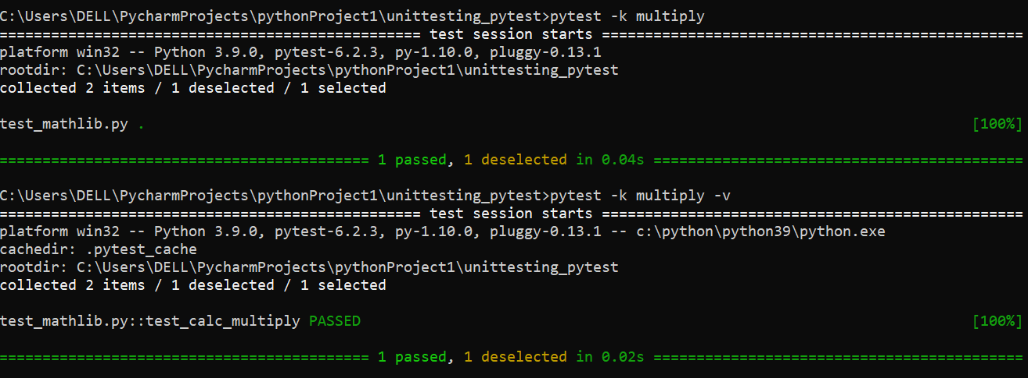
How to run the test based on Name ?
Here, it will only test for those functions which has name as ‘multiply’ within the function.

Slide 7
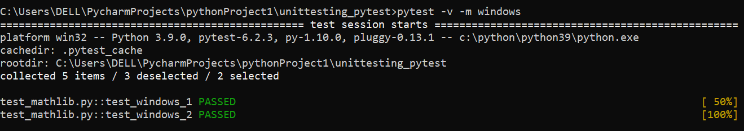
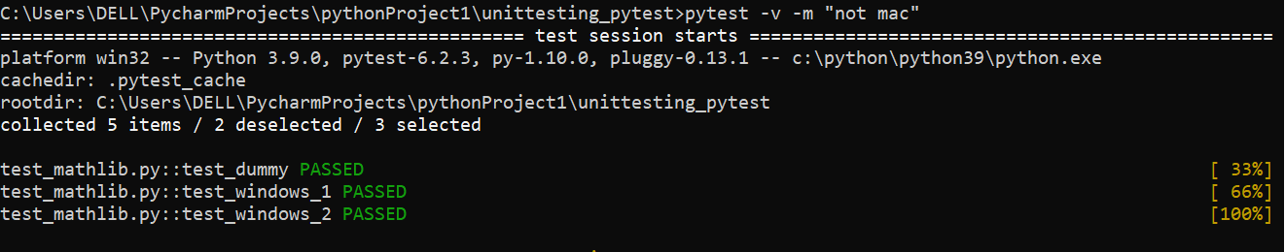
How to run test based on Category ?
Lets say we tag test using specific name or category and we run that test based on the category.
One good example would be, lets say, your software/ application is running on windows & Mac OS and you want to group your test based on the OS that your s/w running on.
In order to do that, you will use ‘custom markers’.
//test_mathlib.py
import mathlib
import pytest
@pytest.mark.windows
def test_windows_1():
assert True
@pytest.mark.windows
def test_windows_2():
assert True
@pytest.mark.mac
def test_mac_1():
assert True
@pytest.mark.mac
def test_mac_2():
assert True
//OR

Slide 8
Python Unit Testing Using pytest fixtures
import pytest
class Fruit:
def __init__(self, name):
self.name = name
def __eq__(self, other):
return self.name == other.name
@pytest.fixture
def my_fruit():
return Fruit("banana")
@pytest.fixture
def fruit_basket(my_fruit):
return [Fruit("banana"), my_fruit]
def test_my_fruit_in_basket(my_fruit, fruit_basket):
assert my_fruit in fruit_basket

Slide 9
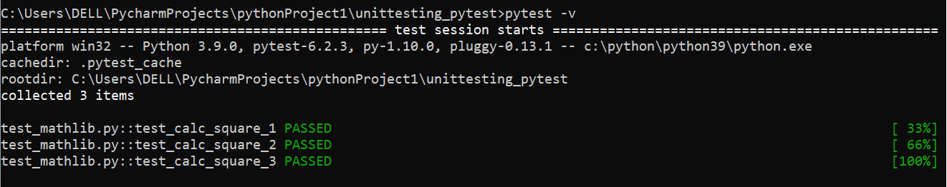
Pytest : Prameterised Test
//Example:
import mathlib
import pytest
def test_calc_square_1():
result = mathlib.calc_square(5)
assert result == 25
def test_calc_square_2():
result = mathlib.calc_square(9)
assert result == 81
def test_calc_square_3():
result = mathlib.calc_square(10)
assert result == 100
Here, there is repetition of the code into each test functions. To avoid that we use parameterized test function.

Slide 10
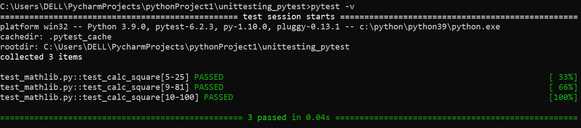
Solution
//Example:
//test_mathlib.py
import mathlib
import pytest
@pytest.mark.parametrize("test_input,expected_output",[(5,25),(9,81),(10,100)])
def test_calc_square(test_input,expected_output):
result = mathlib.calc_square(test_input)
assert result == expected_output

