Slide 1
Spark Funds Investment Case Study

Slide 2
Agenda
Business Understanding
Data Understanding
Investment type analysis
Country Analysis
Sector Analysis
Recommendations

Slide 3
Business understanding
Business objective, Approach and Constraints
Objective
The objective is to identify the best sectors, countries, and a suitable investment type for making investments
Strategy
Spark Funds wants to invest where most other investors are investing, implying that the 'best' sectors and countries are the ones 'where most investors are investing'
It wants to invest between 5 to 15 million USD per round of investment
It wants to invest only in English-speaking countries because of ease of communication
Approach
Identify the most suitable investment type
Identify the countries which have been the most heavily invested in the past in the chosen investment type
Identify the sectors which have performed best in the chosen investment type, among the top countries
Investment type analysis
Constraints
Country Analysis
Sector Analysis

Slide 4
Data (Investments during 1960-2014)
Data understanding
Investments were made in 66,368 companies across 137 countries with an average investment of 10 million USD
Investments were made in companies belonging to 687 categories which fall broadly under 8 main sectors
A total of 1,14,949 investment rounds were made over 54 years across 14 investment types

Slide 5
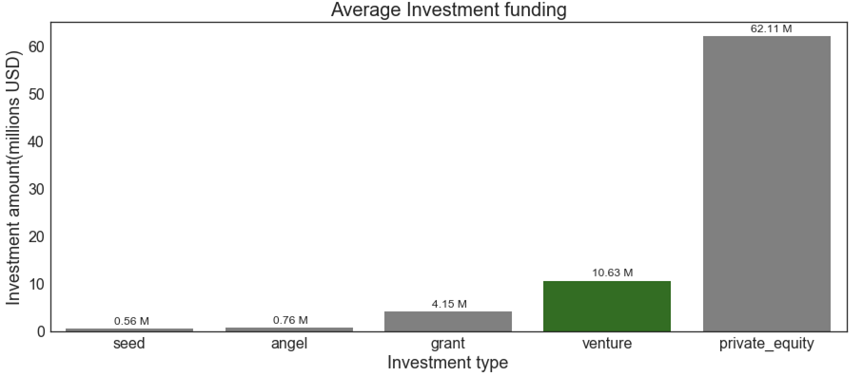
Most suitable Investment type for Spark Funds is Venture with an average investment of ~10M USD
Investment type analysis
Among 14 different investment types, venture is most suitable with average investment amount of ~10M USD

Slide 6
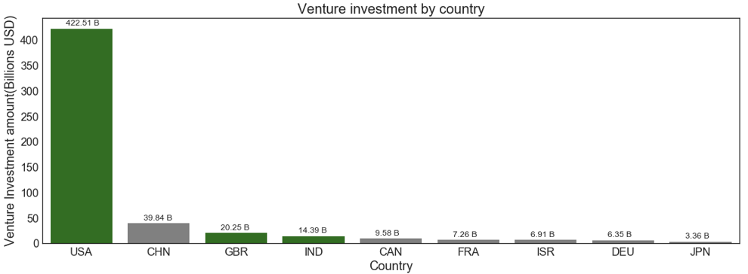
Top 3 Venture countries(English speaking) – USA, GBR, IND
Country analysis
Among 137 countries, 3 English speaking countries with highest venture investments are United States(USA), Great Britain(GBR) and India(IND)

Slide 7
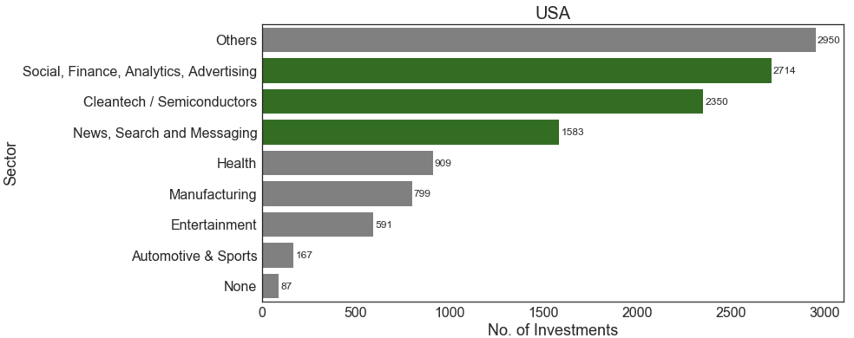
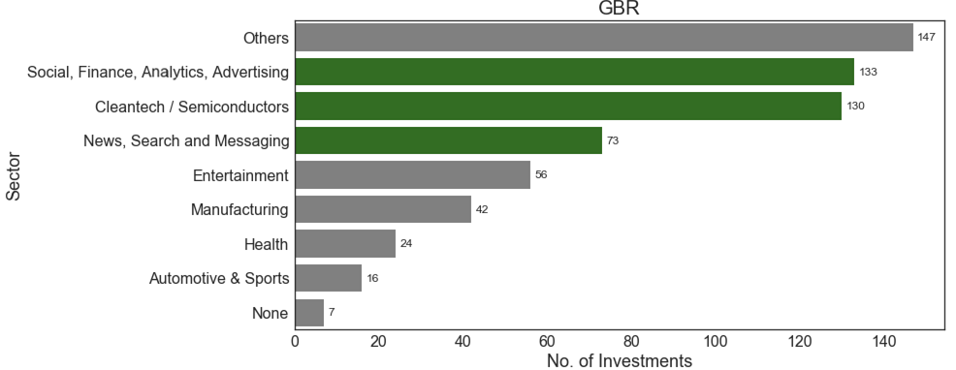
Social, Finance, Analytics, Advertising is the highly invested sector among the top countries
Sector analysis
USA
1.Social,Finance,Analytics,Advertising
2.Cleantech / Semiconductors
GBR
1.Social,Finance,Analytics,Advertising
2.Cleantech / Semiconductors

Slide 8
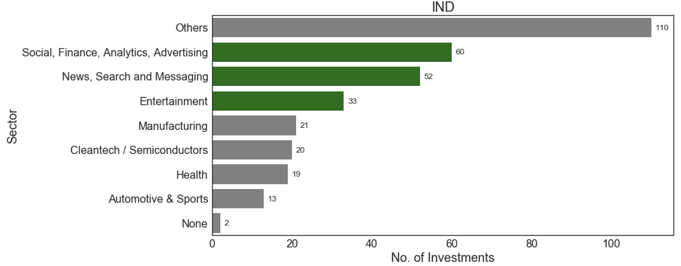
Social, Finance, Analytics, Advertising is the highly invested sector among the top countries
Sector analysis
IND
1.Social,Finance,Analytics,Advertising
2.News, Search and Messaging
**“Others” is the top most sector among top countries which has been excluded from the analysis

Slide 9
Recommendations to Spark Funds
Recommendations
Considering the constraints Spark Funds has on investment amount and ease of communication
Venture is the most suitable investment type
United States(USA), Great Britain(GBR) and India(IND) are the most heavily invested(venture) countries respectively
Best sectors for venture investments among the top countries are:
Sector | USA | GBR | IND
Best Sector | Social,Finance,Analytics,Advertising | Social,Finance,Analytics,Advertising | Social,Finance,Analytics,Advertising
2nd best sector | Cleantech / Semiconductors | Cleantech / Semiconductors | News, Search and Messaging
3rd best sector | News, Search and Messaging | News, Search and Messaging | Entertainment

Slide 10
Thank You

