Slide 1

Docker is a tool to run application in an isolated environment

Slide 2
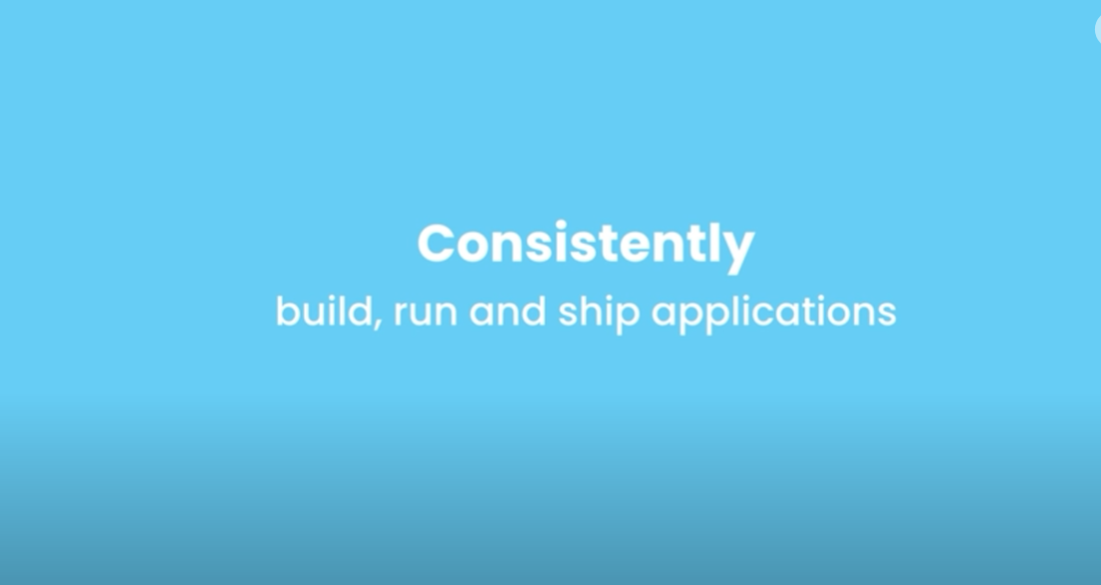
Docker helps

Slide 3
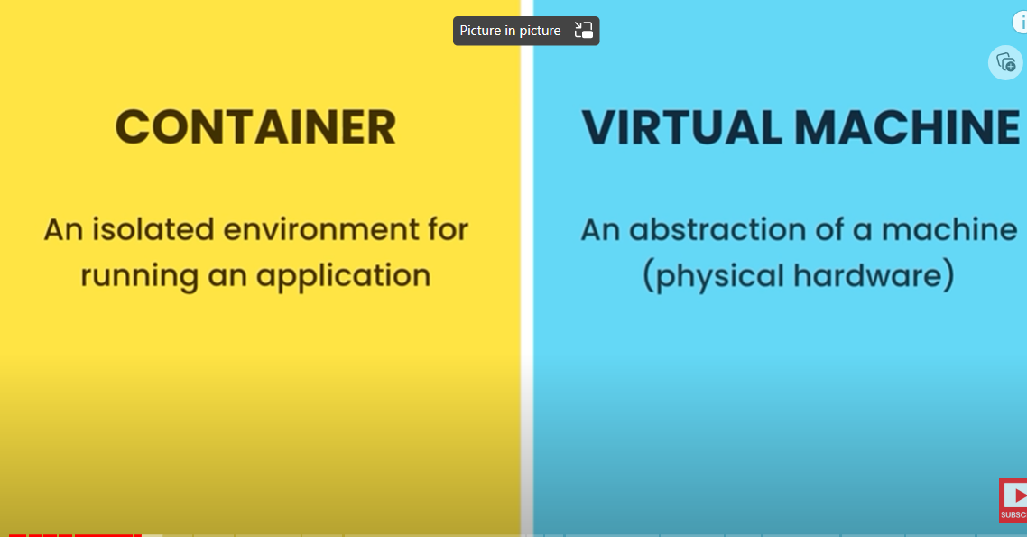

Slide 4
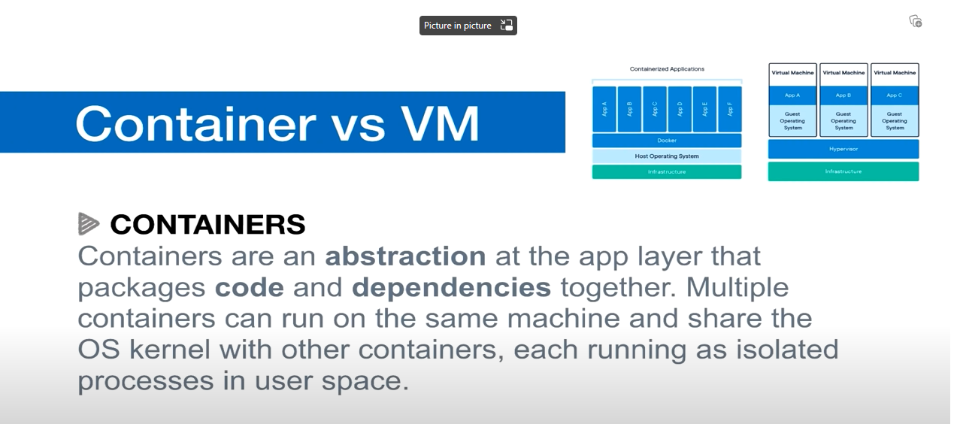

Slide 5
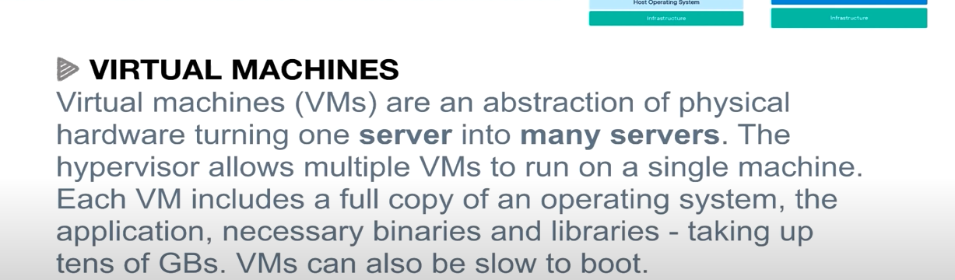

Slide 6
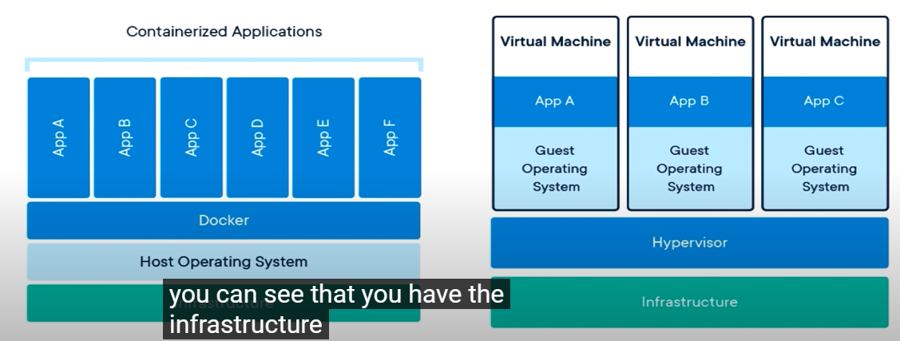

Slide 7
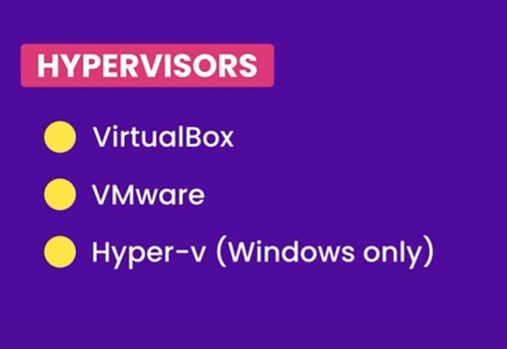

Slide 8
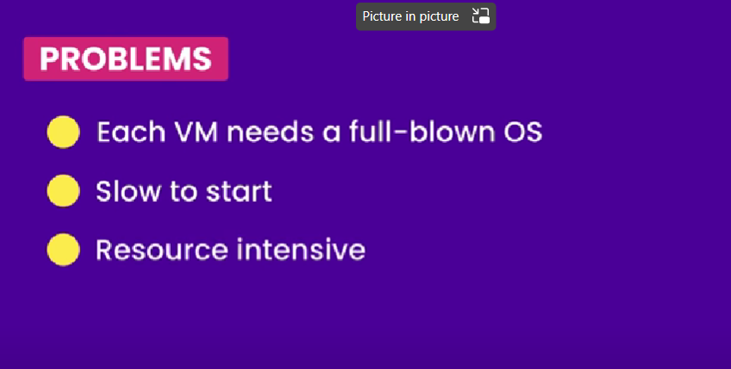
VM Problem

Slide 9
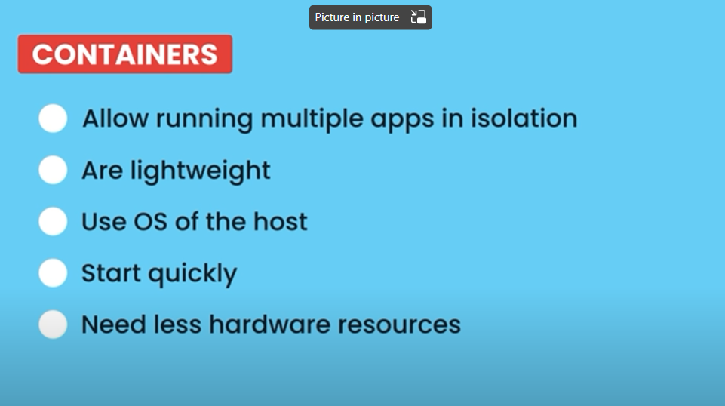
Container is special kind of process

Slide 10
Container do not contain full blown Operating system unlike VM.
All containers on host shares OS of host
All containers share kernel of the host
Kernel: Core of operating system
Kernel manages applications and hardware resources

Slide 11
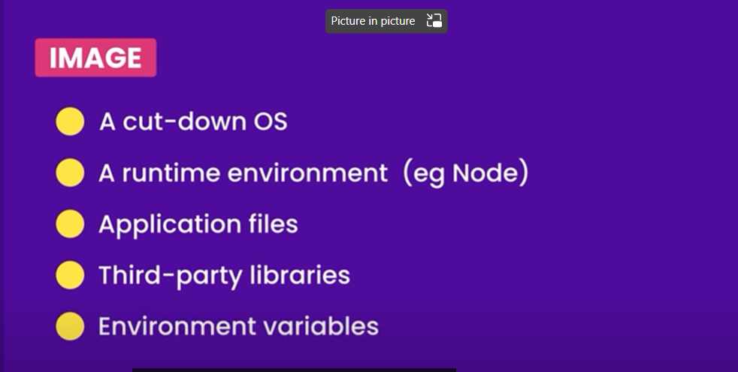
Docker image contains

Slide 12
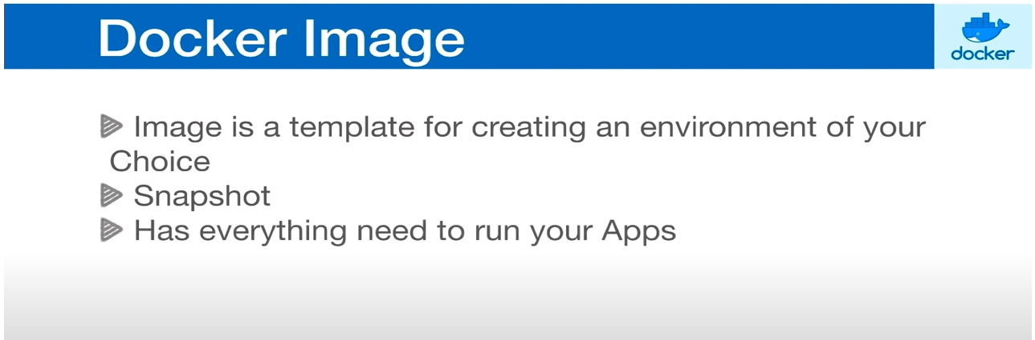

Slide 13
Docker image
Images are read-only templates containing instructions for creating a container. A Docker image creates containers to run on the Docker platform.
An image is composed of multiple stacked layers.
For example, to build a web server image, start with an image that includes Ubuntu Linux (a base OS). Then, add packages like Apache and PHP on top.
Images contain the code or binary, runtimes, dependencies, and other filesystem objects to run an application. The image relies on the host operating system (OS) kernel.

Slide 14
Docker image
You can manually build images using a Dockerfile, a text document containing all the commands to create a Docker image. You can also pull images from a central repository called a registry, or from repositories like Docker Hub using the command docker pull [name]

Slide 15
Container
A container is an isolated place where an application runs without affecting the rest of the system and without the system impacting the application.
You can use containers for packaging an application with all the components it needs, then ship it all out as one unit. This approach is popular because it eliminates the friction between development, QA, and production environments, enabling faster software shipping. Building and deploying applications inside software containers eliminates “works on my machine” problems when collaborating on code with fellow developers.

Slide 16
Docker images vs. containers
The key difference between a Docker image Vs a container is that a Docker image is a read-only immutable template that defines how a container will be realized. A Docker container is a runtime instance of a Docker image that gets created when the $ docker run command is implemented.
40 Ultimate docker commands with examples | Cheat Sheet | CyberITHub

Slide 17
From Dockerfile to Image to Container
The command f
The image is then used as a template (or base), which a developer can copy and use it to run an application. The application needs an isolated environment in which to run – a container.
This environment is not just a virtual “space”. It entirely relies on the image that created it. The source code, files, dependencies, and binary libraries, which are all found in the Docker image, are the ones that make up a container.

Slide 18
From Dockerfile to Image to Container
The command for creating an image from a Dockerfile is docker build.
The image is then used as a template (or base), which a developer can copy and use it to run an application. The application needs an isolated environment in which to run – a container.
This environment is not just a virtual “space”. It entirely relies on the image that created it. The source code, files, dependencies, and binary libraries, which are all found in the Docker image, are the ones that make up a container.
To create a container layer from an image, use the command docker create

Slide 19
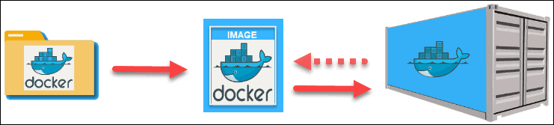
From Dockerfile to Image to Container

Slide 20
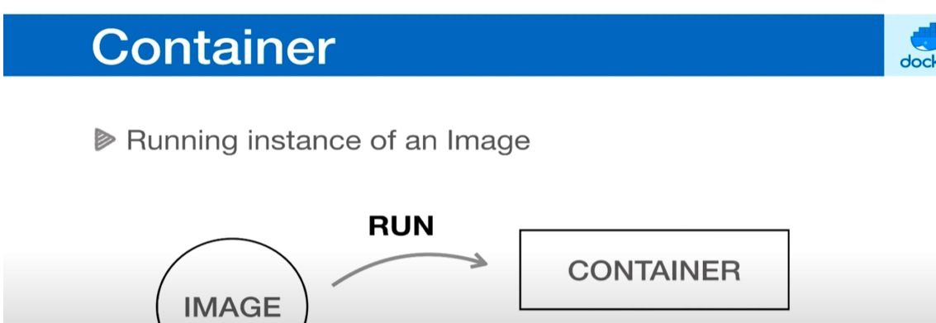

Slide 21
Docker Register
We can push docker image to Docker Registry
Docker Register is like Docker Hub
Registry is storage for docker images so any once can use. Once our docker image is on docker hub then we can put it in on any machines running docker, this machine has same image we have on our development machine which contains specific version of our application with everything it needs

Slide 22
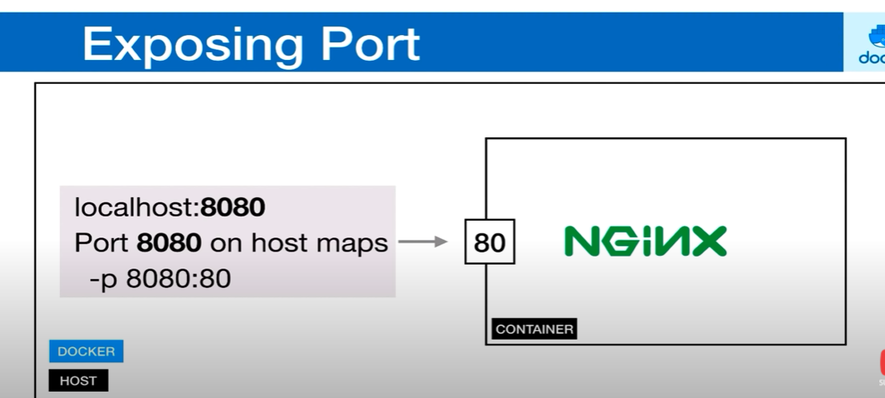

Slide 23
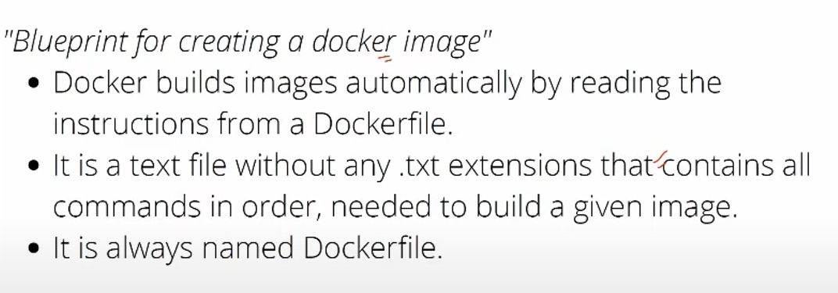
Docker File
In simple words, a Dockerfile is a set of instructions that creates a stacked-layer for each instruction that collectively makes an image(which is a prototype or template for containers)

Slide 24
Docker image
Docker image consists of read-only layers each of which represents a Dockerfile instruction. The layers are stacked and each one is created by the change from the previous layer. For example, if I create a base layer of ubuntu and then in second instruction I install Python it will create a second layer. Likewise, if I do any changes by the instructions(RUN , COPY , ADD) it will create a new layer in that image

Slide 25
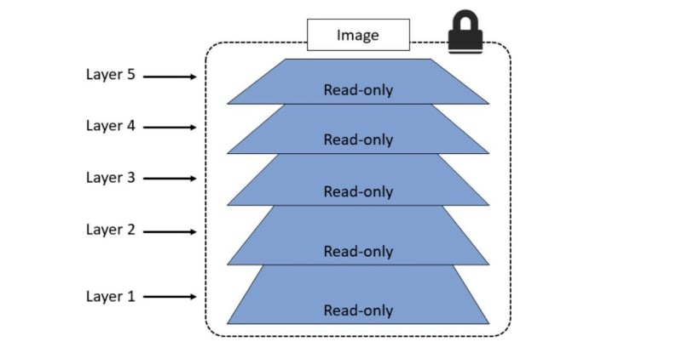
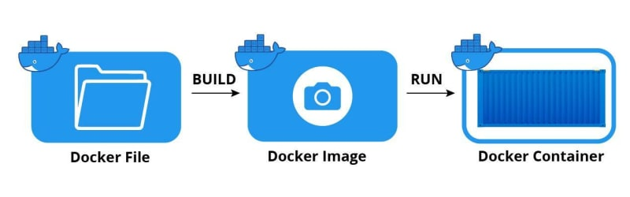
Docker Image

Slide 26
Frequently used Dockerfile commands -
FROM - Defines a base image, it can be pulled from docker hub (for example- if we want to create a javascript application with node as backend then we need to have node as a base image, so it can run node application.)
RUN - Executes command in a new image layer( we can have multiple run commands )
CMD - Command to be executed when running a container( It is asked to have one CMD command, If a Dockerfile has multiple CMDs, it only applies the instructions from the last one.
EXPOSE - Documents which ports are exposed (It is only used for documentation)

Slide 27
Frequently used Dockerfile commands -
ENV - Sets environment variables inside the image
COPY - It is used to copy your local files/directories to Docker Container.
ADD - It is more feature-rich version of the COPY instruction. COPY is preferred over ADD. Major difference b/w ADD and COPY is that ADD allows you to copy from URL that is the source can be URL but in COPY it can only have local ones.
ENTRYPOINT - Define a container's executable (You cannot override and ENTRYPOINT when starting a container unless you add the --entrypoint flag.)

Slide 28
Frequently used Dockerfile commands -
VOLUME - It defines which directory in an image should be treated as a volume. The volume will be given a random name which can be found using docker inspect command.
WORKDIR - Defines the working directory for subsequent instructions in the Dockerfile(Important point to remember that it doesn't create a new intermediate layer in Image)
#Basic Dockerfile FROM ubuntu:18.04 COPY . /app RUN make /app CMD python /app/app.py

Slide 29
Difference between RUN,CMD and ENTRYPOINT?
The RUN command is the central executing directive for Dockerfiles. It takes a command as its argument and runs it to form the image.
RUN apt-get install python.
Specify commands to make changes to your Image and subsequently the Containers started from this Image. This includes updating packages, installing software, adding users, creating an initial database, setting up certificates, etc. These are the commands you would run at the command line to install and configure your application. This is one of the most important dockerfile directives.

Slide 30
Difference between RUN,CMD and ENTRYPOINT?
CMD - CMD instruction allows you to set a default command, which will be executed only when you run container without specifying a command. If Docker container runs with a command, the default command will be ignored. If Dockerfile has more than one CMD instruction, all but last CMD instructions are ignored.
CMD "echo" "Hello World!"

Slide 31
Difference between RUN,CMD and ENTRYPOINT?
RUN - Builds your container
CMD - Specifies what command to run within the container
The VOLUME instruction should be used to expose any database storage area, configuration storage, or files and folders created by your Docker container. You are strongly encouraged to use VOLUME for any combination of mutable or user-serviceable parts of your image.
The VOLUME command is used to enable access from your container to a directory on the host machine (i.e. mounting it).

Slide 32
Difference between RUN,CMD and ENTRYPOINT?
ENTRYPOINT - ENTRYPOINT instruction allows you to configure a container that will run as an executable. It looks similar to CMD, because it also allows you to specify a command with parameters. The difference is ENTRYPOINT command and parameters are not ignored when Docker container runs with command line parameters.
Prefer ENTRYPOINT to CMD when building executable Docker image and you need a command always to be executed. Additionally use CMD if you need to provide extra default arguments that could be overwritten from command line when docker container runs.
Choose CMD if you need to provide a default command and/or arguments that can be overwritten from command line when docker container runs.

Slide 33
Difference between RUN,CMD and ENTRYPOINT?
# First stage: build the Java application
FROM maven:3.8.1-jdk-11-slim AS build
WORKDIR /app
COPY pom.xml .
RUN mvn dependency:go-offline
COPY src/ src/
RUN mvn package
# Second stage: copy the built app from the first stage
FROM openjdk:11-slim
WORKDIR /app
COPY --from=build /app/target/Maven-0.0.1-SNAPSHOT.jar .
EXPOSE 80
CMD ["java", "-jar", "Maven-0.0.1-SNAPSHOT.jar"]

Slide 34
Difference between RUN,CMD and ENTRYPOINT?
volumes:
# Just specify a path and let the Engine create a volume
- /var/lib/mysql
# Specify an absolute path mapping
- /opt/data:/var/lib/mysql
# Path on the host, relative to the Compose file
- ./cache:/tmp/cache
# User-relative path
- ~/configs:/etc/configs/:ro
# Named volume
- datavolume:/var/lib/mysql

Slide 35
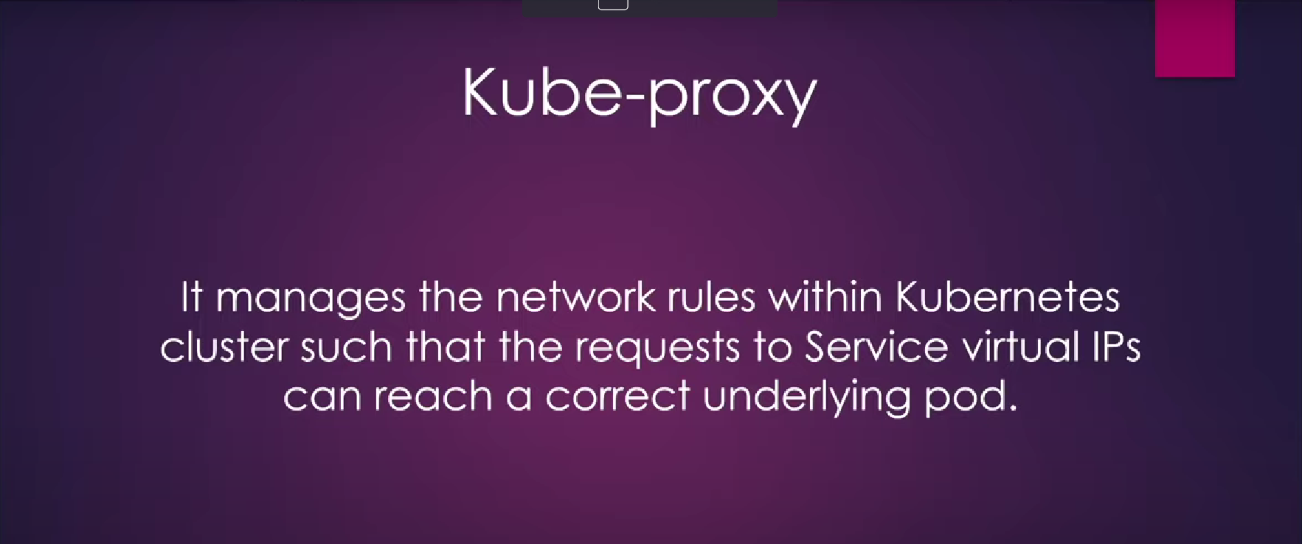

Slide 36
References
https://devopscube.com/kubernetes-architecture-explained/
https://dev.to/setevoy/kubernetes-part-1-architecture-and-main-components-overview-22g6
How Kubernetes Services Work – BMC Software | Blogs
Kubernetes: part 1 – architecture and main components overview - DEV Community
Understanding Docker's CMD and ENTRYPOINT Instructions | Cloudbees Blog
Building Docker Images with Dockerfiles | Codefresh.
Kube-Proxy: What Is It and How It Works (kodekloud.com)

