Slide 1
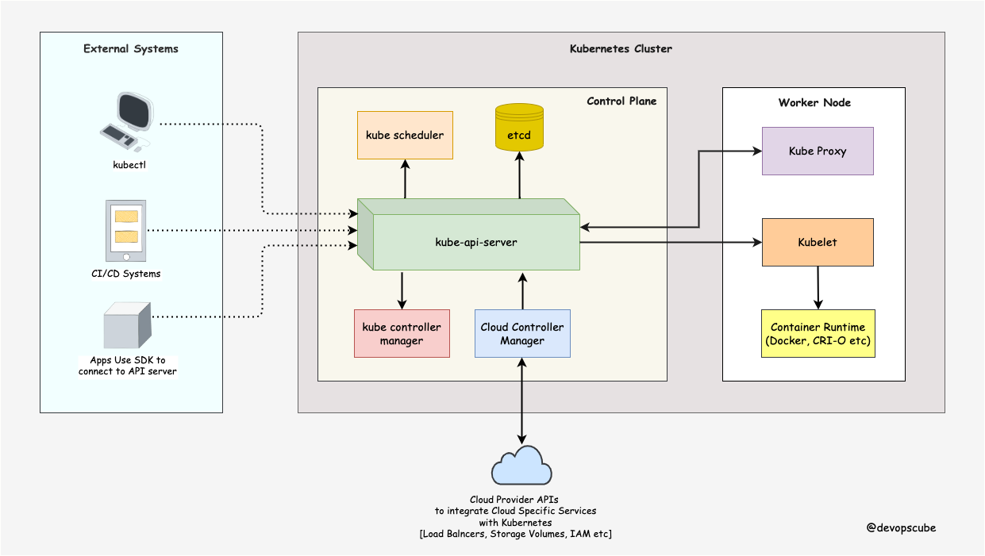
K8
Kubernetes Architecture

Slide 2
A Kubernetes cluster consists of control plane nodes and worker nodes.
Control Plane
kube-apiserver
etcd
kube-scheduler
kube-controller-manager
cloud-controller-manager

Slide 3
kube-apiserver
The Kubernetes API server can be considered as the front end of the Kubernetes control plane. Any interaction or request from users or internal Kubernetes components with the control plane go through this component.
The API (application programming interface) server determines if a request is valid and then processes it.
It acts as a gateway to the cluster and support life cycle orchestration.
Kube API server is the only component that interacts directly with the ETCD data store.
The other components, such as scheduler, kubectl, kubelet, etc., use the Kube API server to perform updates in the cluster in their respective areas.

Slide 4
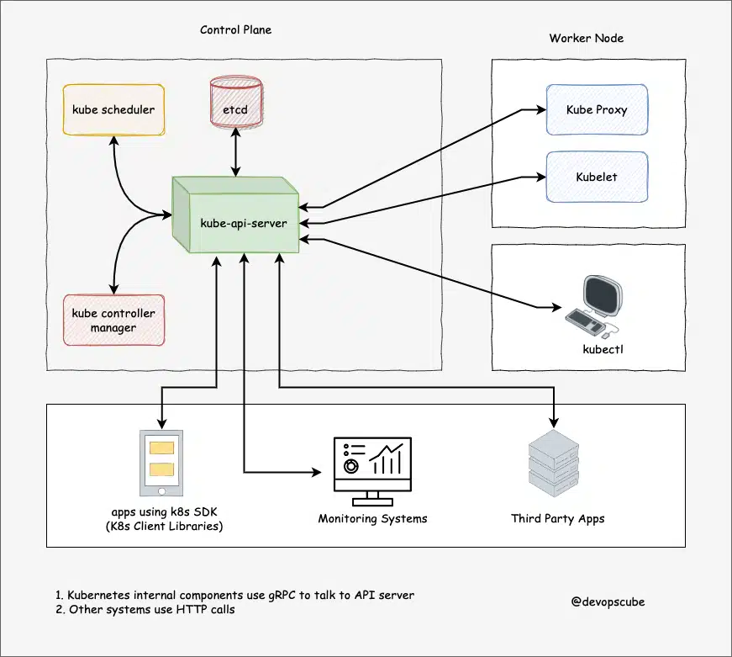

Slide 5
etcd
What is etcd in Kubernetes? | ARMO (armosec.io)
etcd is an open source distributed key-value store used to hold and manage the critical information that distributed systems need to keep running. Most notably, it manages the configuration data, state data, and metadata for Kubernetes, the popular container orchestration platform.
In practice, the keys likely refer to the resources, and the value refers to the state. The changes in the resources and their state are reflected in etcd which facilitates operations such as scheduling tasks.
In Kubernetes, the component that interacts with etcd is the API server which uses etcd's watch API to monitor the cluster and store cluster-wide object configurations. etcd is also used to monitor changes to either the actual or the desired state of its system.

Slide 6
kube-scheduler
A scheduler watches for newly created Pods that have no Node assigned. For every Pod that the scheduler discovers, the scheduler becomes responsible for finding the best Node for that Pod to run on.
Kube Scheduler is one of the key components of the Kubernetes master. This is only responsible for deciding which pod goes on which node. It doesn’t actually place the pod on the nodes. That’s the job of kubelet. the scheduler decides which nodes the pods are placed on depending on specific criteria.
Node selection in kube-scheduler
kube-scheduler selects a node for the pod in a 2-step operation:
Filtering
Scoring

Slide 7
kube-scheduler(Filtering)
The filtering step finds the set of Nodes where it's feasible to schedule the Pod. For example, the PodFitsResources filter checks whether a candidate Node has enough available resource to meet a Pod's specific resource requests. After this step, the node list contains any suitable Nodes; often, there will be more than one. If the list is empty, that Pod isn't (yet) schedulable.
This controller also performs life cycle functions such as namespace creation and life cycle, event garbage collection, terminated-pod garbage collection, node garbage collection, etc.

Slide 8
kube-scheduler(Scoring)
n the scoring step, the scheduler ranks the remaining nodes to choose the most suitable Pod placement. The scheduler assigns a score to each Node that survived filtering, basing this score on the active scoring rules.
Finally, kube-scheduler assigns the Pod to the Node with the highest ranking. If there is more than one node with equal scores, kube-scheduler selects one of these at random

Slide 9
kube-controller-manager
The controller is a process that continuously monitors the state of the various components within the system and works towards bringing the whole system to the desired functioning state.
Basically, a controller watches the desired state of the objects it manages and watches their current state through the API server. If the current state of the objects it manages does not meet the desired state, then the control loop takes corrective steps to make sure that the current state is the same as the desired state.
For example, the node controller is responsible for monitoring the states of the node and taking the necessary actions to keep the applications running

Slide 10
node controller
The node controller checks the status of the nodes every 5 seconds.
If the node controller stops receiving a heartbeat from the node, then the node is marked as unreachable.
The node controller will wait for 40 seconds before it is marked as unreachable.
After the node is marked as unreachable, it takes 5 minutes to come back up. If it doesn’t, it removes the pod assigned to that node and provisions them to the healthy one.

Slide 11
eplication controller
It is responsible for monitoring the status of the replica sets and ensuring that the desired number of pods are available at all times within the set. If a pod dies, it will create another one.
There are many more controllers available in Kubernetes.
These all controllers are packaged into a single process known as Kube controller manager. When you install the controller manager, the different controllers get installed as well.

Slide 12
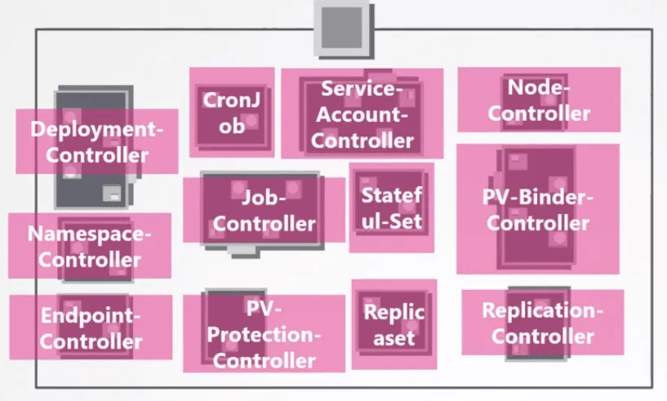

Slide 13
Kubelet
Kubelet is an agent which communicates with the Master node.
The agent is responsible for making sure that the containers are running on the nodes as expected.
The Kubelet in the Kubernetes worker node registers the node in the Kubernetes cluster. This is agent watches the Kube API server for pods assigned by the scheduler to its node, executes the task, and reports back to the Master.
It also monitors pods and reports back to the control panel if a pod is not fully functional. Based on that information, the Master can then decide how to allocate tasks and resources to reach the desired state

Slide 14
What is Kube-Proxy
We know that Pods are ephemeral in Kubernetes. They can be terminated or restarted at any time. Due to this behavior, we cannot rely on their IP addresses as they always change.
Here’s where the Service object comes into play. Services provide a stable IP address to connect to Pods. Each Service is associated with a group of Pods. When traffic reaches the Service, it is redirected to the backend Pods accordingly.
But how actually is this “Service to Pod” mapping implemented on a networking level ?
That’s the role of the Kube-proxy.

Slide 15
What is Kube-Proxy
The kube-proxy is a network proxy that runs on each node in the cluster. It's connected to the API server and is responsible for keeping the services and the backing endpoints (pod IPs) up to date. It also configures and manages the routing rules on the nodes. The kube-proxy supports in four different modes:
iptables
ipvs
userspace
kernelspace

Slide 16
Kube API Server - Simplified Learning (waytoeasylearn.com)
https://medium.com/@amroessameldin/kube-proxy-what-is-it-and-how-it-works-6def85d9bc8f
https://learncloudnative.com/blog/2023-05-31-kubeproxy-iptables

