Slide 1
Caching
Caching is a way for improving application performance. It is a type of temporary memory that sits between the application and the persistent database. Cache memory store previously utilised data items in order to minimise database calls as much as feasible.
The primary reason for using cache is to make data access faster and less expensive. When the highly requested resource is requested multiple times, it is often beneficial for the developer to cache resources so that it can give responses quickly. Using cache in an application enhances the performance of the application. Data access from memory is always faster in comparison to fetching data from the database. It reduces both monetary cost and opportunity cost.

Slide 2
Benefits of Caching
Caching of commonly reused data in an application is an useful technique for improving application speed. We cache such frequently requested data in memory to prevent calling the costly backends every time the user wants the data. Data access from memory is indeed faster than data access from storage such as a database, file system, or other service calls.
Types of Caching
There are four types of caching are as follows:
In-memory Caching
Database Caching
Web server Caching
CDN Caching

Slide 3
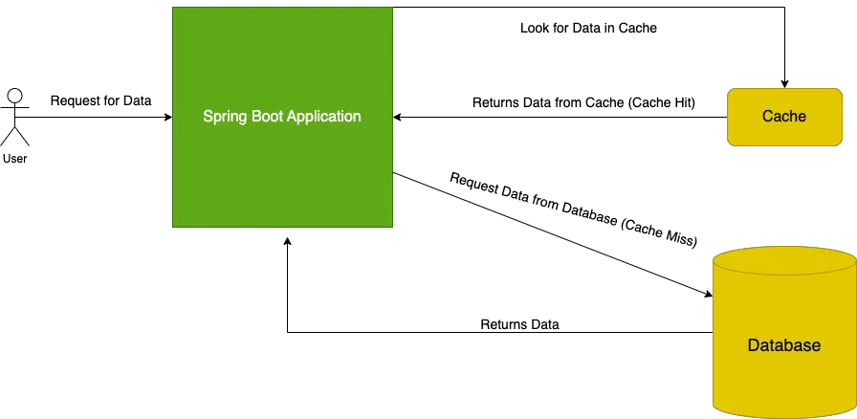

Slide 4
Cache Provider
Generic
JCache (JSR-107)
EhCache 2.x
Hazelcast
Guava
Infinispan
Couchbase
Redis
Caffeine
Simple

Slide 5
Caching
In-memory Caching
In-memory caching is a technique which is widely used. In this type of caching, data is stored in RAM. It stores key-value between application and database . Memcached and Redis are examples of in-memory caching.
Redis is an in-memory key-value data structure store that can be used as a database, cache, and message broker
Database Caching
Database caching is a mechanism that generates web pages on-demand (dynamically) by fetching the data from the database. It is used in a multi-tier environment that involved clients, web-application server, and database. It improves scalability and performance by distributing a query workload. The most popular database caching is the first level cache of Hibernate.

Slide 6
Caching
Database Caching
Database caching is a technique used to improve the speed of web applications by temporarily storing copies of data or result sets. By keeping this data in a cache, future requests for the same data can be served faster since they can be retrieved from the cache rather than requiring a new database lookup. This process significantly reduces the load on the database and shortens the data retrieval time, enhancing overall application performance.

Slide 7
Types of Database Caching
In-Memory Caching
In-memory caching involves storing data in the RAM of the server. It's incredibly fast because accessing RAM is much quicker than disk storage or external data fetches. Redis and Memcached are popular choices for in-memory caching solutions.
Query Caching
Query caching stores the result set of a query. When an identical query is received, the cache can serve the results without re-executing the query against the database. However, this strategy is less effective when data changes frequently, as the cache must be invalidated and refreshed often.
Distributed Caching
Distributed caching spreads the cache across multiple machines or nodes, allowing for greater scale and resilience. This type is particularly useful for high-traffic applications that require large amounts of cache storage or need to maintain cache availability even if one or more nodes fail.

Slide 8
Caching
Web Server Caching
Web server caching is the process of storing data for reuse, like a copy of a web page, on the server itself. When a user visits a page, the browser downloads data to display it. To shorten page load times, the browser caches most of the content on the device's hard drive. The next time the user loads the page, most of the content is already stored locally and the page will load much more quickly.
CDN Caching
A content delivery network (CDN) is a group of distributed servers that speed up the delivery of web content by bringing it closer to where users are. Data centers across the globe use caching, to deliver internet content to a web-enabled device or browser more quickly through a server near you, reducing the load on an application origin and improving the user experience. CDNs cache content like web pages, images, and video in proxy servers near your physical location.

Slide 9
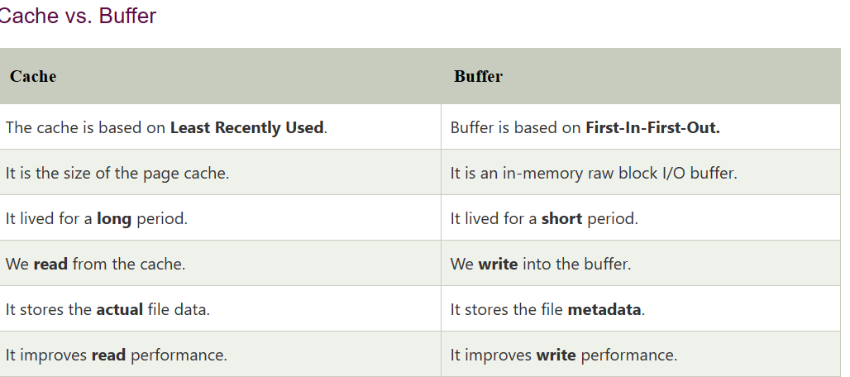
Caching

Slide 10
Caching
Spring Boot Cache Annotations
@EnableCaching
It is a class-level annotation. We can enable caching in the Spring Boot application by using the annotation @EnableCaching. It is defined in org.springframework.cache.annotation package. It is used together with @Configuration class.
The auto-configuration enables caching and setup a CacheManager, if there is no already defined instance of CacheManager. It scans for a specific provider, and when it does not find, it creates an in-memory cache using concurrent HashMap.

Slide 11
Spring boot needs an underlying cache provider that can store and manage the cached objects and support lookups. Spring boot autoconfigures one of these providers with default options if it is present in the classpath and we have enabled cache by @EnableCaching.
JCache (JSR-107) (EhCache 3, Hazelcast, Infinispan, and others)
EhCache (example)
Hazelcast
Infinispan
Couchbase
Redis
Caffeine (example)
Simple cacheconcurrent HashMap.

Slide 12
Spring Cache Annotations
@Cacheable: Triggers cache population.
@CacheEvict: Triggers cache eviction.
@CachePut: Updates the cache without interfering with the method execution.
@Caching: Regroups multiple cache operations to be applied on a method.
@CacheConfig: Shares some standard cache-related settings at the class level.

Slide 13
Spring Cache Annotations
@Cacheable
It is used on the method level to let spring know that the response of the method is cacheable. Spring intercepts the request/response of this method and stores the response in the cache by the name specified in the annotation attribute e.g. @Cacheable(“employees”).
@Cacheable("employees")
public Optional<Employee> getEmployeeById(Long id) {
return repository.findById(id);
}

Slide 14
Since caches are essentially key-value stores, each invocation of a cached method needs to be translated into a suitable key for cache access. By default, Spring uses the method parameters to form the cache keys as follows:
If no params are given, return SimpleKey.EMPTY.
If only one param is given, return that instance.
If more than one param is given, return a SimpleKey that contains all parameters.
It is very necessary to understand that keys must implement valid hashCode() and equals() methods contract for correct lookups.
@Cacheable(value = "employees", key = "#id")
public Optional<Employee> getEmployeeById(Long id) {...}
@Cacheable(value = "employees", key = "#department.id")
public List<Employee> getEmployeesByDepartmentId(Department department) {...}

Slide 15
@CachePut
The @CachePut annotation is very similar to the @Cacheable annotation except the annotated method is always executed irrespective of whether the cache key is present in the cache or not. It supports the same options as @Cacheable.
@CachePut(cacheNames = "employees", key = "#employee.id")
public Employee updateEmployee(Employee employee) {...}

Slide 16
@CacheEvict
This annotation is helpful in evicting (removing) the cache previously loaded. When @CacheEvict annotated methods will be executed, it will clear the cache matched with a cache name, cache key or a condition to be specified.
@CacheEvict(cacheNames="employees", key="#id")
public void deleteEmployee(Long id) {...}
The @CacheEvict annotation offers an extra parameter ‘allEntries’ for evicting the whole specified cache, rather than a key in the cache.
@CacheEvict(cacheNames="employees", allEntries=true)
public void deleteAllEmployees() {...}

Slide 17
@Caching
The @Caching annotation is needed to group multiple annotations when we need to use multiple cache annotations in a single method. In the following example, we are using the @CacheEvict annotation, twice.
@Caching(evict = {
@CacheEvict(cacheNames = "departments", allEntries = true),
@CacheEvict(cacheNames = "employees", key = "...")})
public boolean importEmployees(List<Employee> data) { ... }

Slide 18
@CacheConfig
This annotation allows us to specify some of the cache configurations at the class level, so we do not have to repeat them multiple times over each method.
@Service
@CacheConfig(cacheNames={"employees"})
public class EmployeeService {
@Autowired
EmployeeRepository repository;
@Cacheable(key = "#id")
public Optional<Employee> getEmployeeById(Long id) { ... }
@CachePut(key = "#employee.id")
public Employee updateEmployee(Employee employee) { ... }

Slide 19
Refereneces
Spring Boot Caching – javatpoint
Spring boot database cache example - Java Developer Zone
https://reflectoring.io/spring-boot-cache/
https://bootcamptoprod.com/spring-boot-caching/

Slide 20
How Spring Caching mechanism works
Server receives requests from user.
Spring Created Proxy is created, and intercept these requests. It will check whether information that user need whether is in Data Cache. If found, use it. If not, jump to step 3.
Go to the function that manage this request from controller.
Finally, Spring Created Proxy will add their result into Data Cache.

