Slide 1
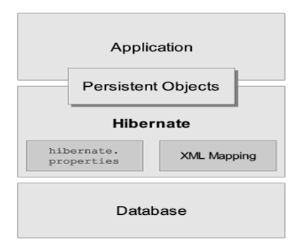
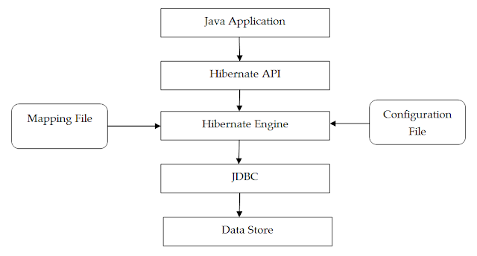
Hibernate Architecture

Slide 2
The main intention of Persistence class or object in Hibernate applications is to manage Persistence data which we want to store in Database or by using this we want to perform the database operations like select, update, delete

Slide 3
hibernate.cfg.xml
<?xml version="1.0" encoding="UTF-8"?>
<!DOCTYPE hibernate-configuration PUBLIC
"-//Hibernate/Hibernate Configuration DTD 3.0//EN"
"http://www.hibernate.org/dtd/hibernate-configuration-3.0.dtd">
<hibernate-configuration>
<session-factory>
<property name="connection.driver_class">com.mysql.jdbc.Driver</property> <property name="connection.url">jdbc:mysql://localhost:3306/hibernatedemo</property>
<property name="connection.username">root</property> <property name="connection.password">your password</property>
<!-- We use dialect to provide information about which
database we are using, we are using mysql -->
<property name="dialect">org.hibernate.dialect.MySQL5Dialect</property>
<!-- This property enables us to update the
table everytime the program runs-->
<property name="hbm2ddl.auto">update</property> <property name="show_sql">true</property>
<!-- List of XML mapping files -->
<!-- path of a mapping file, for us its our
Student class and Address class which is a POJO -->
<mapping class="com.spring.hibernate.Student"></mapping> <mapping class="com.spring.hibernate.Address"></mapping>
</session-factory>
</hibernate-configuration>

Slide 4
SessionFactory
SessionFactory is used to create session object by feeding database configuration details.
Its heavyweight and thread safe(is immutable) and supports second level caching.
// SessionFactory in Hibernate 5 example
Configuration config = new Configuration();
config.configure();
// local SessionFactory bean created
SessionFactory sessionFactory = config.buildSessionFactory();
Session newSession = sessionFactory.openSession();

Slide 5
sessionfactory opensession vs getcurrentsession
openSession() Method | getCurrentSession() Method
It always creates a new Session object. | It creates a new Session iff there is no any session in current hibernate context.
Programmer need to explicitly flush and close session objects. | Programmer do not need to flush and close session objects, it will be taken care by Hibernate internally.
openSession() is slower than getCurrentSession() in single threaded environment. | In single threaded environment it is faster than openSession().
You do not need to configure any property to call this method. | You need to configure additional property in hibernate.cfg.xml file <property name=”hibernate.current_session_context_class”>thread</property> otherwise it will throw an exception.

Slide 6
Session
Session object is created by using SessionFactory.
It provides the connectivity between your application and database.
It is lightweight and not thread safe.
We can perform various database operation using session object.
Methods of Hibernate Session
Save()
Update()
SaveOrUpdate()
Merge()
Delete()

Slide 7
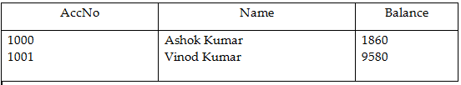
Persistent Object has three life cycle states
An object is said to be in transient state, when it is not associated with session and not present in data base.
Account account = new Account();account.setAccountld(1003);account.setName("Dillesh");account.setBalance(1500);
In the above example account object is not associated with session and there is no matching record in the ACCOUNT table. So we can say that account object is in transient state. In this state object is non-transactional. i.e., object is not synchronized with record. i.e., Modifications done to entity, doesn’t save into database.

Slide 8
Persistent Object has three life cycle states
An object is said to be in persistence state, when it is associated with session as well as object present in database..
Account account = (Account) session.get(Account.class,1001);
In the above example account object is associated with session and there is a matching record in ACCOUNT table. So we can say that account object is in persistent state.
In this state object is transactional. i.e., the object is synchronized with database record.
Changes made to objects in a persistent state are automatically saved to the database without invoking session persistence methods

Slide 9
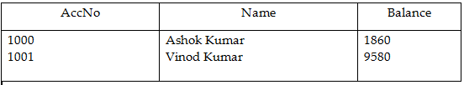
Persistent Object has three life cycle states
An object is said to be in detached state, when the object is not associated with session but present in data base.
Account account = new Account(); account.setAccountld(1004);account.setName("cherry");account.setBalance(2100);//Now the account object is said to be in transient statesession.save(account);// Now the account object is said to be in persistence statesession.close();// Now the account object is said to be in detached state.
In the above example after calling session.close() method, account object is moved to Detached state from persistent state. As session i s garbage collected, if we try to perform some modifications to entity object those changes will not be stored into database.

Slide 10
Removed State
If we perform the operations like remove() or delete() over the POJO object in Persistence state then POJO object will come from Persistence State to Removed State.
In Removed State, Hibernate Software is not aware about POJO object.
In this State, POJO object is not representing any record in Database table.

Slide 11
Hibernate with Multiple Databases
We must provide separate configuration file for each and every Database.
Use either single mapping file if we have same table name and same columns in both the databases tables and use different mapping file for each and every database if we have difference in table names and column names.
In Client application.
Prepare separate Configuration object for each and every DB.
Prepare separate SessionFactory object for each and every DB.
Prepare separate Session object for each and every DB.
Prepare separate Transaction object for each and every DB as per the requirement.
Perform persistence operations on DB respective Session objects

Slide 12
CodeGeneration
hibernate.hbm2ddl.auto
The above property will take the following three values.
Create : it will create a table irrespective of the table is existed or not.
Update: it will create table if table is not existed, it will alter the table if table is existed as per the mapping file.
create-drop: It will create table when SessionFactory object is created and it will drop table when SessionFactory object is closed.
In case of create-drop, schema is not dropped on closing the session. It drops only on closing the SessionFactory.

Slide 13
Primary Key Generation Algorithms
Hibernate has provided support for the following primary key generation algorithms in order to generate primary key values.
assigned
increment
sequence
identity
hilo
native.
seq-hilo
select
UUID
GUID
foreign

Slide 14
Primary Key Generation Algorithms
Assigned : it will request to Client Application to provide primary key value explicitly.
Increment : This primary key generation algorithm is able to generate primary key value by incrementing max value of the primary key column. This algorithm is not required any input parameter to generate primary key values.
3.Sequence: This primary key generation algorithm is able to generate primary key value on the basis of the sequence provided by the underlying Database. If we have not provided any sequence name as input parameter then this algorithm is able to take “hibernate_sequence” as default sequence name, here developers must create “hibernate_sequence” in database explicitly.
identity
hilo

Slide 15
Inheritance Mapping
Hibernate is one of the ORM implementation, it has provided the following three strategies to resolve inheritance mismatch.
Table Per Class Hierarchy.
Table Per Sub Class
Table Per Concrete Class

Slide 16
Table Per Class Hierarchy
In Table Per Class hierarchy, we will prepare a table with the columns representing all the properties of the classes[sub classes and super class] which are existed in inheritance.
In this mechanism, when we store any sub class object then data must be stored in single table in the respective columns, if data is not available for any column then null values will be stored in the respective columns.
If we want to use Table Per Class Hierarchy in Hibernate applications then we have to use the following steps.
To represent Table Per Class Inheritance Mapping javax.persistence package has provided the following three Annotations.
@Inheritance
@DiscriminatorColumn
@DiscriminatorValue

Slide 17
Table Per Class Hierarchy @Inheritance
This annotation is able to specify Inheritance Mapping strategy.
@Inheritance(strategy=value)
Where value may be SINGLE_TABLE constant from InheritanceType enum.
@Inheritance(strategy=InheritanceType.SINGLE_TABLE)

Slide 18
Table Per Class Hierarchy @DiscriminatorColumn
This annotation is able to represent Discriminator Column.
@DiscriminatorColumn(name ="--")
Where “name” is able to take discriminator column name.
@DiscriminatorColumn(name="TYPE")
The above two annotations must be used at super class.

Slide 19
Table Per Class Hierarchy @DiscriminatorValue
It able to provide value to the discriminator column, it must be specified at sub class.

Slide 20
Table Per Sub class
In case of “Table Per Subclass” inheritance mapping, we have to prepare a separate table for each and every class [for both super class and sub classses] existed in inheritance.
While preparing tables for sub classes we have to provide a join column which must be primary key in super class respective table and in sub class respective tables.
In hibernate applications, if we store sub class objects in database then Hibernate software has to recognize and store super class properties data in super class respective table and sub class respective data in sub class respective tables.
To achieve this requirement, Hibernate software has to recognize super class properties and sub class properties separately, for this we have to provide sub classes configuration separately in hibernate mapping file.

Slide 21
Table Per Concrete Class
In “Table per Concrete Class” inheritance mapping , we will prepare a separate table for each and every sub class containing the columns representing both the super class properties and the respective sub class properties.
In the above context, if we save any sub class object then Hibernate software has to distribute sub class objects data in the respective table and in the respective columns. To achieve this we have to use the following XML tags in hibernate mapping file.

Slide 22
Table Per Sub class @Inheritance
This annotation is able to represent a particular Inheritance mapping mechanism,it will use “strategy” member to take a particular inheritance mapping, where “strategy” attribute will take “JOINED” value constant from “InheritanceType” enum.
@Inheritance(strategy=InheritanceType.JOINED)
@PrimaryKeyJoinColumn
This annotation will be used at sub classes in order to provide Join Key column name. It will use “name” attribute to provide “join key column”.
@PrimaryKeyJoinColumn(name="TX_ID")

Slide 23
Association Mapping
In relational Data Model, we are able to achieve associations in the following three ways.
By defining Primary Key-Foreign Key relations between tables
By Providing Join column between tables
By Defining Join table between tables.
Hibernate has provided the following four types of Associations mappings in order to resolve Associations mismatch.
One-To-One Association Mapping
One-To-Many Association Mapping
Many-To-One Association Mapping
Many-To-Many Association Mapping

Slide 24
One-To-One Association Mapping
t is a relation between entities, where one instance of an entity should be mapped with exactly one instance of another entity.
E.g: Every Employee must have exactly one individual Account.
In Hibernate Applications , to represent one-to-one association JPA has provided the following annotation as part of javax.persistence package.
@OneToOne(cascade=Val)
Where val may be the constants like ALL, DETACH, MERGE, REFRESH, REMOVE, PERSIST from CascadeType enum.

Slide 25
One-To-One Association Mapping
@OneToOne(cascade = CascadeType.ALL)
@JoinColumn(name = "student_gfg_detail_id")
private StudentGfgDetail studentGfgDetail;
We add a single object of StudentGfgDetail inside the Student class which is annotated with @OneToOne annotation which specifies the one-to-one mapping. This annotation contains an element called cascade which specifies the cascading strategy. Cascading is a feature that is used to manage the state of the target entity whenever the state of the parent entity changes.

Slide 26
One-To-One Association Mapping
CascadeType.ALL – Propagates all operations from parent to target entity.
CascadeType.PERSIST – Propagates persist from parent to target entity.
CascadeType.MERGE – Propagates merge from parent to target entity.
CascadeType.REMOVE – Propagates remove from parent to target entity.
CascadeType.REFRESH – Propagates refresh from parent to target entity.
CascadeType.DETACH – Propagates detach from parent to target entity.

Slide 27
One-To-One Association Mapping
For example if cascade = CascadeType.REMOVE then if the parent entity is deleted from the database then the target entity will also be deleted from the database i.e. if a Student entity is deleted from the database then the related StudentGfgDetail will get automatically deleted in the same operation. The @JoinColumn annotation specifies the column for joining the target entity. Here it is specified that StudentGfgDetail should be joined to the column student_gfg_detail_id which is correct as student_gfg_detail_id is acting as our foreign key.

Slide 28
One-To-Many Association
It is a relation between entities where one instance of an entity should be mapped with multiple instances of another entity.
E.g: Single Department has Multiple Employees
@OneToMany(cascade=CascadeType.ALL)

Slide 29
One-To-Many Association
Many-To-One Association
It is a relation between entity classes, where multiple instances of an entity should be mapped with exactly single instance of another entity.
E.g: Multiple Students have joined with single branch
To provide Many-To-One Association in Hibernate applications then we have to use the following tag in mapping file.
@ManyToOne(calcade=CascadeType.ALL)

Slide 30
Many-To-Many Associations
It is a relation between entities , where multiple instances of an entity must be mapped with multiple instances of another entity.
E.g: Multiple Students have joined with Multiple Courses.

Slide 31
Hibernate Single Table Inheritance
In Single Table Inheritance for all classes/entities which are in an inheritance relationship, there will be the only one table. @Inheritance(strategy=InheritanceType.SINGLE_TABLE) annotation is used with parent class. EzoicApart from the above annotation @DiscriminatorColumn and @DiscriminatorValue used, for example we are going to use these annotations as (@DiscriminatorColumn(name=”type”,discriminatorType=DiscriminatorType.STRING) and @DiscriminatorValue(value=”INS”)).@DiscriminatorValue needs to use with each entity which used to distinguish one entity from another.
https://www.geeksforgeeks.org/hibernate-table-per-hierarchy-using-annotation/
https://www.javatpoint.com/hibernate-table-per-hierarchy-using-annotation-tutorial-example
https://www.viralpatel.net/hibernate-inheritence-table-per-hierarchy-mapping/

Slide 32
Hibernate Table Per Concrete Class
In table per concrete class mapping, it will create a separate table for each entity.
@Inheritance(strategy = InheritanceType.TABLE_PER_CLASS) is used with parent entity.
Table created for parent entity will have only parent attribute/column whereas child entity will have both parents as well as child attribute/column.
https://www.viralpatel.net/hibernate-inheritance-table-per-concrete-class-annotation-xml-mapping/

Slide 33
Hibernate Table Per Concrete Class
@AttributeOverrides({
@AttributeOverride(name="firstname", column=@Column(name="FIRSTNAME")),
@AttributeOverride(name="lastname", column=@Column(name="LASTNAME"))
})
Both Employee and Owner classes are child of Person class. Thus while specifying the mappings, we used @AttributeOverrides to map them.
@AttributeOverrides – This annotation is used to override mappings of multiple properties or fields.

Slide 34
Hibernate Table Per Subclass
In Table Per Subclass Mapping, subclass mapped tables are related to parent class mapped table with the primary and foreign key relationship.
We need to mention @Inheritance(strategy=InheritanceType.JOINED) with parent class(Insurance.java) and
@PrimaryKeyJoinColumn(name=”id”) with child classes(VehicleInsurance.java and HealthInsurance.java).
https://www.viralpatel.net/hibernate-inheritance-table-per-subclass-annotation-xml-mapping/

Slide 35
Caching in Hibernate
Caching in Hibernate means storing and reusing frequently used data to speed up your application. There are two kinds of caching: Session-level and SessionFactory-level.
Level1: Level 1 cache is a cache that stores objects that have been queried and persist to the current session. It is related to the hibernate session object.
Level2: Hibernate’s Level 2 caching is a built-in caching mechanism that allows you to cache data across several sessions. It is related to the hibernate sessionFactory object.

Slide 36
Cache Eviction
When a cache gets full, it can’t store new data without getting rid of old data. That’s what cache eviction is all about. It’s the process of getting rid of or swapping out data in the cache to make room for new stuff.
Different Types of Cache Eviction
Time-Based Eviction
Count-Based Eviction
Query Result Eviction
Cache Region Clearing
sessionFactory.getCache().evictEntity(User.class, user.getId())

Slide 37
Cache Eviction
Different Types of Cache Eviction
Time-Based Eviction: Time-based eviction is a cache eviction strategy that involves removing data from the cache after a certain period has elapsed since the data was last accessed or added to the cache.
Count-Based Eviction: Count-Based Eviction is a technique used in cache management, where items are removed from the cache based on the number of times they have been accessed
Query Result Eviction: Query result eviction refers to the process of removing or expiring cached query results from a database or data storage system. When a query is executed in a database, the result of that query is typically stored in a cache to improve performance. This cache can be set to expire after a certain period or when new data is added to the database
Cache Region Clearing: Cache region clearing refers to the process of deleting or emptying the cache data stored in a particular region of a device or system

Slide 38
Evict vs Merge vs Clear
evict(): evict() method is used to remove a specified object from the 1st level cache.
Ex:
Transaction tx = hsession.beginTransaction();
hsession.load(e,new BigDecimal(1));
e.setName(“Raju”);
hsession.evict(e);
tx.commit();

Slide 39
Evict vs Merge vs Clear
*merge():
merge method is used to add a specified object to the 1st level cache.
Ex:
Emp e = new Emp();
e.setEno(new BigDecimal(22));
e.setName(“ABC modified”);
e.setSalary(1234d);
hsession.merge(e);
tx.commit();
*Clear():
Clear is used to remove all the objects from 1st level cache. This will remove unperformed operations like save and update also. The clear() method will evict all available objects.

Slide 40
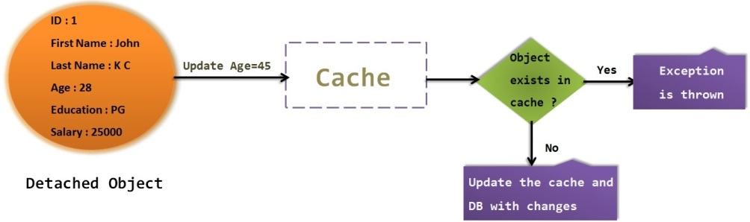
Merge Vs Update
When we call update() method, if the same object is not exist in session cache then the update() method will update the object.
When we call update() method, if the same object is already exist in session cache then the update() method throws an exception called “NonUniqueObjectException”.

Slide 41
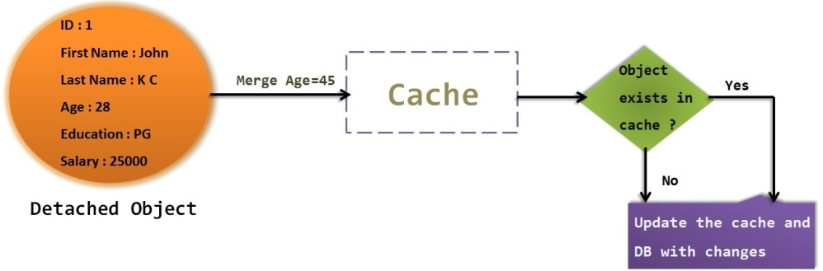
Merge Vs Update
Similar to update() method, merge() method also changes the state of detached state to persistent state.
When we call merge() method, It first checks the same object exist in cache
If exist then it will update the cache with the changes, else if object is not exist in cache then it will load the values to cache.
So in either way,unlike update() method, merge() method will not throw any exception.

Slide 42
Get vs Load
When we use session.get() method, it will hit the DB immediately and returns the real object from DB.
If there is no row corresponding to requested identifier exists , it will return NULL.
When we use session.load() method, it will always return a proxy object without hitting the DB.
Proxy object is a temporary object which does not have any values assigned to it except primary key or identifier value.

Slide 43
How can we reduce database write action times in Hibernate?
Hibernate provides dirty checking feature which can be used to reduce database write times. Dirty checking feature of hibernate updates only those fields which require a change while keeps others unchanged.
What’s the usage of callback interfaces in hibernate?
Callback interfaces of hibernate are useful in receiving event notifications from objects. For example, when an object is loaded or deleted, an event is generated and notification is sent using callback interfaces.
How can we reattach any detached objects in Hibernate?
Objects which have been detached and are no longer associated with any persistent entities can be reattached by calling session.merge() method of session class.

Slide 44
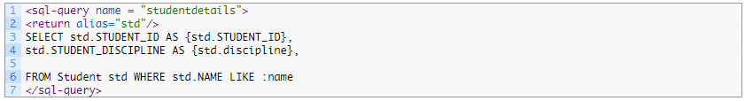
. What different fetching strategies are of hibernate?
Following fetching strategies are available in hibernate:
Join Fetching
Batch Fetching
Select Fetching
Sub-select Fetching
Named SQL queries are those queries which are defined in mapping file and are called as required anywhere. For example, we can write a SQL query in our XML mapping file as follows:

Slide 45
N+1 problem solution
The first solution is to use join fetch:
entityManager.createQuery("select a from Author a left join fetch a.books", Author.class);
Eager Fetching : You can change the fetching strategy to eager loading for specific associations using annotations or XML configuration. This ensures that associated entities are loaded along with the main entity in a single query.
@OneToMany(fetch = FetchType.EAGER)
@JoinColumn(name = "author_id")
private List<Book> books;

Slide 46
N+1 problem solution
Batch Fetching : Implement batch fetching to retrieve multiple entities in a single query. This can be done using Hibernate-specific features like @BatchSize.
@BatchSize(size = 10)
private List<Book> books;
Subselect Fetching : Subselect fetching is another strategy in Hibernate to address the N+1 problem. It allows you to fetch associated entities using subselect queries, which can be particularly useful when you want to load related data lazily but still avoid the N+1 query issue.
@OneToMany(fetch = FetchType.LAZY)
@Fetch(FetchMode.SUBSELECT)
@JoinColumn(name = "author_id")
private List<Book> books;
https://www.baeldung.com/hibernate-fetchmode

Slide 47
@Id @GeneratedValue(strategy = GenerationType.IDENTITY)
@OneToMany(mappedBy = "book", fetch = FetchType.LAZY, cascade = CascadeType.ALL) private Set<Page> pages;
@ManyToOne(fetch = FetchType.LAZY, optional = false) @JoinColumn(name = "book_id", nullable = false)

Slide 48
@OneToMany Annotation
A one-to-many relationship between two entities is defined using the @OneToMany annotation in Spring Data JPA. It declares the mappedBy element to indicate the entity that owns the bidirectional relationship. Usually, the child entity owns the relationship, and the parent entity contains the @OneToMany annotation.
@ManyToOne Annotation
The @ManyToOne annotation defines a many-to-one relationship between two entities in Spring Data JPA. The child entity that has the join column is called the owner of the relationship defined using the @ManyToOne annotation.
@JoinColumn Annotation
The @JoinColumn annotation is used to specify the foreign key column in the relationship owner. The inverse side of the relationship sets the mappedBy attribute to indicate that the relationship is owned by the other entity.

Slide 49
@ManyToMany(fetch = FetchType.LAZY, cascade = CascadeType.PERSIST) @JoinTable(name = "students_courses",
joinColumns = { @JoinColumn(
name = "student_id",
referencedColumnName = "id",
nullable = false,
updatable = false)},
inverseJoinColumns = { @JoinColumn(
name = "course_id",
referencedColumnName = "id",
nullable = false,
updatable = false)})
private Set<Course> courses = new HashSet<>();
@ManyToMany(mappedBy = "courses", fetch = FetchType.LAZY) private Set<Student> students = new HashSet<>();

Slide 50
@ManyToMany Annotation
A many-to-many relationship between two entities is defined using the @ManyToMany annotation in Spring Data JPA. It uses the mappedBy attribute to indicate the entity that owns the bidirectional relationship. In a bidirectional relationship, the @ManyToMany annotation is defined in both entities, but only one entity can own the relationship. We picked the Student class as an owner of the relationship in the above example.
@JoinTable Annotation
The @JoinTable annotation defines the join table between two entities on the owner's side of the relationship. We have used this annotation to define the students_courses table. If the @JoinTable is left out, the default values of the annotation elements apply. The name of the join table is supposed to be the table names of the associated primary tables concatenated together (owning side first) using an underscore.

Slide 51
CompositeKey With IdClass
public class AccountId implements Serializable { private String accountNumber; private String accountType; // default constructor public AccountId(String accountNumber, String accountType) { this.accountNumber = accountNumber; this.accountType = accountTye}
@Entity @IdClass(AccountId.class) public class Account { @Id private String accountNumber; @Id private String accountType; // other fields, getters and setters }pe; } // equals() and hashCode() }

Slide 52
CompositeKey With The EmbeddedId Annotation
@Embeddable public class BookId implements Serializable { private String title; private String language; // default constructor public BookId(String title, String language) { this.title = title; this.language = language; } // getters, equals() and hashCode() methods }
@Entity public class Book { @EmbeddedId private BookId bookId; // constructors, other fields, getters and setters }

Slide 53
How do you optimise Hibernate queries to improve performance?
The following ways are helpful to optimise Hibernate queries-
Use lazy Loading to reduce the data retrieved from the database at once.
Use caching to reduce the number of database queries required.
Use batch fetching to retrieve multiple entities in a single query.
Use indexes on frequently queried columns to improve query performance.

Slide 54
What’s the usage of callback interfaces in hibernate?
Callback interfaces of hibernate are useful in receiving event notifications from objects. For example, when an object is loaded or deleted, an event is generated and notification is sent using callback interfaces.

Slide 55
References
One-to-one bidirectional : https://www.geeksforgeeks.org/hibernate-one-to-one-mapping/
https://javatute.com/hibernate/hibernate-eager-vs-lazy-fetch-type-example/
http://javainsimpleway.com/merge-vs-update-in-hibernate-with-example/
https://www.digitalocean.com/community/tutorials/hibernate-session-merge-vs-update-save-saveorupdate-persist-example
https://www.linkedin.com/pulse/transactions-spring-approach-thiago-leite-e-carvalho/

