Slide 1
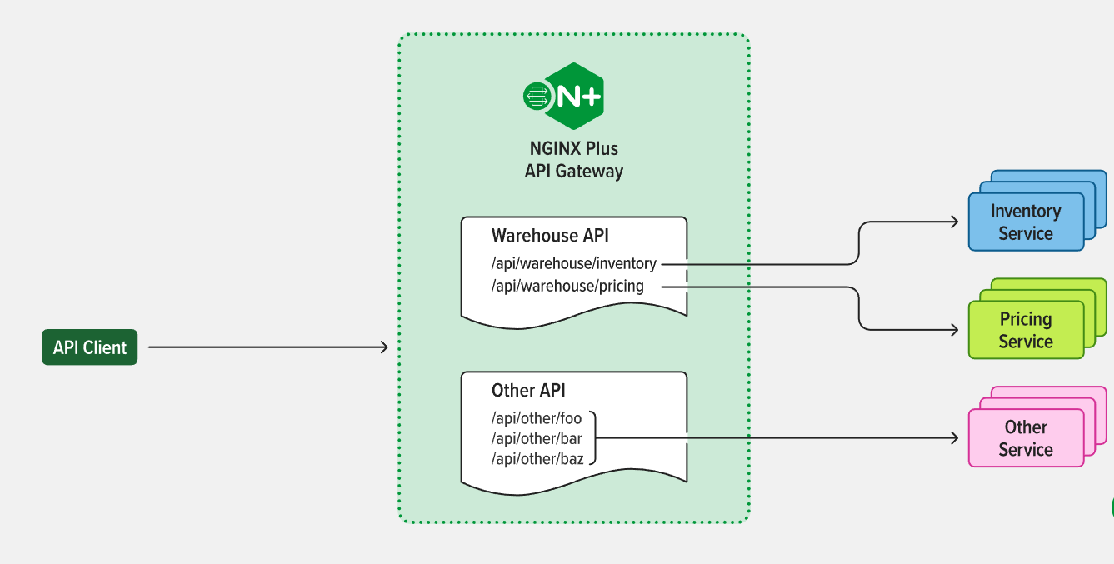
API GateWay
Api Gateway is an Api tools which sits in between client and backend services

Slide 2
API Gateway Capabilities
API gateways commonly implement capabilities that include:
Security policy – Authentication, authorization, access control, and encryption
Routing policy – Routing, rate limiting, request/response manipulation, circuit breaker, blue-green and canary deployments, A/B testing, load balancing, health checks, and custom error handling
Observability policy – Real-time and historical metrics, logging, and tracing
For additional app- and API-level security, API gateways can be augmented with web application firewall (WAF) and denial of service (DoS) protection.

Slide 3
API Gateway Benefits
Deploying an API gateway for app delivery can help:
Reduce complexity and speed up app releases by encapsulating the internal application architecture and providing APIs tailored for each client type
Streamline and simplify request processing and policy enforcement by centralizing the point of control and offloading non-functional requirements to the infrastructure layer
Simplify troubleshooting with granular real-time and historical metrics and dashboards

Slide 4
API Gateway and Microservices Architecture
For microservices‑based applications, an API gateway acts as a single point of entry into the system. It sits in front of the microservices and simplifies both the client implementations and the microservices app by decoupling the complexity of an app from its clients.
In a microservices architecture, the API gateway is responsible for request routing, composition, and policy enforcement. It handles some requests by simply routing them to the appropriate backend service, and handles others by invoking multiple backend services and aggregating the results.
An API gateway might provide other capabilities for microservices such as authentication, authorization, monitoring, load balancing, and response handling, offloading implementation of non-functional requirements to the infrastructure layer and helping developers to focus on core business logic, speeding up app releases.
Learn more about Building Microservices Using an API Gateway on our blog.

Slide 5
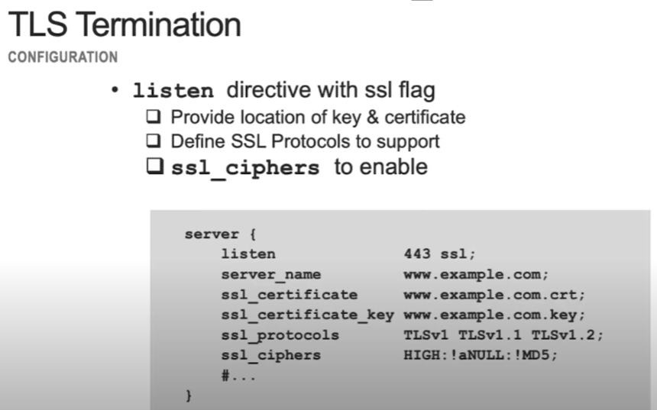

Slide 6
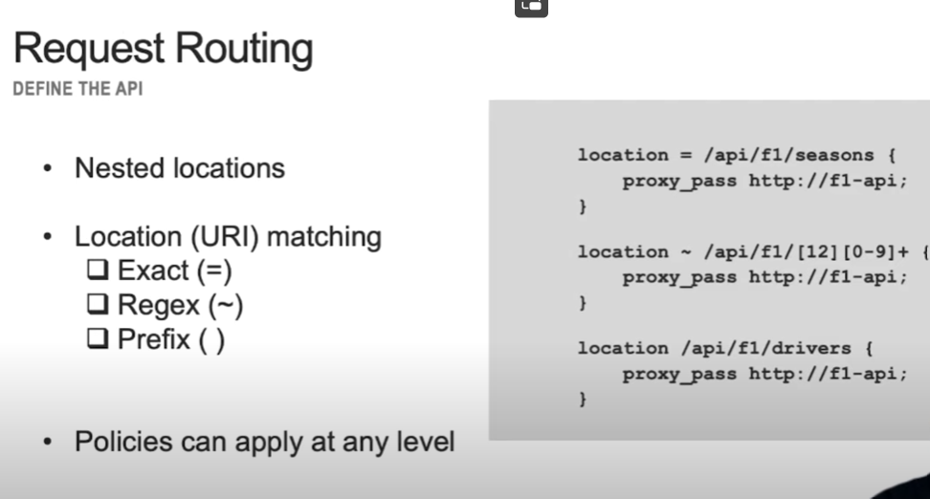

Slide 7
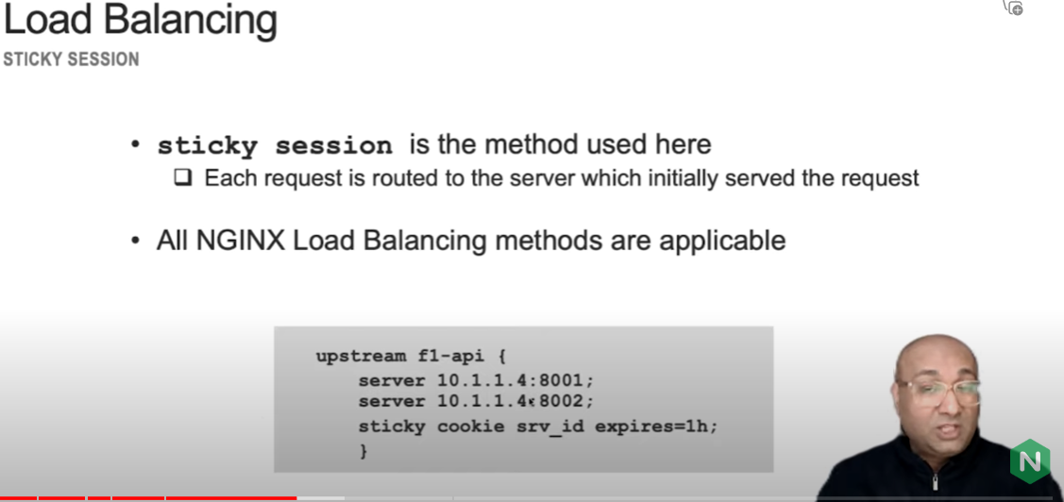

Slide 8
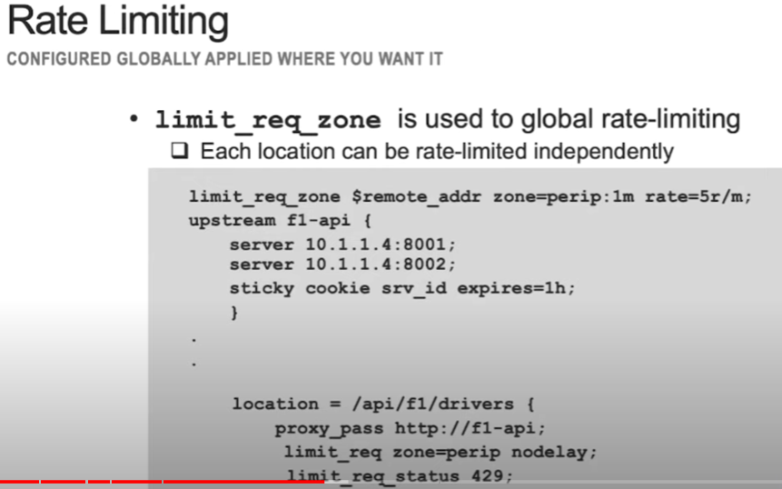

Slide 9
ReFerences
https://dev.to/danielkun/nginx-everything-about-proxypass-2ona
NGINX as Reverse Proxy for Node or Angular application | DigitalOcean

