Slide 1
RabbitMQ

Slide 2
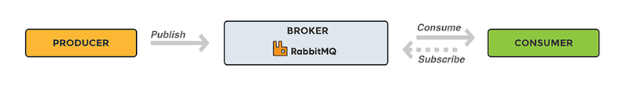
RabbitMQ
A message broker acts as a middleman for various services (e.g. a web application, as in this example). They can be used to reduce loads and delivery times of web application servers by delegating tasks that would normally take up a lot of time or resources to a third party that has no other job.

Slide 3
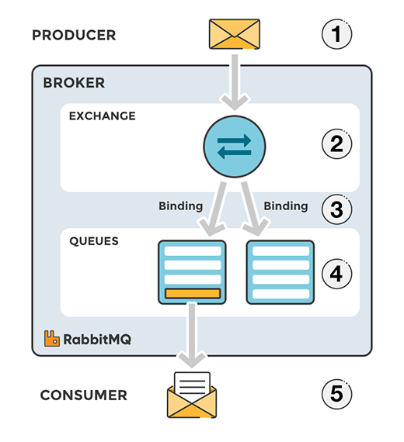
EXCHANGES
an act of giving one thing and receiving another (especially of the same kind) in return:
Messages are not published directly to a queue; instead, the producer sends messages to an exchange. An exchange is responsible for routing the messages to different queues with the help of bindings and routing keys. A binding is a link between a queue and an exchange.

Slide 4
Message flow in RabbitMQ
The producer publishes a message to an exchange.
The exchange receives the message and is now responsible for routing the message. The exchange takes different message attributes into account, such as the routing key, depending on the exchange type.
Bindings must be created from the exchange to queues. In this case(image in previous slide), there are two bindings to two different queues from the exchange. The exchange routes the message into the queues depending on message attributes.
The messages stay in the queue until they are handled by a consumer

Slide 5
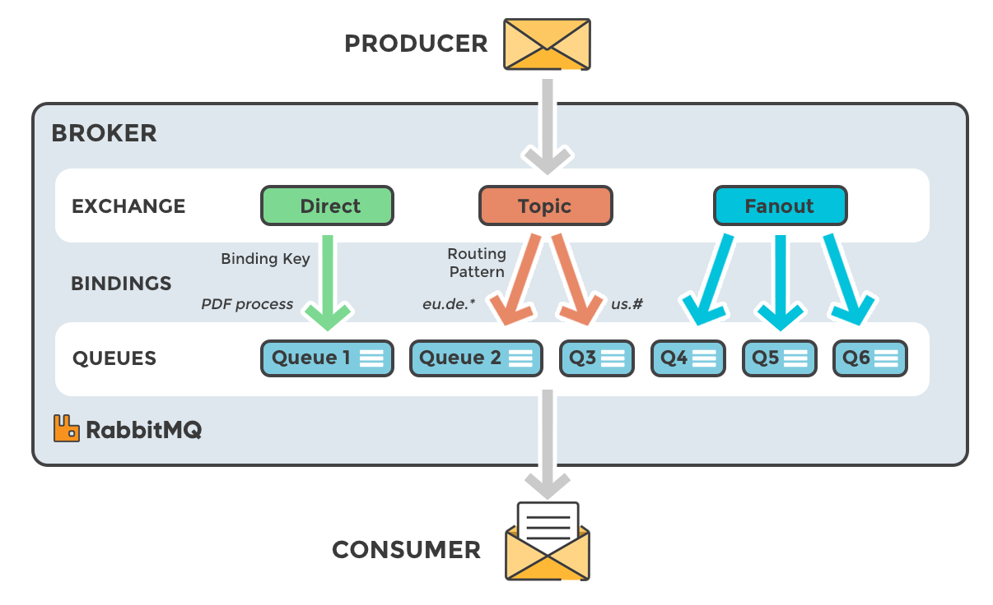
TYPES OF EXCHANGES

Slide 6
TYPES OF EXCHANGES contd..
Direct: The message is routed to the queues whose binding key exactly matches the routing key of the message. For example, if the queue is bound to the exchange with the binding key pdfprocess, a message published to the exchange with a routing key pdfprocess is routed to that queue.
Fanout: A fanout exchange routes messages to all of the queues bound to it.
Topic: The topic exchange does a wildcard match between the routing key and the routing pattern specified in the binding.
Headers: Headers exchanges use the message header attributes for routing.

Slide 7
RABBITMQ AND SERVER CONCEPTS
Producer: Application that sends the messages.
Consumer: Application that receives the messages.
Queue: Buffer that stores messages.
Message: Information that is sent from the producer to a consumer through RabbitMQ.
Connection: A TCP connection between your application and the RabbitMQ broker.
Channel: A virtual connection inside a connection. When publishing or consuming messages from a queue - it's all done over a channel.
Exchange: Receives messages from producers and pushes them to queues depending on rules defined by the exchange type. To receive messages, a queue needs to be bound to at least one exchange.
Binding: A binding is a link between a queue and an exchange.
Routing key: A key that the exchange looks at to decide how to route the message to queues. Think of the routing key like an address for the message.

Slide 8
static final String topicExchangeName = "spring-boot-exchange";
static final String queueName = "spring-boot";
@Bean Queue queue() {
return new Queue(queueName, false);
}
@Bean TopicExchange exchange() {
return new TopicExchange(topicExchangeName);
}
@Bean Binding binding(Queue queue, TopicExchange exchange)
{
return BindingBuilder.bind(queue).to(exchange).with("foo.bar.#");
}

Slide 9
When is a message considered dead ?
There are three identified situations where a message becomes undeliverable after reaching RabbitMQ:
A message is negatively acknowledged by the consumer
The TTL(time to live) of a message expires
The queue reaches capacity.
All this messages are sent to dead letter queue

Slide 10
References
https://medium.com/javarevisited/getting-started-with-rabbitmq-in-spring-boot-6323b9179247

