Slide 1
SQL-Interview-Questions

Slide 2
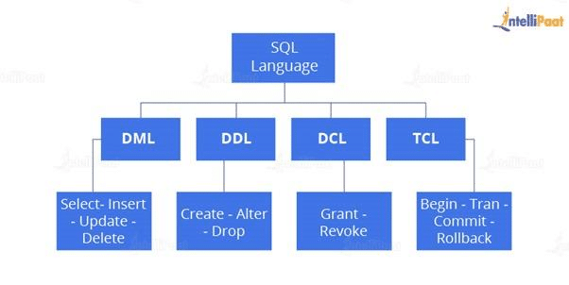

Slide 3
What is SQL, and what are its key components?
SQL (Structured Query Language) is a standardized programming language for managing and manipulating relational databases. It serves as a means of communication between users and databases, allowing them to perform various tasks such as querying data, inserting or updating records, creating and modifying database structures, and controlling access to data.
The key components of SQL include:
Data definition language (DDL): DDL statements are used to define and modify the structure of the database. They include commands like CREATE, ALTER, and DROP, which are used to create or modify tables, indexes, views, constraints, and other database objects.
Data manipulation language (DML): DML statements are used to retrieve, insert, update, and delete data in a database. The main DML commands are SELECT, INSERT, UPDATE, and DELETE, which allow users to perform actions on the data stored in the tables.
Data control language (DCL): DCL statements are used to manage user privileges and control access to the database. GRANT and REVOKE are the primary DCL commands, enabling the granting or revoking of permissions to users or roles.
Transaction control language (TCL): TCL statements are used to manage transactions within a database. They include commands like COMMIT, ROLLBACK, and SAVEPOINT, which ensure data consistency and integrity by defining transaction boundaries and controlling their outcomes.

Slide 4
What are primary keys and foreign keys in SQL?
In SQL, primary keys and foreign keys are used to establish relationships between tables in a relational database. Here's an explanation of each:
A primary key is a column or a set of columns in a table that uniquely identifies each row in that table. It provides a way to ensure data integrity and enforce entity integrity rules. The primary key must have the following characteristics:
It must contain unique values.
It cannot have NULL values.
There can only be one primary key defined per table.
Typically, the primary key is created when the table is initially designed, and it is used to identify each record in the table uniquely. Primary keys are often used as a basis for establishing relationships with other tables through foreign keys.
A foreign key is a column or a set of columns in a table that refers to the primary key of another table. It establishes a link between two tables, enforcing referential integrity and defining a relationship between them. The foreign key column in one table references the primary key column in another table.
The foreign key ensures that the values in the referencing column (foreign key column) match the values in the referenced column (primary key column). It provides a way to maintain data consistency and integrity across related tables.

Slide 5
Describe the differences between the INNER JOIN and OUTER JOIN in SQL
In SQL, JOIN operations are used to combine rows from two or more tables based on a related column between them. The INNER JOIN and OUTER JOIN are two types of join operations with distinct characteristics. Here's a breakdown of their differences:
INNER JOIN:
An INNER JOIN returns only the rows where there is a match between the joining columns in both tables.
It combines rows from two or more tables based on a specified condition, called the join predicate.
The resulting rows include only the matching records from both tables.
If there are no matching records, the rows from both tables are excluded from the result set.
The syntax for an INNER JOIN is as follows:
SELECT columns
FROM table1
INNER JOIN table2 ON join_condition;

Slide 6
OUTER JOIN:
An OUTER JOIN returns all the rows from one table and the matching rows from the other table(s). It includes unmatched rows as well.
It combines rows from two or more tables based on a specified condition, just like an INNER JOIN.
However, an OUTER JOIN includes non-matching rows by filling the missing values with NULLs.
There are three types of OUTER JOIN: LEFT OUTER JOIN, RIGHT OUTER JOIN, and FULL OUTER JOIN.
LEFT OUTER JOIN: Returns all the rows from the left table and the matching rows from the right table(s). If there are no matches, NULL values are filled in for the columns of the right table.
RIGHT OUTER JOIN: Returns all the rows from the right table and the matching rows from the left table(s). If there are no matches, NULL values are filled in for the columns of the left table.
FULL OUTER JOIN: Returns all the rows from both tables, including matching and non-matching rows. If there are no matches, NULL values are filled in for the columns of the non-matching table.
The syntax for an OUTER JOIN varies depending on the specific type of OUTER JOIN, but here's an example of a LEFT OUTER JOIN:
SELECT columns
FROM table1
LEFT OUTER JOIN table2 ON join_condition;

Slide 7
Explain the types of SQL joins.
Inner Join is mostly used to join queries
SELECT * FROM Table_A JOIN Table_B; SELECT * FROM Table_A INNER JOIN Table_B;
Left (Outer) Join: The use of left join is to retrieve all the records or rows from the left and the matched ones from the right.
SELECT * FROM Table_A A LEFT JOIN Table_B B ON A.col = B.col;
Right (Outer) Join: The use of Right join is to retrieve all the records or rows from the right and the matched ones from the left.
SELECT * FROM Table_A A RIGHT JOIN Table_B B ON A.col = B.col;
Full (Outer) Join: The use of Full join is to retrieve the records that have a match either in the left table or the right table.
SELECT * FROM Table_A A FULL JOIN Table_B B ON A.col = B.col;

Slide 8
SQL indexes are data structures that allow for efficient retrieval of data from a database. They are used to speed up queries and improve database performance by reducing the amount of data that needs to be scanned to find the desired information.
Indexes are created on one or more columns in a table, and they work by creating a separate data structure that contains a copy of the indexed data. This data structure is organized in a way that allows for quick lookups, similar to an index in a book. When a query is executed that includes the indexed column(s), the database engine can use the index to quickly locate the relevant data.
CREATE INDEX index_name
ON table_name (column_name);
The CREATE INDEX statement creates a new index with the name index_name on the table table_name. The column column_name is the column on which the index is being created.
Example
For example, suppose we have a table called users with columns id, username, and email. We can create an index on the username column like this:
CREATE INDEX username_index
ON users (username);
https://www.atlassian.com/data/sql/how-indexing-works

Slide 9
Imagine you want to find a piece of information that is within a large database. To get this information out of the database the computer will look through every row until it finds it. If the data you are looking for is towards the very end, this query would take a long time to run.
Visualization for finding the last entry:

Slide 10
If the table was ordered alphabetically, searching for a name could happen a lot faster because we could skip looking for the data in certain rows. If we wanted to search for “Zack” and we know the data is in alphabetical order we could jump down to halfway through the data to see if Zack comes before or after that row. We could then half the remaining rows and make the same comparison.
This took 3 comparisons to find the right answer instead of 8 in the unindexed data.
Indexes allow us to create sorted lists without having to create all new sorted tables, which would take up a lot of storage space.

Slide 11
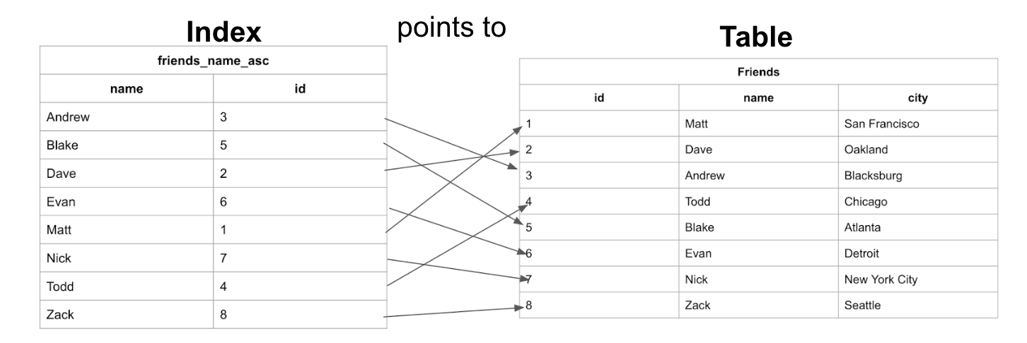
What exactly is an Index?
An index is a structure that holds the field the index is sorting and a pointer from each record to their corresponding record in the original table where the data is actually stored. Indexes are used in things like a contact list where the data may be physically stored in the order you add people’s contact information but it is easier to find people when listed out in alphabetical order.
Let’s look at the index from the previous example and see how it maps back to the original Friends table:
We can see here that the table has the data stored ordered by an incrementing id based on the order in which the data was added. And the Index has the names stored in alphabetical order.
https://www.atlassian.com/data/sql/how-indexing-works

Slide 12
Explain the types of indexes.
https://www.progress.com/tutorials/odbc/using-indexes
https://www.atlassian.com/data/databases/how-does-indexing-work
Primary Index: Think of it as the main key to a building. It is unique and provides entrance into all rooms. In the same way that a primary index in a database uniquely identifies each row and speeds up searches.
Secondary Index: Imagine this like one departmental index in a noticeably big library. Whereas the primary index leads you to the book, the secondary index helps narrow down your search within specific sections, so you find it quicker.
Clustered Index: Picture this as organizing books on shelves with alphabetical titles. Consequently, it organizes data physically in a table that matches the sequence of the index thereby facilitating easy retrieval just like finding them on shelves well arranged.
Non-Clustered Index: Just like card catalogues, a clustered index sorts out data on the shelf while a non-clustered index gives another lookup for some information that can be narrowed down further for ease in searching.

Slide 13
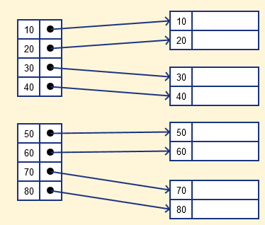
Primary Index
Primary Indexing: The indexing or the index table created using Primary keys is known as Primary Indexing. It is defined on ordered data. As the index is comprised of primary keys, they are unique, not null, and possess one to one relationship with the data blocks. It consists of two fields
The first field is the same a primary key and second, filed is pointed to that specific data block. In the primary Index, there is always one to one relationship between the entries in the index table.
The primary Indexing in DBMS is also further divided into two types.
Dense Index
Sparse Index
Dense Index For every search key value in the data file, there is an index record. In this Indexing, method records contain search key value and points to the real record on the disk.

Slide 14
Characteristics of Primary Indexing:
Search Keys are unique.
Search Keys are in sorted order.
Search Keys cannot be null as it points to a block of data.
Fast and Efficient Searching.

Slide 15
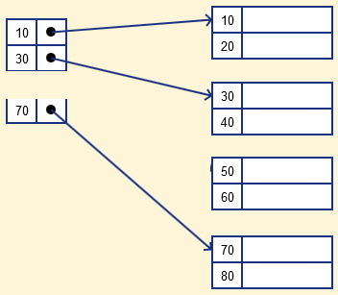
Sparse Index The index record appears only for a few items in the data file
sparse Index stores index records for only some search-key values. It needs less space, less maintenance overhead for insertion, and deletions but It is slower compared to the dense Index for locating records.

Slide 16
Secondary Indexes
A secondary index is an additional index that is not part of the primary key. It can be created on any column or expression that is frequently used in queries or joins. A secondary index can have duplicate or null values, and it can be either unique or non-unique. A secondary index can improve the performance of queries that filter, sort, or group by the indexed column or expression. For example, you can use a secondary index on a last_name column to speed up queries that search for customers by their last names.
Secondary Indexing
Secondary indexing is used to improve the search performance of frequently queried non-key attributes/columns in a database table.
Unlike primary indexing, which is based on the primary key, secondary indexing focuses on non-key columns.
It creates an index structure that maps the values of the indexed column to the corresponding disk block addresses or pointers where the records are stored.
Secondary indexes enable faster access to records based on the values in the indexed column, reducing the need for full table scans.

Slide 17
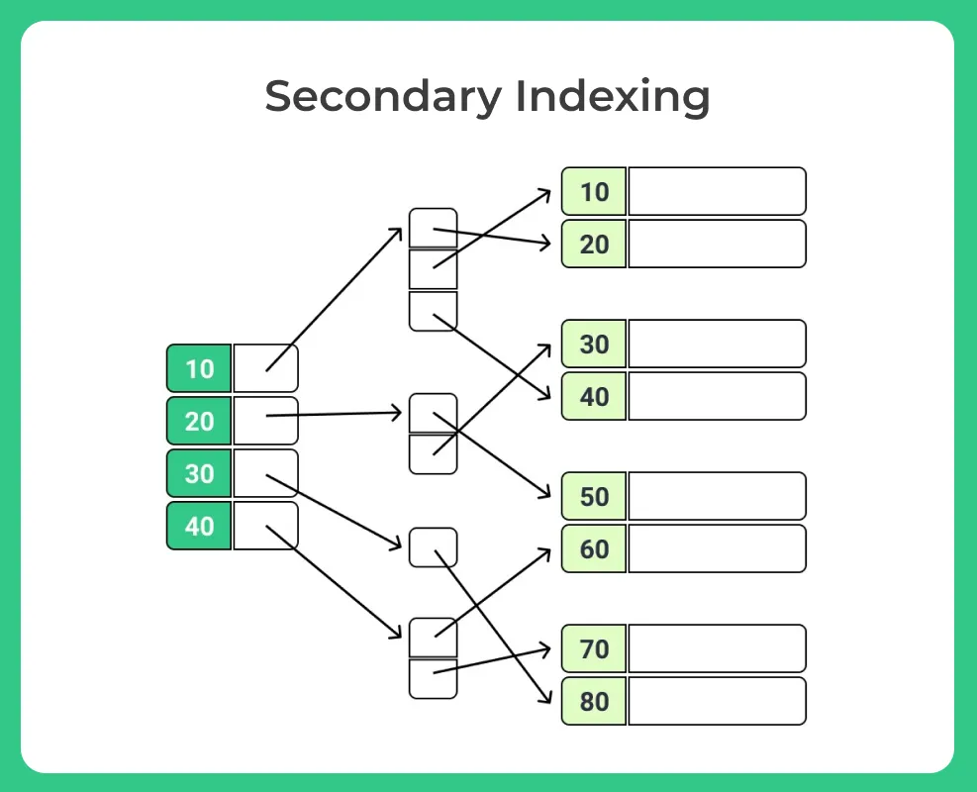
Secondary Indexes
Example
Creation of Secondary Index: A secondary index is created on the “Location” column of the customer database table.
Index Structure: The secondary index structure maps distinct “Location” values to their corresponding disk block addresses or pointers.
Efficient Location-based Queries: With the secondary index, queries that involve searching for customers based on a specific location can be executed more efficiently.

Slide 18
Cluster Indexing
Cluster indexing is a method of indexing used in database management systems (DBMS) to physically order records in a table based on the indexed columns.
The indexed column(s) in a cluster index determine the physical order of the records in the table.
Cluster indexing is particularly useful for range queries and sequential access patterns.
Cluster indexing can be applied to both primary and secondary indexes, depending on the DBMS capabilities and requirements.
In such a situation, you can group two or more columns to get the unique values and create an index which is called clustered Index. This also helps you to identify the record faster.
Example
Let’s consider a database table called “Employees” with columns like “EmployeeID,” “Name,” “Department,” and “Salary.”
We decide to create a cluster index on the “Department” column.
The cluster index organizes the data physically on disk based on the “Department” values.
Rows with the same “Department” value are stored together in the same or nearby data pages.
For example, all employees from the “Sales” department will be stored together, followed by the “Marketing” department, and so on.
When a query is executed that involves filtering or sorting based on the “Department” column, the database can quickly locate the relevant data pages.
This improves query performance, as the database doesn’t need to scan the entire table but can directly access the clustered data pages.

Slide 19
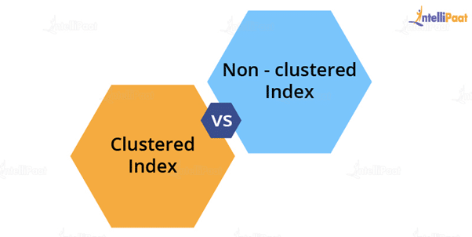
State the differences between clustered and non-clustered indexes
Clustered Index: It is used to sort the rows of data by their key values. A clustered index is like the contents of a phone book. We can directly open the book on David’s index (for “David, Thompson”) and find information for all Davids right next to each other. Since the data are located next to each other, it helps a lot in fetching the data based on range-based queries. A clustered index is actually related to how the data is stored; only one clustered index is possible per table.
Non-Clustered Index: It stores data at one location and indexes at another location. The index has pointers that point to the location of the data. As the indexes in a non-clustered index are stored in a different place, there can be many non-clustered indexes for a table.

Slide 20
Parameters | Clustered Index | Non-Clustered Index
Used For | Sorting and storing records physically in memory | Creating a logical order for data rows; pointers are used for physical data files
Methods for Storing | Stores data in the leaf nodes of the index | Never stores data in the leaf nodes of the index
Size | Quite large | Comparatively, small
Data Accessing | Fast | Slow
Additional Disk Space | Not required | Required to store indexes separately
Type of Key | By default, the primary key of a table is a clustered index | It can be used with the unique constraint on the table that acts as a composite key
Main Feature | Improves the performance of data retrieval | Should be created on columns used in Joins

Slide 21
Explain the differences between clustered and non-clustered indexes in SQL Server
Non-clustered index:
Structure: A non-clustered index creates a separate structure that includes the indexed column(s) and a pointer to the actual data rows.
Multiple indexes: A table can have multiple non-clustered indexes, allowing for different indexing strategies based on query requirements.
Data storage: The data rows in a table with a non-clustered index are stored separately from the index structure. The index structure contains a copy of the indexed column(s) and a pointer to the corresponding data row.
Performance impact: Non-clustered indexes are beneficial for improving query performance by allowing quick data lookup based on the indexed column(s). They generally have minimal impact on data modification operations.

Slide 22
How would you optimize a slow-performing query in SQL Server?
To optimize a slow-performing query in SQL Server, follow these steps:
Analyze the query execution plan for potential issues.
Use appropriate indexing to improve query performance.
Retrieve only necessary columns and rows to minimize data retrieval.
Optimize join conditions and types for efficient data retrieval.
Simplify complex queries by breaking them into smaller parts.
Update table and index statistics for accurate query optimization.
Tune server configuration settings based on hardware and workload.
Consider query rewriting or caching to improve performance.
Monitor and optimize I/O performance.
Keep SQL Server updated and maintain the database regularly.

Slide 23
Query caching
“query caching mechanisms to store and retrieve precomputed query results for frequently executed read-heavy queries. By leveraging technologies like memcached and Redis, I reduced the load on the database server and improved the overall application response time.”

Slide 24
What are triggers in Oracle PL/SQL, and what are their types?
Triggers in Oracle PL/SQL are programs that automatically execute in response to events like database modifications or system-level events. They enforce rules, maintain data integrity, and automate tasks. There are two types: row-level triggers (fire for each affected row) and statement-level triggers (fire once per event). Triggers are valuable for enforcing constraints, automating actions, and implementing business logic in the database.

Slide 25
Parameters | DBMS | RDBMS
Access | Data elements need to be accessed separately | Multiple data elements can be accessed at the same time
Relationship Between Data | No relationship between data | Data in tables are related to each other
Normalization | It is not present | It is present
Distributed Database | It does not support distributed databases. | It supports distributed database
Data Storage Format | Data is stored in either a navigational or hierarchical form | Data is stored in a tabular structure with headers being the column names and the rows containing the corresponding values
Amount of Data | It deals with a small quantity of data | It deals with a larger amount of data
Data Redundancy | It is prevalent | Keys and indexes do not allow data redundancy
Number of Users | It supports a single user | It supports multiple users
Data Fetching | It is slower for large amounts of data | It is speedy due to the relational approach
Data Security | Low-security levels when it comes to data manipulation | Multiple levels of data security exist
Software and Hardware Requirements | Low | High
Examples | XML, Window Registry, etc. | MySQL, SQL Server, Oracle, Microsoft Access, PostgreSQL, etc.

Slide 26
SQL | PL/SQL
It is a database structured query language | It is a programming language for a database that uses SQL
It is an individual query that is used to execute DML and DDL commands | It is a block of codes used to write the entire procedure or a function
It is a declarative and data-oriented language | It is a procedural and application-oriented language
It is mainly used for data manipulation | It is used for creating applications
It provides interaction with the database server | It does not provide interaction with the database server
It cannot contain PL/SQL code | It can contain SQL because it is an extension of SQL

Slide 27
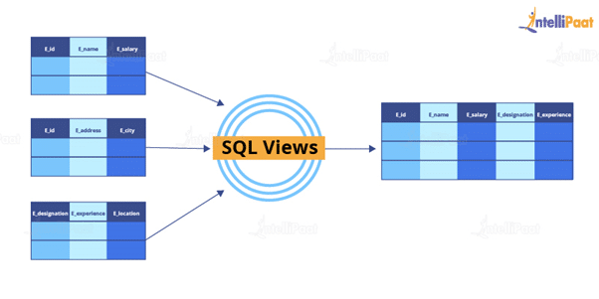
What are views? Give an example.
Views are virtual tables used to limit the tables that we want to display. Views are nothing but the result of an SQL statement that has a name associated with it. Since views are not physically present, they take less space to store.
Let us consider an example. In the following employee table, say we want to perform multiple operations on the records with the gender “Female”. We can create a view-only table for the female employees from the entire employee table.
Now, let us implement it on SQL Server.

Slide 28
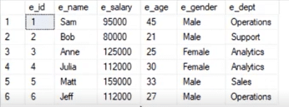

This is the employee table:
create view female_employee as select * from employee where e_gender=’Female’
select * from female_employee
OutPut

Slide 29
Views | Tables
A view is a virtual table that is extracted from a database. | A table is structured with a set number of columns and a boundless number of rows.
A view does not hold the data itself. | A table contains data and stores it in databases.
A view is utilized to query certain information contained in a few distinct tables. | A table holds fundamental client information and cases of a characterized object.
In a view, we will get frequently queried information. | In a table, changing the information in the database changes the information that appears in the view

Slide 30
What are the types of views in SQL?
In SQL, the views are classified into four types. They are the following:
Simple View: It is a view based on a single table and does not have a GROUP BY clause or other features.
Complex View: It is a view built from several tables and includes a GROUP BY clause as well as functions.
Inline View: It is a view built on a subquery in the FROM clause, which provides a temporary table and simplifies a complicated query.
Materialized View: It is a view that saves both the definition and the details. It builds data replicas by physically preserving them.
https://www.linkedin.com/pulse/what-some-common-uses-views-sql-databases-amr-saafan/

Slide 31
What do you understand by Self Join? Explain using an example
Self Join in SQL is used for joining a table with itself. Here, depending on some conditions, each row of the table is joined with itself and with other rows of the table.
SELECT a.column_name, b.column_name
FROM table a, table b
WHERE condition
SELECT a.ID, b.NAME, a.SALARY FROM CUSTOMERS a, CUSTOMERS b WHERE a.SALARY < b.SALARY

Slide 32
What is the difference between HAVING and WHERE clauses?
The main difference between the ‘HAVING’ and ‘WHERE’ clauses in SQL is that the ‘WHERE’ clause operates on individual rows of data, while the ‘HAVING’ clause is used to filter aggregated data. The ‘WHERE’ clause cannot be used with aggregate functions, whereas the ‘HAVING’ clause specifically filters results based on aggregate conditions.
UPDATE table_name SET price = price*1.05;

Slide 33
The self join is a popular special case of the SQL JOIN. While most JOINs link two or more tables with each other to present their data together, a self join links a table to itself. This is usually done by joining a table to itself just once within a SQL query, but it is possible to do so multiple times within the same query.
The self join, as its name implies, joins a table to itself. To use a self join, the table must contain a column (call it X) that acts as the primary key and a different column (call it Y) that stores values that can be matched up with the values in Column X. The values of Columns X and Y do not have to be the same for any given row, and the value in Column Y may even be null.

Slide 34
Let’s take a look at an example. Consider the table Employee
Id | FullName | Salary | ManagerId
1 | John Smith | 10000 | 3
2 | Jane Anderson | 12000 | 3
3 | Tom Lanon | 15000 | 4
4 | Anne Connor | 20000
5 | Jeremy York | 9000 | 1
Each employee has his/her own Id, which is our “Column X.” For a given employee (i.e., row), the column ManagerId contains the Id of his or her manager; this is our “Column Y.” If we trace the employee-manager pairs in this table using these columns:

Slide 35
The manager of the employee John Smith is the employee with Id 3, i.e., Tom Lanon.
The manager of the employee Jane Anderson is the employee with Id 3, i.e., Tom Lanon.
The manager of the employee Tom Lanon is the employee with Id 4, i.e., Anne Connor.
The employee Anne Connor does not have a manager; her ManagerId is null.
The manager of the employee Jeremy York is the employee with Id 1, i.e., John Smith.
This type of table structure is very common in hierarchies. Now, to show the name of the manager for each employee in the same row, we can run the following query:
SELECT
employee.Id,
employee.FullName,
employee.ManagerId,
manager.FullName as ManagerName
FROM Employees employee
JOIN Employees manager
ON employee.ManagerId = manager.Id

Slide 36
https://learnsql.com/blog/what-is-self-join-sql/
https://intellipaat.com/blog/self-join-in-sql/
https://www.javatpoint.com/mysql-self-join
https://www.stratascratch.com/blog/illustrated-guide-about-self-join-in-sql/

Slide 37
A subquery is a query within a query. It's a separate task that needs to be completed before the main query can be executed. It's like asking the database to find some information first, and then using that information to find more specific information later.
https://www.javatpoint.com/sql-subquery
https://learnsql.com/blog/sql-subquery-examples/
https://www.w3resource.com/sql/subqueries/understanding-sql-subqueries.php#google_vignette
https://www.almabetter.com/bytes/tutorials/sql/types-of-subqueries-in-sql

Slide 38
https://www.shiksha.com/online-courses/articles/sql-left-join-examples-and-syntax/
https://learnsql.com/blog/left-join-examples/
https://www.shiksha.com/online-courses/articles/how-to-use-group-by-in-sql/
https://www.datacamp.com/tutorial/group-by-having-clause-sql
https://www.almabetter.com/bytes/tutorials/sql/group-by-clause-in-sql
https://www.scaler.com/topics/sql/group-by-in-sql/
https://www.linkedin.com/pulse/what-some-common-uses-views-sql-databases-amr-saafan/ // views

Slide 39
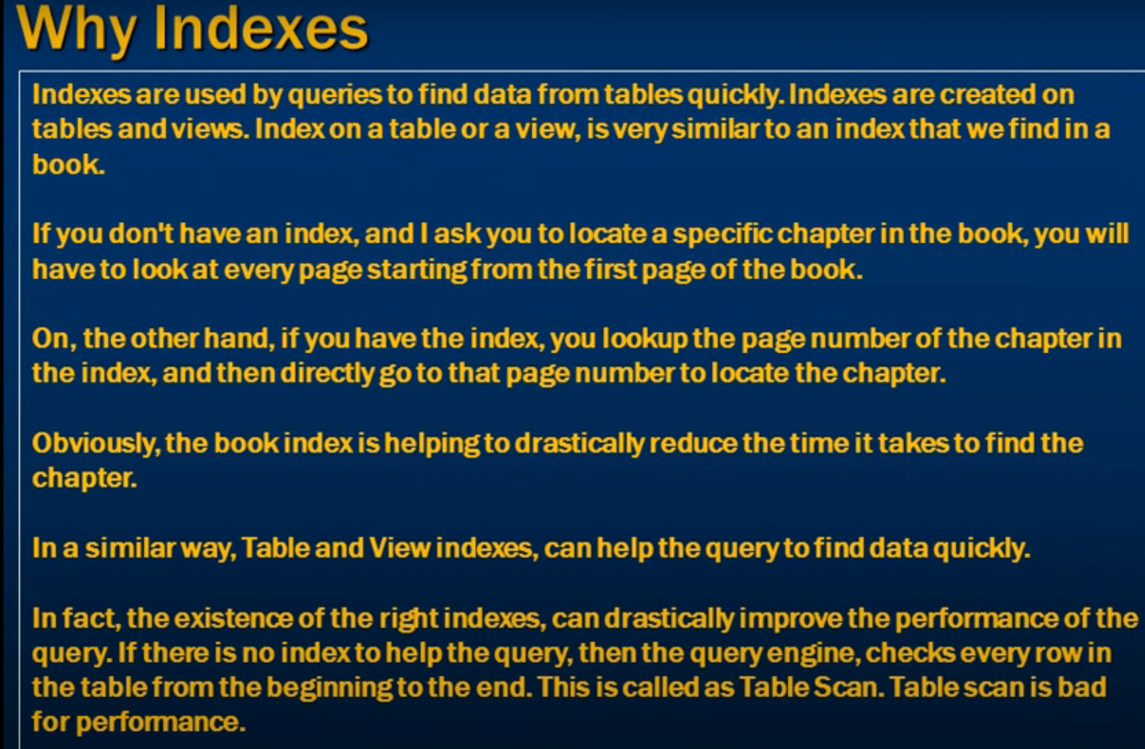

Slide 40
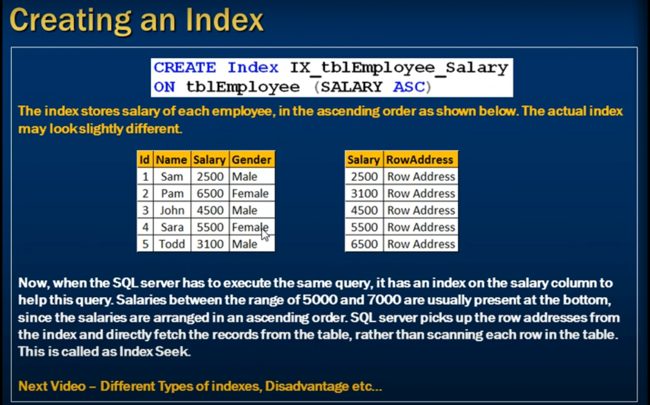

Slide 41
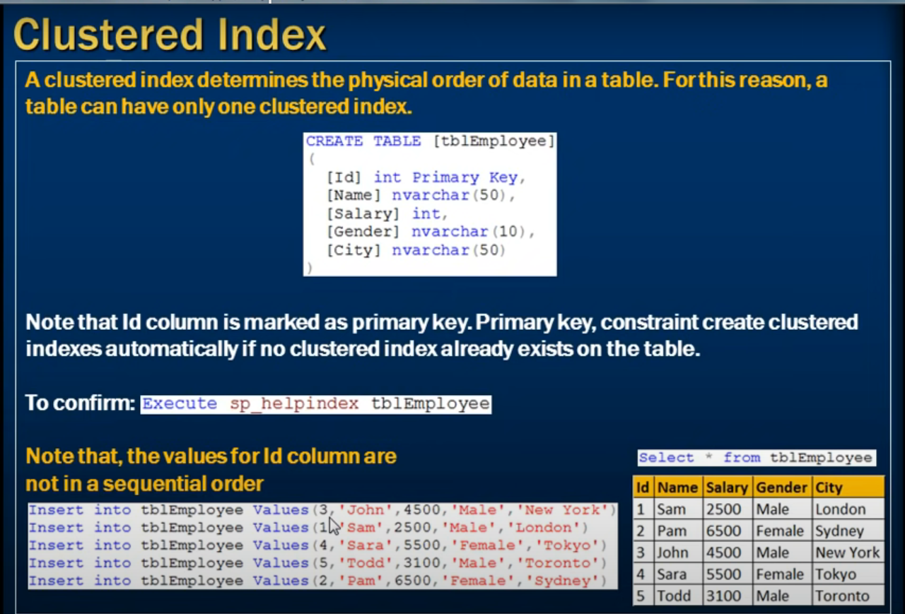

Slide 42
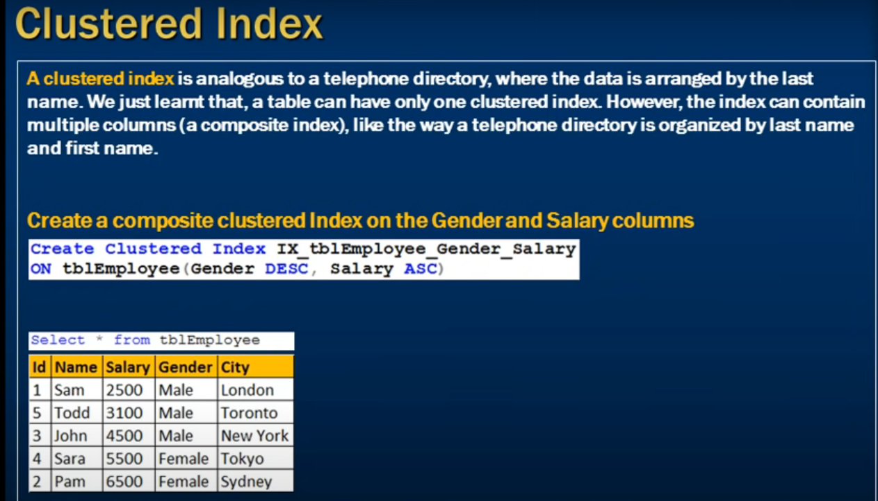

Slide 43
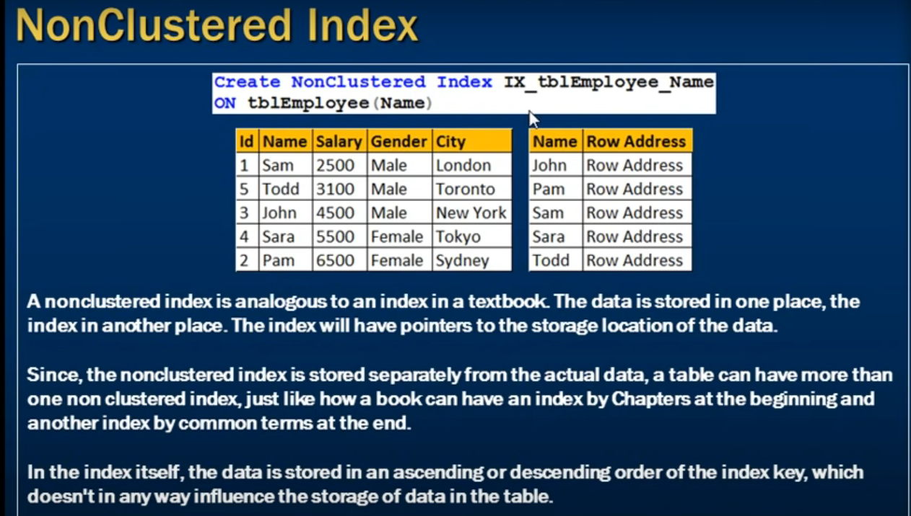

Slide 44
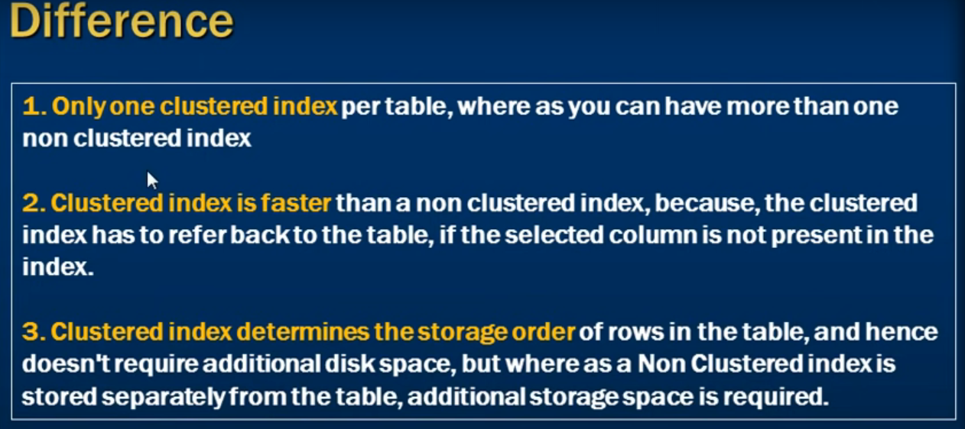

Slide 45
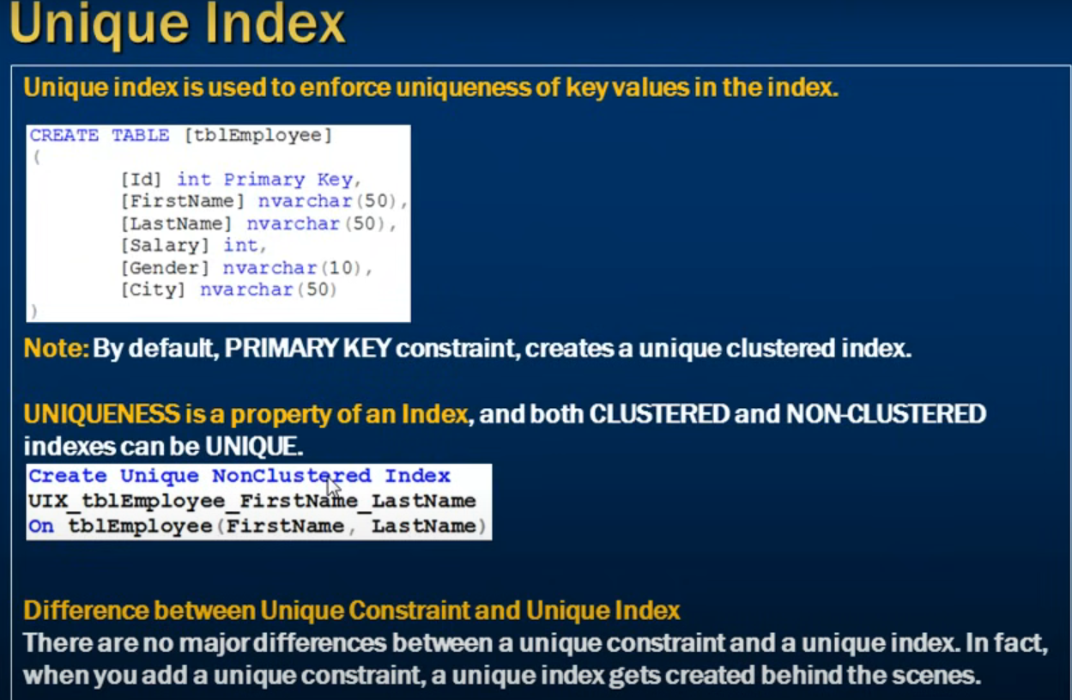

Slide 46
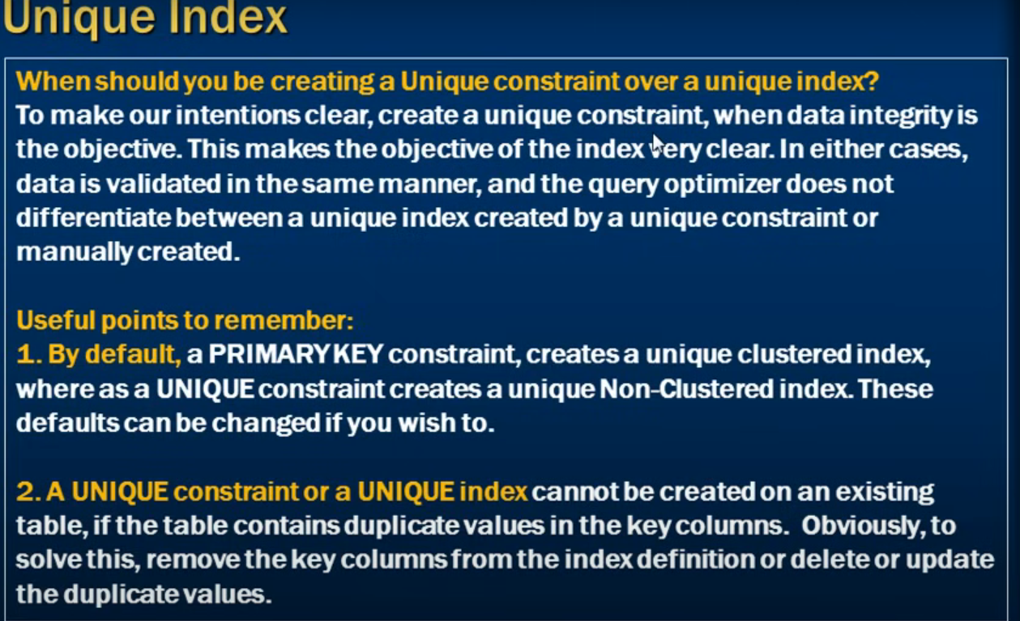

Slide 47
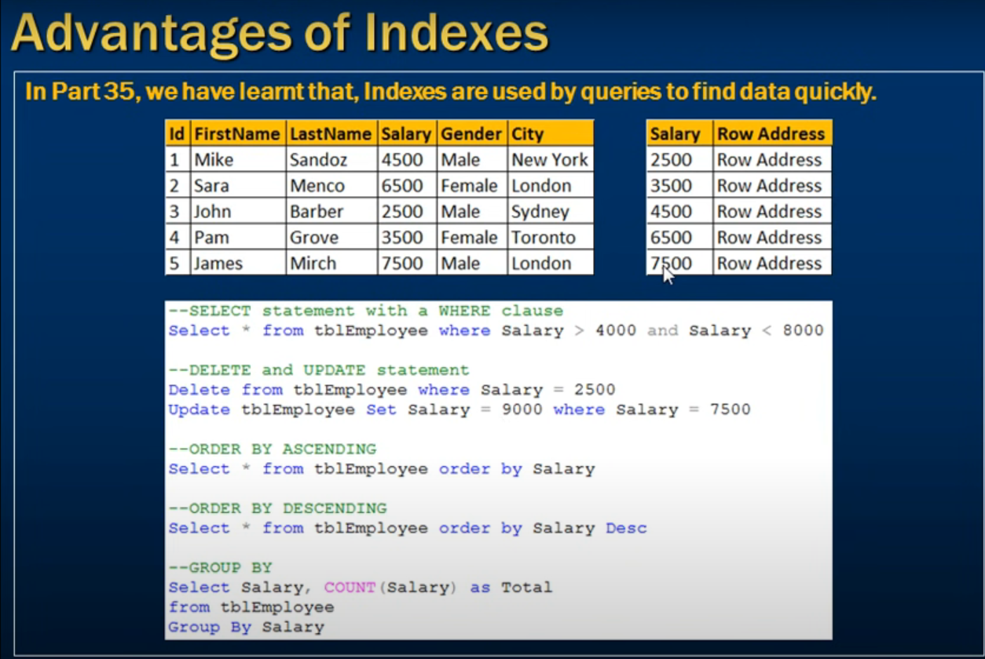

Slide 48
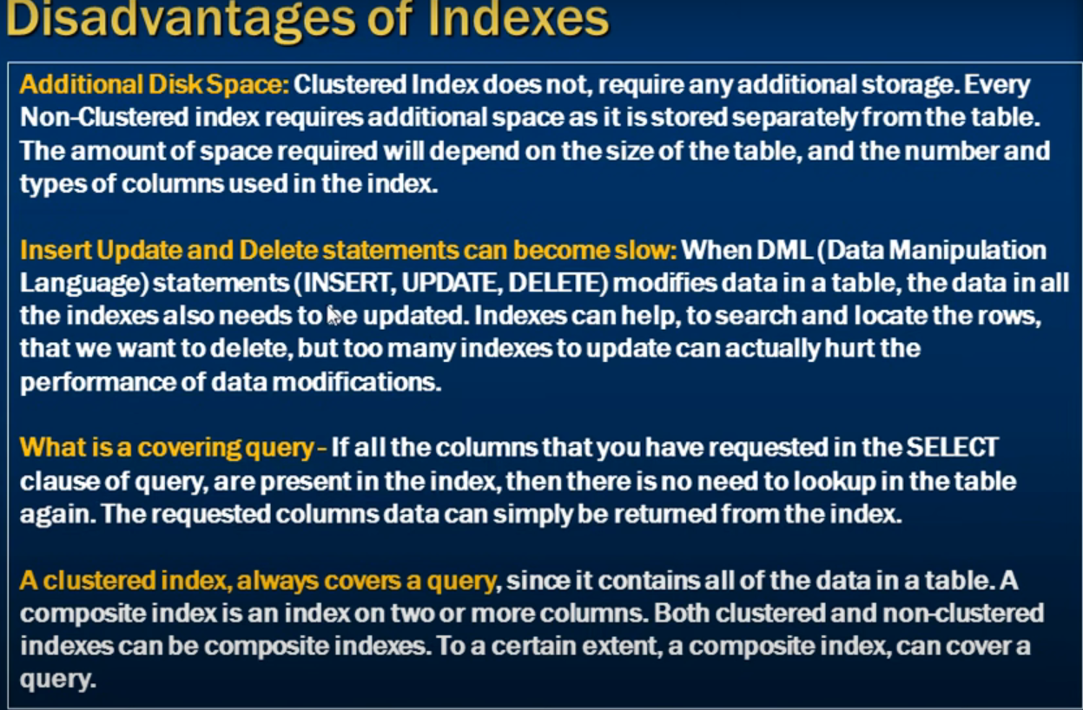

Slide 49
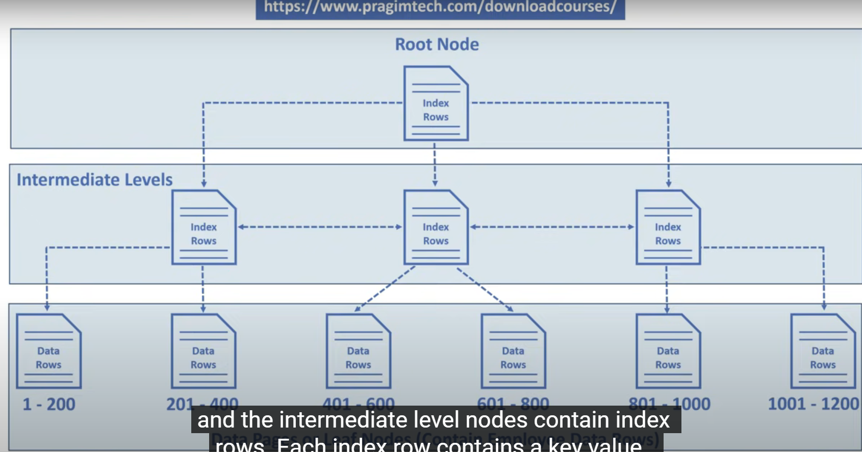

Slide 50
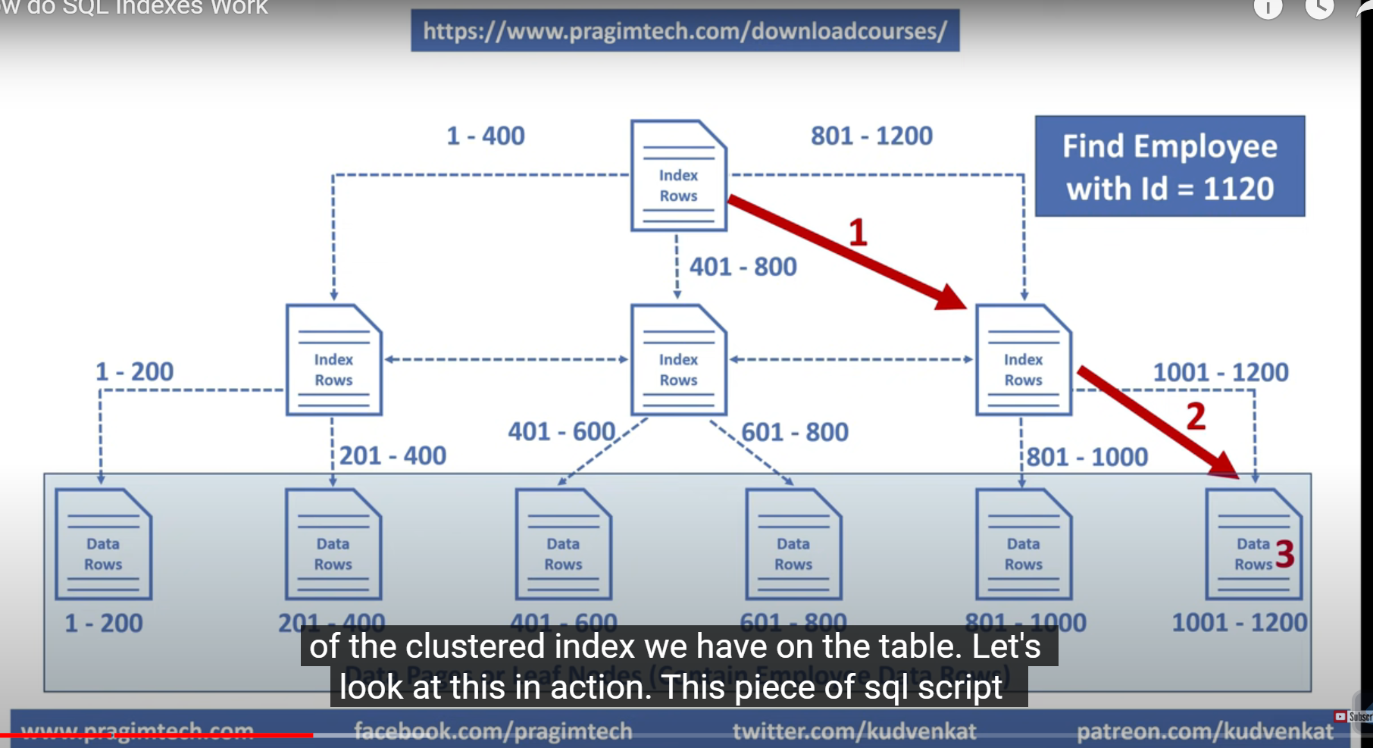

Slide 51
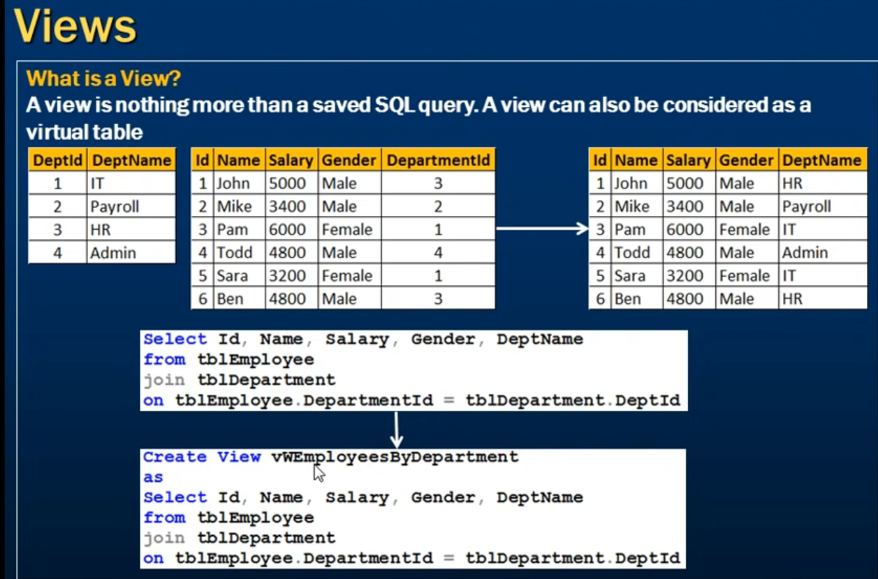
View does not store any data

Slide 52
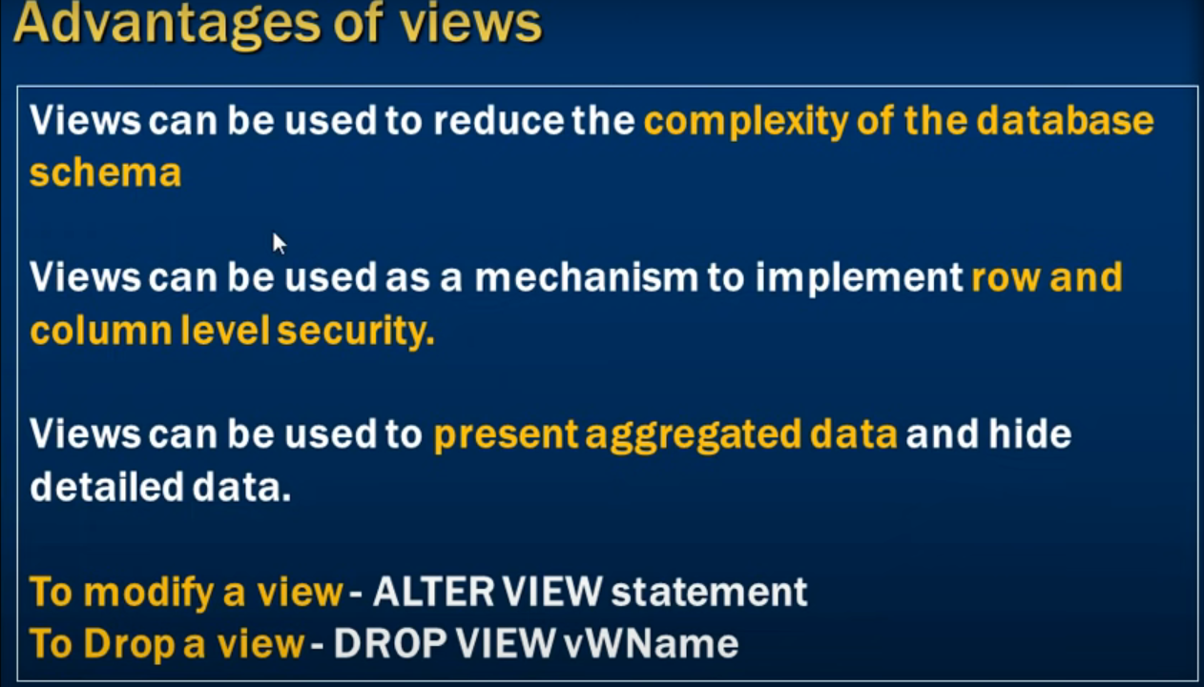

Slide 53
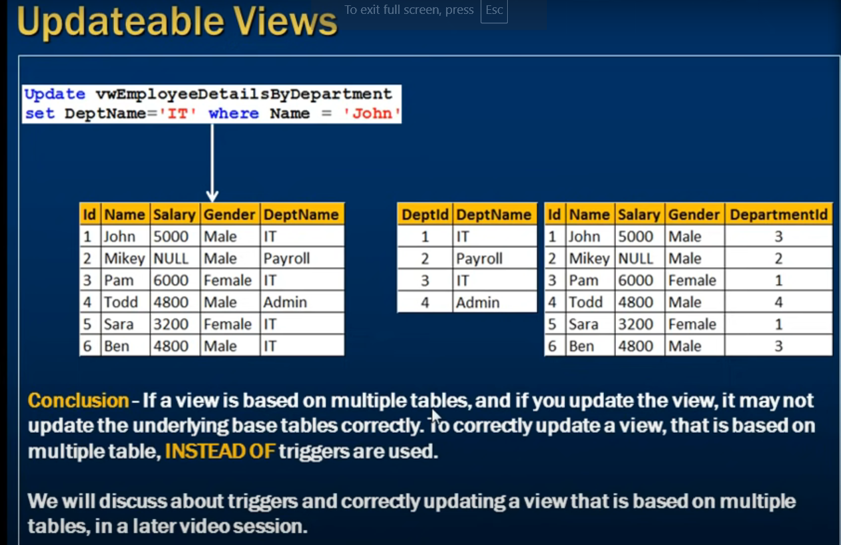

Slide 54
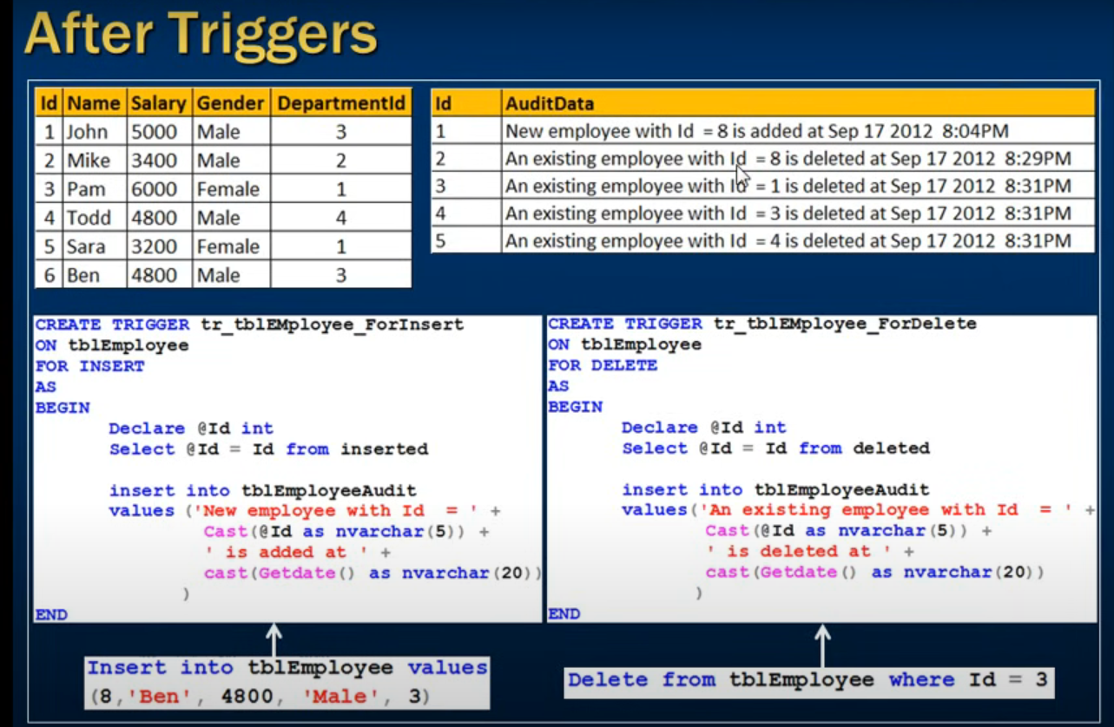

Slide 55
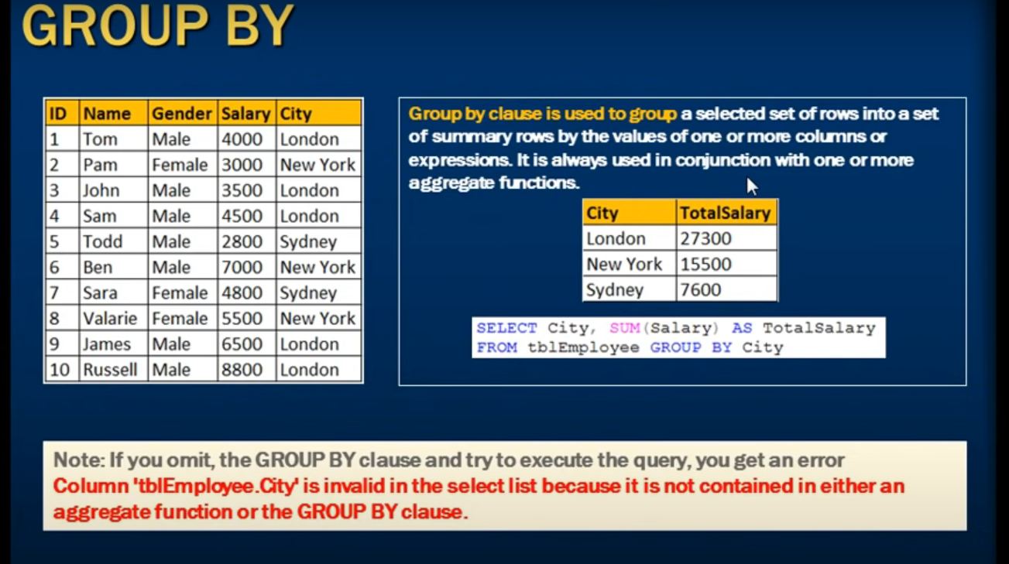

Slide 56
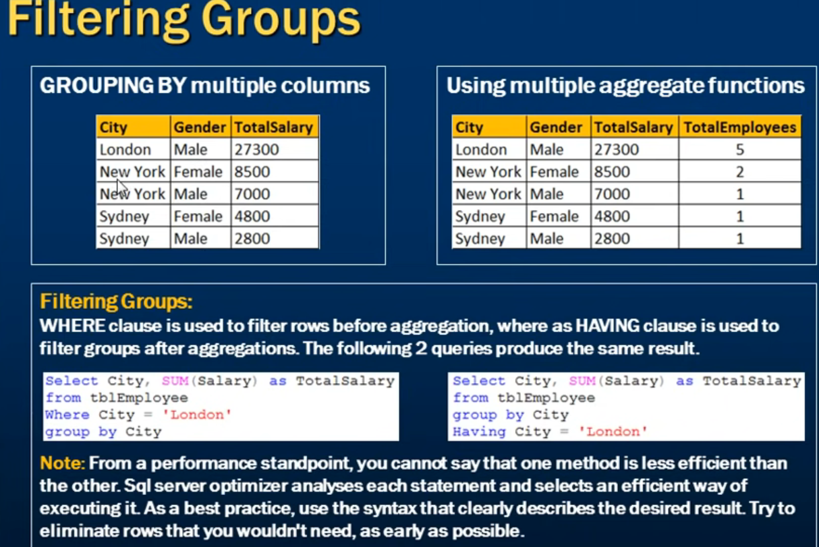

Slide 57
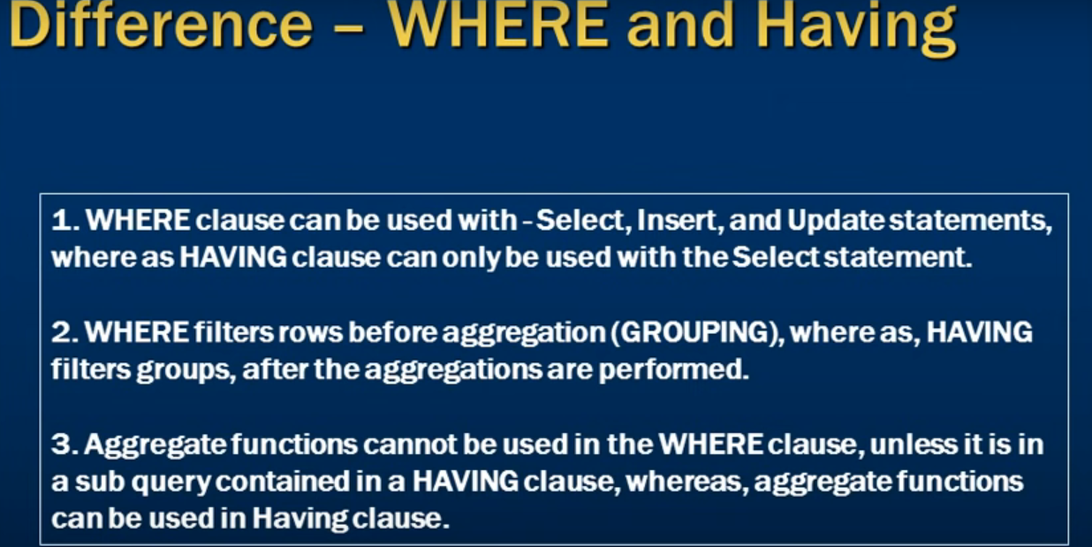

Slide 58
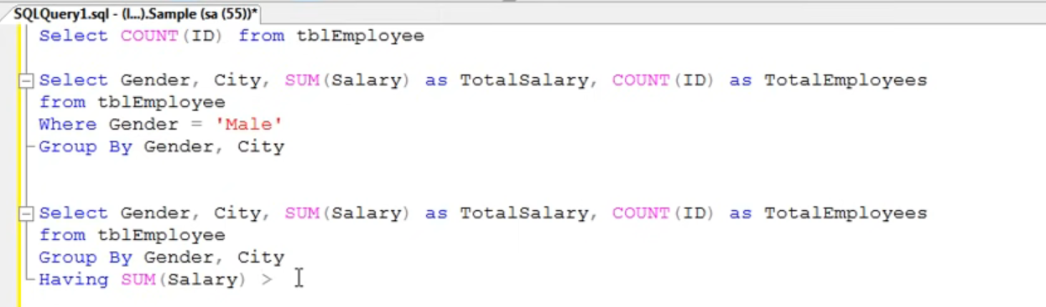
Having Clause With Aggregate Function

Slide 59
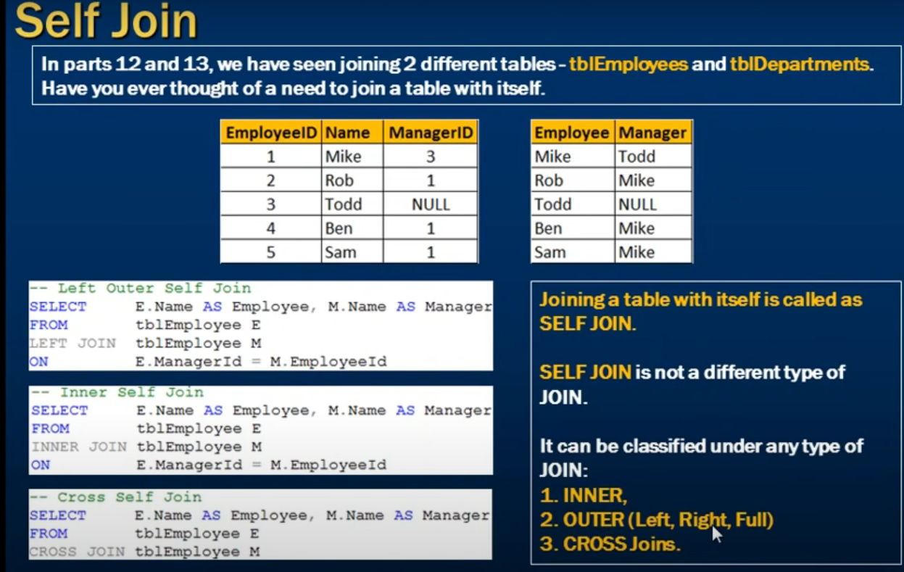

Slide 60
