Slide 1
AOP
We have to use @EnableAspectJAutoProxy in spring boot main class

Slide 2
Aspect-oriented programming (AOP) is defined as a coding approach that helps developers write cleaner, more organized code by separating common tasks, such as logging or error handling, from the main program logic.

Slide 3
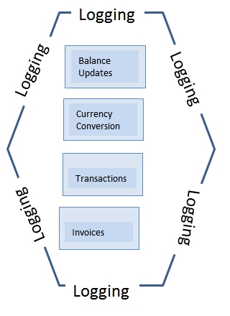
Defining aspects
Aspect: An aspect is a module that encapsulates advice and pointcuts and provides cross-cutting, An application can have any number of aspects. We can implement an aspect using regular class annotated with @Aspect annotation.. For example, you might create an aspect for order validation, another for payment processing, and so on.

Slide 4
Determining join points
A join point is a specific point in your program’s execution where an aspect can be applied. For example, a join point for the order validation aspect might be when a new order is submitted. You can define join points in your code using annotations or other markers.
Joinpoint: A join point is a specific point in the application such as method execution, exception handling, changing object variable values, etc. In Spring AOP a join point is always the execution of a method.
https://www.javaguides.net/2019/05/understanding-spring-aop-concepts-and-terminology-with-example.html

Slide 5
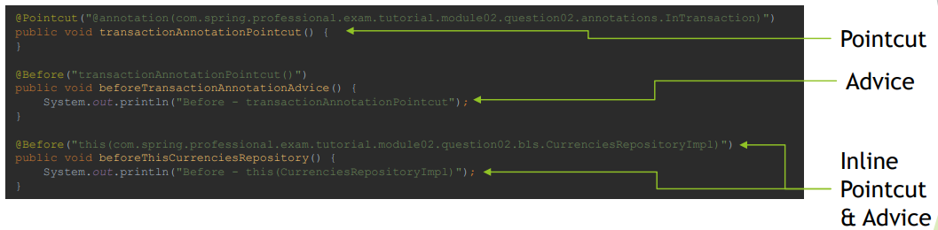
What is Advice?
Advice is additional behavior that will be inserted into the code, at each join point matched by pointcut.

Slide 6
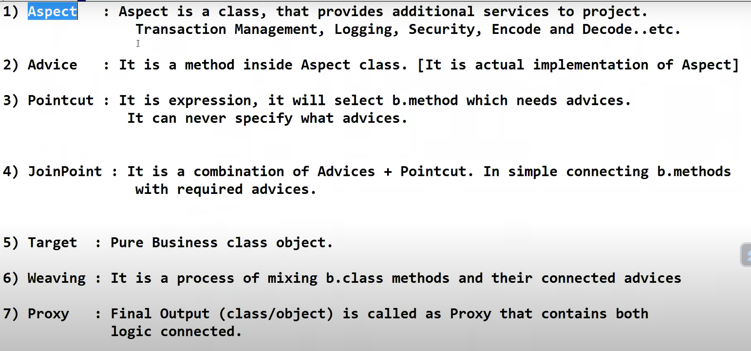
Aspect: An aspect is a module that encapsulates advice and pointcuts and provides cross-cutting An application can have any number of aspects. We can implement an aspect using regular class annotated with @Aspect annotation.

Slide 7
Aspect: An aspect is a module that encapsulates advice and pointcuts and provides cross-cutting An application can have any number of aspects. We can implement an aspect using regular class annotated with @Aspect annotation.
Pointcut: A pointcut is an expression that selects one or more join points where advice is executed. We can define pointcuts using expressions or patterns. It uses different kinds of expressions that matched with the join points. In Spring Framework, AspectJ pointcut expression language is used.
Join point: A join point is a point in the application where we apply an AOP aspect. Or it is a specific execution instance of an advice. In AOP, join point can be a method execution, exception handling, changing object variable value, etc.
Advice: The advice is an action that we take either before or after the method execution. The action is a piece of code that invokes during the program execution. There are five types of advices in the Spring AOP framework: before, after, after-returning, after-throwing, and around advice. Advices are taken for a particular join point. We will discuss these advices further in this section.
Target object: An object on which advices are applied, is called the target object. Target objects are always a proxied It means a subclass is created at run time in which the target method is overridden, and advices are included based on their configuration.
Weaving: Weaving is the process of applying the Advices to the Target objects at given pointcuts to get the Proxy Objects.
It is a process of linking aspects with other application types. We can perform weaving at run time, load time, and compile time.

Slide 8
In the realm of software development, certain functionalities or concerns spread across multiple parts of an application, affecting various modules. These are known as cross-cutting concerns
Join Point: These are specific points in your code where your aspect’s advice can run. For example, method executions, object creations, or exception handling can be Join points.
Weaving: Weaving is the process of integrating your aspects into your application code. In Spring Boot this happens automatically, so you don’t have to worry about it.
https://medium.com/@darogadibia/aspect-oriented-programming-for-dummies-775e1a432daa

Slide 9
These are specific points in your program, such as method executions, object instantiations, or even field access, where you might want to inject additional behavior or logic.
https://debugagent.com/spring-boot-debugging-with-aspect-oriented-programming-aop#heading-logging-aspect

Slide 10
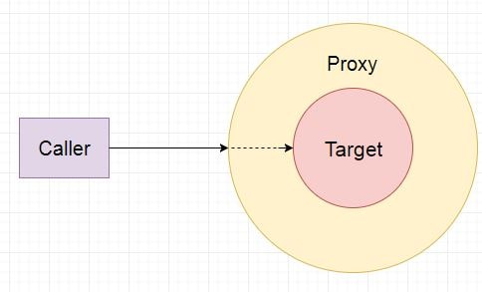
In Spring, aspects are woven into Spring-managed beans at runtime by wrapping them with a proxy class.
The proxy class poses as the target bean, intercepting advised method calls and forwarding those calls to the target bean.
Between the time when the proxy intercepts the method call and the time when it invokes the target bean's method, the proxy performs the aspect logic.

Slide 11
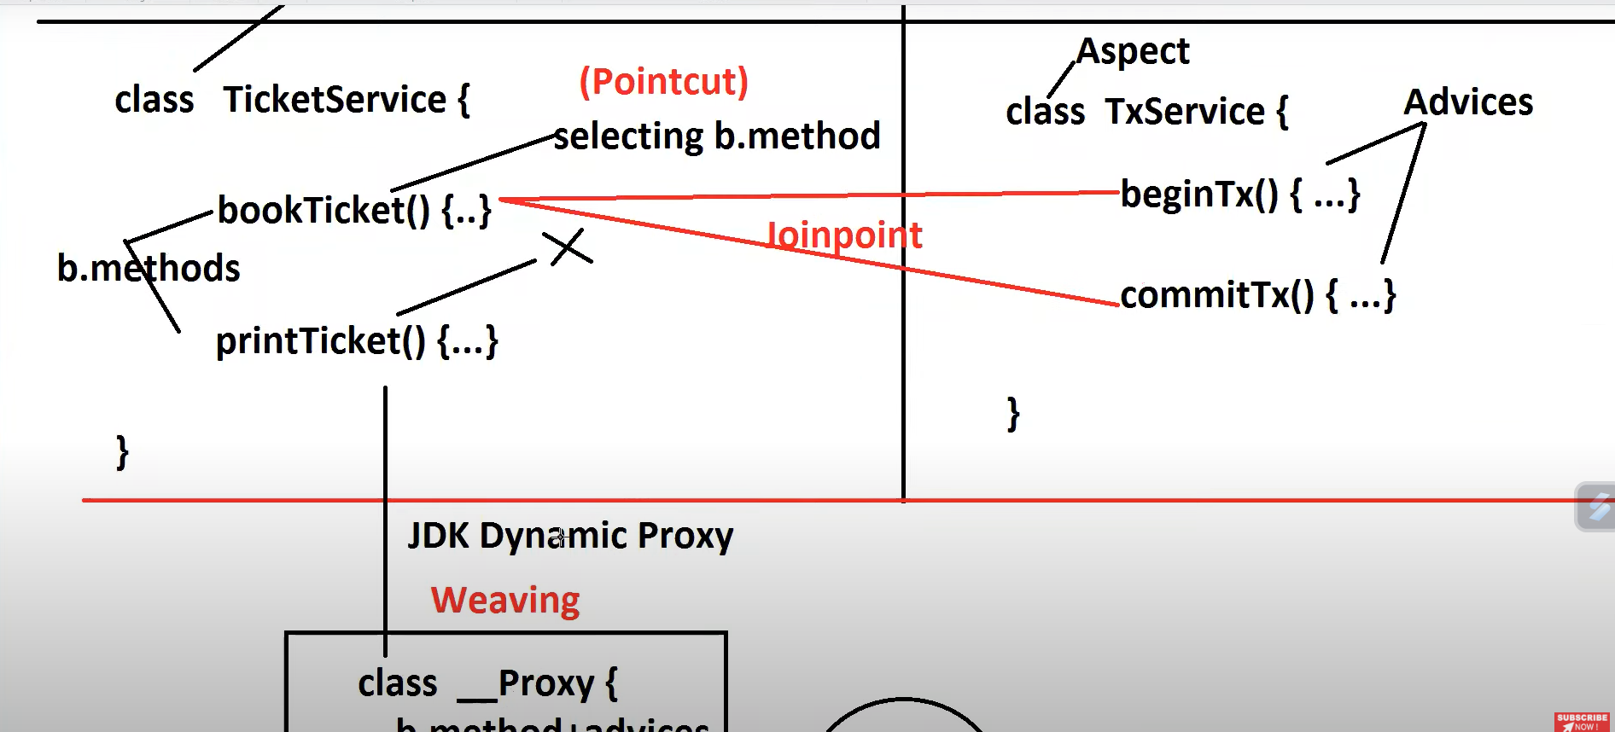

Slide 12
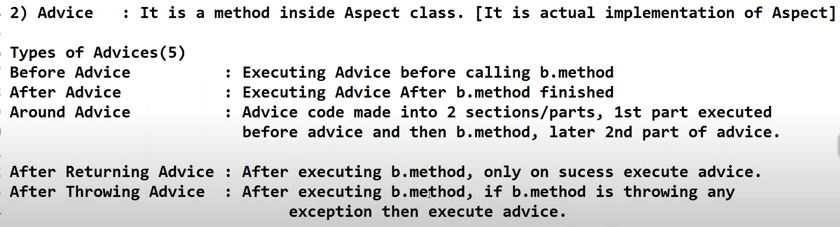

Slide 13
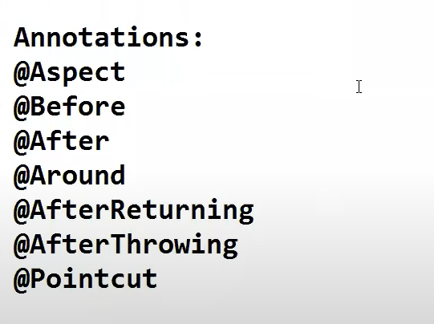

Slide 14
Pointcut(Pointcut Designators)
A pointcut expression starts with a pointcut designator (PCD), which is a keyword telling Spring AOP what to match. There are several pointcut designators, such as the execution of a method, type, method arguments, or annotations.

Slide 15
Pointcut
Pointcut is an expression language of spring AOP which is basically used to match the target methods to apply the advice.

Slide 16
Pointcut(execution)
The primary Spring PCD is execution, which matches method execution join points:
@Pointcut("execution(public String com.baeldung.pointcutadvice.dao.FooDao.findById(Long))")
Copy
This example pointcut will exactly match the execution of the findById method of the FooDao class. This works, but it's not very flexible. Suppose we'd like to match all the methods of the FooDao class, which may have different signatures, return types, and arguments. To achieve this, we can use wildcards:
@Pointcut("execution(* com.baeldung.pointcutadvice.dao.FooDao.*(..))")
Copy
Here, the first wildcard matches any return value, the second matches any method name, and the (..) pattern matches any number of parameters (zero or more).

Slide 17
Pointcut(execution)
This is used to match a joinPoint method’s signature.
@Component
@Aspect
public class LoggingAspect {
...
@Pointcut("execution(public void io.reflectoring.springboot.aop.ShipmentService.shipStuffWithBill())")
public void logPointcutWithExecution(){}
}

Slide 18
Pointcut(execution)
The above Pointcut will match the method named shipStuffWithBill with the signature public void that lives in the class io.reflectoring.springboot.aop.ShipmentService.

Slide 19
Pointcut(within)
This is used to match all the JoinPoint methods in a given class, package, or sub-package.
@Pointcut("within(com.baeldung.pointcutadvice.dao.FooDao)")
Copy
We can also match any type within the com.baeldung package or a sub-package:
@Pointcut("within(com.baeldung..*)")

Slide 20
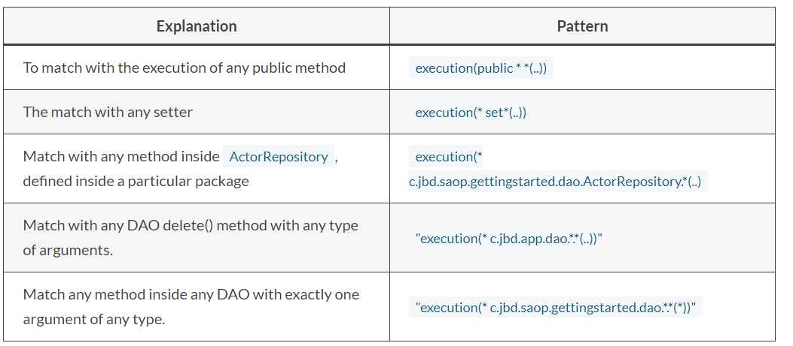

Slide 21
Explanation | Pattern
Match with any joinpoint within business package. | "within(com.jbd.business.*)"
Match with any joinpoint within business and its sub-packages | "within(com.jbd.business..*)"
Match with any join point (method) execution where the declared type of the target object (the class) has an @Transactional annotation. | "@within( org.springframework.transaction.annotation.Transactional )"

Slide 22
Pointcut(@within)
@Component
@Aspect
public class LoggingAspect {
...
@Pointcut("within(io.reflectoring.springboot.aop.BillingService)")
public void logPointcutWithin() {}
@Before("logPointcutWithin()")
public void logMethodCallsWithinAdvice() {
System.out.println("In Aspect from within");
}
}

Slide 23
Within vs execution
execution() - match a joinPoint method’s signature
within() - match all the JoinPoint methods in a given class, package, or sub-package

Slide 24
Pointcut(args)
The args and @args designators
The args limits matching to join points (the execution of methods) where the arguments are instances of a given types.
For example, any join point (method execution) that takes a single parameter and where the argument passed at runtime is Serializable.
"args(java.io.Serializable)"
Similarly, the args limits the matching to join points where the runtime type of the actual arguments passed have annotations of the given types.
For example, any join point (method execution) which takes a single parameter, and where the runtime type of the argument passed has the @Classified annotation:
"@args(com.jbd.security.Classified)"

Slide 25
The @annotation designator
The @annotation designator limits matching to join points where the subject of the join point (the method being executed) has the given annotation.
NOTE: The @annotation limits the matching of joinpoint where the method has the given annotation, whereas the @within matches if a class has the annotation.
Example, match with any join point (method execution) where the executing method has an @Transactional annotation.
"@annotation(org.springframework.transaction.annotation.Transactional)"

Slide 26
The bean Pointcut designator
The bean PCD lets you limit the matching of join points to a particular named Spring bean or to a set of named Spring beans (when using wildcards).
Example, any join point (method execution) on Spring beans having names that match the wildcard expression *Manager.
"bean(*Manager)"
Another example, any join point where the Spring bean name is accountRepository

Slide 27
Pointcut(@annotation)
This is used to match a JointPoint method annotated with a given annotation. We used it in our first example of AOP.
@Component
@Aspect
public class LoggingAspect {
...
@Pointcut("@annotation(Log)")
public void logPointcut(){
}
@Before("logPointcut()")
public void logAllMethodCallsAdvice(){
System.out.println("In Aspect");
}
...
}

Slide 28
Pointcut(@annotation)
@Service
public class ShipmentService {
@Log
// this here is what's called a join point
public void shipStuff(){
System.out.println("In Service");
}
}

Slide 29
Combining Pointcut Expressions
Pointcut expressions can be combined using &&, ||, and ! operators:
@Pointcut("@target(org.springframework.stereotype.Repository)")
public void repositoryMethods() {}
@Pointcut("execution(* *..create*(Long,..))")
public void firstLongParamMethods() {}
@Pointcut("repositoryMethods() && firstLongParamMethods()")
public void entityCreationMethods() {}

Slide 30
References
AOP with Spring (Boot) (reflectoring.io)
Understanding the Pointcut expressions | Javainsimpleway
How To Implement AOP In Spring Boot Application? – JavaTechOnline
Spring Boot + Spring AOP Logging Example Tutorial (javaguides.net)

