Slide 1
Kafka

Slide 2
What Are Events in Programming and Software Design?
Events are data points that represent state changes in a system. When a user makes an action, they trigger an event, which doesn’t specify what should happen and how the change should modify the system. It only notifies the system of a particular state change.
For instance, when you make a financial transaction, you trigger an event that changes your account’s state. When you buy a product, its state changes from “For sale” to “Sold.”

Slide 3
What is Event Streaming?
Event streaming is the practice of capturing data in real-time from event sources like databases, sensors, mobile devices, cloud services, and software applications in the form of streams of events; storing these event streams durably for later retrieval; manipulating, processing, and reacting to the event streams in real-time as well as retrospectively; and routing the event streams to different destination technologies as needed. Event streaming thus ensures a continuous flow and interpretation of data so that the right information is at the right place, at the right time.
https://medium.com/@shortnotes0/kafka-brokers-and-zookeeper-nodes-in-simple-terms-64487c72aa33

Slide 4
What is an Event Streaming Platform?
An event streaming platform is a software system that enables the collection, storage, processing, and analysis of large volumes of real-time events. At its core, an event streaming platform consists of a distributed storage system that can handle large amounts of data, and a set of processing tools and APIs that enable applications to consume and process events and define data models for events.
A common setup for an event streaming platform involves multiple nodes working together to handle event ingestion and processing, using techniques such as partitioning and replication to ensure high scalability, fault tolerance, and availability. A registry to facilitate the use of data models or schema is also considered a standard component of an event streaming platform.

Slide 5
Apache Kafka
Apache Kafka is similar to a super-fast, well-organized warehouse where a large amount of information continuously comes in from various sources. It ensures that all information is kept and processed in the correct order, allowing us to analyze and understand what is happening in real-time. It's a great tool for dealing with massive amounts of data that keep flowing constantly.

Slide 6
Zookeeper with Kafka
It serves as a centralized spot for maintaining and storing the metadata for Kafka, which includes details on topics, partitions, consumer offsets, and cluster setup. ZooKeeper maintains a consistent picture of the cluster across all participating Kafka brokers, ensuring data consistency and fault tolerance. In a Kafka cluster, ZooKeeper ensures fault tolerance by keeping consistent metadata across brokers.
Important functions in the Kafka ZooKeeper cluster include leader election, broker discovery, and distributed operation coordination are handled by ZooKeeper. It makes it possible for Kafka producers and consumers to monitor their progress and keep the cluster's communication dependable.
https://dattell.com/data-architecture-blog/what-is-zookeeper-how-does-it-support-kafka/
https://www.scaler.com/topics/kafka-tutorial/the-role-of-zookeeper-in-the-kafka-cluster/

Slide 7
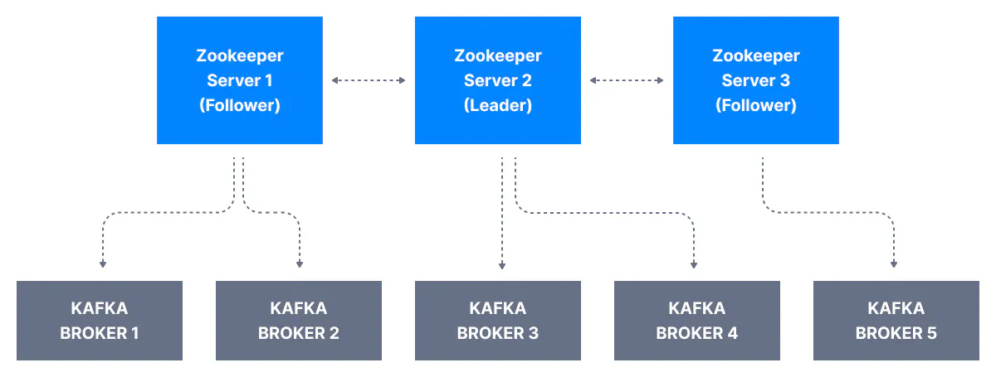
Zookeeper with Kafka
A Zookeeper cluster is called an ensemble. It is recommended to operate the ensemble with an odd number of servers, e.g., 3, 5, 7, as a strict majority of ensemble members (a quorum) must be working in order for Zookeeper to respond to requests. Zookeeper has a leader to handle writes, the rest of the servers are followers to handle reads.

Slide 8
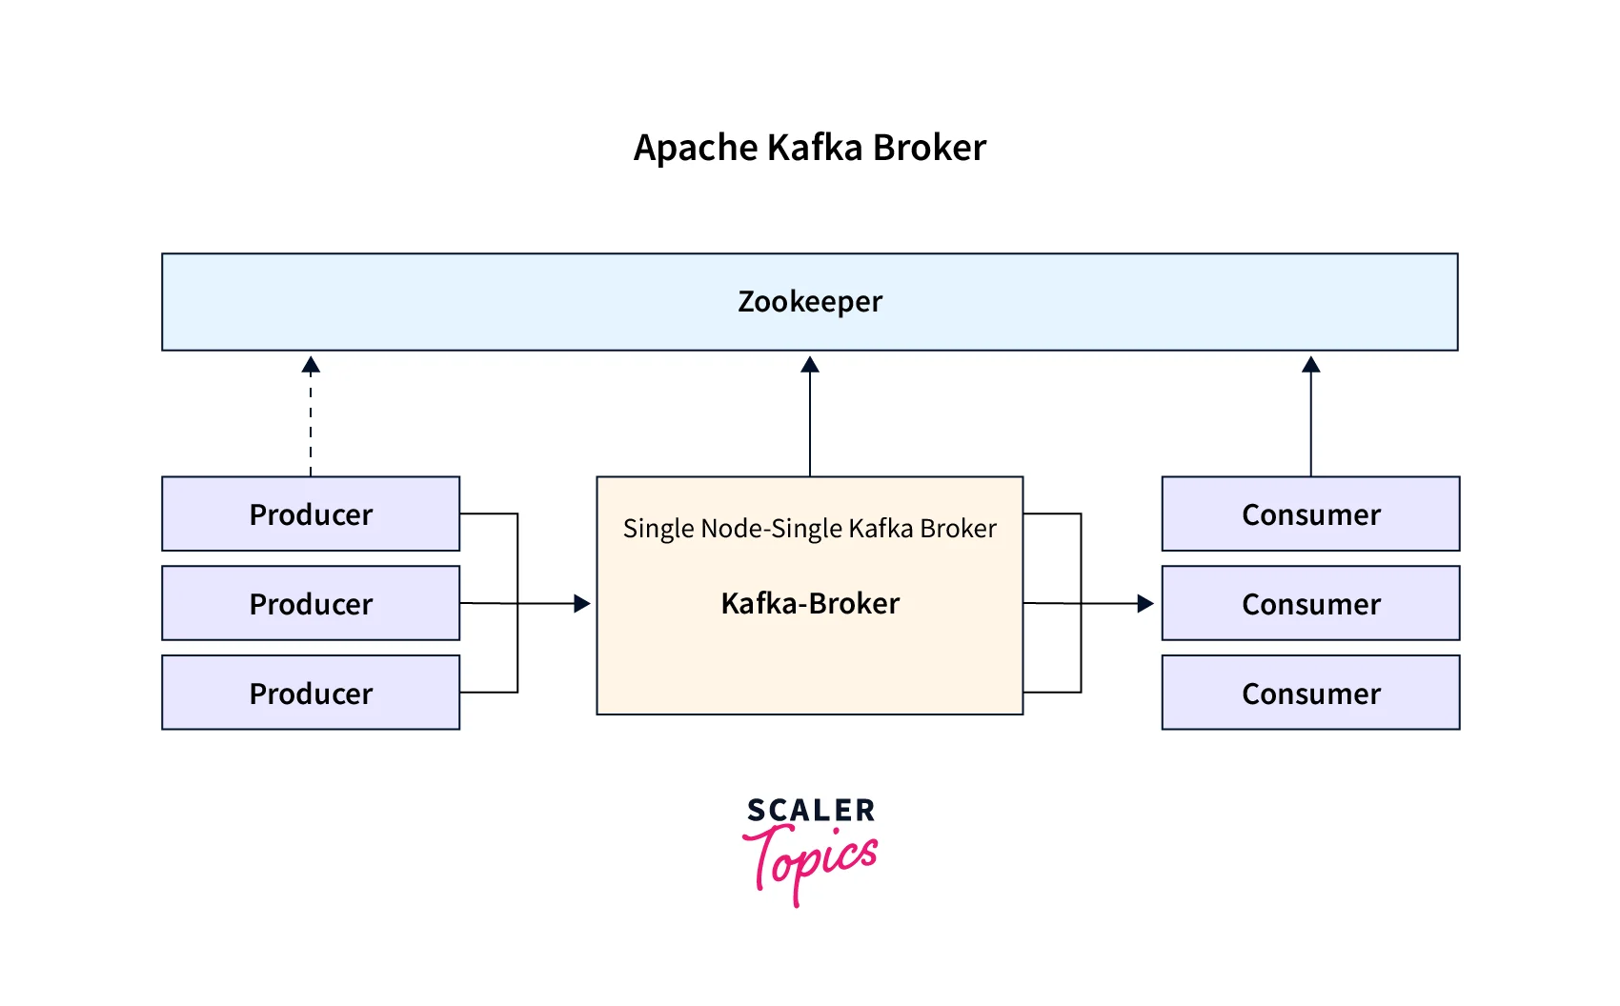
What is a Kafka Broker?
A single Kafka server is called a Kafka Broker.
the Kafka broker is used for managing the storage of the data records/messages in the topic. It acts as an intermediary between producers, which generate data, and consumers, which process and consume the data.

Slide 9
In Kafka Brokers
Kafka brokers are essential components of Apache Kafka, responsible for partition management, message replication, fault tolerance, and collaborating with ZooKeeper for cluster coordination and metadata management.
The following are ZooKeeper's primary functions within Kafka brokers:
Registration of Broker: Kafka brokers register with ZooKeeper to enable other brokers and clients to find and contact them, and ZooKeeper keeps track of active brokers and their connection information.
Membership of Cluster: ZooKeeper keeps track of the Kafka cluster's active brokers and stores membership information, allowing for dynamic cluster membership changes and a current view.

Slide 10
In Kafka Brokers
Controller Election:
ZooKeeper makes the controller election process easier by ensuring that only one broker is the controller at any given time.
Cluster Events and Alerts:
ZooKeeper sends alerts to Kafka brokers about cluster events and changes. For example, if a broker fails or quits the cluster, ZooKeeper can alert the other brokers.

Slide 11
In Kafka Consumers
Kafka consumers use ZooKeeper to coordinate, monitor, record offsets, and perform partition rebalancing within a consumer group. ZooKeeper is used to read data from Kafka topics.
The following are ZooKeeper's primary functions within Kafka Consumers:
Cluster Coordination: ZooKeeper is responsible for arranging consumer groups in Kafka and keeping track of active groups and their members, as well as group membership information such as customers and partitions.
Group Membership and Rebalancing: ZooKeeper simplifies group membership management by assigning partitions fairly among active consumers and coordinating the partition reassignment process when group membership changes.
Offset Commitment: Kafka consumers store their current offset, which can be managed by ZooKeeper, which maintains committed offset information for each consumer group.
Consumer Metadata: ZooKeeper saves consumer-related metadata, which other components or monitoring systems can utilize to track the progress and status of individual consumers or consumer groups.

Slide 12
What is a cluster in the first place?
Within the context of Kafka, a cluster is a group of servers working together for three reasons: speed (low latency), durability, and scalability. Several data streams can be processed by separate servers, which decreases the latency of data delivery. Data is replicated across multiple servers, so if one fails, another server has the data backed up, ensuring stability - meaning data durability and availability. Kafka also balances the load across multiple servers to provide scalability.
An ensemble of Kafka brokers working together is called a Kafka cluster. Some clusters may contain just one broker or others may contain three or potentially hundreds of brokers

Slide 13
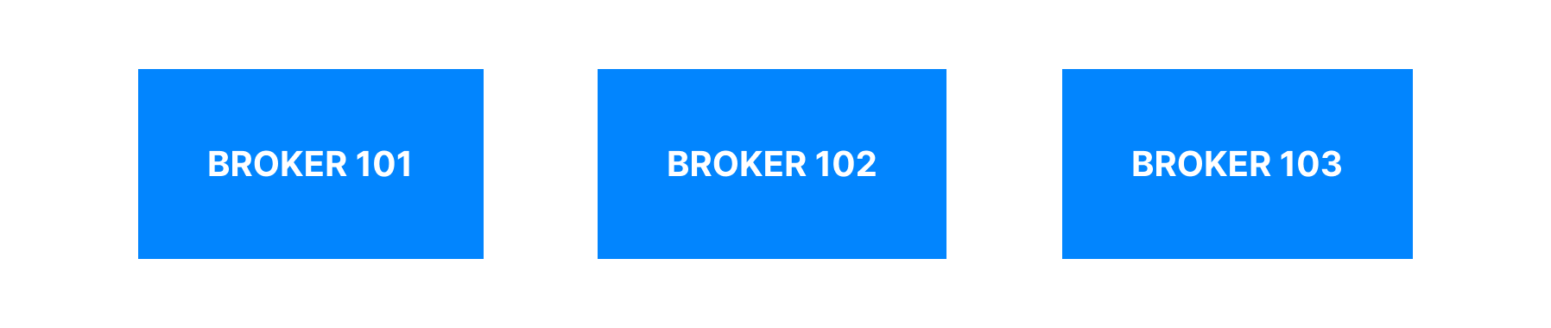
Kafka Cluster

Slide 14
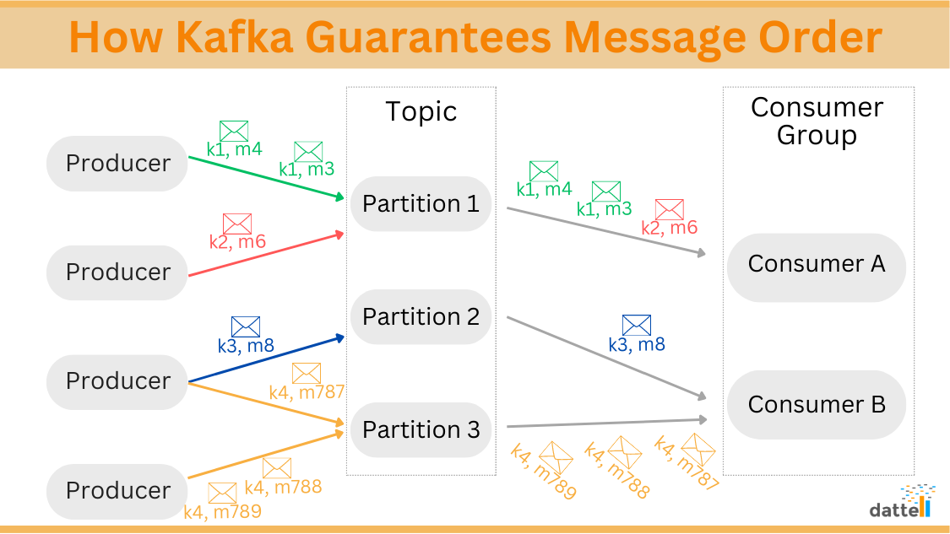
https://www.codingninjas.com/studio/library/what-is-a-kafka-broker https://www.redhat.com/en/blog/apache-kafka-10-essential-terms-and-concepts-explained https://dattell.com/data-architecture-blog/optimizing-kafka-brokers/
Kafka Broker Architecture

Slide 15
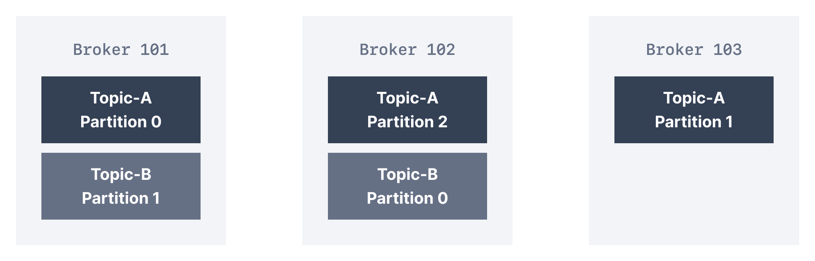
Kafka Broker and Topic partition

Slide 16
How do clients connect to a Kafka Cluster (bootstrap server)?
A client that wants to send or receive messages from the Kafka cluster may connect to any broker in the cluster. Every broker in the cluster has metadata about all the other brokers and will help the client connect to them as well, and therefore any broker in the cluster is also called a bootstrap server.
The bootstrap server will return metadata to the client that consists of a list of all the brokers in the cluster. Then, when required, the client will know which exact broker to connect to to send or receive data, and accurately find which brokers contain the relevant topic-partition.

Slide 17
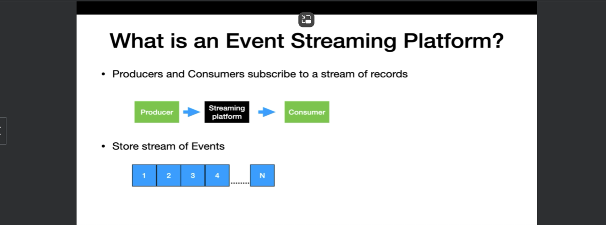
The producer and consumer here are independent of each other, meaning the producer has no clue about which consumer is going to read this message. An even streaming platform also stores the stream of events so that it can be replayed if it's necessary. Events are generally retained in multiple servers for providing fault tolerance and availability.

Slide 18
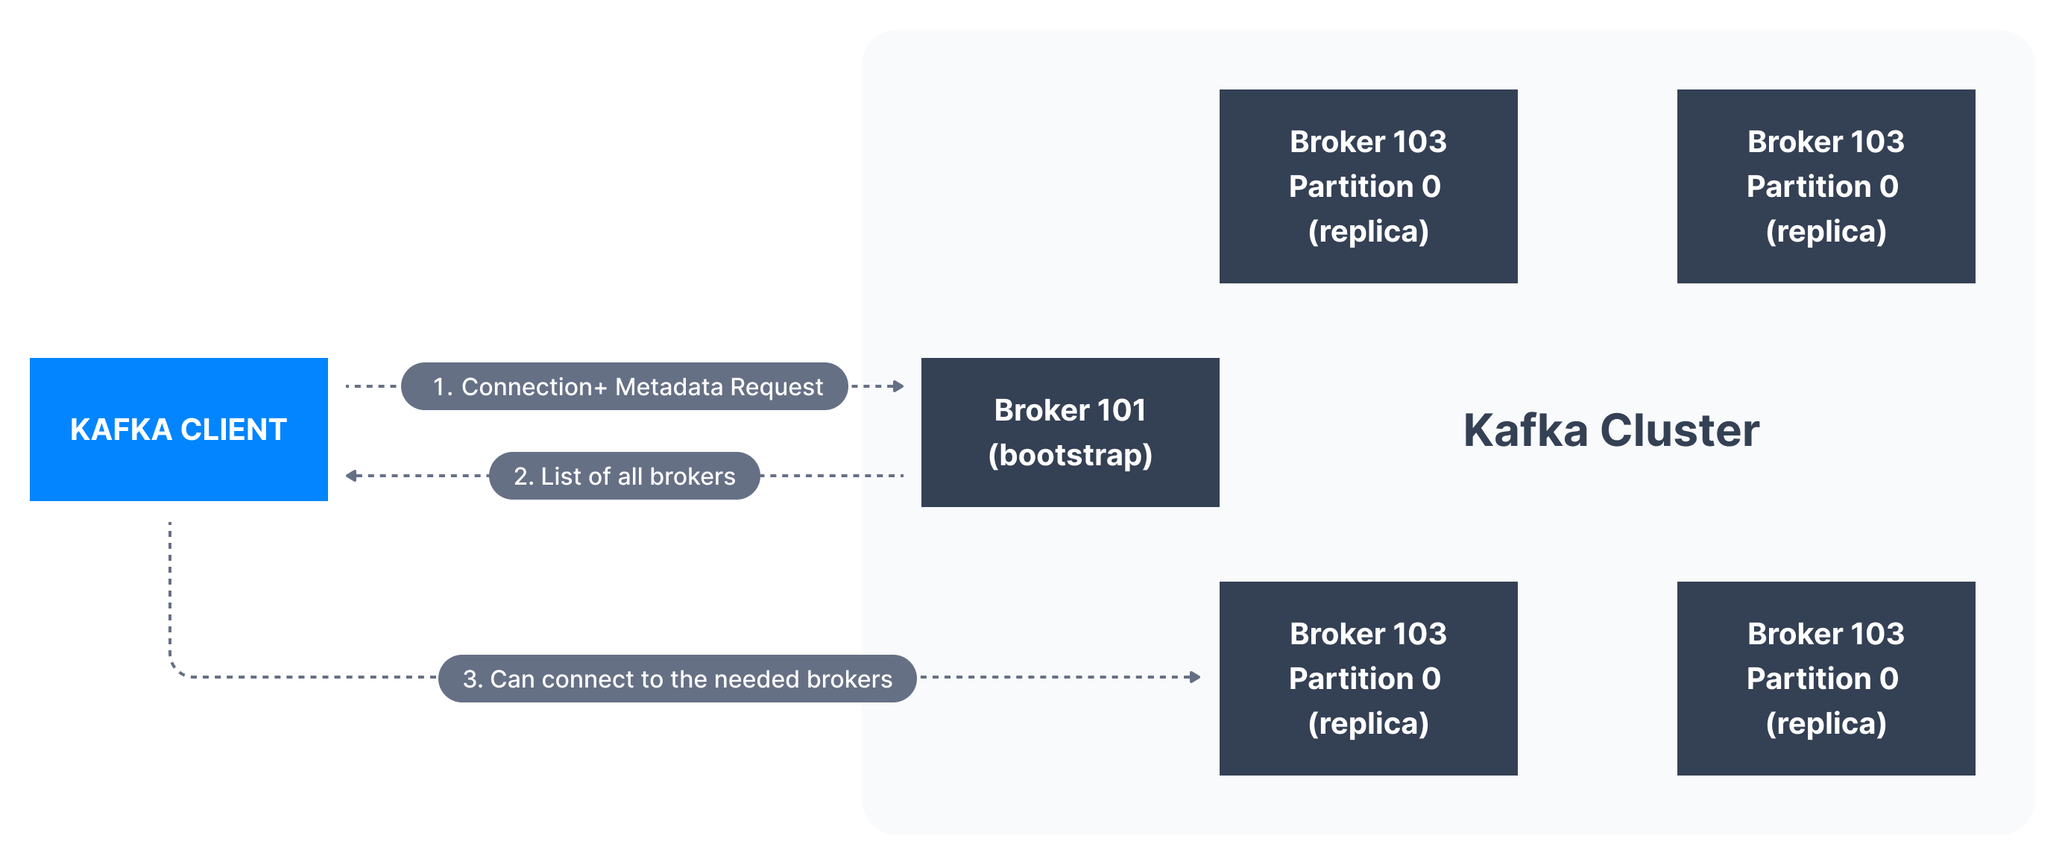

Slide 19
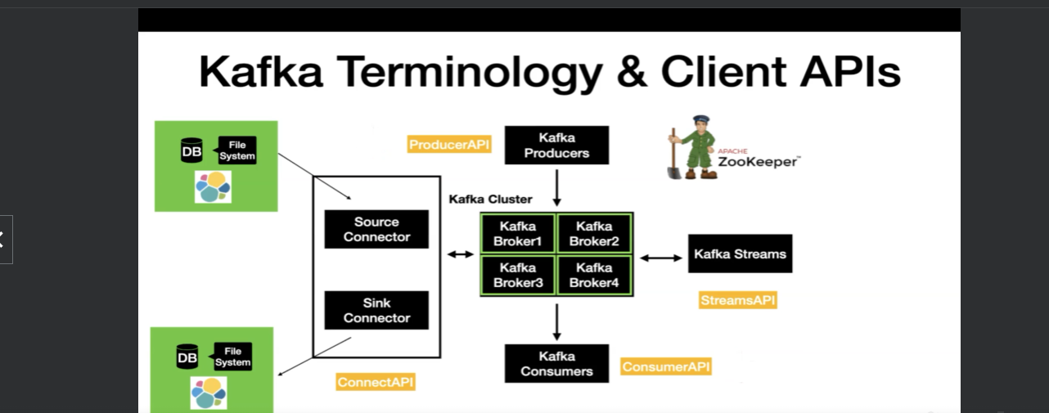

Slide 20
Kafka cluster generally consists of multiple brokers. In order to manage multiple brokers, we need a zookeeper.
Basically, Zookeeper keeps track of the health of the brokers and manage the cluster for you.
Broker is what all the Kafka clients will interact with.
Having just the clusters doesn't add any value.
The very first client that I'm going to introduce you is the Kafka producer.
A Kafka producer are the way to write and produce new data into Kafka.
Client uses the producer API to write the data into the Kafka after the data is written into Kafka.
What needs to be done?
We need to consume the data from Kafka.
So Kafka consumers comes in handy to consume the messages.
They use the Consumer API to consume the message from the Kafka cluster.
Kafka Consumers and producers are basic client APIs through which we can interact with Kafka.
There are two advanced client APIs that comes with Kafka.

Slide 21
Number one is the Kafka Connect.
It has two different types of connectors named Source, Connector and Sink Connector.
The source Connector is used to pull the data from an external data source, such as database or file
system or an Elasticsearch into the Kafka topic.
And the opposite of the same is done using the Sink Connector.
With Kafka Connect, you can perform the data movement in and out of Kafka without writing a single
line of code.
The next advanced API is the Streams API, which is basically used to take the data from Kafka and perform simple to complex transformations on it and put it back to Kafka.
If I have to summarize this lecture, you have four client APIs such as the Producer API, Consumer
API, Connect API and Streams API using which you can interact with Apache Kafka.

Slide 22
Kafka Topic
A Kafka topic is an entity in Kafka, and it has a name.
In Kafka, a topic is basically a storage unit where all the messages sent by the producer are stored.
Similar to how databases have tables to organize and segment datasets, Kafka uses the concept of topics to organize related messages.
Kafka topics can contain any kind of message in any format, and the sequence of all these messages is called a data stream.
Data in Kafka topics is deleted after one week by default (also called the default message retention period), and this value is configurable. This mechanism of deleting old data ensures a Kafka cluster does not run out of disk space by recycling topics over time.
Kafka TopicsKafka topics are immutable: once data is written to a partition, it cannot be changed
Kafka Topics - WarningUnlike database tables, Kafka topics are not query-able. Instead, we have to create Kafka producers to send data to the topic and Kafka consumers to read the data from the topic in orde

Slide 23
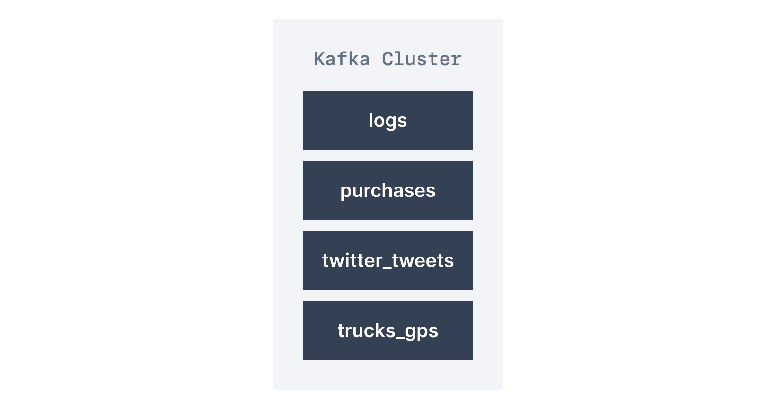
A topic is identified by its name. For example, we may have a topic called logs that may contain log messages from our application, and another topic called purchases that may contain purchase data from our application as it happens.

Slide 24
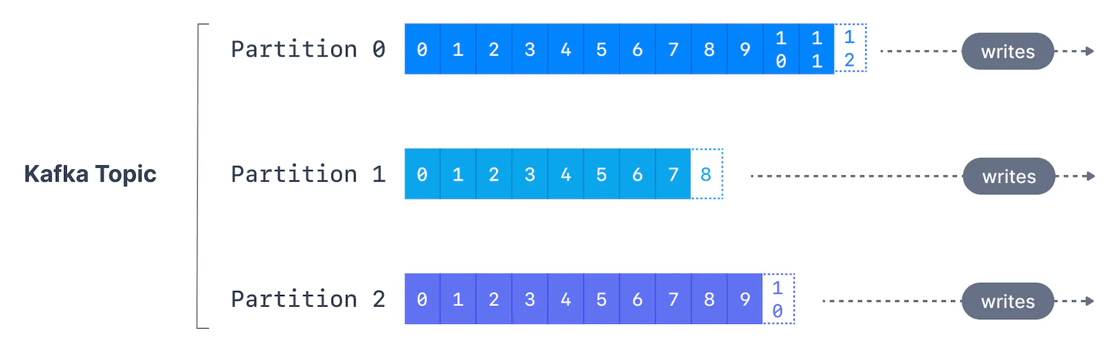
What are Kafka Partitions?
A topic can be further subdivided into multiple storage units and these subdivisions of a topic are known as partitions. By default, a topic is created with only 1 partition and whatever messages are published to this topic are stored in that partition. If you configure a topic to have multiple partitions then the messages sent by the producers would be stored in these partitions such that no two partitions would have the same message/event.
https://codingharbour.com/apache-kafka/the-introduction-to-kafka-topics-and-partitions/

Slide 25
What are Kafka Partitions?
Kafka partitions speed up the processing of large amounts of data in parallel by distributing message processing across many nodes in your Kafka cluster. Instead of writing all of your data from a topic to one partition (and thus one broker), you are able to split your topics into different partitions and distribute those partitions to brokers. Unlike other messaging systems, producers are responsible for deciding which partition messages are written to.
If your messages have keys, then the producer distributes the data such that data with the same key ends up on the same partition. This way, you can guarantee that messages with the same key are always in order. If keys are not used, then messages are distributed to the partitions in a round-robin manner.
https://codingharbour.com/apache-kafka/the-introduction-to-kafka-topics-and-partitions/

Slide 26
What are Kafka Partitions?
Basically, to scale a topic across many servers for producer writes, Kafka uses partitions. Also, in order to facilitate parallel consumers, Kafka uses partitions. Moreover, while it comes to failover, Kafka can replicate partitions to multiple Kafka Brokers.
https://codingharbour.com/apache-kafka/the-introduction-to-kafka-topics-and-partitions/

Slide 27
What are Kafka Offsets
Apache Kafka offsets represent the position of a message within a Kafka Partition. Offset numbering for every partition starts at 0 and is incremented for each message sent to a specific Kafka partition. This means that Kafka offsets only have a meaning for a specific partition, e.g., offset 3 in partition 0 doesn’t represent the same data as offset 3 in partition 1.
The offset is an integer value that Kafka adds to each message as it is written into a partition. Each message in a given partition has a unique offset.
Kafka Offset OrderingIf a topic has more than one partition, Kafka guarantees the order of messages within a partition, but there is no ordering of messages across partitions
Even though we know that messages in Kafka topics are deleted over time (as seen above), the offsets are not re-used. They continually are incremented in a never-ending sequence

Slide 28
Kafka Producers
Once a topic has been created with Kafka, the next step is to send data into the topic. This is where Kafka Producers come in.
Applications that send data into topics are known as Kafka producers. Applications typically integrate a Kafka client library to write to Apache Kafka. Excellent client libraries exist for almost all programming languages that are popular today including Python, Java, Go, and others.
A Kafka producer sends messages to a topic, and messages are distributed to partitions according to a mechanism such as key hashing

Slide 29
Message Keys
Each event message contains an optional key and a value.
In case the key (key=null) is not specified by the producer, messages are distributed evenly across partitions in a topic. This means messages are sent in a round-robin fashion (partition p0 then p1 then p2, etc... then back to p0 and so on...).
If a key is sent (key != null), then all messages that share the same key will always be sent and stored in the same Kafka partition. A key can be anything to identify a message - a string, numeric value, binary value, etc.

Slide 30
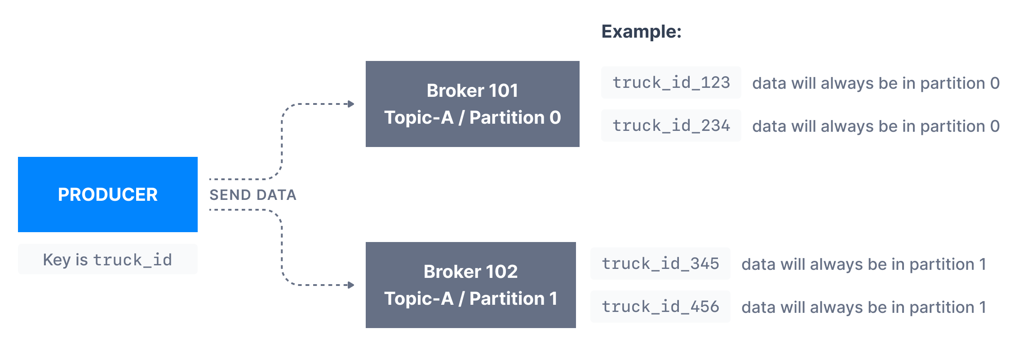
Kafka message keys are commonly used when there is a need for message ordering for all messages sharing the same field. For example, in the scenario of tracking trucks in a fleet, we want data from trucks to be in order at the individual truck level. In that case, we can choose the key to be truck_id. In the example shown below, the data from the truck with id truck_id_123 will always go to partition p0

Slide 31
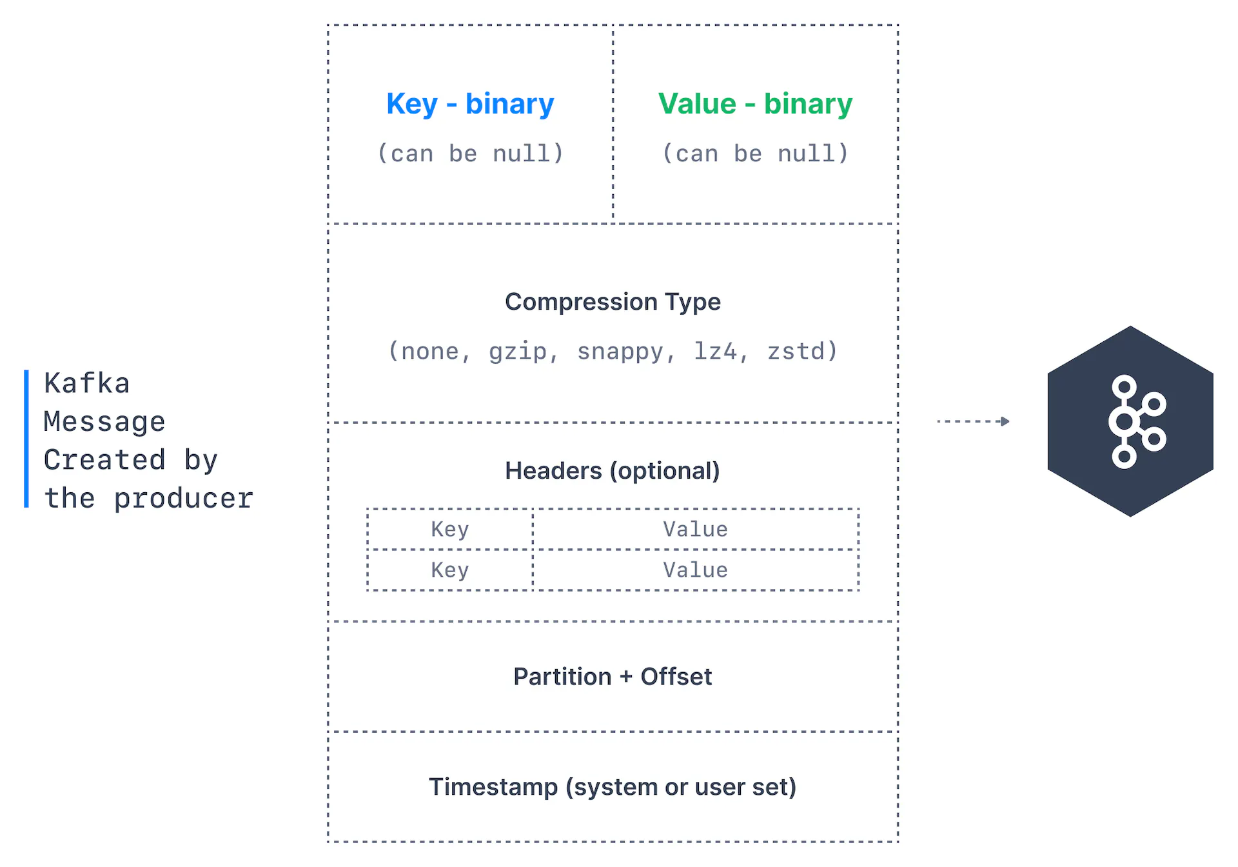
Kafka Message Anatomy
Kafka messages are created by the producer. A Kafka message consists of the following elements:

Slide 32
Kafka Message Anatomy
Key. Key is optional in the Kafka message and it can be null. A key may be a string, number, or any object and then the key is serialized into binary format.
Value. The value represents the content of the message and can also be null. The value format is arbitrary and is then also serialized into binary format.
Compression Type. Kafka messages may be compressed. The compression type can be specified as part of the message. Options are none, gzip, lz4, snappy, and zstd
Headers. There can be a list of optional Kafka message headers in the form of key-value pairs. It is common to add headers to specify metadata about the message, especially for tracing.
Partition + Offset. Once a message is sent into a Kafka topic, it receives a partition number and an offset id. The combination of topic+partition+offset uniquely identifies the message
Timestamp. A timestamp is added either by the user or the system in the message.

Slide 33
Kafka Message Serializers
In many programming languages, the key and value are represented as objects, which greatly increases the code readability. However, Kafka brokers expect byte arrays as keys and values of messages. The process of transforming the producer's programmatic representation of the object to binary is called message serialization.
As shown below, we have a message with an Integer key and a String value. Since the key is an integer, we have to use an IntegerSerializer to convert it into a byte array. For the value, since it is a string, we must leverage a StringSerializer.
Serialization is important for Apache Kafka® because a Kafka broker only works with bytes. Kafka stores records in bytes, and when a fetch request comes in from a consumer, Kafka returns records in bytes. The broker really knows nothing about its records; it just appends them to the end of a file, and that's the end of it.

Slide 34
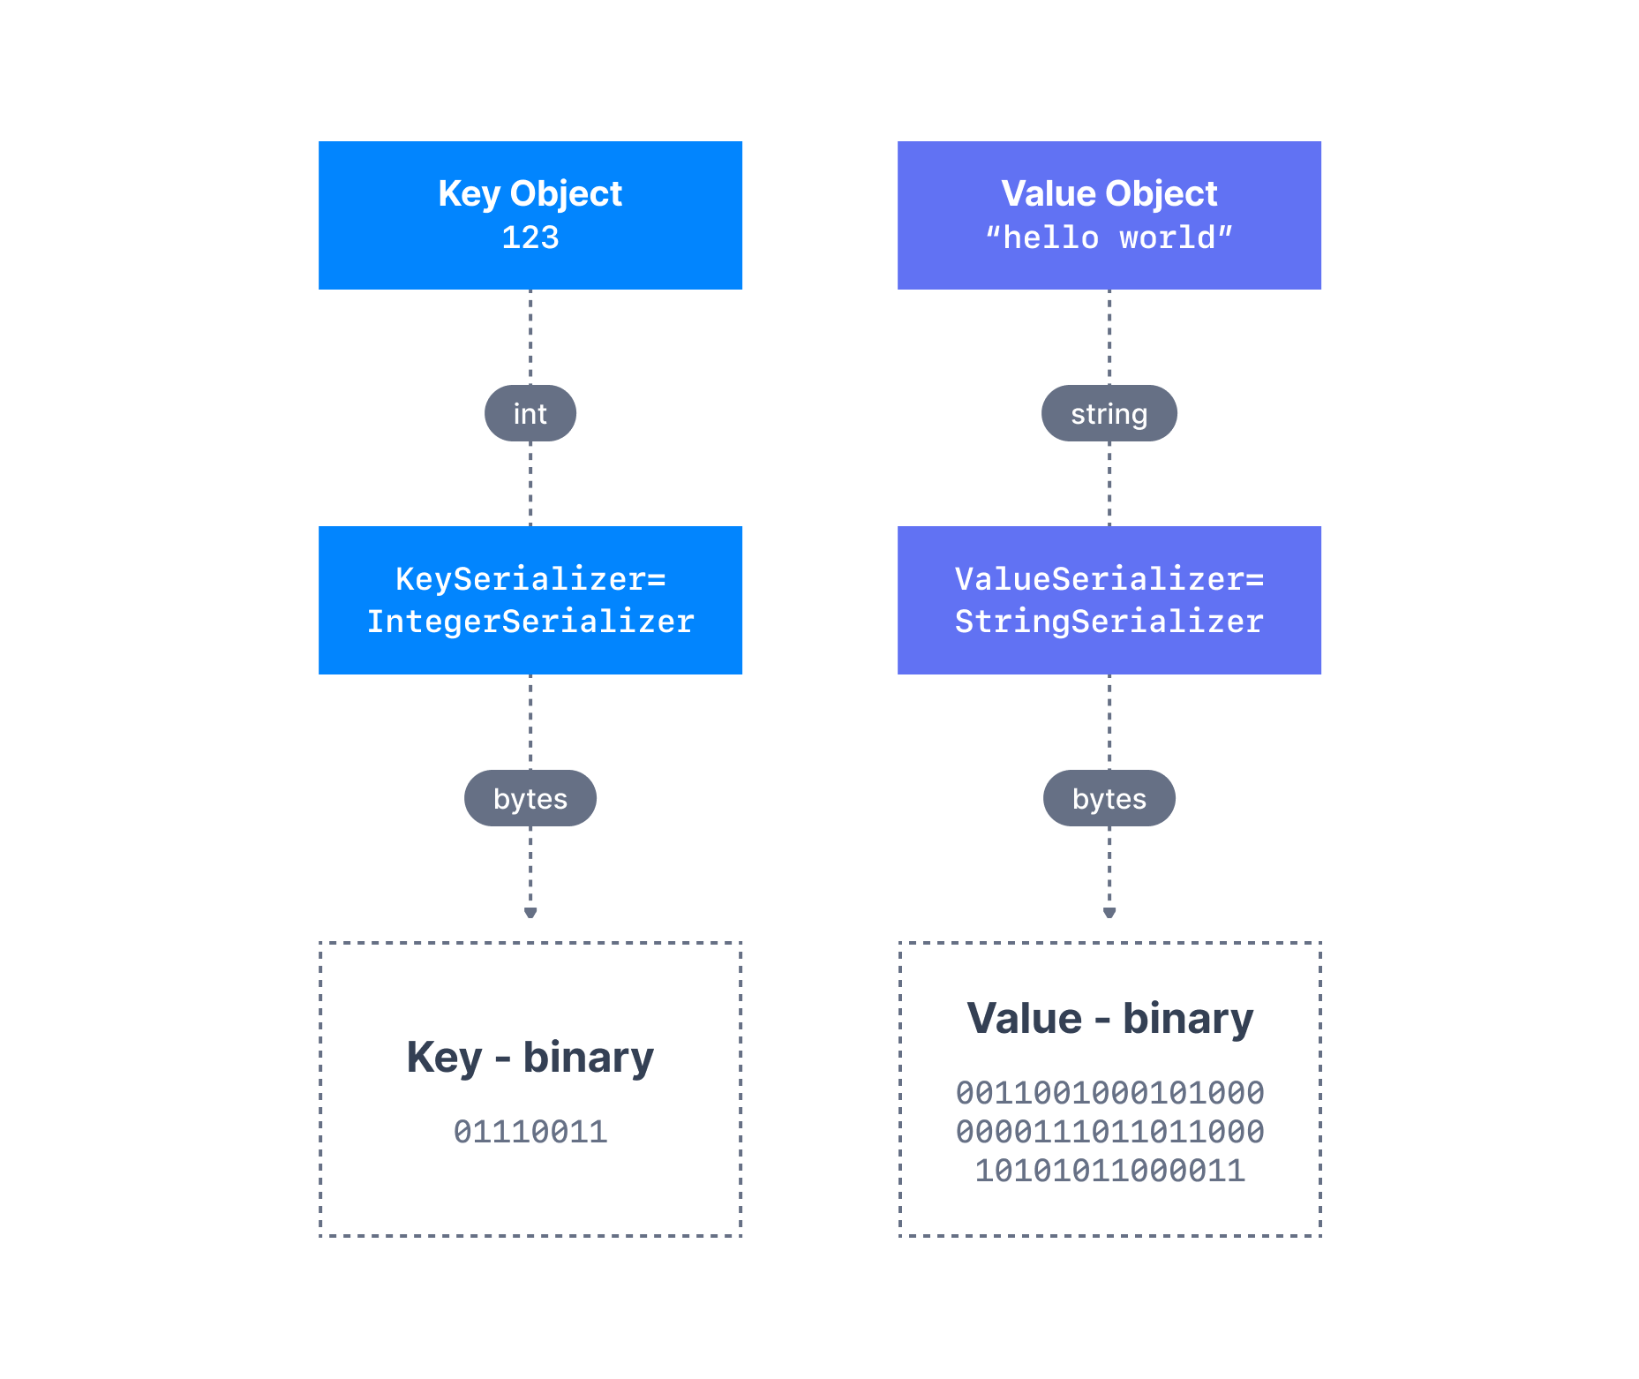
Kafka Message Serializers

Slide 35
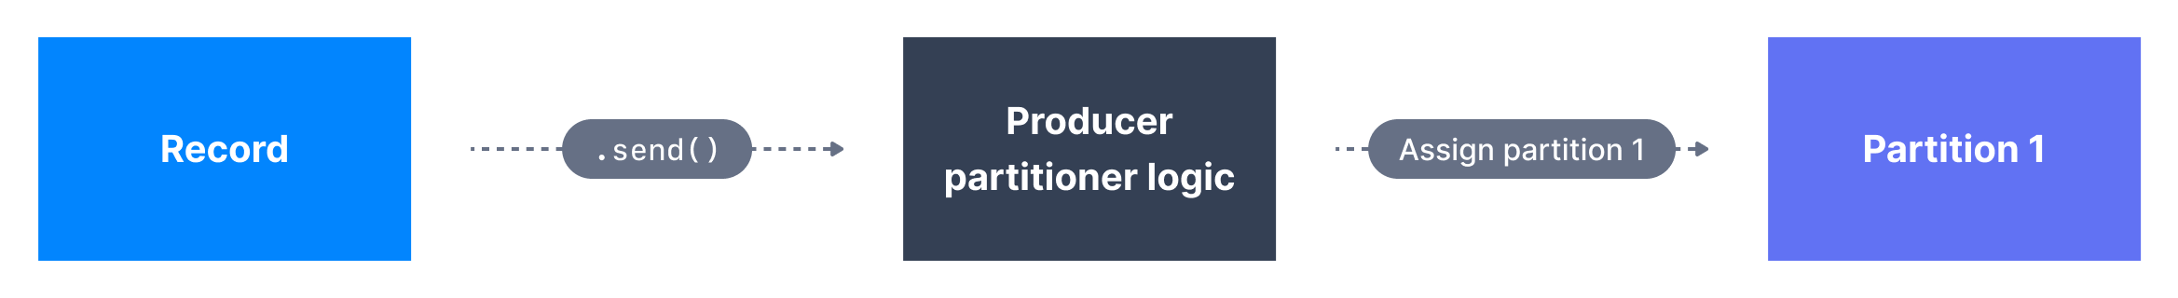
A Kafka partitioner is a code logic that takes a record and determines to which partition to send it into.
Default Partitioner
In that effect, it is common for partitioners to leverage the Kafka message keys to route a message into a specific topic-partition. As a reminder, all messages with the same key will go to the same partition.
In the default Kafka partitioner, the keys are hashed using the murmur2 algorithm.
It is possible to override the default partitioner via the producer property partitioner.class, although it is not advisable unless you know what you are doing.

Slide 36
Kafka Consumers
Applications that read data from Kafka topics are known as consumers.
A consumer always reads data from a lower offset to a higher offset and cannot read data backwards (due to how Apache Kafka and clients are implemented).
If the consumer consumes data from more than one partition, the message order is not guaranteed across multiple partitions because they are consumed simultaneously, but the message read order is still guaranteed within each individual partition.
By default, Kafka consumers will only consume data that was produced after it first connected to Kafka. Which means that to read historical data in Kafka, one must specify it as an input to the command, as we will see in the practice section.

Slide 37
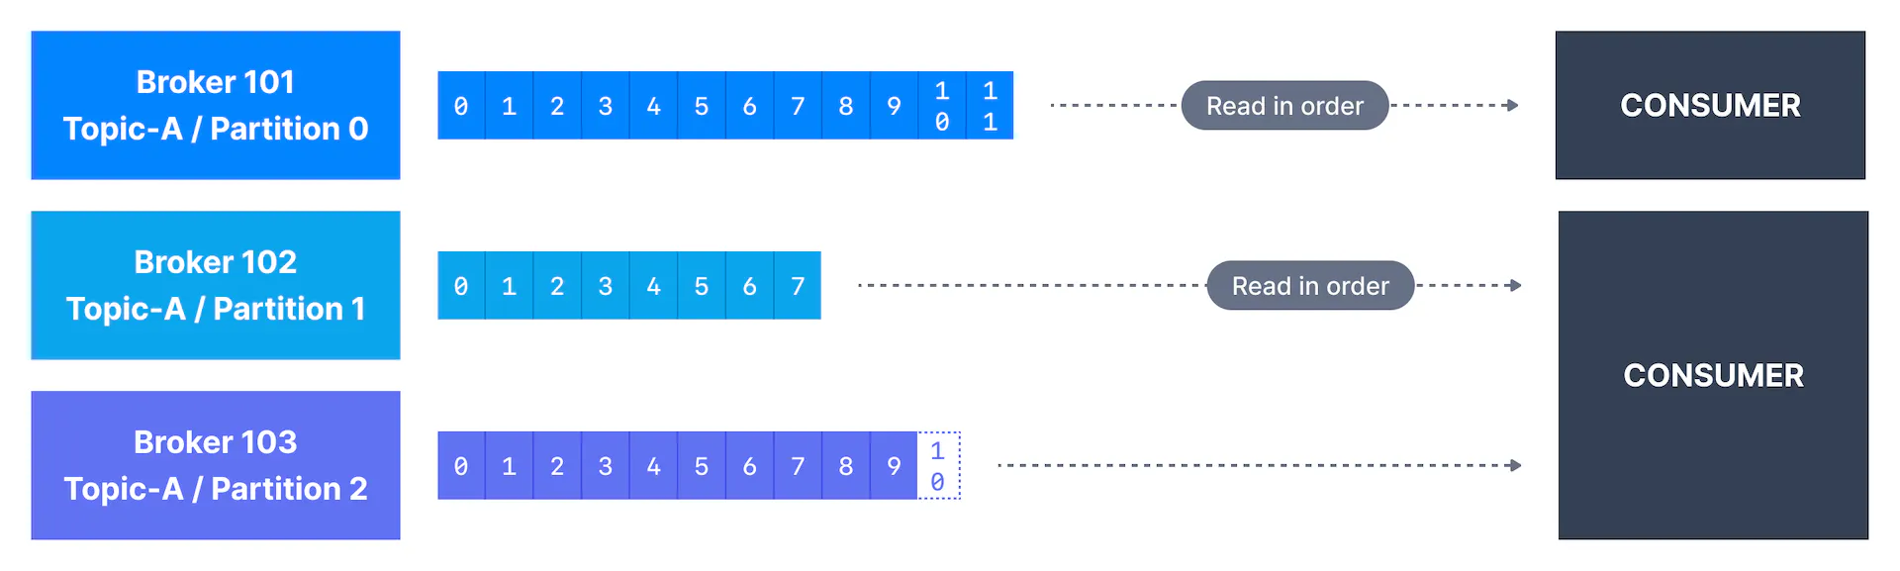
Kafka Consumers
Kafka consumers are also known to implement a "pull model". This means that Kafka consumers must request data from Kafka brokers in order to get it (instead of having Kafka brokers continuously push data to consumers). This implementation was made so that consumers can control the speed at which the topics are being consumed.

Slide 38
Kafka Message Deserializers
Serialization & DeserializationData being consumed must be deserialized in the same format it was serialized in.
As we have seen before, the data sent by the Kafka producers is serialized. This means that the data received by the Kafka consumers must be correctly deserialized in order to be useful within your application. Data being consumed must be deserialized in the same format it was serialized in. For example:
if the producer serialized a String using StringSerializer, the consumer must deserialize it using StringDeserializer
if the producer serialized an Integer using IntegerSerializer, the consumer must deserialize it using IntegerDeserializer.

Slide 39
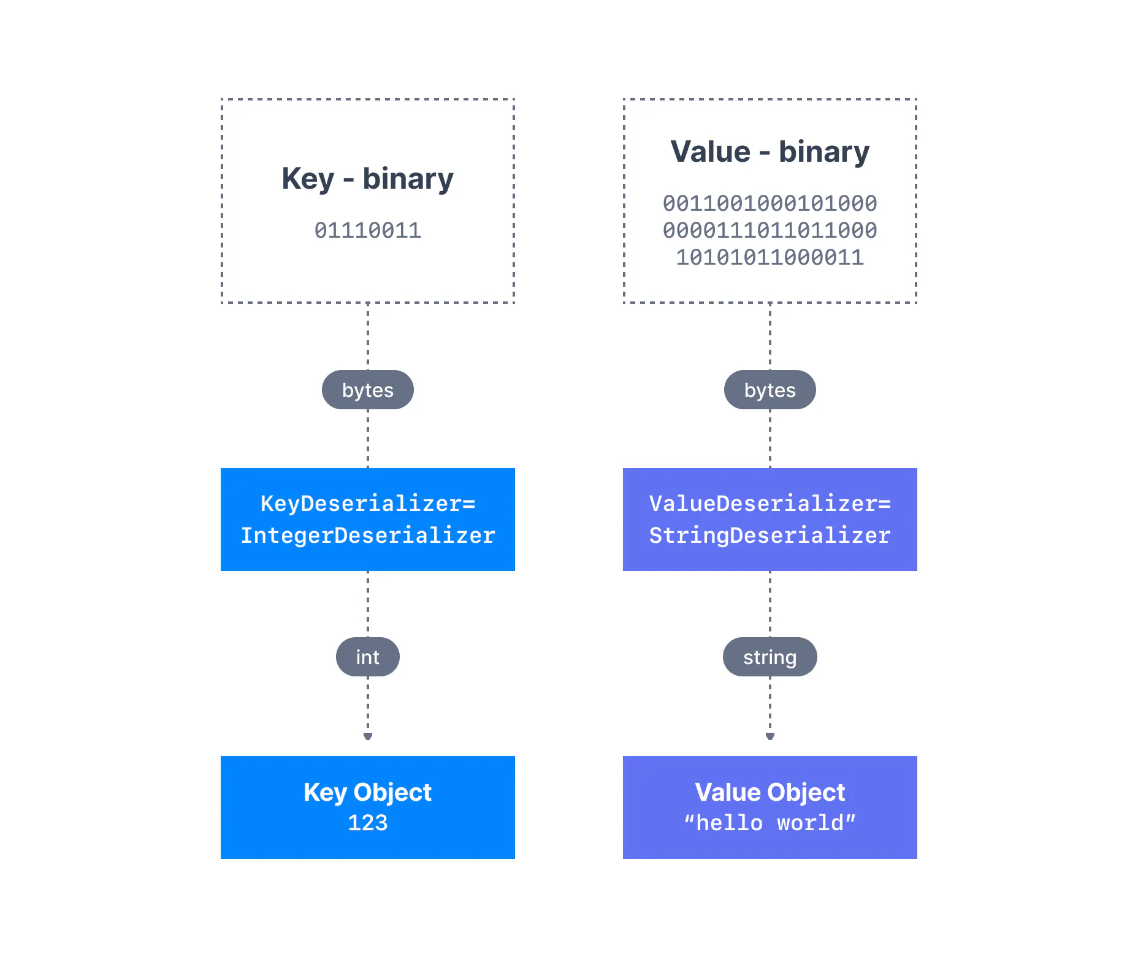
The serialization and deserialization format of a topic must not change during a topic lifecycle. If you intend to switch a topic data format (for example from JSON to Avro), it is considered best practice to create a new topic and migrate your applications to leverage that new topic.
Failure to correctly deserialize may cause crashes or inconsistent data being fed to the downstream processing applications. This can be tough to debug, so it is best to think about it as you're writing your code the first time.

Slide 40
Now, what is a Consumer Group?
A bunch of consumers can form a group in order to cooperate and consume messages from a set of topics. This grouping of consumers is called a Consumer Group. If two consumers have subscribed to the same topic and are present in the same consumer group, then these two consumers would be assigned a different set of partitions and none of these two consumers would receive the same messages.
Note: Consumer Groups can help attain a higher consumption rate, if multiple consumers are consuming from the same topic.
https://medium.com/javarevisited/kafka-partitions-and-consumer-groups-in-6-mins-9e0e336c6c00

Slide 41
Kafka Consumer Group has the following properties:
All the Consumers in a group have the same group.id.
Only one Consumer reads each partition in the topic.
The maximum number of Consumers is equal to the number of partitions in the topic. If there are more consumers than partitions, then some of the consumers will remain idle.
A Consumer can read from more than one partition.
https://www.educba.com/kafka-consumer-group/

Slide 42
What is Kafka Consumer Group ID?
The group ID is very important to how different consumers "load balance" partitions. For example, if you have a topic with 10 partitions then two consumers with the same groupId will read from 5 partitions each.
If you have two consumers with different group ids, both consumers will read from 10 partitions.
In this sense, the groupId is how you define a "consumer group" or group of consumers reading from a given topic/partitions.

Slide 43
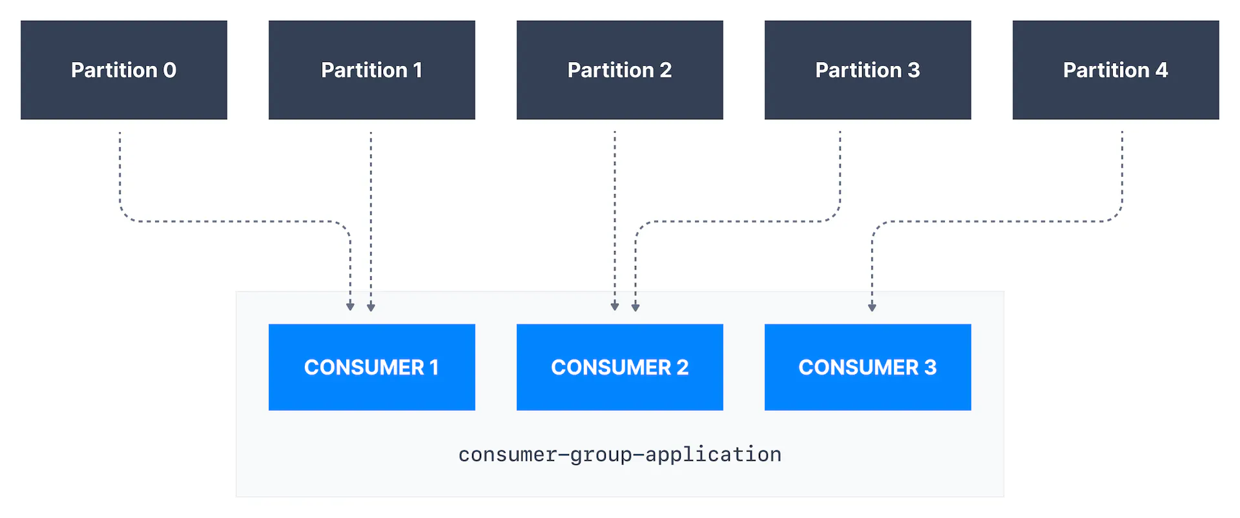
Kafka Consumer Groups & Offsets
Kafka Consumer Groups
Consumers that are part of the same application and therefore performing the same "logical job" can be grouped together as a Kafka consumer group.
A topic usually consists of many partitions. These partitions are a unit of parallelism for Kafka consumers.
The benefit of leveraging a Kafka consumer group is that the consumers within the group will coordinate to split the work of reading from different partitions.

Slide 44
Kafka Consumer Groups & Offsets
Kafka Consumer Group ID
In order for indicating to Kafka consumers that they are part of the same specific group , we must specify the consumer-side setting group.id.
Kafka Consumers automatically use a GroupCoordinator and a ConsumerCoordinator to assign consumers to a partition and ensure the load balancing is achieved across all consumers in the same group.
It is important to note that each topic partition is only assigned to one consumer within a consumer group, but a consumer from a consumer group can be assigned multiple partitions.

Slide 45
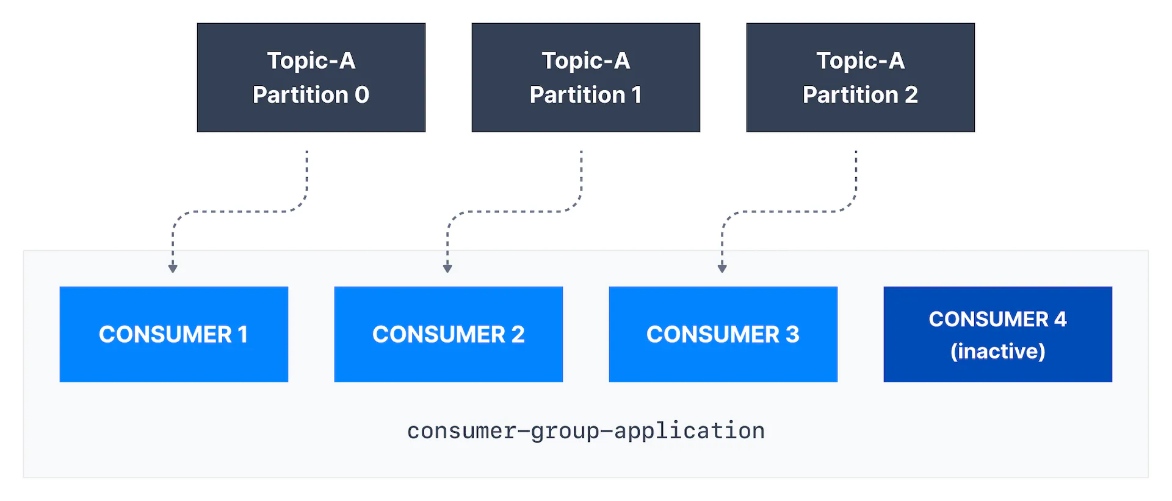
Kafka Consumer Groups & Offsets
If there are more consumers than the number of partitions of a topic, then some consumers will remain inactive as shown below. Usually, we have as many consumers in a consumer group as the number of partitions. If we want more consumers for higher throughput, we should create more partitions while

Slide 46
What is a consumer group in Kafka?
When sending messages in a distributed setup using a messaging system, you typically have two scenarios you want to achieve. Either you want to:
send a message to a targeted group of consumers (which might be just one consumer) or
broadcast the message to all the consumers
Kafka allows you to achieve both of these scenarios by using consumer groups.
The main duty of the "Group Coordinator" is to manage the group, which includes tasks like managing the membership of consumers, offsets, and rebalancing. The "Group Leader" is only required for the task of calculating partition assignments.
Once the partition assignment has been determined, the consumer group leader will forward the list of assignments to the Group Coordinator. The Coordinator will then disseminate this information to all the consumers, who will only be able to view their own assignment.

Slide 47
Kafka Consumer Offsets
Kafka brokers use an internal topic named __consumer_offsets that keeps track of what messages a given consumer group last successfully processed.
As we know, each message in a Kafka topic has a partition ID and an offset ID attached to it.
Therefore, in order to "checkpoint" how far a consumer has been reading into a topic partition, the consumer will regularly commit the latest processed message, also known as consumer offset.
In the figure below, a consumer from the consumer group has consumed messages up to offset 4262, so the consumer offset is set to 4262.

Slide 48
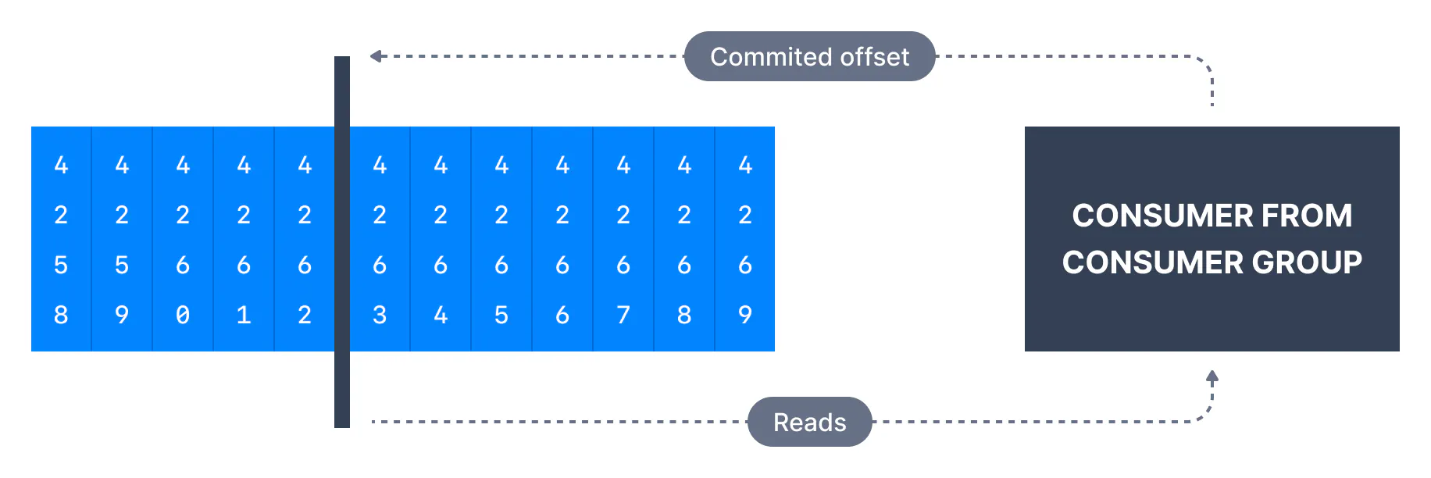
Kafka Consumer Offsets
Consumer Offset

Slide 49
Kafka Consumer Offsets
Most client libraries automatically commit offsets to Kafka for you on a periodic basis, and the responsible Kafka broker will ensure writing to the __consumer_offsets topic (therefore consumers do not write to that topic directly).
The process of committing offsets is not done for every message consumed (because this would be inefficient), and instead is a periodic process.
This also means that when a specific offset is committed, all previous messages that have a lower offset are also considered to be committed.

Slide 50
Why use Consumer Offsets
MOffsets are critical for many applications. If a Kafka client crashes, a rebalance occurs and the latest committed offset help the remaining Kafka consumers know where to restart reading and processing messages.
In case a new consumer is added to a group, another consumer group rebalance happens and consumer offsets are yet again leveraged to notify consumers where to start reading data from.
Therefore consumer offsets must be committed regularly.

Slide 51
Delivery semantics for consumers
By default, Java consumers automatically commit offsets (controlled by the enable.auto.commit=true property) every auto.commit.interval.ms (5 seconds by default) when .poll() is called.
Details of that mechanism are discussed in Delivery Semantics for Consumers.
A consumer may opt to commit offsets by itself (enable.auto.commit=false). Depending on when it chooses to commit offsets, there are delivery semantics available to the consumer

Slide 52
Delivery semantics for consumers
The three delivery semantics are
At most once:
Offsets are committed as soon as the message is received.
If the processing goes wrong, the message will be lost (it won’t be read again).
At least once (usually preferred):
Offsets are committed after the message is processed.
If the processing goes wrong, the message will be read again.
This can result in duplicate processing of messages. Therefore, it is best practice to make sure data processing is idempotent (i.e. processing the same message twice won't produce any undesirable effects
Exactly once:
This can only be achieved for Kafka topic to Kafka topic workflows using the transactions API. The Kafka Streams API simplifies the usage of that API and enables exactly once using the setting processing.guarantee=exactly_once_v2 (exactly_once on Kafka < 2.5)
For Kafka topic to External System workflows, to effectively achieve exactly once, you must use an idempotent consumer.
In practice, at least once with idempotent processing is the most desirable and widely implemented mechanism for Kafka consumers.

Slide 53
Kafka Topic Replication
One of the main reasons for Kafka's popularity, is the resilience it offers in the face of broker failures. Machines fail, and often we cannot predict when that is going to happen or prevent it. Kafka is designed with replication as a core feature to withstand these failures while maintaining uptime and data accuracy.
Kafka Replication : Data Replication helps prevent data loss by writing the same data to more than one broker.
In Kafka, replication means that data is written down not just to one broker, but many.

Slide 54
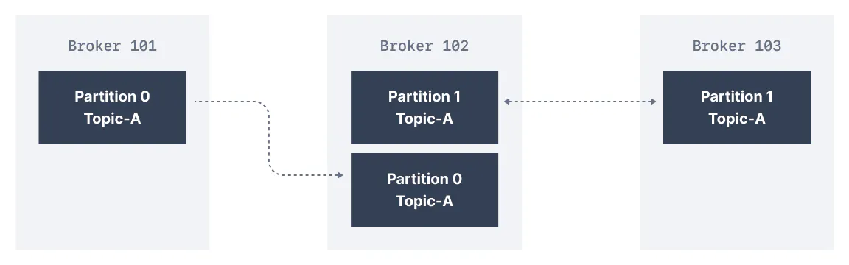
Kafka Topic Replication Factor
The replication factor is a topic setting and is specified at topic creation time.
A replication factor of 1 means no replication. It is mostly used for development purposes and should be avoided in test and production Kafka clusters
A replication factor of 3 is a commonly used replication factor as it provides the right balance between broker loss and replication overhead.
In the cluster below consisting of three brokers, the replication factor is 2. When a message is written down into Partition 0 of Topic-A in Broker 101, it is also written down into Broker 102 because it has Partition 0 as a replica.

Slide 55
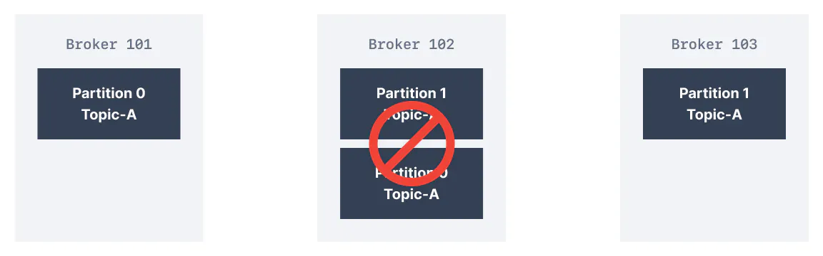
Kafka Topic Replication Factor
Thanks to a replication factor of 2, we can withstand the failure of one broker. This means that if Broker 102 failed, as you see below, Broker 101 & 103 would still have the data.
Kafka Broker Failure

Slide 56
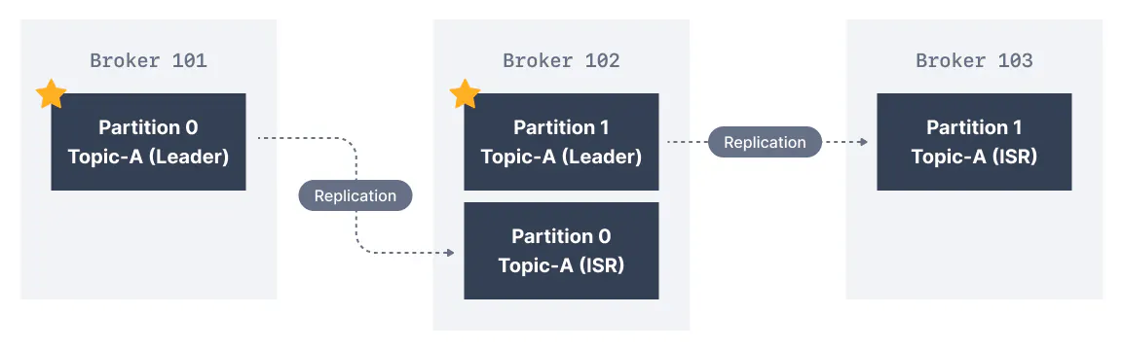
What are Kafka Partitions Leader and Replicas?
For a given topic-partition, one Kafka broker is designated by the cluster to be responsible for sending and receiving data to clients. That broker is known as the leader broker of that topic partition. Any other broker that is storing replicated data for that partition is referred to as a replica.
Therefore, each partition has one leader and multiple replicas.
What are In-Sync Replicas (ISR)?
An ISR is a replica that is up to date with the leader broker for a partition. Any replica that is not up to date with the leader is out of sync.
Leaders & In-Sync Replicas

Slide 57
What are Kafka Partitions Leader and Replicas?
Here we have Broker 101 as Partition 0 leader and Broker 102 as the leader of Partition 1. Broker 102 is a replica for Partition 0 and Broker 103 is a replica for Partition 1. If the leader broker were to fail, one of the replicas will be elected as the new partition leader by an election.

Slide 58
afka producers acks setting
Kafka producers only write data to the current leader broker for a partition.
Kafka producers must also specify a level of acknowledgment acks to specify if the message must be written to a minimum number of replicas before being considered a successful write.
Default acks values in Kafka v3.0
The default value of acks has changed with Kafka v3.0
if using Kafka < v3.0, acks=1
if using Kafka >= v3.0, acks=all

Slide 59
afka producers acks (acks=0)
When acks=0 producers consider messages as "written successfully" the moment the message was sent without waiting for the broker to accept it at all.
acks = 0
If the broker goes offline or an exception happens, we won’t know and will lose data. This is useful for data where it’s okay to potentially lose messages, such as metrics collection, and produces the highest throughput setting because the network overhead is minimized.

Slide 60
afka producers acks (acks=1)
When acks=1 , producers consider messages as "written successfully" when the message was acknowledged by only the leader.
acks = 1
Leader response is requested, but replication is not a guarantee as it happens in the background. If an ack is not received, the producer may retry the request. If the leader broker goes offline unexpectedly but replicas haven’t replicated the data yet, we have a data loss.

Slide 61
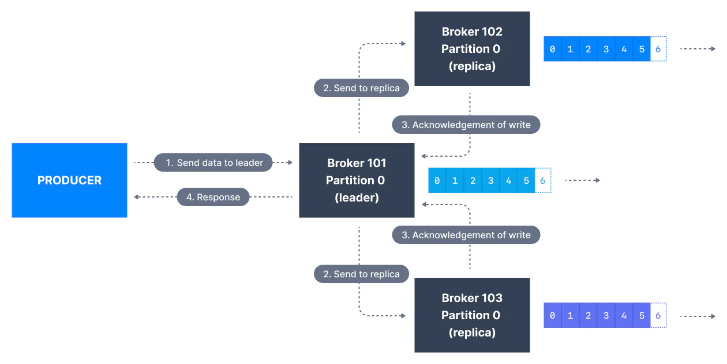
afka producers acks (acks=-1)
When acks=all, producers consider messages as "written successfully" when the message is accepted by all in-sync replicas (ISR).

Slide 62
afka producers acks setting(sckd=-1(all))
The lead replica for a partition checks to see if there are enough in-sync replicas for safely writing the message (controlled by the broker setting min.insync.replicas). The request will be stored in a buffer until the leader observes that the follower replicas replicated the message, at which point a successful acknowledgement is sent back to the client.
Themin.insync.replicas can be configured both at the topic and the broker-level. The data is considered committed when it is written to all in-sync replicas - min.insync.replicas. A value of 2 implies that at least 2 brokers that are ISR (including leader) must respond that they have the data.
If you would like to be sure that committed data is written to more than one replica, you need to set the minimum number of in-sync replicas to a higher value. If a topic has three replicas and you set min.insync.replicas to 2, then you can only write to a partition in the topic if at least two out of the three replicas are in-sync. When all three replicas are in-sync, everything proceeds normally. This is also true if one of the replicas becomes unavailable. However, if two out of three replicas are not available, the brokers will no longer accept produce requests. Instead, producers that attempt to send data will receive NotEnoughReplicasException.

Slide 63
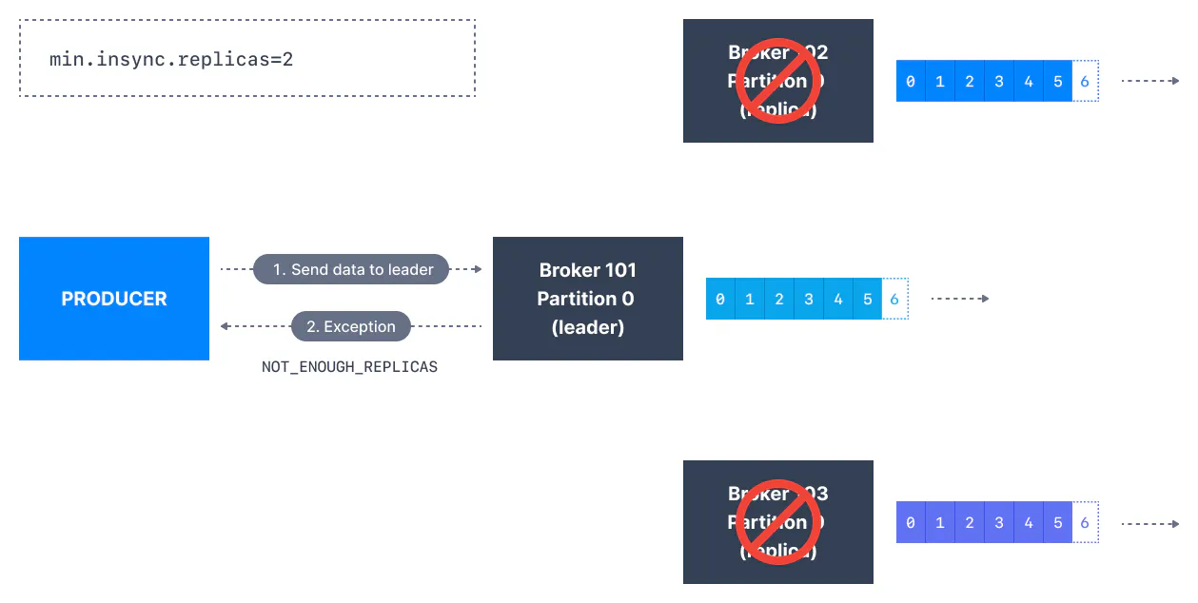
afka producers acks setting(sckd=-1(all))
Kafka Topic Replication, ISR & Message Safety

Slide 64
Kafka Topic Durability & Availability
For a topic replication factor of 3, topic data durability can withstand the loss of 2 brokers. As a general rule, for a replication factor of N, you can permanently lose up to N-1 brokers and still recover your data.
Regarding availability, it is a little bit more complicated... To illustrate, let's consider a replication factor of 3:
Reads: As long as one partition is up and considered an ISR, the topic will be available for reads
Writers:
acks=0 & acks=1 : as long as one partition is up and considered an ISR, the topic will be available for writes.
acks=all:
min.insync.replicas=1 (default): the topic must have at least 1 partition up as an ISR (that includes the reader) and so we can tolerate two brokers being down
min.insync.replicas=2: the topic must have at least 2 ISR up, and therefore we can tolerate at most one broker being down (in the case of replication factor of 3), and we have the guarantee that for every write, the data will be at least written twice.
min.insync.replicas=3: this wouldn't make much sense for a corresponding replication factor of 3 and we couldn't tolerate any broker going down.
in summary, when acks=all with a replication.factor=N and min.insync.replicas=M we can tolerate N-M brokers going down for topic availability purposes

Slide 65
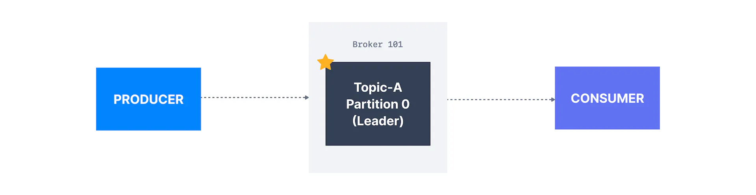
Kafka Consumers Replicas Fetching
Kafka consumers read by default from the partition leader.
But since Apache Kafka 2.4, it is possible to configure consumers to read from in-sync replicas instead (usually the closest).

Slide 66
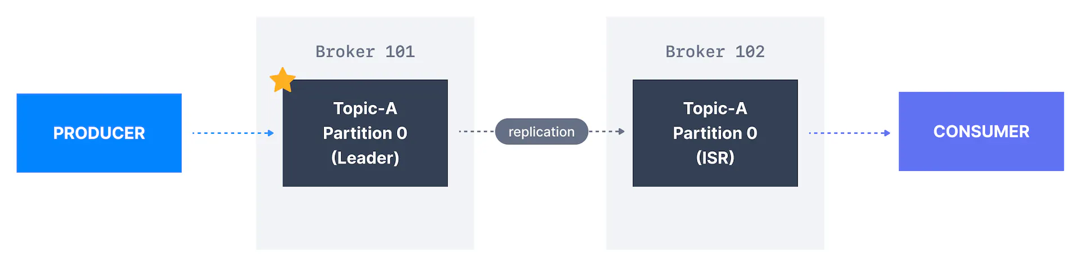
Kafka Consumers Replicas Fetching
Reading from the closest in-sync replicas (ISR) may improve the request latency, and also decrease network costs, because in most cloud environments cross-data centers network requests incur charges.
Preferred leader
The preferred leader is the designated leader broker for a partition at topic creation time (as opposed to being a replica).
Leader ElectionThe process of deciding which broker is a leader at topic creation time is called a preferred leader election.
When the preferred leader goes down, any partition that is an ISR (in-sync replica) is eligible to become a new leader (but not a preferred leader). Upon recovering the preferred leader broker and having its partition data back in sync, the preferred leader will regain leadership for that partition.

Slide 67
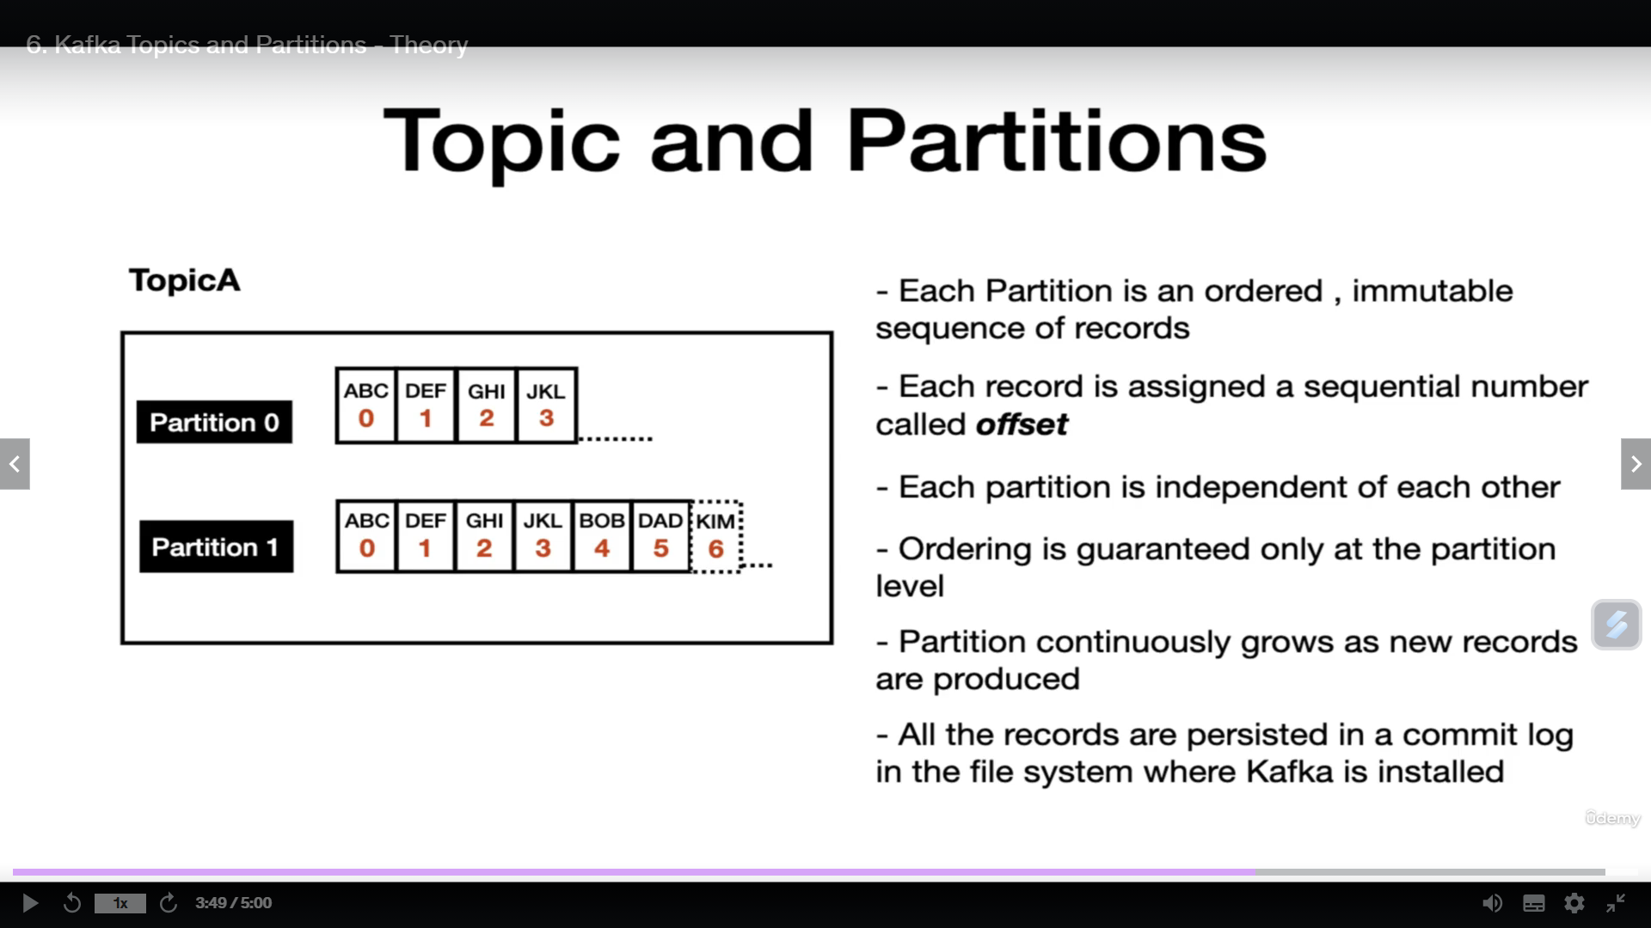

Slide 68
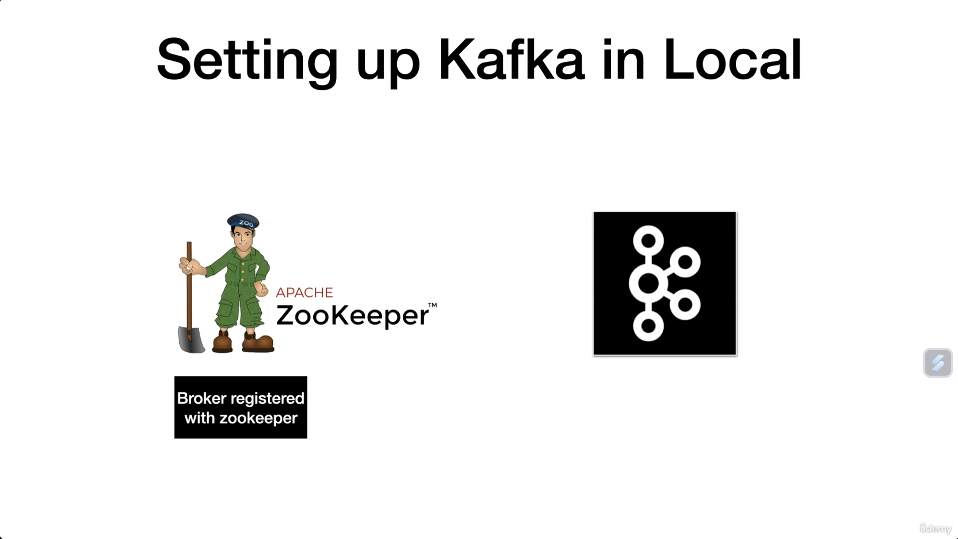

Slide 69
Number one is Zookeeper, and the other one is going to be the Kafka broker.
The reason why we need a zookeeper is that the zookeeper is the one that maintains the metadata about
the Kafka broker and also the Kafka client information.
When we get to the Kafka consumer section, you'll be able to understand more information about the
reason why Zookeeper plays a vital role in maintaining the Kafka consumer information.
So any time we spin up a Kafka broker, the broker registers itself with a zookeeper.
From that point, the zookeeper will keep track of the health of the Kafka broker.
You can think of a zookeeper as a centralized service for maintaining the configuration information
health of the Kafka broker and providing synchronization when we have multiple brokers, which is also
referred to as Kafka Cluster.

Slide 70
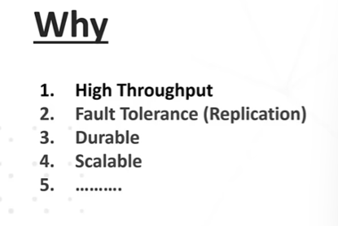
Kafka
Zookeeper manages kafka broker/cluster

Slide 71
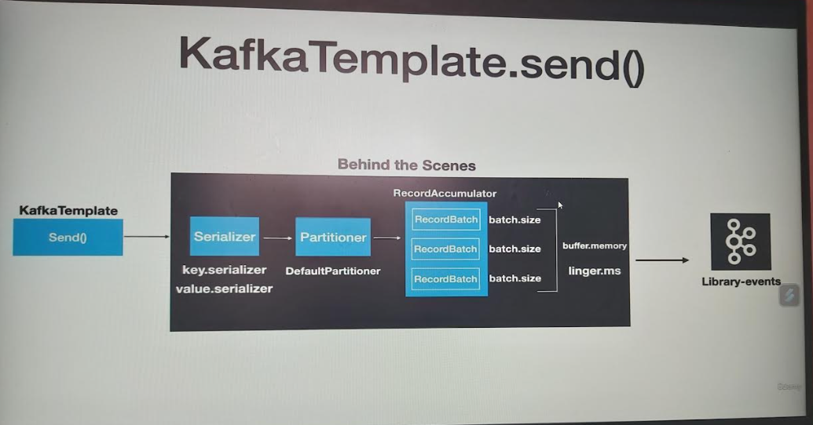

Slide 72
The very first layer is the serializer
Through different layers before the message is sent to the Kafka.
The very first layer is the serializer.
Any record that's sent to the Kafka needs to be serialized, parsed to bytes.
There are two different types of serialization techniques that's applied to any record.
Number one is the key serializer, and the second one is the Value Serializer.
This configuration is mandatory for any producer.
The client needs to provide the key serializer value and value dot serializer value.
The Kafka client Java Libraries comes with some predefined serializers.

Slide 73
The second layer is a partitioner.
This layer determines which partition the message is going to go into the topic.
The Kafka producer API comes up with the default partitioner logic, and in most cases that's enough to handle the partitioning logic and there are options to override this default Partitioner logic too.
But for our use case we will be using the default partitioner.

Slide 74
The second layer is a partitioner.
This layer determines which partition.
The message is going to go into the topic.
The Kafka producer API comes up with the default partitioner logic, and in most cases that's enough
to handle the partitioning logic and there are options to override this default Partitioner logic too.
But for our use case we will be using the default partitioner.

Slide 75
The next layer is the record accumulator.
Any record that's sent from the Kafka template won't get sent to the topic immediately.
The record accumulator buffers, the records and the records are sent to the Kafka topic once the buffer is full.
The reason for this approach is to limit the number of trips from the application to the Kafka cluster and this eventually avoids the overhead of bombarding the Kafka cluster with numerous requests, which also helps in improving the overall performance of the system.

Slide 76
The next layer is the record accumulator.
The record batch that you see here is a representation of the topic partition combination.
If we have a topic with three partitions, then you will have three record batch as it's shown in the slide.
Each and every record batch has a batch size which is represented by the batch dot size property and the value is represented as number of bytes.
It also has a overall buffer memory which is represented by the property buffer dot memory, and this value is also represented as number of bytes.

Slide 77
The next layer is the record accumulator.
So under what scenarios?
The messages are sent to the Kafka topic. Once the batch is full, then the message will be sent to the Kafka topic.
There may be many scenarios where the record batch won't fill up. The producer API is not going to wait for so long to send the message to the Kafka topic.
There is also another handy property called Linger Dot, which will be used in this case to publish
the records into the Kafka topic. As the name suggests, this value is represented in milliseconds.
If the batch is not full and the records accumulated meets the linger dot Ms. value, then the records will be sent to Kafka.

Slide 78
Configuring KafkaTemplate
Bootstrap-server
Key-serializer
Value-serializer
We can write your own key Serializers and value Serializers for complicated examples.

Slide 79
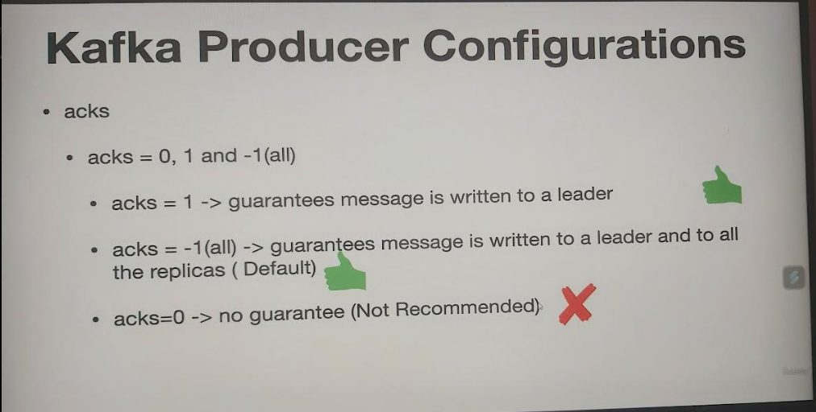

Slide 80
Kafka Producer Configuration
The first one is the acks value, which is the key configuration for reliable data delivery.
The possible values for acks are zero, 1 or -1 or all.
If the acks value is one, that means the producer send call is considered to be successful if the data is successfully produced and persisted into the leader replica.
If the acks value is minus one or all, then that means the producer send call is considered to be successful one only when the data is persisted in the leader and the follower replicas.

Slide 81
Kafka Producer Configuration contd…
So when do you use this option?
If the data that is generated from your app is very critical and the data loss leads to a big problem, then this is the recommended setting and this is a default option that's set for us.
The acks value is zero. Then the producer sent call does not care about whether the message is successfully sent and persisted in the leader replica or the follower replicas.
It is considered successful as soon as the send call is invoked.
So the recommended setting for this particular x value is 1 or -1 and zero is not a recommended setting.

Slide 82
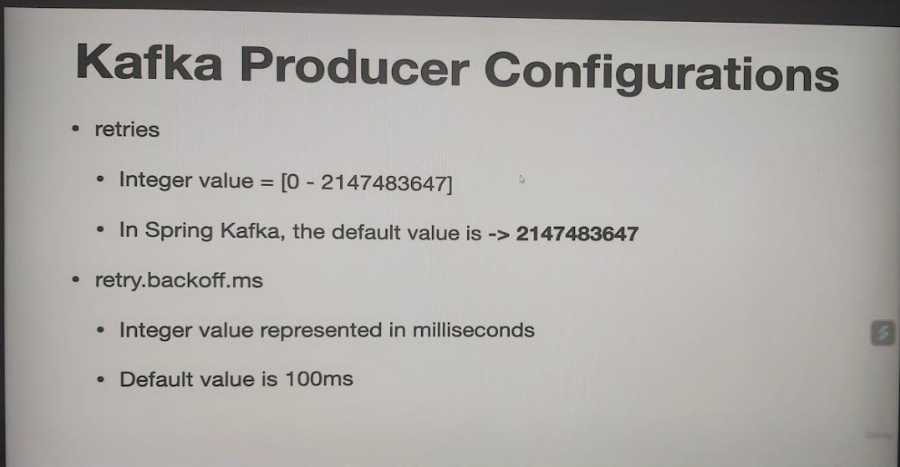

Slide 83
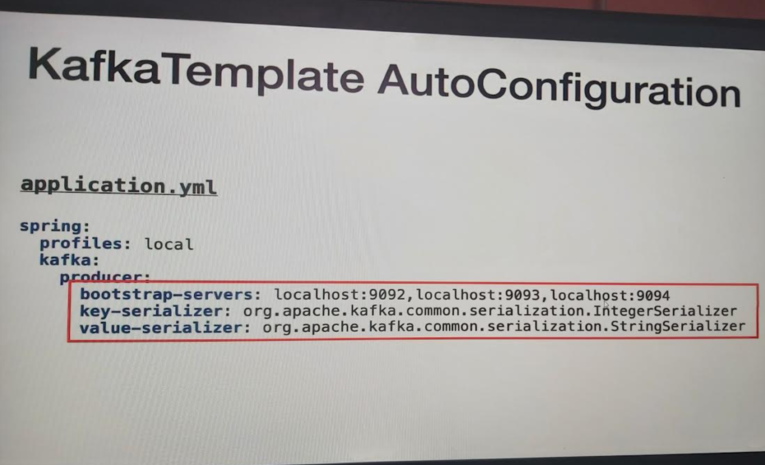
Configuring KafkaTemplate

Slide 84
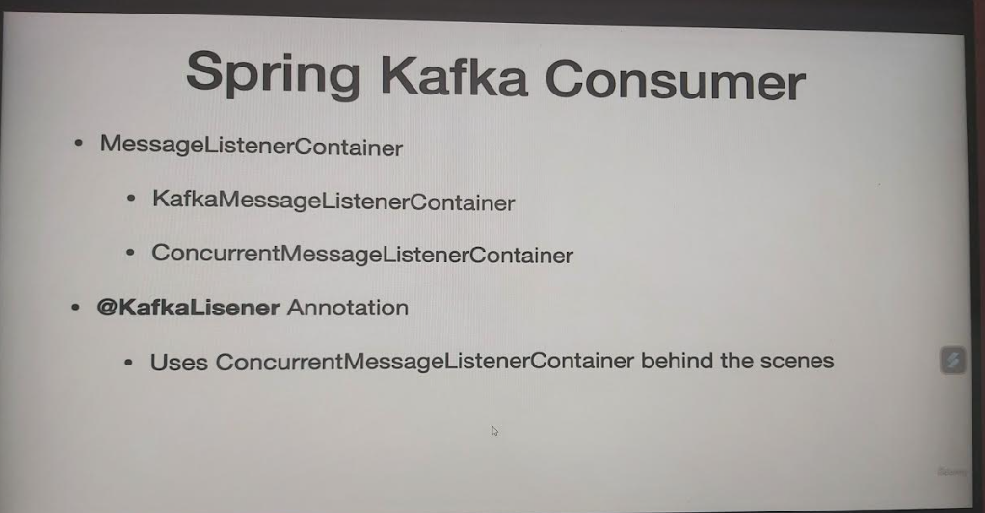

Slide 85
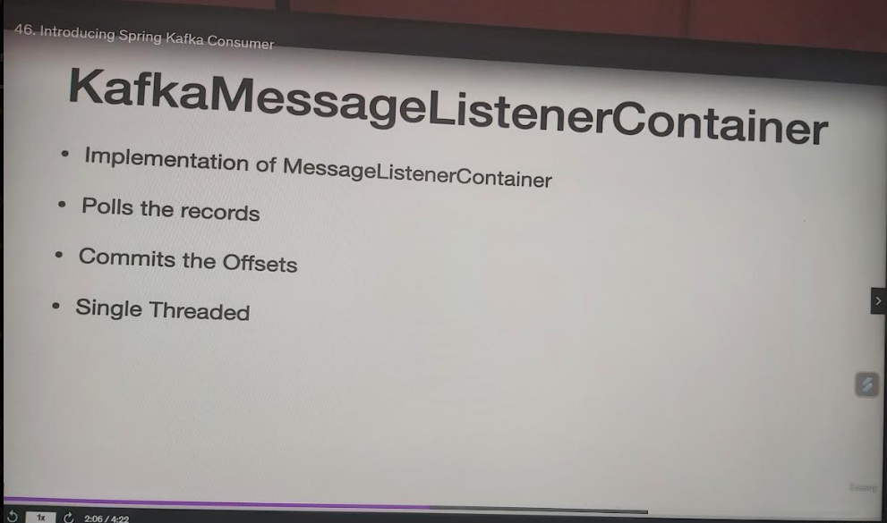

Slide 86
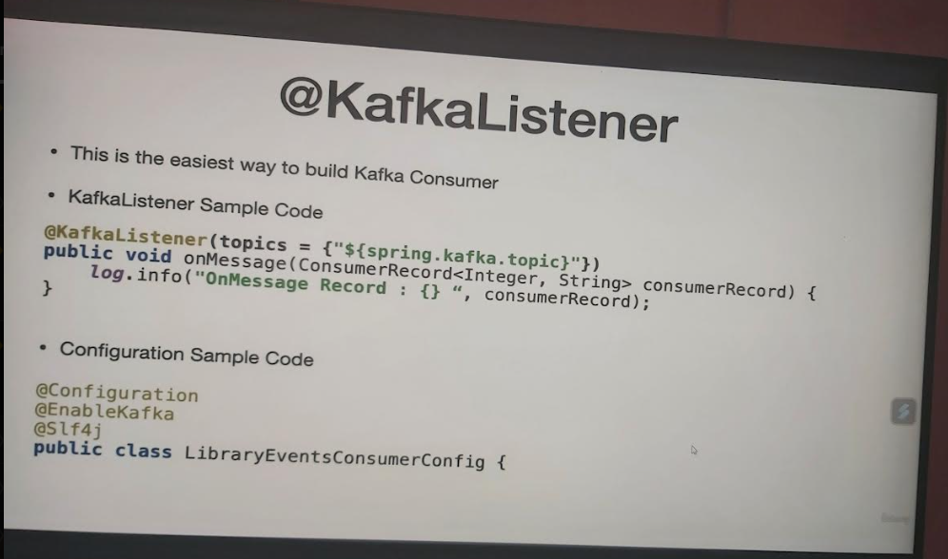

Slide 87
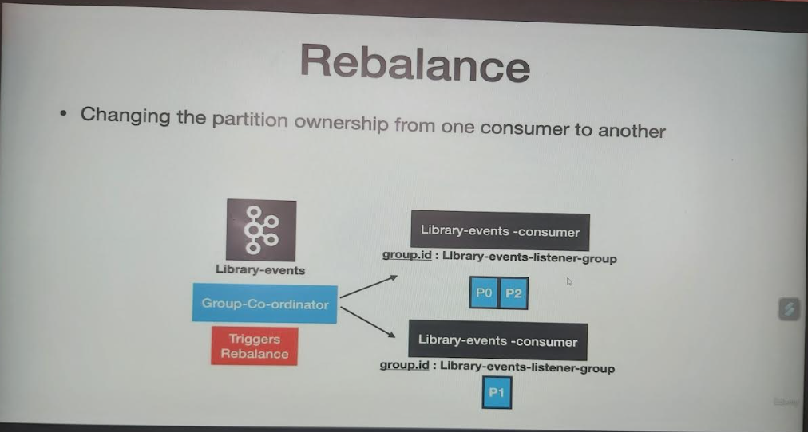

Slide 88
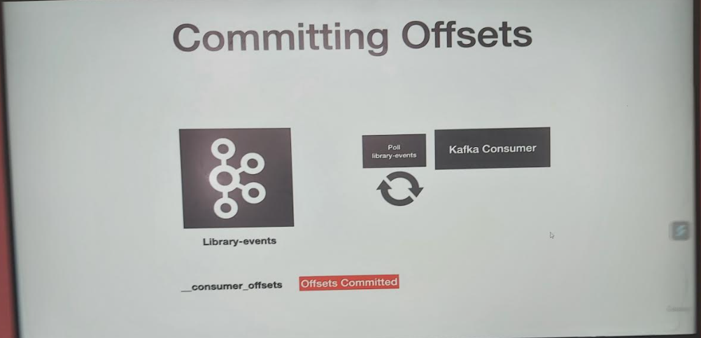

Slide 89
Committing Offsets
So in this slide we have the Kafka consumer and then we have the library events.
On the left, which is the topic here, Our consumer is constantly pulling for records, right?
As you can see, our consumer is pulling for new records.
After the pull loop is executed, it's going to go ahead and retrieve the records from the consumer.
And then our consumer is going to read the messages.
Once the records are processed successfully, then there is a activity that happens behind the scenes, which we do not see it at all.
So what happens behind the scenes is that after the records are processed, it's going to commit the offsets.
This happens behind the scenes and once the offsets are committed, now when the poll loop executes again, it knows from where it needs to read the records from the Kafka topic.
That's one of the reason why it's not reading the same message again.
This is how the consumer offsets are managed by default in spring.

Slide 90
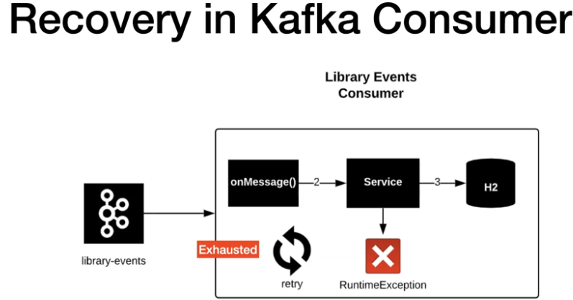
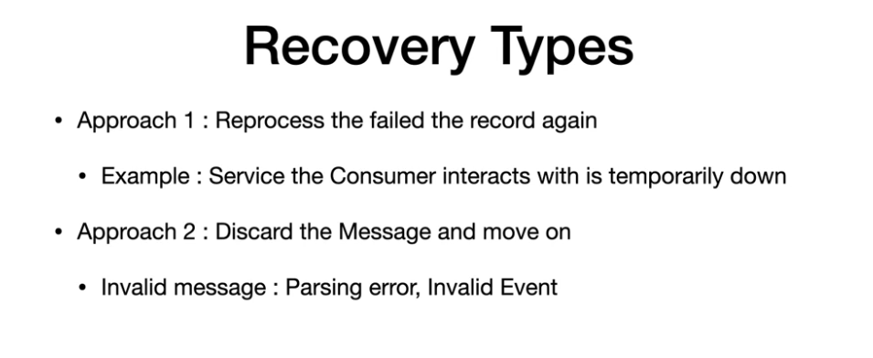

Slide 91
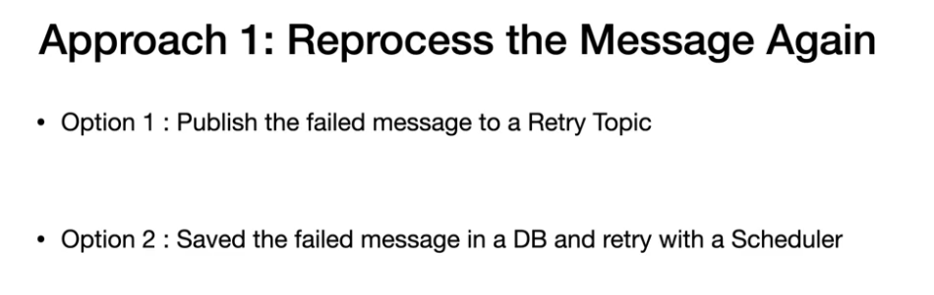

Slide 92
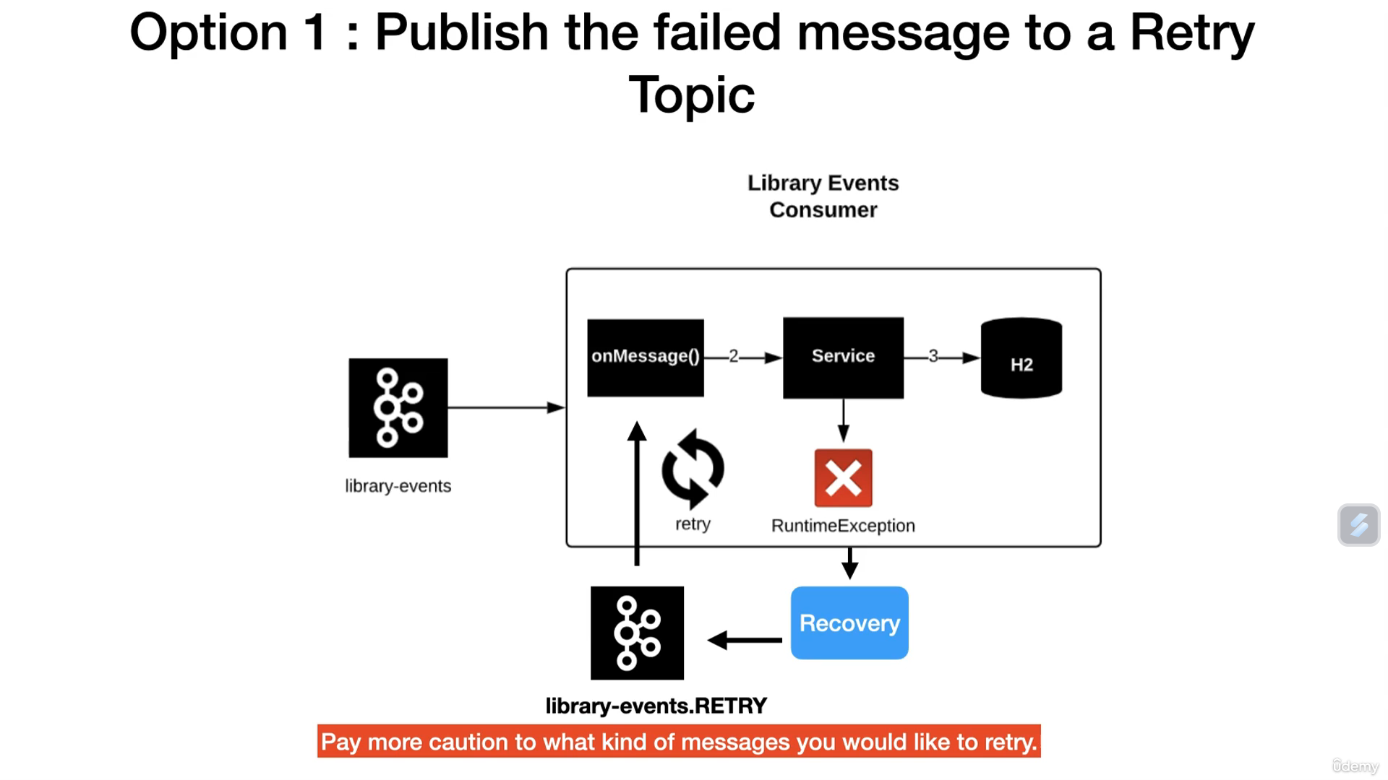

Slide 93
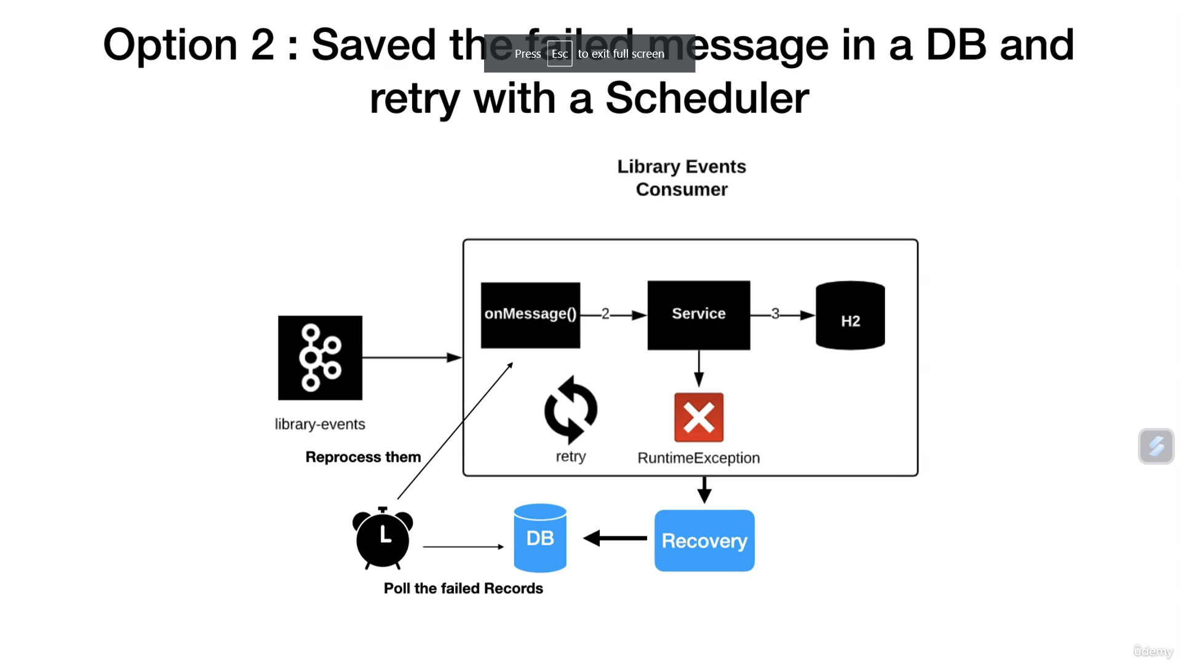

Slide 94
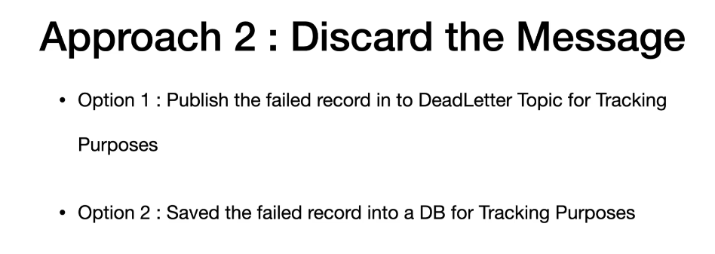

Slide 95
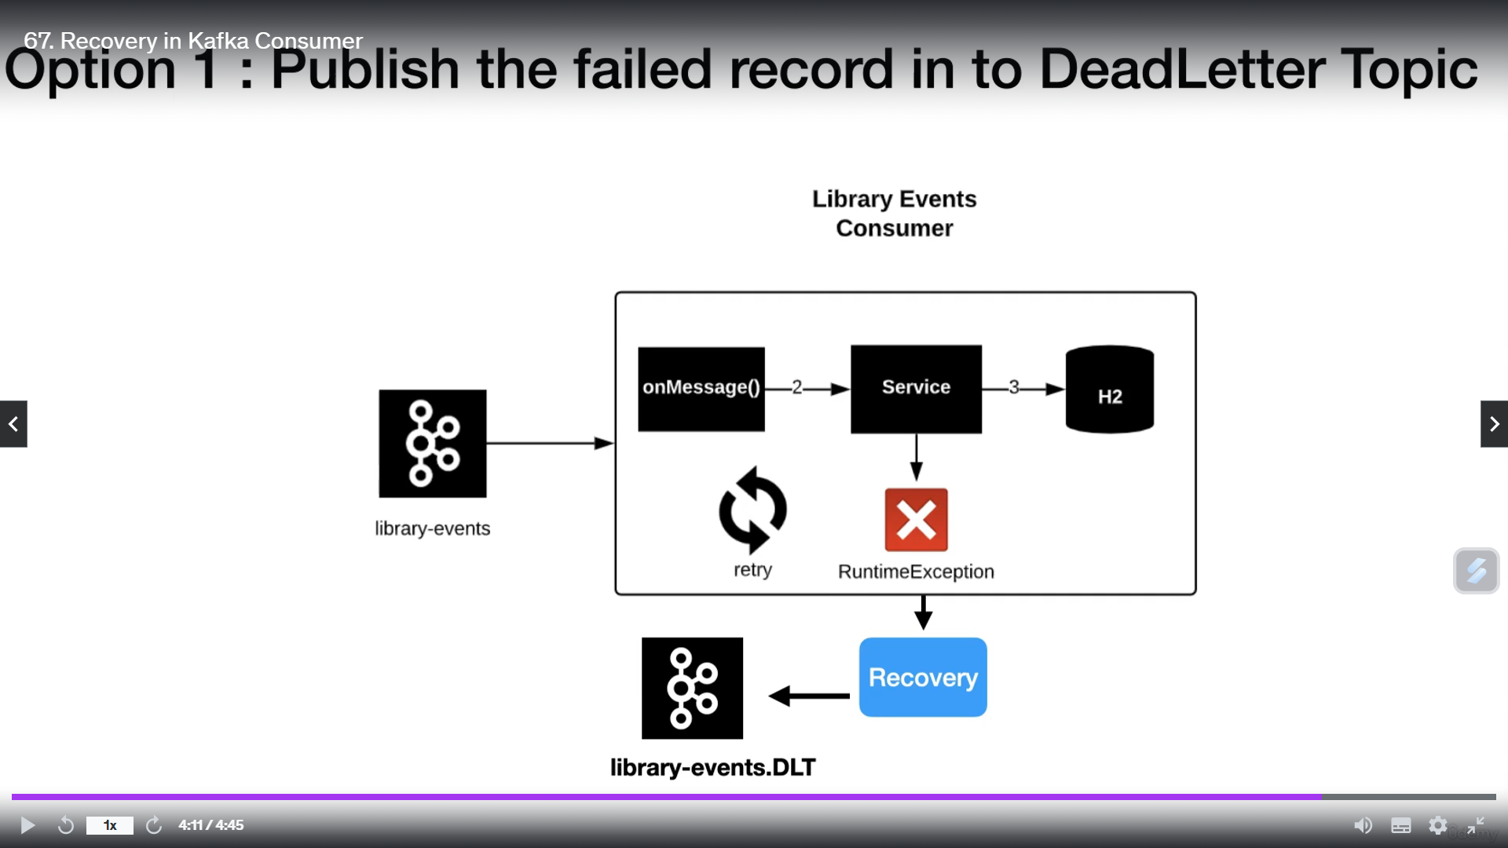

Slide 96
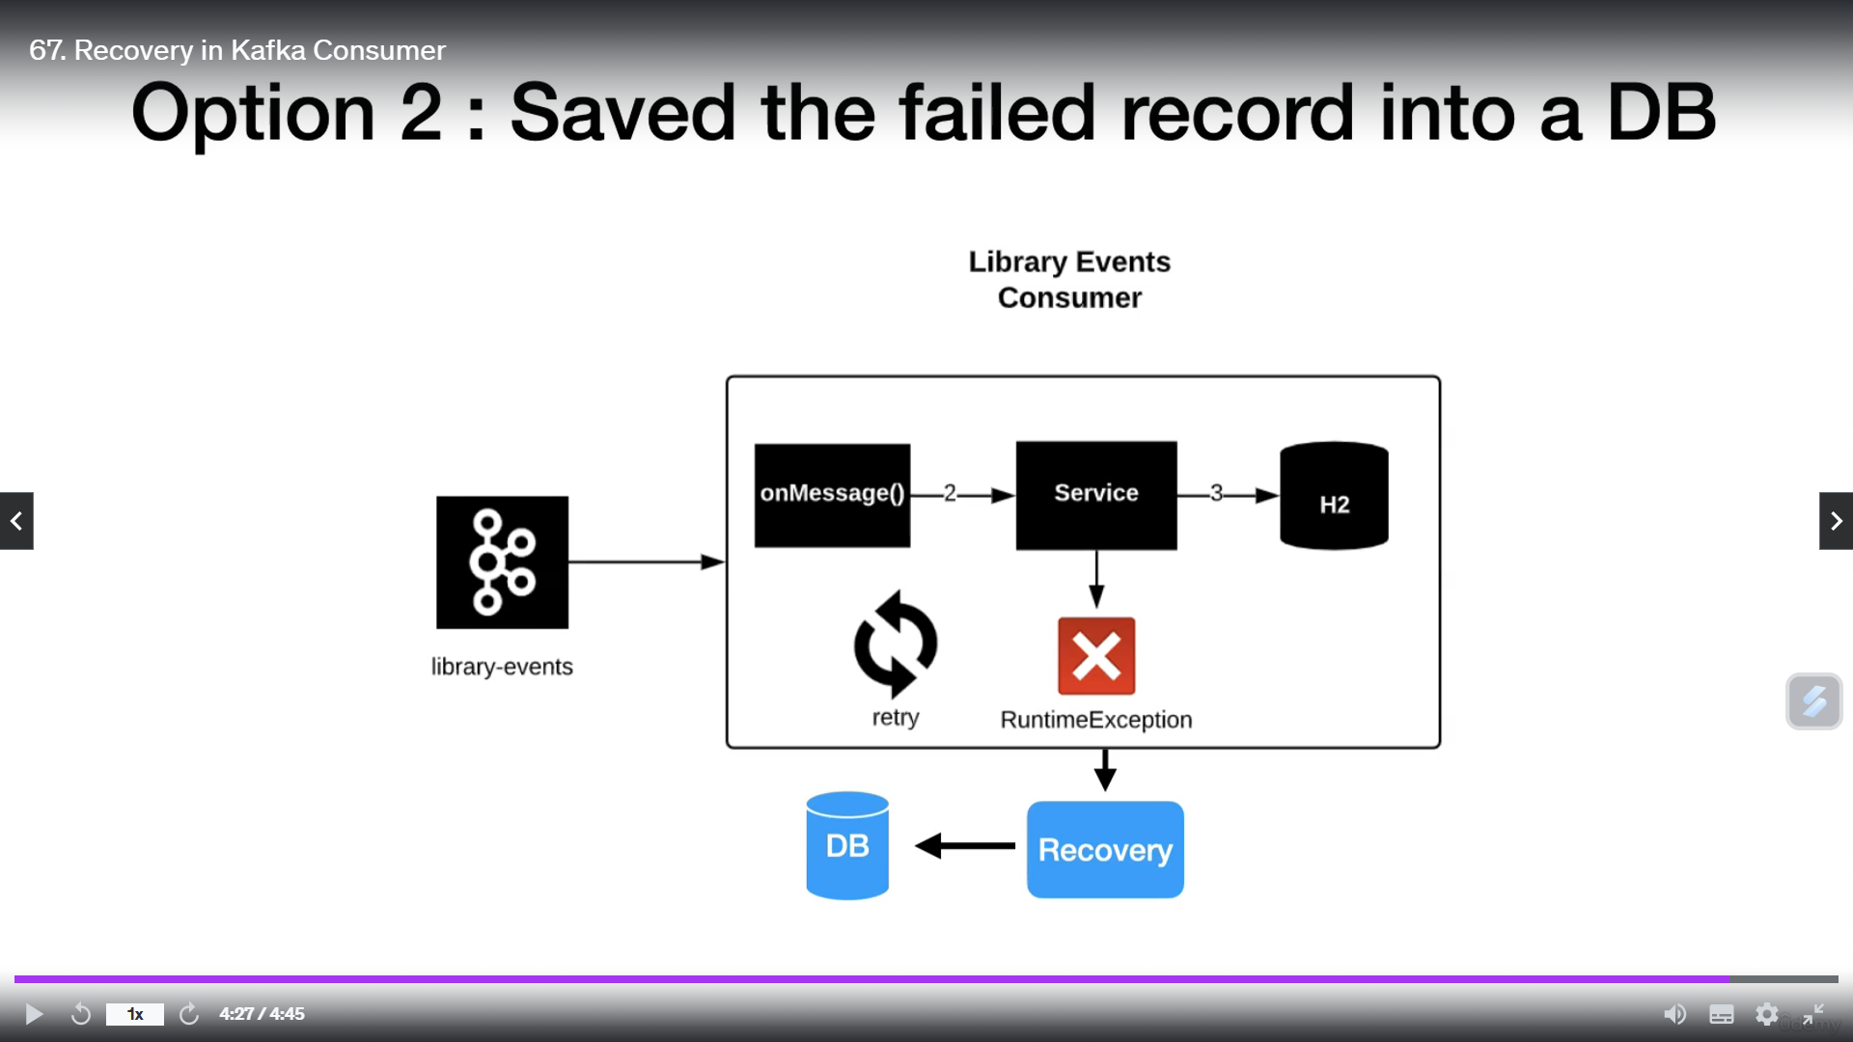

Slide 97
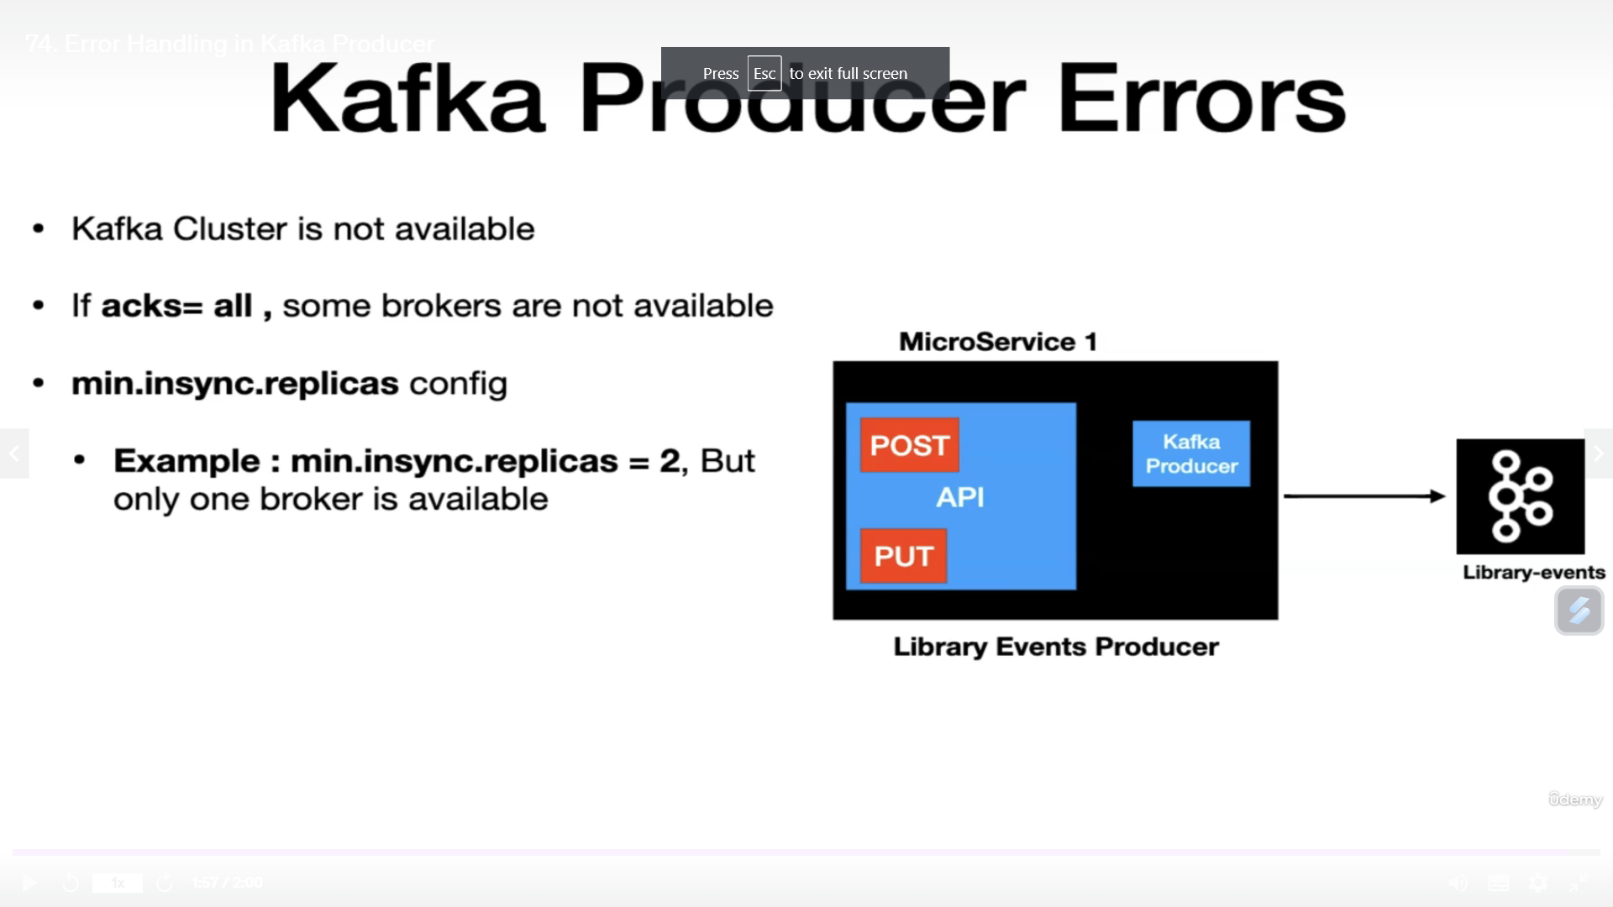

Slide 98
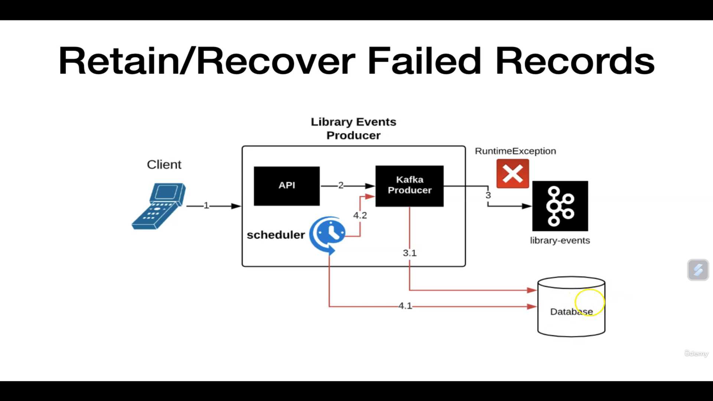

Slide 99
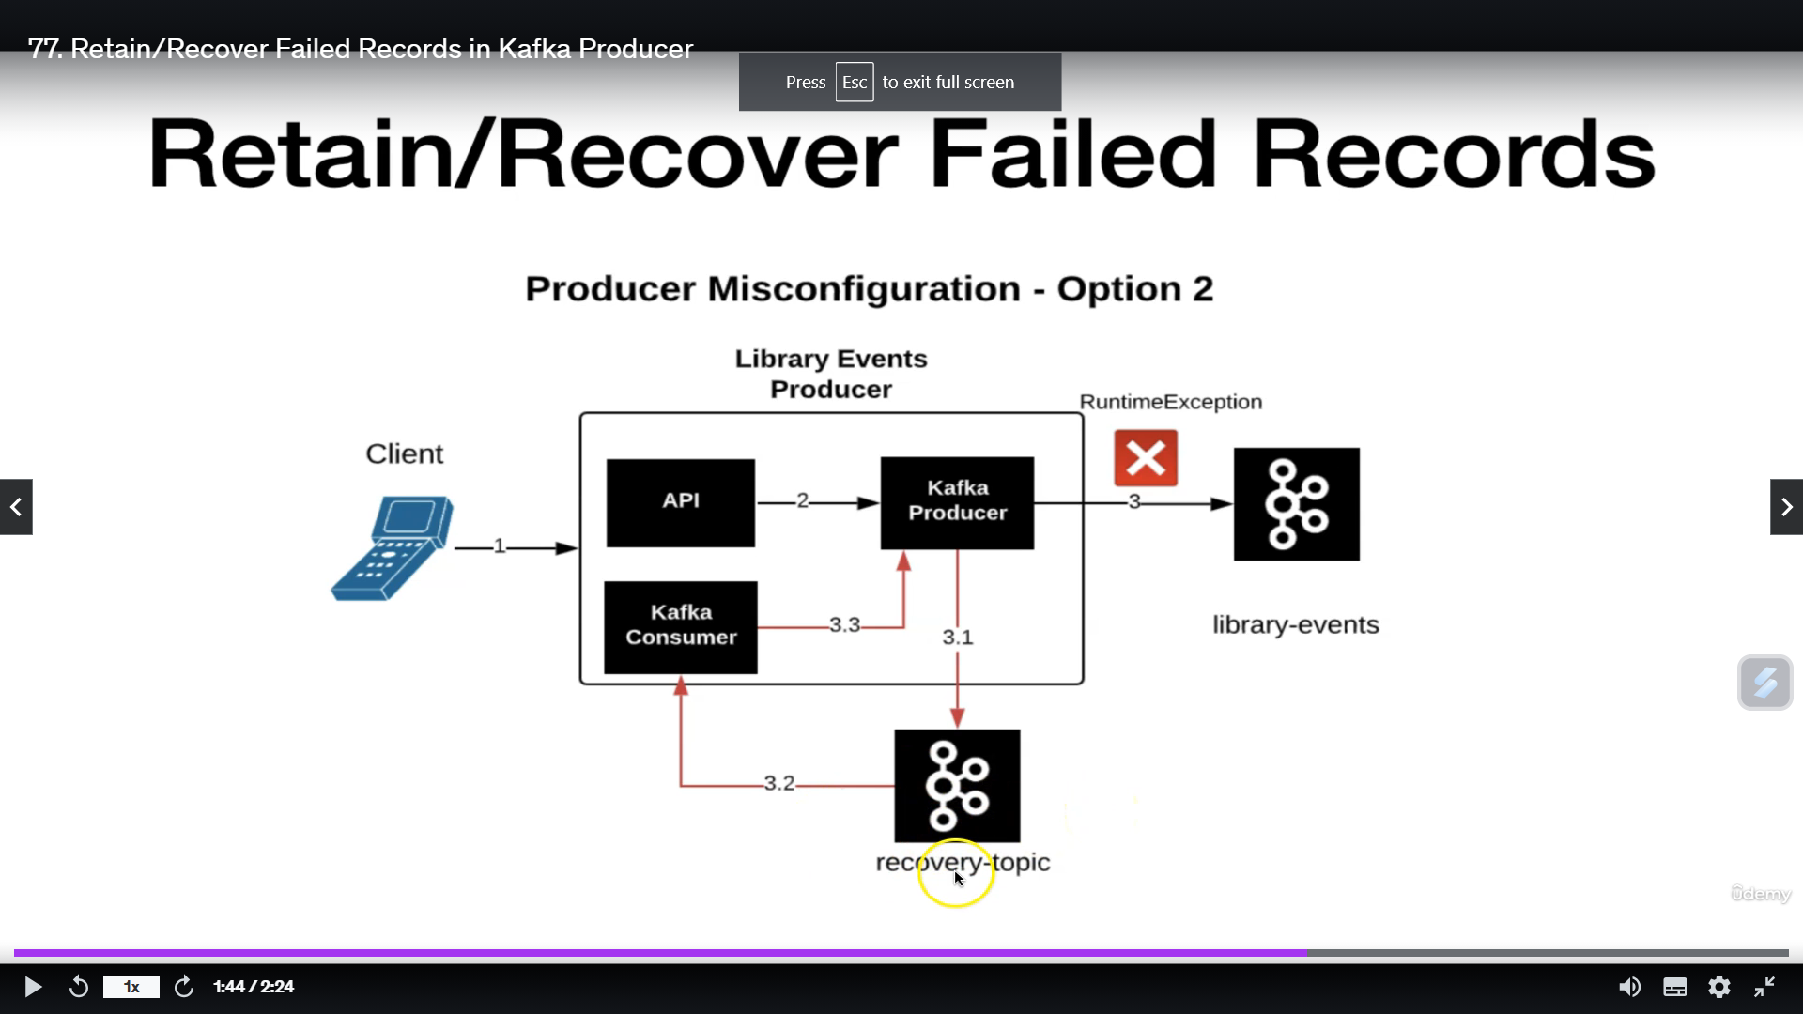

Slide 100
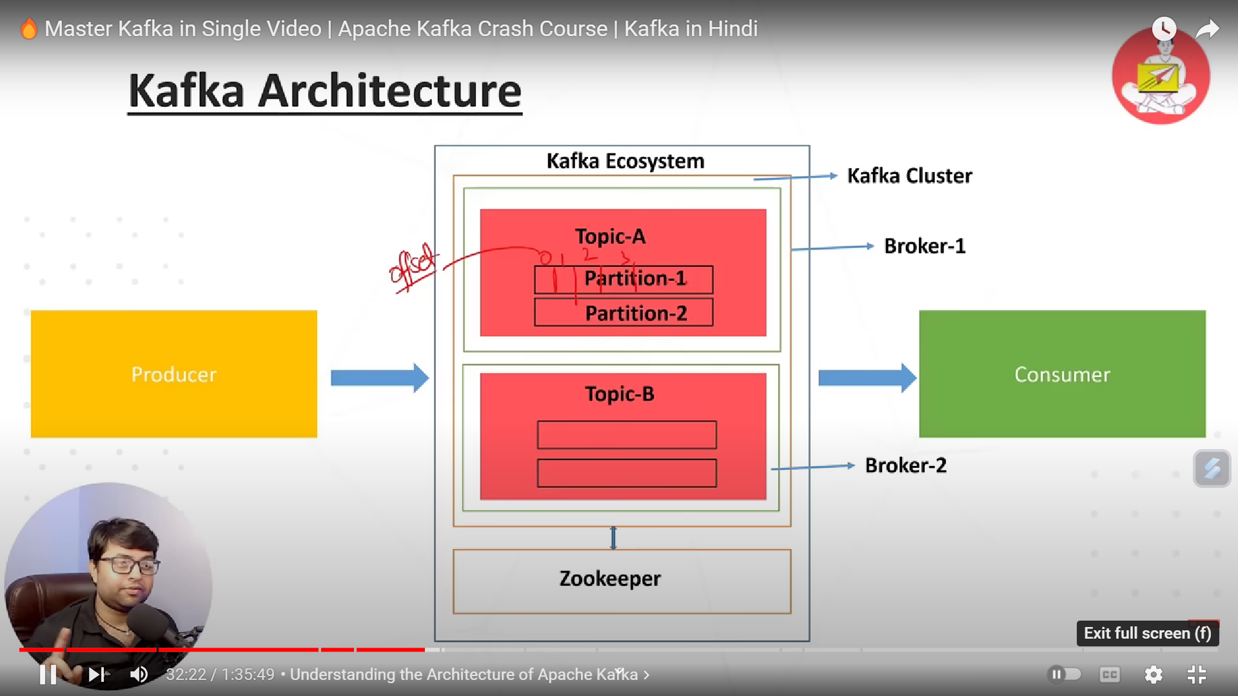

Slide 101


Slide 102
References
https://kafka.apache.org/documentation/#producerconfigs
https://docs.spring.io/spring-kafka/docs/current/reference/html/#receiving-messages
https://medium.com/@anupriya7295/spring-boot-kafka-error-handling-retry-and-dlt-670798d6c

