Slide 1
Mutual Fund Analytics Project
Submitted By: Sunayana

Slide 2
Project Overview
Objective
Analyze Indian Mutual Fund Industry
Study SIP growth and AUM trends
Evaluate fund performance using risk metrics
Build interactive Power BI dashboard
Datasets Used
Fund Master
NAV History
AUM Data
SIP Inflows
Investor Transactions
Portfolio Holdings
Benchmark Indices

Slide 3
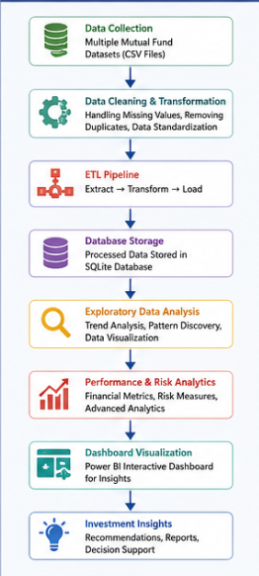
Data Pipeline
Tools Used
Python for ETL
SQLite for storage
Jupyter Notebook for analysis
Power BI for visualization

Slide 4
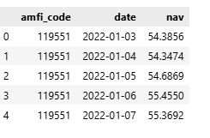
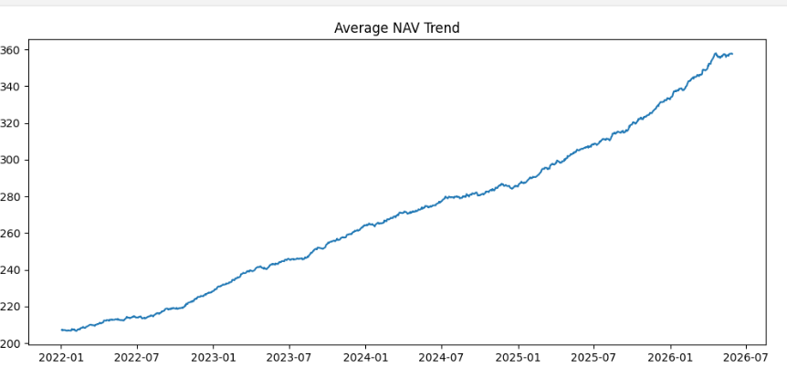
Key EDA Insights
Industry folios increased from 13.26 Cr to 26.12 Cr.
SIP inflows reached record highs in 2025.
SBI Mutual Fund maintained the highest AUM.
Equity-oriented funds attracted the largest investor participation.
T30 cities contributed the majority of investments.
Male investors represented a larger transaction share.
Small-cap funds delivered higher returns with higher risk.
Monthly SIP contributions showed consistent growth.
Investor participation expanded across multiple age groups.
Category inflows varied significantly across market cycles.

Slide 5
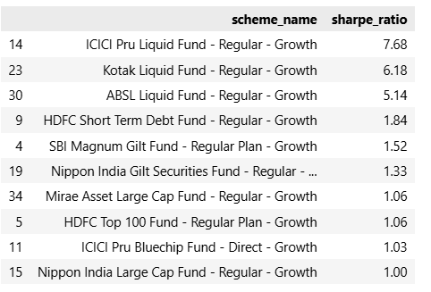
Performance Analytics
Metrics Calculated
CAGR
Sharpe Ratio
Sortino Ratio
Alpha
Beta
Maximum Drawdown
Fund Score
Outcome
A comprehensive scorecard was developed to rank mutual funds based on return, risk, alpha, expenses, and drawdown performance.
Analysis Performed
Daily return calculation
Risk-adjusted performance evaluation
Benchmark comparison
Fund ranking system

Slide 6
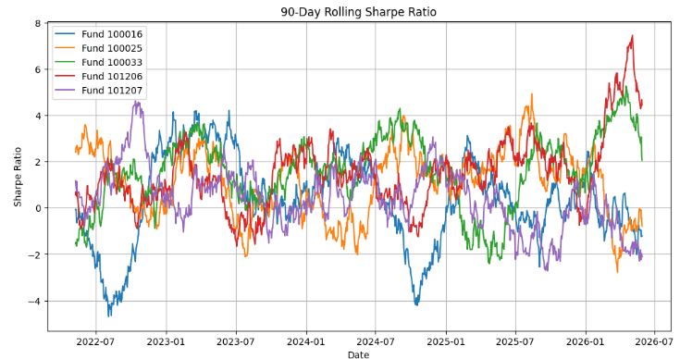
Advanced Analytics
Risk Analytics
Historical VaR (95%)
Conditional VaR (CVaR)
Rolling 90-Day Sharpe Ratio
Investor Analytics
Cohort Analysis
SIP Continuity Analysis
At-Risk Investor Detection
Portfolio Analytics
Sector Concentration (HHI)
Fund Recommendation Engine
Key Insight
Small Cap funds generated higher returns but carried significantly higher downside risk.

Slide 7
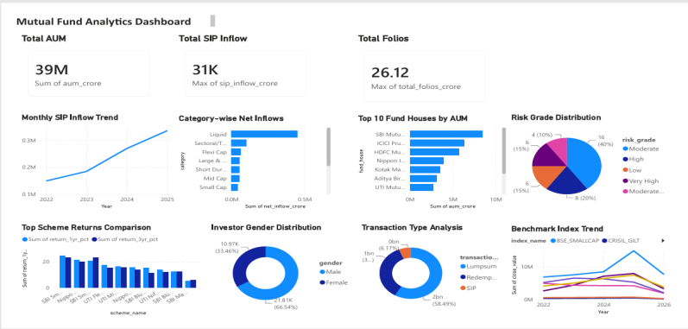
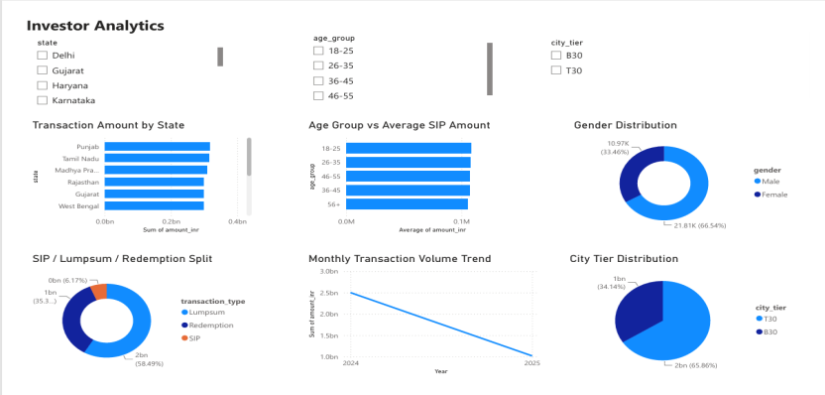
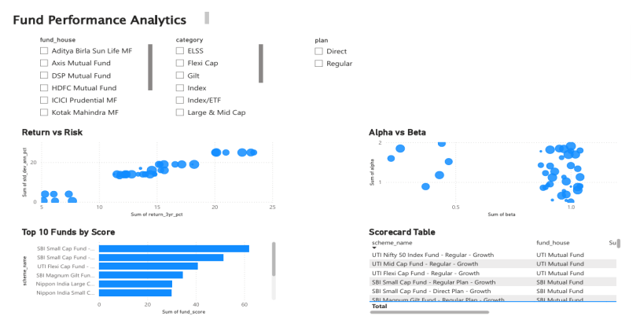
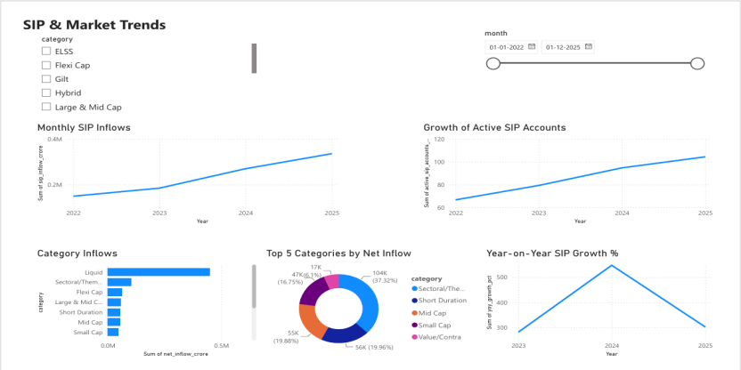
Interactive Dashboard
Page 1 – Industry Overview
AUM
SIP Inflows
Folios
Industry Trends
Page 2 – Fund Performance
Return vs Risk
Fund Scorecard
Alpha-Beta Analysis
Page 3 – Investor Analytics
State Analysis
Age Group Analysis
Transaction Distribution
Page 4 – SIP & Market Trends
SIP Growth
Category Inflows
Market Trends

Slide 8
Conclusion & Future Scope
Conclusion
Successfully developed an end-to-end mutual fund analytics solution.
Performed ETL, EDA, risk analysis, and performance evaluation.
Built a fully interactive Power BI dashboard.
Generated actionable investment insights using advanced analytics.
Future Scope
Live NAV integration using APIs
Automated daily data refresh
Streamlit web application
Machine Learning-based fund recommendation
Portfolio optimization using Modern Portfolio Theory

Slide 9


