Slide 1
Diabetic Retinopathy Detection
Sunayana Hubli
Group 8
ML5450

Slide 2
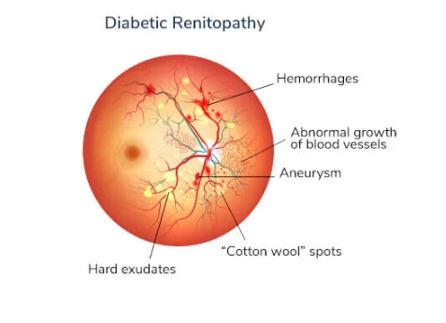
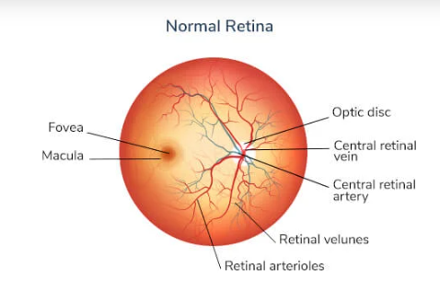
What is Diabetic Retinopathy?
Retinopathy is a diabetes complication that affects eyes. It's caused by damage to the blood vessels of the light-sensitive tissue at the back of the eye (retina).
On retinal images, these damages to the blood vessel appear as spots

Slide 3
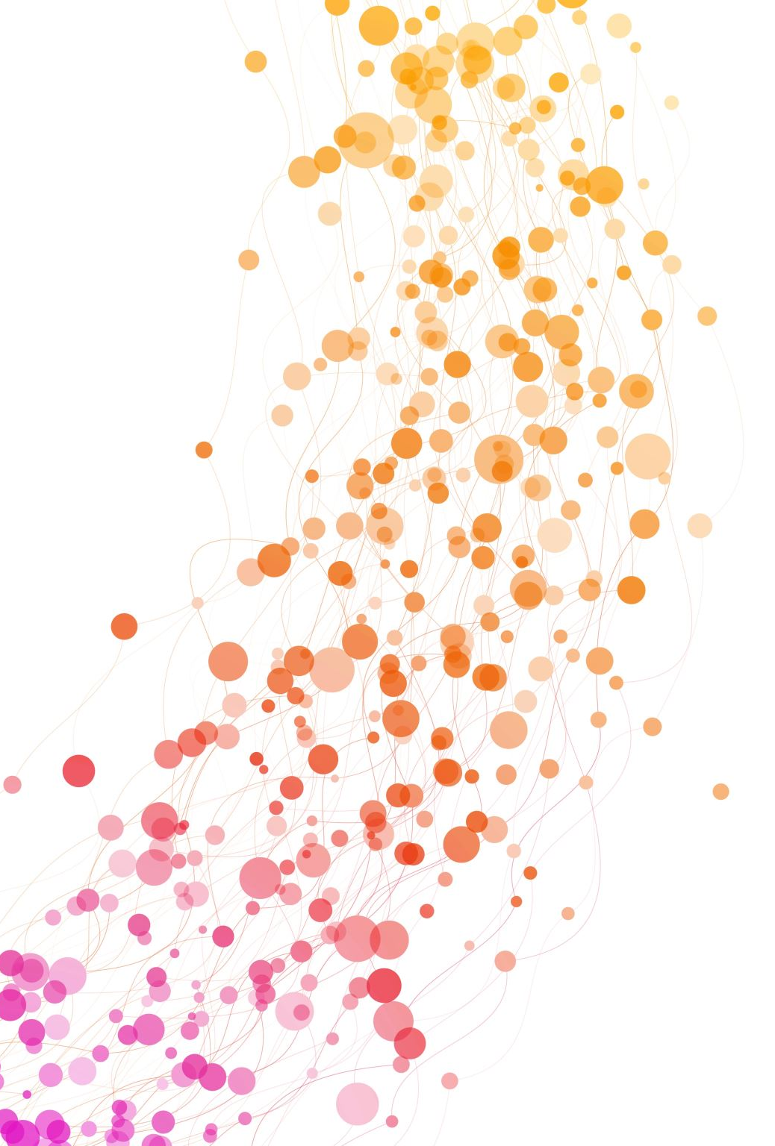
Objective
Goal: Comparative study of different machine learning algorithms for the detection of diabetic retinopathy from retinal images

Slide 4
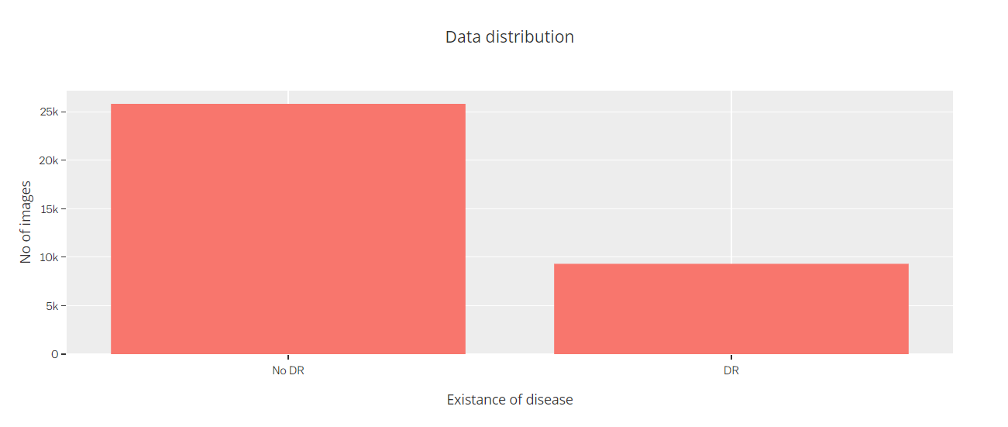
Data Specifications
Dataset Details:
Retinal images
Total Images: 35126
Size: 224x224 pixels
Source: Kaggle
Dataset with known categories
Normal (No DR): 25810
With DR : 9316 images

Slide 5

Algorithms
Naïve Bayes
K-Nearest Neighbor
Support Vector Machine
Convoluted Neural Network
ResNet50

Slide 6
Image Processing
Data size reduction
Converted to Grayscale
Increasing contrast
Resizing the images
Image is converted to an array

Slide 7
Naïve Bayes
Naive Bayes Algorithm calculates the conditional probability of all classes and, because it is naive, it will assume that every feature is independent of one another. Baye's Theorem
It will assume there is no correlation between any feature and so, their contribution to predicting the class is not impacted by other features.

Slide 8
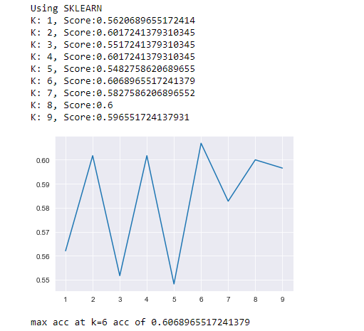
KNN
K-Nearest Neighbors is a supervised machine learning algorithm
The model learns the entire training set and for prediction gives the output as the class with the majority in the ‘k’ nearest neighbors calculated according to some distance metric.

Slide 9
SVM
  SVM Model used the functional relationship between the two observations. It will add more dimensions to the data so we can easily differentiate among them.
  Only the vector points are used to determine the decision boundary
  The Kernel used here is Polynomial
  An accuracy of 68% is achieved.

Slide 10
Neural Network
  CNN
  ResNet

Slide 11
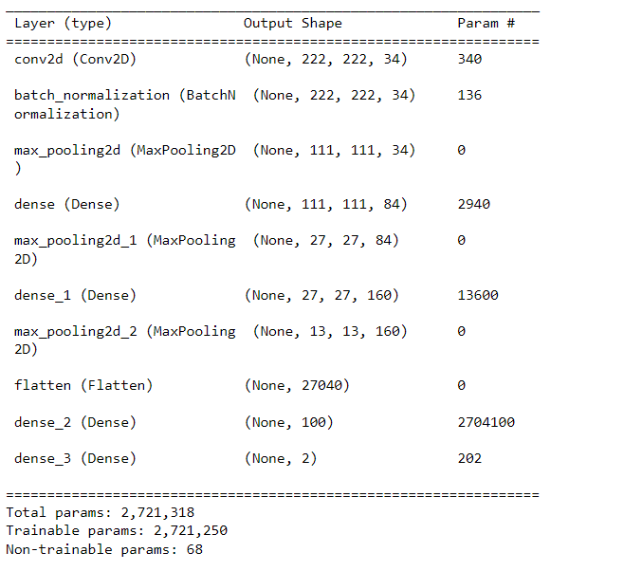
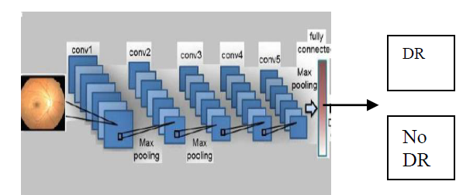
CNN
Components of Convolutional Neural Network (ConvNet or CNN)
There are four components of a Convnets
Convolution
Non Linearity Pooling or Sub Sampling
Classification (Fully Connected Layer)

Slide 12
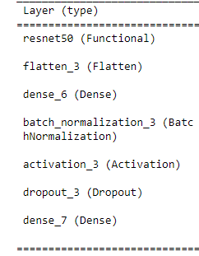
ResNet
  Residual Network (ResNet) is a Convolutional Neural Network (CNN) architecture that overcame the “vanishing gradient” problem, making it possible to construct networks with up to thousands of convolutional layers, which outperform shallower networks.

Slide 13
Performance
 | Naïve Bayes | KNN | SVM | CNN | ResNet
Accuracy | 60.063 % | 60.8% at K=6 | 68.6% | 72.55% | 74.3 %
Training Time | ~2-5 secs | ~ 108 secs | ~25 mins | ~20 mins | ~35 mins

Slide 14
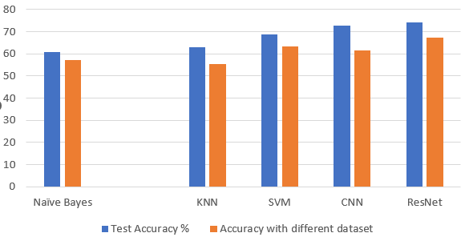
Performance
Accuracy Comparison

Slide 15
Conclusion
ResNet and CNN display the best accuracy and performance amongst all the techniques used.
SVM performs comparably and can act as a relevant classifier in detection of Diabetic Retinopathy.
The traditional method of KNN perform well only with limited dataset and do not fare well when the data set is large or when predicting with new dataset i.e., from a different source.

Slide 16

Future Work
Delve further into Transfer Learning/ Deep Learning Techniques
Move to Categorical prediction of disease
Improve the performance

Slide 17
-
Thank You

