Slide 1
MACHINE LEARNING
End to End Process
Trainer : Sujata Mohite
Email: sujata.mohite@sunbeaminfo.com
www.sunbeaminfo.com

Slide 2

Measures of Correlation
Sunbeam Infotech
www.sunbeaminfo.com

Slide 3
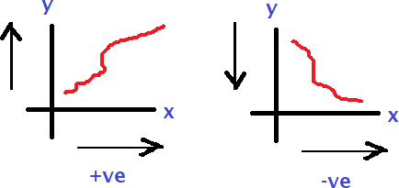
Terminology
Univariate
  This type of data consists of only one variable (eg. Temperature value)
  It does not deal with causes or relationships
  the main purpose of the analysis is to describe the data and find patterns that exist within it
Bivariate
  This type of data involves two different variables
  The analysis of this type of data deals with causes and relationships
  the analysis is done to find out the relationship among the two variables
Multivariate
  When the data involves three or more variables
  It is similar to bivariate but contains more than one independent variable
Sunbeam Infotech
www.sunbeaminfo.com

Slide 4

Terminology
Independent variable(s)
  A variable that represents a quantity that is being manipulated in an experiment
  Represents input
  Also known as regressors in a statistical context.
  x is often the variable used to represent the independent variable in an equation
Dependent variable
  A quantity whose value depends on how the independent variable is manipulated
  Represents output
  y is often the variable used to represent the independent variable in an equation
Sunbeam Infotech
www.sunbeaminfo.com

Slide 5
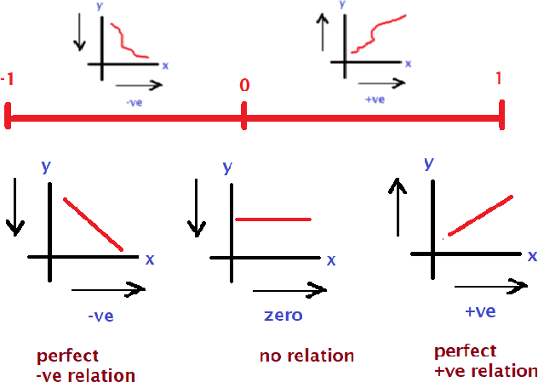
Correlation
Measures the strength of the relationship between two or more variables
Correlation is the scaled measure of covariance
It is dimensionless: the correlation coefficient is always a pure value and not measured in any units
𝑐𝑜𝑣(𝑋, 𝑌)
𝜌 𝑋, 𝑌 =
𝜎 𝜎
𝑥 𝑦
Where
  ρ(X,Y) – the correlation between the variables X and Y
  cov(X,Y) – the covariance between the variables X and Y
  σ_{X} – the standard deviation of the X-variable
  σ_{Y} – the standard deviation of the Y-variable
Sunbeam Infotech
www.sunbeaminfo.com

Slide 6
Correlation
Even a high degree of correlation does not necessarily mean that the relationship of cause and effect exists between the variables.
The explanation of significant degree of correlation may be one or both of the following-
    ▪ The correlation may be due to pure chance, especially in a small sample-
    ▪ Both the correlated variables may be influenced by one or more other variables
    ▪ Both the correlated variables are mutually influencing each other.

Slide 7
Correlation coefficient
Following are the ways to calculate correlation coefficient
  Karl Pearson’s coefficient of correlation
  Spearman’s Rank correlation
  Scatter diagram
  Coefficient of concurrent duration
Correlation (r) → corr(x , y) = corr(y , x)
  The coefficient of correlation lies between -1 and +1, symbolically -1 <= r <= 1
  r = 1 (perfect correlation)
  r = -1 (perfect negative correlation)
  r > 0 (positive correlation)
  r < 0 (negative correlation)
  r = 0 (no correlation)
Sunbeam Infotech
www.sunbeaminfo.com

Slide 8
Covariance vs Correlation
Both primarily assess the relationship between variables
The closest analogy to the relationship between them is the relationship between the variance and standard deviation
Covariance measures the total variation of two random variables from their expected values while correlation measures the strength of the relationship between variables
Using covariance, we can only gauge the direction of the relationship while correlation is the scaled measure of covariance
Sunbeam Infotech
www.sunbeaminfo.com

Slide 9
End to End Process

Slide 10
Steps
Look at the big picture
Get the data → collect/organize data
Discover and visualize the data to gain insights (Exploratory Data Analysis (EDA))
Prepare the data for Machine Learning algorithms → data cleansing
Select a model and train it → by trial and error method
Fine-tune your model
Present your solution
Launch, monitor, and maintain your system

Slide 11
Look at the Big Picture
Frame the Problem(Domain Knowledge)
The first question to ask your boss is what exactly the business objective is Building a model is probably not the end goal
How does the company expect to use and benefit from this model?
Knowing the objective is important because it will determine
how you frame the problem
which algorithm you will select
which performance measure you will use to evaluate your model
how much effort you will spend tweaking it
Select a Performance Measure
Your next step is to select a performance measure
A typical performance measure for regression problems is the Root Mean Square Error (RMSE) and MAE(Mean Absolute Error)
It gives an idea of how much error the system typically makes in its predictions, with a
higher weight for large errors

Slide 12
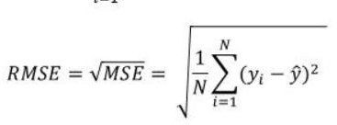



Performance Measures
Regression
RMSE (Root Mean Squared Error) :square root of Mean Squared error
MAE (Mean Absolute Error) : the average of the absolute difference between the actual and predicted values in the dataset
MSE :the average of the squared difference between the original and predicted values in the data set
The lower value of MAE, MSE, and RMSE implies higher accuracy of a regression model

Slide 13
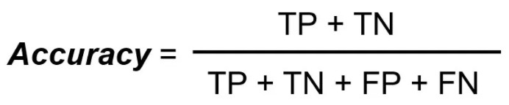
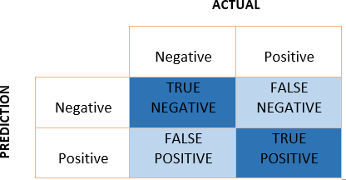



Performance Measures
Classification
Accuracy Score : measures how often the classifier correctly predicts
F1-Score : the harmonic mean of precision and recall.
Confusion Matrix :It is a matrix of size 2×2 for binary classification with actual values on one axis and predicted on another

Slide 14
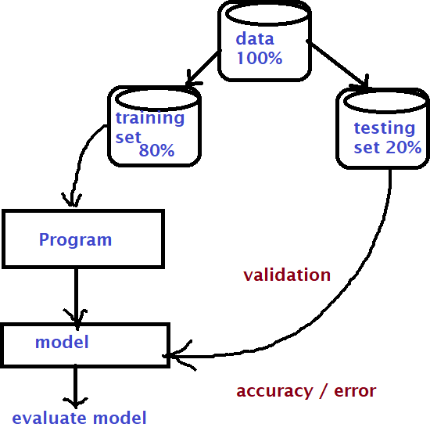
Get the data
Decide the data source ( file / database / online /api )
Download the data and make it available for the further learning
Take a Quick Look at the Data Structure
  Understand the data set (numeric / textual / categorical etc) and understand its features
/columns /variables
  Evaluate the features and decide which one(s) are needed(dependent/independent→ correlation analysis)
Create a Test Set
  Keep some records aside for testing and validation

Slide 15
Discover and Visualize the Data to Gain Insights
Visualize the data
  Use libraries like matplotlib or seaborn
  Understand the pattern and relationship
Look for correlation
Experiment with attribute combinations

Slide 16
Prepare the Data for Machine Learning Algorithms
Data Cleaning
  Process of cleaning the data set to prepare it for ML algorithm
  Steps
    Check for the missing data(NA values)
    Check for wrong data types
    Add features if needed
    Remove unwanted features
Feature Scaling
  ML algorithms don’t perform well when the input numerical attributes have very different scale
  Scale the features to bring all of them to a single scale
Handle categorical / text data
  Use transformers to convert categorical to numerical (eg. Label encoding / ordinal encoding, one-hot encoding etc)

Slide 17
Select and Train a Model
Training the model using train data set
  Create a model using selected algorithm
  Save the model for future use
Evaluation the model
  Evaluate the model to see if there is any chance to improve the accuracy
  Techniques
    Cross Validation

Slide 18
Fine-Tune Your Model
Grid Search
  One option would be to fiddle with the hyperparameters manually, until you find a great combination of hyper parameter values(configuration of algorithms)
  This would be very tedious work, and you may not have time to explore many combinations
  You can also automate this process using libraries like sci-kit
Randomized Search
  The grid search approach is fine when you are exploring relatively few combinations
  But when the hyperparameter search space is large, it is often preferable to use randomized search
Ensemble Methods
  Another way to fine-tune your system is to try to combine the models that perform best
  The group (or “ensemble”) will often perform better than the best individual model, especially if the individual models make very different types of errors.
Analyse the Best Models and Their Errors
Evaluate Your System on the Test Set

Slide 19
Launch, Monitor, and Maintain Your System
Deploy the application for the end users → production
Monitor the application’s performance
If the data keeps evolving, update your datasets and retrain your model regularly
You should probably automate the whole process as much as possible
  Collect fresh data regularly and label it
  Write a script to train the model and fine-tune the hyperparameters automatically. This script could run automatically, for example every day or every week, depending on your needs
  Write another script that will evaluate both the new model and the previous model on the updated test set, and deploy the model to production if the performance has not decreased (if it did, make sure you investigate why)

Slide 20










Summary
Data Collection
What problem are we trying to solve ?
What data do we have ?
What defines success ?
What features should we model ?
What model should we use ?
What have we tried/
what else can we try ?
Data Modelling
?
✓
Problem definition
Data
Evaluation
Features
Modelling
Experiments
Deployment

Slide 21
Discrete Variable
A discrete variable is a type of variable that can only take on specific, distinct values.
These values are typically whole numbers or integers.
Discrete variables often represent counts or categories.
eg: Number of students in a classroom:
It is a discrete variable because it can only take on whole
number values (e.g., 25 students, 30 students).
Outcomes of rolling a six-sided die:
The output will be (1, 2, 3, 4, 5, or 6) which are discrete because
they consist of distinct, separate categories.
Number of books on a shelf:
The number of books is discrete because it cannot take on
fractional or continuous values
(e.g., 5 books, 10 books, 15 books).

Slide 22
Continuous Variable
Continuous variable is a type of variable that can take on any value within a given range.
continuous variables can represent an infinite number of possible values, including fractional and decimal values.
Continuous variables often represent measurements or quantities.
Eg:
Height: Height is a continuous variable because it can take on any value within a range (e.g., 150.5 cm, 162.3 cm, 175.9 cm).
Weight: Weight is continuous because it can be measured with precision and can take on any value within a range
(e.g., 55.3 kg, 68.7 kg, 72.1 kg).
Time: Time can be measured with precision, and it can take on any value (e.g., 10:30:15.5 AM, 10:45:30.75 AM).

Slide 23
Categorical Data
Categorical data refers to variables that belong to distinct categories such as labels, names or types.
Since most machine learning algorithms require numerical inputs, encoding categorical data to numerical data becomes important.
Proper encoding ensures that models can interpret categorical variables effectively, leading to improved predictive accuracy and reduced bias.
.

Slide 24
Types of Categorical Data
1. Nominal Data: Nominal data consists of categories without any inherent order or ranking. These are simple labels used to classify data.
Eg: 'Red', 'Blue', 'Green' (Car Color).
Encoding Options: One-Hot Encoding or Label Encoding, depending on the model's needs.
2. Ordinal Data: Ordinal data includes categories with a defined order or ranking, where the relationship between values is important.
Eg: 'Low', 'Medium', 'High' (Car Engine Power).
Encoding Options: Ordinal Encoding.
Using the right encoding techniques, we can effectively transform categorical data for machine learning models which improves their performance and predictive capabilities

Slide 25
Thank You!!

