Slide 1


AUTOMATION

Slide 2



FRAMEWORK
EYES ON COMPETITION
“What are the big boys upto?”
DISRUPTIVE TECHNOLOGIES
“What could sweep the rug from under our feet?”
What information is relevant?
Where is it to be found?
How is it applied?

Slide 3




TECHNOLOGIES

Slide 4

API MAGIC

Slide 5


UNIT TESTING

Slide 6
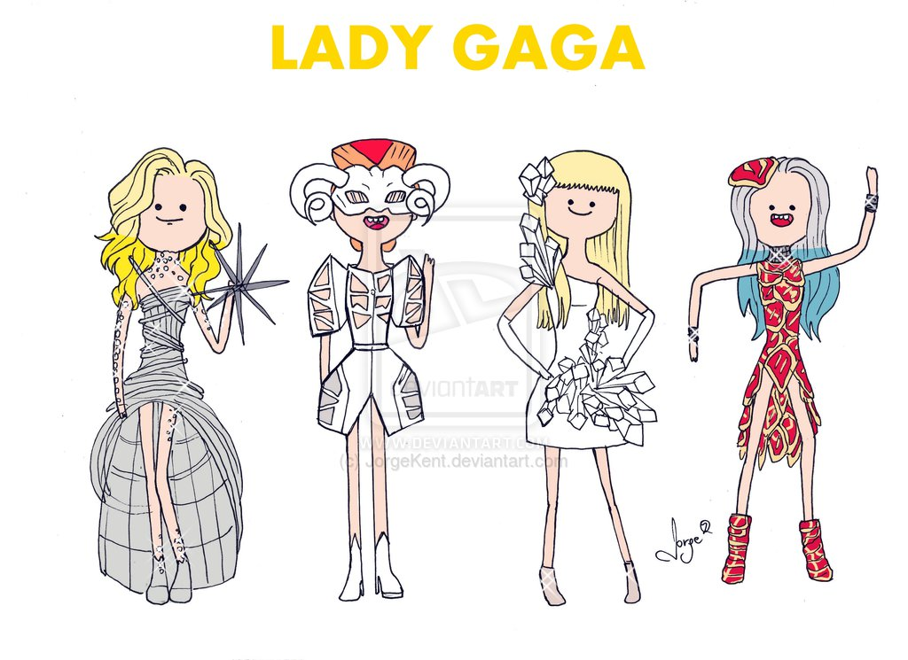

VERSION CTRL

Slide 7

MOBILITY STACK

