Slide 1
SENTIMETER
ASSESS SENTIMENT
ANALYZE ROOT-CASE
APPLY RECOMMENDATION

Slide 2
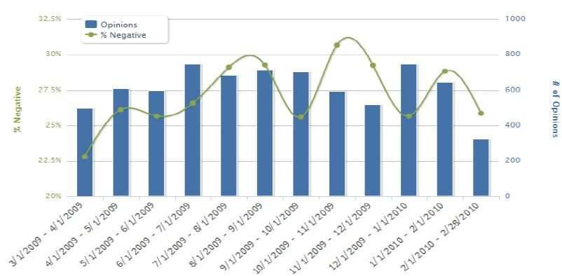
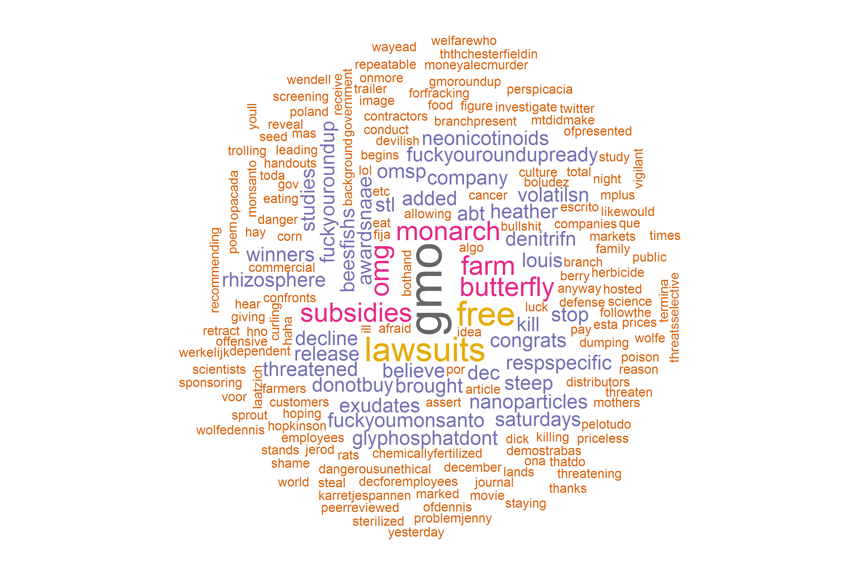
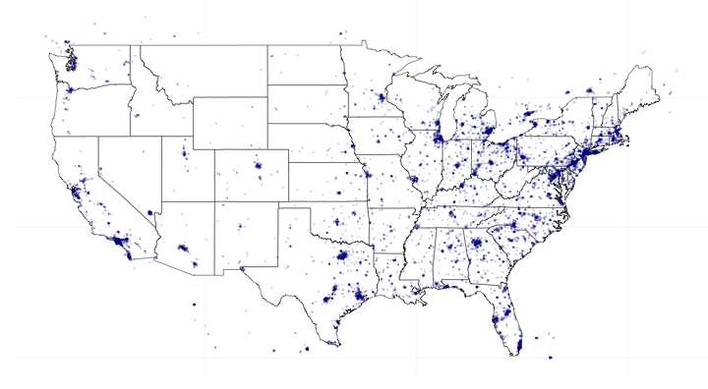
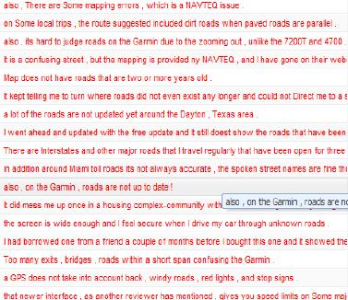
SENTIMENT @ MONSANTO
HOW
it is trending
WHY
it is trending
WHERE
it is trending
PROTOTYPE
DETAILS
Notes:
PROTOTYPE

Slide 3
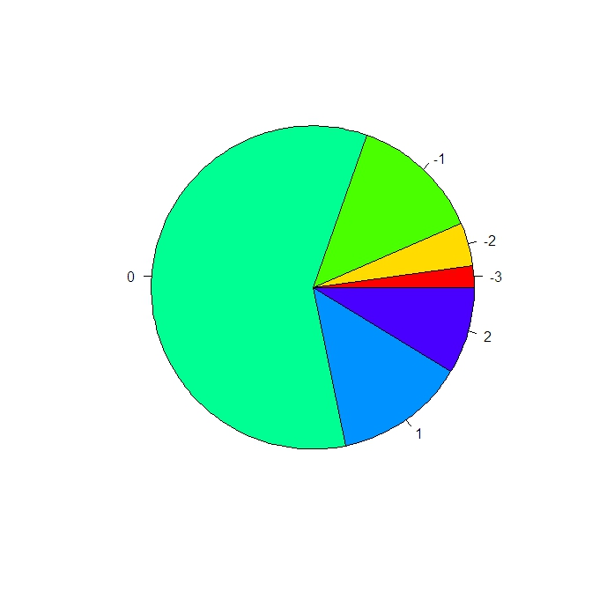
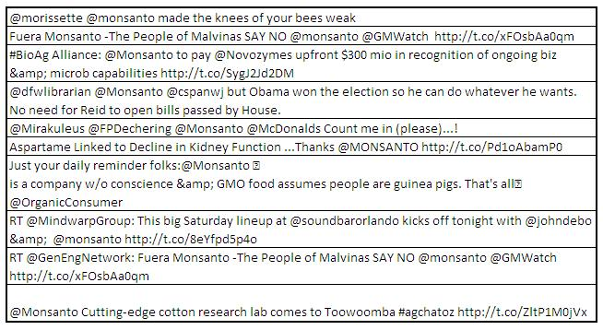
SENTIMENT @ MONSANTO
HOW
it is trending
WHY
it is trending
WHERE
it is trending
DETAILS
Notes:
PROTOTYPE

Slide 4
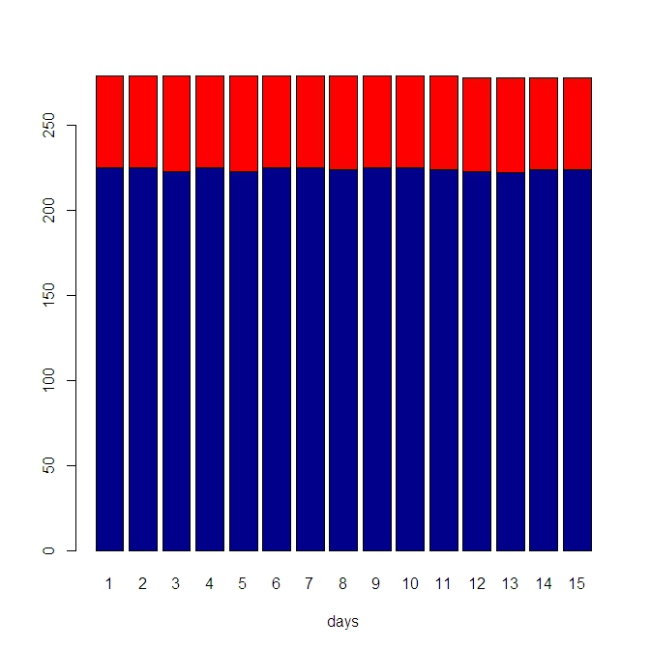
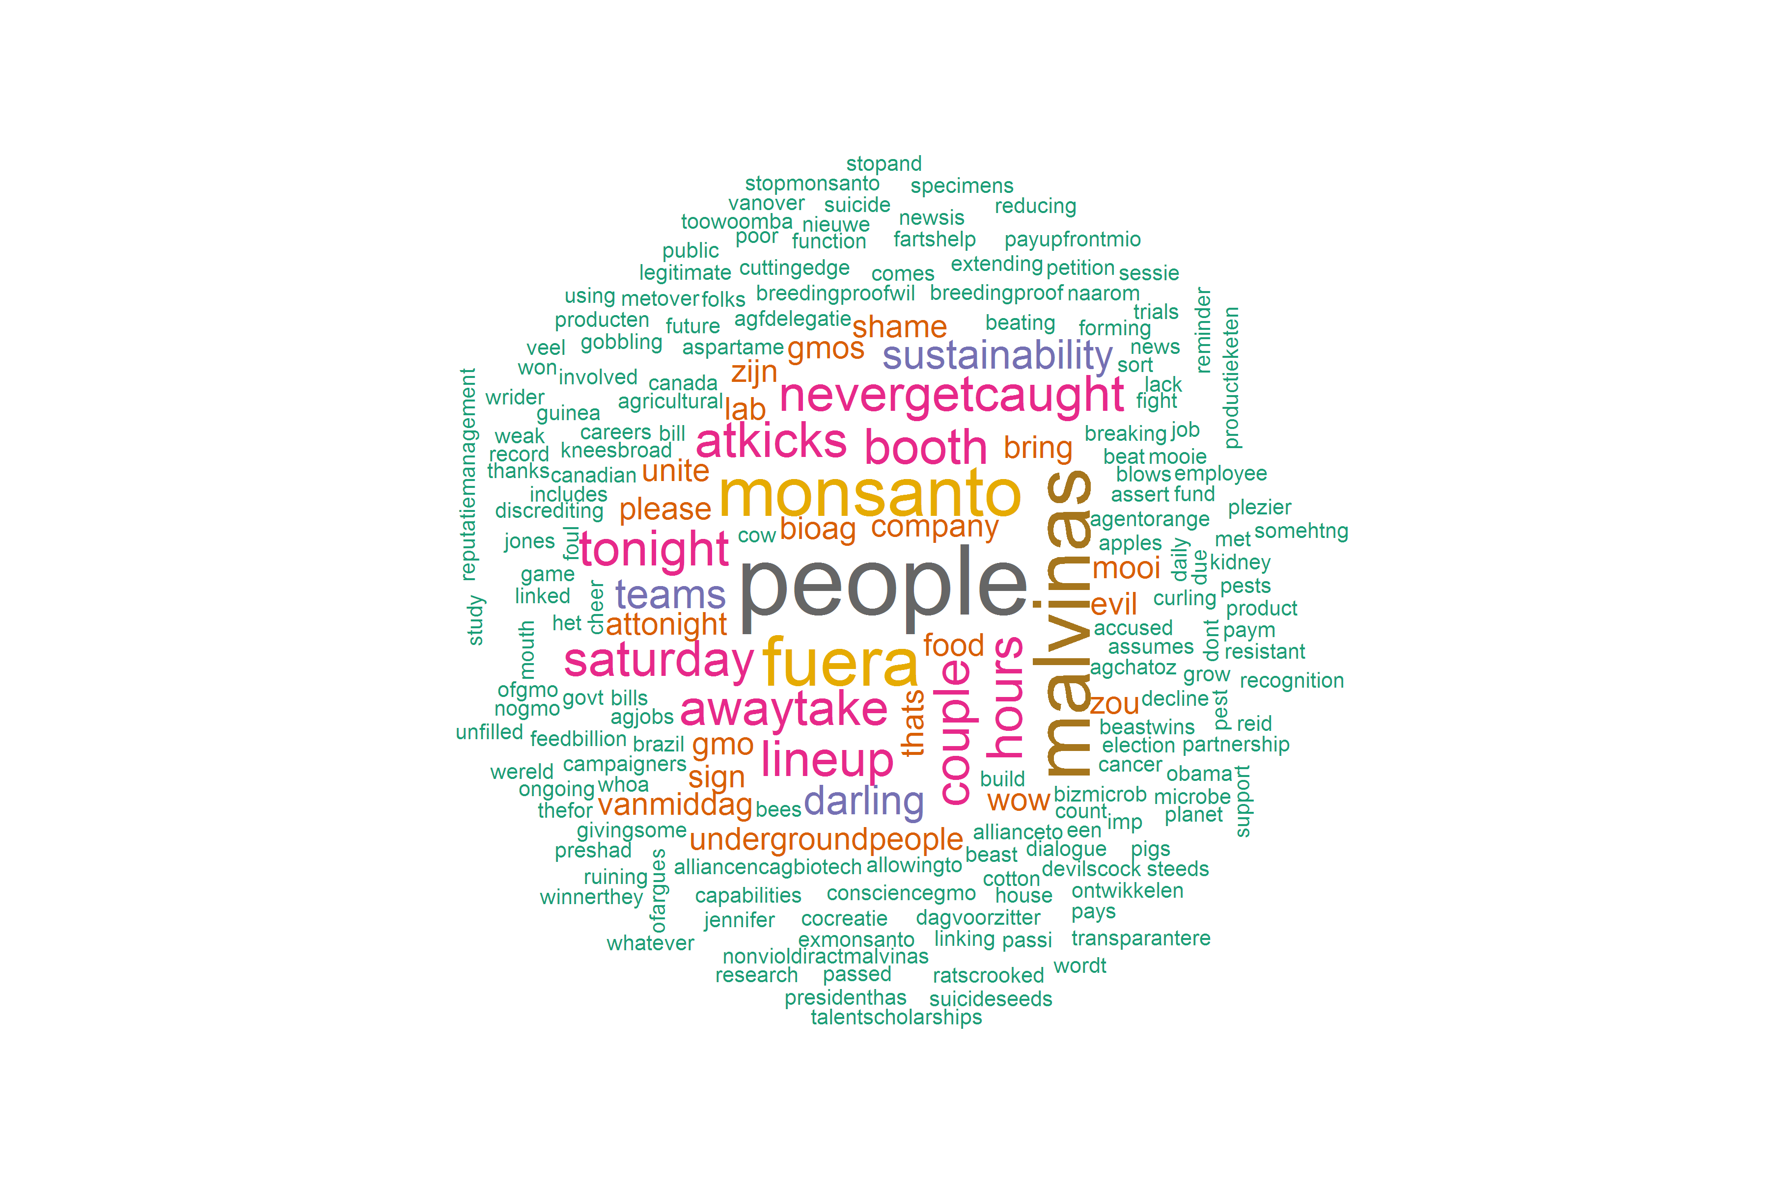
SENTIMENT @ MONSANTO
HOW
it is trending
WHY
it is trending
WHERE
it is trending
ACTUAL
DETAILS

Slide 5
NEEDS INVESTMENT
Mine sentiment off Social Media including Twitter and Facebook
Use HootSuite to blast appropriate messages via social media
Use Cloud infrastructure for acceleration

Slide 6
TWEAKS
Get more tweets SOLVED
Use streaming API streamR
Render tweets by trending terms SOLVED
Put source on Github for version-control
Use Hadoop and Map-Reduce with streaming API
Use Amazon AWS to host
Overlay on maps
Add Facebook Graph API to search
Notes:
Invest in:
Hadoop – Training, Development
Amazon AWS – Rental
Maps – Development
Facebook – Development

Slide 7
APPENDIX I
DETAILS

Slide 8
PROPORTION OF NEGATIVE TWEETS
HOW
SENTIMENT IS TRENDING
PROPORTION OF POSITIVE TWEETS
ACTUAL TWITTER DATA, UPTO DEC-14

Slide 9
HOW
SENTIMENT IS TRENDING (SNAPSHOT)
NEGATIVE
NEUTRAL
MODERATELY NEGATIVE
EXTREMELY NEGATIVE
MODERATELY POSITIVE
POSITIVE
ACTUAL TWITTER DATA, UPTO DEC-14

Slide 10
WHY
SENTIMENT IS TRENDING
ACTUAL TWITTER DATA, DEC-14

Slide 11
WHERE
SENTIMENT IS TRENDING
REPRESENTATIVE TWITTER DATA

