Slide 1
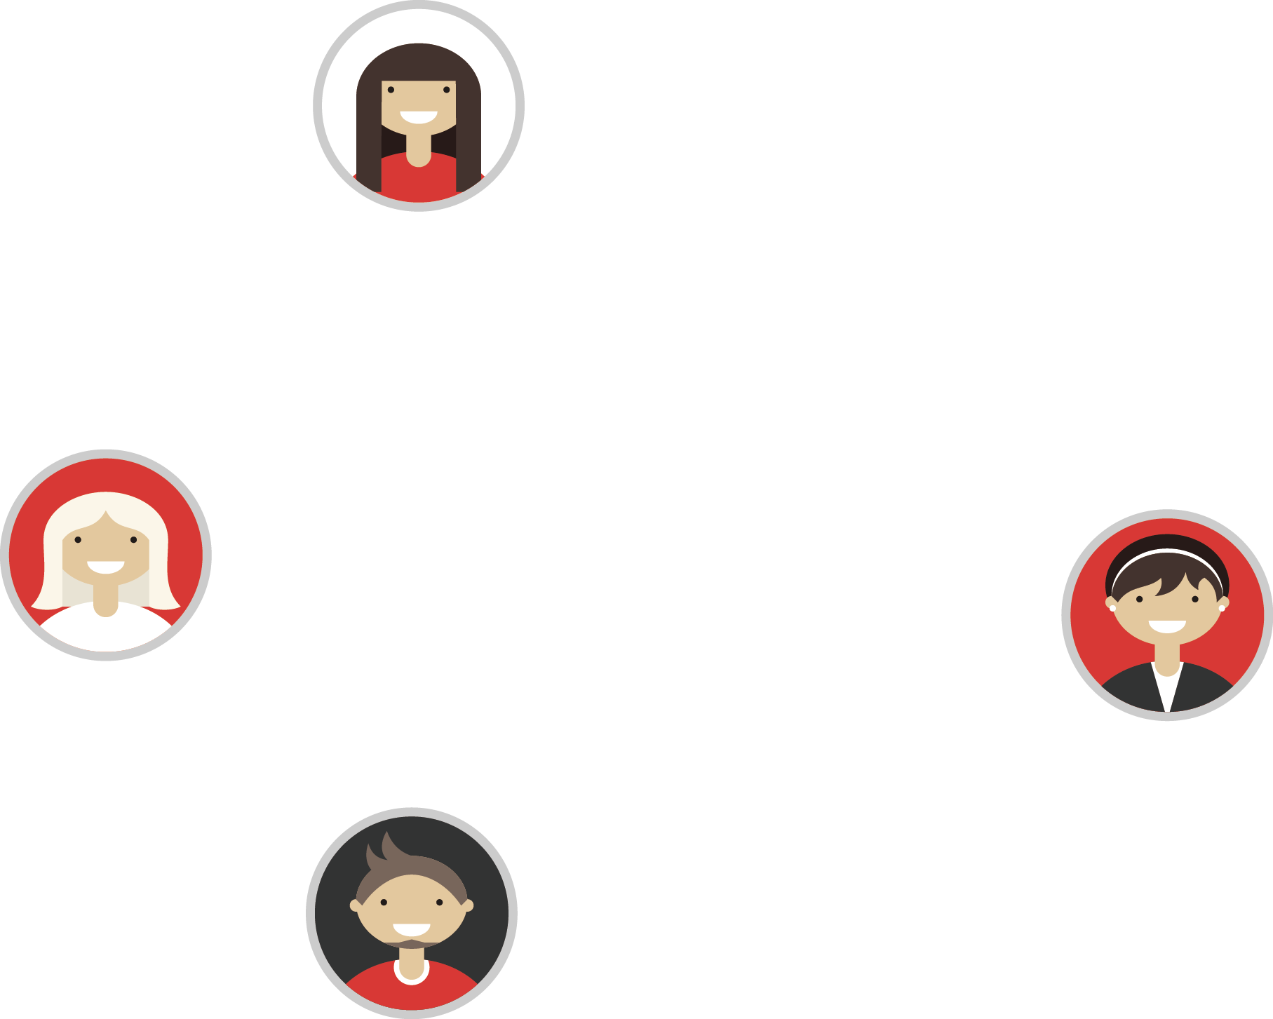


CONAN 入门教程
Garrick 2018.9
CONAN Introduction

Slide 2

名侦探 Conan

Slide 3

Chapter1
Install
Chapter2
Using packages
Chapter3
Creating Packages
Chapter4
Uploading Packages

Slide 4
Chapter1
Install

Slide 5

Conan, the C/C++ Package Manager for Developers
https://conan.io/
https://docs.conan.io/en/latest/
Python
pip, conda
Java
maven
JavaScript
npm

Slide 6

Feature.
FLEXIBILITY
All platforms (Windows, Linux, Apple, FreeBSD, Android, iOS, embedded, cross-building, etc)
All build systems, (Visual Studio , CMake, Makefiles)
CONTROL
Decentralized client-server system (like gitlab)

Slide 7
Installation is Easy
pip install conan

Slide 8
Conan config
conan config install git@gitlab.uni-ubi.com:algorithm-group/conan-config.git

Slide 9
Chapter2
Using packages

Slide 10

Using Packages
Installing dependencies
Requires
Generators
Options
Imports
With CMake
Using profiles

Slide 11
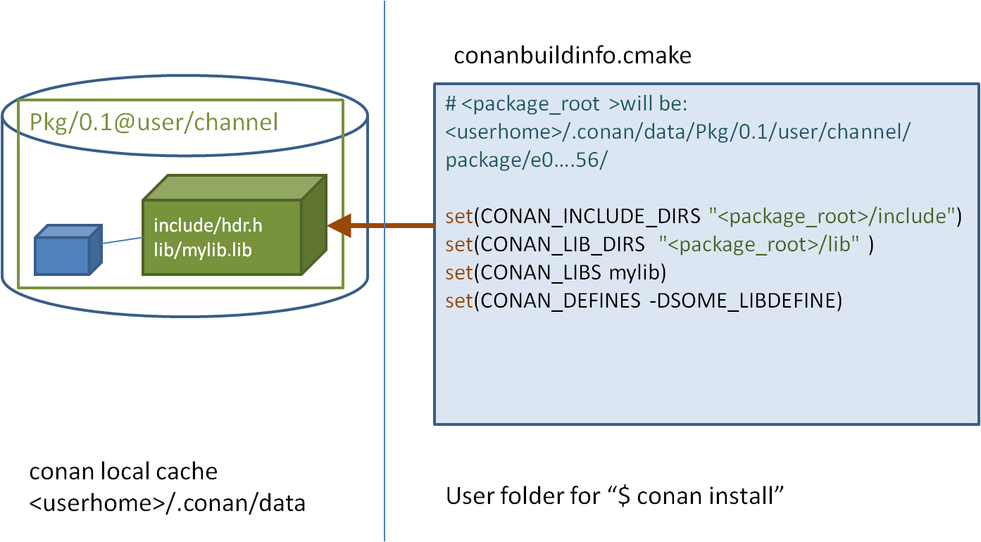
Using Packages

Slide 12
Requires
conanfile.txt
[requires]
opencv/3.4.1@garrick/stable

Slide 13
Generators
conanfile.txt
[requires]
opencv/3.4.1@garrick/stable
[generators]
cmake

Slide 14
Options
conanfile.txt
[requires]
opencv/3.4.1@garrick/stable
[generators]
cmake
[options]
opencv:shared=True

Slide 15
With CMake
cmake_minimum_required(VERSION 3.0)
project(ucnn)
include(${CMAKE_BINARY_DIR}/conanbuildinfo.cmake)
conan_basic_setup()

Slide 16
Using profiles
clang_3.5.profile
[settings]
os=Macos
arch=x86_64
compiler=clang
compiler.version=3.5
compiler.libcxx=libstdc++11
build_type=Release
[env]
CC=/usr/bin/clang
CXX=/usr/bin/clang++
conan install . -pr=clang_3.5.profile

Slide 17
Chapter3
Creating Packages

Slide 18
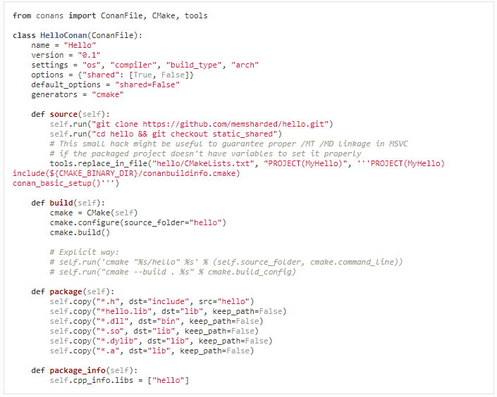
Creating Packages
$ mkdir mypkg && cd mypkg
$ conan new Hello/0.1 –t
conanfile.py
test_package
conanfile.py
CMakeLists.txt
example.cpp

Slide 19
Creating Packages
$ conan create . demo/testing -s build_type=Debug
$ conan create . demo/testing -o Hello:shared=True -s arch=x86
$ conan create . demo/testing -pr my_gcc49_debug_profile
...
$ conan create ...

Slide 20
Chapter4
Uploading Packages

Slide 21
Uploading Packages
Remotes
Uploading Packages to Remotes

Slide 22
Remotes
$ conan remote add conan-center https://conan.bintray.com
$ conan remote add uniubi http://conan.uni-ubi.com:8081/artifactory/api/conan/conan-local
...

Slide 23
Uploading Packages
conan upload Hello/0.1@demo/testing --all -r=uniubi

Slide 24
THANKS
CONAN Introduction

