Slide 1
Research Seminar
How Much Does Air Connectivity
Increase Aviation CO2? ✈
Transportation and Energy Economics
Sunbin YOO (SKKU), Junya KUMAGAI (Fukuoka Univ.), Longfei ZHENG (Tsinghua Univ), I-Yun Hsieh (National Taiwan Univ),
Jinwoo LEE (KAIST), and Anming Zhang (University of British Columbia)
1 / 70

Slide 2

TODAY'S TALK
Brief Introduction about Me
Sunbin YOO
RESEARCH THEMES
유선빈
1
Infrastructure, Rail networks, regional inequality & post-disaster recovery
CURRENT
·
HSR, expressways & post-GEJE revitalization — Transportation Research A , 2026
Associate Professor
Sungkyunkwan University (SKKU)
·
Sectoral Decarbonization and HSR – Energy Economics, 2026 (Top 0.2% Journal)
·
Double-edged trains: HSR & regional disparity — Transport Policy · 2023
2
ESG, sustainability & financial performance under crises
PREVIOUSLY
Kyushu University (Faculty of Engineering)
The University of Tokyo (PhD)
·
Disclosure or Action: ESG behavior & financial performance — Finance Research Letters · 2021
·
Sustainability performance during financial crises (COVID-19) — Energy Policy · 2021
3
Energy economics & environmental policy
RESEARCH INTERESTS
·
Diesel Policy Abandonment and Consumer Behavior- Energy Economics. 2020
• Transportation economics
• Urban & regional development
• Environmental economics
·
Global mortality benefits of COVID-19 action — Tech. Forecasting & Social Change · 2020
4
Micro-mobility, AVs & freight innovation
·
Drone vs truck: choice & WTP for last-mile delivery — Transportation Research E, 2026
·
Ethical Dilemma of Autonomous Vehicle – Transportation Research Part A ,2023
Sunbin Yoo · KAIST Seminar · 2026
2 / 70

Slide 3
B A C K G R O U N D
교통경제란 무엇인가
• 사람들이 움직이는 것에 대한 경제학
• Core questions: which roads, rails, and airports are worth building; how to price them (congestion charges, fares, fuel taxes); and what they cost society beyond the ticket (congestion, accidents, noise, emissions).
• Its central insight: transport is a DERIVED demand. Nobody flies for the pleasure of sitting in seat 43E; people buy access, and access shapes trade, jobs, and where activity locates.
🚗 🚌 🚄 ✈️ 🚢
Transport economics asks what a connection is worth, and who pays its full cost.
Air Connectivity and Aviation CO2, 1996–2023
3 / 70

Slide 4
B A C K G R O U N D
And transportation & energy economics?
• The intersection of the two fields: transport runs almost entirely on energy, and mostly on oil.
• It studies how transport choices and infrastructure drive energy use and emissions, and how to decarbonise mobility (fuel taxes, EVs, SAF, modal shift) without losing the access benefits.
🌍 Transport ≈ 1/4 of global energy-related CO2
✈️ Aviation ≈ 2–3% of global CO2, and growing
🔋 And aviation has no near-term electrification path
Today's talk sits exactly at this intersection: a network investment (connectivity) meets an energy outcome (jet fuel burned).
Air Connectivity and Aviation CO2, 1996–2023
4 / 70

Slide 5
T O D A Y ' S T A L K
What this paper does
• We compute CO2 for every scheduled flight in the world, stage by stage, for 6,000+ airports over 1996–2023.
• We then ask a causal question: when a country becomes better connected by air, how much does its aviation CO2 rise?
• The answer is: much more than proportionally. A 1% gain in connectivity raises national aviation CO2 by 5.7%.
• We finish with the bill: who owes it, where it is booked, and what (only fuel switching) can shrink it.
A data contribution (the emissions panel) and a causal contribution (the elasticity).
Air Connectivity and Aviation CO2, 1996–2023
5 / 70

Slide 6
T O D A Y ' S T A L K
One index, two ledgers: the benefit and the bill
THE BENEFIT (our companion trade paper)
+1.30%
trade openness per 1% rise in hub quality
≈ $7.8 trillion of 2023 trade, 17% of the world total
THE BILL (this paper)
+5.67%
aviation CO2 per 1% rise in hub quality
356 Mt of 2023 CO2, $18–68 billion per year
Same countries, same connectivity index, same IV logic: the trade paper found the benefit, this paper prices the bill.
Air Connectivity and Aviation CO2, 1996–2023
6 / 70

Slide 7
R O A D M A P
Seven parts
01 💡
Motivation
Policy premise meets carbon
02 🛰️
Data
CO2 for every scheduled flight
03 🕸️
Building GACI
Five centralities, PCA, one index
04 🔍
Identification
A geography instrument
05 📈
Results
The elasticity and its anatomy
06 💸
The carbon bill
Attribution, mismatch, SAF
07 🎯
Conclusion
What it implies
Air Connectivity and Aviation CO2, 1996–2023
7 / 70

Slide 8
01
Motivation
Policy premise meets carbon reality
💡
8 / 70

Slide 9
M O T I V A T I O N
Everyone wants connectivity; nobody priced the carbon
• Governments subsidise routes, expand airports, and sign air-service agreements on the premise that connectivity raises trade, tourism, and productivity (it does: our companion paper finds +1.3% trade openness per 1% of connectivity).
• But aviation is among the hardest transport sectors to decarbonise: no near-term electrification path, and emissions booked under separate bunker conventions, outside national inventories.
• The direction is obvious (more connections = more flying). The magnitude and structure are not, and no causal estimate exists at the global level.
The carbon consequence of connectivity policy is a first-order question with no causal answer. Until now.
Air Connectivity and Aviation CO2, 1996–2023
9 / 70

Slide 10
M O T I V A T I O N
Three empirical questions
01 📏
Proportionality
Does a 1% gain in connectivity raise emissions by more or less than 1%? Hubs consolidate traffic into fewer, fuller, more efficient movements, so the answer is not obvious.
02 🗺️
Incidence
Whose emissions respond? Poor or rich countries? And does the response spill across borders through the network?
03 📒
Accounting
Are emissions booked where they are generated? International aviation follows bunker conventions, not territory.
Magnitude, geography, and bookkeeping: all three turn out to matter.
Air Connectivity and Aviation CO2, 1996–2023
10 / 70

Slide 11
02
Data
CO2 for every scheduled flight on Earth, 1996–2023
🛰️
11 / 70

Slide 12
D A T A
Carbon for every flight, stage by stage
• Source: OAG schedules, every scheduled commercial flight, Jan 1996 to Jun 2024.
• EEA/EMEP Guidebook: fuel burn by engine type × stage length, × 3.15 kg CO2 per kg of Jet A.
✈
Taxi-out
Take-off
Climb
CRUISE
Approach
Taxi-in
🛫🛬 LTO phases: 11.8% of CO2
💨 Cruise: ~88% of CO2
Departure + arrival sides kept separate
Stage-resolved once, aggregated under any allocation rule, with no double counting.
Air Connectivity and Aviation CO2, 1996–2023
12 / 70

Slide 13
D A T A
Does it add up? Yes, to the tonne (almost) ✅
0.919 Gt
our 2019 world total vs ICCT's 0.92 Gt
r = 0.99
log-log match with OWID/ICCT country series, every year
11.8%
LTO share of fuel burn, right in the standard range
6,000+
airports with stage-resolved monthly CO2
184
countries in the estimation panel
4,634
country-years, 1996–2023
Schedule-based capacity, not load factors: the carbon content of the network itself.
Air Connectivity and Aviation CO2, 1996–2023
13 / 70

Slide 14
D A T A
Whose emissions are they? Three answers, one dataset
🛬 Territorial (LTO)
Each landing-and-take-off phase booked at its own airport. Physical, local.
🛫 Bunker (headline)
★ our headline
Cruise assigned to the departure country: the IEA fuel-uplift convention.
⚖️ 50/50 split
Cruise shared equally between the endpoint countries.
Spoiler: the elasticity barely moves across all three (5.62–5.92). The result is not an accounting artefact.
Air Connectivity and Aviation CO2, 1996–2023
14 / 70

Slide 15
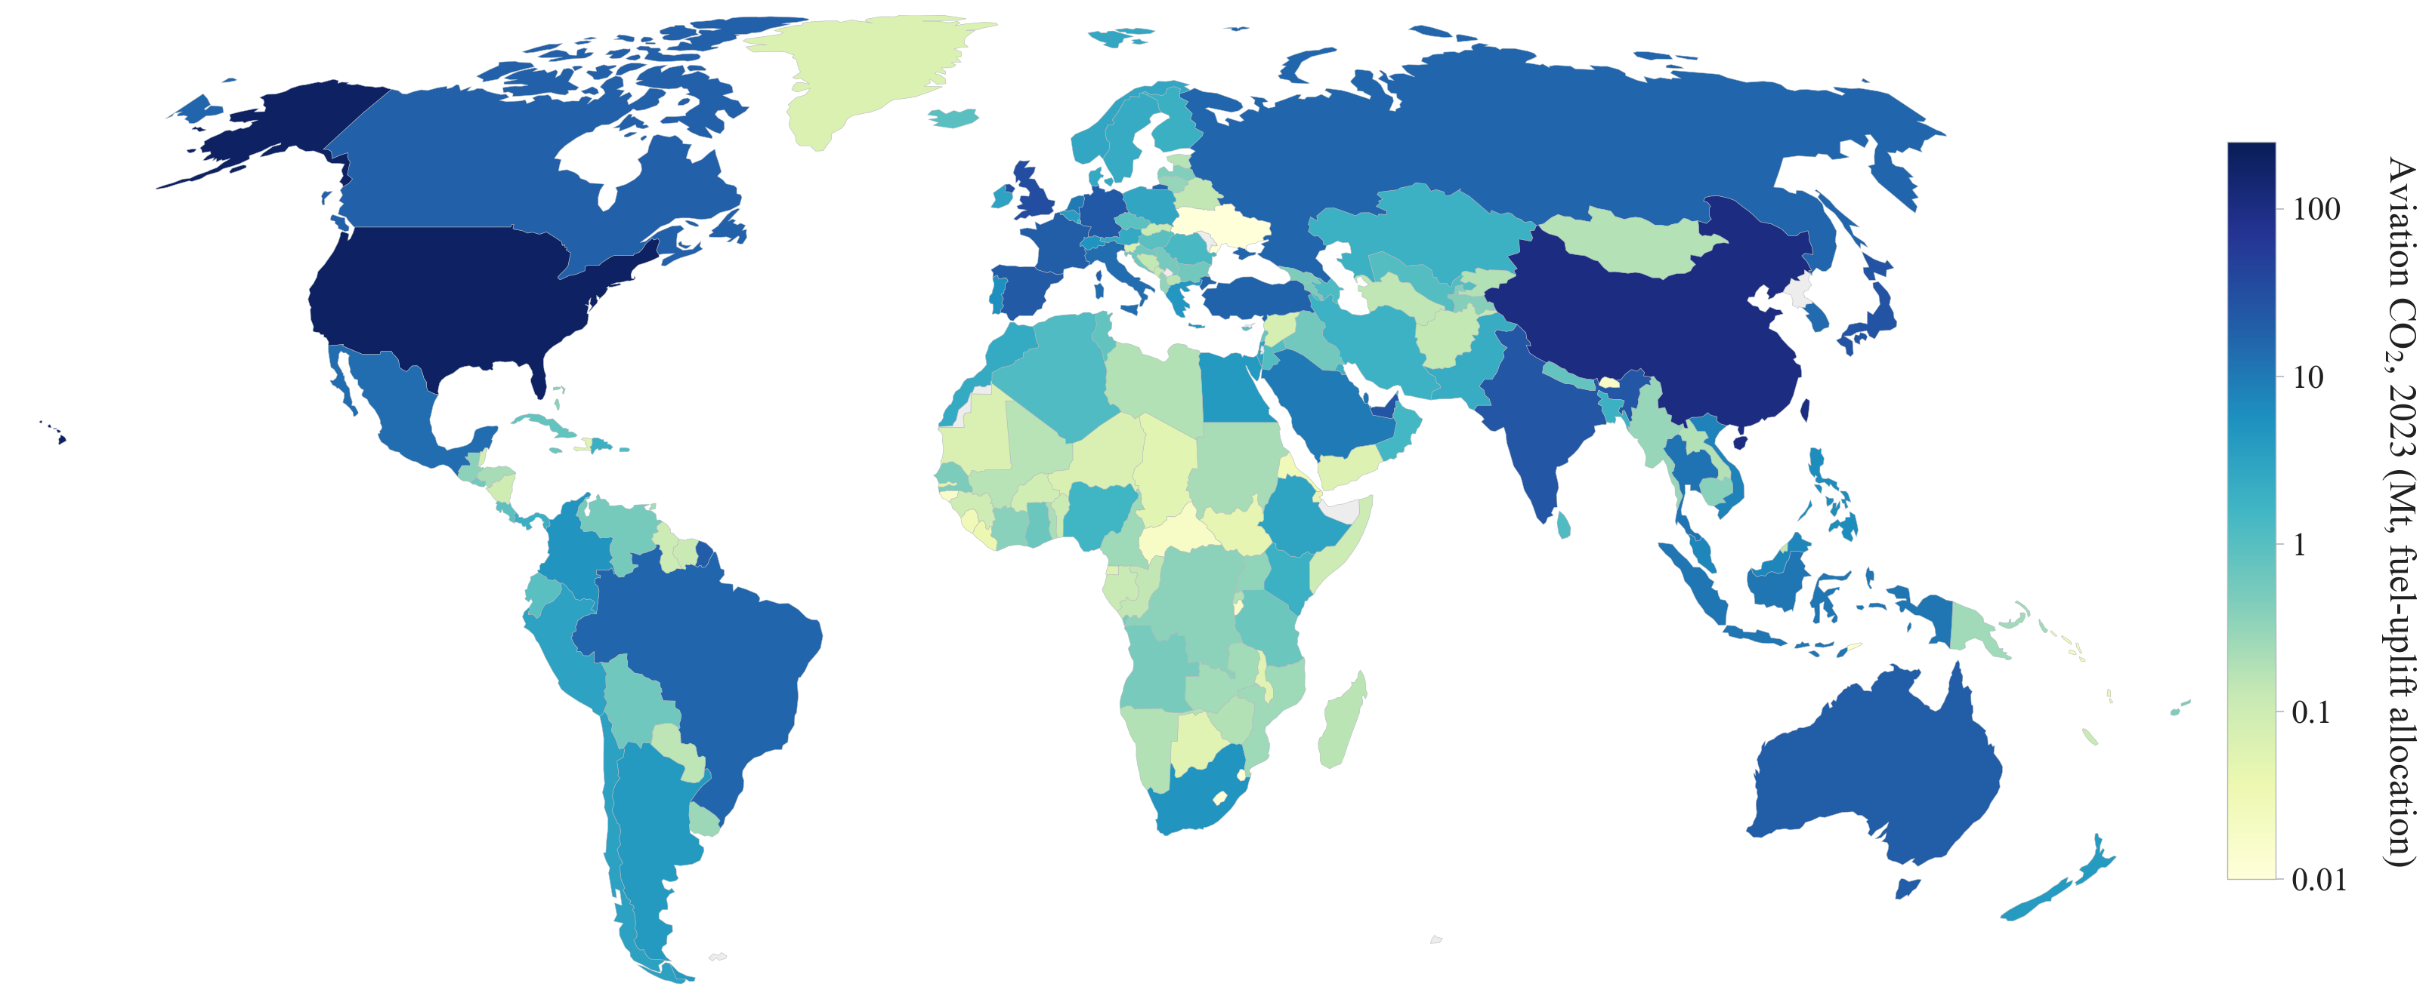
D A T A
Where aviation CO2 lives, 2023
National aviation CO2 under the bunker convention, 2023. This is the outcome variable.
Air Connectivity and Aviation CO2, 1996–2023
15 / 70

Slide 16
D A T A
The emitters: top 15 countries, 2023
# | Country | ISO | CO2 2023 (Mt) | World share | Intl share | LTO (Mt) | Rank 1996 | CO2 1996 (Mt)
1 | United States | USA | 193.4 | 23.1% | 37% | 21.4 | 1 | 180.1
2 | China | CHN | 103.9 | 12.4% | 19% | 15.7 | 8 | 10.3
3 | United Kingdom | GBR | 32.9 | 3.9% | 96% | 2.9 | 3 | 18.6
4 | Japan | JPN | 26.4 | 3.1% | 59% | 3.7 | 2 | 28.4
5 | UAE | ARE | 25.7 | 3.1% | 100% | 1.7 | 20 | 4.7
6 | India | IND | 24.3 | 2.9% | 48% | 3.3 | 19 | 5.6
7 | Germany | DEU | 22.9 | 2.7% | 96% | 2.2 | 4 | 16.0
8 | Spain | ESP | 21.9 | 2.6% | 80% | 2.8 | 12 | 7.1
9 | Australia | AUS | 20.0 | 2.4% | 60% | 2.0 | 7 | 11.3
10 | France | FRA | 19.2 | 2.3% | 91% | 2.0 | 5 | 12.5
11 | Canada | CAN | 18.4 | 2.2% | 64% | 1.8 | 6 | 12.1
12 | Turkey | TUR | 17.4 | 2.1% | 81% | 2.1 | 32 | 1.8
13 | Brazil | BRA | 16.0 | 1.9% | 41% | 2.2 | 10 | 8.5
14 | Russia | RUS | 15.8 | 1.9% | 31% | 1.7 | 9 | 10.1
15 | Korea | KOR | 14.4 | 1.7% | 90% | 1.4 | 13 | 7.1
Reading the list
838 Mt of world aviation CO2 in 2023 under the bunker convention.
US + China = 35% of the world total. China: 8th in 1996, 2nd today.
Movers: UAE 20th to 5th, Turkey 32nd to 12th, India 19th to 6th, Qatar into the top 20.
Korea: 15th, 14.4 Mt, 90% international.
Intl share = international share of bunker CO2; LTO = physical landing-and-take-off CO2 at own airports.
Aviation CO2 is concentrated, and its geography has shifted toward the newly connecting world since 1996.
Air Connectivity and Aviation CO2, 1996–2023
16 / 70

Slide 17
03
Building GACI
What the index is, and exactly how we compute it
🕸️
17 / 70

Slide 18
B U I L D I N G G A C I
What is "air connectivity", really?
• It is not how many airports or routes a country has.
• It is a country's POSITION in the world air network: how easily, through how many and how important partners, it can reach everywhere else.
• Two airports with 'international' in the name are not equal: Incheon plugs into the world's hub network; Yangyang has a handful of point-to-point routes.
Connectivity = network position, not a simple count.
Air Connectivity and Aviation CO2, 1996–2023
18 / 70

Slide 19
B U I L D I N G G A C I
How we measure it: the Global Air Connectivity Index
• GACI summarises each airport's position in the weighted world air network as a single, time-comparable number (Cheung, Wong & Zhang, 2020).
• It blends three ideas:
REACH: how many, and how well-placed, are its connections
FLOW: how much passenger traffic moves through it
STANDING: how important are the airports it connects to
One number that captures reach, flow, and standing in the global network.
Air Connectivity and Aviation CO2, 1996–2023
19 / 70

Slide 20
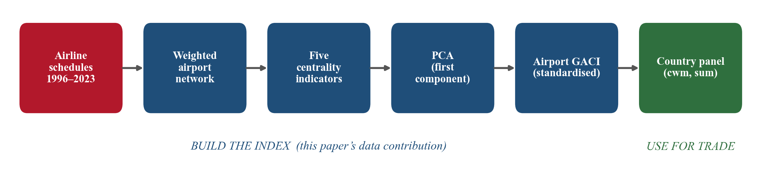
B U I L D I N G G A C I
How the index is built: the pipeline
From raw schedules to one number per airport per year:
today: USE FOR CO2 ✈
Each step is computed for every year, then aggregated to countries.
Air Connectivity and Aviation CO2, 1996–2023
20 / 70

Slide 21
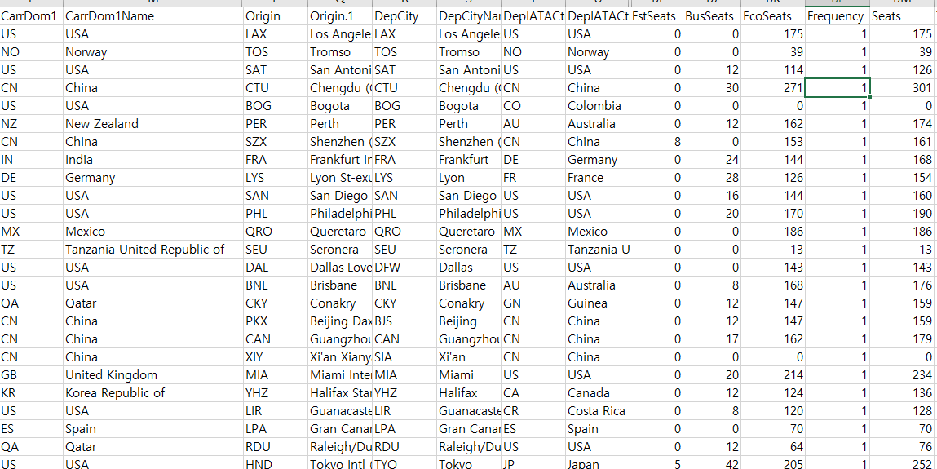
B U I L D I N G G A C I
The raw data: OAG airline schedules
Connected dummy
Total seat capacity (the link weight)
Route-segment level, every scheduled commercial flight, 1996–2024H1.
Air Connectivity and Aviation CO2, 1996–2023
21 / 70

Slide 22
B U I L D I N G G A C I
Step 0: building a clean weighted network
• Source: global airline schedule data at the route-segment level (OAG; it is big).
• Keep only scheduled commercial service; exclude military, charter, seaplanes, heliports, and airports that closed in-window.
• Aggregate segments per airport pair per year into one link; the link weight is passenger seat capacity.
• Two matrices per year: adjacency A (who connects) and weight W (how much).
Adjacency A: who connects
Weight W: seat capacity (millions, illustrative)
 | ICN | GMP | CJU | PUS | YNY
ICN | – | 0 | 1 | 0 | 0
GMP | 0 | – | 1 | 1 | 0
CJU | 1 | 1 | – | 1 | 1
PUS | 0 | 1 | 1 | – | 0
YNY | 0 | 0 | 1 | 0 | –
 | ICN | GMP | CJU | PUS | YNY
ICN | – | 0 | 0.5 | 0 | 0
GMP | 0 | – | 17.0 | 4.0 | 0
CJU | 0.5 | 17.0 | – | 2.5 | 0.1
PUS | 0 | 4.0 | 2.5 | – | 0
YNY | 0 | 0 | 0.1 | 0 | –
The Korean corner of the matrix: Gimpo–Jeju alone is the world's busiest air route.
Air Connectivity and Aviation CO2, 1996–2023
22 / 70

Slide 23
B U I L D I N G G A C I
Step 1a: topological indicators (position)
• Degree: the number of direct connections (raw reach).
• Closeness: inverse of the average number of transfers needed to reach all other airports (accessibility).
Toy domestic network: GMP–CJU, GMP–PUS, GMP–YNY, CJU–PUS
+ Eigenvector: how much am I connected to "BIG" airports?
Hops | GMP | CJU | PUS | YNY | Avg
GMP | – | 1 | 1 | 1 | 1.00
CJU | 1 | – | 1 | 2 | 1.33
PUS | 1 | 1 | – | 2 | 1.33
YNY | 1 | 2 | 2 | – | 1.67
Airport | Degree (# friends) | Eigenvector (rank of friends)
GMP | 3 | High
CJU | 2 | High
PUS | 2 | High
YNY | 1 | Low
Airport | Closeness | Reading
GMP | 1.00 | Hub: everyone in one hop
CJU | 0.75 | Intermediate
PUS | 0.75 | Intermediate
YNY | 0.60 | Spoke: always via Gimpo
Yangyang's one friend is a big hub, but one friend is still one friend.
Air Connectivity and Aviation CO2, 1996–2023
23 / 70

Slide 24
B U I L D I N G G A C I
Step 1b: volumetric indicators (passenger flow)
• Flow betweenness: the share of passengers transferring through the airport; the hub / transfer role (Gimpo < Incheon: transfers concentrate at ICN).
• Regional importance: average connection intensity within its own region (Gimpo > Incheon: the domestic backbone).
• These two flow measures make GACI flow-aware, not purely topological.
Position says where you sit; flow says how much actually moves through you.
Air Connectivity and Aviation CO2, 1996–2023
24 / 70

Slide 25
B U I L D I N G G A C I
The five indicators, read through Korean airports
Airport | Degree | Closeness | Eigenvector | Flow betw. | Regional imp.
ICN Incheon | High | High | High | High | Mid
GMP Gimpo | Mid | Mid | Mid | Low | High
CJU Jeju | Mid | Mid | Low | Low | High
PUS Gimhae | Mid | Mid | Mid | Low | Mid
YNY Yangyang | Low | Low | Low | Low | Low
ICN: global gateway, strong on every margin. GMP and CJU: enormous traffic (the world's busiest route) but little global position: volume is not connectivity. YNY: connected on paper only.
Five airports, five different network stories: no single indicator captures them all, so we combine all five.
Air Connectivity and Aviation CO2, 1996–2023
25 / 70

Slide 26
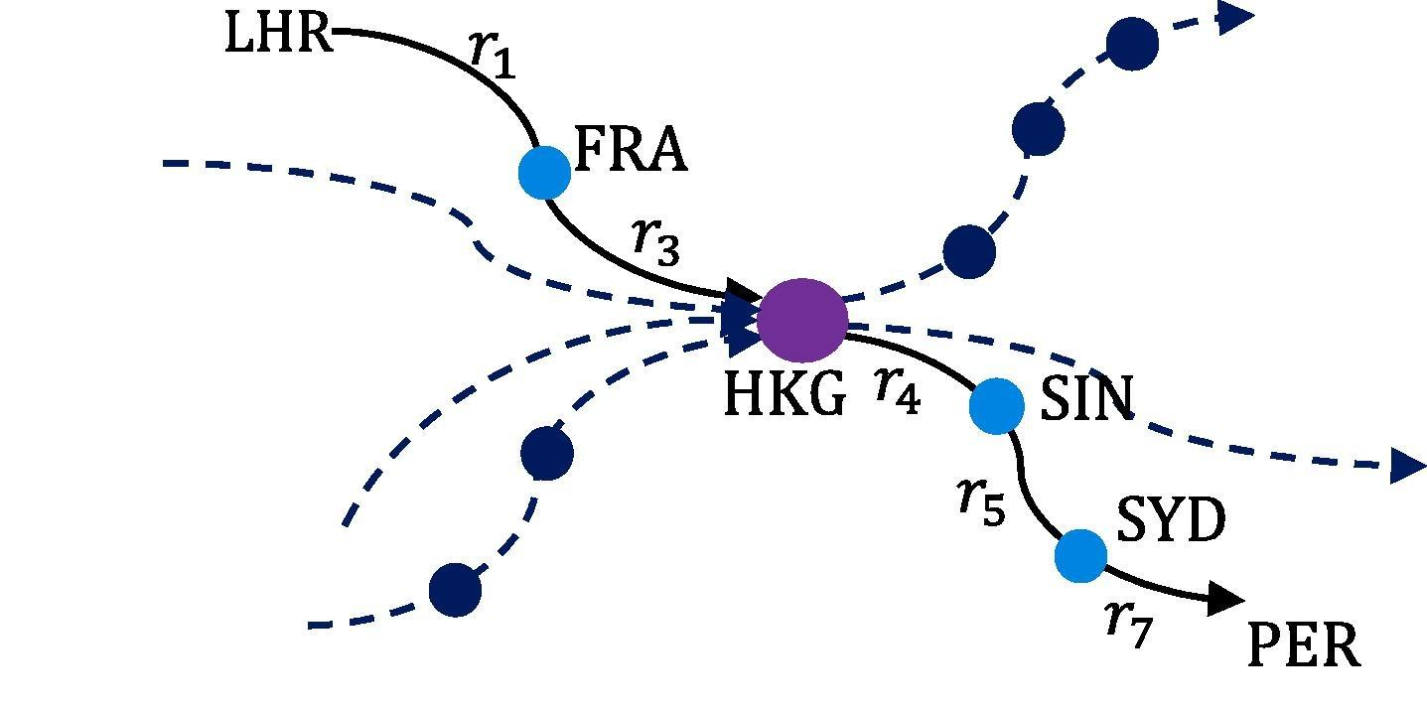
B U I L D I N G G A C I
Flow betweenness: passengers as electrical current
Each route is a resistor with resistance inversely proportional to its passenger intensity; betweenness = current through the node. Incheon plays this HKG-style bridge role between North America and Southeast Asia. Source: Cheung et al. (2020).
Air Connectivity and Aviation CO2, 1996–2023
26 / 70

Slide 27
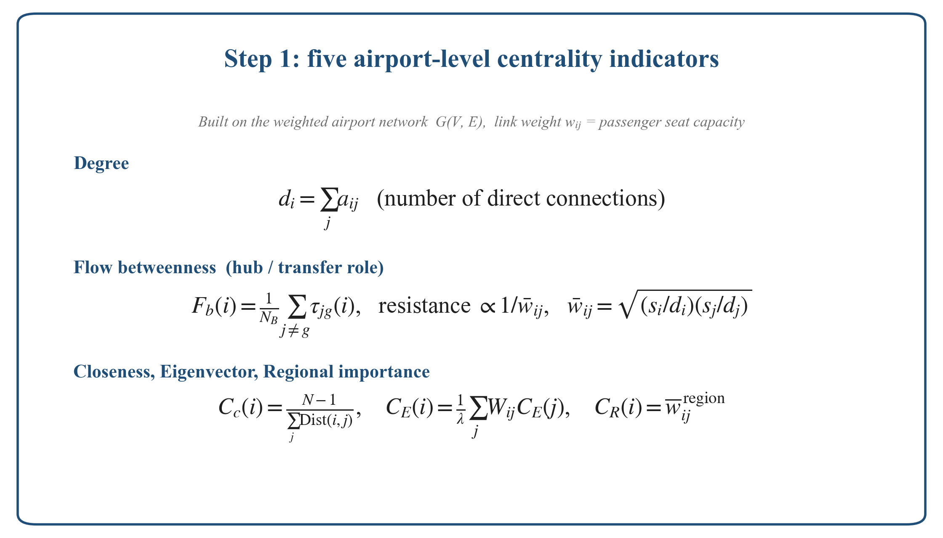
B U I L D I N G G A C I
Step 1: the exact formulas
Air Connectivity and Aviation CO2, 1996–2023
27 / 70

Slide 28
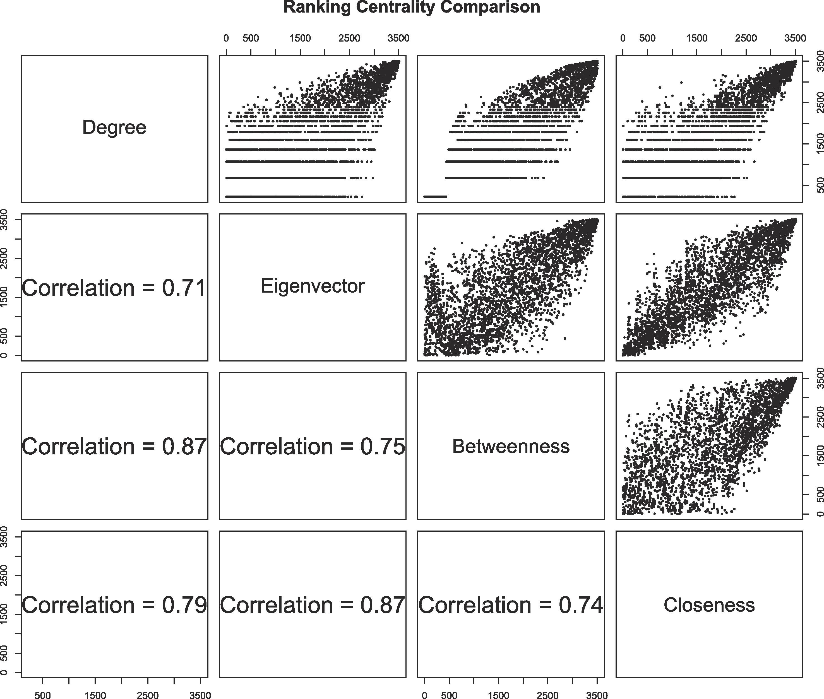
B U I L D I N G G A C I
The five indicators are related but not redundant
Pairwise rank correlations 0.71–0.87: each adds information, so we combine rather than pick one. Source: Cheung et al. (2020).
Air Connectivity and Aviation CO2, 1996–2023
28 / 70

Slide 29
B U I L D I N G G A C I
Step 2: combine the five into one index (PCA)
• Five indicators, different scales, partly correlated.
• GACI = the first principal component: the single weighted combination capturing the most variance across airports.
• On our 1996–2023 panel, PC1 explains 74% of total variance, so one number retains most of the information.
One index, five ingredients, no arbitrary weights.
Air Connectivity and Aviation CO2, 1996–2023
29 / 70

Slide 30
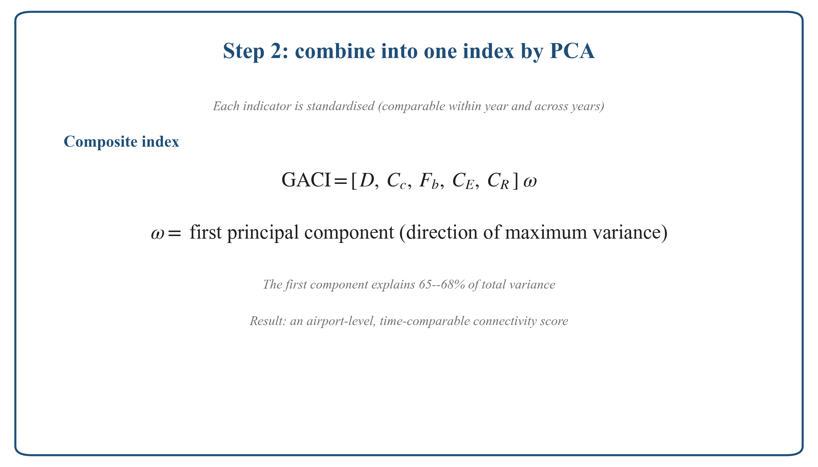
B U I L D I N G G A C I
Step 2: the aggregation formula
Air Connectivity and Aviation CO2, 1996–2023
30 / 70

Slide 31
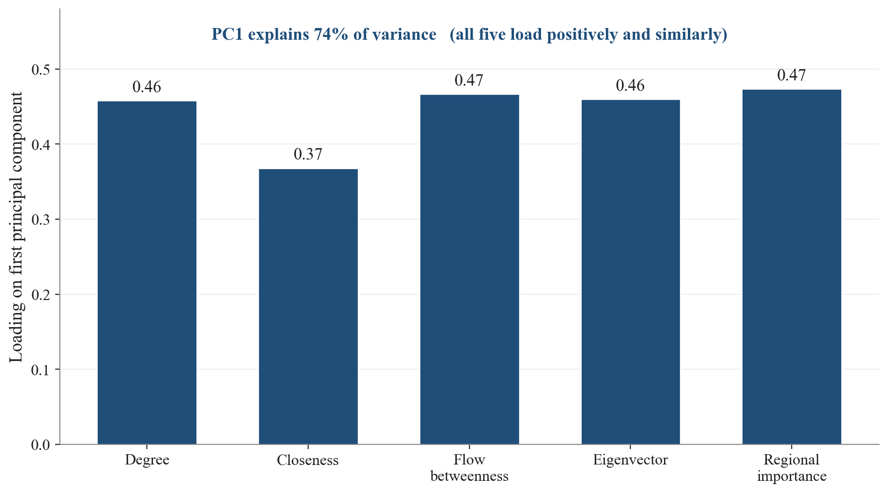
B U I L D I N G G A C I
PCA weights, computed on our panel
First-component loadings on our 1996–2023 data: all positive and similar; PC1 explains 74% of variance.
Air Connectivity and Aviation CO2, 1996–2023
31 / 70

Slide 32
B U I L D I N G G A C I
Making GACI comparable over time
• A naive yearly PCA would re-scale every year, so scores could not be compared across years.
• We standardise so that rankings WITHIN a year and relative scores ACROSS years are both preserved.
• The result: one index that tracks an airport or country up and down the global hierarchy from 1996 to 2023.
Essential here: the CO2 question is about changes over 28 years.
Air Connectivity and Aviation CO2, 1996–2023
32 / 70

Slide 33
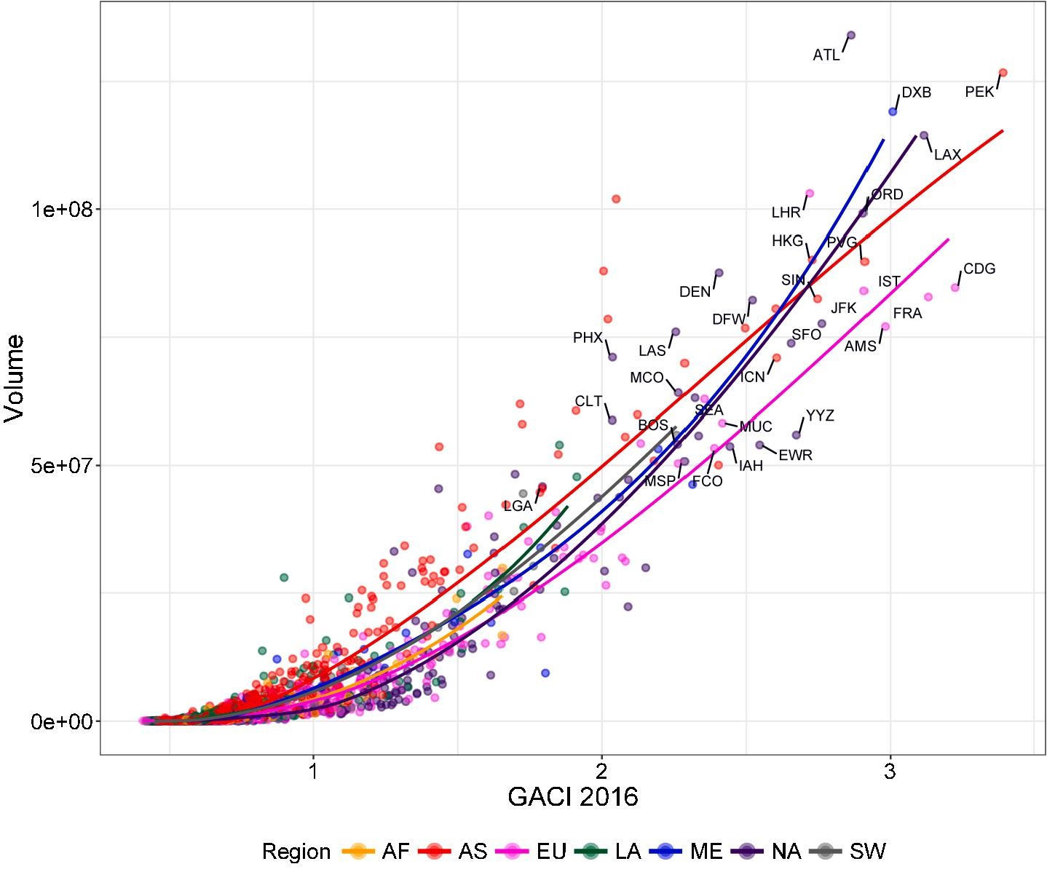
B U I L D I N G G A C I
Face validity: high GACI = the world's major hubs
Air Connectivity and Aviation CO2, 1996–2023
GACI tracks passenger volume; the top of the scale is ATL, PEK, DXB, LHR, HKG, SIN. Source: Cheung et al. (2020).
33 / 70

Slide 34
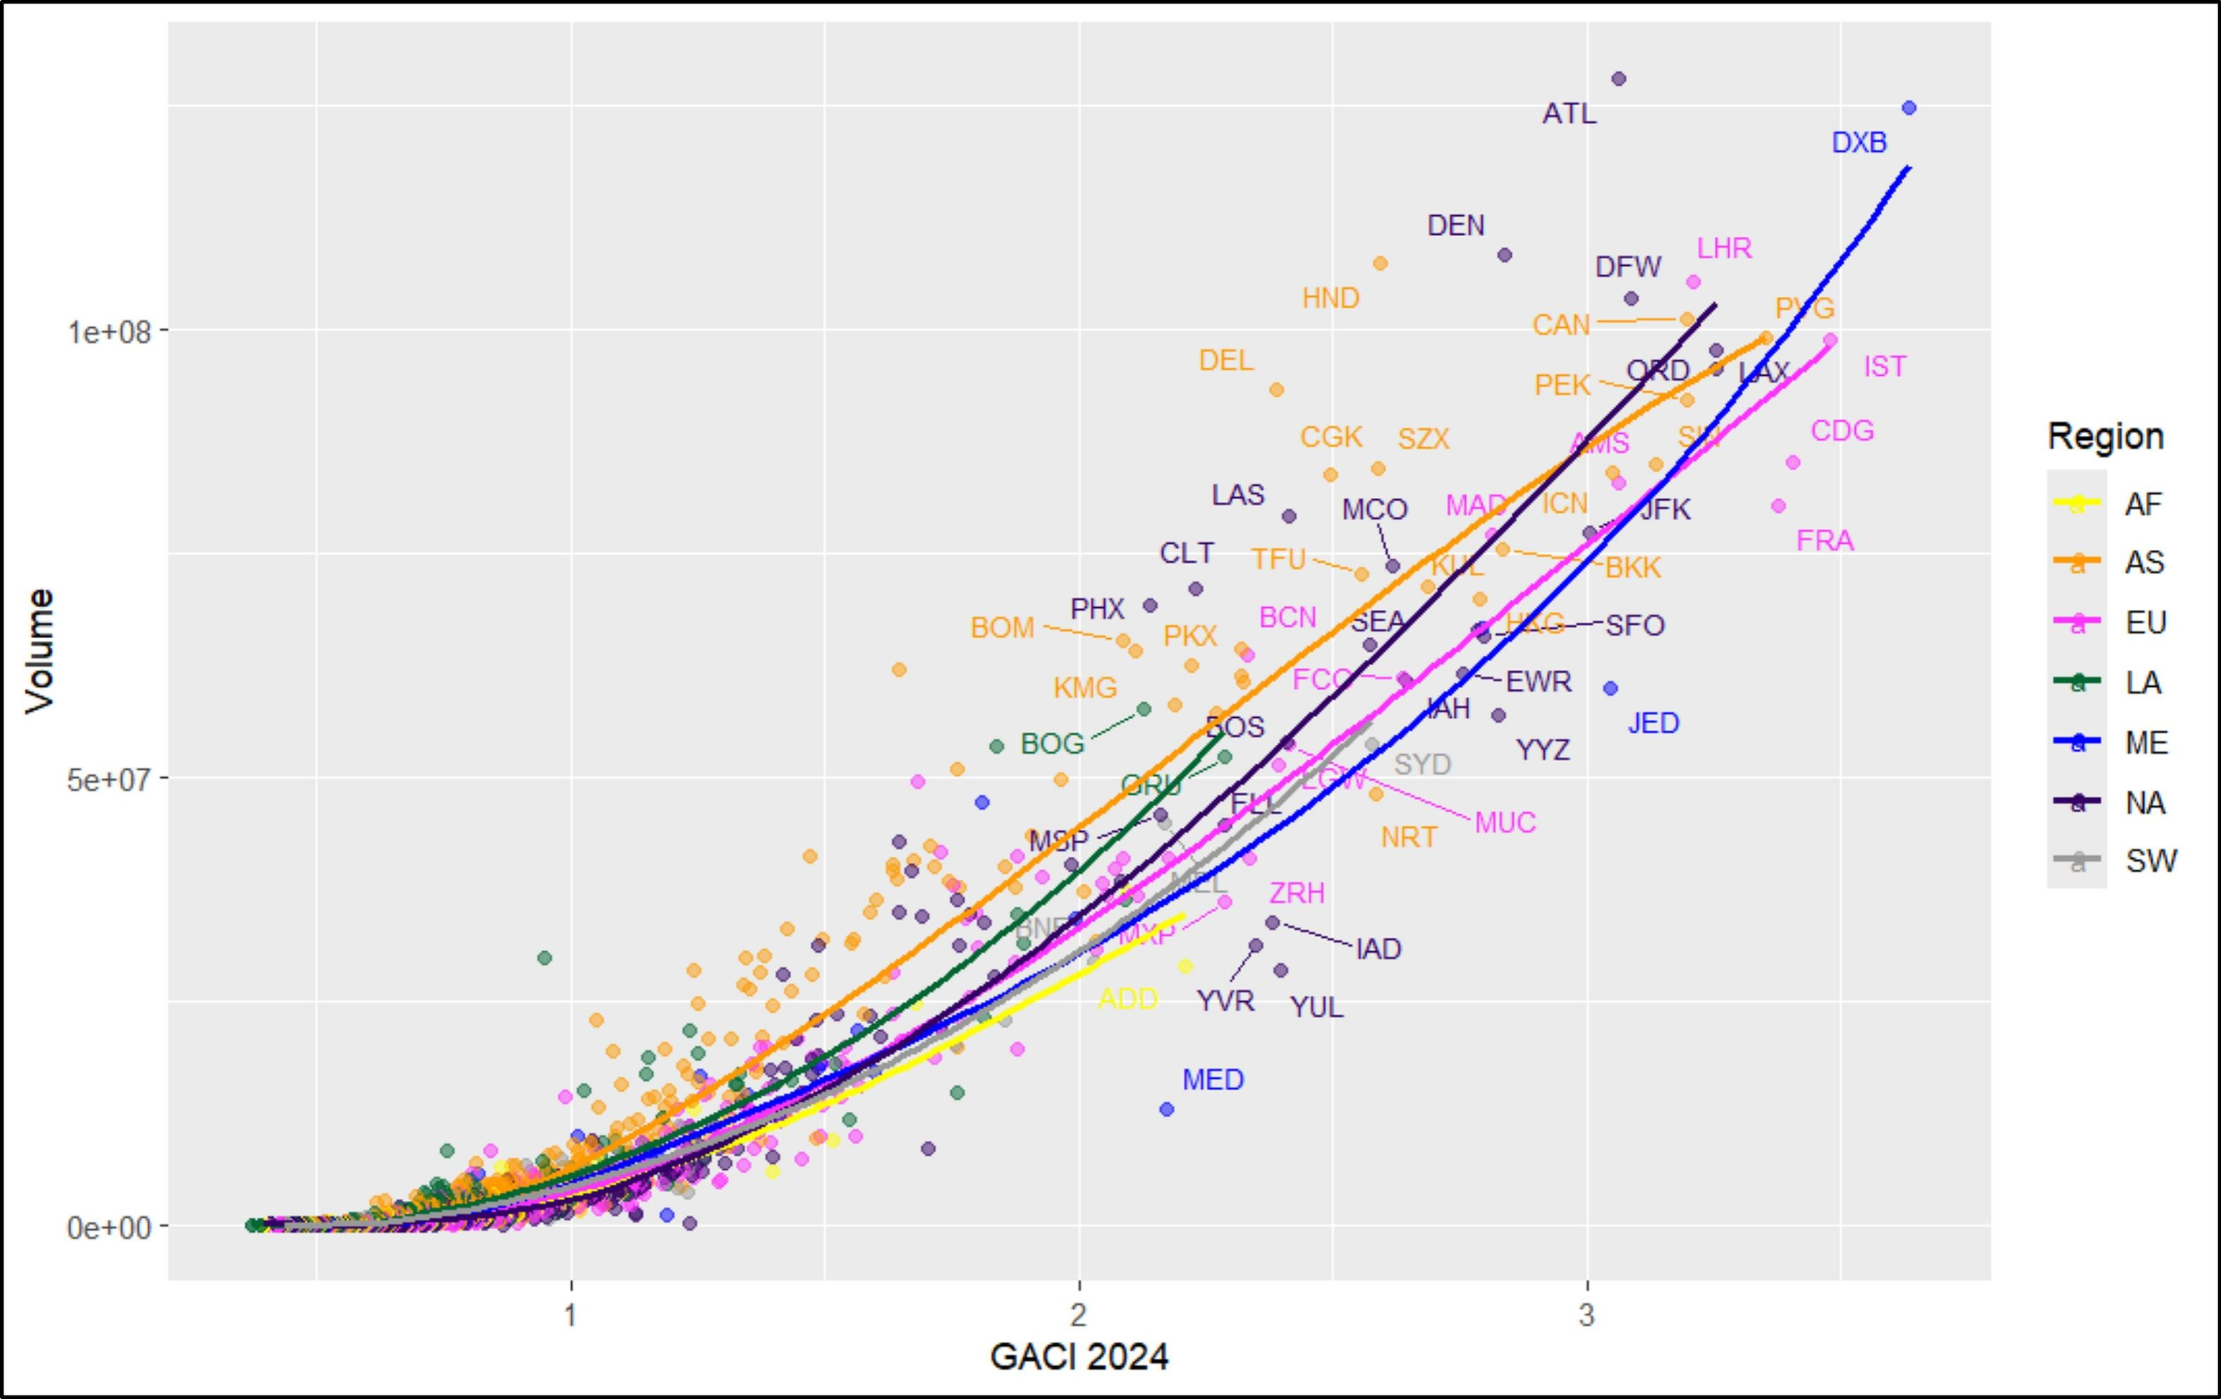
B U I L D I N G G A C I
Air Connectivity and Aviation CO2, 1996–2023
GACI tracks passenger volume; the top of the scale is ATL, PEK, DXB, LHR, HKG, SIN. Source: Cheung et al. (2020).
34 / 70

Slide 35
B U I L D I N G G A C I
Airport ranking, 2023: the top 15 (of 3,833 scored)
# | Airport | Country | GACI 2023 | Seats (M) | Rank 1996
1 | FRA | Germany | 3.24 | 76 | 2
2 | IST | Turkey | 3.24 | 95 | 98
3 | DXB | UAE | 3.23 | 117 | 92
4 | CDG | France | 3.13 | 83 | 4
5 | LAX | United States | 3.11 | 96 | 1
6 | ORD | United States | 3.06 | 91 | 3
7 | LHR | United Kingdom | 3.04 | 101 | 9
8 | ATL | United States | 3.04 | 129 | 5
9 | AMS | Netherlands | 2.97 | 78 | 10
10 | DFW | United States | 2.94 | 97 | 7
11 | DEN | United States | 2.84 | 113 | 16
12 | JED | Saudi Arabia | 2.82 | 54 | 89
13 | JFK | United States | 2.79 | 77 | 6
14 | PVG | China | 2.77 | 80 | new
15 | MIA | United States | 2.76 | 63 | 8
Korean airports in the same ranking
# | Airport | GACI | Seats (M) | 1996
24 | ICN | 2.60 | 68.1 | new
293 | PUS | 1.18 | 15.6 | 347
320 | CJU | 1.16 | 26.1 | 319
500 | GMP | 0.96 | 22.2 | new
708 | TAE | 0.84 | 2.7 | 724
877 | CJJ | 0.79 | 3.2 | new
ICN sits in the world top 25: Korea's one global gateway, opened in 2001 and already above NRT and HND in reach.
GMP and CJU carry the world's busiest route yet rank 300-500: enormous domestic volume, little network reach.
The top of the table is FRA, IST, DXB: Istanbul and Dubai were ranked in the 90s in 1996.
GACI ranks network position: the Gulf and Turkey climbed from the 90s into the top 3 in one generation.
Air Connectivity and Aviation CO2, 1996–2023
35 / 70

Slide 36
B U I L D I N G G A C I
Step 3: from airports to countries
• Hub quality = capacity-weighted MEAN (headline): average gateway quality, not inflated by having many tiny airports.
• Total connectivity = SUM: the overall network footprint, larger for big countries.
• In this paper the headline treatment is hub quality; sum, max, and unweighted mean all reappear as robustness checks (spoiler: they agree).
ln GACI (capacity-weighted mean) is the right-hand side of everything that follows.
Air Connectivity and Aviation CO2, 1996–2023
36 / 70

Slide 37
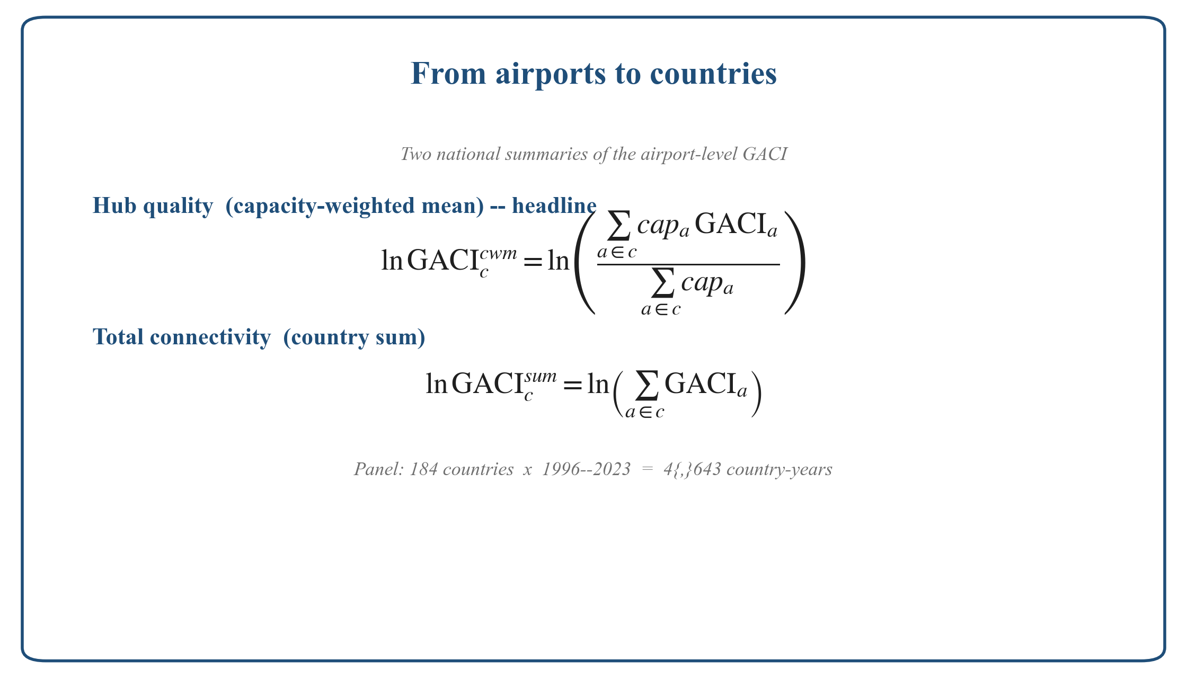
B U I L D I N G G A C I
Step 3: the aggregation formulas
Air Connectivity and Aviation CO2, 1996–2023
37 / 70

Slide 38
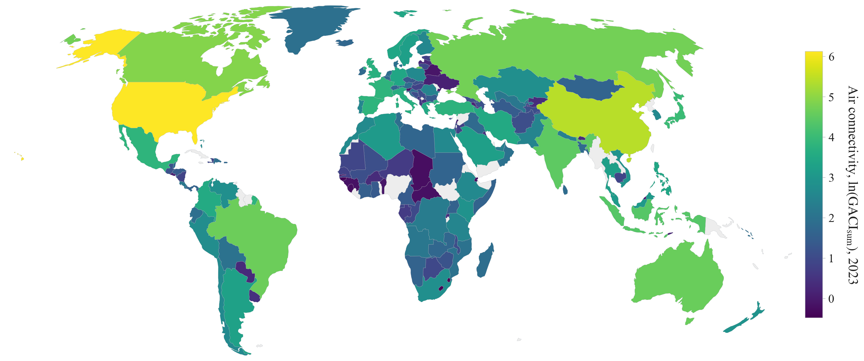
B U I L D I N G G A C I
The built index, mapped: connectivity by country, 2023
Total connectivity (country sum), 2023. Yellow = highly connected.
Air Connectivity and Aviation CO2, 1996–2023
38 / 70

Slide 39
B U I L D I N G G A C I
Country ranking, 2023: hub quality vs network size
Hub quality: capacity-weighted mean GACI (the regressor), 166 countries
Network size: sum of airport GACI (an alternative aggregation)
# | Country | Hub quality | Best airport | Airports
1 | UAE | 2.79 | 3.23 | 7
2 | Netherlands | 2.74 | 2.97 | 5
3 | Singapore | 2.67 | 2.68 | 2
4 | Hong Kong | 2.15 | 2.15 | 1
5 | Germany | 2.15 | 3.24 | 29
6 | United States | 2.09 | 3.11 | 569
7 | Turkey | 2.08 | 3.24 | 50
8 | France | 2.06 | 3.13 | 53
9 | United Kingdom | 2.06 | 3.04 | 42
10 | Switzerland | 1.99 | 2.21 | 4
11 | Saudi Arabia | 1.97 | 2.82 | 28
12 | Israel | 1.90 | 1.93 | 2
13 | Ethiopia | 1.87 | 2.08 | 19
14 | Austria | 1.87 | 1.99 | 6
15 | Ireland | 1.84 | 2.02 | 6
19 | Korea | 1.79 | 2.60 | 16
# | Country | GACI sum | Airports
1 | United States | 459 | 569
2 | China | 226 | 254
3 | Canada | 135 | 211
4 | Russia | 113 | 174
5 | Brazil | 103 | 166
6 | Australia | 101 | 160
7 | India | 89 | 117
8 | Indonesia | 80 | 123
9 | Japan | 56 | 70
10 | France | 47 | 54
11 | Spain | 46 | 48
12 | Mexico | 45 | 57
13 | Turkey | 44 | 50
14 | United Kingdom | 41 | 42
15 | Italy | 39 | 39
44 | Korea | 14 | 16
The regression uses hub quality: small hub states (UAE, Netherlands, Singapore) lead; the size list is a different world. Korea: 19th vs 44th.
Air Connectivity and Aviation CO2, 1996–2023
39 / 70

Slide 40
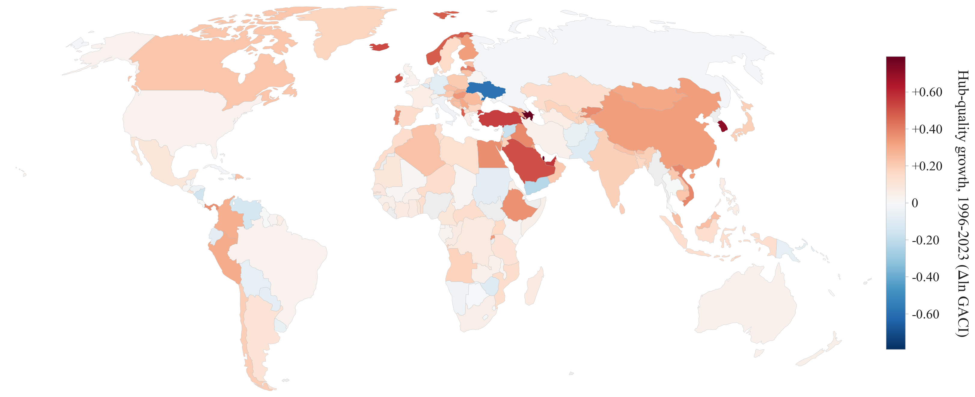
B U I L D I N G G A C I
The treatment: who got connected, 1996–2023
Change in log connectivity, 1996–2023. The Gulf, Turkey, China, and Korea connect; parts of Europe quietly disconnect.
Air Connectivity and Aviation CO2, 1996–2023
40 / 70

Slide 41
04
Identification
Breaking reverse causality with geography
🔍
41 / 70

Slide 42
I D E N T I F I C A T I O N
The problem: airlines follow the economy
• Airlines add capacity where income, trade, and travel demand are already growing: reverse causality, upward and downward biases at once.
• OLS would also be attenuated by measurement error in the index (it is: OLS = 3.59 vs 2SLS = 5.67).
• We need variation in connectivity that has nothing to do with a country's economic trajectory.
Our answer: geography that was fixed before the boom, interacted with a global technology cycle.
Air Connectivity and Aviation CO2, 1996–2023
42 / 70

Slide 43
I D E N T I F I C A T I O N · E S T I M A T I N G E Q U A T I O N
The model: a log-log panel with two-way fixed effects
ln CO_{2,ct} = β ln GACI_{ct} + γ ln pop_{ct} + δ ln seaMA_{ct} + α_{c} + τ_{t} + ε_{ct} (1)
β = elasticity of national aviation CO2 with respect to hub quality: the % change in CO2 per 1% change in GACI. Benchmark: β = 1 (emissions grow in proportion to connectivity).
Variables
CO2_{ct} national aviation CO2 in year t; headline = bunker rule. Also LTO-only, 50/50 split, international only, seat-km, CO2 per seat-km.
GACI_{ct} hub quality: capacity-weighted mean of airport GACI scores (alternatives: max, mean, sum).
pop_{ct} population (log).
seaMA_{ct} sea-distance market access (log): the surface-shipping alternative, held fixed.
α_{c} country fixed effects: geography, size, institutions.
τ_{t} year fixed effects: fuel prices, world traffic cycle, technology.
ε_{ct} error; robust standard errors.
Why OLS is not enough
Reverse causality: airlines add capacity where demand is already growing.
Measurement: the index is an estimate; noise attenuates OLS.
Sample: 184 countries × 1996–2023, N = 4,634 country-years.
Answer: instrument ln GACI with fixed 1996 geography × the world aviation cycle (next slides). OLS gives 3.59; 2SLS gives 5.67.
Air Connectivity and Aviation CO2, 1996–2023
43 / 70

Slide 44
I D E N T I F I C A T I O N
The fine print: the exclusion restriction
The instrument may affect CO2 through ONE door only: connectivity.
✓
✓
🔍 Instrument (geography × cycle)
✈️ Connectivity (GACI)
💨 Aviation CO2
✗
no direct path to CO2 allowed (untestable by assumption, so we attack it three ways)
🚢 Geography also moves SEA trade
✓ controlled directly: ln sea market access in every regression
💰 Big, rich countries ride the global cycle anyway
✓ stress test: add cycle × 1996 pop, GDP, capacity. F 120 → 106, β stable (the test that killed our other instruments)
🔬 Some direct effect might still remain
✓ Conley bounds: results survive direct effects up to 85% of the reduced form
Air Connectivity and Aviation CO2, 1996–2023
45 / 70

Slide 45
I D E N T I F I C A T I O N
A Feyrer-type air-vs-sea geography instrument
🗺️ 1996 air-vs-sea market-access geography
fixed before the sample
🌐 World aviation technology cycle
global, no country steers it
GACI
first stage
💨 Aviation CO2
×
Controls: log population, log sea market access, country and year fixed effects.
Kleibergen–Paap F = 153.6
Stress test (cycle × baseline size): F 120 → 106. Tourism IV: 14 → 0, dies.
Conley bounds: tolerates direct effects up to 85% of the reduced form
The only instrument we tried that survives its own execution squad.
Air Connectivity and Aviation CO2, 1996–2023
44 / 70

Slide 46
I D E N T I F I C A T I O N · E S T I M A T I O N
Two-stage least squares, step by step
1
First stage: predict connectivity from geography
2
Second stage: plug the prediction into (1)
ln GACI_{ct} = π Z_{ct} + γ₁ ln pop_{ct} + δ₁ ln seaMA_{ct} + α_{c} + τ_{t} + u_{ct}
ln CO_{2,ct} = β ln ĜACI_{ct} + γ ln pop_{ct} + δ ln seaMA_{ct} + α_{c} + τ_{t} + ε_{ct}
Z_{ct} = a_{t} × ln airMA_{c,1996} (Feyrer-type shifter)
Exactly identified: one instrument, one endogenous regressor, so β is a ratio of two reduced forms: 0.726 / 0.128 = 5.67.
Only the geography-driven part of connectivity growth is used; demand-driven capacity is purged.
Inference: robust SEs; Conley (spatial) SEs and plausibly-exogenous bounds as checks.
a_{t}: world aviation capacity index, min-max scaled 0 (1996) to 1: the global cycle nobody steers.
airMA_{c,1996}: air market access on fixed 1996 geography, the differential exposure to that cycle.
π̂ = 0.128 (s.e. 0.010), t = 12.4, Kleibergen–Paap F = 153.6
Reduced form: ln CO2 on Z directly = 0.726 (s.e. 0.057).
β̂ = 5.669 (s.e. 0.412), p < 0.001
OLS on the same sample: 3.585 (0.175). N = 4,634.
A 1% rise in hub quality raises national aviation CO2 by 5.7%: far from the proportional benchmark of one.
Air Connectivity and Aviation CO2, 1996–2023
46 / 70

Slide 47
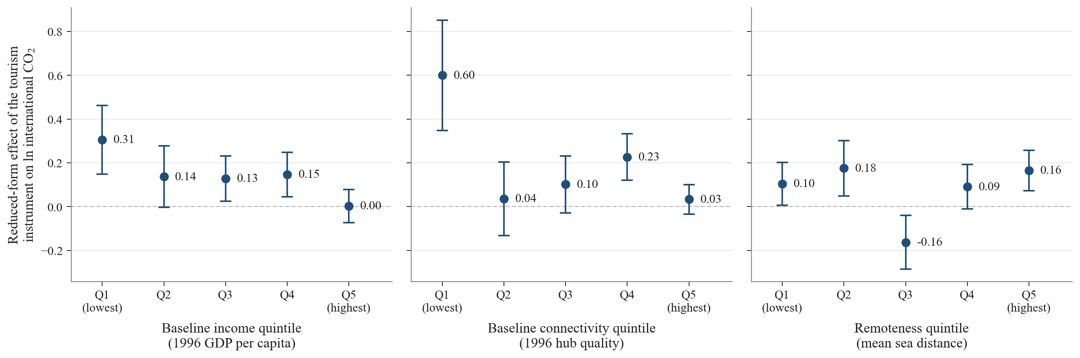
I D E N T I F I C A T I O N
The raw first look: shifter up, emissions up
Reduced form by instrument quintile: countries with stronger geography-driven connectivity growth emit more.
Air Connectivity and Aviation CO2, 1996–2023
47 / 70

Slide 48
05
Results
The elasticity, and everything inside it
📈
48 / 70

Slide 49
+1% → +5.7%
connectivity up one percent, national aviation CO2 up 5.67 percent (s.e. 0.41)
The benchmark is an elasticity of one: hubs could in principle absorb growth efficiently.
An elasticity of one is rejected at any conventional level.
49 / 70

Slide 50
R E S U L T S · T A B L E 1
Main results: OLS versus 2SLS across six outcomes
Dependent variable (log) | Bunker CO2 | LTO CO2 | 50/50 CO2 | Intl. CO2 | Seat-km | CO2 / seat-km
Panel A. OLS, country and year FE
ln GACI (cwm) | 3.585*** | 3.043*** | 3.566*** | 3.874*** | 3.941*** | −0.355***
 | (0.175) | (0.177) | (0.175) | (0.198) | (0.183) | (0.043)
Panel B. 2SLS, Feyrer instrument, capacity-weighted mean (headline)
ln GACI (cwm) | 5.669*** | 5.921*** | 5.620*** | 5.690*** | 6.068*** | −0.399***
 | (0.412) | (0.448) | (0.409) | (0.415) | (0.443) | (0.118)
Kleibergen–Paap F | 153.6 | 153.6 | 153.6 | 152.7 | 153.6 | 153.6
Panel C. 2SLS, alternative aggregations of airport GACI to the country
ln GACI (sum) | 2.283*** | 2.384*** | 2.263*** | 2.291*** | 2.443*** | −0.161***
KP F = 90.3 | (0.224) | (0.219) | (0.222) | (0.237) | (0.250) | (0.052)
ln GACI (max) | 4.822*** | 5.036*** | 4.780*** | 4.836*** | 5.161*** | −0.340***
KP F = 172.0 | (0.329) | (0.348) | (0.327) | (0.343) | (0.361) | (0.101)
ln GACI (mean) | 5.897*** | 6.159*** | 5.846*** | 5.902*** | 6.313*** | −0.415***
KP F = 136.2 | (0.591) | (0.623) | (0.587) | (0.593) | (0.624) | (0.122)
N (country-years) | 4,634 | 4,634 | 4,634 | 4,633 | 4,634 | 4,634
Headline
β = 5.67 (0.41)
+1% hub quality = +5.7% national aviation CO2. Benchmark of one rejected by a wide margin.
OLS understates
3.59 vs 5.67: the 2SLS estimate exceeds OLS, so the net OLS bias is downward.
Allocation rule irrelevant
5.62 to 5.92 across territorial, bunker and split conventions.
Scale vs technique
Seat-km +6.07 and intensity −0.40: volume, not efficiency.
Notes: country-year panel, 184 countries, 1996–2023. All columns include country and year fixed effects and control for log population and log sea market access. Instrument: world aviation cycle × 1996 air market access. Robust SE in parentheses. ***, **, *: 1, 5, 10% significance.
Air Connectivity and Aviation CO2, 1996–2023
50 / 70

Slide 51
R E S U L T S
However you count it: far above one
+5.67***
Bunker CO2 (headline)
+5.92***
LTO-only (territorial)
+5.62***
50/50 cruise split
+5.69***
International CO2
+6.07***
Seat-kilometres
−0.40***
CO2 per seat-km
Aggregation checks: GACI sum +2.28***, max +4.82***, mean +5.90*** (KP F 90–172). 2SLS, Feyrer IV, N = 4,634.
Allocation rule, aggregation, instrument: nothing pushes the elasticity anywhere near one.
Air Connectivity and Aviation CO2, 1996–2023
51 / 70

Slide 52
R E S U L T S
Efficiency is real. It is also hopelessly outgunned.
Scale (seat-km)
+6.07%
Technique (CO2 per seat-km)
−0.40%
• The same 1% of connectivity raises seat-kilometres by 6.07%, faster than emissions rise.
• So emissions per seat-km fall by 0.40%: hubbing does deliver larger, fuller, longer-range operations.
• But the efficiency margin offsets less than one tenth of the scale response.
The emissions consequence of connectivity is a volume story, not an efficiency story.
Air Connectivity and Aviation CO2, 1996–2023
52 / 70

Slide 53
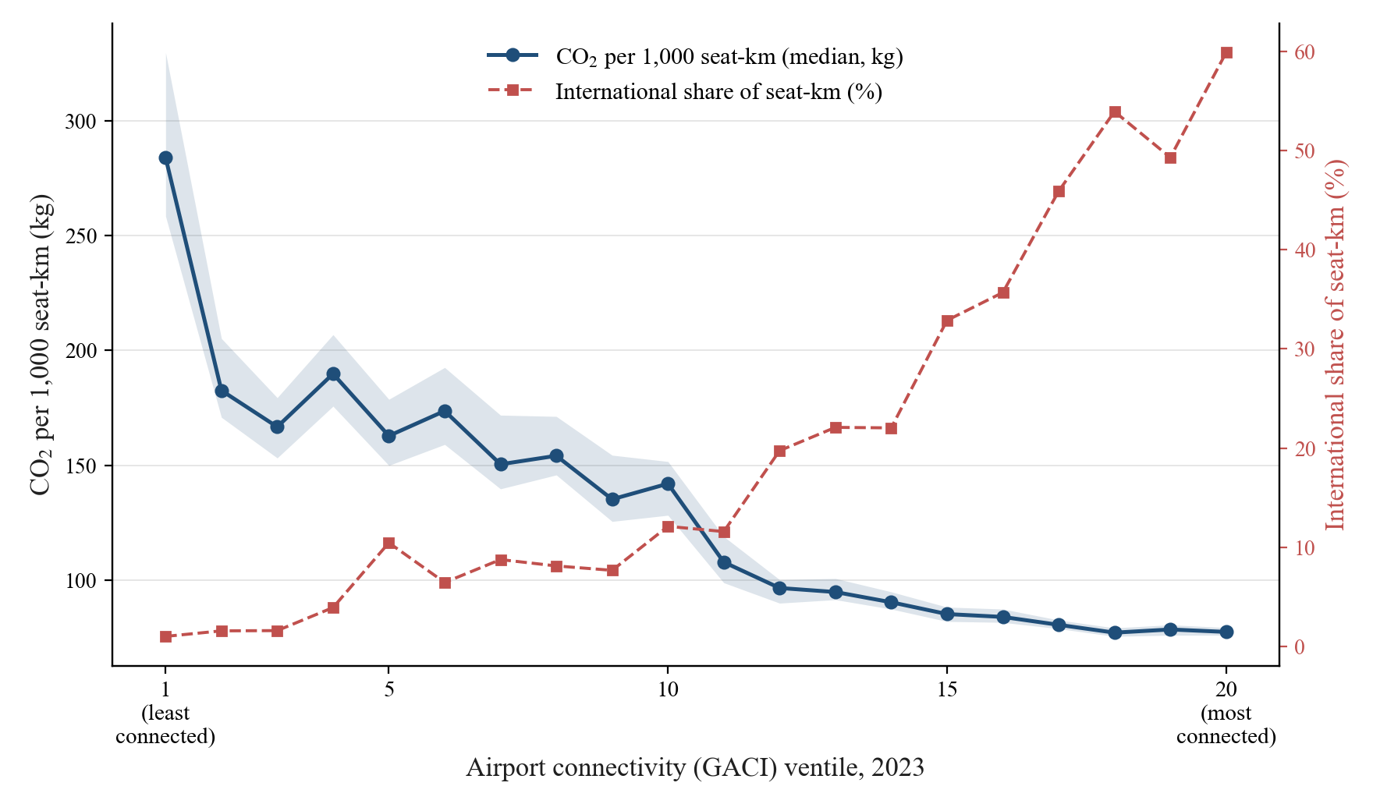
R E S U L T S
Zoom to the airport: the efficiency curve
2023 cross-section by connectivity ventile: median intensity falls 284 → 77 kg per 1,000 seat-km while the international share climbs from 1% to 60%.
Efficiency is real at the node, and dominated by scale at the aggregate.
Air Connectivity and Aviation CO2, 1996–2023
53 / 70

Slide 54
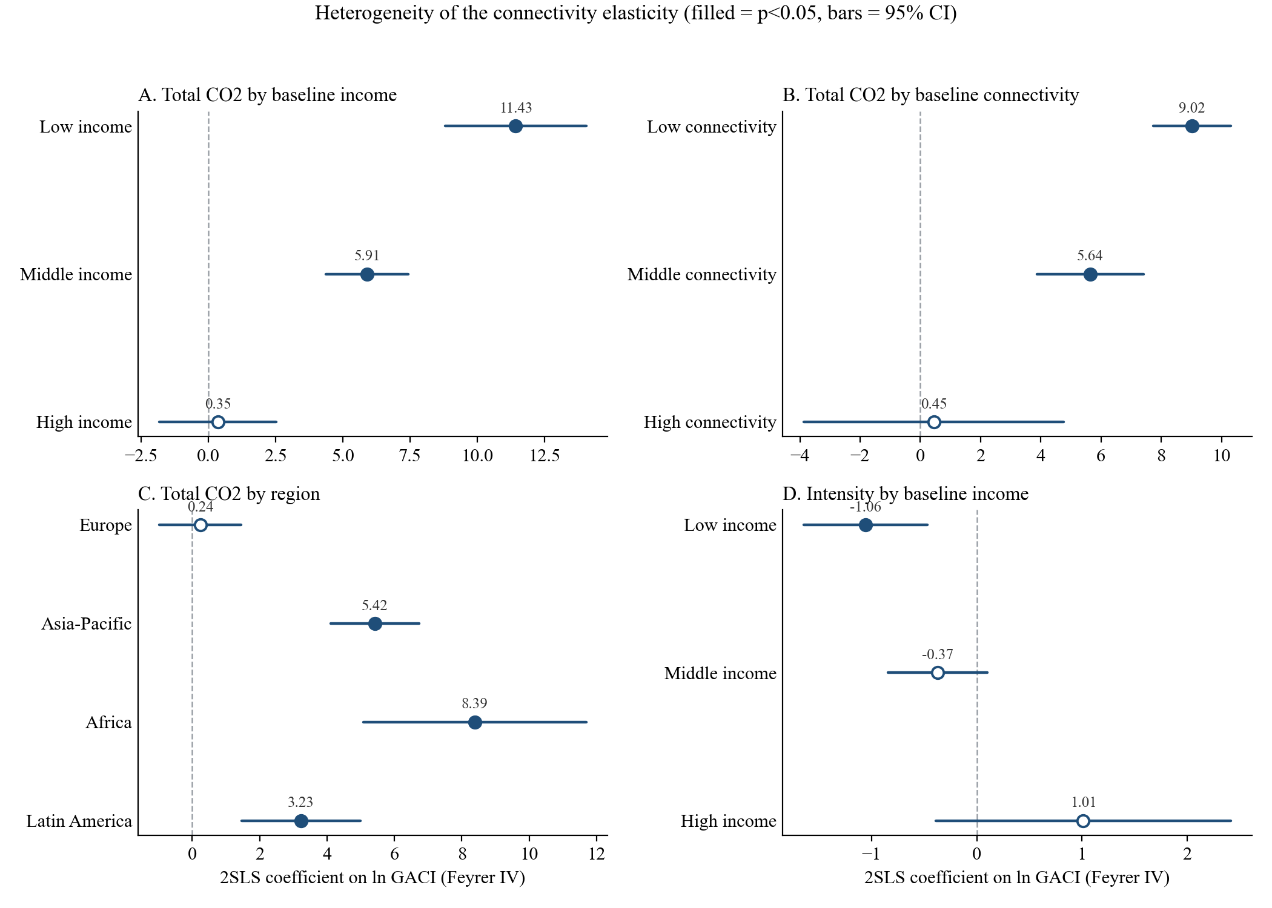
R E S U L T S
Who drives it: the newly connecting world
By 1996 income: 11.4 (bottom) · 5.9 (middle) · 0.35 ns (top)
By region: Africa 8.4 · Asia–Pacific 5.4 · Latin America 3.2 · Europe 0.24 ns
Efficiency gains also appear only in the bottom income tercile.
For mature networks, connectivity growth is roughly carbon-neutral at the margin. The elasticity is the sound of countries entering the network.
Air Connectivity and Aviation CO2, 1996–2023
54 / 70

Slide 55
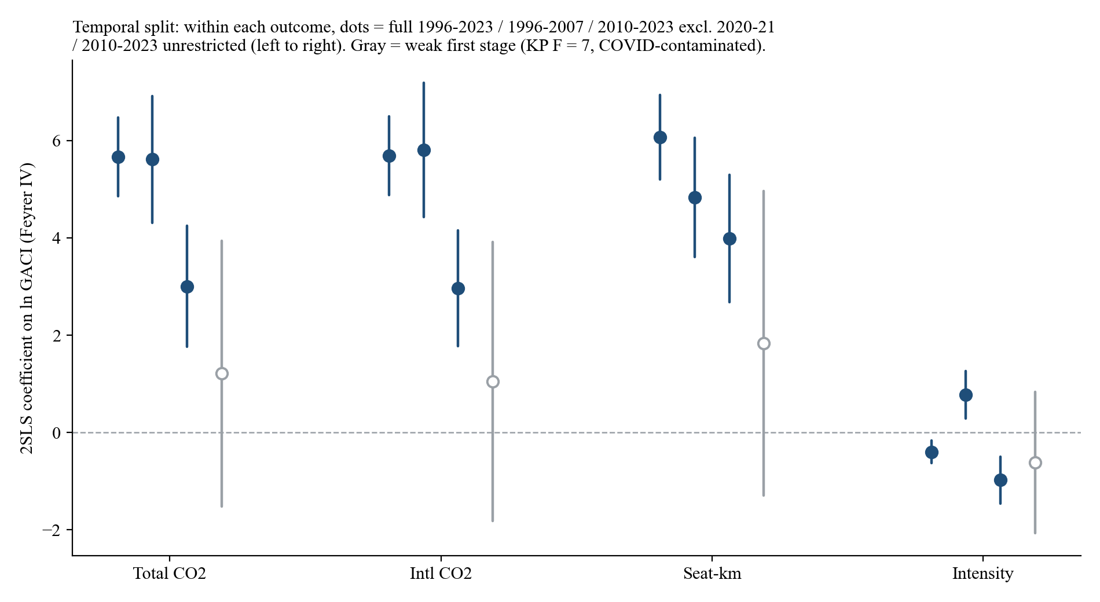
R E S U L T S
And it is fading as the network matures
5.61 → 3.01 excluding crisis years: the elasticity halves from 1996–2007 to 2010–2023 (p = 0.005).
+0.78 → −0.98 the efficiency margin only appears in the mature era.
COVID alone breaks the late-period first stage (F 36.7 → 7.0 with 2020–21 included).
Still far above one in both eras: maturity slows the meter, it does not stop it.
Air Connectivity and Aviation CO2, 1996–2023
55 / 70

Slide 56
R E S U L T S · T A B L E 2
Who and when: split-sample 2SLS
A. Heterogeneity (total bunker CO2; terciles on 1996 values)
B. Temporal split (2SLS, Feyrer instrument)
Subsample | β | s.e. | KP F | N
By baseline income
Low income | 11.431*** | (1.338) | 35.2 | 1,595
Middle income | 5.906*** | (0.782) | 48.2 | 1,547
High income | 0.350 | (1.106) | 10.1 | 1,491
By baseline connectivity
Low connectivity | 9.018*** | (0.656) | 117.4 | 1,452
Middle connectivity | 5.642*** | (0.908) | 29.9 | 1,526
High connectivity | 0.452 | (2.201) | 1.8 | 1,655
By region
Europe | 0.236 | (0.616) | 55.5 | 1,189
Asia–Pacific | 5.424*** | (0.667) | 64.4 | 1,110
Africa | 8.385*** | (1.688) | 20.2 | 1,230
Latin America | 3.229*** | (0.900) | 14.1 | 683
Sample | Bunker CO2 | Intl. CO2 | Seat-km | Intensity | KP F
Full, 1996–2023 | 5.669*** | 5.690*** | 6.068*** | −0.399*** | 153.6
N = 4,634 | (0.412) | (0.415) | (0.443) | (0.118)
Expansion era, 1996–2007 | 5.613*** | 5.809*** | 4.837*** | +0.776*** | 75.0
N = 1,883 | (0.665) | (0.704) | (0.626) | (0.249)
Mature era, 2010–23 ex-COVID | 3.005*** | 2.965*** | 3.984*** | −0.979*** | 36.7
N = 2,065 | (0.635) | (0.610) | (0.668) | (0.248)
Unrestricted 1996–2009 | 6.109*** | 6.262*** | 5.537*** | +0.571*** | 127.7
N = 2,218 | (0.565) | (0.590) | (0.534) | (0.192)
Unrestricted 2010–2023 | 1.213 | 1.051 | 1.829 | −0.617 | 7.0
N = 2,415 (weak IV) | (1.394) | (1.463) | (1.598) | (0.739)
Pre vs post difference: 2.61 (p = 0.005). The elasticity halves as the network matures but stays far above one. The weak unrestricted post-2010 first stage is a COVID artefact: dropping 2020–21 restores F to 36.7.
Middle East and North America: not identified (KP F < 2). Robust SE in parentheses; ***, **, *: 1, 5, 10%.
The elasticity is the sound of a network being built: newly connecting, low-income countries carry it; mature networks are near carbon-neutral at the margin.
Air Connectivity and Aviation CO2, 1996–2023
56 / 70

Slide 57
R E S U L T S
Anatomy: volume carries it, hub quality recomposes it
What mediates the effect?
86.5%
of the effect runs through seat-kilometres
83.9%
through flight frequency
~0%
through the international share
A different lever, hub quality (secondary tourism IV), moves the mix instead:
Total CO2: no response
International CO2: +3.16***
CO2 per seat-km: +1.23***
Market access scales flying; hub quality tilts it toward international long-haul.
Air Connectivity and Aviation CO2, 1996–2023
57 / 70

Slide 58
R E S U L T S
Your neighbour's hub, your emissions
✈️ Neighbours' connectivity +1%
💨 Own aviation CO2 +7.45***
International CO2 +10.2***
Trade volume: +2.1, ns
KP F = 134
The margins are the converse of the own-network response:
Flights: ns
Aircraft size +5.4***
Intl share +1.0***
Stage length −2.0**
Feeding foreign hubs: the CO2 lands at home, the trade gains do not. National accounting misses a regional externality.
Air Connectivity and Aviation CO2, 1996–2023
58 / 70

Slide 59
R E S U L T S · T A B L E 3
Spillovers: neighbours' connectivity, own outcomes
Panel A. 2SLS: neighbour connectivity instrumented by neighbours' Feyrer shifters (inverse-distance weighted)
How to read it
Neighbour GACI: distance-weighted average of all other countries' log hub quality.
Why reduced form for own: own and neighbour shifters are collinear within country, so only one can be instrumented.
Result: +1% in neighbours' hubs raises own CO2 by 7.5% and international CO2 by 10%, with no trade gain.
Margins: not more flights, but bigger aircraft, shorter stages, more international share: feeding the foreign hub.
Dependent variable (log) | Bunker CO2 | Intl. CO2 | CO2 / seat-km | Trade volume
ln neighbour GACI | 7.454*** | 10.237*** | 1.312** | 2.072 (ns)
 | (1.994) | (2.092) | (0.534) | (2.011)
Own Feyrer shifter (reduced form) | 0.254** | 0.076 | −0.134*** | 0.157
 | (0.122) | (0.128) | (0.037) | (0.124)
Kleibergen–Paap F | 134.1 | 134.0 | 134.1 | 134.1
N | 4,623 | 4,622 | 4,623 | 4,623
Panel B. Margins of the own response to neighbour connectivity (same specification)
Dependent variable (log) | Flights | Seat-km | Aircraft size | Stage length | Intl. share
ln neighbour GACI | 2.730 (ns) | 6.141*** | 5.437*** | −2.026** | 1.046***
 | (2.216) | (2.083) | (1.170) | (1.008) | (0.281)
Notes: country and year FE; controls log population and log sea market access; robust SE in parentheses. ***, **, *: 1, 5, 10% significance. ns = not significant.
Feeding foreign hubs: the CO2 lands at home, the trade gain does not.
Air Connectivity and Aviation CO2, 1996–2023
59 / 70

Slide 60
06
The carbon bill
Attribution, who pays, and the only real lever
💸
60 / 70

Slide 61
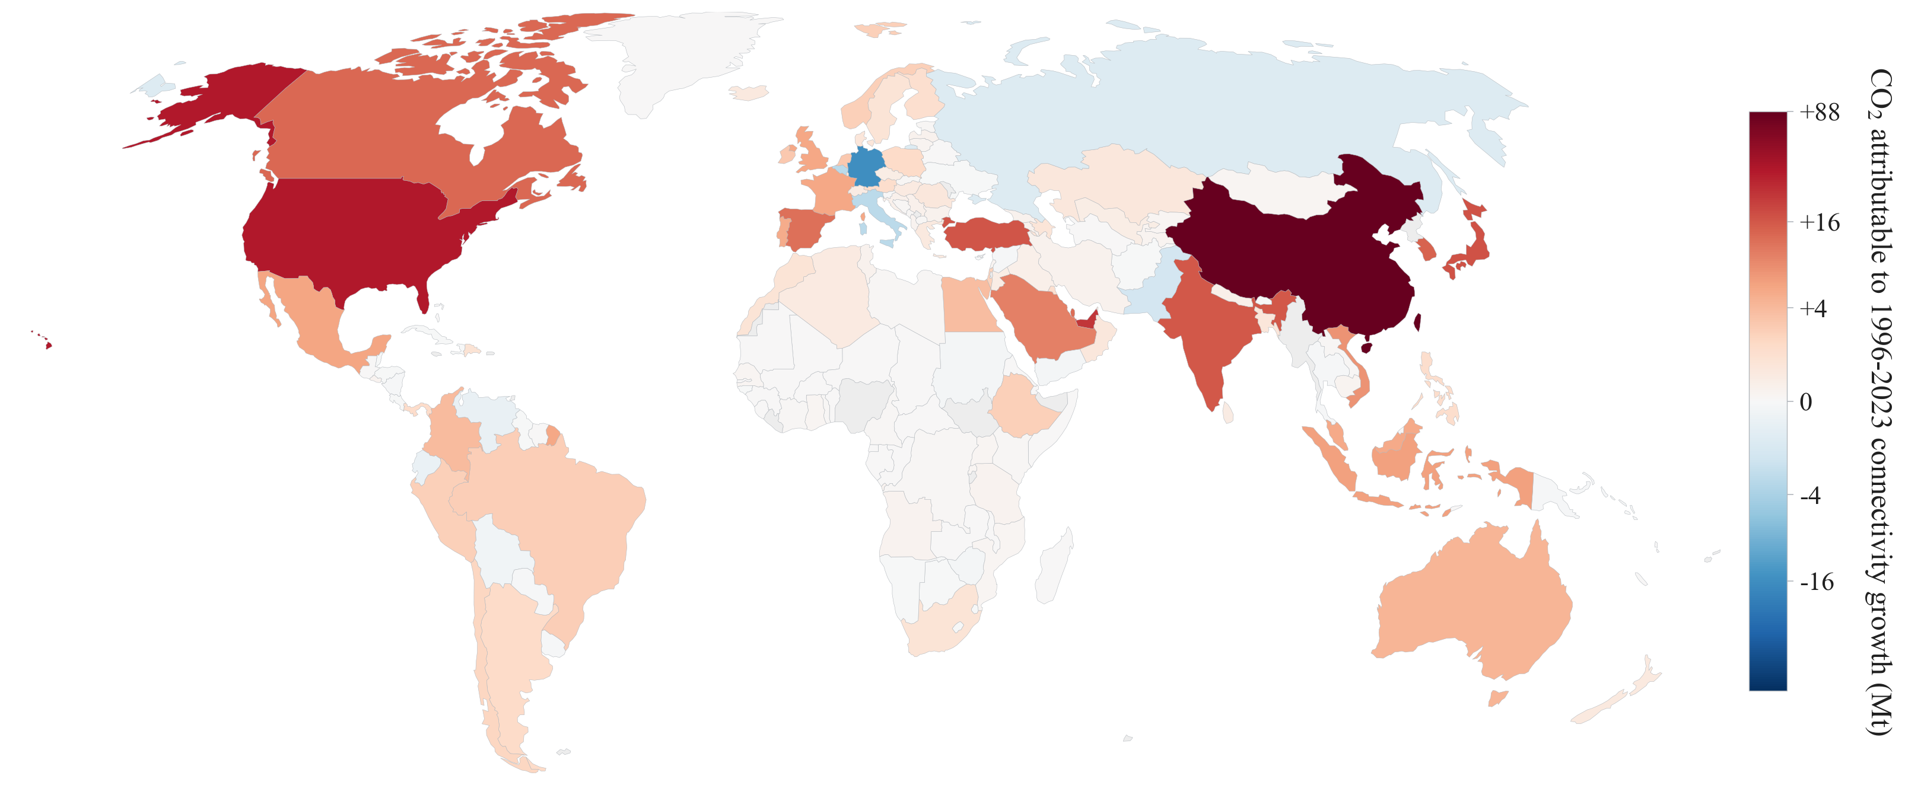
T H E C A R B O N B I L L
356 Mt: the CO2 the connectivity boom built
2023 aviation CO2 attributed to post-1996 connectivity growth: 356 Mt, 42.5% of the world total. White = zero.
Air Connectivity and Aviation CO2, 1996–2023
61 / 70

Slide 62
T H E C A R B O N B I L L
The price tag: the social cost of carbon
SCC = the present value of all future damage caused by one extra tonne of CO2.
🏭 1 tonne of CO2, emitted today
one flight's worth at a time
🌡️ A century of damages
heat, crops, storms, sea level, health, productivity
💵 Discounted back to today
= one price per tonne
Three standard price tags (2020 USD per tonne):
$51 per tonne
US Interagency Working Group (2021) · 3% discount rate
$185 per tonne
Rennert et al. (2022, Nature) · 2% near-term discount rate
$190 per tonne
US EPA (2023) central value · 2% Ramsey discounting
The gap is mostly the discount rate, not the climate science: how much do we care about damages 50 years out?
Attach this price tag to our 356 Mt: an $18–68 billion bill, recurring every year the traffic persists.
Air Connectivity and Aviation CO2, 1996–2023
62 / 70

Slide 63
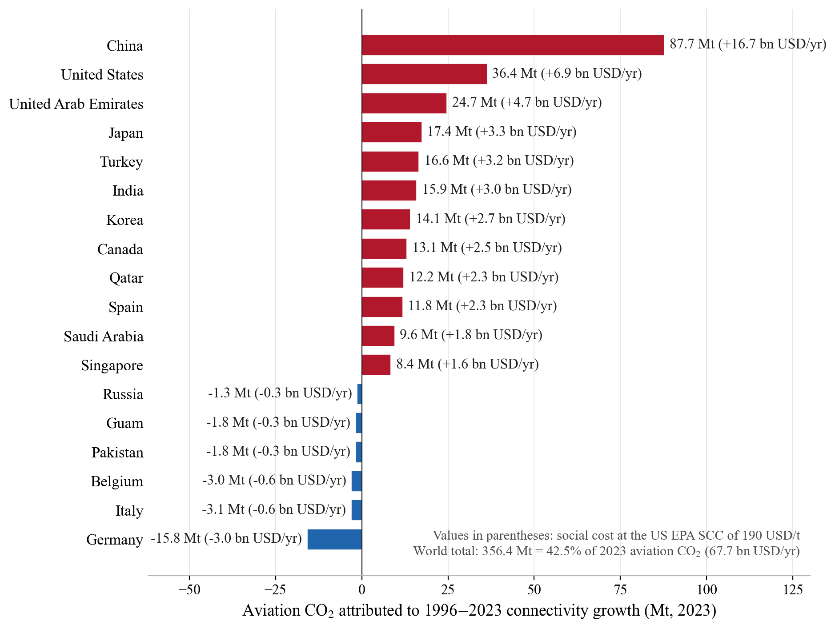
T H E C A R B O N B I L L
Who owes what: the country bill, priced 💸
China +88 Mt · $16.7 bn/yr
United States +36 Mt · $6.9 bn/yr
UAE +25 Mt · $4.7 bn/yr
Japan / Turkey +17 Mt each
Korea +14 Mt
Germany −16 Mt · −$3.0 bn/yr
World: $18.2 / 65.9 / 67.7 bn per year at SCC $51 / $185 / $190.
A climate bill in the tens of billions of dollars, recurring annually while the traffic persists.
Air Connectivity and Aviation CO2, 1996–2023
63 / 70

Slide 64
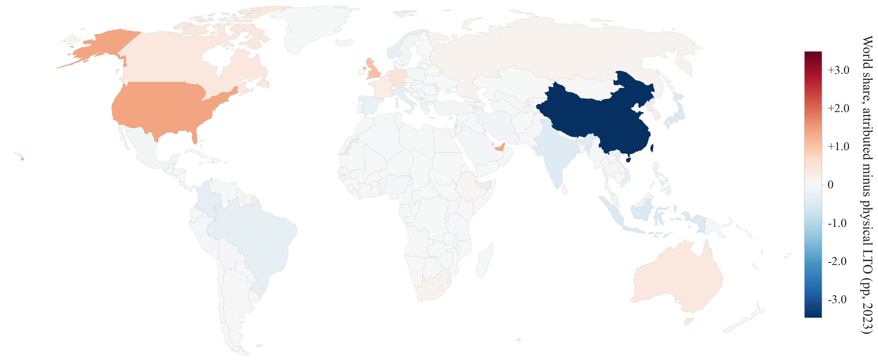
T H E C A R B O N B I L L
Generated here, booked there
Bunker-attributed share minus physical LTO share, 2023: +1.4 pp for the US and the UAE, −3.5 pp for China. Positive at every international mega-hub.
Any scheme that allocates responsibility by booked emissions, CORSIA included, embeds a transfer across these lines.
Air Connectivity and Aviation CO2, 1996–2023
64 / 70

Slide 65
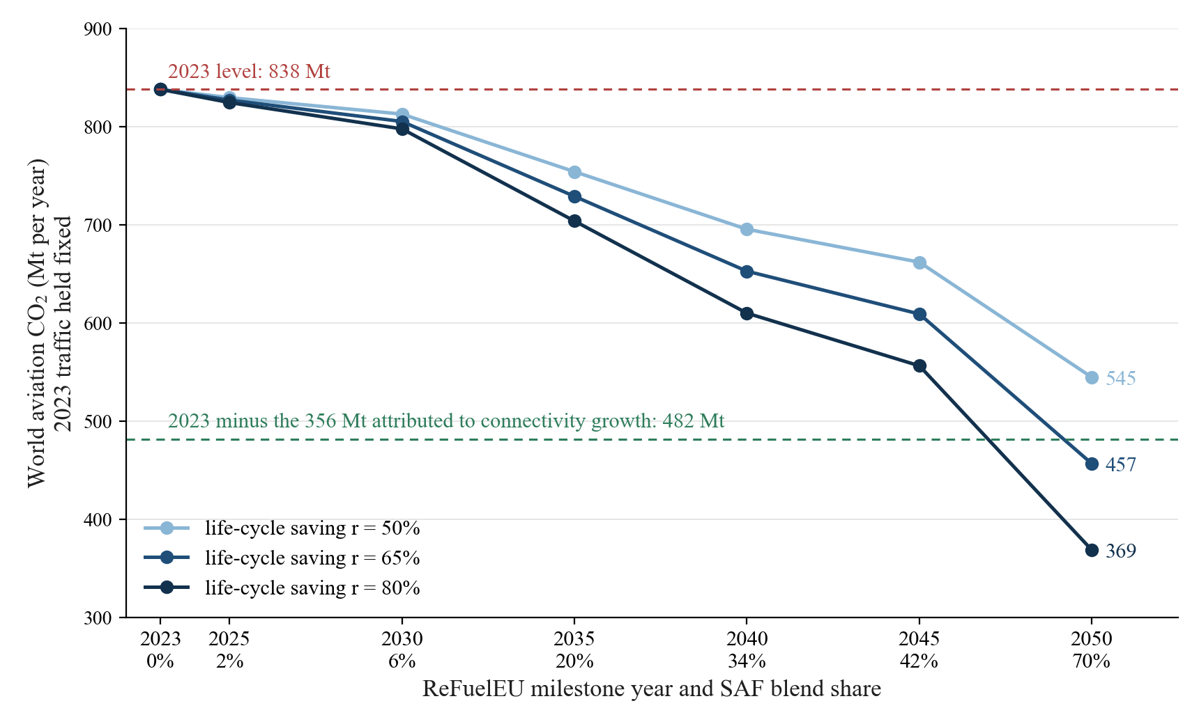
T H E C A R B O N B I L L
The only lever that moves the level: change the fuel
HOW THE SCENARIO IS COMPUTED
E(s, r) = 838 Mt × [ 1 − s × r ]
838 Mt = world aviation CO2 in 2023 (bunker convention); 2023 scheduled traffic held fixed, fuel backed out at 3.15 kg CO2 per kg Jet A.
s = SAF blend share on the ReFuelEU path: 2% (2025), 6% (2030), 20% (2035), 34% (2040), 42% (2045), 70% (2050).
r = life-cycle CO2 saving of SAF vs fossil Jet A: 50 / 65 / 80% (literature range).
g per $ = E(s, r) ÷ attributed trade ($7.8 tn): 21 g/$ in 2023, 9–14 g/$ on the 2050 path.
Mt CO2 per year | SAF blend | r = 50% | r = 65% | r = 80%
2023 actual | 0% | 838 | 838 | 838
2035 mandate | 20% | 754 | 729 | 704
2050 mandate | 70% | 545 | 457 | 369
CO2 saved in 2050 |  | 293 Mt | 381 Mt | 469 Mt
… as % of the 356 Mt |  | 82% | 107% | 132%
World aviation CO2 along the ReFuelEU blending path, 2023 traffic held fixed: 838 Mt → 704–754 Mt at the 2035 mandate → 369–545 Mt at the 2050 mandate. Green line: the 2023 level minus the 356 Mt attributed to post-1996 connectivity growth (elasticity 5.67).
The full 2050 path (≥65% life-cycle saving) offsets about as much CO2 as the past generation of connectivity growth created.
Air Connectivity and Aviation CO2, 1996–2023
65 / 70

Slide 66
07
Conclusion
Three myths, three implications, one bill
🎯
66 / 70

Slide 67
C O N C L U S I O N
Three comfortable myths, audited
MYTH 🧚
WHAT THE DATA SAY 🔬
“Hub efficiency will absorb the traffic growth.”
It offsets less than one tenth of the scale response.
“Emissions are booked where they are generated.”
Hub accounting shifts up to 3.5 pp of world emissions across borders.
“Your emissions depend on your own network.”
+1% in neighbours' connectivity raises your CO2 by 7.5%.
Connectivity policy needs a carbon line in its cost-benefit table. Here is the number to put there.
Air Connectivity and Aviation CO2, 1996–2023
67 / 70

Slide 68
C O N C L U S I O N
Summary and policy
• New data: flight-stage CO2 for 6,000+ airports, 1996–2023, valid under any allocation rule.
• New estimate: the connectivity-emissions elasticity is 5.67, far above one, concentrated in newly connecting countries, spilling across borders.
• The bill: 42.5% of 2023 aviation CO2 (356 Mt, $18–68 bn per year) traces to the post-1996 connectivity boom.
• Policy: evaluate connectivity investments jointly with fuel and demand-side instruments; efficiency gains are not a decarbonisation strategy, and booked-emissions schemes embed cross-border transfers.
Connect if it pays, but put the carbon in the ledger, and bring the fuel.
Air Connectivity and Aviation CO2, 1996–2023
68 / 70

Slide 69
C O N C L U S I O N
Points to discuss (a.k.a. our limitations)
• Schedule-based emissions: carbon content of scheduled capacity, not of realised load factors.
• The instrument is strongest in the expansion era; the late period is identified only excluding COVID years.
• Airport-level results are descriptive: no valid airport-level instrument survived our checks.
• Attribution and SAF scenarios are partial-equilibrium accounting; non-CO2 climate effects (contrails, NOx) are out of scope.
• Where next: load factors? Airline-level behaviour? Non-CO2 forcing? Your ideas welcome.
Air Connectivity and Aviation CO2, 1996–2023
69 / 70

Slide 70
Thank you ✈
How Much Does Air Connectivity Increase Aviation CO2?
+1% connectivity → +5.7% CO2 · 356 Mt since 1996 · only fuel switching bends the level
70 / 70

