Slide 1
Research Seminar
Global Air Connectivity and Trade Openness, 1996–2023
Building a global aviation connectivity index, and estimating its effect on trade
Sunbin YOO,
Junya KUMAGAI
Longfei ZHENG
Chunan WANG
Jinwoo LEE
Anming ZHANG

Slide 2
T O D A Y ' S T A L K
Motivation
• We simply wanted to Graduate from Railway research.
We had a chance to meet Professor Anming Zhang (Chief editor of Transportation Research Part A)
He suggested me about aviation research.
Global Air Connectivity and Trade, 1996–2023
2 / 43

Slide 3
T O D A Y ' S T A L K
What this paper does
• We build a new measure of how connected each country is to the world by air, covering 184 countries from 1996 to 2023.
• We then ask whether that connectivity causally raises a country’s trade openness, using an instrument based on tourism and UNESCO national heritage to break reverse causality.
A data contribution (the index) and a causal contribution (the effect on trade).
Global Air Connectivity and Trade, 1996–2023
2 / 43

Slide 4
R O A D M A P
Five parts
01
Motivation
Why connectivity & trade
02
Building GACI
What it is and how we build it
03
Identification
Tourism–heritage IV
04
Results
Effect, who gains, how much
05
Conclusion
Policy & extensions
Global Air Connectivity and Trade, 1996–2023
3 / 43

Slide 5
01
Motivation
Why air connectivity, and why trade
4 / 43

Slide 6
M O T I V A T I O N
Air connectivity shrinks economic distance
• A country’s position in the world air network sets how near it is, in time and cost, to markets, suppliers, and partners.
• Among the flows distance impedes (people, capital, ideas, goods), trade responds most robustly and is observed most cleanly.
• Trade is the proximate, observable margin on which connectivity acts; income is the distant, confounded end of the chain.
So we study trade: the clearest economic footprint of air access.
Global Air Connectivity and Trade, 1996–2023
5 / 43

Slide 7
M O T I V A T I O N
Why connectivity should move trade: two channels
Why a continuous index, not a count or a discrete treatment- Continuous, not lumpy.
Airports rarely open or close; position moves every year as partners rewire. A discrete DID misses this.
Weighted, not counted. A mega-hub ≠ a thin regional field (top ~2.4% of airports carry half the world's seats). A count erases this; a capacity-weighted index keeps it.
- Captures shocks. War, sanctions, COVID collapse connectivity while airports stay open. No open/close event to see but the index registers the drop.
Incheon
Haneda
Small airports (i.e., Kitakyushu)
Global Air Connectivity and Trade, 1996–2023
6 / 43

Slide 8
02
Building GACI
What is it, and how do we construct it?
7 / 43

Slide 9
C O N C E P T
What is "air connectivity", really?
• It is not how many airports or routes a country has.
• It is a country’s POSITION in the world air network: how easily, through how many and how important partners, it can reach everywhere else.
• Two countries with the same number of routes differ if one connects to global hubs and the other to dead-ends.
Connectivity = network position, not a simple count.
Global Air Connectivity and Trade, 1996–2023
8 / 43

Slide 10
C O N C E P T
How we measure it: the Global Air Connectivity Index
• GACI summarises each airport’s position in the weighted world air network as a single, time-comparable number (Cheung, Wong & Zhang, 2020).
• It blends three ideas:
  – REACH — how many and how well-placed are its connections;
  – FLOW — how much passenger traffic moves through it;
  – STANDING — how important are the airports it connects to.
One number that captures reach, flow, and standing in the global network.
Global Air Connectivity and Trade, 1996–2023
9 / 43

Slide 11
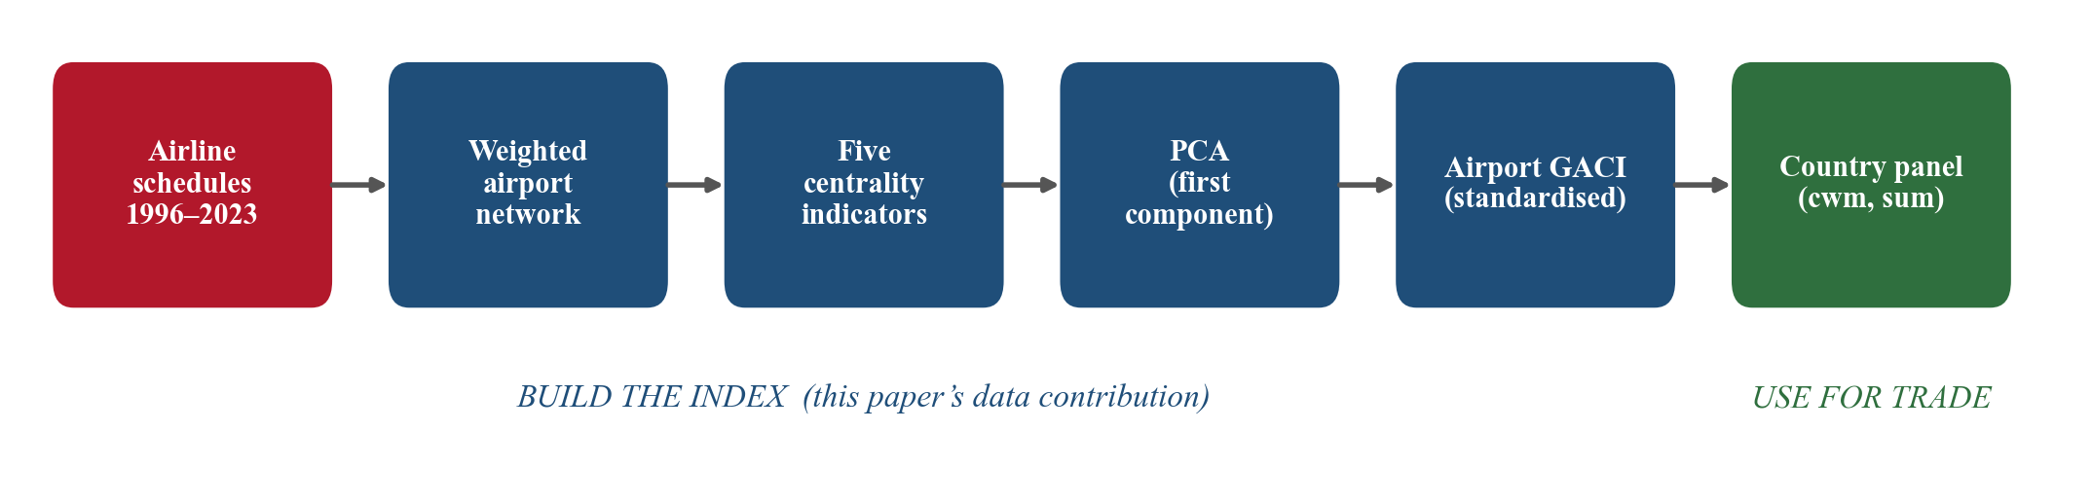
B U I L D I N G G A C I
How the index is built: the pipeline
Each step is computed for every year, then aggregated to countries.
Global Air Connectivity and Trade, 1996–2023
10 / 43

Slide 12
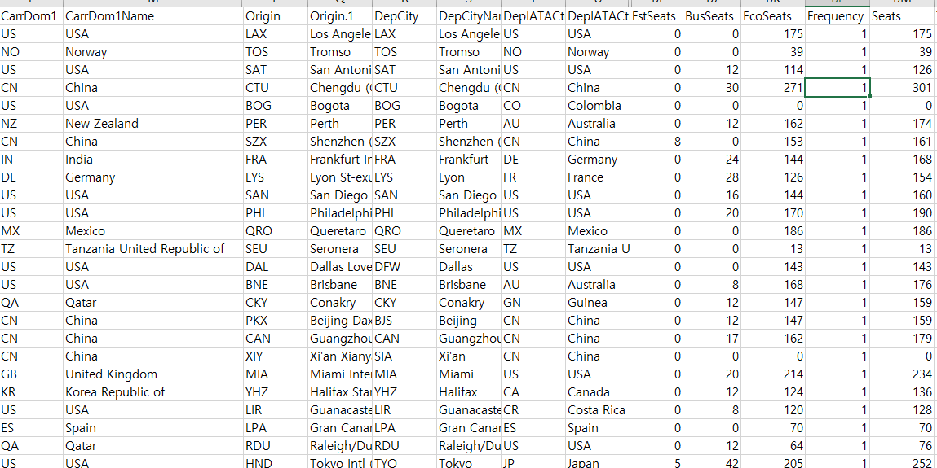
B U I L D I N G G A C I
元データ
Connected Dummy
Total Riding capacity
Global Air Connectivity and Trade, 1996–2023
12 / 43

Slide 13

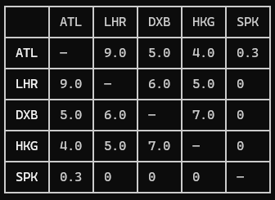
B U I L D I N G G A C I
Step 0: building a clean weighted network
• Source: global airline schedule data (route-segment level). OAG Datasource (So big!)
• Keep only scheduled commercial service; exclude military, charter, seaplane, heliports, and airports that closed in-window.
• Aggregate segments per airport pair per year into one link; set the link weight to passenger seat capacity.
• Two matrices per year: adjacency A (who connects) and weight W (how much).
Global Air Connectivity and Trade, 1996–2023
12 / 43

Slide 14
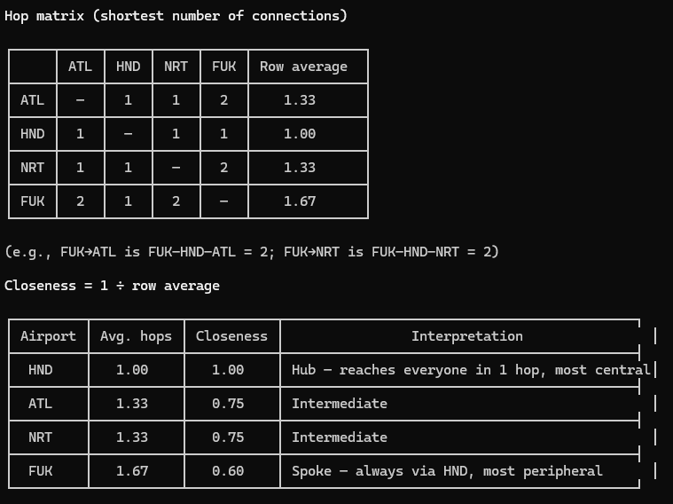
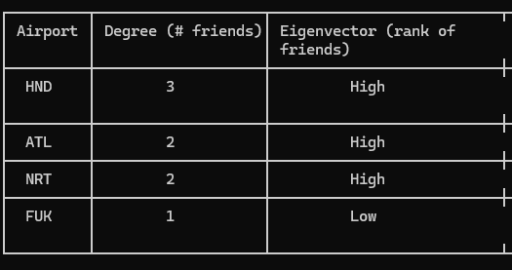
B U I L D I N G G A C I
Step 1a: topological indicators (position)
• Degree — number of direct connections (raw reach).
• Closeness — inverse of the average number of Transfers to reach all others (accessibility).
+ Eigenvector:
How much I am connected to “BIG” airports.
Global Air Connectivity and Trade, 1996–2023
15 / 43

Slide 15
B U I L D I N G G A C I
Step 1b: volumetric indicators (passenger flow)
• Flow betweenness — share of passenger transferring through the airport; the hub / transfer role. (Haneda < Narita) .
• Regional importance — average connection intensity within its own region (Haneda > Narita) .
• These two flow measures make GACI flow-aware, not purely topological.
Global Air Connectivity and Trade, 1996–2023
16 / 43

Slide 16
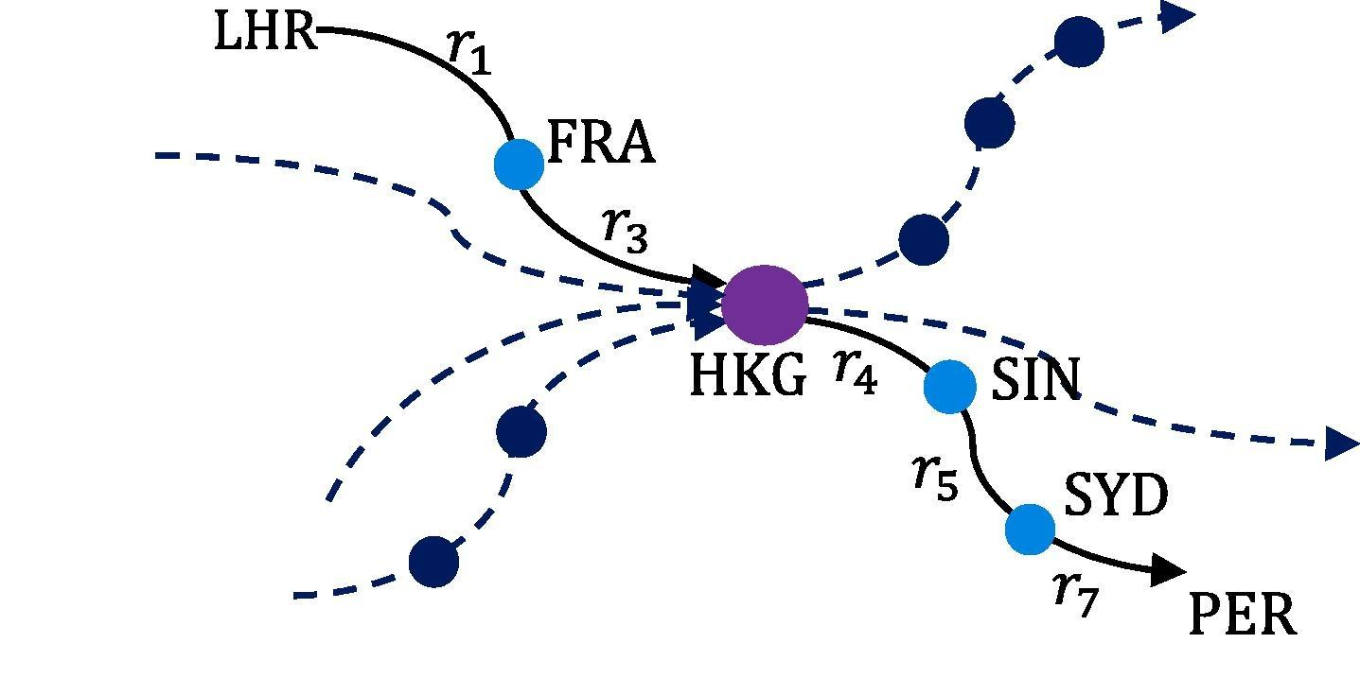
B U I L D I N G G A C I
Flow betweenness: passengers as electrical current
Each route is a resistor with resistance inversely proportional to its passenger intensity; betweenness = current through the node. Source: Cheung et al. (2020).
Global Air Connectivity and Trade, 1996–2023
17 / 43

Slide 17
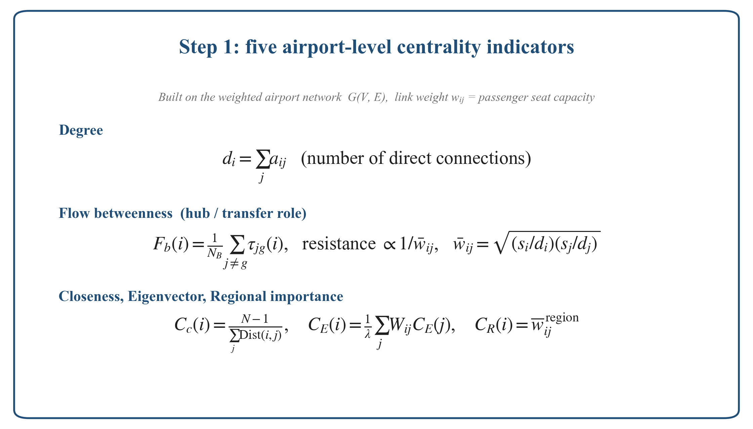
B U I L D I N G G A C I
Step 1: the exact formulas
Global Air Connectivity and Trade, 1996–2023
18 / 43

Slide 18
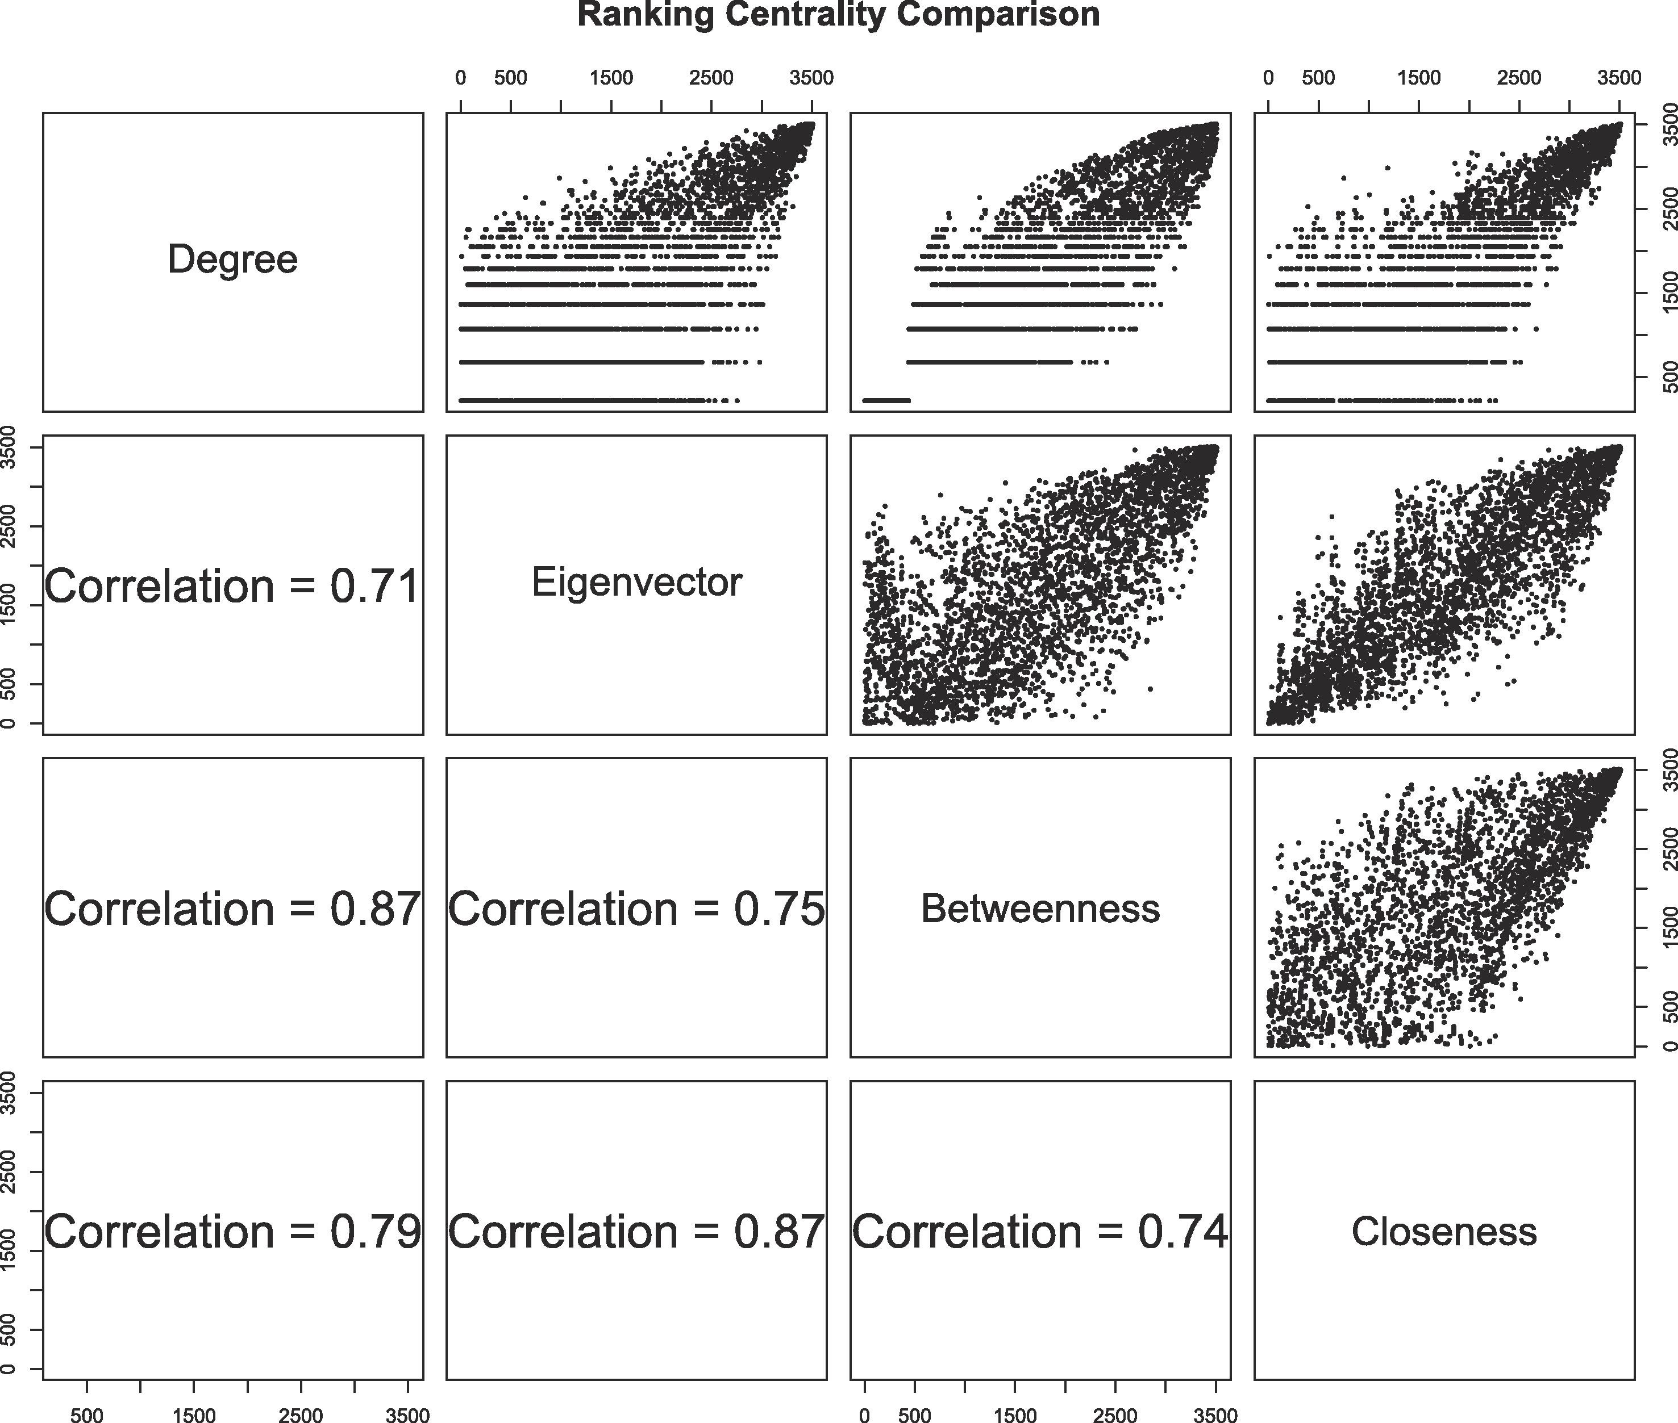
B U I L D I N G G A C I
The five indicators are related but not redundant
Pairwise rank correlations 0.71–0.87: each adds information, so we combine rather than pick one. Source: Cheung et al. (2020).
Global Air Connectivity and Trade, 1996–2023
19 / 43

Slide 19
B U I L D I N G G A C I
Step 2: combine the five into one index (PCA)
• Five indicators, different scales, partly correlated.
• GACI = the first principal component: the single weighted combination capturing the most variance across airports.
• It explains about two-thirds of total variance, so one number retains most of the information.
Global Air Connectivity and Trade, 1996–2023
20 / 43

Slide 20
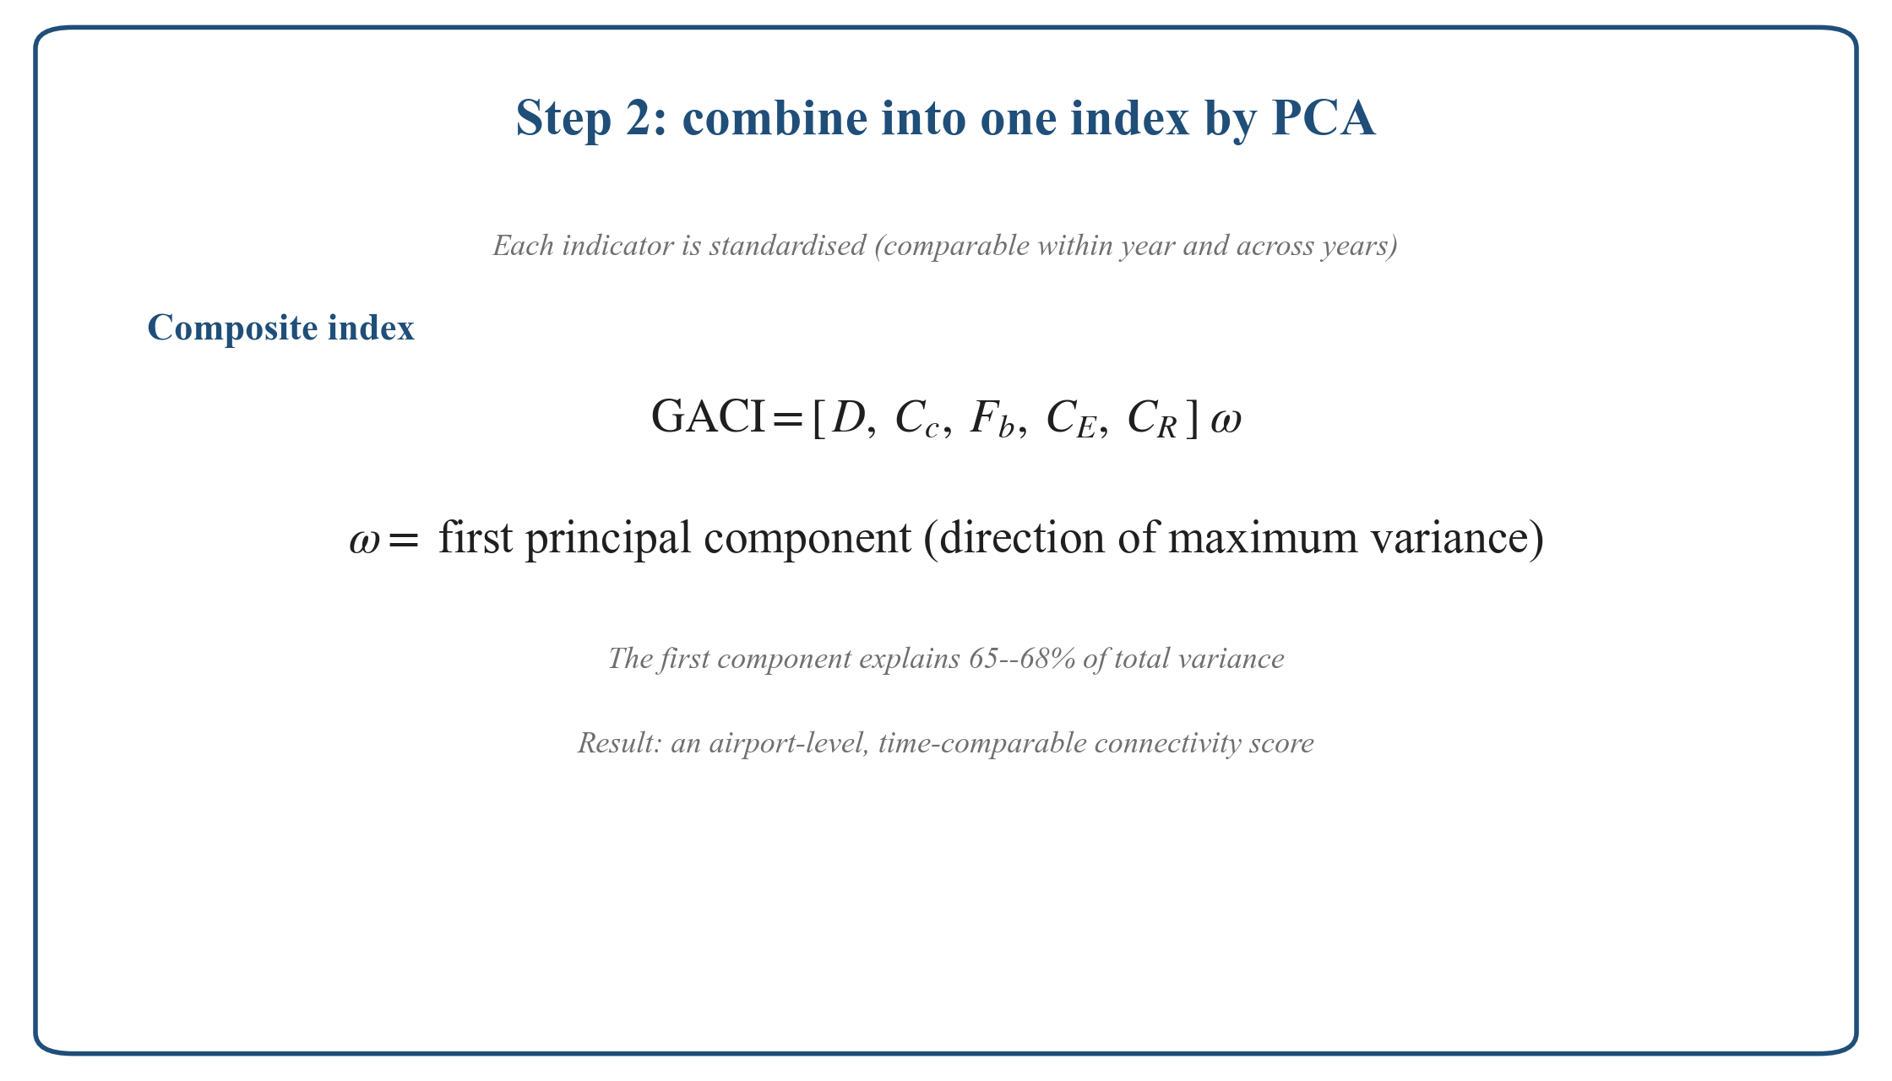
B U I L D I N G G A C I
Step 2: the aggregation formula
Global Air Connectivity and Trade, 1996–2023
21 / 43

Slide 21
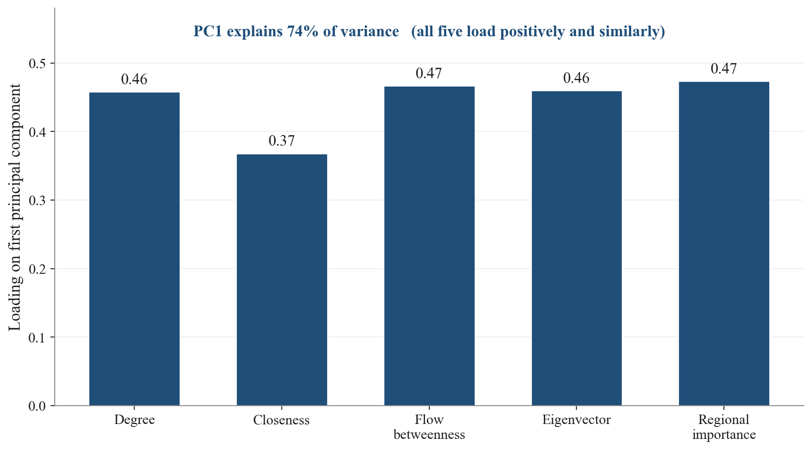
B U I L D I N G G A C I
PCA weights, computed on our panel
First-component loadings on our 1996–2023 data: all positive and similar; PC1 explains 74% of variance.
Global Air Connectivity and Trade, 1996–2023
22 / 43

Slide 22
B U I L D I N G G A C I
Making GACI comparable over time
• A naive yearly PCA would re-scale every year, so scores could not be compared across years.
• We standardise so rankings WITHIN a year and relative scores ACROSS years are both preserved.
• Result: one index that tracks an airport or country up and down the global hierarchy from 1996 to 2023.
Global Air Connectivity and Trade, 1996–2023
23 / 43

Slide 23
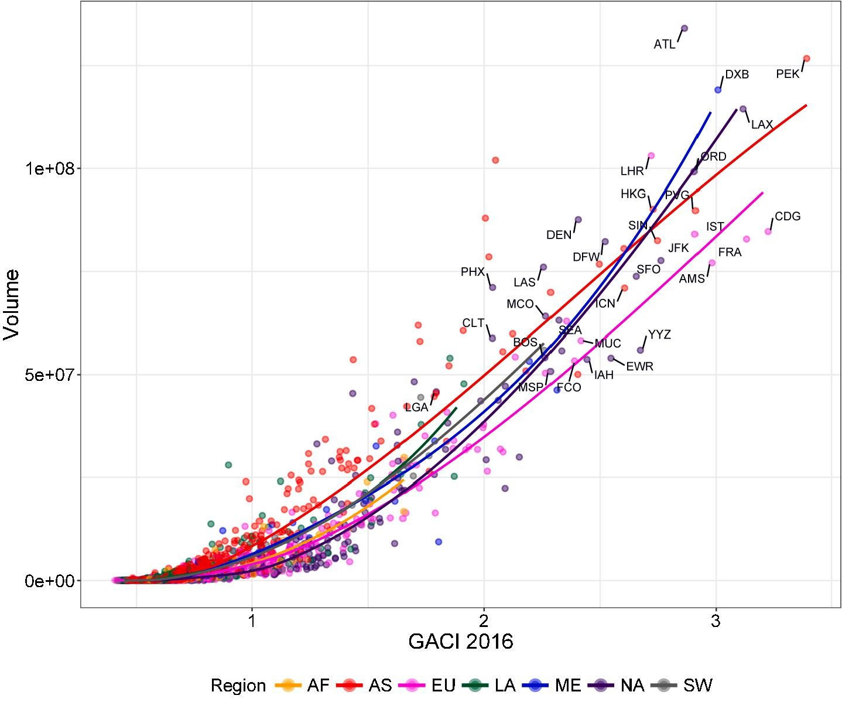
B U I L D I N G G A C I
Face validity: high GACI = the world’s major hubs
GACI tracks passenger volume; the top of the scale is ATL, PEK, DXB, LHR, HKG, SIN. Source: Cheung et al. (2020).
Global Air Connectivity and Trade, 1996–2023
24 / 43

Slide 24
B U I L D I N G G A C I
Global Air Connectivity and Trade, 1996–2023
24 / 43

Slide 25
B U I L D I N G G A C I
Step 3: from airports to countries, two ways
• Hub quality = capacity-weighted MEAN (headline): average gateway quality, not inflated by having many tiny airports.
• Total connectivity = SUM: overall network footprint, larger for big countries.
• We report both; hub quality is the headline because its first stage is stronger.
Global Air Connectivity and Trade, 1996–2023
25 / 43

Slide 26
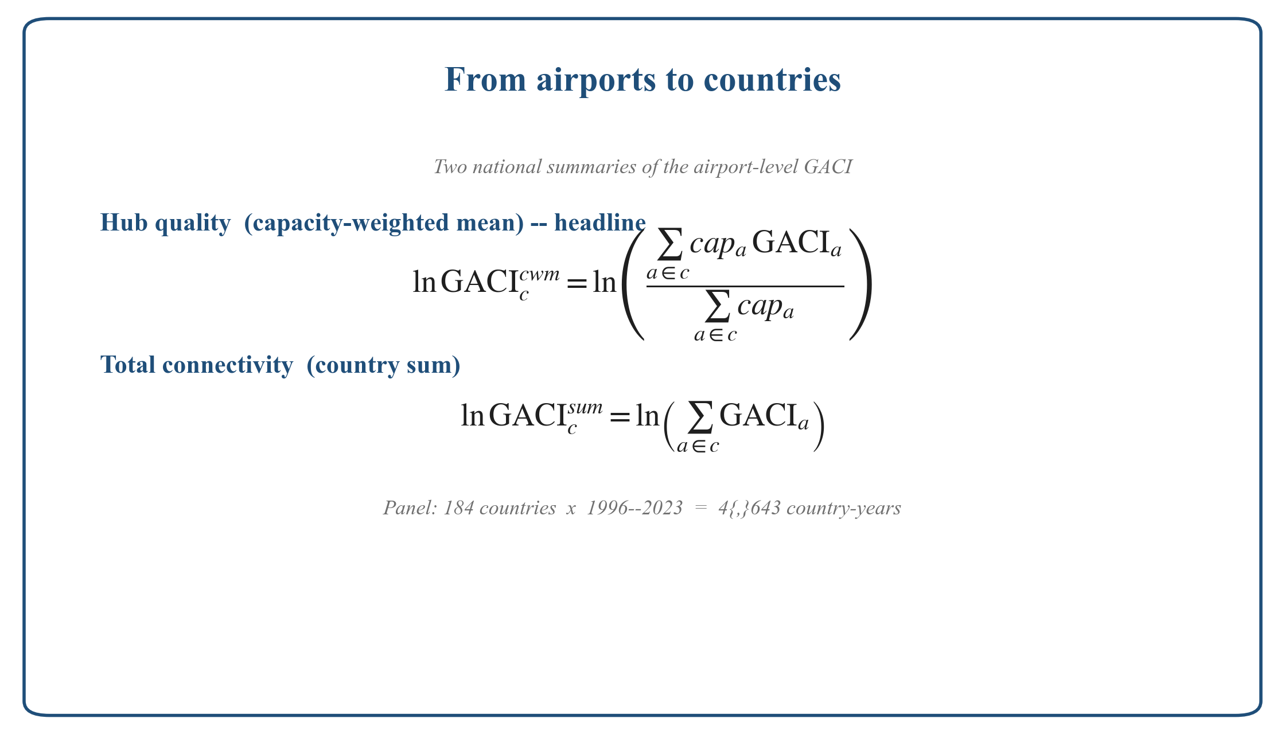
B U I L D I N G G A C I
Step 3: the aggregation formulas
Global Air Connectivity and Trade, 1996–2023
26 / 43

Slide 27
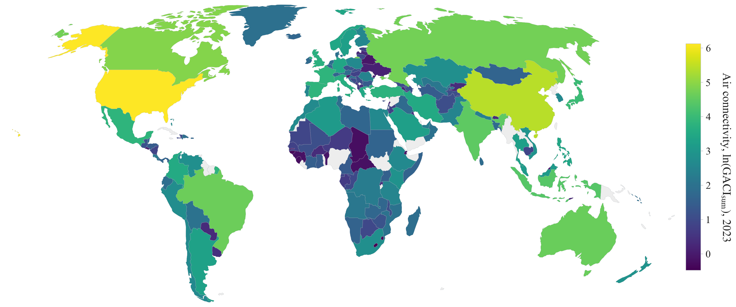
B U I L D I N G G A C I
The built index, mapped: connectivity by country, 2023
Total connectivity (country sum), 2023. Yellow = highly connected. This is the explanatory variable for Part 03.
Global Air Connectivity and Trade, 1996–2023
27 / 43

Slide 28
03
Identification
Breaking reverse causality
28 / 43

Slide 29
I D E N T I F I C A T I O N
The problem: connectivity is endogenous
• Airlines add capacity WHERE TRADE IS ALREADY GROWING (reverse causality).
• Routes open lumpily: a coarse proxy for the connectivity that actually changes.
• OLS mixes the true effect with demand-driven entry and measurement error.
We need variation in connectivity unrelated to goods-trade fundamentals.
Global Air Connectivity and Trade, 1996–2023
29 / 43

Slide 30
I D E N T I F I C A T I O N
A tourism–heritage shift-share instrument
GACI
Tourism Demand
National Heritage
Trade
Global Air Connectivity and Trade, 1996–2023
30 / 43

Slide 31
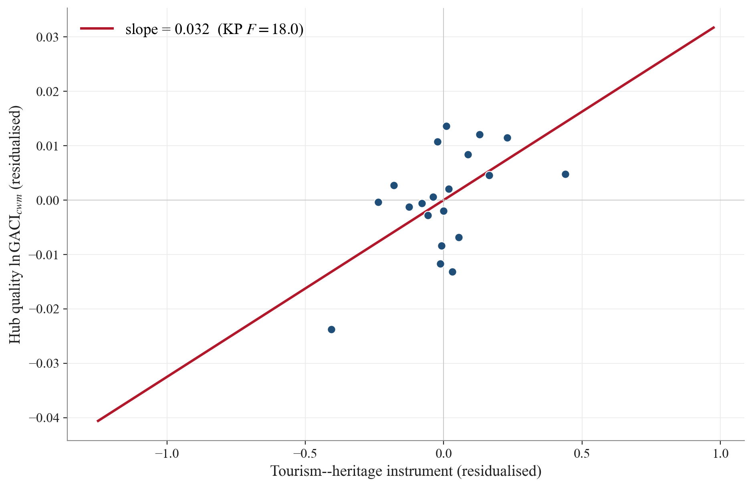
I D E N T I F I C A T I O N
First stage: the instrument strongly predicts connectivity
Binned partial-residual plot (country + year FE, population removed). Slope 0.032, Kleibergen–Paap F = 18.0.
Global Air Connectivity and Trade, 1996–2023
31 / 43

Slide 32
04
Results
Effect, who gains, and how much
32 / 43

Slide 33
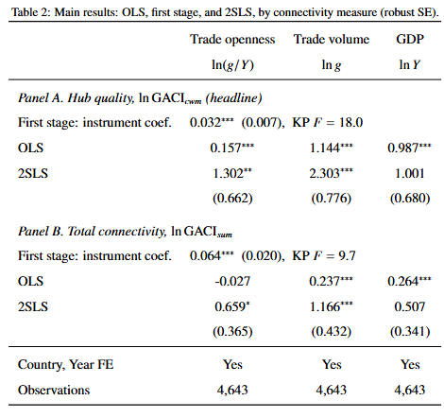
R E S U L T S
A one-percent rise in hub quality: openness +1.30%, volume +2.30%, GDP +1.00% (ns).
Global Air Connectivity and Trade, 1996–2023
33 / 43

Slide 34
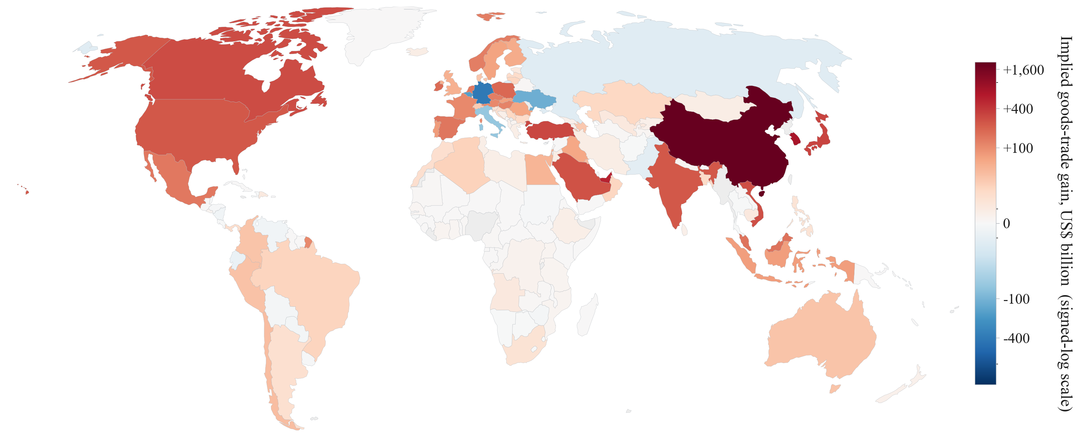
R E S U L T S
Where the gains fall: ~$7.8 trillion of 2023 trade
≈17% of world trade, 7.4% of world GDP. Concentrated in China, the Gulf, and East/Southeast Asia.
Global Air Connectivity and Trade, 1996–2023
36 / 43

Slide 35
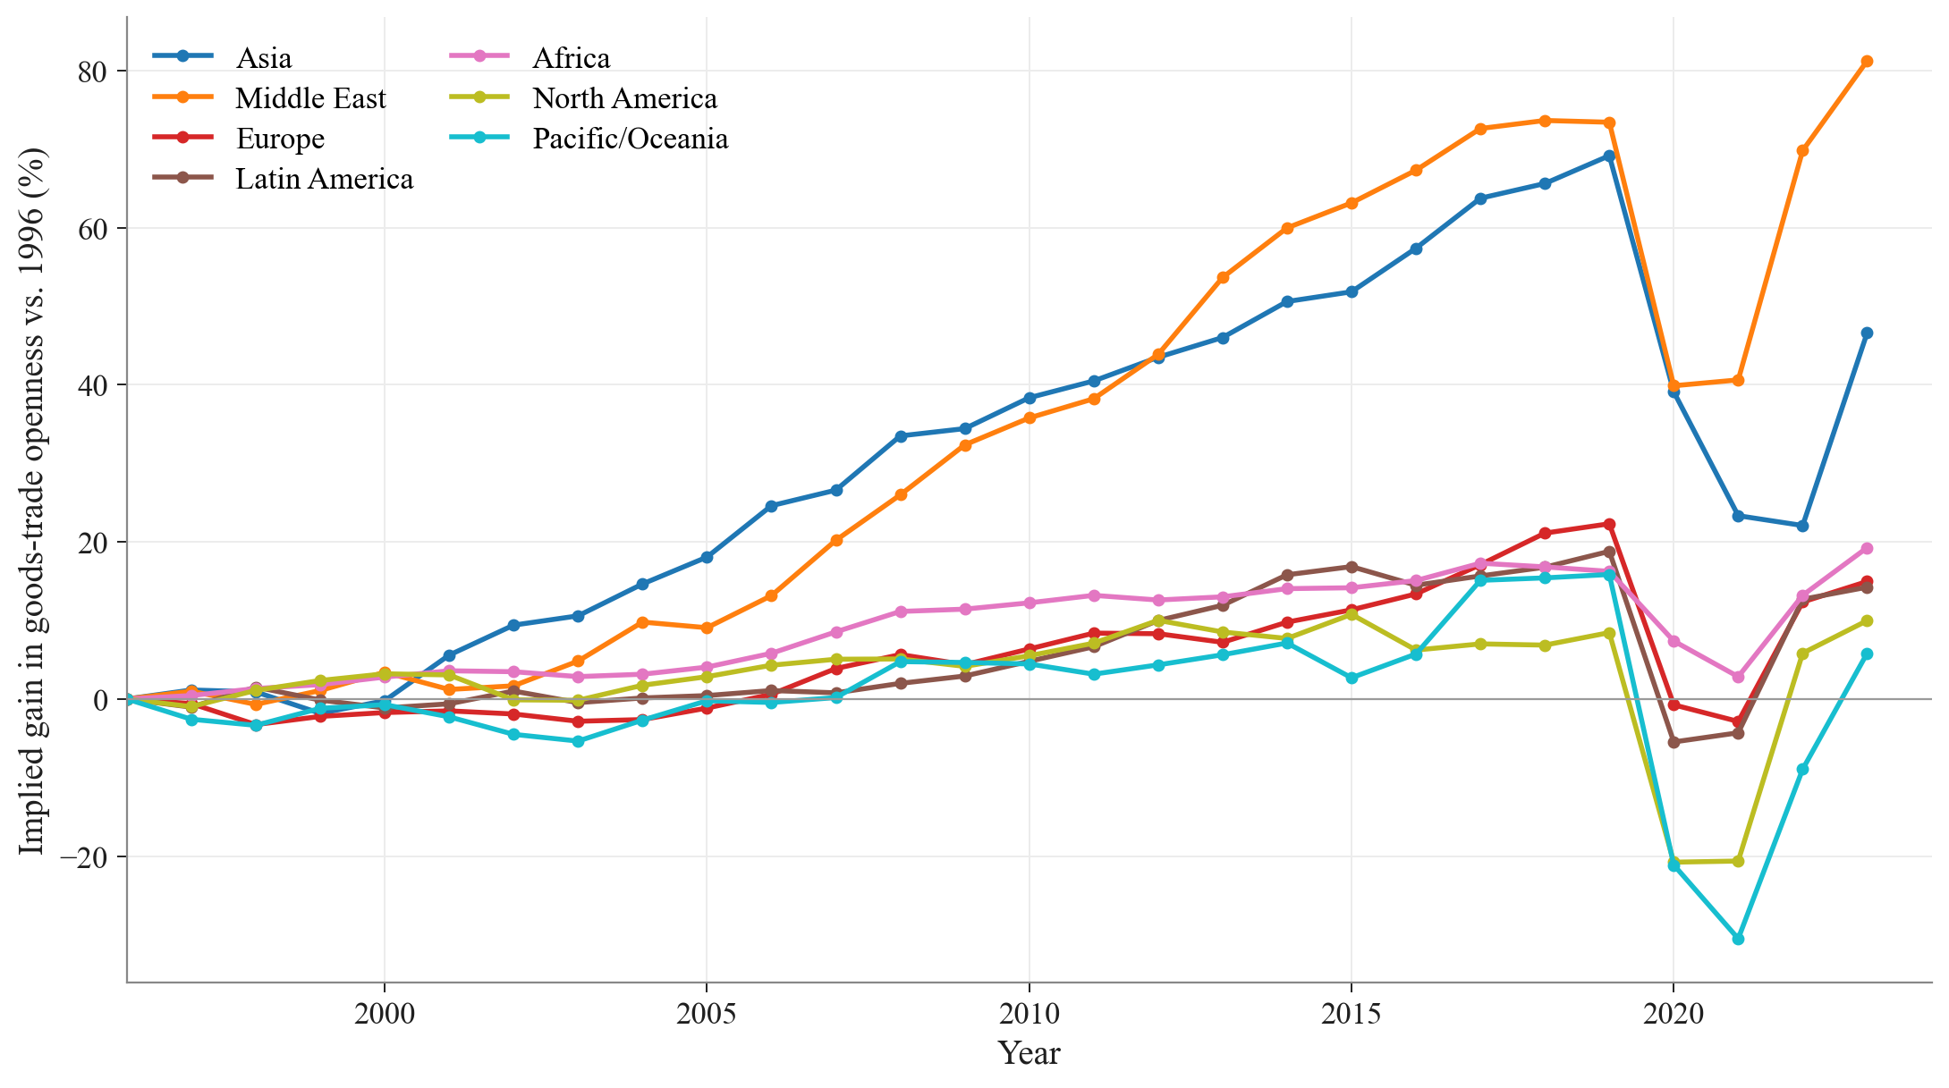
R E S U L T S
When and where: Gulf and Asia pull away after 2005
Implied gain in trade openness relative to 1996, by continent.
Global Air Connectivity and Trade, 1996–2023
37 / 43

Slide 36
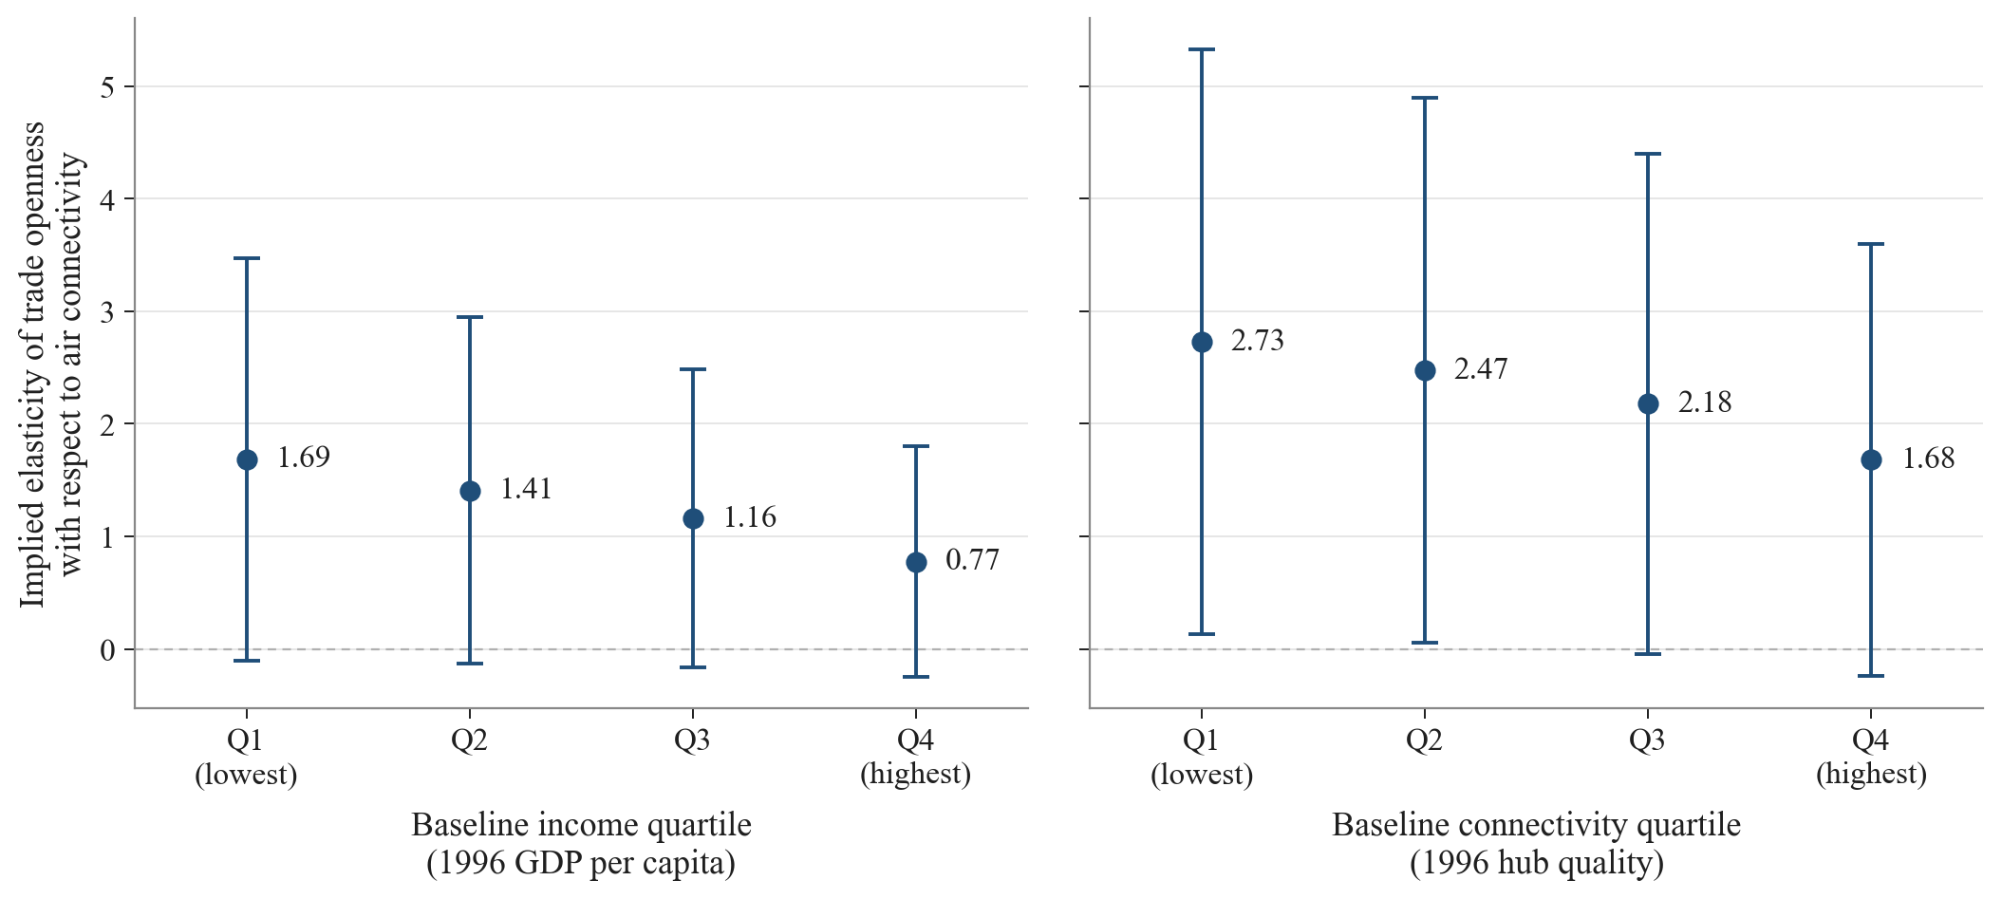
R E S U L T S
Who gains most: poorer, less-connected economies
Implied openness elasticity falls monotonically with baseline income and connectivity: aviation as a convergence lever.
Global Air Connectivity and Trade, 1996–2023
38 / 43

Slide 37
R E S U L T S
Robustness: the design survives four checks
• Over-identification — heritage as two instruments: Hansen J not rejected (p = 0.52–0.84); volume 2.18.
• Falsification — adding cultural heritage: Hansen J rejects (p = 0.004).
• Independent instrument — Frankel–Romer/Feyrer geography: volume 2.26; combined, the two agree (J p = 0.95).
• Timing — identification concentrated post-2010 (pre-2010 first stage F = 0.29).
Global Air Connectivity and Trade, 1996–2023
39 / 43

Slide 38
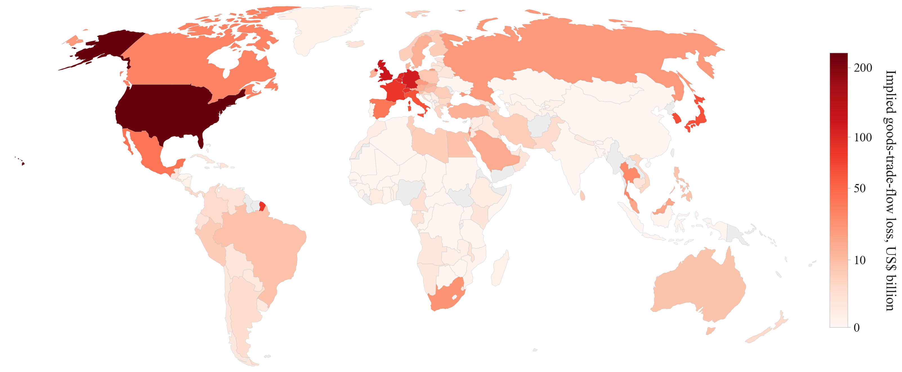
R E S U L T S
Symmetry: the COVID-19 connectivity collapse
2019→2020: connectivity fell in 140 of 177 countries; implied trade disruption ~$1.8 trillion, concentrated in major hubs.
Global Air Connectivity and Trade, 1996–2023
40 / 43

Slide 39
05
Conclusion
What we learn, and what it implies
41 / 43

Slide 40
C O N C L U S I O N
Summary and policy
• We build a 184-country, 1996–2023 panel of global aviation connectivity from the weighted world airport network (five centralities, PCA).
• Using a tourism–heritage IV, connectivity causally raises trade, mainly on the openness margin.
• Returns are largest for poorer, less-connected economies; large in aggregate (~$7.8 trillion); symmetric in collapses (COVID-19).
Airport/route investment and liberalisation: concrete trade levers, highest returns in peripheral economies.
Global Air Connectivity and Trade, 1996–2023
42 / 43

Slide 41
C O N C L U S I O N
Points to discuss
Why Trade?
How Trade? < Mechanism
Global Air Connectivity and Trade, 1996–2023
42 / 43

Slide 42
Thank you
Global Air Connectivity and Trade Openness, 1996–2023
43 / 43

