Slide 1
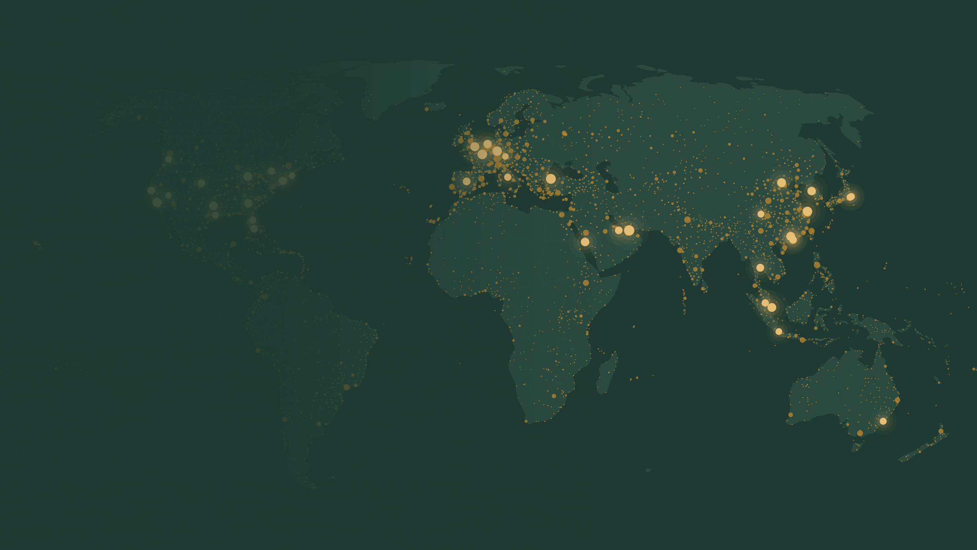
1996–2024 · 185 COUNTRIES · 3,863 AIRPORTS
Global Air Connectivity and Trade Openness, 1996–2024
Building a 29-year index of the world air network, and estimating what it does to goods trade
Sunbin YOO, Junya KUMAGAI, Longfei ZHENG, Chunan WANG, Jinwoo LEE, Anming ZHANG
Background: every airport with scheduled service in 2024, dot size proportional to its GACI score
Notes:
Thank you for the introduction. I am Sunbin Yoo from SKKU, and this is joint work with Junya Kumagai, Longfei Zheng, Chunan Wang, Jinwoo Lee and Anming Zhang.
The paper does two things. First, it builds a long panel of global air connectivity, every year from 1996 to 2024. The background map is the 2024 network: every airport with scheduled service, sized by its connectivity score. Second, it asks whether a country's position in this network causally raises its goods trade, through which goods, and for whom.

Slide 2
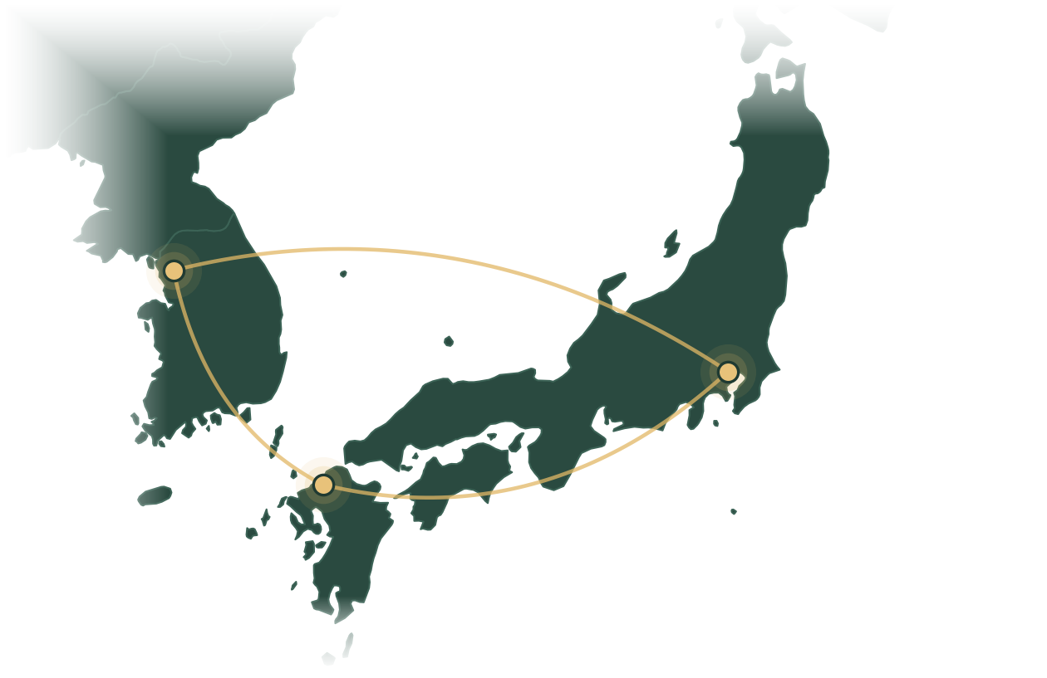
ABOUT ME
Research themes
Sunbin YOO
유선빈
Energy & environmental economics · Energy policy evaluation · Behavioral economics & choice modeling
Low-carbon transport & infrastructure · AI data centers & clean power systems
CURRENT
1
Transport infrastructure & decarbonization
today’s talk
Associate Professor, Department of Energy
Sungkyunkwan University (SKKU), Korea
Project Associate Professor (joint appointment)
Keio University, Graduate School of Media Design
HSR, expressways & energy infra revitalization
Transportation Research Part A, 2026
Sectoral decarbonization and HSR
Energy Economics, 2026
Air connectivity and aviation CO₂
Under review
2
AI data centers & power systems
PREVIOUSLY
Can renewables meet AI power demand? A systematic review
RSER, 2026
Kyushu University, Faculty of Engineering
The University of Tokyo, PhD
Yonsei University, M.A. in Economics
Clean power buildout for AI data centers (Minnesota & Korea)
Applied Energy (in prep.)
3
Energy & mobility behavior
Diesel policy abandonment and consumer behavior
Energy Economics, 2020
Seoul
SKKU · Yonsei
Drone vs truck: choice & WTP for last-mile delivery
Transportation Research Part E, 2026
Ethical dilemma of autonomous vehicles
Transportation Research Part A, 2023
4
Low-carbon cities & solar land use
Tokyo
UTokyo · Keio
Railway expansion and air pollution in Tokyo over 25 years
Sustainable Cities and Society, 2025
Fukuoka
Kyushu Univ.
How much solar can a land-constrained country fit?
RSER, under review
2
Notes:
저는 연세대에서 경제학 석사, 도쿄대에서 박사를 받고 규슈대 공학부를 거쳐 성균관대에 왔습니다. 올해 9월부터는 게이오대 미디어디자인연구과에도 공동으로 적을 두고 있습니다. 주제는 오른쪽 네 갈래이고, 오늘은 그중 가장 재미있는 결과 위주로 보여드리겠습니다. (약 30초)
[English] I did my M.A. in economics at Yonsei, my PhD at the University of Tokyo, then worked at Kyushu University's Faculty of Engineering before moving to SKKU. Since this September I also hold a joint appointment at Keio's Graduate School of Media Design. My work falls into the four themes on the right; today's paper belongs to the first one, transport infrastructure and decarbonization.

Slide 3
HOW THIS PROJECT STARTED
From railway networks to the world air network
1
RAIL
We simply wanted to graduate from railway research.
Stations along a corridor, within one country
2
We had the chance to meet Professor Anming Zhang (UBC; Co-Editor-in-Chief, Transportation Research Part A).
AIR
3
He suggested that we look at aviation.
One global network, rewired every year
3
Notes:
A word on how this project started. Most of our earlier work is on railways and market access. We simply wanted to graduate from railway research. We then had the chance to meet Professor Anming Zhang, and he suggested that we look at aviation.
Aviation turned out to be a good laboratory for the same network questions. A railway is a corridor inside one country. The air network is one global system, it is rewired every year as airlines add and drop routes, and, as 2020 showed, it can contract within months.

Slide 4
WHY AVIATION
Why aviation? One global network, rebuilt every year and recorded seat by seat
SHOCKS HIT EVERYWHERE AT ONCE
AIRPORTS COME AND GO
World scheduled seats, 2019 = 100
2,253 served in all 29 years
3,175 opened, closed or paused along the way
5,428 airports had scheduled flights in at least one year since 1996. One square is about 54 airports.
NUMBER ONE AIRPORT, EACH YEAR
Six airports have held the top spot
LAX
FRA
LAX
LAX
LAX
LAX
FRA
FRA
FRA
FRA
FRA
FRA
LAX
LAX
FRA
FRA
FRA
LAX
CDG
PEK
PEK
PEK
PEK
PEK
PEK
CAN
FRA
FRA
DXB
1996
2000
2005
2010
2015
2020
2024
Seats: all scheduled seats, summed over airports. Airports: IATA codes with scheduled service in the GACI panel, 1996 to 2024. Number one: highest airport GACI in that year.
4
Notes:
Why aviation? For an economist the air network is an unusually good laboratory, for one main reason: it is a single global network, it is rebuilt every year, and every scheduled seat is on record.
On the left are world scheduled seats, with 2019 set to 100. Seats grew steadily for two decades, then fell by 44 percent in a single year, 2020, and by 2024 were back to 98. A shock like that hits every country at the same time, and we can see it airport by airport.
On the right, airports come and go. 5,428 airports had scheduled flights in at least one year since 1996, but only 2,253 had them in every one of the 29 years.
At the bottom, the top spot changes hands. Los Angeles and Frankfurt traded first place until 2013, Beijing held it from 2015 to 2020, and in 2024 Dubai is number one. Six different airports in 29 years.
Railways and roads change slowly and inside one country. Here the whole world network moves every year. That movement is the variation we use.

Slide 5
MOTIVATION
Does a country’s place in the air network raise its goods trade?
1
2
Whether, and how
Who gains, and when
Is the effect causal?
Does it raise openness (trade relative to GDP), or only the size of the economy?
Which goods respond?
Richer or poorer, better or less connected economies?
What happens when connectivity collapses rather than grows?
Why trade? Trade is the proximate, observable margin on which connectivity acts. Income sits at the far end of a long and confounded chain.
5
Notes:
Our question is simple to state: does a country's position in the world air network raise its goods trade?
We split it in two. First, whether and how. Is the effect causal? Does connectivity raise openness, meaning trade relative to GDP, or does it only make the economy bigger? And which goods respond?
Second, who gains and when. Do richer or poorer countries, better or less connected countries, gain more? And what happens when connectivity collapses rather than grows?
We look at trade because it is the most direct measure of integration and the proximate margin on which connectivity acts. Income is at the far end of a long and confounded chain.

Slide 6
MOTIVATION
Most trade moves by sea, yet air carries about a third of its value
>80%
Our measure is built from passenger networks. They matter even for goods that later go by ship, because they move the people who make trade happen:
of world trade volume travels by sea
buyers meeting sellers
managers inspecting suppliers
engineers servicing production lines
~33%
of world trade value travels by air
Passenger connectivity lowers the cost of the transaction, whichever mode carries the cargo.
Sources: UNCTAD, Review of Maritime Transport 2021; IATA, The Value of Air Cargo.
6
Notes:
The first objection we always hear is that trade travels by sea. By weight, that is right: more than 80 percent of world trade volume moves by ship.
By value the picture is different. Roughly one third of world trade by value moves by air.
And our measure is built from passenger networks. Those matter even for goods that are later shipped by sea, because they move the people who make trade happen: buyers meeting sellers, managers inspecting suppliers, engineers servicing production lines. Passenger connectivity lowers the cost of the transaction, whichever mode then carries the cargo.

Slide 7
MOTIVATION
Three channels, each with a prediction we can test
Channel | What moves by air | Prediction | Data
Transaction costs | Buyers, sellers and managers: face-to-face contact that matches partners and builds trust | H1 Trade rises relative to GDP (openness) | WDI merchandise trade
Belly-hold cargo | Time-sensitive, high-value goods; each day in transit costs 0.6–2.1% of value | H2 Higher share of high value-to-weight goods | BACI unit values ($/kg)
Value chains | Engineers, samples and urgent components that keep production networks running | H3 More intermediate relative to consumption goods | BACI end use (BEC)
H2 and H3 concern the composition of trade, which we test with product-level data after the main results.
Time cost of transit: Hummels and Schaur (2013, AER).
7
Notes:
This gives three channels, each with a prediction we can test.
First, transaction costs. Face-to-face contact lowers the cost of finding and trusting partners, so trade should rise relative to GDP. That is hypothesis one.
Second, the belly hold. Much of air cargo flies in passenger aircraft, and for time-sensitive goods each day in transit costs roughly 0.6 to 2.1 percent of their value. So connectivity should raise the share of high value-to-weight goods. Hypothesis two.
Third, value chains. Engineers, samples and urgent components move by air, so intermediate goods should rise relative to consumption goods. Hypothesis three.
Two and three are about composition, and we test them with product-level data after the main results.

Slide 8
01
Building the index
How do we measure a country’s position in the world air network?
Notes:
Part one: how we measure connectivity.

Slide 9
01 BUILDING THE INDEX
Connectivity is a position in the network, not a count of routes
SIN
106
airports (2.7% of 3,863) carried half of all scheduled seats in 2024
A
B
DXB
FRA
A route to Incheon or Haneda is not a route to Kitakyushu. The measure has to weight capacity and the importance of partners.
Country A
Three routes to global hubs: most of the world within two legs
Country B
Three routes to small regional fields: same count, far less reach
9
Notes:
The first design point is that connectivity is not a count.
Look at these two countries. Each has three international routes. Country A connects to Dubai, Frankfurt and Singapore, and through them reaches most of the world within two legs. Country B connects to three small regional fields that lead nowhere. Same count, very different access. A route to Incheon or Haneda is not the same as a route to Kitakyushu.
The network is also extremely concentrated: in 2024 only 106 airports, 2.7 percent of the total, carried half of all scheduled seats. So the measure has to weight by capacity and by the importance of partners.

Slide 10
01 BUILDING THE INDEX
We rebuild the network every year from airline schedules
OAG SCHEDULE RECORDS
A CONNECTED (0/1)
W SEAT CAPACITY
Carrier | Origin | Country | First | Business | Economy | Freq. | Seats
US | LAX | US | 0 | 0 | 175 | 1 | 175
CN | CTU | CN | 0 | 30 | 271 | 1 | 301
IN | FRA | DE | 0 | 24 | 144 | 1 | 168
QA | CKY | GN | 0 | 12 | 147 | 1 | 159
GB | MIA | US | 0 | 20 | 214 | 1 | 234
US | HND | JP | 5 | 42 | 205 | 1 | 252
 | ATL | LHR | DXB | HKG | SPK
ATL | – | 1 | 1 | 1 | 1
LHR | 1 | – | 1 | 1 | 0
DXB | 1 | 1 | – | 1 | 0
HKG | 1 | 1 | 1 | – | 0
SPK | 1 | 0 | 0 | 0 | –
 | ATL | LHR | DXB | HKG | SPK
ATL | – | 9.0 | 5.0 | 4.0 | 0.3
LHR | 9.0 | – | 6.0 | 5.0 | 0
DXB | 5.0 | 6.0 | – | 7.0 | 0
HKG | 4.0 | 5.0 | 7.0 | – | 0
SPK | 0.3 | 0 | 0 | 0 | –
w_{ij} = √( s_{i} s_{j} / d_{i} d_{j} )
One row per scheduled flight segment: carrier, airports, seats by cabin, frequency
Link intensity: seat capacity per connection at both ends (s = seats, d = degree)
29 annual networks, 1996–2024 3,171 to 3,863 active airports per year scheduled commercial service links weighted by annual seats
10
Notes:
We rebuild the network from airline schedules, OAG route-segment data, every year from 1996 to 2024.
Each row is one scheduled flight segment, with its carrier, airports, seats by cabin and frequency. We aggregate segments into airport pairs and form two matrices for every year: A records which airports are connected, and W how much seat capacity links them. From these we build a link intensity, the geometric mean of capacity per connection at the two ends.
Across the 29 years the network has between 3,171 and 3,863 active airports. Airports enter and leave as service starts and stops, so the network is genuinely rebuilt every year.

Slide 11
01 BUILDING THE INDEX
Five indicators describe each airport’s position and flow
 | Indicator | What it measures | HND | FUK
Position | Degree | Number of direct connections | 3 | 1
 | Closeness | 1 ÷ average legs to every other airport | 1.00 | 0.60
 | Eigenvector | Links to airports that are themselves central | high | low
Flow | Flow betweenness | Share of passenger flow routed through the airport (flow as electrical current) | high | 0
 | Regional importance | Mean intensity of links within the airport’s own region
ATL
NRT
HND
FUK
Toy network: Fukuoka reaches Atlanta only through Haneda
Indicator definitions follow Cheung, Wong and Zhang (2020, Transportation Research Part E).
11
Notes:
On each annual network we compute five centrality indicators, following Cheung, Wong and Zhang in Transportation Research Part E.
Take this toy network. Haneda links to every other airport directly: degree three, closeness one. Fukuoka reaches Atlanta only through Haneda, two legs, so its closeness is 0.60. Eigenvector centrality rewards links to airports that are themselves central.
Those three describe position. The other two describe flow. Flow betweenness treats passengers like current in an electrical circuit and measures how much of it passes through the airport: the transfer-hub role. In the toy network nothing routes through Fukuoka, so it is zero. Regional importance is the average intensity of the airport's links within its own region.

Slide 12
01 BUILDING THE INDEX
One index: the first principal component, stable over 29 years
GACI_{it} = [ d̃ f̃ c̃ ẽ r̃ ]_{it} · α_{t}
αₜ = first principal component, re-estimated every year
63–77%
of variance explained by PC1, year by year (74% pooled)
≤ 0.03
year-to-year SD of each loading; all loadings positive
0.74–0.92
rank correlations among the five indicators in 2024: related, not redundant
0.98
correlation with an index from a single pooled PCA
Mean PC1 loading across the 29 annual networks; whiskers show ±1 SD across years
12
Notes:
The five indicators are correlated, with rank correlations between 0.74 and 0.92 in 2024, but they are not redundant. We combine them by principal components, re-estimated every year.
The first component explains between 63 and 77 percent of the variance, depending on the year. The loadings are all positive and almost the same size: about 0.49 for degree, 0.48 for regional importance, 0.43 for flow betweenness and eigenvector, and 0.39 for closeness. They barely move over 29 years; the whiskers are one standard deviation across years.
Why re-estimate every year rather than once? Because the network itself changes: airports enter and exit and the scale of the indicators shifts. Re-estimating keeps the weights right for each year's network, and because the weights barely move, nothing is lost in comparability.
So GACI is close to an equal-weighted summary of the five indicators, and a single pooled PCA gives almost the same index, correlation 0.98. That is what makes the index comparable over time.

Slide 13
01 BUILDING THE INDEX
From airports to countries: hub quality is the headline measure
Hub quality (headline)
ILLUSTRATION
GACI_{cwm,c} = Σ_{i∈c} s_{i} GACI_{i} / Σ_{i∈c} s_{i}
Airport | Seats | GACI
Main hub | 80 | 3.0
Second airport | 15 | 1.5
Regional field | 5 | 0.6
Hub quality |  | 2.66
Sum |  | 5.10
Capacity-weighted mean: uses every airport, weights by seats
Maximum hub
GACI_{max,c} = max_{i∈c} GACI_{i}
Quality of the single best gateway
Add ten small airfields (GACI 0.55, one seat unit in total): the sum jumps from 5.10 to 10.60, while hub quality moves from 2.66 to 2.63.
Total connectivity
GACI_{sum,c} = Σ_{i∈c} GACI_{i}
Network footprint; grows with the number of airports
All three measures give the same pattern of signs and significance; results below use hub quality unless stated.
13
Notes:
We then move from airports to countries, in three ways.
Our headline is hub quality: the capacity-weighted mean of airport GACI. It uses the entire airport system but puts most weight on the airports that carry the seats.
We also use the maximum, the quality of the single best gateway, and the sum, the total network footprint.
The illustration on the right shows why hub quality is the headline. Adding ten small airfields doubles the sum, but hardly changes hub quality. We do not want to reward a country for opening many tiny airfields.
All three measures give the same pattern of results, so I will show hub quality and mention the others as robustness.

Slide 14
01 BUILDING THE INDEX
The index tracks the rise of Gulf, Turkish and East Asian hubs
Rank
1
DXB
FROM 1996 TO 2024
IST
Dubai | 92 → 1
Istanbul | 98 → 2
Guangzhou | 155 → 10
Beijing | 47 → 9
CDG
5
FRA
PVG
LAX
ORD
LHR
10
PEK
CAN
SIN
DFW
ATL
TOP COUNTRIES, 2024
15
AMS
ICN
1 | Singapore
2 | UAE
3 | Netherlands
4 | Qatar
5 | Hong Kong
6 | Germany
20
50
100
150
Country rank: hub quality
Gold: airports outside the top 20 in 1996. Ranks beyond 20 are compressed below the dashed line.
14
Notes:
Here is what the index shows. These are the rank paths of the fifteen highest-ranked airports of 2024; the gold lines are airports that were outside the top twenty in 1996.
Dubai goes from 92nd to first, Istanbul from 98th to second, Guangzhou from 155th to tenth, and Shanghai Pudong, Beijing, Singapore and Incheon climb into the top fifteen. The large American and European hubs drift down.
At the country level, Singapore, the UAE, the Netherlands, Qatar and Hong Kong lead on hub quality in 2024.
This is also a face-validity check: the index reproduces what anyone in the industry would recognise, the rise of the Gulf carriers, Istanbul and the Chinese hubs.
Notice that most of this reshuffling happens after 2010. That timing will matter for identification.

Slide 15
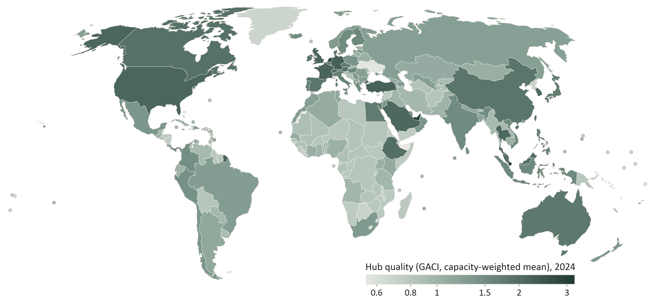
01 BUILDING THE INDEX
In 2024 the best-connected hubs sit in Singapore, the Gulf and Western Europe
Hub quality computed from all 2024 airports (212 economies). The regressions use within-country change over time; levels are shown for orientation.
15
Notes:
This is hub quality in 2024, computed from every airport with scheduled service. The darkest shades are the Gulf states, Western European gateway countries, Turkey and the East and Southeast Asian hubs. Most of Africa and Central Asia is light.
Levels differ a lot across countries, but our design does not use these differences. With country fixed effects, identification comes from changes within a country over time.

Slide 16
01 BUILDING THE INDEX
Northeast Asia’s hub race: Chinese hubs rose to the top, Incheon and Haneda climbed
World rank
1
WORLD RANK BY AIRPORT GACI
2
Airport | 1996 | Best | 2024
Shanghai Pudong | n.a. | 3 | 5
Beijing Capital | 47 | 1 | 9
Guangzhou | 155 | 1 | 10
Incheon | n.a. | 15 | 15
Hong Kong | 28 | 11 | 24
Tokyo Haneda | 151 | 29 | 31
Tokyo Narita | 40 | 21 | 33
Taipei Taoyuan | 80 | 39 | 54
Osaka Kansai | 41 | 35 | 88
5
Pudong
10
Beijing
Guangzhou
20
Incheon
Hong Kong
Haneda
50
Incheon opens
Narita
Taipei
100
Kansai
200
2020: Beijing, Guangzhou and Shanghai Pudong ranked 1st, 2nd and 3rd in the world.
Rank among all airports with scheduled service (3,171 to 3,863 a year), log scale. n.a.: not yet open in 1996 (Pudong opened in 1999, Incheon in 2001).
16
Notes:
A closer look at our own neighbourhood. These are the world ranks of nine Northeast Asian airports, out of roughly 3,800 airports, on a log scale.
The Chinese hubs rose fastest. Guangzhou was 155th in 1996 and Beijing 47th. Beijing was number one in the world from 2015 to 2020. In 2020 Beijing, Guangzhou and Shanghai Pudong were first, second and third, as China's large domestic network restarted early while most international routes were shut.
Incheon entered at 42nd when it opened in 2001 and is 15th in 2024. Haneda climbed from 151st to 31st, most of it after it reopened to regular international flights around 2010. Narita and Kansai moved the other way; Kansai fell from 41st to 88th.
Keep Korea in mind. It comes back on the next slide, and again in the results.

Slide 17
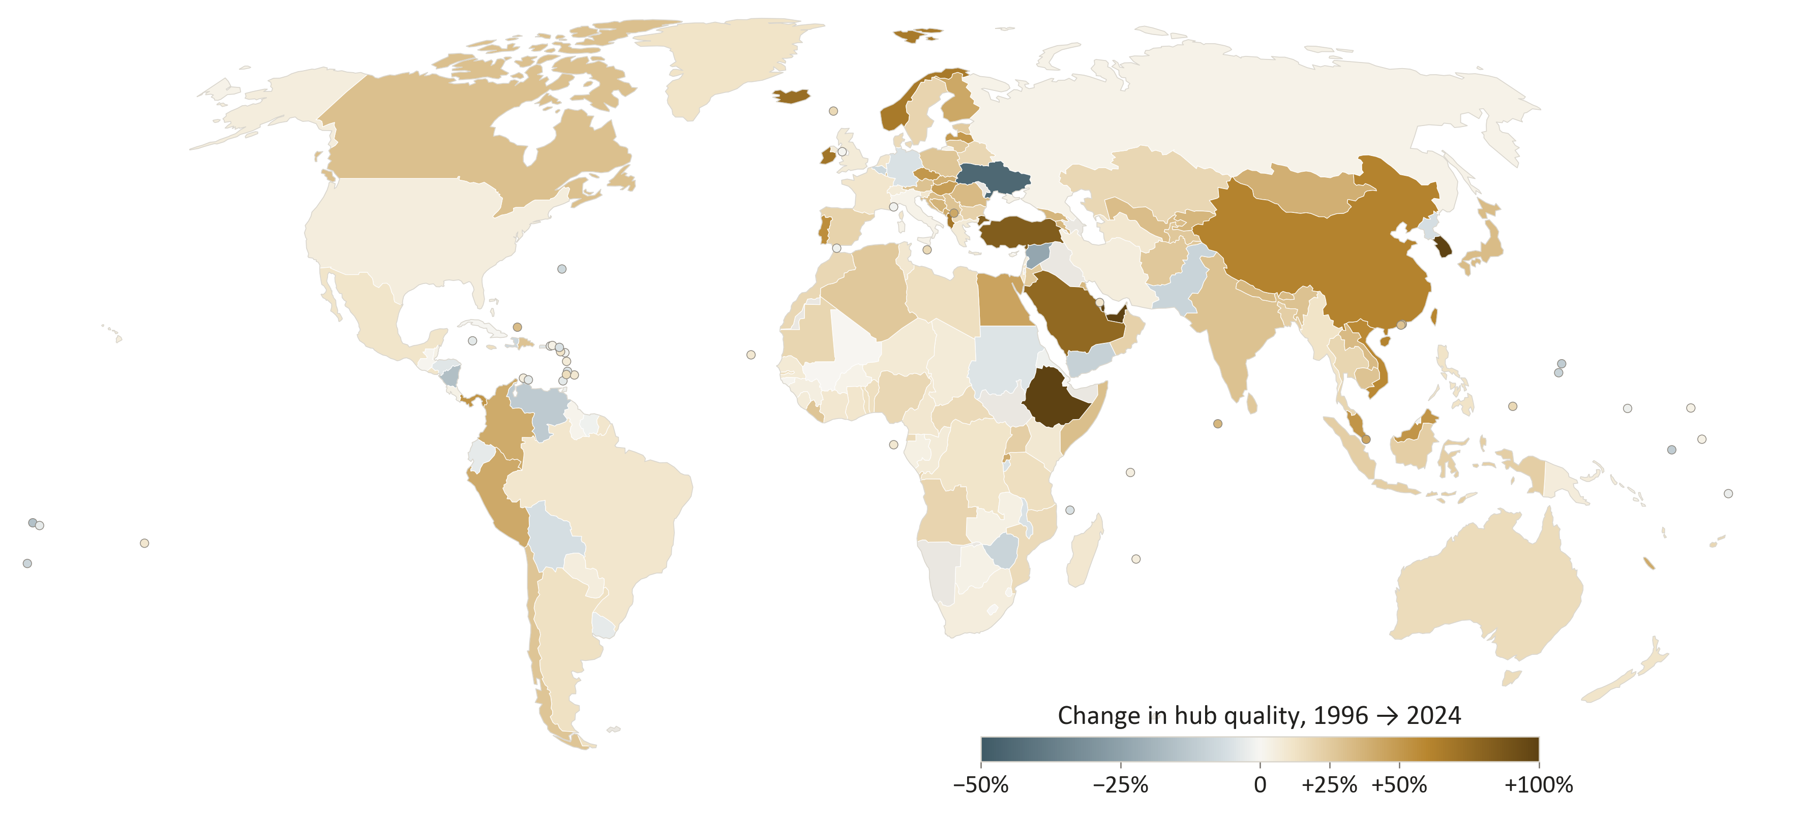
01 BUILDING THE INDEX
Hub quality rose in three of every four economies; Qatar, South Korea and the UAE gained most
LARGEST GAINS, 1996 TO 2024
Economy | Change | Rank
Qatar | +159% | 54 → 4
South Korea | +139% | 108 → 12
UAE | +121% | 21 → 2
Ethiopia | +107% | 86 → 15
Türkiye | +84% | 30 → 7
Saudi Arabia | +77% | 33 → 13
SOUTH KOREA’S RANK
1
50
2001: Incheon opens, 106th → 42nd
100
Hub quality: capacity-weighted mean GACI over each economy’s airports. Ranks among all economies with scheduled service (229 in 1996, 233 in 2024). Largest falls: Ukraine −45%, Syria −23%.
17
Notes:
The same index at the country level. The map shows how hub quality changed between 1996 and 2024. It rose in three of every four economies, and the darkest areas are the Gulf, Ethiopia, Türkiye and South Korea.
The largest gains are Qatar, up 159 percent, South Korea, up 139 percent, and the UAE, up 121 percent. Ethiopia, Türkiye and Saudi Arabia follow.
South Korea also climbed further in rank than any other economy, from 108th to 12th. Much of that happened in a single year: in 2001, when Incheon opened, Korea went from 106th to 42nd. It dipped during the pandemic and was back to 12th by 2024.
Falls are few. The largest are Ukraine and Syria.
Remember Korea: in the results it has the second-largest trade gain from better connectivity, after China.

Slide 18
02
Identification
Airlines follow trade. How do we isolate connectivity that trade did not cause?
Notes:
Part two: identification.

Slide 19
02 IDENTIFICATION
Airlines add capacity where trade is already growing
Common shocks (booms, crises)
OLS mixes the effect of connectivity with demand-driven route entry and with shocks that move both.
A difference-in-differences design does not fit either: large airport openings are rare and lumpy, while network position changes every year.
We need variation in connectivity that goods-trade fundamentals did not create.
effect we want
Air connectivity (GACI)
Goods trade
route entry follows demand
× no direct path (exclusion)
Heritage × world tourism (instrument)
19
Notes:
Why not simply regress trade on connectivity? Because airlines add capacity where trade and income are already growing, and both respond to common shocks such as a commodity boom or a financial crisis. OLS mixes the effect we want with demand-driven route entry.
A difference-in-differences design does not fit either. Large airport openings are rare and lumpy, while a country's network position changes every year through frequencies, partners and re-routing.
So we need variation in connectivity that goods-trade fundamentals did not create. That is the gold box: an instrument that moves connectivity, with no direct path to goods trade.

Slide 20
02 IDENTIFICATION
The instrument: natural heritage × the global tourism cycle
Z_{ct} = D̃_{t} × ln(1 + H_{c}^{nat+mix})
Share: natural and mixed UNESCO World Heritage sites (reefs, mountain ranges, national parks). The median country holds one; the richest, nineteen.
Shift: world tourist arrivals (WDI to 2019, UNWTO for 2020–2024).
Why it moves routes: airlines place marginal capacity where leisure demand rises most.
Comparisons: each country is compared with itself over time, so its fixed heritage stock and the world cycle cancel out; only their combination is used.
global tourism shift
fixed heritage share
D̃ₜ: world international arrivals, scaled to [0, 1]
Related designs: Arezki et al. (2009) use World Heritage listings for tourism; Faber and Gaubert (2019) use coastal attractiveness.
20
Notes:
Our instrument is a shift-share design.
The share is each country's stock of natural and mixed UNESCO World Heritage sites: reefs, mountain ranges, national parks. These are endowments of geography rather than of economic activity. The median country has one; the richest has nineteen.
The shift is the global cycle in international tourist arrivals, scaled between zero and one. You can see the long rise and the collapse in 2020.
The logic is airline route allocation. When world tourism grows, airlines put marginal aircraft where leisure demand grows most, which is in heritage-rich destinations. Country fixed effects absorb the endowment, year fixed effects absorb the cycle, so only their interaction identifies the effect.
Why natural and mixed sites, and not all heritage? Cultural sites tend to sit in old urban and manufacturing centres, which could affect trade directly. I will come back to this in two slides, because the data themselves reject cultural sites as an instrument.

Slide 21
02 IDENTIFICATION
Strength test passed: heritage-rich countries gained connections as world tourism grew
Effect of instrument on hub quality | 0.034***
 | (0.007)
Strength test F (rule of thumb: above 10) | 21.9
Country-years | 4,814
Strength before 2010 | 0.3
Strength from 2010 | 31.6
The instrument only has bite from 2010 onward, when low-cost long-haul flights and Gulf and Asian hubs took off. Our answers describe this recent era.
Each dot averages about 240 country-years. Country and year effects and population are removed.
21
Notes:
Does the instrument actually move connectivity? Yes. Each dot groups about 240 country-years. Where the heritage-times-tourism signal rises, hub quality rises too.
The usual strength test gives 21.9, well above the rule-of-thumb threshold of 10.
One caveat, stated openly. The instrument has almost no bite before 2010, and a lot from 2010 onward. That is when low-cost long-haul flights and the Gulf and Asian hubs took off. So our answers describe the recent era of aviation, and I come back to this at the end.

Slide 22
02 IDENTIFICATION
Why tourism should affect goods trade only through air links
1
We only count goods trade
What could still go wrong?
A tourism boom can strengthen the currency and hurt exports. That would make our estimate smaller.
Tourism raises income, and income raises imports. Holding GDP fixed, the estimate stays at 1.34–1.54.
No test can prove the assumption. These checks make a violation hard to explain.
Tourist spending is counted as a services export, so it never enters our outcome.
2
We only use natural and mixed sites
Cultural sites sit in old cities and could affect trade directly. When we try them, the data reject them (p = 0.008).
3
We compare each country with itself over time
Country effects absorb how much heritage a country has; year effects absorb the world tourism cycle.
22
Notes:
The key assumption is that heritage tourism affects goods trade only through air links. Three choices make this plausible.
First, we only count goods trade. Tourist spending is counted as a services export, so it never enters our outcome.
Second, we only use natural and mixed sites. Cultural sites sit in old cities and could affect trade directly. When we try them anyway, the data reject them.
Third, we compare each country with itself over time, so the amount of heritage a country has, and the world tourism cycle, both cancel out.
What could still go wrong? A tourism boom can strengthen the currency and hurt exports, but that would make our estimate smaller. Tourism raises income and income raises imports, but holding GDP fixed the estimate hardly moves. No test can prove the assumption; these checks make a violation hard to explain.

Slide 23
03
Results
How much does connectivity move trade, through which goods, and for whom?
Notes:
Part three: results.

Slide 24
03 RESULTS
10% better air links raise trade relative to GDP by about 12%
 | Trade ÷ GDP | Total trade | GDP
 | (openness) | (volume) | (size)
Simple correlation (OLS) | 0.167*** | 1.141*** | 0.975***
Causal estimate (IV) | 1.208** | 2.126*** | 0.919
 | (0.593) | (0.703) | (0.624)
10% better connections | +12% | +22% | +9%, not sig.
Other measures (IV)
Best airport only | 0.897** | 1.580*** | 0.683
All airports summed | 0.635* | 1.119*** | 0.483
TWO PARTS OF THE TOTAL EFFECT
= Total trade 2.13
The headline is the first part: better-connected countries trade more for their size.
The GDP part is positive but not statistically clear.
Numbers are elasticities: the % change in each outcome for a 1% rise in hub quality (the seat-weighted connectivity of a country’s airports). Robust SE in parentheses; * p<0.10, ** p<0.05, *** p<0.01. N = 4,814; strength test F = 21.9.
24
Notes:
Here is the main result. The first row is the simple correlation. The second row is our causal estimate, using the instrument.
The easiest way to read it: if a country's air connections improve by 10 percent, its trade relative to GDP rises by about 12 percent, and its total trade by about 22 percent.
The bar on the right splits the total into two parts: the country becomes more open, and the economy becomes bigger. The bigger-economy part is positive, but not statistically clear. So our headline is the first part: better-connected countries trade more for their size.
The last two rows measure connectivity in other ways, using only the best airport, or summing all airports. The numbers are on different scales, but the story is the same: positive and significant.

Slide 25
03 RESULTS
The answer holds when we change the controls or the instrument
EFFECT ON TRADE ÷ GDP, WITH DIFFERENT CONTROLS
CHECKS ON THE INSTRUMENT (OUTCOME: TOTAL TRADE)
Check | What we find
Split heritage into natural and mixed sites | Same answer (1.90); the two agree (p = 0.73)
Add cultural heritage, which should fail | Fails, as expected (p = 0.008)
A completely different instrument: air vs sea distance | Same answer (2.30); both together 2.26
Let the instrument affect trade directly a little | Holds unless that direct effect is over a third (36%) of its total effect; trade ÷ GDP: 4%
Whiskers: 95% confidence intervals. Adding GDP is a tough test, since GDP itself responds to connectivity.
25
Notes:
Is this result fragile? We tried two kinds of checks.
On the left, we change what else we control for. The effect on trade relative to GDP stays between 1.21 and 1.54 every time. Adding GDP is a tough test, because GDP itself responds to connectivity.
On the right, we check the instrument. Splitting heritage into natural and mixed sites gives the same answer. Cultural heritage, which we expect to fail, does fail, which tells us the test has teeth. A completely different instrument, built from geography, air versus sea distance, gives almost the same number: 2.30, against our 2.13 for total trade.
Finally, if we allow the instrument to affect trade directly a little, the total-trade result survives unless that direct effect is more than a third of its total effect. For trade relative to GDP the margin is thinner, about 4 percent.

Slide 26
03 RESULTS · MECHANISM
What changes: better-connected countries trade more parts and more high-value goods
LOOKING INSIDE TRADE: PRODUCT-LEVEL DATA (BACI)
About 5,000 products, about 200 countries, exports plus imports
Parts ratio: intermediate inputs ÷ final consumer goods
Value ratio: high-value ÷ low-value goods, by dollars per kilogram
Ratios cancel out anything that moves all of a country’s trade together
10% better connections: parts ratio +15%, value ratio +19%
IV estimates with 95% CI; N = 4,785; strength test F = 22.1
26
Notes:
So how does connectivity raise trade? We look inside trade using product-level data: about 5,000 products for about 200 countries.
We build two simple ratios. The parts ratio: intermediate inputs relative to final consumer goods. The value ratio: high-value relative to low-value goods, measured in dollars per kilogram. These are the goods that tend to fly. Because they are ratios, anything that moves all of a country's trade up or down together cancels out.
Both ratios rise with connectivity. With 10 percent better connections, the parts ratio rises by about 15 percent and the value ratio by about 19 percent. In other words, better-connected countries trade more of the goods that fly.

Slide 27
03 RESULTS · MECHANISM
Accounting for the goods mix shrinks the effect by about 30%
EFFECT OF CONNECTIVITY ON TRADE ÷ GDP, 95% CI
Same countries and years in every bar (4,785), so the drop comes from the added ratios.
With both ratios, the effect falls from 1.18 to 0.83 and is no longer statistically clear.
In plain words: the trade gain comes with, and runs through, a shift toward goods that fly.
The mix is itself an outcome, so this supports the channel without proving it.
27
Notes:
Next: does this change in the mix explain the trade gain? We run the main regression again and add the two ratios, keeping exactly the same countries and years.
The connectivity effect drops from 1.18 to 0.83, about 30 percent smaller, and it is no longer statistically clear. Meanwhile the mix of goods itself strongly predicts how open a country is.
If connectivity simply made all trade a bit cheaper, the mix would not change, and adding the ratios would change nothing. That is not what we see. The trade gain comes with, and runs through, a shift toward goods that fly.
One caution: the mix is itself an outcome, so this supports the channel but does not prove it.

Slide 28
03 RESULTS
Poorer and less-connected countries gain the most
BY INCOME IN 1996
BY AIR CONNECTIVITY IN 1996
10% better connections: +16% trade ÷ GDP for the poorest quarter, +7% for the richest
10% better connections: +26% for the least connected quarter, +15% for the best connected
Effect of hub quality on trade ÷ GDP by quarter of countries, 95% CI. These estimates are less precise (strength test F ≈ 6–10), so the slope matters more than each number. A simpler check without this weakness shows the same slope.
28
Notes:
Who gains most? We split countries by how rich and how well connected they were in 1996.
The pattern is the same in both panels: the gain shrinks as we move to richer and better-connected countries. With 10 percent better connections, trade relative to GDP rises about 16 percent in the poorest quarter of countries, and about 7 percent in the richest. By connectivity, it is about 26 percent for the least connected quarter and 15 percent for the best connected.
These estimates are less precise, so the downward slope matters more than each number. A simpler check that avoids this weakness shows the same slope.
The message: an extra air link is worth most where links are scarce.

Slide 29
03 RESULTS · MAGNITUDES
Better air links since 1996 add about $10 trillion to 2024 trade
EXTRA TRADE ÷ GDP FROM CONNECTIVITY GAINS SINCE 1996 (%)
Extra 2024 goods trade | $10.0 tn
Share of world goods trade | 21%
Share of world GDP | 9.2%
Plausible range (95% CI) | $0.5–15.9 tn
Using the other two measures | $8.0–10.0 tn
A rough figure: it holds other countries and prices fixed, and applies an effect measured after 2010 back to 1996.
Each country: 2024 trade × the share implied by its own connectivity gain since 1996 (elasticity 1.21).
29
Notes:
How much does this add up to? For each country we take its own improvement in connectivity since 1996 and ask how much of its 2024 trade that improvement accounts for, keeping everything else fixed.
Added up, it comes to about 10 trillion dollars: about a fifth of world goods trade, or about 9 percent of world GDP.
Please treat this as a rough number. The plausible range is wide, from half a trillion to 16 trillion. It holds other countries and prices fixed. And it applies an effect we measure after 2010 back to 1996.
The chart on the left shows where the gains go: mostly to Asia and the Middle East, which pull away from the rest after 2005.

Slide 30
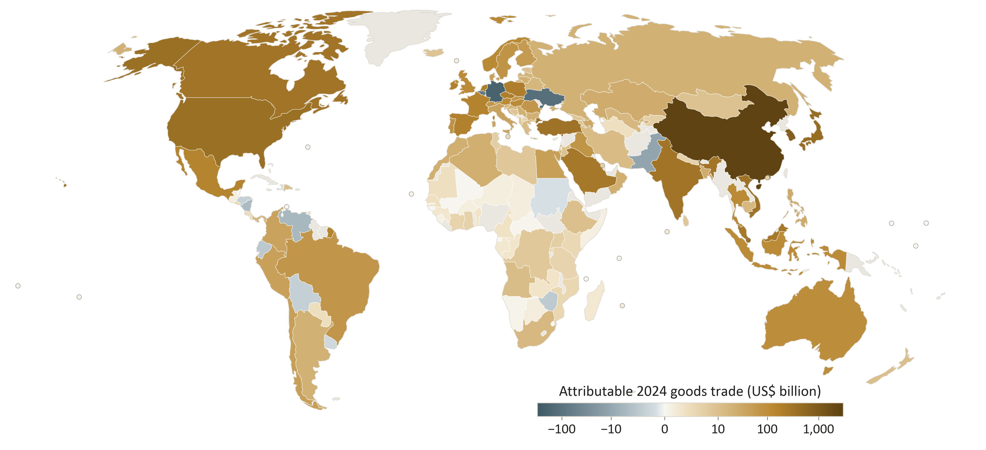
03 RESULTS · MAGNITUDES
China gains most, then Korea and Japan; 18 countries lost ground
EXTRA 2024 TRADE, US$ BILLION
Biggest losses, where connectivity fell: Germany (−$202 bn), Ukraine (−$119 bn), Belgium (−$69 bn). Grey: no 2024 trade data (31 economies, incl. UAE and Qatar), counted as zero.
30
Notes:
Country by country, China gains the most, about 2.7 trillion dollars, followed by Korea, Japan, the United States, Hong Kong and Singapore.
Not everyone gained. In 18 countries connectivity fell, and the biggest implied loss is Germany, about 200 billion dollars, then Ukraine and Belgium.
One data note: countries without 2024 trade data, including the UAE and Qatar, are grey and count as zero.

Slide 31
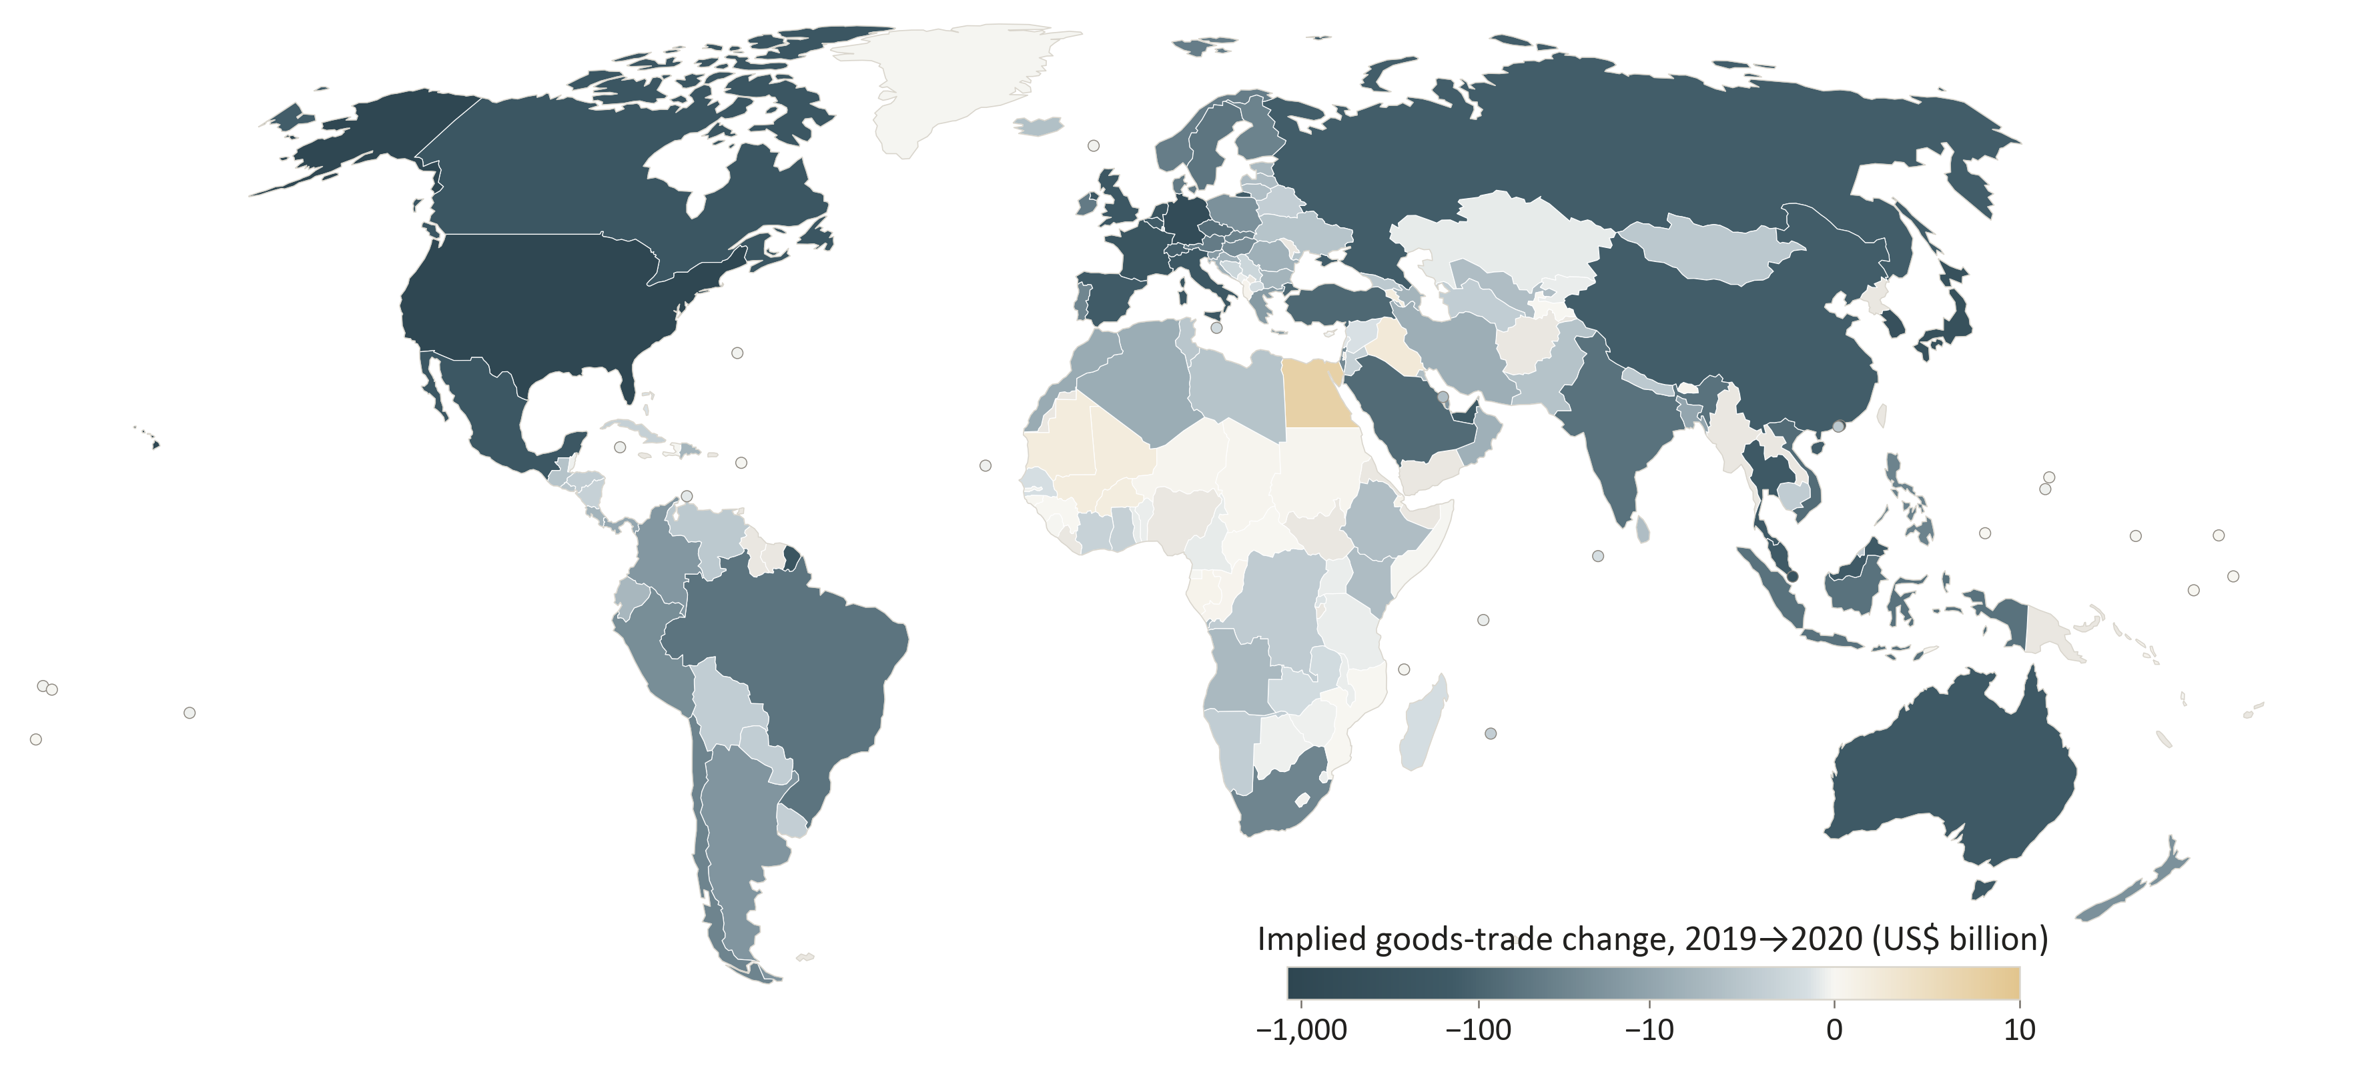
03 RESULTS · MAGNITUDES
The same logic in reverse: the 2020 collapse
ROUGH ONE-YEAR TRADE LOSS
Main measure | $7.1 tn
Best airport only | $6.3 tn
All airports summed | $1.7 tn
Connections fell in 154 of 175 countries. Biggest losses: United States, Germany, Hong Kong, Korea, Japan.
Treat as an upper range. In 2020 the pandemic cut trade and flights at the same time, so not all of this loss is due to fewer flights.
Main measure (hub quality), 2019 to 2020. This assumes the effect works the same way when connectivity falls as when it rises.
31
Notes:
The same logic should work in reverse. In 2020, connections fell in 154 of 175 countries.
Running the same calculation backwards gives a one-year trade loss of about 7 trillion dollars on our main measure, and less on the others, down to 1.7 trillion.
Please read this as an upper range. Our effect is a long-run effect, and in 2020 the pandemic cut trade and flights at the same time, so not all of this loss is due to fewer flights.

Slide 32
CONCLUSION
Better air links raise trade, through goods that fly, most where links are scarce
1
Air links cause more trade
POLICY
10% better connections: about 12% more trade relative to GDP.
Investing in airports and routes, and opening air markets, are practical ways to raise trade, especially where connections are poor.
2
It works through what is traded
More parts and more high-value goods, the goods that fly.
LIMITS
3
Poorer, less-connected countries gain most
Totals are rough, one country at a time
Evidence comes mainly from 2010 onward
Rich-versus-poor comparison is less precise
The payoff falls as income and connectivity rise.
4
The total is large
NEXT
Roughly $10 tn of 2024 trade since 1996 (a rough estimate).
Trade between country pairs (gravity)
A full model where prices and partners adjust
32
Notes:
Let me sum up in four points.
One: better air links cause more trade. Ten percent better connections mean about 12 percent more trade relative to GDP.
Two: they work through what is traded, more parts and more high-value goods, the goods that fly.
Three: poorer and less-connected countries gain the most.
Four: the total is large, roughly 10 trillion dollars of 2024 trade since 1996.
For policy, investing in airports and routes, and opening air markets, are practical ways to raise trade, especially where connections are poor.
The limits: the totals are rough, the evidence comes mainly from 2010 onward, and the rich-versus-poor comparison is less precise. Next, we want to look at trade between country pairs, and at a full model where prices and partners adjust. Thank you.

Slide 33
Thank you
Global Air Connectivity and Trade Openness, 1996–2024
Sunbin YOO, Junya KUMAGAI, Longfei ZHENG, Chunan WANG, Jinwoo LEE, Anming ZHANG
Comments and questions are very welcome.
Notes:
Thank you. I look forward to your comments and questions.

