Slide 1
Home-Work-for-BDIF
Homework 4
Bingren Sun

Slide 2
Q1
#figure5
hist(ret, col = "grey", breaks = 40, freq = FALSE)
lines(density(ret), lwd = 2)
par(mfrow = c(1, 2))
# histogram of returns
hist(ret, col = "grey", breaks = 20, freq = FALSE, ylim = c(0, 25), xlab = NA)
lines(density(ret), lwd = 2)
mu = mean(ret)
sigma = sd(ret)
x = seq(-4, 4, length = 100)
curve(dnorm(x, mean = mean(ret), sd = sd(ret)), add = TRUE, col = "red",
lwd = 2)
# qq-plot
qqnorm(ret)
qqline(ret, col = "blue", lwd = 3)
#figure6
library(forecast)
library(tseries)
Acf(ret)
library(rjson)
json_file = "http://crix.hu-berlin.de/data/crix.json"
json_data = fromJSON(file=json_file)
crix_data_frame <- as.data.frame(json_data)
w=crix_data_frame
dim(w)
n=dim(w)
a=seq(1,n[2],2)
b=seq(2,n[2],2)
data=t(w[1,a])
price=t(w[1,b])
#figure3
ts.plot(price)
#figure4
ret=diff(log(price))
ts.plot(ret)

Slide 3
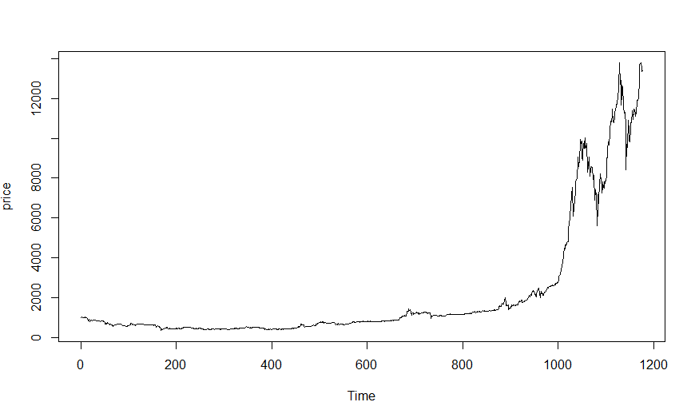
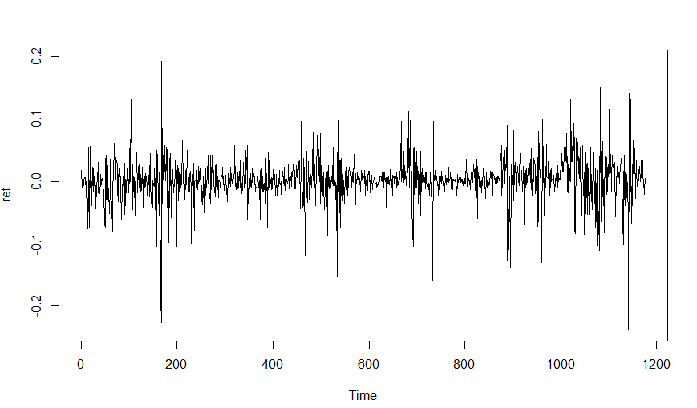
Q1-Figures
02
03
04
HEADLINE HERE
HEADLINE HERE
HEADLINE HERE
Thought for customer service "is the sacred mission of hi design.
Thought for customer service "is the sacred mission of hi design.
Thought for customer service "is the sacred mission of hi design.
Figure 3
Figure 4

Slide 4
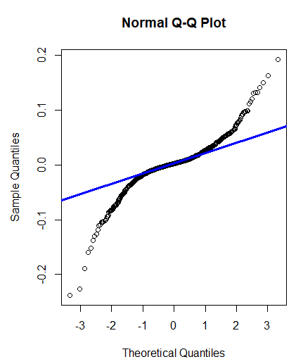
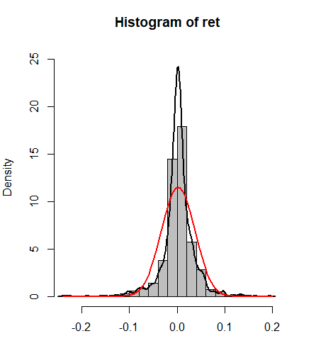
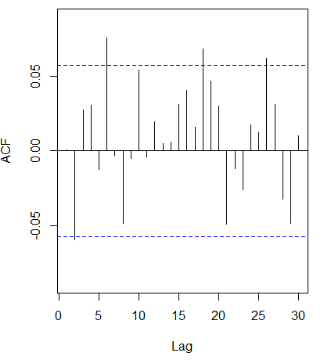
Q1-Figures
02
03
04
HEADLINE HERE
HEADLINE HERE
HEADLINE HERE
Thought for customer service "is the sacred mission of hi design.
Thought for customer service "is the sacred mission of hi design.
Thought for customer service "is the sacred mission of hi design.
Figure 5
Figure 6

Slide 5
Q2
# install and load packages
libraries = c("zoo", "tseries")
lapply(libraries, function(x) if (!(x %in% installed.packages())) {
install.packages(x)
})
lapply(libraries, library, quietly = TRUE, character.only = TRUE)
# d order
Box.test(ret, type = "Ljung-Box", lag = 20)
# stationary test
adf.test(ret, alternative = "stationary")
kpss.test(ret, null = "Trend")
par(mfrow = c(1, 2))
# acf plot
autocorr = acf(ret, lag.max = 20, ylab = "Sample Autocorrelation", main = NA,
lwd = 2, ylim = c(-0.3, 1))
# LB test of linear dependence
print(cbind(autocorr$lag, autocorr$acf))
Box.test(ret, type = "Ljung-Box", lag = 1, fitdf = 0)
Box.test(autocorr$acf, type = "Ljung-Box")
# plot of pacf
autopcorr = pacf(ret, lag.max = 20, ylab = "Sample Partial Autocorrelation",
main = NA, ylim = c(-0.3, 0.3), lwd = 2)
print(cbind(autopcorr$lag, autopcorr$acf))

Slide 6
Q2
# arima model
par(mfrow = c(1, 1))
auto.arima(ret)
fit1 = arima(ret, order = c(1, 0, 1))
tsdiag(fit1)
Box.test(fit1$residuals, lag = 1)
# aic
aic = matrix(NA, 6, 6)
for (p in 0:4) {
for (q in 0:3) {
a.p.q = arima(ret, order = c(p, 0, q))
aic.p.q = a.p.q$aic
aic[p + 1, q + 1] = aic.p.q
}
}
aic
# bic
bic = matrix(NA, 6, 6)
for (p in 0:4) {
for (q in 0:3) {
b.p.q = arima(ret, order = c(p, 0, q))
bic.p.q = AIC(b.p.q, k = log(length(ret)))
bic[p + 1, q + 1] = bic.p.q
}
}
bic
# select p and q order of ARIMA model
fit4 = arima(ret, order = c(2, 0, 3))
tsdiag(fit4)
Box.test(fit4$residuals, lag = 1)
fitr4 = arima(ret, order = c(2, 1, 3))
tsdiag(fitr4)
Box.test(fitr4$residuals, lag = 1)

Slide 7
Q2
# arima202 predict
fit202 = arima(ret, order = c(2, 0, 2))
crpre = predict(fit202, n.ahead = 30)
dates = seq(as.Date("02/08/2014", format = "%d/%m/%Y"), by = "days", length = length(ret))
plot(ret, type = "l", xlim = c(0, 1200), ylab = "log return", xlab = "days",
lwd = 1.5)
lines(crpre$pred, col = "red", lwd = 3)
lines(crpre$pred + 2 * crpre$se, col = "red", lty = 3, lwd = 3)
lines(crpre$pred - 2 * crpre$se, col = "red", lty = 3, lwd = 3)
# to conclude, 202 is better than 213
fit202 = arima(ret, order = c(2, 0, 2))
tsdiag(fit202)
tsdiag(fit4)
tsdiag(fitr4)
AIC(fit202, k = log(length(ret)))
AIC(fit4, k = log(length(ret)))
AIC(fitr4, k = log(length(ret)))
fit202$aic
fit4$aic
fitr4$aic

Slide 8
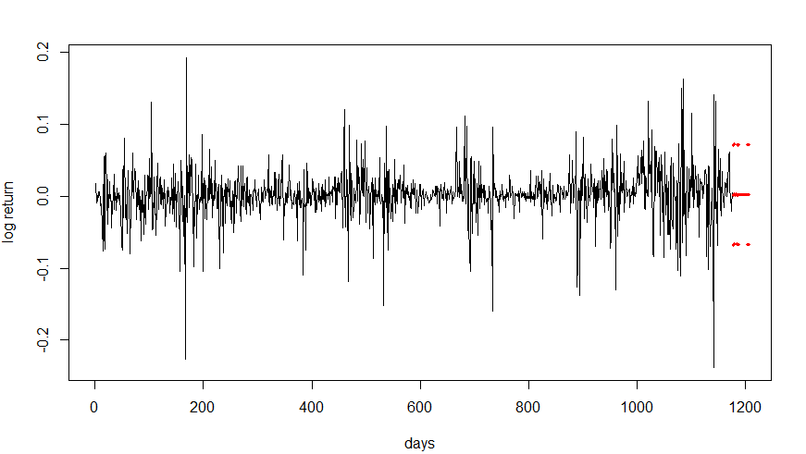
Q2-figure
Figure 7

Slide 9
THANKS FOR WATCHING

