Slide 1
Home-Work-for-BDIF
Homework 5
Bingren Sun

Slide 2
Q1
#install.packages("bitops")
#install.packages("stringr")
library(bitops)
library(stringr)
abs1 = lapply(url1, FUN = function(x) htmlParse(x, encoding = "Latin-1"))
abs2 = lapply(url2, FUN = function(x) htmlParse(x, encoding = "Latin-1"))
abs3 = lapply(url3, FUN = function(x) htmlParse(x, encoding = "Latin-1"))
clean_txt = function(x) {
cleantxt = xpathApply(x, "//body//text()
[not(ancestor :: script)][ not(ancestor :: style)]
[not(ancestor :: noscript)] " ,xmlValue)
cleantxt = paste(cleantxt, collapse="\n")
cleantxt = str_replace_all(cleantxt, "\n", " ")
cleantxt = str_replace_all(cleantxt, "\r", "")
cleantxt = str_replace_all(cleantxt, "\t", "")
cleantxt = str_replace_all(cleantxt, "<br>", "")
return(cleantxt)
}
rm(list = ls())
#install.packages("RCurl")
#install.packages("XML")
library(RCurl)
library(XML)
url1 = "http://shakespeare.mit.edu/romeo_juliet/full.html"
url2 = "http://shakespeare.mit.edu/julius_caesar/full.html"
url3 = "http://shakespeare.mit.edu/hamlet/full.html"
html1 = readLines(url1, encoding = "UTF-8")
html2 = readLines(url2, encoding = "UTF-8")
html3 = readLines(url3, encoding = "UTF-8")
html1 = htmlParse(html1, encoding = "UTF-8")
html2 = htmlParse(html2, encoding = "UTF-8")
html3 = htmlParse(html3, encoding = "UTF-8")

Slide 3
Q1
abs_dtm1 = DocumentTermMatrix(abs1, control = list(
stemming = TRUE, stopwords = TRUE, minWordLength = 3,
removeNumbers = TRUE, removePunctuation = TRUE))
abs_dtm2 = DocumentTermMatrix(abs2, control = list(
stemming = TRUE, stopwords = TRUE, minWordLength = 3,
removeNumbers = TRUE, removePunctuation = TRUE))
abs_dtm3 = DocumentTermMatrix(abs3, control = list(
stemming = TRUE, stopwords = TRUE, minWordLength = 3,
removeNumbers = TRUE, removePunctuation = TRUE))
##WordCloud
instal.packages("ggplot2")
install.packages("wordcloud")
library(ggplot2)
library(wordcloud)
freq1 = colSums(as.matrix(abs_dtm1))
freq2 = colSums(as.matrix(abs_dtm2))
freq3 = colSums(as.matrix(abs_dtm3))
wf1 = data.frame(word=names(freq1), freq=freq1)
wf2 = data.frame(word=names(freq2), freq=freq2)
wf3 = data.frame(word=names(freq3), freq=freq3)
cleantxt1 = lapply(abs1,clean_txt)
cleantxt2 = lapply(abs2,clean_txt)
cleantxt3 = lapply(abs3,clean_txt)
vec_abs1 = unlist(cleantxt1)
vec_abs2 = unlist(cleantxt2)
vec_abs3 = unlist(cleantxt3)
###Text Mining
install.packages("tm")
install.packages("SnowballC")
library(tm)
library(SnowballC)
abs1 = Corpus(VectorSource(vec_abs1))
abs2 = Corpus(VectorSource(vec_abs2))
abs3 = Corpus(VectorSource(vec_abs3))

Slide 4
Q1
freq2 = colSums(as.matrix(abs_dtm2))
dark2_2 = brewer.pal(6, "Dark2")
wordcloud(names(freq2), freq2, max.words=100, rot.per=0.2, colors=dark2_2)
#Hamlet
plot3 = ggplot(subset(wf3, freq>15), aes(word, freq3))
plot3 = plot3 + geom_bar(stat="identity")
plot3 = plot3 + theme(axis.text.x=element_text(angle=45, hjust=1))
plot3
freq3 = colSums(as.matrix(abs_dtm3))
dark2_3 = brewer.pal(6, "Dark2")
wordcloud(names(freq3), freq3, max.words=100, rot.per=0.2, colors=dark2_3)
#Romeo and Juliet
plot1 = ggplot(subset(wf1, freq>15), aes(word, freq1))
plot1 = plot1 + geom_bar(stat="identity")
plot1 = plot1 + theme(axis.text.x=element_text(angle=45, hjust=1))
plot1
freq1 = colSums(as.matrix(abs_dtm1))
dark2_1 = brewer.pal(6, "Dark2")
wordcloud(names(freq1), freq1, max.words=100, rot.per=0.2, colors=dark2_1)
#Julius Caeser
plot2 = ggplot(subset(wf2, freq>15), aes(word, freq2))
plot2 = plot2 + geom_bar(stat="identity")
plot2 = plot2 + theme(axis.text.x=element_text(angle=45, hjust=1))
plot2

Slide 5
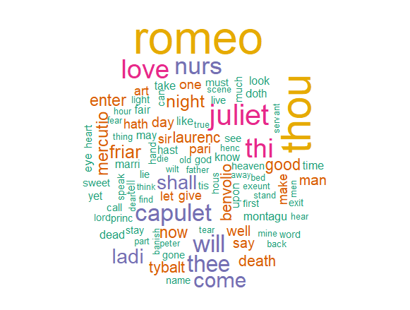
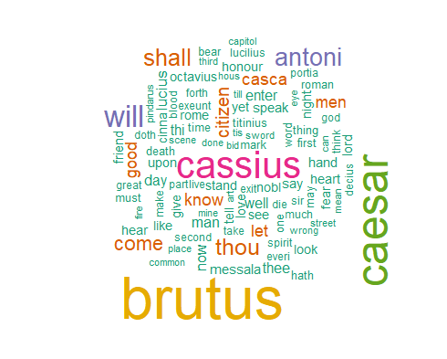
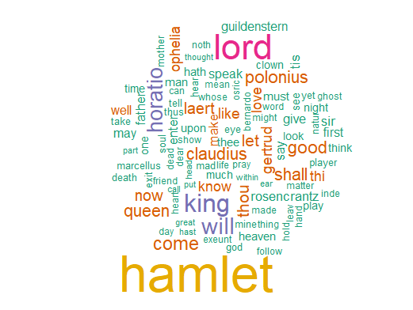
Q1-Figures
02
04
HEADLINE HERE
HEADLINE HERE
Thought for customer service "is the sacred mission of hi design.
Thought for customer service "is the sacred mission of hi design.
Figure 1
Figure 2
Figure 3

Slide 6
Q2
#Romeo and Juliet
wf1 <- wf1[order(-wf1$freq),]
wf1 <- wf1[c(1:20),]
p1 = ggplot(subset(wf1, freq > 15), aes(word, freq))
p1 = p1 + geom_bar(stat = "identity")
p1 = p1 + theme(axis.text.x = element_text(angle = 45, hjust = 1))
p1
#Julius Caeser
wf2 <- wf2[order(-wf2$freq),]
wf2 <- wf2[c(1:20),]
p2 = ggplot(subset(wf2, freq > 15), aes(word, freq))
p2 = p2 + geom_bar(stat = "identity")
p2 = p2 + theme(axis.text.x = element_text(angle = 45, hjust = 1))
p2
#Hamlet
wf3 <- wf3[order(-wf3$freq),]
wf3 <- wf3[c(1:20),]
p3 = ggplot(subset(wf3, freq > 15), aes(word, freq))
p3 = p3 + geom_bar(stat = "identity")
p3 = p3 + theme(axis.text.x = element_text(angle = 45, hjust = 1))
p3

Slide 7
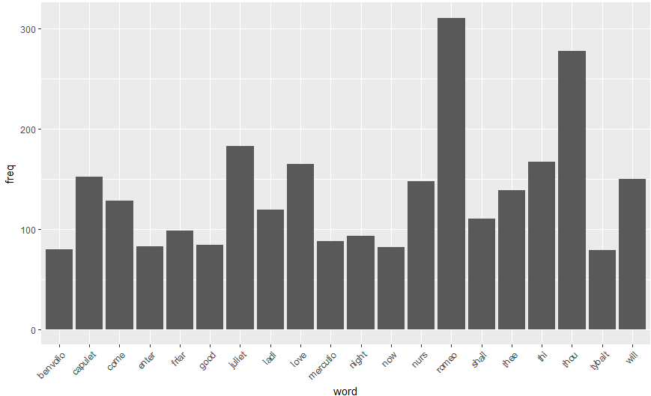
Q2-Figures
02
03
04
HEADLINE HERE
HEADLINE HERE
HEADLINE HERE
Thought for customer service "is the sacred mission of hi design.
Thought for customer service "is the sacred mission of hi design.
Thought for customer service "is the sacred mission of hi design.
Figure 4

Slide 8
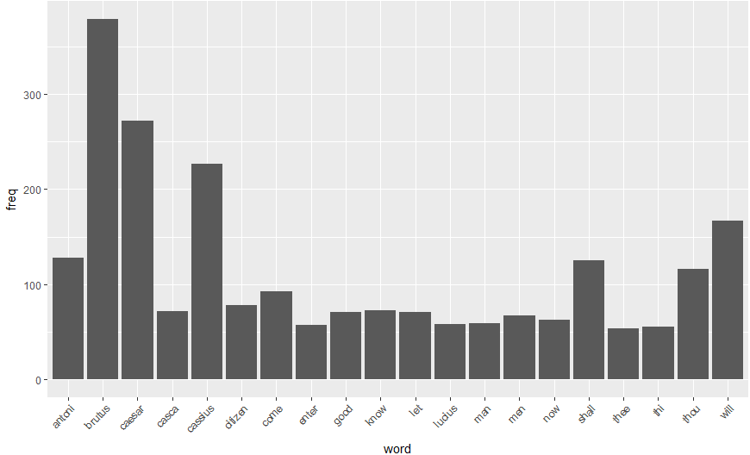
Q2-figure
Figure 5

Slide 9
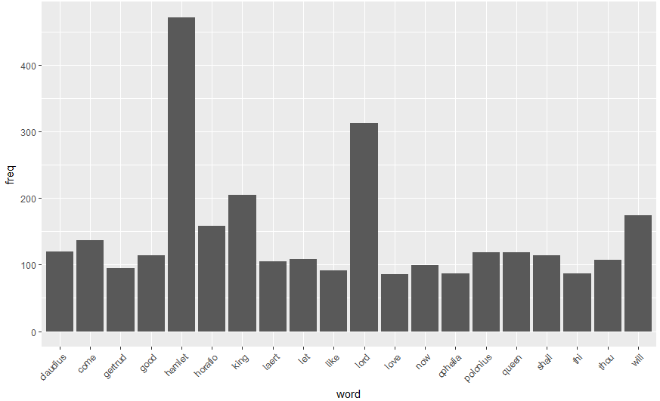
Q2-figure
Figure 6

Slide 10
THANKS FOR WATCHING

